Slide 1
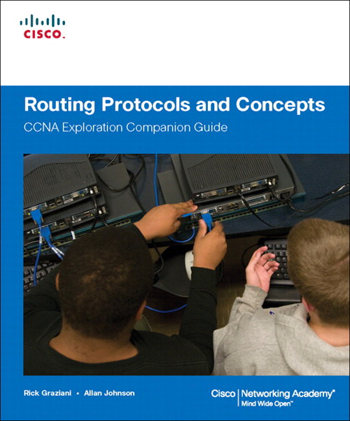
Chapter 2
Static Routing – Part 1
CIS 82 Routing Protocols and Concepts
Rick Graziani
Cabrillo College
graziani@cabrillo.edu
Last Updated: 2/22/2009

Slide 2
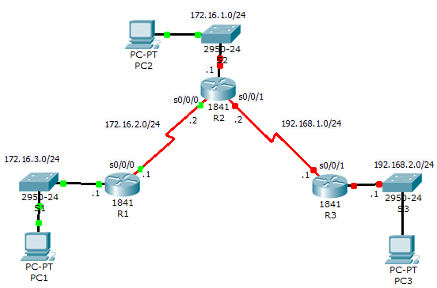
CIS 82 Online students, before we begin:
Download: Packet Tracer File:
  http://netacad.cabrillo.edu/curriculum/graziani/cis82/labs-e2/e2-1-5-2.pkt
Print out this topology

Slide 3
Note
My web site is www.cabrillo.edu/~rgraziani.
For access to these PowerPoint presentations and other materials, please email me at graziani@cabrillo.edu.
See Notes section of PowerPoint for additional information.

Slide 4
For further information
This presentation is an overview of what is covered in the curriculum/book.
For further explanation and details, please read the chapter/curriculum.
Book:
  Routing Protocols and Concepts
  By Rick Graziani and Allan Johnson
  ISBN: 1-58713-206-0
  ISBN-13: 978-58713-206-3

Slide 5
Topics
Routers and the Network
  Role of the Router
  Introducing the Topology
  Examining the Connections of the Router
Router Configuration Review
  Examining Router Interfaces
  Configuring an Ethernet Interface
  Verifying Ethernet Addresses
  Configuring a Serial Interfaces
  Examining Serial Interfaces
Exploring Directly Connected Networks
  Verifying Changes to the Routing Table
  Devices on Directly Connected Networks
Static Routes - Next-Hop Addresses
  ip route command
  Configuring Static Routes
  Routing Table Principles
  Resolving to an Exit Interface with a Recursive Lookup
Static Routes - Exit Interfaces
  Configuring a Static Route with an Exit Interfaces
  Static Routes and Point-to-Point Networks
  Modifying Static Routes
  Verifying the Static Route Configuration
  Static Routes - Ethernet Interface
Summary and Default Static Routes
  Summary Static Routes
  Default Static Routes

Slide 6
Routers and the Network
Role of the Router
Introducing the Topology
Examining the Connection on the Router

Slide 7
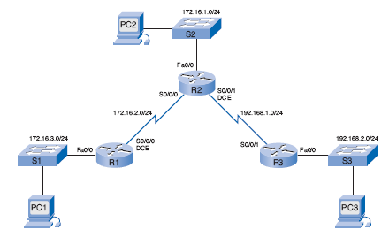
Role of the Router
What is the best path to 192.168.2.0/24 network?
Routers are primarily responsible for interconnecting networks by:
  Determining the best path
  Forwarding packets
Notes:
Routers are primarily responsible for interconnecting networks by:
Determining the best path
Forwarding packets

Slide 8
Introducing the Topology
172.16.1.0/24
.1
172.16.2.0/24
.2
.2
192.168.1.0/24
172.16.3.0/24
.1
.1
192.168.2.0/24
.1
.1
Notes:
Topology
A Cisco 1841 router has the following interfaces:
Two Fast Ethernet interfaces: FastEthernet 0/0 and FastEthernet 0/1
Two serial interfaces: Serial 0/0/0 and Serial0/0/1
The interfaces on your routers can vary.
Packet Tracer Activities are referenced throughout these chapters for additional practices.

Slide 9
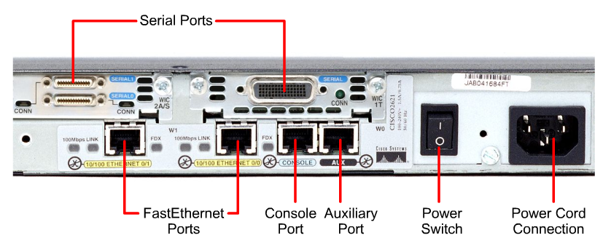
Examining the Connections
Smart Serial
“Older” Serial
Unlike most user PCs, a router will have multiple network interfaces.
These interfaces can include a variety of connectors.
Notes:
Unlike most user PCs, a router will have multiple network interfaces.
These interfaces can include a variety of connectors.

Slide 10
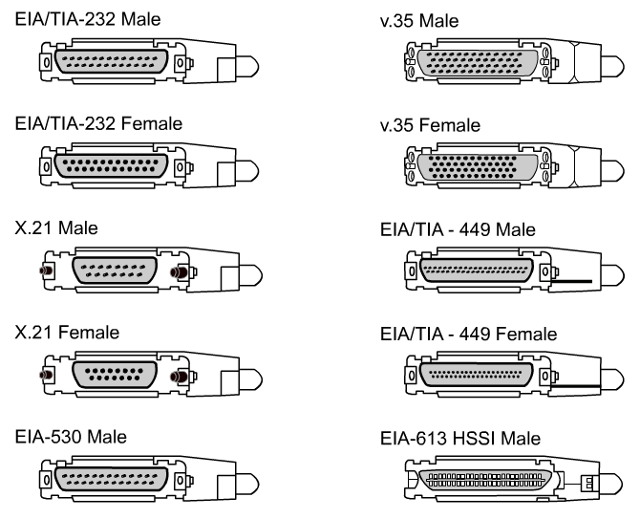
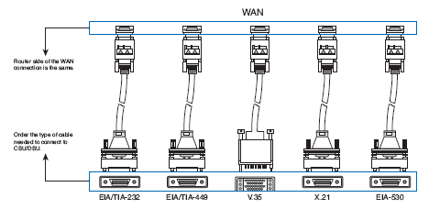
Serial Connectors
Notes:
Cisco routers support the EIA/TIA-232, EIA/TIA-449, V.35, X.21, and EIA/TIA-530 standards for serial connections,
Memorizing these connection types is not important.
Just know that a router has a DB-60 port that can support five different cabling standards.

Slide 11
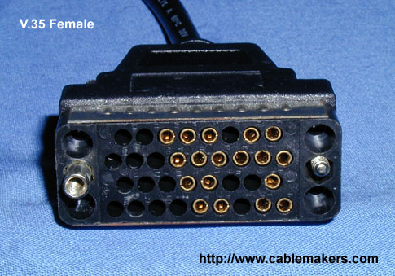
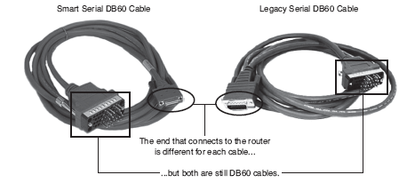
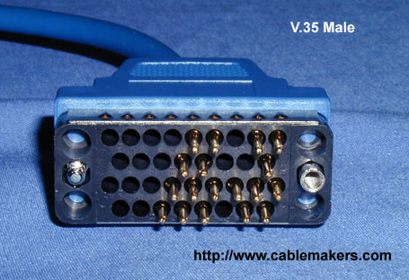
Serial Connectors
DCE Cable
DTE Cable
Router is typically a DTE device.
The DTE cable is connected to the serial interface on the router to a CSU/DSU device (DCE).
Notes:
Router is typically a DTE device.
The DTE cable is connected to the serial interface on the router to a CSU/DSU device (DCE).

Slide 12
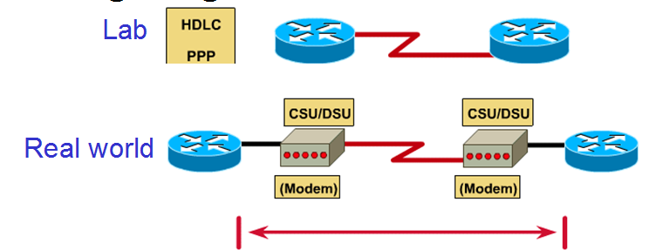
Serial Connectors
DTE
DCE
DTE
DTE
Labs we will use serial DTE/DCE cables (no CSU/DSU).
Real World – Router connected to CSU/DSU using a DTE cable.
Notes:
In our labs we will use serial DTE/DCE cables (no CSU/DSU) with a DTE cable connected to one router and a DCE cable connected to the other router.

Slide 13
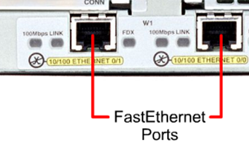
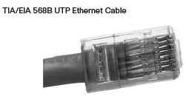
Ethernet Connectors
When do you use a straight-through cable?
Unlike devices
  Switch-to-router
  Hub-to-router
  Switch-to-PC/server
  Hub-to-PC/server
When do you use a crossover cable?
Like devices
  Switch-to-switch
  PC/server-to-PC/server
  Switch-to-hub
  Hub-to-hub
  Router-to-router
  Router-to-PC/server
Notes:
Straight-through cables are used for:
Switch-to-router
Hub-to-router
Switch-to-PC/server
Hub-to-PC/server
Crossover cables are used for:
Switch-to-switch
PC/server-to-PC/server
Switch-to-hub
Hub-to-hub
Router-to-router
Router-to-PC/server

Slide 14
Router Configuration Review
Examining Router Interfaces
Configuring an Ethernet Interface
Verifying Ethernet Addresses
Configuring a Serial Interfaces
Examining Serial Interfaces
Note: This section is for review purposes only and will not be discussed in the lecture (except for Slide 29). Please see Week 1 - Lab: 1.5.2 Basic Router Configuration (Cabrillo Version) for a complete introduction/review of Cisco IOS.

Slide 15
Examining Router Interfaces
R1# show ip route
Codes: C - connected, S - static, I - IGRP, R - RIP, M - mobile, B - BGP
D - EIGRP, EX - EIGRP external, O - OSPF, IA - OSPF inter area
N1 - OSPF NSSA external type 1, N2 - OSPF NSSA external type 2
E1 - OSPF external type 1, E2 - OSPF external type 2, E - EGP
i - IS-IS, L1 - IS-IS level-1, L2 - IS-IS level-2, ia - IS-IS inter area
* - candidate default, U - per-user static route, o - ODR
P - periodic downloaded static route
Gateway of last resort is not set
R1#
show ip route command is used to display the routing table.
Initially, the routing table is empty if no interfaces have been configured.
Note: Static routes and dynamic routes cannot be added to the routing table until the appropriate local interfaces, also known as the exit interfaces, have been configured on the router. (later)

Slide 16
Interfaces and their Statuses
R1# show interfaces
FastEthernet0/0 is administratively down, line protocol is down
Hardware is AmdFE, address is 000c.3010.9260 (bia 000c.3010.9260)
<output omitted>
Serial0/0/0 is administratively down, line protocol is down
<output omitted>

Slide 17
Interfaces and their Statuses
R1# show ip interface brief
Interface IP-Address OK? Method Status Protocol
FastEthernet0/0 unassigned YES manual administratively down down
Serial0/0 unassigned YES unset administratively down down
FastEthernet0/1 unassigned YES unset administratively down down
Serial0/1 unassigned YES unset administratively down down
R1#
Used to see a portion of the interface information in a condensed format
Note: Great command for checking interfaces before starting a lab!

Slide 18
Interfaces and their Statuses
R1# show running-config
<output omitted>
interface FastEthernet0/0
mac-address 000c.3010.9260
no ip address
duplex auto
speed auto
shutdown
!
interface FastEthernet0/1
mac-address 000c.3010.9261
no ip address
duplex auto
speed auto
shutdown
<output omitted>
show running-config command displays current configuration file
another way to verify the configuration of an interface

Slide 19
Configuring an Ethernet Interface
R1(config)# interface fastethernet 0/0
R1(config-if)# ip address 172.16.3.1 255.255.255.0
R1(config-if)# no shutdown
*Mar 1 01:16:08.212: %LINK-3-UPDOWN: Interface FastEthernet0/0, changed state to up
*Mar 1 01:16:09.214: %LINEPROTO-5-UPDOWN: Line protocol on Interface
FastEthernet0/0, changed state to up
changed state to up message indicates that, physically, the connection is good.
  interface is properly connected to a switch or a hub.
  receiving a carrier signal from another device (switch, hub, PC, or another router).
changed state to up message indicates that the data link layer is operational.
  LAN interfaces, typically no data link parameter changes.
  WAN interfaces in a lab environment require clocking on one side of the link

Slide 20
Unsolicited Messages from IOS
R1(config)# int fa0/0
R1(config-if)# ip address 172.16.3.1 255.255.255.0
R1(config-if)# no shutdown
R1(config-if)# descri
*Mar 1 01:16:08.212: %LINK-3-UPDOWN: Interface FastEthernet0/0, changed state to up
*Mar 1 01:16:09.214: %LINEPROTO-5-UPDOWN: Line protocol on Interface
FastEthernet0/0, changed state to upption
R1(config-if)#
The IOS often sends unsolicited messages
  Does not affect the command
  Can cause you to lose your place when typing.

Slide 21
Unsolicited Messages from IOS
R1(config)# line console 0
R1(config-line)# logging synchronous
R1(config-if)# descri
*Mar 1 01:28:04.242: %LINK-3-UPDOWN: Interface FastEthernet0/0, changed state to up
*Mar 1 01:28:05.243: %LINEPROTO-5-UPDOWN: Line protocol on Interface
FastEthernet0/0, changed state to up
R1(config-if)# description
To keep the unsolicited output separate from your input, enter line configuration mode for the console port and add the logging synchronous

Slide 22
Reading the Routing Table
R1# show ip route
Codes: C - connected, S - static, I - IGRP, R - RIP, M - mobile, B - BGP
<output omitted>
Gateway of last resort is not set
172.16.0.0/24 is subnetted, 1 subnets
C 172.16.3.0 is directly connected, FastEthernet0/0
The interface was configured with the 172.16.3.1/24 IP address, which makes it a member of the 172.16.3.0/24 network.
C = directly connected
  R1 has an interface that belongs to this network
The /24 subnet mask for this route is displayed in the line above the actual route.

Slide 23
Routers Usually Store Network Addresses
R1# show ip route
Codes: C - connected, S - static, I - IGRP, R - RIP, M - mobile, B - BGP
<output omitted>
Gateway of last resort is not set
172.16.0.0/24 is subnetted, 1 subnets
C 172.16.3.0 is directly connected, FastEthernet0/0
Phone book analogy: Families not individuals with same number
Occasionally, a “host route” is entered in the routing table; the host route represents an individual host IP address.
The host route is listed with the device’s host IP address and a /32 (255.255.255.255) subnet mask.
The topic of host routes is discussed in another course.

Slide 24
Commands to Verify Interface Configuration
R1# show interfaces fastethernet 0/0
FastEthernet0/0 is up, line protocol is up
Hardware is AmdFE, address is 000c.3010.9260 (bia 000c.3010.9260)
Internet address is 172.16.3.1/24
<output omitted>
R1# show ip interface brief
Interface IP-Address OK? Method Status Protocol
FastEthernet0/0 172.16.3.1 YES manual up up
Serial0/0/0 unassigned YES unset administratively down down
FastEthernet0/1 unassigned YES unset administratively down down
Serial0/0/1 unassigned YES unset administratively down down
R1# show running-config
<output omitted>
interface FastEthernet0/0
ip address 172.16.3.1 255.255.255.0
<output omitted> Note: no shutdown is not displayed.

Slide 25
Ethernet Interfaces Participate in ARP
R1# show interfaces fastethernet 0/0
FastEthernet0/0 is up, line protocol is up
Hardware is AmdFE, address is 000c.3010.9260 (bia 000c.3010.9260)
Internet address is 172.16.3.1/24
<output omitted>
A router’s Ethernet interface participates in a LAN network just like any other device on that network.
This means that these interfaces:
  Layer 2 MAC address
  ARP Cache
  Issue ARP Requests when needed
  Issue ARP Replies when required

Slide 26
Configuring a Serial Interface
R1(config)# interface serial 0/0/0
R1(config-if)# ip address 172.16.2.1 255.255.255.0
R1(config-if)# no shutdown
R1# show interfaces serial 0/0/0
Serial0/0/0 is down, line protocol is down
Hardware is PowerQUICC Serial
Internet address is 172.16.2.1/24
MTU 1500 bytes, BW 1544 Kbit, DLY 20000 usec,
<output omitted>
The serial interface will be in the up state only after the other end of the serial link has also been properly configured.

Slide 27
Configuring a Serial Interface
Can be different
R1(config)# interface serial 0/0/0
R1(config-if)# ip address 172.16.2.1 255.255.255.0
R1(config-if)# no shutdown
R2(config)# interface serial 0/0/0
R2(config-if)# ip address 172.16.2.2 255.255.255.0
R2(config-if)# no shutdown
Must be hosts on same network
Both interfaces do NOT have to be the same (Serial 0/0/0).
Both interfaces do have to be members of the same network
  Same 172.16.2.0/24 network.
(The terms network and subnet can be used interchangeably in this case.)

Slide 28
Configuring a Serial Interface
R2# show interfaces serial 0/0/0
Serial0/0/0 is up, line protocol is down
<output omitted>
Need clock rate on DCE end
Physical link between R1 and R2 is up
  both ends configured correctly with:
    IP address/mask
    no shutdown command
Line protocol is still down.
  Interface is not receiving a clock signal.
  clock rate command, on the router with the DCE cable.

Slide 29
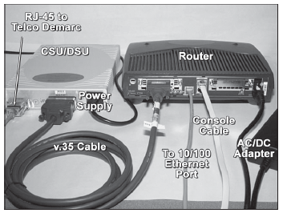
Physically Connecting a WAN Interface
Typically, the router is the DTE device and is connected to a CSU/DSU, which is the DCE device.
  Serial interfaces require a clock signal to control the timing of the communications.
  In most environments, the service provider (a DCE device such as a CSU/DSU) will provide the clock.
  By default, Cisco routers are DTE devices

Slide 30
Configuring Serial Links in a Lab Environment
R1# show controllers serial 0/0/0
Interface Serial0/0/0
Hardware is PowerQUICC MPC860
DCE V.35, no clock
<output omitted>
In a lab environment, one side of a connection must be considered a DCE and provide a clocking signal.
Although Cisco serial interfaces are DTE devices by default, they can be configured as DCE devices.

Slide 31
Configuring Serial Links in a Lab Environment
R1(config)# interface serial 0/0/0
R1(config-if)# clock rate 64000
01:10:28: %LINEPROTO-5-UPDOWN: Line protocol on Interface Serial0/0/0, changed state to up
Available clock rates, in bits per second, are 1200, 2400, 9600, 19200, 38400, 56000, 64000, 72000, 125000, 148000, 500000, 800000, 1000000, 1300000, 2000000, and 4000000.
If DTE interface is configured with the clock rate command, IOS disregards it.

Slide 32
Verifying the Serial Interface Configuration
R1# show interfaces serial 0/0/0
Serial0/0/0 is up, line protocol is up
Hardware is PowerQUICC Serial
Internet address is 172.16.2.1/24
<output omitted>
R1# show ip interface brief
Interface IP-Address OK? Method Status Protocol
FastEthernet0/0 172.16.3.1 YES manual up up
Serial0/0/0 172.16.2.1 YES manual up up
<output omitted>
R1# ping 172.16.2.2
Sending 5, 100-byte ICMP Echos to 172.16.2.2, timeout is 2 seconds: <output omitted>
!!!!!
R1#

Slide 33
Verifying the Serial Interface Configuration
R1# show ip route
<output omitted>
Gateway of last resort is not set
172.16.0.0/24 is subnetted, 2 subnets
C 172.16.2.0 is directly connected, Serial0/0/0
C 172.16.3.0 is directly connected, FastEthernet0/0
172.16.2.0/24 serial network is now in the routing table for R1

Slide 34
Verifying the Serial Interface Configuration
R1# show running-config
<output omitted>
!
interface FastEthernet0/0
description R1 LAN
ip address 172.16.3.1 255.255.255.0
!
interface Serial0/0/0
description Link to R2
ip address 172.16.2.1 255.255.255.0
clockrate 64000
!
<output omitted>
R1#
Although the clock rate command is two words, IOS spells clockrate as a single word in the running configuration and startup configuration files.

Slide 35
Exploring Directly Connected Networks
Verifying Changes to the Routing Table
Devices on Directly Connected Networks
Cisco Discovery Protocol (CDP)
Using CDP for Network Discovery

Slide 36
Introducing the Topology
Notes:
Topology
A Cisco 1841 router has the following interfaces:
Two Fast Ethernet interfaces: FastEthernet 0/0 and FastEthernet 0/1
Two serial interfaces: Serial 0/0/0 and Serial0/0/1
The interfaces on your routers can vary.
Packet Tracer Activities are referenced throughout these chapters for additional practices.

Slide 37
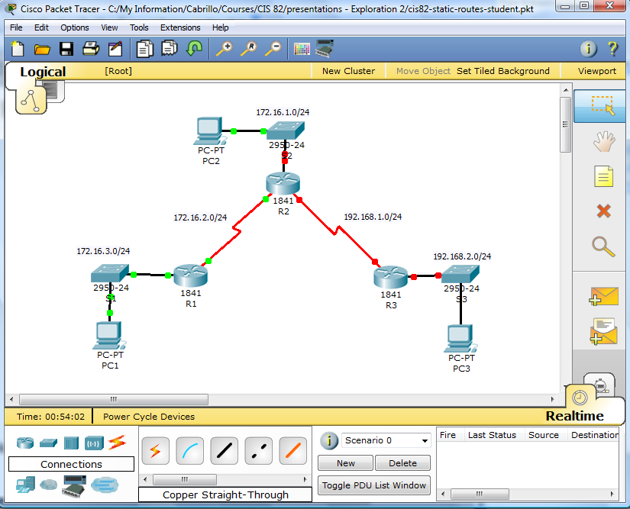

OPTION: Follow along with Packet Tracer
Edit -> Preferences
IMPORTANT: It is more important that you watch and listen to what I am explaining than to follow along in Packet Tracer. You can always go back through these slides and follow along later.
Download: cis82-static-routes-student.pkt

Slide 38
R1’s configuration (so far)
R1# show running-config
!
hostname R1
!
interface FastEthernet0/0
ip address 172.16.3.1 255.255.255.0
!
interface Serial0/0/0
ip address 172.16.2.1 255.255.255.0
clock rate 64000
!
line con 0
exec-timeout 0 0
logging synchronous
line vty 0 4
login
See previous slides for configuration commands.

Slide 39
R2’s configuration (so far)
R2# show running
!
hostname R2
!
interface FastEthernet0/0
no ip address
shutdown
!
interface Serial0/0/0
ip address 172.16.2.2 255.255.255.0
!
interface Serial0/0/1
no ip address
shutdown
!
line con 0
exec-timeout 0 0
logging synchronous
line vty 0 4
login
See previous slides for configuration commands.

Slide 40
R3’s configuration (so far)
R3# show run
!
hostname R3
!
interface FastEthernet0/0
no ip address
shutdown
!
interface Serial0/0/1
no ip address
shutdown
!
line con 0
exec-timeout 0 0
logging synchronous
line vty 0 4
login
See previous slides for configuration commands.

Slide 41
What interface have been configured and are “up”?
On each router do: show ip interface brief
Which interfaces still need to be configured?
Don’t configure them yet!
Notes:
The debug ip routing displays routing table processes for any route,
directly connected network
static route
dynamic route.
Disable debug ip routing by either:
undebug ip routing
undebug all

Slide 42
Which interfaces have been configured and are “up”?
Use show ip interface brief
To be configured
R1# show ip interface brief
Interface IP-Address OK? Method Status Protocol
FastEthernet0/0 172.16.3.1 YES manual up up
FastEthernet0/1 unassigned YES manual administratively down down
Serial0/0/0 172.16.2.1 YES manual up up
Serial0/0/1 unassigned YES manual administratively down down
R2# show ip interface brief
Interface IP-Address OK? Method Status Protocol
FastEthernet0/0 unassigned YES manual administratively down down
FastEthernet0/1 unassigned YES manual administratively down down
Serial0/0/0 172.16.2.2 YES manual up up
Serial0/0/1 unassigned YES manual administratively down down
R3# show ip interface brief
Interface IP-Address OK? Method Status Protocol
FastEthernet0/0 unassigned YES manual administratively down down
FastEthernet0/1 unassigned YES manual administratively down down
Serial0/0/0 unassigned YES manual administratively down down
Serial0/0/1 unassigned YES manual administratively down down
Notes:
The debug ip routing displays routing table processes for any route,
directly connected network
static route
dynamic route.
Disable debug ip routing by either:
undebug ip routing
undebug all

Slide 43
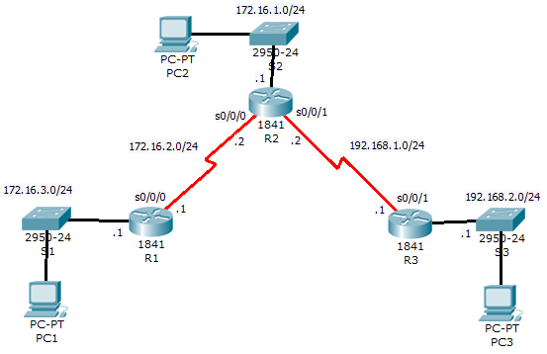
Examine the routing tables
R1# show ip route
<output omitted>
Gateway of last resort is not set
172.16.0.0/24 is subnetted, 2 subnets
C 172.16.2.0 is directly connected, Serial0/0/0
C 172.16.3.0 is directly connected, FastEthernet0/0
R2# show ip route
<output omitted>
Gateway of last resort is not set
172.16.0.0/24 is subnetted, 1 subnets
C 172.16.2.0 is directly connected, Serial0/0/0
The routing table consists of a list of “known” networks.
How does a router learn about networks? (3 ways)
  Directly connected, configured statically, and learned dynamically.
How did R1 and R2 learn about their networks?
  Directly connected networks, when the interfaces were configured with an IP address, subnet mask and no shutdown. (clock rate for serial DCE)
Notes:
The routing table consists of a list of “known” network addresses—that is, those addresses that are directly connected, configured statically, and learned dynamically.
R1 and R2 only have routes for directly connected networks.

Slide 44
Using debug ip routing
R2# debug ip routing
IP routing debugging is on
R2# conf t
R2(config)# int fa0/0
R2(config-if)# ip address 172.16.1.1 255.255.255.0
R2(config-if)# no shutdown
%LINK-3-UPDOWN: Interface FastEthernet0/0, changed state to up
%LINEPROTO-5-UPDOWN: Line protocol on Interface FastEthernet0/0, changed state to up
RT: add 172.16.1.0/24 via 0.0.0.0, connected metric [0/0]
RT: interface FastEthernet0/0 added to routing table
debug ip routing - displays any changes in the routing table.
  After no shutdown interface up and up
  debug: Network added to routing table
Notes:
The debug ip routing command will display any changes that the router performs when adding or removing routes.
After no shutdown interface up and up
Network added to routing table

Slide 45
Do show ip route on R2
R2# show ip route
<output omitted>
Gateway of last resort is not set
172.16.0.0/24 is subnetted, 2 subnets
C 172.16.1.0 is directly connected, FastEthernet0/0
C 172.16.2.0 is directly connected, Serial0/0
Was there a change to the R2 routing table as a result of the interface being configured?
  Yes

Slide 46
Turn of debug…
R2# undebug all
All possible debugging has been turned off
!
or
!
R2# undebug ip routing
IP routing debugging is off
R2#
Notes:
The debug ip routing displays routing table processes for any route,
directly connected network
static route
dynamic route.
Disable debug ip routing by either:
undebug ip routing
undebug all

Slide 47
Do NOT do this, just watch…
R2# debug ip routing
IP routing debugging is on
R2# config t
Enter configuration commands, one per line. End with CNTL/Z.
R2(config)# int fa0/0
R2(config-if)# shutdown
%LINK-5-CHANGED: Interface FastEthernet0/0, changed state to administratively down
%LINEPROTO-5-UPDOWN: Line protocol on Interface FastEthernet0/0, changed state to down
is_up: 0 state: 6 sub state: 1 line: 1
RT: interface FastEthernet0/0 removed from routing table
RT: del 172.16.1.0/24 via 0.0.0.0, connected metric [0/0]
RT: delete subnet route to 172.16.1.0/24
<some ouput omitted>
R2(config-if)# no ip address
R2(config-if)# end
R2# undebug all
All possible debugging has been turned off
The shutdown command is used to disable interfaces.
Retains the IPaddress/mask configuration on the interface but shuts it down temporarily.
To completely remove the configuration, enter no ip address
Notes:
The shutdown command is used to disable interfaces.
Retains the IPaddress/mask configuration on the interface but shuts it down temporarily.
To completely remove the configuration, enter no ip address

Slide 48
Assume we did not remove this interface
R2# show ip route
Gateway of last resort is not set
172.16.0.0/24 is subnetted, 1 subnets
C 172.16.2.0 is directly connected, Serial0/0/0
R2(config)# interface fastethernet 0/0
R2(config-if)# ip address 172.16.1.1 255.255.255.0
R2(config-if)# no shutdown
As we continue, assume we did not remove the fa0/0 interface.
Notes:
The show ip route command verifies the directly connected network was removed from the routing table.

Slide 49
Note on debug command
R2# undebug all
All possible debugging has been turned off
The debug commands, especially the debug all command, should be used sparingly.
  Useful for troubleshooting
  CPU and memory intensive
  Use sparingly
  Disable them immediately when they are no longer needed.
Notes:
The debug commands, especially the debug all command, should be used sparingly.
Useful when configuring or troubleshooting a network
Can disrupt router operations.
Intensive use of CPU and memory resources.
Run as few debug processes as necessary
Disable them immediately when they are no longer needed.

Slide 50
Configure the rest of the interfaces for R2 and R3
R2(config)# interface serial 0/0/1
R2(config-if)# ip address 192.168.1.2 255.255.255.0
R2(config-if)# clock rate 64000
R2(config-if)# no shutdown
R3(config)# interface fastethernet 0/0
R3(config-if)# ip address 192.168.2.1 255.255.255.0
R3(config-if)# no shutdown
R3(config-if)# exit
R3(config)# interface serial 0/0/1
R3(config-if)# ip address 192.168.1.1 255.255.255.0
R3(config-if)# no shutdown
The rest of the configurations for Routers R2 and R3.
Notes:
The rest of the configurations for Routers R2 and R3.

Slide 51
Verifying the configurations…
How do you know if the interfaces are active?
R1# show ip interface brief
Interface IP-Address OK? Method Status Protocol
FastEthernet0/0 172.16.3.1 YES manual up up
Serial0/0/0 172.16.2.1 YES manual up up
FastEthernet0/1 unassigned YES manual administratively down down
Serial0/0/1 unassigned YES manual administratively down down
R2# show ip interface brief
Interface IP-Address OK? Method Status Protocol
FastEthernet0/0 172.16.1.1 YES manual up up
Serial0/0/0 172.16.2.2 YES manual up up
FastEthernet0/1 unassigned YES manual administratively down down
Serial0/0/1 192.168.1.2 YES manual up up
R3# show ip interface brief
Interface IP-Address OK? Method Status Protocol
FastEthernet0/0 192.168.2.1 YES manual up up
Serial0/0/0 unassigned YES manual administratively down down
FastEthernet0/1 unassigned YES manual administratively down down
Serial0/0/1 192.168.1.1 YES manual up up

Slide 52
Verifying the new entries in the routing table…
R1# show ip route
172.16.0.0/24 is subnetted, 2 subnets
C 172.16.2.0 is directly connected, Serial0/0/0
C 172.16.3.0 is directly connected, FastEthernet0/0
R2# show ip route
172.16.0.0/24 is subnetted, 2 subnets
C 172.16.1.0 is directly connected, FastEthernet0/0
C 172.16.2.0 is directly connected, Serial0/0/0
C 192.168.1.0/24 is directly connected, Serial0/0/1
R3# show ip route
C 192.168.1.0/24 is directly connected, Serial0/0/1
C 192.168.2.0/24 is directly connected, FastEthernet0/0
How did these networks get into the routing table?
When the interfaces were configured with an IP address, subnet mask, and no shutdown. (clock rate for DCE serial)

Slide 53
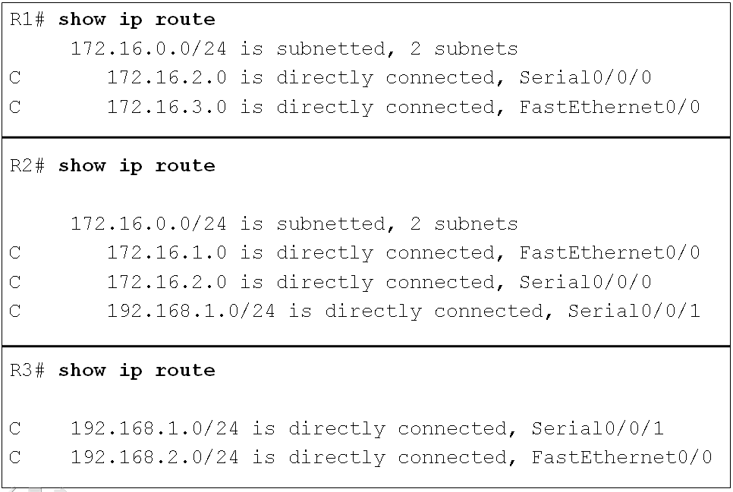
Verifying Configurations
Which networks can R1 communicate with?
  172.16.3.0/24 and 172.16.2.0/24
Which networks can R2 communicate with?
  172.16.1.0/24, 172.16.2.0/24, and 192.168.1.0/24
Which networks can R3 communicate with?
  192.168.1.0/24 and 192.168.2.0/24
Notes:
When a router only has its interfaces configured, and the routing table contains the directly connected networks but no other routes, only devices on those directly connected networks are reachable:
R1 can communicate with any device on the 172.16.3.0/24 and 172.16.2.0/24 networks.
R2 can communicate with any device on the 172.16.1.0/24, 172.16.2.0/24, and 192.168.1.0/24 networks.
R3 can communicate with any device on the 192.168.1.0/24 and 192.168.2.0/24 networks.

Slide 54
Try pinging remote networks from R2…
R2# ping 172.16.3.1
Type escape sequence to abort.
Sending 5, 100-byte ICMP Echos to 172.16.3.1, timeout is 2 seconds:
.....
Success rate is 0 percent (0/5)
R2# ping 192.168.2.1
Type escape sequence to abort.
Sending 5, 100-byte ICMP Echos to 192.168.2.1, timeout is 2 seconds:
.....
Success rate is 0 percent (0/5)
Why did these pings fail?
  R2 does not know about these networks.
  R2 does not have a match in it’s routing table for these IP addresses.
Notes:
The pings failed
R2 does not have a route in its routing table that matches either
172.16.3.1 or
192.168.2.1
To have a match between the packet’s destination IP address of 172.16.3.1 and a route in the routing table
The address must match the number of leftmost bits of the network address as indicated by the prefix of the route. (more soon)

Slide 55

Pings from R2 to 172.16.3.1
R2# ping 172.16.3.1
.....
R2# show ip route
172.16.0.0/24 is subnetted, 2 subnets
C 172.16.1.0 is directly connected, FastEthernet0/0
C 172.16.2.0 is directly connected, Serial0/0/0
C 192.168.1.0/24 is directly connected, Serial0/0/1
IP Packet
172.16.3.1
…
Destination IP Address
This is how IOS looks for a match (more later):
  172.16.3.1 matches 16 bits of 172.16.0.0 (more later)
    Does 172.16.3.1’s 24 leftmost bits match the 172.16.1.0/24 network?
      No
    Does 172.16.3.1’s 24 leftmost bits match the 172.16.2.0/24 network?
      No
    Does 172.16.3.1’s 24 leftmost bits match the 192.168.1.0/24 network?
      No
    Packets (with pings) are dropped.
Notes:
The IOS routing table process
Checks to see whether the 24 leftmost bits of”
packet’s destination IP address, 172.16.3.1
match the 172.16.1.0/24 network?
match the 172.16.2.0/24 network?
match the 192.168.1.0/24 network?
Convert these addresses to binary and compare them,
See that the first 24 bits of this route do not match.
Packets (with pings) are dropped.

Slide 56
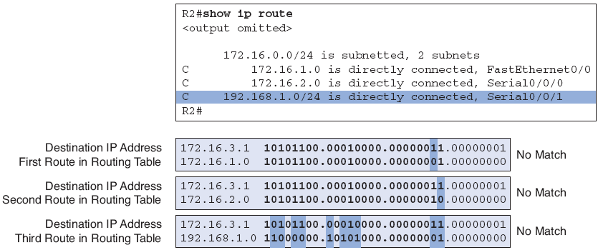
Looking at the bits…
IP Packet
172.16.3.1
…
Destination IP Address
Match?
Only 1 bit matches between 172.16.3.1 and 192.168.1.0
Only 22 bits match between 172.16.3.1 and 172.16.1.0
Only 23 bits match between 172.16.3.1 and 172.16.1.0
Notes:
If you convert these addresses to binary and compare them, you will see that the first 24 bits of this route do not match because the twenty-third bit does not match.
Packets are dropped.

Slide 57
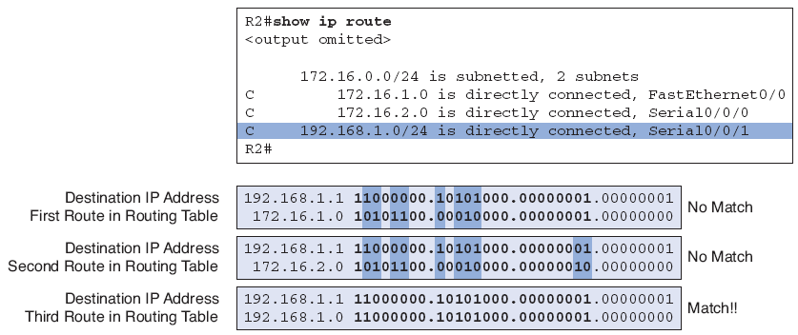
Pings from R2 to 192.168.1.1
IP Packet
192.168.1.1
…
R2# ping 192.168.1.1
!!!!
R2# show ip route
172.16.0.0/24 is subnetted, 2 subnets
C 172.16.1.0 is directly connected, FastEthernet0/0
C 172.16.2.0 is directly connected, Serial0/0/0
C 192.168.1.0/24 is directly connected, Serial0/0/1
Destination IP Address
Match?
Why does this ping succeed?
  24 bits match between 192.168.1.1 and 192.168.1.0.
Notes:
This time the ping succeeds!
It is successful because R2 has a route in its routing table that
matches 192.168.1.1, which is the ping packet’s destination IP address.

Slide 58
R2# ping 192.168.1.1
!!!!
R2# show ip route
172.16.0.0/24 is subnetted, 2 subnets
C 172.16.1.0 is directly connected, FastEthernet0/0
C 172.16.2.0 is directly connected, Serial0/0/0
C 192.168.1.0/24 is directly connected, Serial0/0/1
The exit interface for this route is Serial 0/0/1
IP Packet
HDLC Hdr
192.168.1.1
…
CRC
Destination IP Address
Notes:
The packet is:
encapsulated in the Layer 2 High-Level Data Link Control (HDLC) protocol of Serial 0/0/1, the exit interface,
forwarded through the Serial 0/0/1 interface.
R2 is now done making the forwarding decisions for this packet
Decisions made by other routers regarding this packet are not its concern.
Note: More later in Chapter 8 The Routing Table!

Slide 59
Static Routes with “Next-Hop” Addresses
ip route command
Configuring Static Routes
Routing Table Principles
Resolving to an Exit Interface with a Recursive Lookup

Slide 60
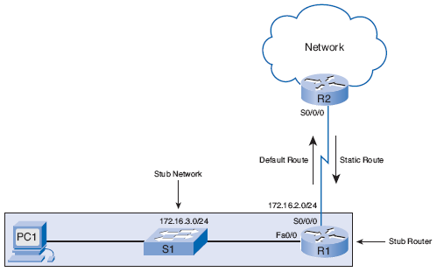
Purpose and Command Syntax of the ip route Command
I only have one way to 172.16.3.0/24 network, so I will use a static route.
I only have one way to rest of the world (Internet), so I will use a static route.
Static routes are commonly used when routing from a network to a stub network.
  A stub network is a network accessed by a single route.
Dynamic routing protocol between R1 and R2 is a waste of resources.
Notes:
Static routes are commonly used when routing from a network to a stub network.
A stub network is a network accessed by a single route.
R1 only has one way to reach other destinations via R2.
Therefore, network 172.16.3.0 is a stub network and R1 is a stub router.
Dynamic routing protocol between R1 and R2 is a waste of resources.

Slide 61
ip route Command
The command for configuring a static route is ip route.
The complete syntax for configuring a static route is:
ip route prefix mask {ip-address | interface-type interface-number [ip-address]} [dhcp] [distance] [name next-hop-name] [permanent | track number] [tag tag]

Slide 62
ip route Command
Simpler version of the syntax:
Router(config)# ip route network-address subnet-mask {ip-address | exit-interface}
network-address: Destination network address of the remote network
subnet-mask: Subnet mask of the remote network
One or both of the following parameters must also be used:
  ip-address: Next-hop router’s IP address. (Does not have to be next-hop.)
  exit-interface: Outgoing or exit interface
Notes:
The following parameters are used:
network-address: Destination network address of the remote network to be added to the routing table. (Equivalent to the prefix parameter in the complete syntax.)
subnet-mask: Subnet mask of the remote network to be added to the routing table. The subnet mask can be modified to summarize a group of networks. (Equivalent to the mask parameter in the complete syntax.)
One or both of the following parameters must also be used:
ip-address: Commonly referred to as the next-hop router’s IP address. (Equivalent to the ip-address parameter in the complete syntax.)
exit-interface: Outgoing interface that would be used in forwarding packets to the destination network. (Equivalent to the interface-type interface-number parameter in the complete syntax.)
Note:
The ip-address parameter is commonly referred to as the “next-hop” router’s IP address.
The actual next-hop router’s IP address is commonly used for this parameter.
However, the ip-address parameter could be any IP address, as long as it is resolvable in the routing table.
This is beyond the scope of this course.

Slide 63
Configuring Static Routes
What are the remote networks that R1 does not know about?
  172.16.1.0/124: The LAN on R2
  192.168.1.0/24: The serial network between R2 and R3
  192.168.2.0/24: The LAN on R3
Notes:
R1 in our chapter topology knows about its directly connected networks.
The remote networks that R1 does not know about are as follows:
172.16.1.0/124: The LAN on R2 (static route above solved this)
192.168.1.0/24: The serial network between R2 and R3
192.168.2.0/24: The LAN on R3

Slide 64
Configure a static route with debug ip routing on
R1# debug ip routing
R1# conf t
R1(config)# ip route 172.16.1.0 255.255.255.0 172.16.2.2
00:20:15: RT: add 172.16.1.0/24 via 172.16.2.2, static metric [1/0]
R1# show ip route
Codes: C - connected, S - static, I - IGRP, R - RIP,
172.16.0.0/24 is subnetted, 3 subnets
S 172.16.1.0 [1/0] via 172.16.2.2
C 172.16.2.0 is directly connected, Serial0/0/0
C 172.16.3.0 is directly connected, FastEthernet0/0
R1# un all
The remote networks that R1 does not know about:
  172.16.1.0/124: The LAN on R2
  192.168.1.0/24: The serial network between R2 and R3
  192.168.2.0/24: The LAN on R3
Notes:
R1 in our chapter topology knows about its directly connected networks.
The remote networks that R1 does not know about are as follows:
172.16.1.0/124: The LAN on R2 (static route above solved this)
192.168.1.0/24: The serial network between R2 and R3
192.168.2.0/24: The LAN on R3

Slide 65
Looking at what we just did…
R1(config)# ip route 172.16.1.0 255.255.255.0 172.16.2.2
Remote Network and Mask
Next-hop IP address
The IP address is the actual next-hop router’s IP address.
This IP address is reachable from one of this router’s directly connected networks.
Notes:
Examining each element in this output reveals the following:
ip route: Static route command
172.16.1.0: Network address of remote network
255.255.255.0: Subnet mask of remote network
172.16.2.2: Serial 0/0/0 interface IP address on R2, which is the next hop to this network
When the IP address is the actual next-hop router’s IP address, this IP address is reachable from one of this router’s directly connected networks.
The next-hop IP address 172.16.2.2 belongs to Router R1’s directly connected Serial 0/0/0 network 172.16.2.0/24.

Slide 66
Configure the other two static routes for R1 and verify with show ip route
R1(config)# ip route 192.168.1.0 255.255.255.0 172.16.2.2
R1(config)# ip route 192.168.2.0 255.255.255.0 172.16.2.2
R1(config)# end
R1# show ip route
172.16.0.0/24 is subnetted, 3 subnets
S 172.16.1.0 [1/0] via 172.16.2.2
C 172.16.2.0 is directly connected, Serial0/0/0
C 172.16.3.0 is directly connected, FastEthernet0/0
S 192.168.1.0/24 [1/0] via 172.16.2.2
S 192.168.2.0/24 [1/0] via 172.16.2.2
We have just configured static routes on R1 to reach:
  172.16.1.0/24: The LAN on R2
  192.168.1.0/24: The serial network between R2 and R3
  192.168.2.0/24: The LAN on R3
Why do all three static routes have the same next-hop IP address?
Notes:
Notice that all three static routes configured on R1 have the same next-hop IP address: 172.16.2.2, because packets for all the remote networks must be forwarded to Router R2, the nexthop router.
[1/0]
1 = Administrative Distance (later)
0 = Metric (always 0 – later)

Slide 67
Looking at the static routes we just configured…
R1(config)# ip route 172.16.1.0 255.255.255.0 172.16.2.2
R1(config)# ip route 192.168.1.0 255.255.255.0 172.16.2.2
R1(config)# ip route 192.168.2.0 255.255.255.0 172.16.2.2
R1# show ip route
172.16.0.0/24 is subnetted, 3 subnets
S 172.16.1.0 [1/0] via 172.16.2.2
C 172.16.2.0 is directly connected, Serial0/0/0
C 172.16.3.0 is directly connected, FastEthernet0/0
S 192.168.1.0/24 [1/0] via 172.16.2.2
S 192.168.2.0/24 [1/0] via 172.16.2.2
Because packets for all the remote networks must be forwarded to Router R2, the nexthop router 172.16.2.2.
[1/0]
  1 = Administrative Distance (later)
  0 = Metric (always 0 – later)
Notes:
Notice that all three static routes configured on R1 have the same next-hop IP address: 172.16.2.2, because packets for all the remote networks must be forwarded to Router R2, the nexthop router.
[1/0]
1 = Administrative Distance (later)
0 = Metric (always 0 – later)

Slide 68
Verifying Static Routes
R1# show running-config
<output omitted>
!
ip route 172.16.1.0 255.255.255.0 172.16.2.2
ip route 192.168.1.0 255.255.255.0 172.16.2.2
ip route 192.168.2.0 255.255.255.0 172.16.2.2
!
<output omitted>
R1# copy running-config startup-config
Now is a good time to save the configuration to NVRAM with the copy running-config startup-config command.
Notes:
Now is a good time to save the configuration to NVRAM with the copy running-config startup-config command.

Slide 69
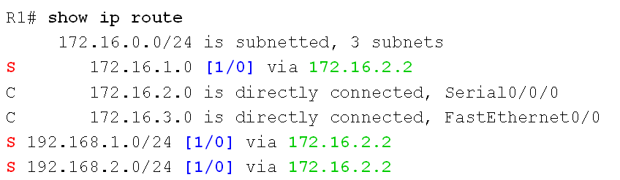
Alex Zinin’s Routing Table Principles
I know about my remote networks but it is not my responsibility if R2 and R3 know about their remote networks.
Principle 1: Every router makes its decision alone, based on the information it has in its own routing table.
R1 makes forwarding decisions based solely on the information in the routing table.
R1 does not consult the routing tables in any other routers.
Making each router aware of remote networks is the responsibility of the network administrator.
Notes:
Principle 1: Every router makes its decision alone, based on the information it has in its own routing table.
R1 has three static routes in its routing table and makes forwarding decisions based solely on the information in the routing table.
R1 does not consult the routing tables in any other routers, nor does it know whether those routers have routes to other networks.
Making each router aware of remote networks is the responsibility of the network administrator.

Slide 70
Alex Zinin’s Routing Table Principles
Just because I know how to get to R3’s LAN, 192.168.2.0/24 and I send that packet to R2, doesn’t mean R2 knows how to get there.
???
Principle 2: The fact that one router has certain information in its routing table does not mean that other routers have the same information.
Notes:
Principle 2: The fact that one router has certain information in its routing table does not mean that other routers have the same information.
R1 does not know what information other routers have in their routing table.
For example, R1 has a route to the 192.168.2.0/24 network through Router R2.
Any packets that match this route belong to the 192.168.2.0/24 network and will be forwarded to Router R2.
R1 does not know whether R2 has a route to the 192.168.2.0/24 network.
Again, the network administrator would be responsible for ensuring that the next-hop router also has a route to this network.
Using Principle 2, you still need to configure the proper routing on the other routers (R2 and R3) to make sure that they have routes to these three networks.

Slide 71
Alex Zinin’s Routing Table Principles
And if the packet for R3’s LAN reaches 192.168.2.0/24, I don’t know if R3 has a route back to 172.16.3.0/24 for any return traffic.
???
Principle 3: Routing information about a path from one network to another does not provide routing information about the reverse, or return, path.
Notes:
Principle 3: Routing information about a path from one network to another does not provide routing information about the reverse, or return, path.
Most of the communication over networks is bidirectional.
This means that packets must travel in both directions between the end devices involved.
A packet from PC1 can reach PC3 because all the routers involved have routes to the destination network 192.168.2.0/24.
However, the success of any returning packets going from PC3 to PC1 depends on whether the routers involved have a route to the return path, PC1’s 172.16.3.0/24 network.
Using Principle 3 as guidance, you will configure proper static routes on the other routers to make sure that they have routes back to the 172.16.3.0/24 network.

Slide 72
Configure R2 and R3 Static Routes and verify using show ip route
R2(config)# ip route 172.16.3.0 255.255.255.0 172.16.2.1
R2(config)# ip route 192.168.2.0 255.255.255.0 192.168.1.1
R3(config)# ip route 172.16.1.0 255.255.255.0 192.168.1.2
R3(config)# ip route 172.16.2.0 255.255.255.0 192.168.1.2
R3(config)# ip route 172.16.3.0 255.255.255.0 192.168.1.2
Configure static routes for R2 to reach all remote networks.
  Which networks are they?
    172.16.3.0 255.255.255.0
    192.168.2.0 255.255.255.0
Configure static routes for R3 to reach all remote networks.
  Which networks are they?
    172.16.1.0 255.255.255.0
    172.16.2.0 255.255.255.0
    172.16.3.0 255.255.255.0
Do you need to configure static routes for directly connected networks?
  No, the router learned about these when the interface was configured.

Slide 73
R1# show ip route
<output omitted>
172.16.0.0/24 is subnetted, 3 subnets
S 172.16.1.0 [1/0] via 172.16.2.2
C 172.16.2.0 is directly connected, Serial0/0/0
C 172.16.3.0 is directly connected, FastEthernet0/0
S 192.168.1.0/24 [1/0] via 172.16.2.2
S 192.168.2.0/24 [1/0] via 172.16.2.2
R2# show ip route
<output omitted>
172.16.0.0/24 is subnetted, 3 subnets
C 172.16.1.0 is directly connected, FastEthernet0/0
C 172.16.2.0 is directly connected, Serial0/0/0
S 172.16.3.0 [1/0] via 172.16.2.1
C 192.168.1.0/24 is directly connected, Serial0/0/1
S 192.168.2.0/24 [1/0] via 192.168.1.1
R3# show ip route
<output omitted>
172.16.0.0/24 is subnetted, 3 subnets
S 172.16.1.0 [1/0] via 192.168.1.2
S 172.16.2.0 [1/0] via 192.168.1.2
S 172.16.3.0 [1/0] via 192.168.1.2
C 192.168.1.0/24 is directly connected, Serial0/0/1
C 192.168.2.0/24 is directly connected, FastEthernet0/0

Slide 74
Verify End-to-End Connectivity using ping
R1# ping 172.16.1.1
!!!!!
Success rate is 100 percent (5/5), round-trip min/avg/max = 28/28/32 ms
R1# ping 192.168.1.1
!!!!!
Success rate is 100 percent (5/5), round-trip min/avg/max = 56/56/56 ms
R1# ping 192.168.1.2
!!!!!
Success rate is 100 percent (5/5), round-trip min/avg/max = 28/29/32 ms
R1# ping 192.168.2.1
!!!!!
Success rate is 100 percent (5/5), round-trip min/avg/max = 56/56/56 ms
R1#

Slide 75

Resolving to an Exit Interface with a Recursive Route Lookup
IP Packet
192.168.1.1
…
Destination IP Address
R1# show ip route
<output omitted>
172.16.0.0/24 is subnetted, 3 subnets
S 172.16.1.0 [1/0] via 172.16.2.2
C 172.16.2.0 is directly connected, Serial0/0/0
C 172.16.3.0 is directly connected, FastEthernet0/0
S 192.168.1.0/24 [1/0] via 172.16.2.2
S 192.168.2.0/24 [1/0] via 172.16.2.2
Exit Interface
2
1
Route resolvability - Before any packet is forwarded by a router, the routing table process must determine the exit interface to use to forward the packet.
When the router has to perform multiple lookups in the routing table before forwarding a packet, it is performing a process known as a recursive route lookup.
Notes:
route resolvability - Before any packet is forwarded by a router, the routing table process must determine the exit interface to use to forward the packet.
Example: Packet destination IP address: 192.168.2.10
1. The packet’s destination IP address is matched to the static route 192.168.2.0/24 with the next-hop IP address 172.16.2.2.
2. The next-hop IP address of the static route, 172.16.2.2, is matched to the directly connected network 172.16.2.0/24, with the exit interface of Serial 0/0/0.
When the router has to perform multiple lookups in the routing table before forwarding a packet, it is performing a process known as a recursive routelookup.
Every route that references only a next-hop IP address and does not reference an exit interface must have the next-hop IP address resolved using another route in the routing table that has an exit interface.
Typically, these routes are resolved to routes in the routing table that are directly connected networks, because these entries will always contain an exit interface

Slide 76
Exit Interface Is Down (Don’t do this)
If an interface is down (removed from routing table), all three static routes that are resolved to that interface as the exit interface will be removed from the routing table.
Can’t have a route if the exit interface does not exist.
R1# debug ip routing
IP routing debugging is on
R1# config t
R1(config)# int s0/0/0
R1(config-if)# shutdown
R1(config-if)# end
RT: interface Serial0/0/0 removed from routing table
RT: del 172.16.2.0/24 via 0.0.0.0, connected metric [0/0]
RT: delete subnet route to 172.16.2.0/24
RT: del 192.168.1.0 via 172.16.2.2, static metric [1/0]
RT: delete network route to 192.168.1.0
RT: del 172.16.1.0/24 via 172.16.2.2, static metric [1/0]
RT: delete subnet route to 172.16.1.0/24
R1# show ip route
<output omitted>
Gateway of last resort is not set
172.16.0.0/24 is subnetted, 1 subnets
C 172.16.3.0 is directly connected, FastEthernet0/0
Interface
Static Route
Static Route
Note: Packet Tracer Output should include “del 192.168.2.0”
Notes:
If an interface is down (removed from routing table), all routes that are resolved to that interface as the exit interface will be removed from the routing table.
Can’t have a route if the exit interface does not exist.

Slide 77
When the interface comes back up…
The static routes are still in R1’s running configuration.
If the interface comes back up (is enabled again with no shutdown), the IOS routing table process will reinstall these static routes into the routing table.
R1# show ip route
<output omitted>
172.16.0.0/24 is subnetted, 3 subnets
S 172.16.1.0 [1/0] via 172.16.2.2
C 172.16.2.0 is directly connected, Serial0/0/0
C 172.16.3.0 is directly connected, FastEthernet0/0
S 192.168.1.0/24 [1/0] via 172.16.2.2
S 192.168.2.0/24 [1/0] via 172.16.2.2
Serial 0/0/0: no shutdown
Directly connected network route is reinstalled in the routing table.
Static routes using that exit interface are reinstalled in the routing table.
Notes:
However, the static routes are still in R1’s running configuration.
If the interface comes back up (is enabled again with no shutdown), the IOS routing table process will reinstall these static routes into the routing table.

Slide 78
Static Routes with Exit Interfaces
Configuring a Static Route with an Exit Interfaces
Static Routes and Point-to-Point Networks
Modifying Static Routes
Verifying the Static Route Configuration
Static Routes - Ethernet Interface

Slide 79
Static Routes with Next-hop IP Addresses
Router(config)# ip route network-address subnet-mask {ip-address | exit-interface}
Currently, R1’s static route for the 192.168.2.0/24 network is configured with the next-hop IP address of 172.16.2.2.
The exit-interface is resolved with a recursive lookup
ip route 192.168.2.0 255.255.255.0 172.16.2.2
R1# show ip route
<output omitted>
172.16.0.0/24 is subnetted, 3 subnets
S 172.16.1.0 [1/0] via 172.16.2.2
C 172.16.2.0 is directly connected, Serial0/0/0
C 172.16.3.0 is directly connected, FastEthernet0/0
S 192.168.1.0/24 [1/0] via 172.16.2.2
S 192.168.2.0/24 [1/0] via 172.16.2.2
Recursive Lookup
Notes:
Consider another way to configure the same static routes.
Currently, R1’s static route for the 192.168.2.0/24 network is configured with the next-hop IP address of 172.16.2.2.

Slide 80
Remove this current static route and configure it with an exit interface.
R1(config)# no ip route 192.168.2.0 255.255.255.0 172.16.2.2
R1(config)# ip route 192.168.2.0 255.255.255.0 serial 0/0/0
R1(config)# end
R1# show ip route
<output omitted>
172.16.0.0/24 is subnetted, 3 subnets
S 172.16.1.0 [1/0] via 172.16.2.2
C 172.16.2.0 is directly connected, Serial0/0/0
C 172.16.3.0 is directly connected, FastEthernet0/0
S 192.168.1.0/24 [1/0] via 172.16.2.2
S 192.168.2.0/24 is directly connected, Serial0/0/0
Delete this current static route.
Configure same static route using an exit interface.
  The exit interface is the same one that the static route was resolved to when it used the next-hop IP address.
Verify with show ip route
  Resolves the route to an exit interface in a single lookup, the same Serial 0/0/0 interface.
Notes:
Notice that the entry in the routing table no longer refers to the next-hop IP address but refers directly to the exit interface.
This exit interface is the same one that the static route was resolved to when it used the next-hop IP address.
Resolve the route to an exit interface in a single lookup, the same Serial 0/0/0 interface.

Slide 81
Important note
R1# show ip route
<output omitted>
172.16.0.0/24 is subnetted, 3 subnets
S 172.16.1.0 [1/0] via 172.16.2.2
C 172.16.2.0 is directly connected, Serial0/0/0
C 172.16.3.0 is directly connected, FastEthernet0/0
S 192.168.1.0/24 [1/0] via 172.16.2.2
S 192.168.2.0/24 is directly connected, Serial0/0/0
The static route displays the route as directly connected.
It is important to understand that this does not mean that this route is a directly connected network or a directly connected route.
This route is still a static route.
The next chapter examines the importance of this fact when it discusses administrative distances in the next chapter.
You will learn that this type of static route still has an administrative distance of 1.
For now, just note that this route is still a static route with an administrative distance of 1 and is not a directly connected network.
Notes:
The static route displays the route as directly connected.
It is important to understand that this does not mean that this route is a directly connected network or a directly connected route.
This route is still a static route.
The next chapter examines the importance of this fact when it discusses administrative distances in the next chapter.
You will learn that this type of static route still has an administrative distance of 1.
For now, just note that this route is still a static route with an administrative distance of 1 and is not a directly connected network.

Slide 82
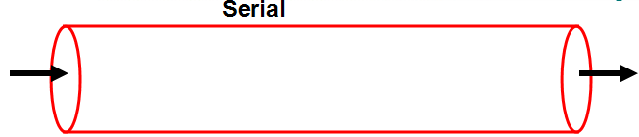
Static Routes and Point-to-Point Networks
Static routes that are configured with exit interfaces instead of next-hop IP addresses are ideal for most serial point-to-point networks.
Point-to-point networks that use protocols such as HDLC and PPP
Notes:
Static routes that are configured with exit interfaces instead of next-hop IP addresses are ideal for most serial point-to-point networks.
Point-to-point networks that use protocols such as HDLC and PPP
These types of point-to-point serial links are like pipes.
A pipe has only two ends.
What enters one end can only have a single destination: the other end of the pipe.
Any packets that are sent through R1’s Serial 0/0/0 interface can only have one destination: R2’s Serial 0/0/0 interface.

Slide 83
Modifying Static Routes (already did this)
<Done in previously>
R1(config)# no ip route 192.168.2.0 255.255.255.0 172.16.2.2
R1(config)# ip route 192.168.2.0 255.255.255.0 serial 0/0/0
There is no way to modify an existing static route.
The static route must be deleted and a new one configured.
Notes:
There is no way to modify an existing static route.
The static route must be deleted and a new one configured.

Slide 84
Modifying Static Routes
R1(config)# no ip route 172.16.1.0 255.255.255.0 172.16.2.2
R1(config)# ip route 172.16.1.0 255.255.255.0 serial 0/0/0
R1(config)# no ip route 192.168.1.0 255.255.255.0 172.16.2.2
R1(config)# ip route 192.168.1.0 255.255.255.0 serial 0/0/0
R2(config)# no ip route 172.16.3.0 255.255.255.0 172.16.2.1
R2(config)# ip route 172.16.3.0 255.255.255.0 serial 0/0/0
R2(config)# no ip route 192.168.2.0 255.255.255.0 192.168.1.1
R2(config)# ip route 192.168.2.0 255.255.255.0 serial 0/0/1
R3(config)# no ip route 172.16.1.0 255.255.255.0 192.168.1.2
R3(config)# ip route 172.16.1.0 255.255.255.0 serial 0/0/1
R3(config)# no ip route 172.16.2.0 255.255.255.0 192.168.1.2
R3(config)# ip route 172.16.2.0 255.255.255.0 serial 0/0/1
R3(config)# no ip route 172.16.3.0 255.255.255.0 192.168.1.2
R3(config)# ip route 172.16.3.0 255.255.255.0 serial 0/0/1
Modifying the rest of the serial point-to-point static routes using exit interfaces.
Delete the previous static routes
Notes:
Modifying the rest of the serial point-to-point static routes.

Slide 85
Verifying Static Route Changes
R1# show running-config
<output omitted>
ip route 172.16.1.0 255.255.255.0 Serial0/0/0
ip route 192.168.1.0 255.255.255.0 Serial0/0/0
ip route 192.168.2.0 255.255.255.0 Serial0/0/0
<output omitted>
R2# show running-config
<output omitted>
ip route 172.16.3.0 255.255.255.0 Serial0/0/0
ip route 192.168.2.0 255.255.255.0 Serial0/0/1
<output omitted>
R3# show running-config
<output omitted>
ip route 172.16.1.0 255.255.255.0 Serial0/0/1
ip route 172.16.2.0 255.255.255.0 Serial0/0/1
ip route 172.16.3.0 255.255.255.0 Serial0/0/1
<output omitted>

Slide 86
Verifying Static Route Changes
R1# show ip route
172.16.0.0/24 is subnetted, 3 subnets
S 172.16.1.0 is directly connected, Serial0/0/0
C 172.16.2.0 is directly connected, Serial0/0/0
C 172.16.3.0 is directly connected, FastEthernet0/0
S 192.168.1.0/24 is directly connected, Serial0/0/0
S 192.168.2.0/24 is directly connected, Serial0/0/0
R2# show ip route
172.16.0.0/24 is subnetted, 3 subnets
C 172.16.1.0 is directly connected, FastEthernet0/0
C 172.16.2.0 is directly connected, Serial0/0/0
S 172.16.3.0 is directly connected, Serial0/0/0
C 192.168.1.0/24 is directly connected, Serial0/0/1
S 192.168.2.0/24 is directly connected, Serial0/0/1
R3# show ip route
172.16.0.0/24 is subnetted, 3 subnets
S 172.16.1.0 is directly connected, Serial0/0/1
S 172.16.2.0 is directly connected, Serial0/0/1
S 172.16.3.0 is directly connected, Serial0/0/1
C 192.168.1.0/24 is directly connected, Serial0/0/1
C 192.168.2.0/24 is directly connected, FastEthernet0/0

Slide 87
Verifying Static Route Changes
R1# ping 192.168.2.1
Sending 5, 100-byte ICMP Echos to 172.16.3.1, timeout is 2 seconds:
!!!!!
Success rate is 100 percent (5/5), round-trip min/avg/max = 28/28/32 ms
R2# ping 172.16.3.1
Sending 5, 100-byte ICMP Echos to 172.16.1.1, timeout is 2 seconds:
!!!!!
Success rate is 100 percent (5/5), round-trip min/avg/max = 28/29/32 ms
R2# ping 192.168.2.1
Sending 5, 100-byte ICMP Echos to 192.168.2.1, timeout is 2 seconds:
!!!!!
Success rate is 100 percent (5/5), round-trip min/avg/max = 56/56/60 ms
R3# ping 172.16.3.1
Sending 5, 100-byte ICMP Echos to 172.16.1.1, timeout is 2 seconds:
!!!!!
Success rate is 100 percent (5/5), round-trip min/avg/max = 28/29/32 ms

Slide 88
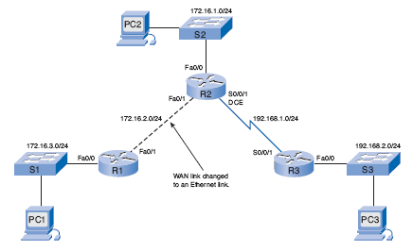
Static Routes with Ethernet Interfaces
Modified topology

Slide 89
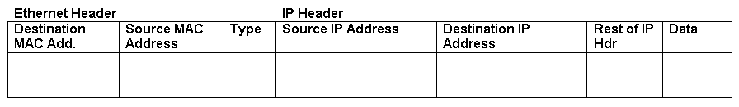
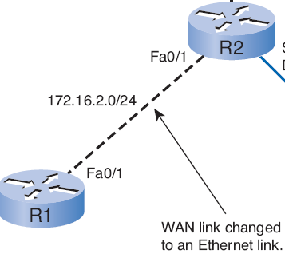
Sending an ARP Request
R1(config)# ip route 192.168.2.0 255.255.255.0 172.16.2.2
R2’s MAC?
abcd
192.168.2.10
172.16.2.2
R1 checks ARP Cache for 172.16.2.2 matching MAC address.
If does not exist, R1 sends ARP Request and R2 sends ARP Reply.
R1 uses R2’s MAC address for 172.16.2.2 as the destination MAC address for the packet.
ARP Reply
ARP Request
ARP Cache
IP Add <-> MAC Add
172.16.2.2 <->
abcd
Notes:
R1 checks ARP Cache for 172.16.2.2 matching MAC address.
If does not exist, R1 sends ARP Request and R2 sends ARP Reply.
R1 uses R2’s MAC address for 172.16.2.2 as the destination MAC address for the packet.

Slide 90
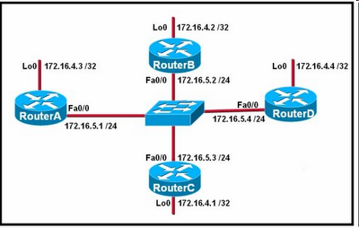
Static Routes and Ethernet Exit Interfaces
<Not recommended>
R1(config)# ip route 192.168.2.0 255.255.255.0 fastethernet0/1
<Recommended>
R1(config)# ip route 192.168.2.0 255.255.255.0 fastethernet0/1 172.16.2.2
R1# show ip route
S 192.168.2.0/24 [1/0] via 172.16.2.2 FastEthernet0/1
Best not to use only an exit interface with Ethernet interfaces.
  Ethernet networks is a multiaccess network.
  Can be multiple next-hope addresses, multiple routers.
  Router will not have sufficient information to determine which device is the next-hop device.
Use both the next-hop interface and the exit interface for Ethernet exit interfaces.
Only a single route lookup now needed.
Notes:
Best not to use only an exit interface with Ethernet interfaces.
Router will have difficulty determining the destination MAC address.
With Ethernet networks, many different devices can be sharing the same multiaccess network, including hosts and even multiple routers.
Router will not have sufficient information to determine which device is the next-hop device.
Use both the next-hop interface and the exit interface for Ethernet exit interfaces.
Only a single route lookup now needed.
The is an advantage to using exit interfaces in static routes for both serial point-to-point and Ethernet outbound networks is:
The routing table process only has to perform a single lookup to find the exit interface instead of a second lookup to resolve a next-hop address.

Slide 91
Summary and Default Static Routes
Summary Static Routes
Default Static Routes

Slide 92
Summarizing Routes to Reduce the Size of the Routing Table
Summary route is a single route that can be used to represent multiple routes.
  Generally a set of contiguous networks (but do not have to be)
  Have the same exit interface or next-hop IP address.
Example:
  10.0.0.0/16, 10.1.0.0/16, 10.2.0.0/16, 10.3.0.0/16, 10.4.0.0/16, 10.5.0.0/16, all the way through 10.255.0.0/16
  Can be represented by a single network address: 10.0.0.0/8.
Creates smaller routing tables
  More efficient routing table lookup process more efficient.
A single static route can be used to represent dozens, hundreds, or even thousands of routes.
  As of Feb 2010, there are more than 300,000 routes in the Internet core routers.
  Most of these are summarized routes.
Notes:
Summary route is a single route that can be used to represent multiple routes.
Generally a set of contiguous networks (but do not have to be)
Have the same exit interface or next-hop IP address.
Example:
10.0.0.0/16, 10.1.0.0/16, 10.2.0.0/16, 10.3.0.0/16, 10.4.0.0/16, 10.5.0.0/16, all the way through 10.255.0.0/16
Can be represented by a single network address: 10.0.0.0/8.
Creates smaller routing tables
More efficient routing table lookup process more efficient.
A single static route can be used to represent dozens, hundreds, or even thousands of routes.
As of March 2007, there are more than 200,000 routes in the Internet core routers.
Most of these are summarized routes.

Slide 93
Summarizing Routes to Reduce the Size of the Routing Table
R3:
ip route 172.16.1.0 255.255.255.0 Serial0/0/1
ip route 172.16.2.0 255.255.255.0 Serial0/0/1
ip route 172.16.3.0 255.255.255.0 Serial0/0/1
All three routes are forwarding traffic out the same Serial 0/0/1 interface.
Can be summarized to the single 172.16.0.0 255.255.252.0
Let’s see how!
Notes:
All three routes are forwarding traffic out the same Serial 0/0/1 interface.
Can be summarized to the single 172.16.0.0 255.255.252.0

Slide 94
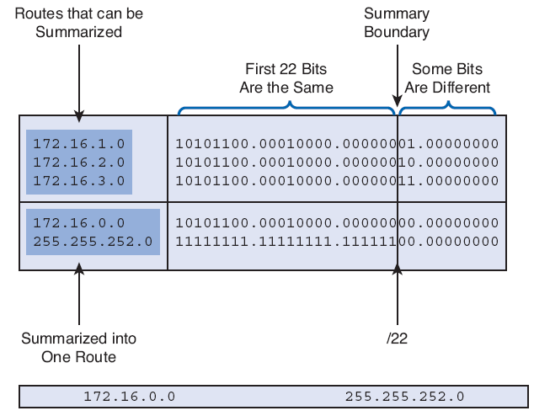
Calculating a Summary Route
Step 1. Write out the networks that you want to summarize in binary.
Step 2. To find the subnet mask for summarization, start with the leftmost bit.
Step 3. Work your way to the right, finding all the bits that match consecutively.
ip route 172.16.0.0 255.255.252.0 serial0/0/1
Step 4. When you find a column of bits that do not match, stop. You are at the summary boundary.
Step 5. Count the number of leftmost matching bits, which in our example is 22. This number becomes your subnet mask for the summarized route, /22 or 255.255.252.0.
Step 6. To find the network address for summarization:
  Copy the matching 22 bits
  Add all 0 bits to the end to make 32 bits.
Notes:
Step 1. Write out the networks that you want to summarize in binary.
Step 2. To find the subnet mask for summarization, start with the leftmost bit.
Step 3. Work your way to the right, finding all the bits that match consecutively.
Step 4. When you find a column of bits that do not match, stop. You are at the summary boundary.
Step 5. Count the number of leftmost matching bits, which in our example is 22. This number becomes your subnet mask for the summarized route, /22 or 255.255.252.0.
Step 6. To find the network address for summarization, copy the matching 22 bits and add all 0 bits to the end to make 32 bits..

Slide 95
Configure a Summary Route
R3(config)# no ip route 172.16.1.0 255.255.255.0 serial0/0/1
R3(config)# no ip route 172.16.2.0 255.255.255.0 serial0/0/1
R3(config)# no ip route 172.16.3.0 255.255.255.0 serial0/0/1
R3(config)# ip route 172.16.0.0 255.255.252.0 serial0/0/1
Delete individual static routes.
Configure single summary route.
Notes:
Delete individual static routes.
Configure single summary route.

Slide 96
Changes in Routing Table
R3# show ip route
<output omitted>
172.16.0.0/24 is subnetted, 3 subnets
S 172.16.1.0 is directly connected, Serial0/0/1
S 172.16.2.0 is directly connected, Serial0/0/1
S 172.16.3.0 is directly connected, Serial0/0/1
C 192.168.1.0/24 is directly connected, Serial0/0/1
C 192.168.2.0/24 is directly connected, FastEthernet0/0
Before
R3# show ip route
<output omitted>
172.16.0.0/22 is subnetted, 1 subnets
S 172.16.0.0 is directly connected, Serial0/0/1
C 192.168.1.0/24 is directly connected, Serial0/1
C 192.168.2.0/24 is directly connected, FastEthernet0/0
After
Fewer routes mean faster lookups!
What do you expect to see?
Any packet with a destination IP address belonging to the 172.16.1.0/24, 172.16.2.0/24, or 172.16.3.0/24 network matches this summarized route.
Notes:
Any packet with a destination IP address belonging to the 172.16.1.0/24, 172.16.2.0/24, or 172.16.3.0/24 network matches this summarized route.

Slide 97
Verify the Summary Route
R3# ping 172.16.1.1
Type escape sequence to abort.
Sending 5, 100-byte ICMP Echos to 172.16.1.1, timeout is 2 seconds:
!!!!!
Success rate is 100 percent (5/5), round-trip min/avg/max = 28/29/32 ms
R3# ping 172.16.2.1
Type escape sequence to abort.
Sending 5, 100-byte ICMP Echos to 172.16.2.1, timeout is 2 seconds:
!!!!!
Success rate is 100 percent (5/5), round-trip min/avg/max = 56/56/60 ms
R3# ping 172.16.3.1
Type escape sequence to abort.
Sending 5, 100-byte ICMP Echos to 172.16.3.1, timeout is 2 seconds:
!!!!!
Success rate is 100 percent (5/5), round-trip min/avg/max = 56/56/60 ms
R3#

Slide 98
Default Static Route
I only have one way to rest of the world (Internet), so I will use a static default route.
A default route is used to represent all routes with zero or no bits matching.
When there are no routes that have a more specific match, the default route will be a match. (more later)
A default static route is a route that will match all packets.
Notes:
A default route is used to represent all routes with zero or no bits matching.
In other words, when there are no routes that have a more specific match, the default route will be a match. (more later throughout the course)
A default static route is a route that will match all packets.
Default static routes are used
To represent destination networks outside the router’s own routing domain.
A common use is when connecting a company’s edge router to the ISP network.
When no other routes in the routing table match the packet’s destination IP address—in other words, when a more specific match does not exist.
When a router has only one other router to which it is connected. This condition is known as a stub router.

Slide 99
Configuring a Default Static Route
Router(config)# ip route 0.0.0.0 0.0.0.0 [exit-interface | ip-address ]
0.0.0.0 0.0.0.0 network address and mask is called a quad-zero route.
Notes:
0.0.0.0 0.0.0.0 network address and mask is called a quad-zero route.

Slide 100
Configuring a Default Static Route
ip route 172.16.1.0 255.255.255.0 serial 0/0/0
ip route 192.168.1.0 255.255.255.0 serial 0/0/0
ip route 192.168.2.0 255.255.255.0 serial 0/0/0
Stub network
R1 is a stub router and is connected only to R2.
R1 doesn’t need specific routing information to reach R3 networks.
Currently R1 has three static routes.
All three static routes have a(n):
  Exit interface Serial 0/0/0
  Next-hop Router R2
Notes:
R1 is a stub router and is connected only to R2.
R1 doesn’t need specific routing information to reach R3 networks.
Currently R1 has three static routes.
All three static routes have:
the exit interface Serial 0/0/0
next-hop Router R2

Slide 101
Configuring a Default Static Route
R1(config)# no ip route 172.16.1.0 255.255.255.0 serial 0/0/0
R1(config)# no ip route 192.168.1.0 255.255.255.0 serial 0/0/0
R1(config)# no ip route 192.168.2.0 255.255.255.0 serial 0/0/0
R1(config)# ip route 0.0.0.0 0.0.0.0 serial 0/0/0
Delete individual static routes.
Configure single default static route.
Notes:
Delete individual static routes.
Configure single default static route.

Slide 102
What will the routing table look like now?
R1# show ip route
172.16.0.0/24 is subnetted, 3 subnets
S 172.16.1.0 is directly connected, Serial0/0/0
C 172.16.2.0 is directly connected, Serial0/0/0
C 172.16.3.0 is directly connected, FastEthernet0/0
S 192.168.1.0/24 is directly connected, Serial0/0/0
S 192.168.2.0/24 is directly connected, Serial0/0/0
Before
R1# show ip route
<some codes omitted>
* - candidate default, U - per-user static route, o - ODR
Gateway of last resort is 0.0.0.0 to network 0.0.0.0
172.16.0.0/24 is subnetted, 2 subnets
C 172.16.2.0 is directly connected, Serial0/0/0
C 172.16.3.0 is directly connected, FastEthernet0/0
S* 0.0.0.0/0 is directly connected, Serial0/0/0
After

Slide 103
Verifying a Default Static Route
R1# show ip route
<some codes omitted>
* - candidate default, U - per-user static route, o - ODR
Gateway of last resort is 0.0.0.0 to network 0.0.0.0
172.16.0.0/24 is subnetted, 2 subnets
C 172.16.2.0 is directly connected, Serial0/0/0
C 172.16.3.0 is directly connected, FastEthernet0/0
S* 0.0.0.0/0 is directly connected, Serial0/0/0
A /0 mask indicates that zero or no bits are needed to match.
As long as a more specific match doesn’t exist, the default static route will match all packets.
Very common
No need to store hundreds or thousands of routes to different networks.
Notes:
A /0 mask indicates that zero or no bits are needed to match.
As long as a more specific match doesn’t exist, the default static route will match all packets.
Default routes are very common on routers.
Instead of routers having to store routes for all the networks in the Internet, they can store a single default route to represent any network that is not in the routing table.
You will see in later chapters that a default route does not always have to be a static route.

Slide 104
Managing and Troubleshooting Static Routes
Static Routes and Packet Forwarding
Troubleshooting a Missing Route
Solving the Missing Route

Slide 105
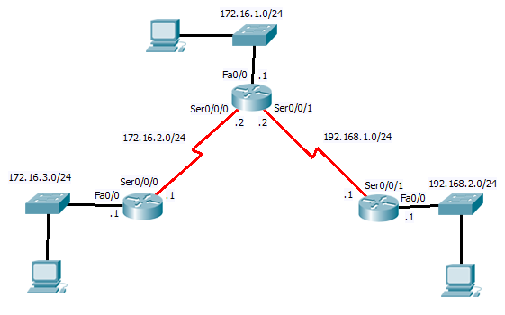
Static Routes and Packet Forwarding

Slide 106
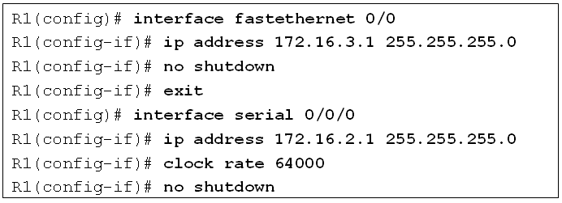
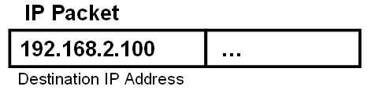
How did R1 learn about this static route?
How did R1 learn about its directly connected networks?
R1(config)# ip route 0.0.0.0 0.0.0.0 serial 0/0/0
R1# show ip route
Gateway of last resort is 0.0.0.0 to network 0.0.0.0
172.16.0.0/24 is subnetted, 2 subnets
C 172.16.2.0 is directly connected, Serial0/0/0
C 172.16.3.0 is directly connected, FastEthernet0/0
S* 0.0.0.0/0 is directly connected, Serial0/0/0
No Match with Dest. IP Add
No Match with Dest. IP Add
Matches Dest. IP Add

Slide 107
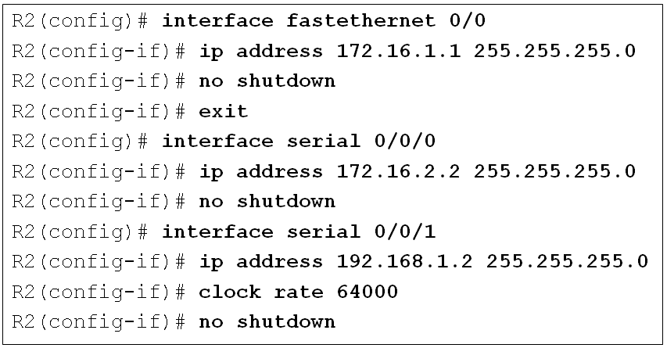
How did R2 learn about these static routes?
How did R2 learn about its directly connected networks?
R2(config)# ip route 172.16.3.0 255.255.255.0 serial 0/0/0
R2(config)# ip route 192.168.2.0 255.255.255.0 serial 0/0/1
R2# show ip route
172.16.0.0/24 is subnetted, 3 subnets
C 172.16.1.0 is directly connected, FastEthernet0/0
C 172.16.2.0 is directly connected, Serial0/0/0
S 172.16.3.0 is directly connected, Serial0/0/0
C 192.168.1.0/24 is directly connected, Serial0/0/1
S 192.168.2.0/24 is directly connected, Serial0/0/1
No Match
No Match
No Match
No Match
Match!

Slide 108
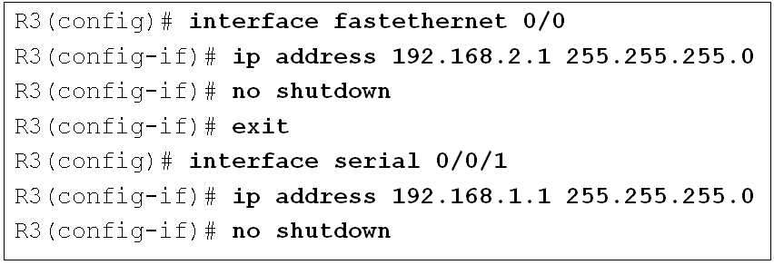
How did R3 learn about these static routes?
How did R3 learn about its directly connected networks?
R3(config)# ip route 172.16.0.0 255.255.252.0 serial0/0/1
R3# show ip route
172.16.0.0/22 is subnetted, 1 subnets
S 172.16.0.0 is directly connected, Serial0/0/1
C 192.168.1.0/24 is directly connected, Serial0/1
C 192.168.2.0/24 is directly connected, FastEthernet0/0
No Match
No Match
Match!

Slide 109
Troubleshooting a Missing Route
When end-to-end connectivity is a problem, begin by making sure that you can ping your own interface and other devices on your own directly connected networks.
When this has been verified, begin testing connectivity to remote networks and from other devices.
Networks are subject to many different forces that can cause their status to change quite often:
  Interface failure
  Dropped connection by a service provider
  Oversaturation of links
  Incorrect configuration entered by an administrator.
Tools:
  ping
  traceroute
  show ip route
  show ip interface brief
Notes:
When end-to-end connectivity is a problem, begin by making sure that you can ping your own interface and other devices on your own directly connected networks.
When this has been verified, begin testing connectivity to remote networks and from other devices.
Networks are subject to many different forces that can cause their status to change quite often:
Interface failure
Dropped connection by a service provider
Oversaturation of links
Incorrect configuration entered by an administrator.
Tools:
ping
traceroute
show ip route
show ip interface brief

Slide 110
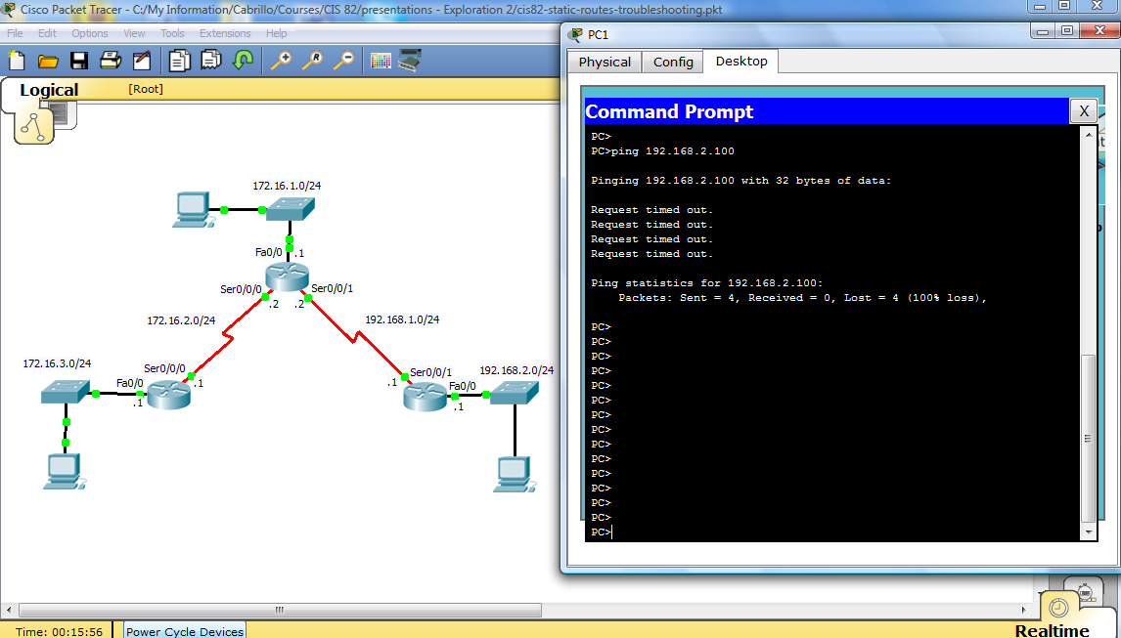
Troubleshooting Static Routes
Download: cis82-static-routes-troubleshooting.pkt
Determine why the PCs cannot ping each other and fix the problem.
Notes:
PC1 cannot ping PC3.
R2 reveals that the 172.16.3.0/24 network is configured incorrectly.

Slide 111
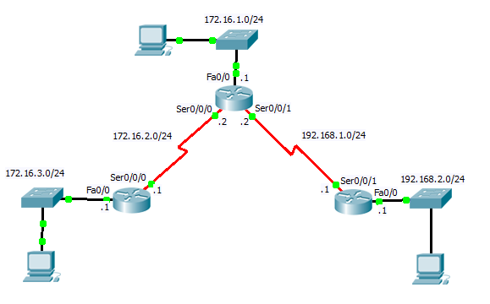
Troubleshooting Techniques
Make sure all interfaces are “up” and “up”
What command will help you determine this?
  R1# show ip interface brief
What are some of the reasons an interface may be down?
  Didn’t issue the “no shutdown” command
  Missing “clock rate” command on Serial DCE interface.
  Missing or incorrect cable
  No connection to other end device:
    Ethernet: No switch or hub attached
    Serial: Other end not connected or configured
      Both ends of serial interface must be configured correctly to be “up”
Notes:
Delete the incorrect static route.
Configure the correct static route.

Slide 112
Troubleshooting Techniques
Can you ping addresses on directly connected networks (next-hop addresses)?
Can you ping other interfaces on the next-hop router?
Can you ping the next-hop interface?
If unsuccessful:
  Make sure each router on the path to that network have the remote network in its routing table.
  Make sure each router on the path to that network have a return route back to this router.
Notes:
Delete the incorrect static route.
Configure the correct static route.

Slide 113
Alex Zinin’s Routing Table Principles
I know about my remote networks but it is not my responsibility if R2 and R3 know about their remote networks.
Principle 1: Every router makes its decision alone, based on the information it has in its own routing table.
R1 makes forwarding decisions based solely on the information in the routing table.
R1 does not consult the routing tables in any other routers.
Making each router aware of remote networks is the responsibility of the network administrator.
Notes:
Principle 1: Every router makes its decision alone, based on the information it has in its own routing table.
R1 has three static routes in its routing table and makes forwarding decisions based solely on the information in the routing table.
R1 does not consult the routing tables in any other routers, nor does it know whether those routers have routes to other networks.
Making each router aware of remote networks is the responsibility of the network administrator.

Slide 114
Alex Zinin’s Routing Table Principles
Just because I know how to get to R3’s LAN, 192.168.2.0/24 and I send that packet to R2, doesn’t mean R2 knows how to get there.
???
Principle 2: The fact that one router has certain information in its routing table does not mean that other routers have the same information.
Notes:
Principle 2: The fact that one router has certain information in its routing table does not mean that other routers have the same information.
R1 does not know what information other routers have in their routing table.
For example, R1 has a route to the 192.168.2.0/24 network through Router R2.
Any packets that match this route belong to the 192.168.2.0/24 network and will be forwarded to Router R2.
R1 does not know whether R2 has a route to the 192.168.2.0/24 network.
Again, the network administrator would be responsible for ensuring that the next-hop router also has a route to this network.
Using Principle 2, you still need to configure the proper routing on the other routers (R2 and R3) to make sure that they have routes to these three networks.

Slide 115
Alex Zinin’s Routing Table Principles
And if the packet for R3’s LAN reaches 192.168.2.0/24, I don’t know if R3 has a route back to 172.16.3.0/24 for any return traffic.
???
Principle 3: Routing information about a path from one network to another does not provide routing information about the reverse, or return, path.
Notes:
Principle 3: Routing information about a path from one network to another does not provide routing information about the reverse, or return, path.
Most of the communication over networks is bidirectional.
This means that packets must travel in both directions between the end devices involved.
A packet from PC1 can reach PC3 because all the routers involved have routes to the destination network 192.168.2.0/24.
However, the success of any returning packets going from PC3 to PC1 depends on whether the routers involved have a route to the return path, PC1’s 172.16.3.0/24 network.
Using Principle 3 as guidance, you will configure proper static routes on the other routers to make sure that they have routes back to the 172.16.3.0/24 network.

Slide 116
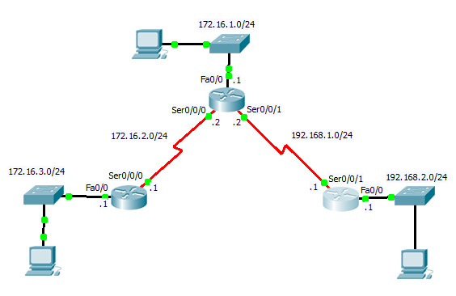
Cisco Discovery Protocol (CDP)
Download: cis82-static-routing-cdp.pkt
CDP does not have anything specifically to do with static routing, but it is covered in this chapter.

Slide 117
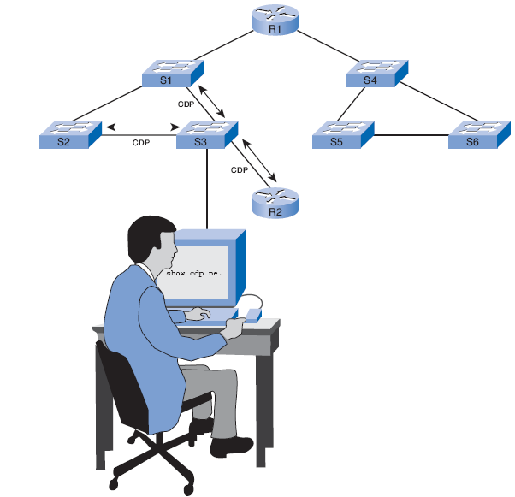
Cisco Discovery Protocol (CDP)
Cisco Discovery Protocol (CDP)
  Network-monitoring and troubleshooting tool.
  Get information about directly connected Cisco devices.
  Cisco proprietary.
Notes:
Cisco Discovery Protocol (CDP) is a powerful network-monitoring and –troubleshooting tool.
CDP is an information-gathering tool used by network administrators to get information about directly connected Cisco devices.
CDP is a proprietary tool that enables you to access a summary of protocol and address information about Cisco devices that are directly connected.

Slide 118
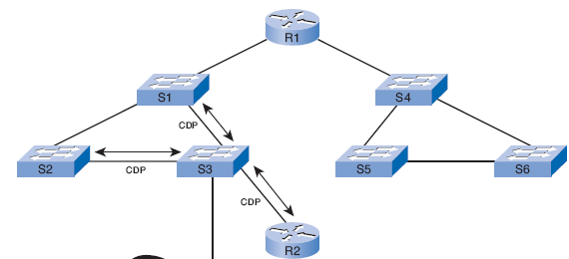
CDP Advertisements
By default, each Cisco device sends periodic messages to directly connected Cisco devices.
  CDP advertisements.
Information gathered from other devices can assist you:
  Troubleshooting
  Network discovery tool
Notes:
By default, each Cisco device sends periodic messages to directly connected Cisco devices.
These messages are known as CDP advertisements.
A Cisco device frequently has other Cisco devices as neighbors on the network.
Information gathered from other devices can assist you:
in making network design decisions
in troubleshooting
in making changes to equipment.
CDP can be used as a network discovery tool

Slide 119
Layer 2 Neighbors
CDP operates at Layer 2 only.
Therefore, CDP neighbors are Cisco devices that are directly connected physically and share the same data link.
  R1 and S1 are CDP neighbors
  R1 and R2 are CDP neighbors
  R2 and S2 are CDP neighbors
  R2 and R3 are CDP neighbors
  R3 and S3 are CDP neighbors
Notes:
CDP operates at Layer 2 only.
Therefore, CDP neighbors are Cisco devices that are directly connected physically and share the same data link.
R1 and S1 are CDP neighbors
R1 and R2 are CDP neighbors
R2 and S2 are CDP neighbors
R2 and R3 are CDP neighbors
R3 and S3 are CDP neighbors

Slide 120
CDP Operation
R3# show cdp neighbors
Capability Codes: R - Router, T - Trans Bridge, B - Source Route Bridge
S - Switch, H - Host, I - IGMP, r - Repeater, P - Phone
Device ID Local Intrfce Holdtme Capability Platform Port ID
Switch Fas 0/0 135 S 2950 Fas 0/1
R2 Ser 0/0/1 135 R C1841 Ser 0/0/1
R3#
What is the Device ID?
What is the Capability?
Hostname
S=Switch R= Router
What is the Platform?
Model Number
Notes:
Device identifiers: For example, the configured host name of a switch Address list: Up to one network layer address for each protocol supported
Port identifier: The name of the local and remote port, in the form of an ASCII character string such as ethernet0
Capabilities list: For example, whether this device is a router or a switch
Platform: The hardware platform of the device; for example, a Cisco 7200 series router

Slide 121
Try it on R1…
R1# show cdp neighbors
Capability Codes: R - Router, T - Trans Bridge, B - Source Route Bridge
S - Switch, H - Host, I - IGMP, r - Repeater, P - Phone
Device ID Local Intrfce Holdtme Capability Platform Port ID
Switch Fas 0/0 153 S 2950 Fas 0/1
R2 Ser 0/0/0 153 R C1841 Ser 0/0/0
R1#
Notes:
Device identifiers: For example, the configured host name of a switch Address list: Up to one network layer address for each protocol supported
Port identifier: The name of the local and remote port, in the form of an ASCII character string such as ethernet0
Capabilities list: For example, whether this device is a router or a switch
Platform: The hardware platform of the device; for example, a Cisco 7200 series router

Slide 122
Try it on R2…
R2# show cdp neighbors
Capability Codes: R - Router, T - Trans Bridge, B - Source Route Bridge
S - Switch, H - Host, I - IGMP, r - Repeater, P - Phone
Device ID Local Intrfce Holdtme Capability Platform Port ID
Switch Fas 0/0 176 S 2950 Fas 0/1
R3 Ser 0/0/1 176 R C1841 Ser 0/0/1
R1 Ser 0/0/0 176 R C1841 Ser 0/0/0
R2#
Notes:
Device identifiers: For example, the configured host name of a switch Address list: Up to one network layer address for each protocol supported
Port identifier: The name of the local and remote port, in the form of an ASCII character string such as ethernet0
Capabilities list: For example, whether this device is a router or a switch
Platform: The hardware platform of the device; for example, a Cisco 7200 series router

Slide 123
Try it with the detail option
R3# show cdp neighbors detail
Device ID: Switch
Entry address(es):
Platform: cisco 2950, Capabilities: Switch
Interface: FastEthernet0/0, Port ID (outgoing port): FastEthernet0/1
<output omitted>
Duplex: full
---------------------------
Device ID: R2
Entry address(es):
IP address : 192.168.1.2
Platform: cisco C1841, Capabilities: Router
Interface: Serial0/0/1, Port ID (outgoing port): Serial0/0/1
Holdtime: 122
Version :
Cisco IOS Software, 1841 Software (C1841-ADVIPSERVICESK9-M), Version 12.4(15)T1, RELEASE SOFTWARE (fc2)
<output omitted>
IP Address of remote router

Slide 124
Disabling CDP
Router(config)# no cdp run
or
Router(config-if)# no cdp enable
CDP can be a security risk.
To disable CDP globally, for the entire device, use this command:
  Router(config)# no cdp run
To stop CDP advertisements on a particular interface:
  Router(config-if)# no cdp enable
Notes:
CDP can be a security risk.
To disable CDP globally, for the entire device, use this command: no cdp run
To stop CDP advertisements on a particular interface: no cdp enable

Slide 125
Chapter 2
Static Routing
CIS 82 Routing Protocols and Concepts
Rick Graziani
Cabrillo College
graziani@cabrillo.edu

