Slide 1
Dynamic Routing
CCNA Exploration Semester 2
Chapter 3
S Ward Abingdon and Witney College
Notes:
dYNAMICrOUTING
S Ward Abingdon and Witney College

Slide 2
Topics
Dynamic routing protocols and network design
Classifying routing protocols
Metrics
Administrative distance
Routing tables
Subnetting
S Ward Abingdon and Witney College

Slide 3
Routing protocols
Exterior gateway protocols
Between ISPs, between ISP and major client
  Path vector
    BGP (border gateway protocol), EGP
Interior gateway protocols
Within private groups of networks
  Distance vector
    RIPv1 and 2, (IGRP), EIGRP
  Link state
    OSPF, IS-IS
S Ward Abingdon and Witney College

Slide 4
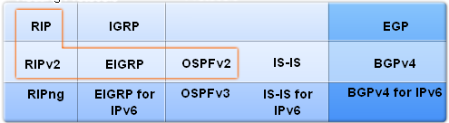
Routing protocols
Interior gateway protocols
Exterior gateway protocols
Classful
Classless
IPv6
S Ward Abingdon and Witney College

Slide 5
Routing protocols
Interior gateway protocols
Exterior gateway protocols
Classful
Classless
IPv6
Distance vector, open standard
S Ward Abingdon and Witney College

Slide 6
Routing protocols
Interior gateway protocols
Exterior gateway protocols
Classful
Classless
IPv6
Distance vector, Cisco proprietary
S Ward Abingdon and Witney College

Slide 7
Routing protocols
Interior gateway protocols
Exterior gateway protocols
Classful
Classless
IPv6
Link state
S Ward Abingdon and Witney College

Slide 8
Routing protocol - purpose
Purpose is to add dynamic routes to a router’s routing table.
They let routers exchange information about routes.
They choose the best route to each known destination and put it in the routing table.
S Ward Abingdon and Witney College

Slide 9
Static Dynamic
Requires knowledge to configure efficiently
CPU processing and memory used
Uses bandwidth
Adjusts automatically to topology changes
Less prone to error
Scales well to large networks
Less secure
Easy to understand and configure
Little CPU processing.
Uses no bandwidth
Needs re-configuring when topology changes
Prone to error in configuring
Does not scale well to large networks
More secure
S Ward Abingdon and Witney College

Slide 10
Autonomous systems
An autonomous system (AS) is a collection of networks under a common administration sharing a common routing strategy.
Also known as a routing domain.
Each AS has a 16 bit autonomous system number.
Interior gateway protocol used within an AS, Exterior gateway protocol between them.
S Ward Abingdon and Witney College

Slide 11
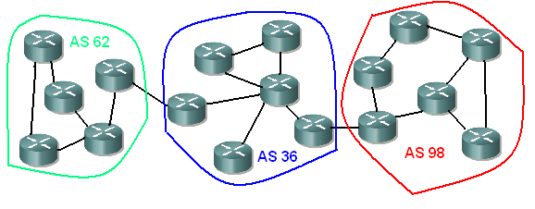
Autonomous systems
Autonomous systems divide up the global internetwork into manageable units
S Ward Abingdon and Witney College

Slide 12
Interior and Exterior
BGP used between
BGP used between
RIP in AS 62
EIGRP in AS 36
OSPF in AS 98
S Ward Abingdon and Witney College

Slide 13
Types of interior routing protocol
There are two main types of interior routing protocol
  Distance Vector
  Link State (Shortest Path First)
They work in different ways but they have the same purposes
  Discover routes and put the best ones in the routing table
  Remove routes that are no longer available
S Ward Abingdon and Witney College

Slide 14
Distance vector
A distance vector protocol learns:
  The distance to a network, measured in hops or in some other way
  The direction of the network: which port should be used to reach it
It puts the routes in the routing table
It does not know any more details of the route or the other routers along the way
S Ward Abingdon and Witney College

Slide 15
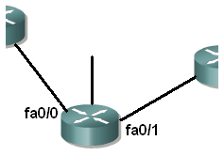
Distance vector
Network 192.168.48.0 is 3 hops away using port fa0/0
Network 192.168.22.0 is 2 hops away using port fa0/0
S Ward Abingdon and Witney College

Slide 16
Distance vector
Distance vector protocols typically use the Bellman-Ford algorithm for the best path route determination.
EIGRP uses the DUAL algorithm.
Some distance vector protocols send complete routing tables to all connected neighbors at intervals.
This can cause significant traffic on the links.
S Ward Abingdon and Witney College

Slide 17
Distance vector
Suitable for simple “flat” networks without hierarchical design.
Suitable for hub-and-spoke networks.
Easier to configure and troubleshoot than link-state protocols.
Slower to converge than link state.
Typically use more bandwidth but need less processing power than link state.
S Ward Abingdon and Witney College

Slide 18
Link state
A link state routing protocol finds out about all the routers in the system and the networks they link to.
It builds up a complete picture of the topology
It can then work out the best path to any network
It puts these best paths in the routing table
S Ward Abingdon and Witney College

Slide 19
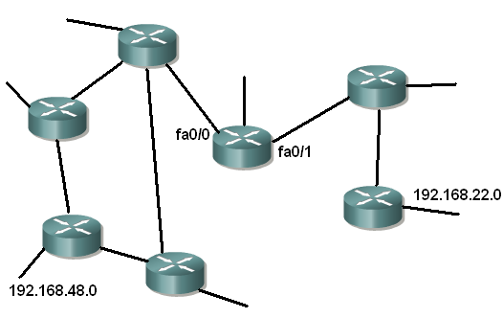
Link state
I know all the routers and paths in this system of networks.
S Ward Abingdon and Witney College

Slide 20
Link state
Link-state routing protocols do not send periodic updates of whole routing tables.
After the network has converged, a link-state update only sent when there is a change in the topology.
All the routers have the same “map” of the network and each router works out its own best routes.
S Ward Abingdon and Witney College

Slide 21
Link state
Link-state protocols are suitable for large networks with hierarchical designs.
They can be difficult to configure efficiently: the administrators need a good knowledge of the protocol.
They provide fast convergence.
OSPF uses the Open Shortest Path First or Dijkstra algorithm
S Ward Abingdon and Witney College

Slide 22
Types of routing protocol
Distance vector
RIP v 1 and 2
IGRP
EIGRP
Link state
OSPF
IS-IS
Not typical distance vector. Has some characteristics of link state.
S Ward Abingdon and Witney College

Slide 23
Classful routing protocols
IP addresses were based on classes.
Class A has subnet mask 255.0.0.0
first octet 1 to 126
Class B has subnet mask 255.255.0.0
first octet 128 to 191
Class C has subnet mask 255.255.255.0
first octet 192 to 223
S Ward Abingdon and Witney College

Slide 24
Classful routing protocols
Classful routing protocols do not send subnet masks in updates. There was no need because subnet masks were known from the first octet of the address.
They could be used with traditional subnetting where all subnets had the same mask. They do not support VLSM.
RIP v1 and IGRP are classful.
S Ward Abingdon and Witney College

Slide 25
Classless routing protocols
Modern addressing does not keep strictly to classes, so a knowledge of subnet masks is important.
Classless routing protocols exchange subnet masks in updates.
They support VLSM and CIDR
RIP v2 and EIGRP and OSPF are classless,
so are IS-IS and BGP
S Ward Abingdon and Witney College

Slide 26
Convergence
In a converged network, all routers have up-to-date, accurate information and their routing tables are consistent. (But not the same.)
Networks are not properly operational until they have converged.
RIP and IGRP, traditional distance vector routing protocols, are slow to converge
Link state such as OSPF are faster.
EIGRP is also faster to converge.
S Ward Abingdon and Witney College

Slide 27
Metrics
Routing protocols may find several routes to the same destination
They need to choose the best route
They use metrics (measurements)
The simplest metric is hop count
Other metrics are bandwidth, delay, load, reliability, cost
S Ward Abingdon and Witney College

Slide 28
Hop count as a metric
Used by RIP (Maximum 15 hop counts)
Easy to understand – the number of routers that the message must pass through
May not be the best route – there might be a faster route with more hops.
R 192.168.8.0/24 [120/2] via 192.168.4.1, 00:00:26, Serial0/0/1
metric
S Ward Abingdon and Witney College

Slide 29
Other metrics
IGRP and EIGRP: Bandwidth and Delay by default. Can use Reliability, and Load too. Formula to combine these and give metric.
OSPF: “Cost” – calculated from bandwidth in Cisco implementation. Higher bandwidth, lower cost.
S Ward Abingdon and Witney College

Slide 30
Load balancing
R 192.168.6.0/24 [120/1] via 192.168.2.1, 00:00:24, Serial0/0/0
[120/1] via 192.168.4.1, 00:00:26, Serial0/0/1
Routing table lists two routes to the same destination, with the same metric.
Both routes were discovered by the same protocol.
Both routes will be used.
S Ward Abingdon and Witney College

Slide 31
Administrative distance
Different routes could be found by different routing protocols, or one route could be dynamic and one static.
The route with the lowest administrative distance is used.
Administrative distance is an indication of the “trustworthiness” or desirability of a route.
S Ward Abingdon and Witney College

Slide 32
Administrative distances
0 directly connected
1 static route
90 route found using EIGRP
100 route found using IGRP
110 route found using OSPF
120 route found using RIP
Maximum possible value is 255
These are default values.
S Ward Abingdon and Witney College

Slide 33
Administrative distance
D 192.168.6.0/24 [90/2172416] via 192.168.2.1, 00:00:24, Serial0/0
R 192.168.8.0/24 [120/1] via 192.168.3.1, 00:00:20, Serial0/1
Two routing protocols running on a router linking two areas with the different protocols
Administrative distances are the defaults for the routing protocols.
D means EIGRP. Note the metric is not hop count.
S Ward Abingdon and Witney College

Slide 34
Show ip rip database
Command shows all routes discovered by RIP, whether or not they go into the routing table.
S Ward Abingdon and Witney College

Slide 35
Show ip protocols
Information and statistics about all routing protocols that are running.
S Ward Abingdon and Witney College

Slide 36
Show ip route [route]
E.g. show ip route 192.168.1.0
This gives additional information such as administrative distance for directly connected routes (0) or for static routes where the exit interface is given (1).
S Ward Abingdon and Witney College

Slide 37
Subnetting
Keep revising and practising.
S Ward Abingdon and Witney College

Slide 38
The End
S Ward Abingdon and Witney College

