Slide 1
RIP v2
CCNA Exploration Semester 2
Chapter 7

Slide 2
Topics
Limitations of RIP v1
Configure RIP v2
Verify and troubleshoot RIP v2
Observe RIP v2 support for VLSM and CIDR

Slide 3
Routing protocols
Interior
Exterior
Distance vector
Link state
RIP v1
RIP v2
IGRP
EIGRP
OSPF
IS-IS
EGP
BGP

Slide 4
RIP – both versions
For small, homogeneous networks
Support for multiple vendors
Simple to configure and use
Still very much with us
Good starting point for learning

Slide 5
RIP – both versions
Metric is hop count, maximum 15
Uses 16 metric to mean unreachable (“infinity”)
Same timers with same default values.
Update 30 sec, invalid, holddown 180 sec, flush 240 sec
Same methods of preventing routing loops
Split horizon, route poisoning and poison reverse, holddown timer, count to infinity.
Uses triggered updates when topology changes.

Slide 6
RFC 1918 Private Addresses
10.0.0.0/8 (10.0.0.0 to 10.255.255.255)
172.16.0.0/12 (172.16.0.0 to 172.31.255.255)
192.168.0.0/16 (192.168.0.0 to 192.168.255.255)
Not routed over the Internet
Used without restriction
Used most of the time in Cisco labs

Slide 7
Public addresses
Routed over the Internet
Use only address allocated to you
Cisco has addresses for use in labs
209.165.200.224/27 (209.165.200.224 – 255)
209.165.201.0/27 (209.165.201.0 – 31)
209.165.202.128/27 (209.165.202.128 – 159)
Used where simulation requires a public address.

Slide 8
Loopback interface
A virtual interface that can be set up by the IOS. No real connection.
Can be given an IP address.
Can be pinged, it will reply.
Useful in simulations.
Used in real networks, e.g. when running OSPF. Loopback cannot go down with physical problems.

Slide 9
Null interface
Can be used as the destination in a static route.
Any traffic directed there will be dropped.
Can be used as a way of getting rid of unwanted traffic (though there are other ways).
R2(config)#ip route 192.168.0.0 255.255.0.0 Null0

Slide 10
Redistribution
A routing protocol can pass on static routes or routes learned from other protocols
  R2(config)#router rip
  R2(config-router)#redistribute static
  R2(config-router)#redistribute eigrp
And other similar commands

Slide 11
RIP v1 limitations
Classful
Does not send subnet mask information
So does not support VLSM or CIDR
Discontiguous subnets are a problem
No authentication

Slide 12
Configuring RIP v2
Router(config)#router rip
Router(config-router)#version 2
Router(config-router)#network 192.168.1.0
And any other required networks.

Slide 13

Updates
Version 1
V1 update
Version 2
X
√
V2 update
Sends version 1
Receives both
ignores extra v2 information
Sends version 2
Receives v2
ignores any v1 updates

Slide 14
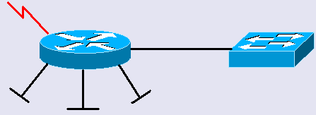
No VLSM support: v1
172.30.120.0/30
172.30.100.0/24
172.30.110.0/24
172.30.200.32/28
172.30.200.16/28
VLSM has been used when subnetting 172.30.0.0/16.

Slide 15
No VLSM support: v1
172.30.120.0/30
172.30.100.0/24
172.30.110.0/24
172.30.200.32/28
172.30.200.16/28
Updates sent over serial link, it has mask /30.
Subnets with other masks are not included.

Slide 16
VLSM support: RIP v2
172.30.120.0/30
172.30.100.0/24
172.30.110.0/24
172.30.200.32/28
172.30.200.16/28
Updates include masks. All subnets are advertised with the right masks.

Slide 17
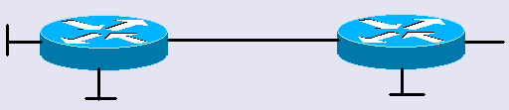
No CIDR support: v1
Want to advertise summary route to
192.168.0.0/16
Has static
routes to
192.168.1.0/24
192.168.2.0/24
192.168.3.0/24
192.168.4.0/24
No good. Cannot accept subnet mask smaller than default.

Slide 18
CIDR support: RIP v2
Advertise summary route to
192.168.0.0/16
Has static
routes to
192.168.1.0/24
192.168.2.0/24
192.168.3.0/24
192.168.4.0/24
Has summary route to 192.168.0.0/16

Slide 19
Discontiguous subnets: v1
172.16.1.0/24
172.30.200.0/24
172.30.201.0/24
Discontiguous subnets of 172.30.0.0/16 separated by a different major network.

Slide 20
Discontiguous subnets: v1
172.16.1.0/24
172.30.200.0/24
172.30.201.0/24
Route to 172.30.201.0 is summarised to class boundary 172.30.0.0/16.
Better route to 172.30.0.0 is already known.
No route to 172.30.201.0 in routing table.

Slide 21
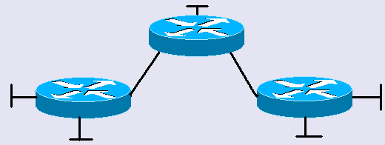
Discontiguous subnets: v1
172.16.2.0/24
172.16.1.0/24
172.30.200.0/24
172.30.201.0/24
Discontiguous subnets of 172.30.0.0/16 separated by a different major network.

Slide 22
Discontiguous subnets: v1
172.16.2.0/24
172.16.1.0/24
172.30.200.0/24
172.30.201.0/24
Learns two equal cost routes to 172.30.0.0/16.
Load balance and use both.
Packets have 50:50 chance of going the right way.

Slide 23
Discontiguous subnets: v2
172.16.1.0/24
172.30.200.0/24
172.30.201.0/24
Route to 172.30.201.0 is summarised to class boundary 172.30.0.0/16 by default.
Better route to 172.30.0.0 is already known.
No route to 172.30.201.0 in routing table.

Slide 24
Discontiguous subnets: v2
172.16.1.0/24
172.30.200.0/24
172.30.201.0/24
No auto-summary command on both.
Does not summarise to class boundary.
Route to 172.30.201.0 goes in routing table.

Slide 25
Verifying
Show ip interface brief (links up or down, IP addresses on interfaces)
Show ip route (for routing table)
Show ip protocols (for version sent and received, for autosummary or not.)
Debug ip rip (to see updates being sent.)

Slide 26
Authentication
RIPv2, EIGRP, OSPF, IS-IS, and BGP support authentication.
Routers check password before accepting routing information from other routers.
Avoids picking up accidental or malicious false information.
Authentication does not encrypt the routing table.

Slide 27
Summary
RIP is OK on small, simple networks.
Use version 2 on all routers if using VLSM or CIDR.
Avoid discontiguous subnets. If you must have them then disable auto-summary.

Slide 28
The End

