Slide 1
Routing Table
CCNA Exploration Semester 2
Chapter 8

Slide 2
Topics
The routing table
Types of route
Route lookup
Routing behaviour in routed networks

Slide 3

Adding a connected route
Configure IP address on interface
Give no shutdown command
Directly connected route is put in routing table at once.
Use debug ip routing to see this.

Slide 4
Level 1 routes
A route with a subnet mask equal to or less than the classful mask.
  192.168.1.0/24 is a level 1 network route. /24 is the classful mask.
  192.168.128.0/20 is a level 1 supernet route. Less than classful mask.
  0.0.0.0/0 Default route
Can be directly connected, static or dynamic

Slide 5
Ultimate Route
An ultimate route is a route that includes:
  either a next-hop IP address (another path)
  and/or an exit interface
C 192.168.1.0/24 is directly connected, Serial0/0/1

Slide 6

Parent and child
Level 2
Child route
Subnet of classful network
Level 1
Parent route
Added when child route is added
No exit information

Slide 7
Parent and child
Parent route shows subnet mask used by child route(s).
This is shown when all subnets have the same mask.

Slide 8

VLSM used (classless)
Parent route shown with default mask, variably subnetted, number of subnets and masks used.
Each child route shown with its own mask.

Slide 9
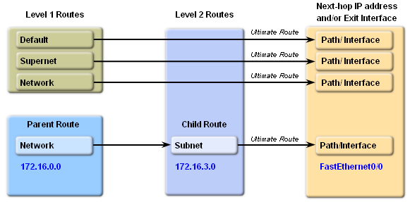
Hierarchy

Slide 10
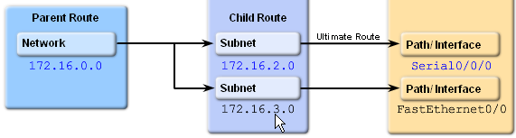
More than one child route
Parent route can have several child routes.
Parent route is added with first child route.
Parent is deleted if all child routes are deleted.

Slide 11
Route lookup step 1
Packet addressed to 192.168.3.4
172.16.0.0/16 is variably subnetted, 3 subnets, 2 masks
C 172.16.1.4/30 is directly connected, Serial0/0
C 172.16.1.8/30 is directly connected, Serial0/1
C 172.16.1.0/24 is directly connected, FastEthernet0/0
C 192.168.3.0/24 is directly connected, FastEthernet0/1
S* 0.0.0.0/0 is directly connected, Serial0/0
Examine level 1 routes for best match
Finds match with 192.168.3.0/24
Ultimate route – forward packet

Slide 12
Route lookup step 1
Packet addressed to 172.16.1.6
172.16.0.0/16 is variably subnetted, 3 subnets, 2 masks
C 172.16.1.4/30 is directly connected, Serial0/0
C 172.16.1.8/30 is directly connected, Serial0/1
C 172.16.1.0/24 is directly connected, FastEthernet0/0
C 192.168.3.0/24 is directly connected, FastEthernet0/1
S* 0.0.0.0/0 is directly connected, Serial0/0
Examine level 1 routes for best match
Finds match with 172.16.0.0/16 (parent)
Examine child routes of this parent

Slide 13
Route lookup step 2
Packet addressed to 172.16.1.6
172.16.0.0/16 is variably subnetted, 3 subnets, 2 masks
C 172.16.1.4/30 is directly connected, Serial0/0
C 172.16.1.8/30 is directly connected, Serial0/1
C 172.16.1.0/24 is directly connected, FastEthernet0/0
C 192.168.3.0/24 is directly connected, FastEthernet0/1
S* 0.0.0.0/0 is directly connected, Serial0/0
Examine child routes of 172.16.0.0
Match with 172.16.1.0/24
Ultimate route – forward packet

Slide 14
Route lookup step 1
Packet addressed to 172.16.2.8
172.16.0.0/16 is variably subnetted, 3 subnets, 2 masks
C 172.16.1.4/30 is directly connected, Serial0/0
C 172.16.1.8/30 is directly connected, Serial0/1
C 172.16.1.0/24 is directly connected, FastEthernet0/0
C 192.168.3.0/24 is directly connected, FastEthernet0/1
S* 0.0.0.0/0 is directly connected, Serial0/0
Examine level 1 routes for best match
Finds best match with 172.16.0.0/16 (parent)
Examine child routes of this parent

Slide 15
Route lookup step 2
Packet addressed to 172.16.2.8
172.16.0.0/16 is variably subnetted, 3 subnets, 2 masks
C 172.16.1.4/30 is directly connected, Serial0/0
C 172.16.1.8/30 is directly connected, Serial0/1
C 172.16.1.0/24 is directly connected, FastEthernet0/0
C 192.168.3.0/24 is directly connected, FastEthernet0/1
S* 0.0.0.0/0 is directly connected, Serial0/0
Examine child routes of 172.16.0.0
None of the child routes matches
Are we doing classful or classless routing?

Slide 16
Route lookup step 3
Packet addressed to 172.16.2.8
172.16.0.0/16 is variably subnetted, 3 subnets, 2 masks
C 172.16.1.4/30 is directly connected, Serial0/0
C 172.16.1.8/30 is directly connected, Serial0/1
C 172.16.1.0/24 is directly connected, FastEthernet0/0
C 192.168.3.0/24 is directly connected, FastEthernet0/1
S* 0.0.0.0/0 is directly connected, Serial0/0
Classful routing
That’s it – drop the packet

Slide 17
Route lookup step 4
Packet addressed to 172.16.2.8
172.16.0.0/16 is variably subnetted, 3 subnets, 2 masks
C 172.16.1.4/30 is directly connected, Serial0/0
C 172.16.1.8/30 is directly connected, Serial0/1
C 172.16.1.0/24 is directly connected, FastEthernet0/0
C 192.168.3.0/24 is directly connected, FastEthernet0/1
S* 0.0.0.0/0 is directly connected, Serial0/0
Classless routing
Check level 1 routes for any other match
Find match with default route and use that

Slide 18
Best (longest) match
IP Packet
Destination
172.16.0.10
10100011.00010000.00000000.00001010
Route 1
172.16.0.0/12
10100011.00010000.00000000.00000000
Match 12 bits?
Yes

Slide 19
Best (longest) match
IP Packet
Destination
172.16.0.10
10100011.00010000.00000000.00001010
Route 1
172.16.0.0/12
10100011.00010000.00000000.00000000
Route 2
172.16.0.0/18
10100011.00010000.00000000.00000000
Match 18 bits?
Yes - better

Slide 20
Best (longest) match
IP Packet
Destination
172.16.0.10
10100011.00010000.00000000.00001010
Route 1
172.16.0.0/12
10100011.00010000.00000000.00000000
Route 2
172.16.0.0/18
10100011.00010000.00000000.00000000
Route 3
172.16.0.0/26
10100011.00010000.00000000.00000000
Match 26 bits? Yes – better still

Slide 21
No match
IP Packet
Destination
172.16.0.10
10100011.00010000.00000000.00001010
Route 4
172.17.0.0/16
10100011.00010001.00000000.00000000
Need to match 16 bits.
No. Only the first 15 bits match so no good.

Slide 22
Default route match
IP Packet
Destination
172.16.0.10
10100011.00010000.00000000.00001010
Default Route
0.0.0.0/0
00000000.00000000.00000000.00000000
0 bits need to match.
Anything can match with the default route but it will always be the least good match

Slide 23
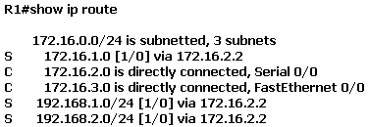
Recursive lookup reminder
Find a route to 172.16.1.0/24
There it is, via 172.16.2.2
How do you get to 172.16.2.2?
There it is via serial 0/0.

Slide 24
Routing source
Routing sources
Directly connected networks
Static routes
Classful routing protocols
RIPv1, IGRP
Classless routing protocols
RIPv2, EIGRP, OSPF, IS-IS
Build up routing table
Can use several sources

Slide 25
Routing behaviour
Routing behaviours
No IP classless
Classful behaviour
IP classless
Classless behaviour
Searching routing table
Can only use one
Default since IOS version 11.3

Slide 26
A puzzle
A router has a default route but it still drops packets.
Possible solution: the router is using classful routing behaviour. It will drop packets addressed to subnets that are not in its routing table if the parent network is in the routing table.
Change to classless routing behaviour

Slide 27
The End

