Slide 1
EIGRP
CCNA Exploration Semester 2
Chapter 9
S Ward Abingdon and Witney College
Notes:
EIGRP
S Ward Abingdon and Witney College

Slide 2
Topics
Background and history of EIGRP
Features and operation of EIGRP
Basic EIGRP configuration
EIGRP’s composite metric
Concepts and operation of DUAL
More EIGRP configuration commands
S Ward Abingdon and Witney College

Slide 3
Routing protocols
Interior
Exterior
Distance vector
Link state
RIP v1
RIP v2
IGRP
EIGRP
OSPF
IS-IS
EGP
BGP
S Ward Abingdon and Witney College

Slide 4
EIGRP
Cisco proprietary – only on Cisco routers
Developed from the older IGRP (classful)
EIGRP is classless, supports VLSM, CIDR
Distance vector
But has some features more typical of link state
Has a composite metric
S Ward Abingdon and Witney College

Slide 5
EIGRP atypical features
Reliable Transport Protocol (RTP)
Bounded Updates
Diffusing Update Algorithm (DUAL)
Establishing Adjacencies
Neighbor and Topology Tables
S Ward Abingdon and Witney College

Slide 6
EIGRP packet header
EIGRP packet header
Opcode specifies packet type:
Update, Query, Reply, Hello
Autonomous system (AS) number specifies the EIGRP process. Several can run at the same time.
Other fields allow for reliability if needed.
S Ward Abingdon and Witney College

Slide 7
EIGRP TLV field
Type/ length/ value data
Values needed for calculating metric
K1 value, default 1, weighting for bandwidth
K2 value, default 0, weighting for
K3 value, default 1, weighting for delay
K4 value, default 0, weighting for
K5 value, default 0, weighting for
S Ward Abingdon and Witney College

Slide 8
Metrics
Bandwidth is the lowest configured bandwidth on any interface on the route.
It is not an actual measured value.
You should always configure a bandwidth value on an interface when using EIGRP, otherwise a default is used.
S Ward Abingdon and Witney College

Slide 9
Metrics
Delay is calculated as the sum of delays from source to destination in units of 10 microseconds.
S Ward Abingdon and Witney College

Slide 10

Hello packets
Used by EIGRP to discover neighbours
Used to form adjacencies with neighbours.
Multicasts
Unreliable delivery
Hello
Hello
S Ward Abingdon and Witney College

Slide 11
Update packets
Used to propagate routing information.
No periodic updates.
Sent only when necessary.
Include only required information
Sent only to those routers that require it.
Reliable delivery.
Multicast if to several routers, unicast if to one router.
S Ward Abingdon and Witney College

Slide 12
Update packets
EIGRP updates are sent only when a route changes.
EIGRP updates are partial. They include only information about the changed route.
EIGRP updates are bounded. They go only to routers that are affected by the change.
This keeps updates small and saves bandwidth.
S Ward Abingdon and Witney College

Slide 13
Acknowledgement (ACK) packets
Sent when reliable delivery is used by RTP.
Sent in response to update packets.
Unreliable delivery
Unicast
Update (reliable)
ACK (unreliable)
S Ward Abingdon and Witney College

Slide 14
Query packet
Used when searching for a network
E.g. a route goes down. Is there another route?
Uses reliable delivery so requires ACK
Multicast or unicast
All neighbours must reply
Query (reliable)
ACK (unreliable)
S Ward Abingdon and Witney College

Slide 15
Reply packet
Sent in response to a query from a neighbour.
Sent reliably so requires ACK.
Unicast
Query (reliable)
ACK (unreliable)
Reply (reliable)
ACK (unreliable)
S Ward Abingdon and Witney College

Slide 16
Summary of message types
 | Unicast | Multicast | Either
Reliable | Reply |  | Update Query
Unreliable | ACK | Hello
S Ward Abingdon and Witney College

Slide 17
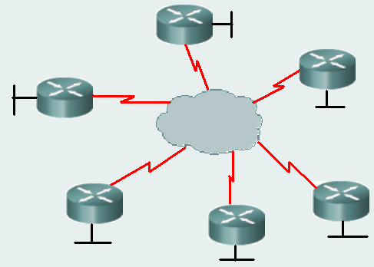
NBMA network
NonBroadcast MultiAccess network (NBMA)
Examples are X.25, Frame Relay, and ATM
More than two devices on the same subnet.
Ethernet is not NBMA.
It is multiaccess, but it
allows broadcasts.
Frame relay
S Ward Abingdon and Witney College

Slide 18
Neighbour
Router on a shared network, running EIGRP.
Discover through Hello messages sent every 5 sec (default) on most networks, but every 60 sec on slow NBMA networks.
Hellos received = neighbour still up, its routes are still valid.
No Hello? Wait for holdtime (3 hello intervals) and if still no Hello then neighbour is down.
S Ward Abingdon and Witney College

Slide 19
Route source | Administrative distance
Connected | 0
Static | 1
EIGRP summary | 5
External BGP | 20
Internal EIGRP | 90
IGRP | 100
OSPF | 110
IS-IS | 115
RIP | 120
External EIGRP | 170
Internal BGP | 200
S Ward Abingdon and Witney College

Slide 20
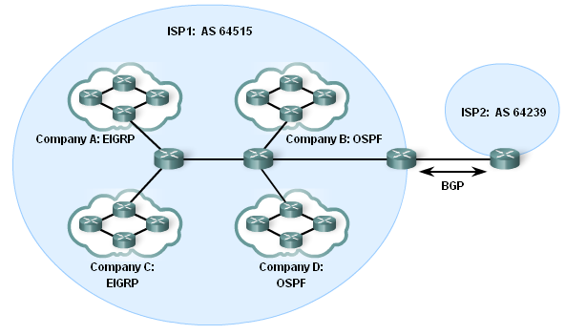
Autonomous systems
ISPs
Internet Backbone providers
Large organisations connecting directly
S Ward Abingdon and Witney College

Slide 21
EIGRP “AS number”
EIGRP uses an “autonomous system number” in its configuration.
This is not a real AS number.
It is a process number to distinguish different EIGRP processes.
Neighbours must use the same AS number.
OSPF also uses process numbers.
S Ward Abingdon and Witney College

Slide 22
Configuring EIGRP
AS number
Router(config)#router eigrp 1
Router(config-router)#network 172.16.0.0
Router(config-router)#network 192.168.1.0
Network commands have the same purpose as for RIP.
The classful network address is used here.
S Ward Abingdon and Witney College

Slide 23
Configuring EIGRP with mask
Router(config-router)#network 172.16.0.0
All subnets of 172.16.0.0 will be included.
To specify certain subnets only:
network 172.16.3.0 0.0.0.255
Wildcard mask
S Ward Abingdon and Witney College

Slide 24
Subnet mask, wildcard mask
255.255.255.255
255.255.255. 0
0 . 0 . 0 .255
255.255.255.255
255.255.255.240
0 . 0 . 0 . 15
-
Subnet mask
Wildcard mask
-
255.255.255.255
255.255.255.252
0 . 0 . 0 . 3
255.255.255.255
255.255.248. 0
0 . 0 . 7 .255
-
Subnet mask
Wildcard mask
-
Wildcard mask is the inverse of the subnet mask
S Ward Abingdon and Witney College

Slide 25
Subnet mask, wildcard mask
Some router IOS versions let you enter the subnet mask and they convert it to the wildcard mask for you.
network 172.16.3.0 255.255.255.0
Output from show run includes
router eigrp 1
network 172.16.3.0 0.0.0.255
S Ward Abingdon and Witney College

Slide 26
Finding a neighbour
If a router is configured for EIGRP and exchanges Hello packets with another router that is configured for EIGRP using the same AS number, then they become adjacent.
%DUAL-5-NBRCHANGE: IP-EIGRP 1: Neighbor 172.16.3.1 (Serial0/0) is up: new adjacency
S Ward Abingdon and Witney College

Slide 27
Show ip eigrp neighbors
IP EIGRP neighbors for process 1
H | Address | Interface | Hold sec | Uptime | SRTT (ms) | RTP | Q cnt | Seq type num
1 | 192.168.1.1 | Se0/0 | 10 | 00:01:41 | 20 | 200 | 0 | 7
0 | 172.16.1.1 | Se0/1 | 10 | 00:08:24 | 25 | 200 | 0 | 28
Order in which neighbours were learned
S Ward Abingdon and Witney College

Slide 28
Show ip eigrp neighbors
IP EIGRP neighbors for process 1
H | Address | Interface | Hold sec | Uptime | SRTT (ms) | RTP | Q cnt | Seq type num
1 | 192.168.1.1 | Se0/0 | 10 | 00:01:41 | 20 | 200 | 0 | 7
0 | 172.16.1.1 | Se0/1 | 10 | 00:08:24 | 25 | 200 | 0 | 28
Address of neighbour
S Ward Abingdon and Witney College

Slide 29
Show ip eigrp neighbors
IP EIGRP neighbors for process 1
H | Address | Interface | Hold sec | Uptime | SRTT (ms) | RTP | Q cnt | Seq type num
1 | 192.168.1.1 | Se0/0 | 10 | 00:01:41 | 20 | 200 | 0 | 7
0 | 172.16.1.1 | Se0/1 | 10 | 00:08:24 | 25 | 200 | 0 | 28
Interface that connects to neighbour
S Ward Abingdon and Witney College

Slide 30
Show ip eigrp neighbors
IP EIGRP neighbors for process 1
H | Address | Interface | Hold sec | Uptime | SRTT (ms) | RTP | Q cnt | Seq type num
1 | 192.168.1.1 | Se0/0 | 10 | 00:01:41 | 20 | 200 | 0 | 7
0 | 172.16.1.1 | Se0/1 | 10 | 00:08:24 | 25 | 200 | 0 | 28
Time remaining before neighbour is considered down. Set to maximum when Hello arrives.
S Ward Abingdon and Witney College

Slide 31
Show ip eigrp neighbors
IP EIGRP neighbors for process 1
H | Address | Interface | Hold sec | Uptime | SRTT (ms) | RTP | Q cnt | Seq type num
1 | 192.168.1.1 | Se0/0 | 10 | 00:01:41 | 20 | 200 | 0 | 7
0 | 172.16.1.1 | Se0/1 | 10 | 00:08:24 | 25 | 200 | 0 | 28
How long neighbour has been adjacent.
S Ward Abingdon and Witney College

Slide 32
Show ip eigrp neighbor
IP EIGRP neighbors for process 1
H | Address | Interface | Hold sec | Uptime | SRTT (ms) | RTP | Q cnt | Seq type num
1 | 192.168.1.1 | Se0/0 | 10 | 00:01:41 | 20 | 200 | 0 | 7
0 | 172.16.1.1 | Se0/1 | 10 | 00:08:24 | 25 | 200 | 0 | 28
Used in reliable transport
Tracks updates, queries etc
S Ward Abingdon and Witney College

Slide 33
Show ip protocols
Details of EIGRP configuration
Networks being advertised
Sources of information
S Ward Abingdon and Witney College

Slide 34
Show ip route
Output might include:
192.168.10.0/24 is variably subnetted, 3 subnets, 2 masks
D 192.168.10.0/24 is a summary, 00:03:50, Null0
C 192.168.10.4/30 is directly connected, Serial 0/1
D 192.168.10.8/30 [90/26818581] via 192.168.10.6,
00:02:43, Serial 0/1
Note that EIGRP routes are labelled D for DUAL
VLSM is supported
S Ward Abingdon and Witney College

Slide 35
Null zero summary route
192.168.10.0/24 is variably subnetted, 3 subnets, 2 masks
D 192.168.10.0/24 is a summary, 00:04:13, Null0
D 192.168.10.4/30 [90/2681856] via 192.168.10.10, 00:03:05, Serial 0/1
C 192.168.10.8/30 is directly connected, Serial 0/1
The router has routes to some subnets of 192.168.10.0 so it puts in a parent route.
If autosummary is enabled then it also puts in a route sending 192.168.10.0/24 to Null0
Packets to unknown subnets are dropped even if a default route exists.
S Ward Abingdon and Witney College
Notes:
Discard any packets that match the parent route but do not match any of the child routes
EIGRP
S Ward Abingdon and Witney College

Slide 36
EIGRP metric
Bandwidth and delay are used by default.
Load and reliability can be used too.
metric =
[K1*bandwidth + K2*bandwidth + K3*delay] * K5
256 - load
Reliability + K4
If K1 = K3 = 1 and K2 = K4 = K5 = 0
metric =
(bandwidth + delay)
S Ward Abingdon and Witney College

Slide 37
K values
Show ip protocols will show the K values.
EIGRP metric weight K1=1, K2=0, K3=1, K4=0, K5=0
Leave them alone unless there is a very good reason to change them.
Router(config-router)#metric weights tos k1 k2 k3 k4 k5
tos (type of service) must be 0
S Ward Abingdon and Witney College

Slide 38
Metric values in use
Show interface:
MTU 1500 bytes, BW 1544 Kbit, DLY 20000 usec,
reliability 255/255, txload 1/255, rxload 1/255
usec means microseconds. It should be μsec but the μ symbol is not available.
S Ward Abingdon and Witney College

Slide 39
Bandwidth
The actual bandwidth is NOT measured.
Most serial interfaces use the default T1 bandwidth value of 1544 Kbps (1.544 Mbps).
If this is not close to the actual bandwidth then change the bandwidth setting.
Router(config-if)#bandwidth 64
This does not change the bandwidth of the link.
S Ward Abingdon and Witney College

Slide 40
Using bandwidth
Take the lowest bandwidth value in the path.
Calculate (10,000,000/bandwidth) * 256
This is the bandwidth part of the metric.
Just to confuse you, this is also called “bandwidth” in the formula:
metric = “bandwidth” + delay
S Ward Abingdon and Witney College

Slide 41
Delay
Delay is a measure of the time it takes for a packet to traverse a route.
Delay is not measured dynamically.
Default values are used, e.g.
  Serial interfaces 20,000 microseconds
  FastEthernet interfaces 100 microseconds
The delay value can be changed.
S Ward Abingdon and Witney College

Slide 42
Using delay
Find the delay value on every outgoing interface along the path.
Add up all these values.
Delay metric = (sum of delay/10)* 256
Just to confuse you, this is also called “delay” in the formula:
metric = “bandwidth” + “delay”
S Ward Abingdon and Witney College

Slide 43
Example step 1
Metric to this network?
BW 1,024 Kbps
delay 20000
BW 100,000 Kbps
delay 100
Bandwidth metric = (10,000,000/1024)*256
Round 10,000,000/1024 to a whole number before multiplying by 256
Bandwidth metric = 2,499,840.
S Ward Abingdon and Witney College

Slide 44
Example step 2
Metric to this network?
BW 1,024 Kbps
delay 20000
BW 100,000 Kbps
delay 100
Delay metric = (sum of delay/10)* 256
= (20100/10)*256
= 514560
S Ward Abingdon and Witney College

Slide 45
Example step 3
Metric to this network?
BW 1,024 Kbps
delay 20000
BW 100,000 Kbps
delay 100
Bandwidth metric = 2,499,840
Delay metric = 514560
Bandwidth + delay = 3014400
This is the metric calculated by the router on the left.
S Ward Abingdon and Witney College

Slide 46
Reliability and Load
Reliability is measured dynamically. It measures the frequency of errors and the probability that the link will fail.
255 is totally reliable, 0 is totally unreliable.
Load is measured dynamically. It shows the amount of traffic using the link.
1/255 is minimal load. 255/255 is fully saturated.
Both transmit and receive load are measured.
S Ward Abingdon and Witney College

Slide 47
Aaaaaargh! Page 9.3.4
Default metric = [K1*bandwidth + K3*delay] * 256
Since K1 and K3 both equal 1,
The formula simplifies to bandwidth + delay
This is algebra, Jim, but not as we know it.
IGRP used bandwidth + delay
EIGRP multiplies by a factor of 256
Do we incorporate *256 into the bandwidth and delay values or not? We seem uncertain.
S Ward Abingdon and Witney College

Slide 48
DUAL terminology
D 192.168.1.0/24 [90/3014400] via 192.168.10.10, 00:00:31, Serial0/0/1
Interface of successor router that provides the next hop on the best path.
Feasible distance: the metric of the best path.
S Ward Abingdon and Witney College

Slide 49
DUAL terminology
Reported distance: the metric that a neighbour (closer to the destination) reports for a route. This is the neighbours feasible distance for the route.
destination
FD 3016960
RD 3014400
FD 3014400
RD 28160
FD 28160
S Ward Abingdon and Witney College

Slide 50
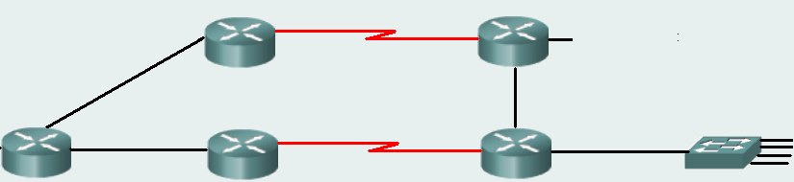
Feasibility condition (FC)
This condition is met if the reported distance (RD) to a network, learned from a neighbour, is less than the router’s own feasible distance.
3016960
30720
no
destination
yes
3016960
3014400
28160
S Ward Abingdon and Witney College

Slide 51
Feasible successor (FS)
A feasible successor (FS) is a neighbour who has a path to the same network as the successor, and satisfies the feasibility condition.
This path should be loop-free and is kept as a backup path.
S Ward Abingdon and Witney College

Slide 52
Topology table
P 192.168.1.0/24, 1 successors, FD is 3014400
via 192.168.10.10 (3014400/28160), Serial0/1
via 172.16.3.1 (41026560/2172416), Serial0/0
Lists all successors and feasible successors (backup routes)
Gives feasible distance and reported distance
Note that reported distance of backup route is less than feasible distance of successor.
S Ward Abingdon and Witney College

Slide 53
Topology table – passive/active
P 192.168.1.0/24, 1 successors, FD is 3014400
via 192.168.10.10 (3014400/28160), Serial0/1
via 172.16.3.1 (41026560/2172416), Serial0/0
P is for passive. The route is stable, not being recalculated, therefore it can be used.
A means active. An active route is in the process of being recalculated by DUAL and cannot be used.
S Ward Abingdon and Witney College

Slide 54
Show commands
show ip eigrp topology
for basic topology table
show ip eigrp topology 192.168.1.0
for full details of routes to 192.168.1.0 including metrics used and hop count
show ip eigrp topology all-links
for all known routes including routes that are not successors or feasible successors
S Ward Abingdon and Witney College

Slide 55
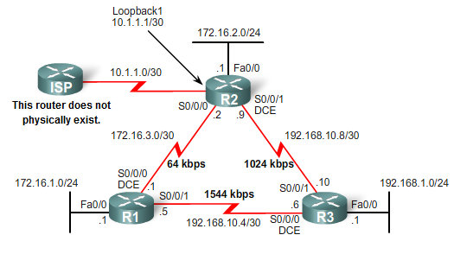
Topology
may not
Download: cis82-EIGRP-B-student.pkt
Completed configuration from cis82-EIGRP-A-student.pkt
  EIGRP has been configured on R1, R2 and R3
  All routers have the proper bandwidth commands.
  Do show run
Notes:
Includes the addition of the ISP router.
R1 and R2 routers have subnets that are part of the 172.16.0.0/16.

Slide 56
Successor and Feasible Distance
R2# show ip route
<code output omitted>
D 192.168.1.0/24 [90/3014400] via 192.168.10.10, 00:00:15, S0/0/1
IP address of the successor
R3 is my successor for getting to 192.168.1.0/24
Successor
A successor is a neighboring router that is used for packet forwarding and is the least-cost route to the destination network.
What router is the success for R2?
  R3
Notes:
A successor is a neighboring router that is used for packet forwarding and is the least-cost route to the destination network.
The IP address of a successor is shown in a routing table entry right after the word via.

Slide 57
Successor and Feasible Distance
R2# show ip route
<code output omitted>
D 192.168.1.0/24 [90/3014400] via 192.168.10.10, 00:00:15, S0/0/1
Feasible Distance
Feasible distance (FD) is the lowest calculated metric to reach the destination network.
  The metric for the route.
Notes:
Feasible distance (FD) is the lowest calculated metric to reach the destination network.
FD is the metric listed in the routing table entry as the second number inside the brackets.
As with other routing protocols, this is also known as the metric for the route.

Slide 58
Feasible Successors, Feasibility Condition, and Reported Distance
I wonder if R1 could be a feasible successor for getting to 192.168.1.0/24?
Feasible Successor?
Successor
DUAL fast convergence because it can use backup paths to other routers known as feasible successors.
  Does not require to recompute DUAL.
Notes:
DUAL fast convergence because it can use backup paths to other routers known as feasible successors.
Does not require to recompute DUAL

Slide 59
Feasible Successors, Feasibility Condition, and Reported Distance
I wonder if R1 could be a feasible successor for getting to 192.168.1.0/24?
Feasible Successor?
Successor
Is R1 a Feasible Successor?
Does R2 know if R1 has a loop-free backup path to 192.168.1.0/24?
Remember, EIGRP is a Distance Vector Routing protocol.
Notes:
Is R1 a Feasible Successor?
Does R2 know if R1 has a loop-free backup path to 192.168.1.0/24?
Remember, EIGRP is a Distance Vector Routing protocol.

Slide 60
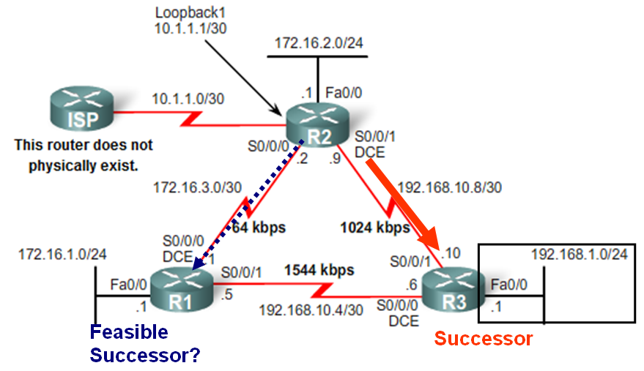
Feasible Successor
A feasible successor (FS) is a neighbor who has a loop-free backup path to the same network as the successor by satisfying the feasibility condition.
Would R2 consider R1 to be a feasible successor to network 192.168.1.0/24?
To be a feasible successor, R1 must satisfy the feasibility condition (FC).
Notes:
A feasible successor (FS) is a neighbor who has a loop-free backup path to the same network as the successor by satisfying the feasibility condition.
Would R2 consider R1 to be a feasible successor to network 192.168.1.0/24?
To be a feasible successor, R1 must satisfy the feasibility condition (FC).

Slide 61
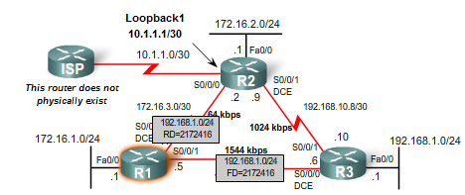
Feasibility Condition
Feasibility Condition: For R1 to be a Feasible Successor it must tell me that it’s metric to reach 192.168.1.0/24 is less than my metric through my Successor R3.
I will send R2 my RD to 192.168.1.0/24 of 2,172,416.
My FD to 192.168.1.0/24 is 2,172,416 (my routing table).
R1# show ip route
<output omitted>
D 192.168.1.0/24 [90/2172416] via 192.168.10.6, 01:12:26, Serial0/0/1
The reported distance (advertised distance) - EIGRP neighbor’s FD to the same destination network.
  The metric that a router reports to a neighbor about its own cost to that network.
Feasibility Condition: The FC is met when a neighbor’s reported distance (RD) to a network is less than the local router’s FD to the same destination network.
Notes:
Feasibility Condition: The FC is met when a neighbor’s reported distance (RD) to a network is less than the local router’s FD to the same destination network.
The reported distance (advertised distance) - EIGRP neighbor’s FD to the same destination network.
The metric that a router reports to a neighbor about its own cost to that network.

Slide 62
Feasibility Condition
Feasibility Condition: For R1 to be a Feasible Successor it must tell me that it’s metric to reach 192.168.1.0/24 is less than my metric through my Successor R3.
Feasible Successor?
Successor
If R3 is the successor, can the neighbor R1 be a Feasible Successor to this same 192.161.0/24 network?
  In other words, if the link between R2 and R3 fails, can R1 immediately be used as a backup path without a recomputation of DUAL?
R1 can only be an FS (Feasible Successor) if it meets the FC (Feasibility Condition).
Notes:
If R3 is the successor, can the neighbor R1 be a Feasibile Successor to this same 192.161.0/24 network?
In other words, if the link between R2 and R3 fails, can R1 immediately be used as a backup path without a recomputation of DUAL?
R1 can only be an FS (Feasible Successor) if it meets the FC (Feasibility Condition).

Slide 63
Feasibility Condition
I will send R2 my RD to 192.168.1.0/24 of 2,172,416.
My FD to 192.168.1.0/24 is 2,172,416 (my routing table).
R1# show ip route
<output omitted>
D 192.168.1.0/24 [90/2172416] via 192.168.10.6, 01:12:26, Serial0/0/1
R1’s FD to 192.168.1.0/24 is 2,172,416.
R1 reports 2,172,416 to R2 as its RD (Reported Distance)
R2’s perspective: 2,172,416 is?
  R1’s RD (Reported Distance) to 192.168.1.0/24
R1’s perspective: 2,172,416 is?
  Its FD (Feasible Distance) to 192.168.1.0/24
Notes:
R1 FD to 192.168.1.0/24 is 2,172,416.
R1 reports 2,172,416 to R2 as its RD (Reported Distance)
R2’s perspective: 2,172,416 is R1’s RD (Reported Distance).
R1’s perspective: 2,172,416 is its FD (Feasible Distance).

Slide 64
R2# show ip route
<output omitted>
D 192.168.1.0/24 [90/3014400] via 192.168.10.10, 00:00:15, Serial0/0/1
Feasible Distance
R1’s RD is less than R2’s FD, so R1 is the FS for 192.168.1.0/24
Feasibility Condition: For R1 to be a Feasible Successor it must tell me that it’s metric to reach 192.168.1.0/24 (Reported Distance) is less than my metric (Feasible Distance) through my Successor R3.
R1# show ip route
<output omitted>
D 192.168.1.0/24 [90/2172416] via 192.168.10.6, 01:12:26, Serial0/0/1
Reported Distance sent to R2
Does R1 meet the Feasibility Condition?
Is the RD of R1, 2,172,416, less than R2’s own FD of 3,014,400?
Yes, R1 meets the feasibility condition.
  R1 is a FS (Feasible Successor) for R2 to the 192.168.1.0/24 network.
Notes:
Because the RD of R1, 2,172,416, is less than R2’s own FD of 3,014,400, R1 meets the feasibility condition.
R1 is now an FS (Feasible Successor) for R2 to the 192.168.1.0/24 network.

Slide 65
R2# show ip route
<output omitted>
D 192.168.1.0/24 [90/3014400] via 192.168.10.10, 00:00:15, Serial0/0/1
Feasible Distance
If R1 was the successor, the 64 Kbps link is the slowest bandwidth, plus another delay of R1’s s0/0/1. This would be a higher metric (41,026.560) than 3,014,400 via successor R3.
R1# show ip route
<output omitted>
D 192.168.1.0/24 [90/2172416] via 192.168.10.6, 01:12:26, Serial0/0/1
Reported Distance sent to R2
Why isn’t R1 the successor if its RD is less than R2’s FD to 192.168.1.0/24?
  The 64 Kbps link would be used as the “slowest bandwidth part of the metric calculation.
  The total cost for R2, its FD to reach 192.168.1.0/24 is greater through R1 41,026.560 than it is through R3 3,014,400.
Notes:
Why isn’t R1 the successor if its RD is less than R2’s FD to 192.168.1.0/24?
The 64 Kbps link would be used as the “slowest bandwidth part of the metric calculation.
The total cost for R2, its FD to reach 192.168.1.0/24 is greater through R1 41,026.560 than it is through R3 3,014,400.

Slide 66
Topology Table: Successor and Feasible Successor
R2# show ip eigrp topology
IP-EIGRP Topology Table for AS(1)/ID(10.1.1.1)
Codes: P - Passive, A - Active, U - Update, Q - Query, R - Reply,
r - reply Status, s - sia Status
<output omitted>
P 192.168.1.0/24, 1 successors, FD is 3014400
via 192.168.10.10 (3014400/28160), Serial0/0/1
via 172.16.3.1 (41026560/2172416), Serial0/0/0
P 192.168.10.8/30, 1 successors, FD is 3011840
via Connected, Serial0/1
<output omitted>
Successor
Feasible Successor
The successor, FD, and any FSs with their RDs are kept by a router in its EIGRP topology table or topology database.
Do on R2: show ip eigrp topology
Can you find the successor and feasible successor for 192.168.1.0/24?
Notes:
The successor, FD, and any FSs with their RDs are kept by a router in its EIGRP topology table or topology database.

Slide 67
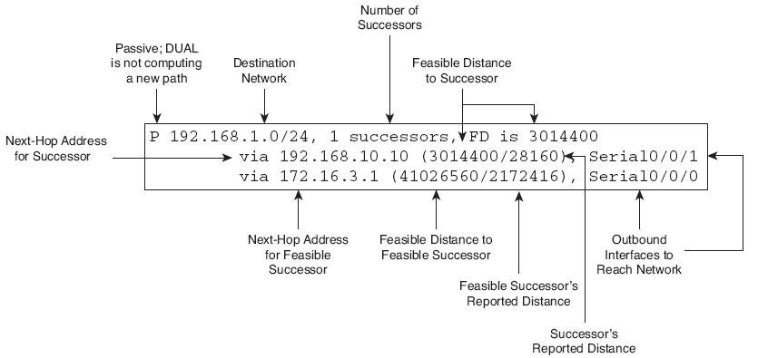
Topology Table: Successor and Feasible Successor
P: This route is in the Passive state.
  DUAL is not performing its diffusing computations to determine a path for a network
  The route is in a stable mode
  Active state - DUAL is recalculating or searching for a new path
192.168.1.0/24: This is the destination network that is also found in the routing table.
How many successors are there? What does it mean?
1 successors: This shows the number of successors for this network.
  If there are multiple equal-cost paths to this network, there will be multiple successors.
FD is 3014400: This is the FD, the EIGRP metric to reach the destination network.
Notes:
P: This route is in the passive state.
DUAL is not performing its diffusing computations to determine a path for a network
The route is in a stable mode
All routes should be in this state for stable routing domain.
active state - DUAL is recalculating or searching for a new path,
192.168.1.0/24: This is the destination network that is also found in the routing table.
1 successors: This shows the number of successors for this network.
If there are multiple equal-cost paths to this network, there will be multiple successors.
FD is 3014400: This is the FD, the EIGRP metric to reach the destination network.

Slide 68
Successor Information
via 192.168.10.10: This is the next-hop address of the successor, R3.
  This address is shown in the routing table.
3,014,400: This is the FD to 192.168.1.0/24.
  It is the metric shown in the routing table.
28,160: This is the RD of the successor
  R3’s cost to reach this network.
Serial0/0/1: This is the outbound interface used to reach this network.
  Also shown in the routing table.
Notes:
via 192.168.10.10: This is the next-hop address of the successor, R3.
This address is shown in the routing table.
3,014,400: This is the FD to 192.168.1.0/24.
It is the metric shown in the routing table.
28,160: This is the RD of the successor
R3’s cost to reach this network.
Serial0/0/1: This is the outbound interface used to reach this network.
Also shown in the routing table.

Slide 69
Feasible Successor Information
via 172.16.3.1: This is the next-hop address of the FS, R1.
41,026,560: This would be R2’s new FD to 192.168.1.0/24 if R1 became the new successor.
2,172,416: This is the RD of the FS or R1’s metric to reach this network.
  This value, RD, must be less than the current FD of 3,014,400 to meet the FC.
Serial0/0/0: This is the outbound interface used to reach the FC, if this router becomes the successor.
Notes:
via 172.16.3.1: This is the next-hop address of the FS, R1.
41,026,560: This would be R2’s new FD to 192.168.1.0/24 if R1 became the new successor.
2,172,416: This is the RD of the FS or R1’s metric to reach this network.
This value, RD, must be less than the current FD of 3,014,400 to meet the FC.
■ Serial0/0/0: This is the outbound interface used to reach the FC, if this router becomes the successor.

Slide 70
Show eigrp topology [network]
R2# show ip eigrp topology 192.168.1.0
IP-EIGRP topology entry for 192.168.1.0/24
State is Passive, Query origin flag is 1, 1 Successor(s), FD is 3014400
Routing Descriptor Blocks:
192.168.10.10 (Serial0/0/1), from 192.168.10.10, Send flag is 0x0
Composite metric is (3014400/28160), Route is Internal
Vector metric:
Minimum bandwidth is 1024 Kbit
Total delay is 20100 microseconds
Reliability is 255/255
Load is 1/255
Minimum MTU is 1500
Hop count is 1
172.16.3.1 (Serial0/0/0), from 172.16.3.1, Send flag is 0x0
Composite metric is (41026560/2172416), Route is Internal
Vector metric:
Minimum bandwidth is 64 Kbit
Total delay is 40100 microseconds
Reliability is 255/255
Load is 1/255
Minimum MTU is 1500
Hop count is 2
Successor
Default metrics calculations
Optional metrics
Other information passed in routing update (not part of composite metric)
Feasible Successor
Reported Distance of R1 to R2 for 192.168.1.0
Feasible Distance for to 192.168.1.0 if R3 was the successor. This is the metric that would be if R2’s routing table if R3 was the successor.

Slide 71

R2# show ip route
<output omitted>
D 192.168.1.0/24 [90/41026560] via 192.168.10.10, 00:00:15, Serial0/0/1
R2# show ip route
<output omitted>
D 192.168.1.0/24 [90/3014400] via 192.168.10.10, 00:00:15, Serial0/0/1
Feasible Distance
X
Feasible Successor
Successor
Successor
What if the link between R2 and R3 failed?
Notes:
Because the RD of R1, 2,172,416, is less than R2’s own FD of 3,014,400, R1 meets the feasibility condition.
R1 is now an FS (Feasible Successor) for R2 to the 192.168.1.0/24 network.

Slide 72
Topology Table: No Feasible Successor
R1# show ip route
192.168.10.0/24 is variably subnetted, 3 subnets, 2 masks
D 192.168.10.0/24 is a summary, 00:45:09, Null0
C 192.168.10.4/30 is directly connected, Serial0/0/1
D 192.168.10.8/30 [90/3523840] via 192.168.10.6, 00:44:56, S0/0/1
172.16.0.0/16 is variably subnetted, 4 subnets, 3 masks
D 172.16.0.0/16 is a summary, 00:46:10, Null0
C 172.16.1.0/24 is directly connected, FastEthernet0/0
D 172.16.2.0/24 [90/40514560] via 172.16.3.2, 00:45:09, S0/0/0
C 172.16.3.0/30 is directly connected, Serial0/0/0
D 192.168.1.0/24 [90/2172416] via 192.168.10.6, 00:44:55, S0/0/1
Successor
Route to 192.168.1.0/24:
  What router is the Successor for 192.168.10.6?
    R3
  What is R1’s FD?
    2,172,416
Notes:
Route to 192.168.1.0/24:
Successor is R3 via 192.168.10.6
FD of 2,172,416

Slide 73
Topology Table: No Feasible Successor
Feasible Successor?
R1# show ip route
D 192.168.1.0/24 [90/2172416] via 192.168.10.6, 00:44:55, S0/0/1
Is R2 a Feasible Successor?
If current path to 192.168.1.0/24 fails will R1 (DUAL) automatically use R2 as a backup route?
Is the path to 192.168.1.0/24 via R2 a guaranteed loop-free path? (more later)
Does R2 meet the Feasibility Condition?
Notes:
Is R2 a Feasible Successor?
If current path to 192.168.1.0/24 fails will R1 (DUAL) automatically use R2 as a backup route?
Is the path to 192.168.1.0/24 via R2 a guaranteed loop-free path? (more later)
Does R2 meet the Feasibility Condition?

Slide 74
Topology Table: No Feasible Successor
Feasible Successor?
R1# show ip eigrp topology
<output omitted>
P 192.168.1.0/24, 1 successors, FD is 2172416
via 192.168.10.6 (2172416/28160), Serial0/0/1
Does the topology table only any Feasible Successors?
  No, only the successor.
Why do you think R2 is not a Feasible Successor?
  R2 is not an FS because it does not meet the FC.
Topology shows that R2 has a backup route
  EIGRP does not have a map of the network topology.
  EIGRP is a distance vector routing protocol
Notes:
The topology table only shows the successor 192.168.10.6.
No Feasible Successors.
R2 is not an FS because it does not meet the FC.
Topology shows that R2 has a backup route
EIGRP does not have a map of the network topology.
EIGRP is a distance vector routing protocol

Slide 75
Topology Table: No Feasible Successor
R1# show ip eigrp topology all-links
<output omitted>
P 192.168.1.0/24, 1 successors, FD is 2172416, serno 5
via 192.168.10.6 (2172416/28160), Serial0/0/1
via 172.16.3.2 (41026560/3014400), Serial0/0/0
<output omitted>
R1’s FD
Successor
Feasible Successor? (No)
R2’s RD
You can view all possible links whether they satisfy the feasible condition or not by adding the [all-links] option.
  Even those routes that are not FSs.
Is R2 a Feasible Successor?
  Does R2 meet the Feasibility Condition?
  Is R2’s RD less than R1’s FD?
Notes:
You can view all possible links whether they satisfy the feasible condition or not by adding the [all-links] option.
Even those routes that are not FSs.
Is R2 a Feasible Successor?
Does R2 meet the Feasibility Condition?
Is R2’s RD less than R1’s FD?

Slide 76
Topology Table: No Feasible Successor
Feasible Successor?
My FD is 3,014,400. I will send this as my RD to R1.
R2 does not meet FC!
R2’s RD 3,014,400 > R1’s FD 2,172,416
R1# show ip eigrp topology all-links
<output omitted>
P 192.168.1.0/24, 1 successors, FD is 2172416, serno 5
via 192.168.10.6 (2172416/28160), Serial0/0/1
via 172.16.3.2 (41026560/3014400), Serial0/0/0
<output omitted>
R1’s FD
R2’s RD
Even though R2 looks like a viable backup path to 192.168.1.0/24, R1 has no idea that its path is not a potential loop back through itself.
Notes:
Even though R2 looks like a viable backup path to 192.168.1.0/24, R1 has no idea that its path is not a potential loop back through itself.

Slide 77
Topology Table: No Feasible Successor
Feasible Successor?
My FD is 3,014,400. I will send this as my RD to R1.
R2 does not meet FC!
R2’s RD 3,014,400 > R1’s FD 2,172,416
R1# show ip eigrp topology all-links
<output omitted>
P 192.168.1.0/24, 1 successors, FD is 2172416, serno 5
via 192.168.10.6 (2172416/28160), Serial0/0/1
via 172.16.3.2 (41026560/3014400), Serial0/0/0
<output omitted>
Does this mean R2 cannot be used if the successor fails?
  R2 can be used, but there will be a longer delay before adding it to the routing table.
  Before this can happen, DUAL will need to do some further processing, which is explained in the next topic.
Notes:
Does this mean R2 cannot be used if the successor fails?
R3 can be used, but there will be a longer delay before adding it to the routing table.
Before this can happen, DUAL will need to do some further processing, which is explained in the next topic.

Slide 78
Recalculation
Other loop-free routes can be found if necessary but DUAL has to do the calculation again on the basis of the latest information.
Successor route fails
No feasible successor (back-up)
Query neighbours for routes and get replies
Calculate and find new successor if one exists
S Ward Abingdon and Witney College

Slide 79
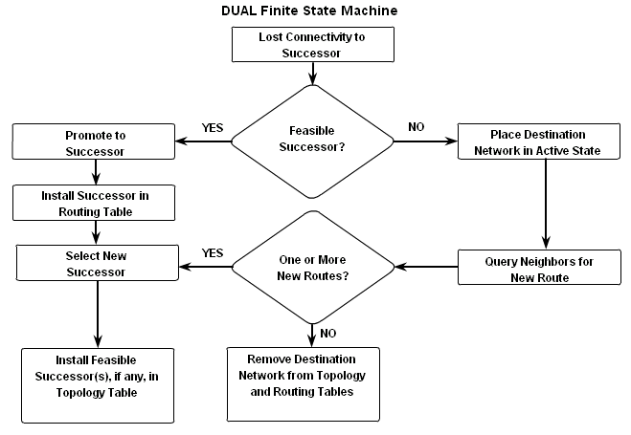
DUAL finite state machine
A set of possible states
Events that lead to the states
Events that result from the states
Think “flow chart”
S Ward Abingdon and Witney College

Slide 80
debug eigrp fsm
Displays DUAL activity e.g. when a link goes down or comes up.
DUAL: Find FS for dest 192.168.1.0/24. FD is 3014400, RD is 3014400
DUAL: 192.168.10.10 metric 4294967295/4294967295
DUAL: 172.16.3.1 metric 41026560/2172416 found Dmin is 41026560
DUAL: Removing dest 192.168.1.0/24, nexthop 192.168.10.10
DUAL: RT installed 192.168.1.0/24 via 172.16.3.1
S Ward Abingdon and Witney College

Slide 81
Manual summary routes
To summarise 192.168.4.0 and 192.168.5.0
Find the summary address 192.168.4.0/23
Go to each interface that should send the summary
Router(config-if)#ip summary-address eigrp 1 192.168.4.0 255.255.254.0
AS number
Summary address
Subnet mask
S Ward Abingdon and Witney College

Slide 82
Static default route
R2(config-router)#redistribute static
This command allows static default routes to be included with EIGRP updates
These are external routes as shown in the routing tables.
D*EX 0.0.0.0/0 [170/3651840] via 192.168.10.6,
00:01:08, Serial0/1
Another option is ip default-network and give the address of a known network
S Ward Abingdon and Witney College

Slide 83
Fine tuning
If EIGRP updates are using too much bandwidth, restrict them:
Router(config-if)#ip bandwidth-percent eigrp 1 40
By default the limit is 50%
AS number
Percent
S Ward Abingdon and Witney College

Slide 84
Hello interval and hold time
These are configured on the interface and need not match the neighbour’s timers.
R2(config-if)#ip hello-interval eigrp 1 60
R2(config-if)#ip hold-time eigrp 1 180
Hold time must be greater than or equal to hello interval.
Values 1 to 65,535 are possible.
AS number
Seconds
S Ward Abingdon and Witney College

Slide 85
Is it very complicated?
No. Basic EIGRP configuration is simple.
Router(config)#router eigrp 1
Router(config-router)#network 192.168.1.0
Router(config-router)#network 192.168.2.0
S Ward Abingdon and Witney College

Slide 86
The End
S Ward Abingdon and Witney College

