Slide 1
Chapter 21
Networking
and
Internetworking
Devices

Slide 2
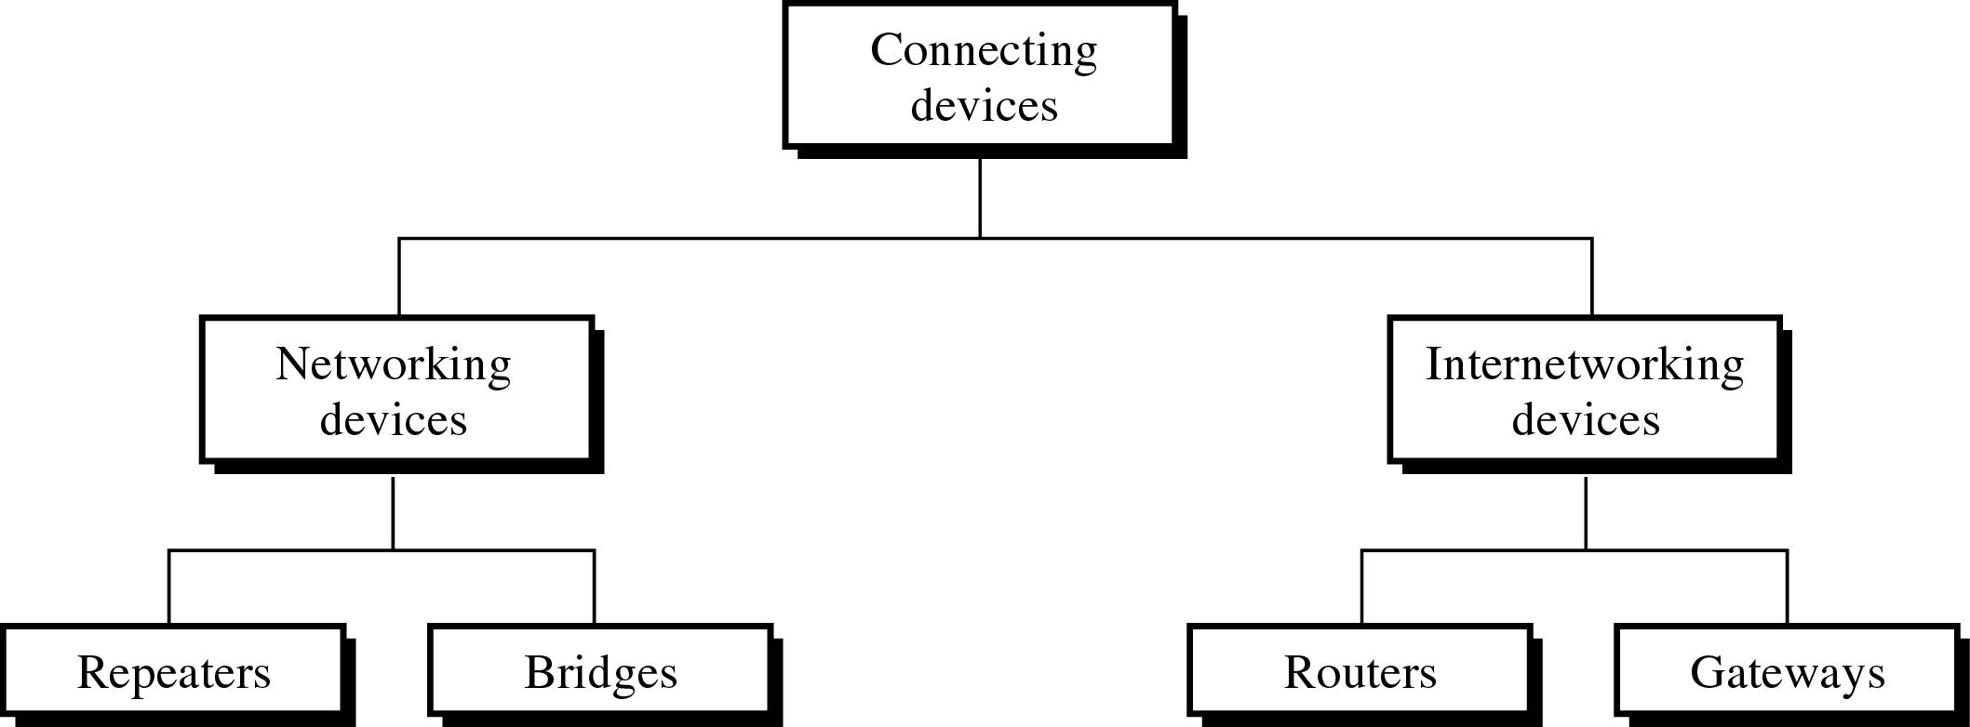
Figure 21-1
Connecting Devices

Slide 3
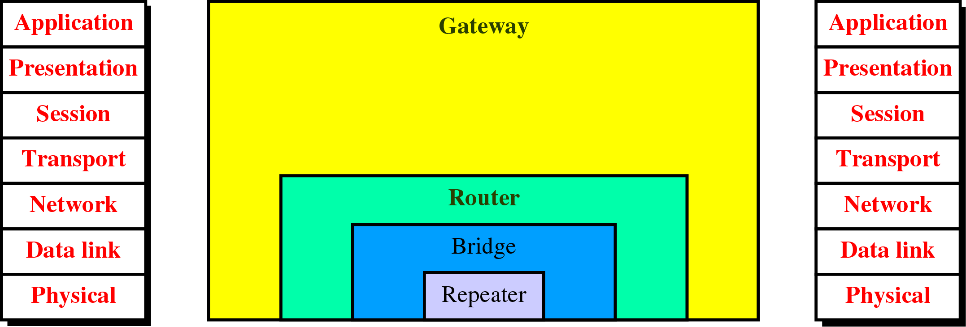
Figure 21-2
Connecting Devices and the OSI Model

Slide 4
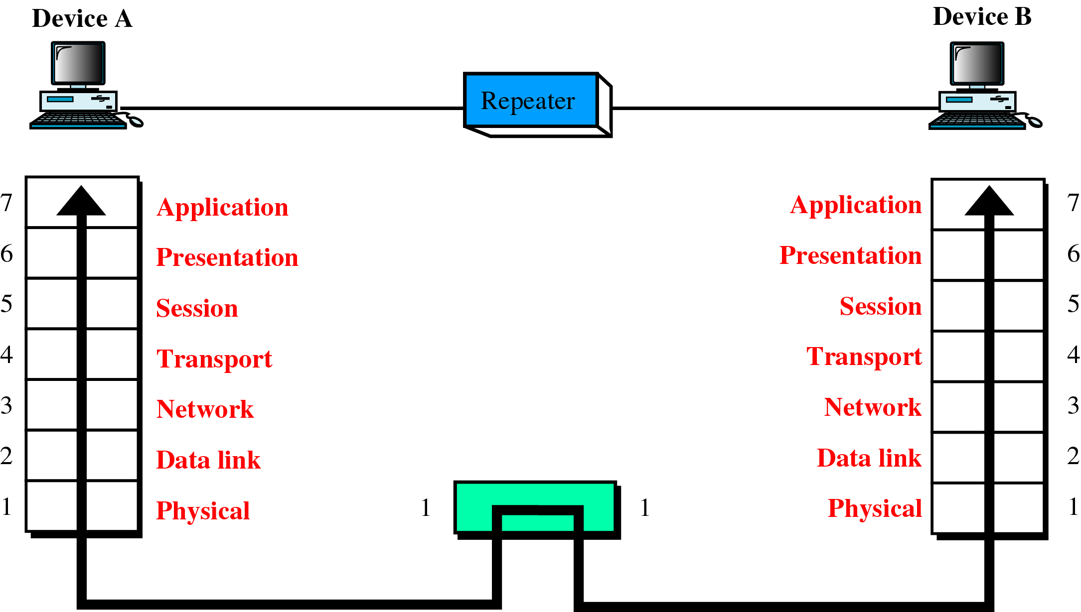
Figure 21-3
A Repeater in the OSI Model

Slide 5
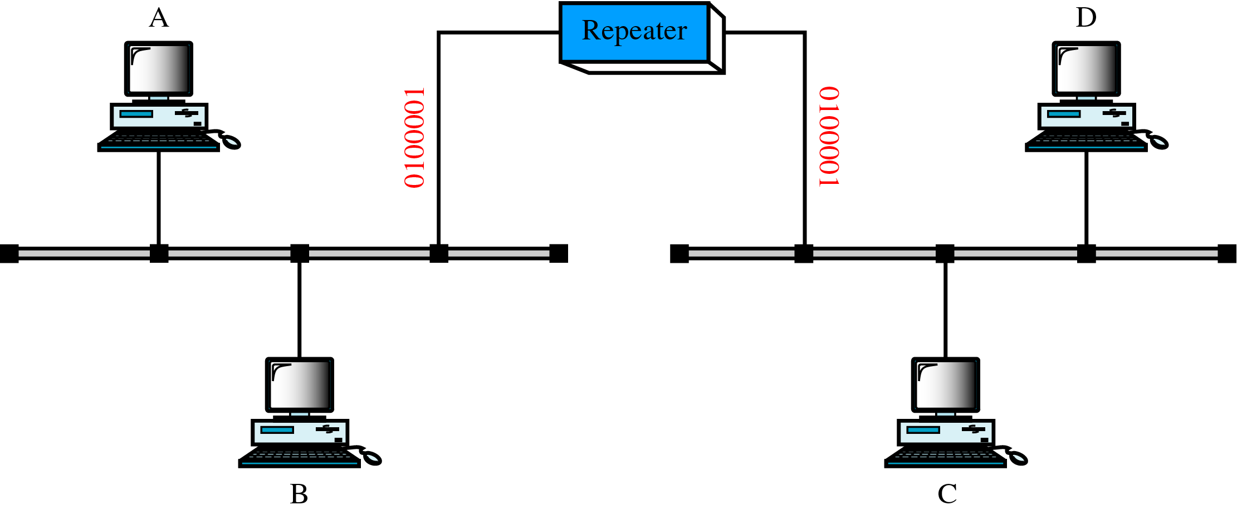
Figure 21-4
A Repeater

Slide 6
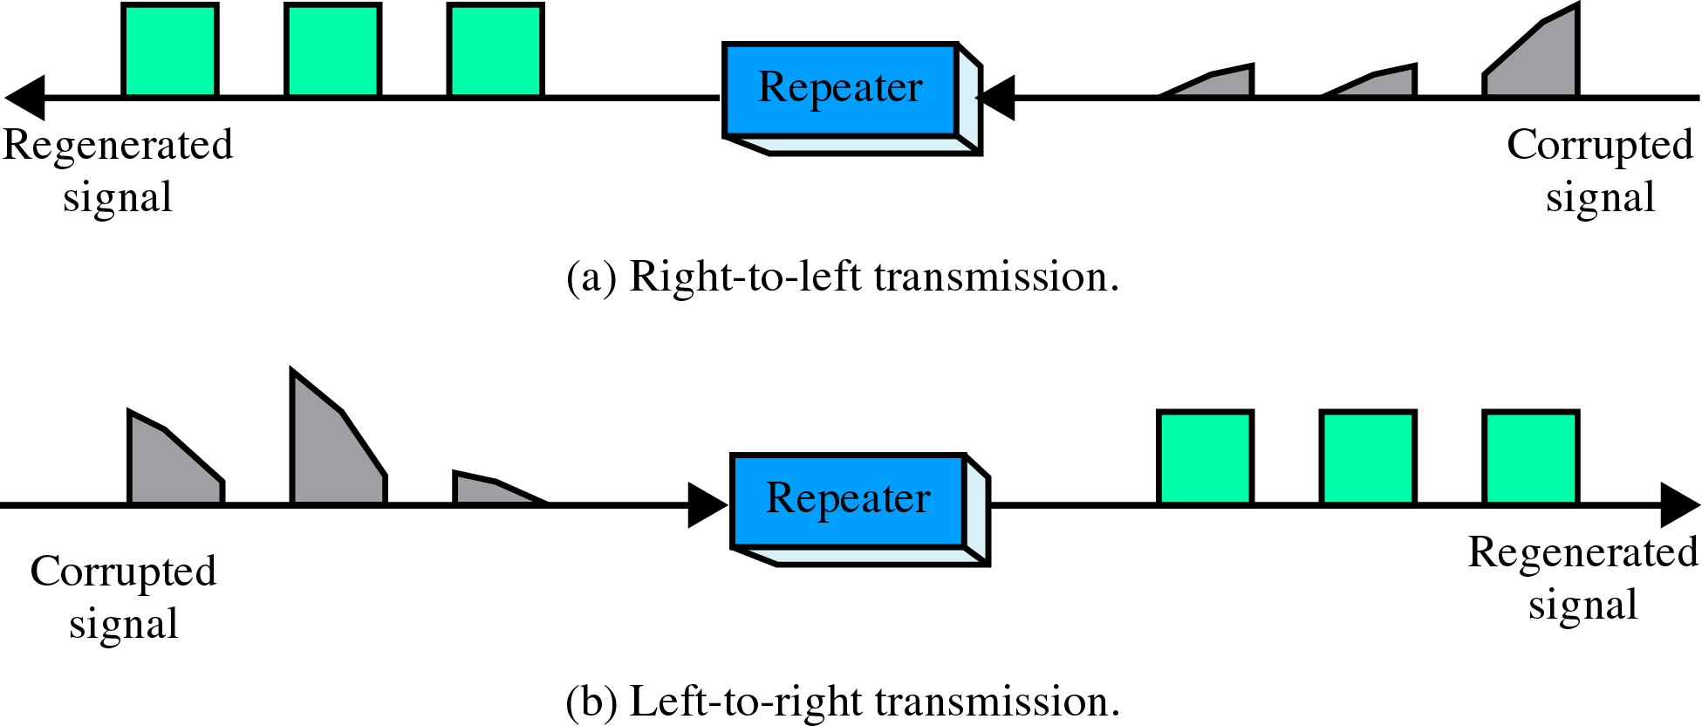
Figure 21-5
Function of a Repeater

Slide 7
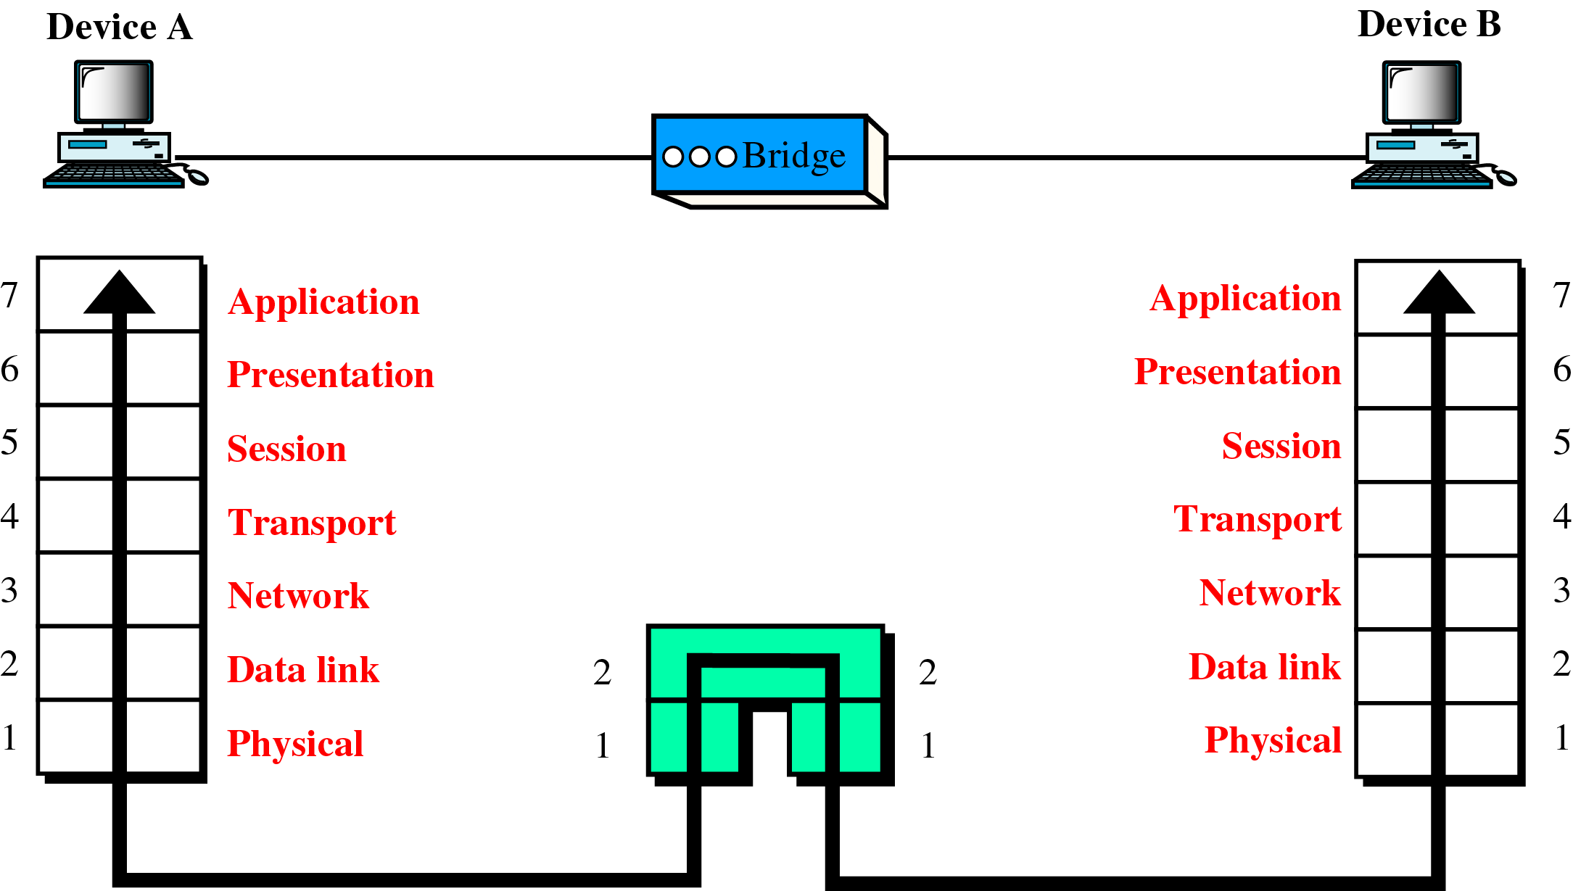
Figure 21-6
A Bridge in the OSI Model

Slide 8
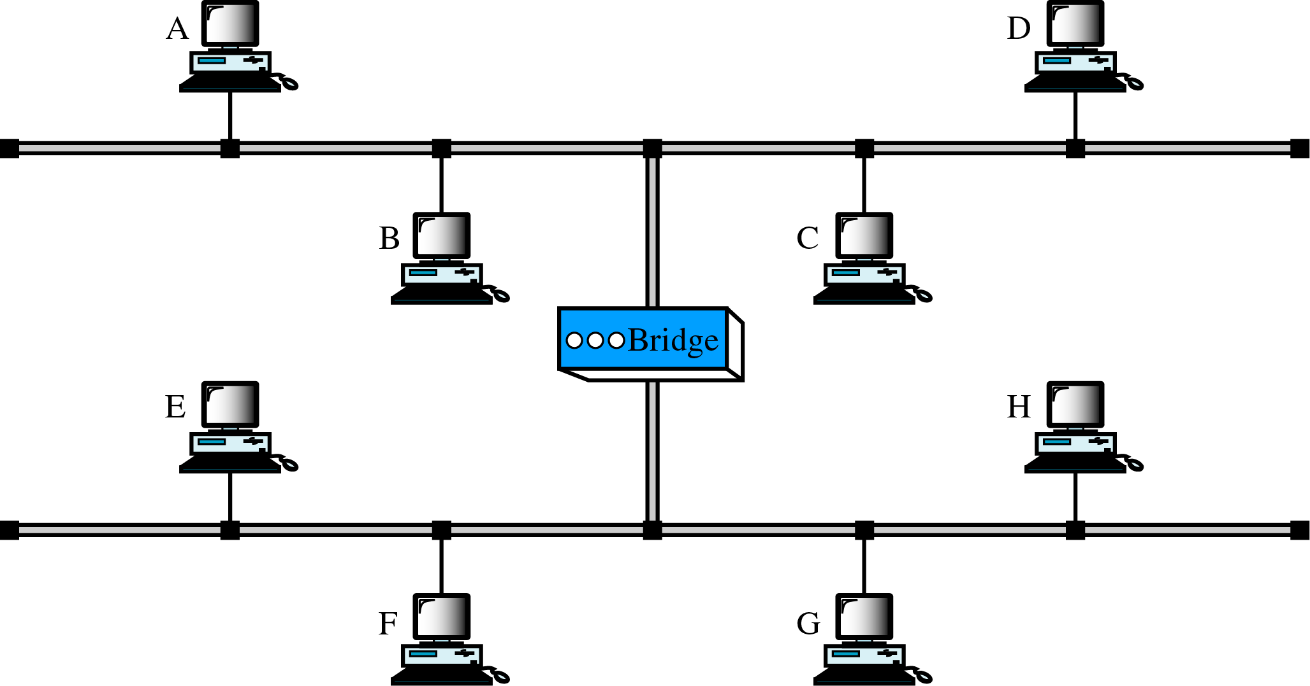
Figure 21-7
A Bridge

Slide 9
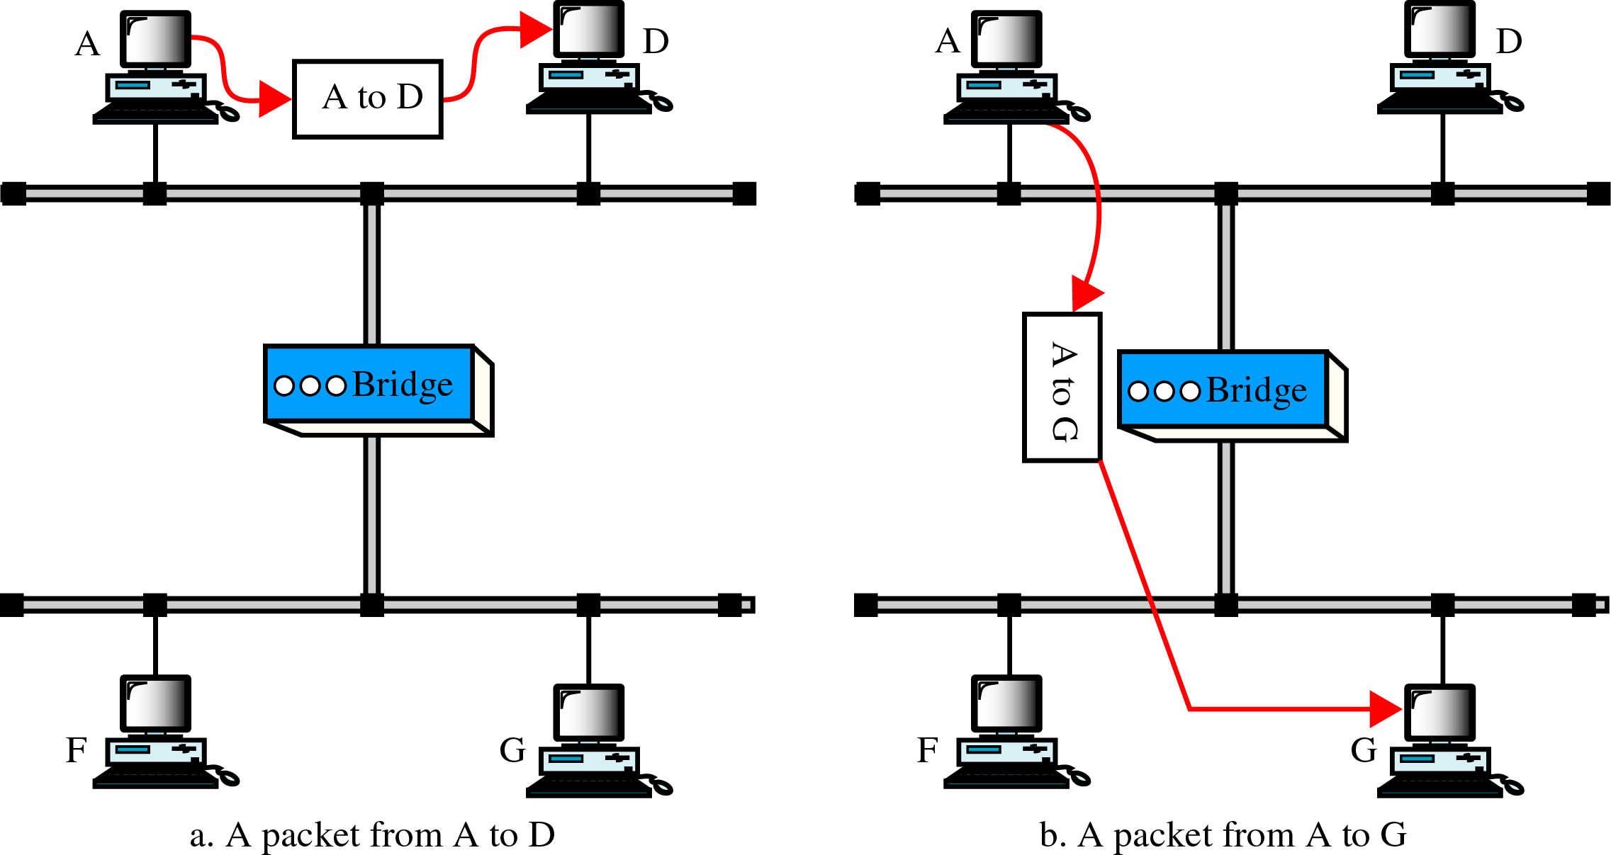
Figure 21-8
Function of a Bridge

Slide 10
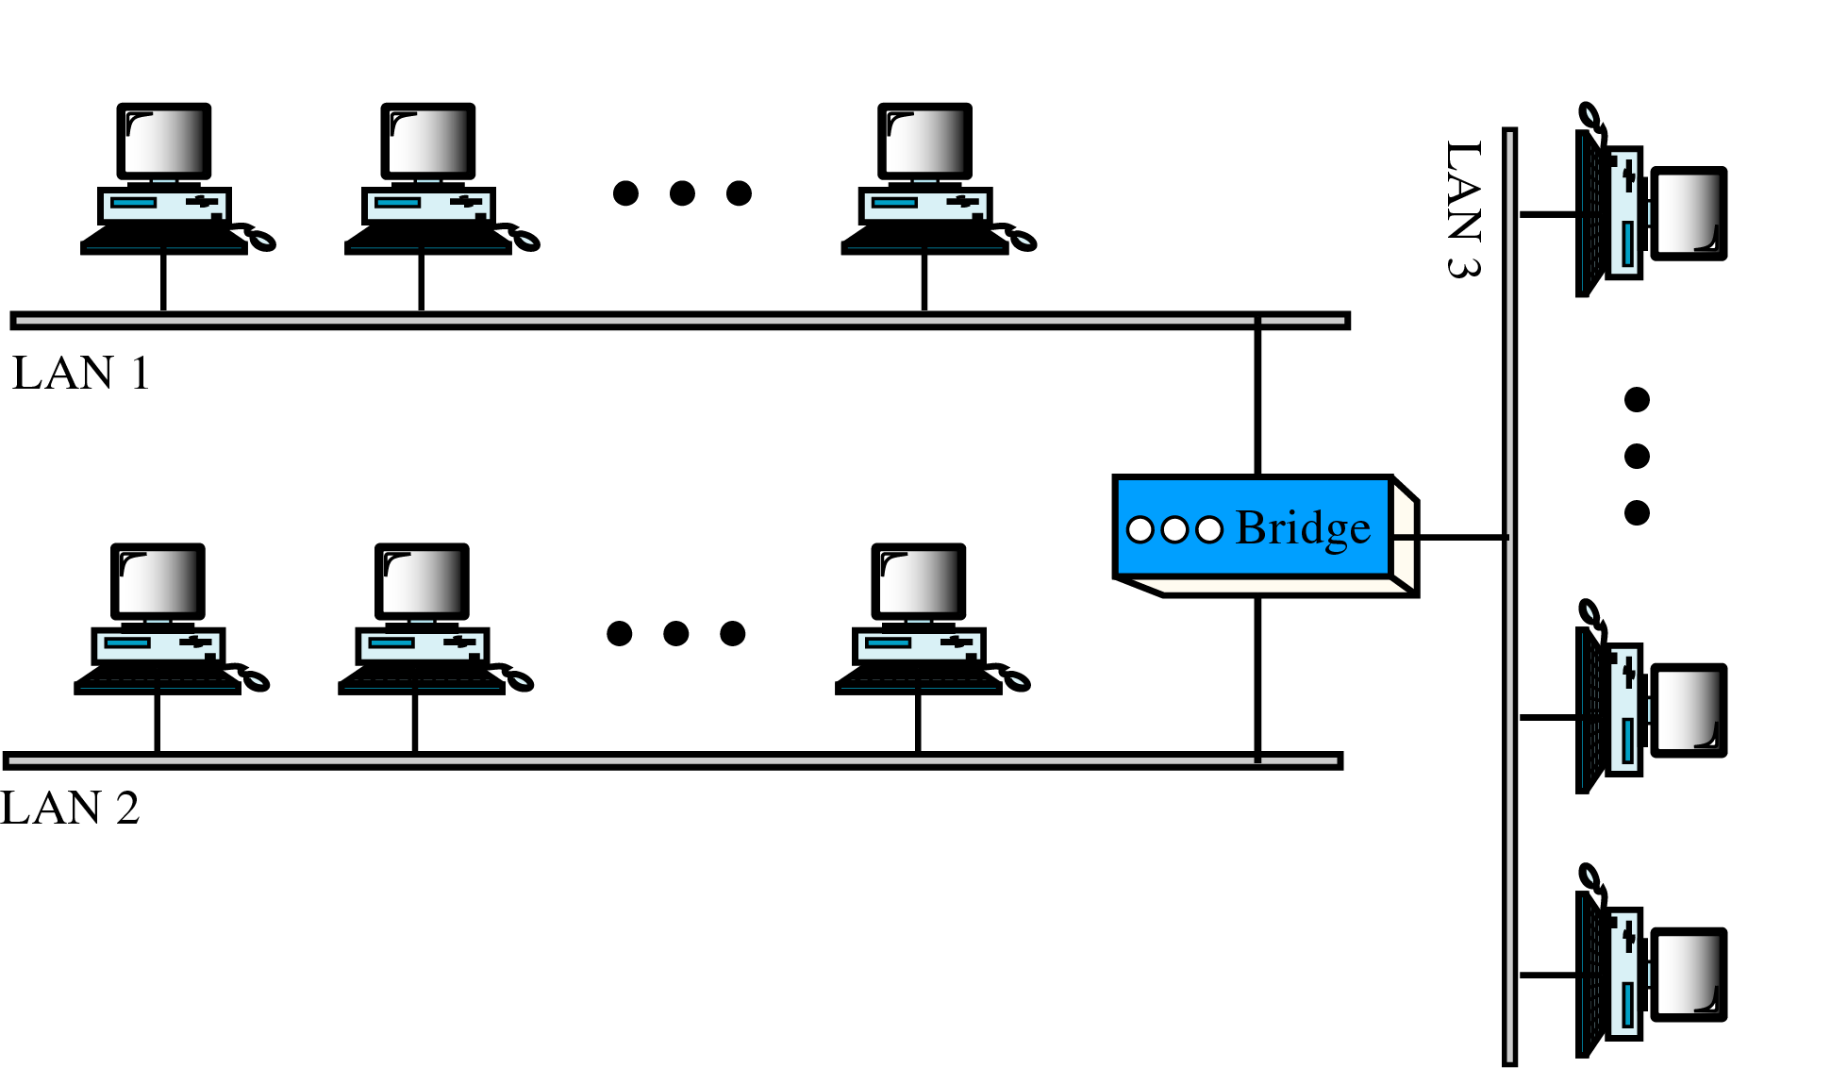
Figure 21-9
Multiport Bridge

Slide 11
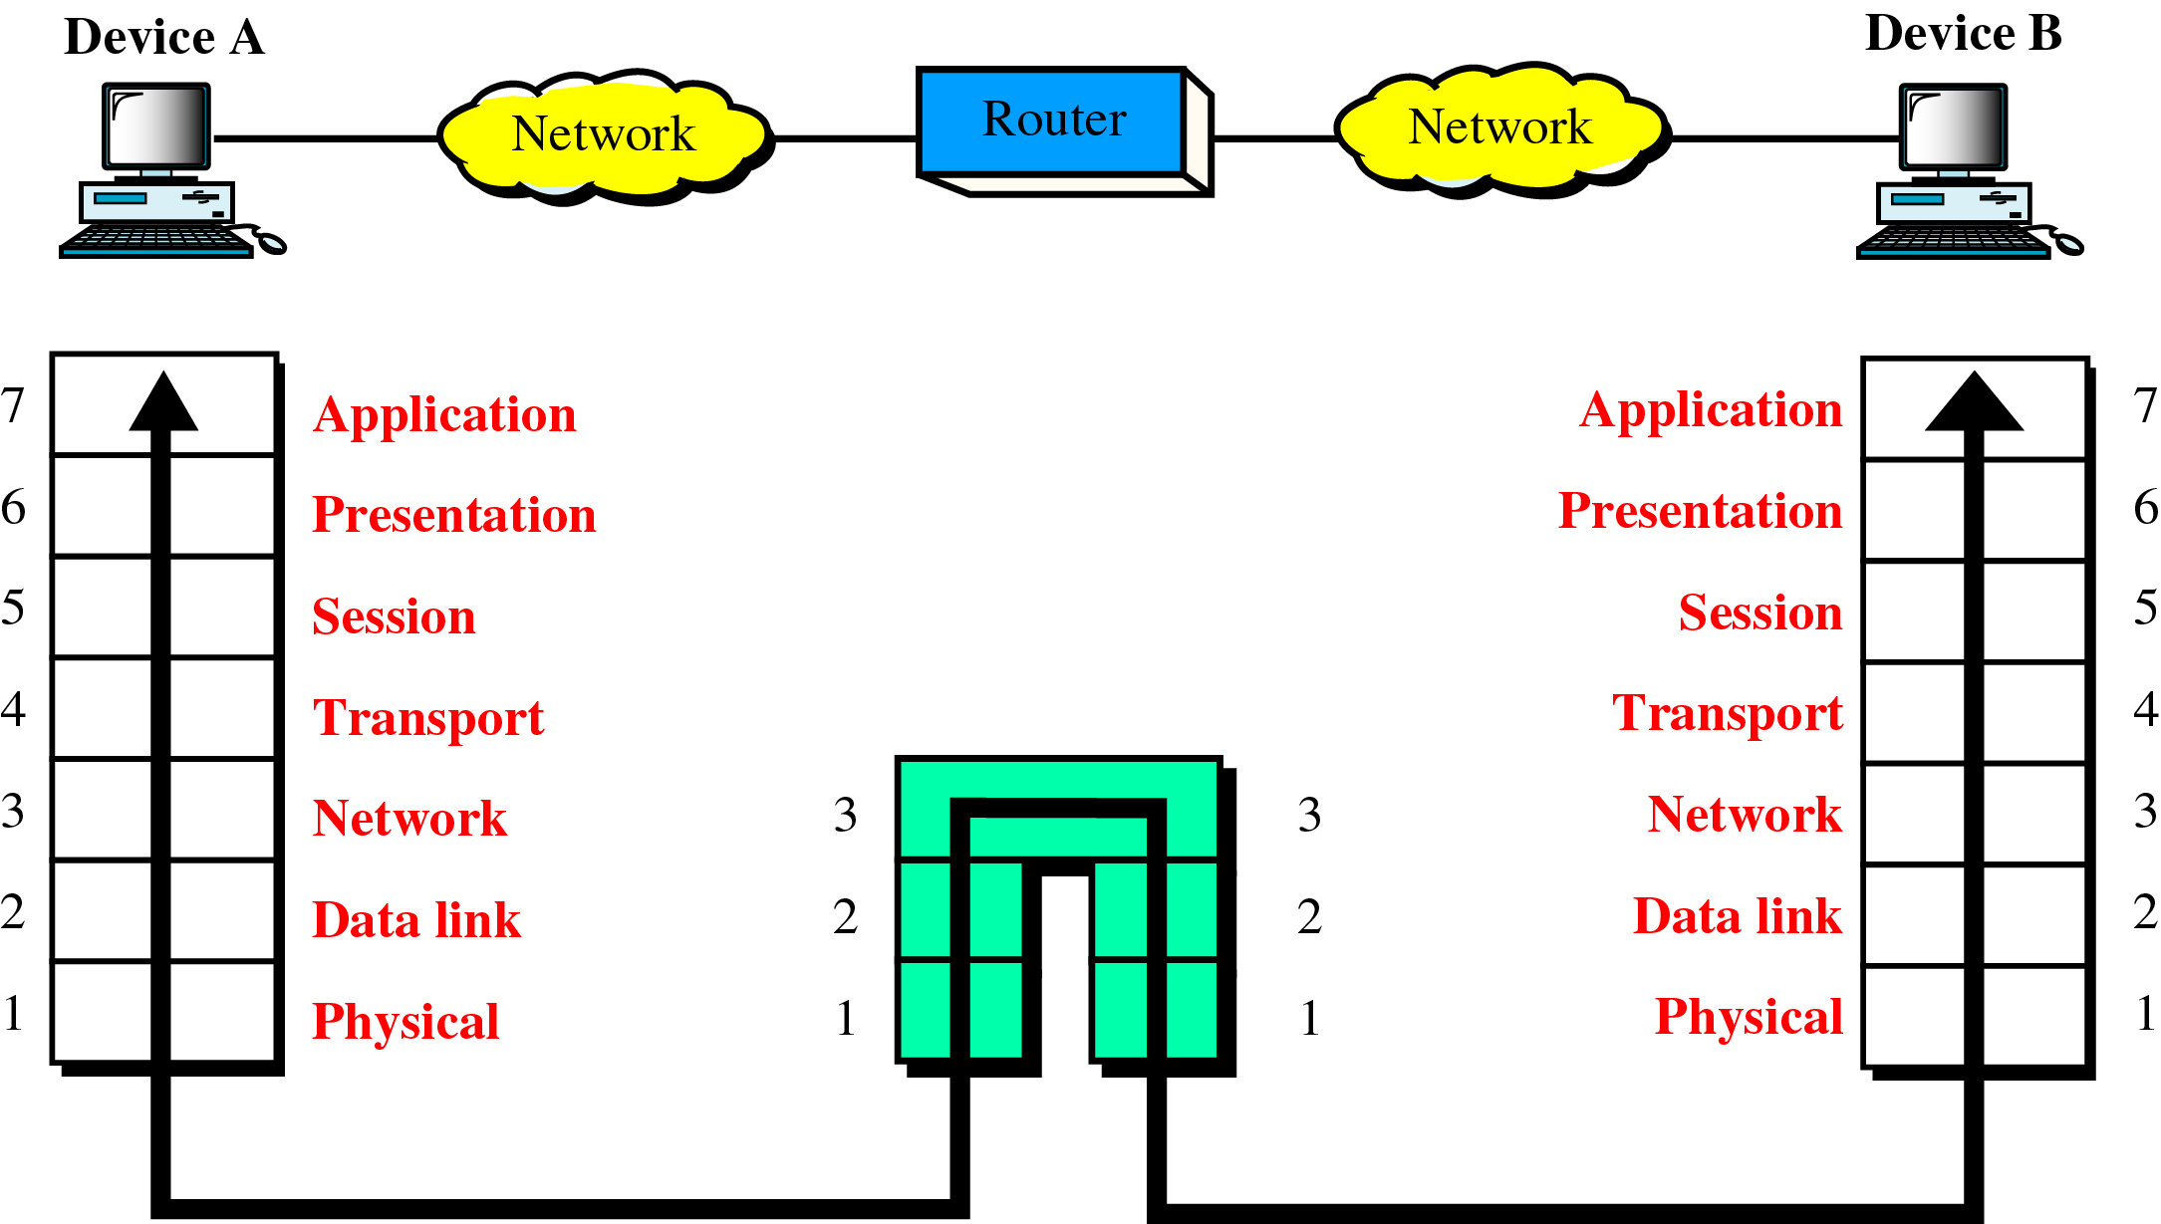
Figure 21-10
A Router in the OSI Model

Slide 12
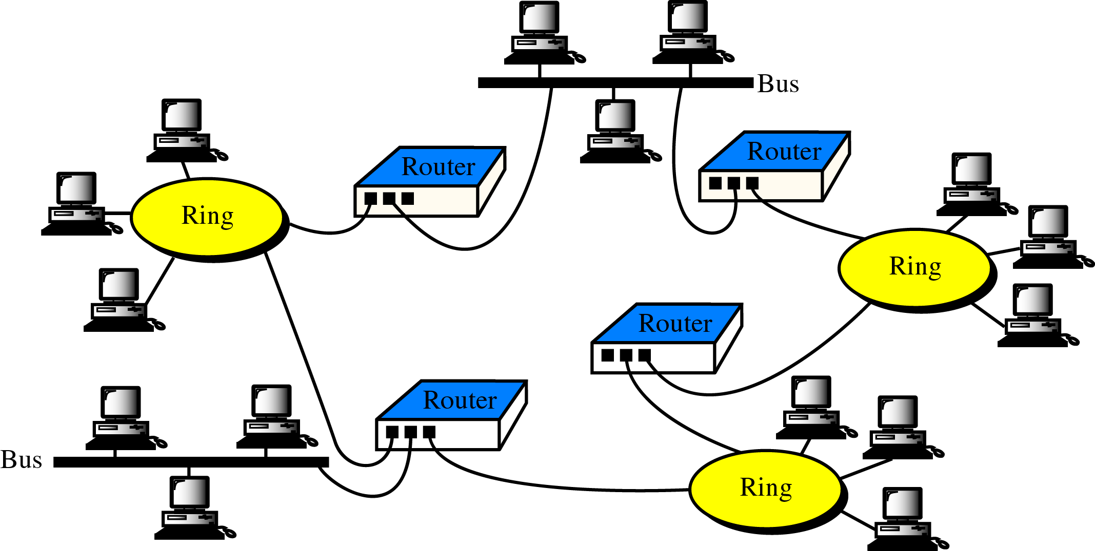
Figure 21-11
Routers in an Internet

Slide 13
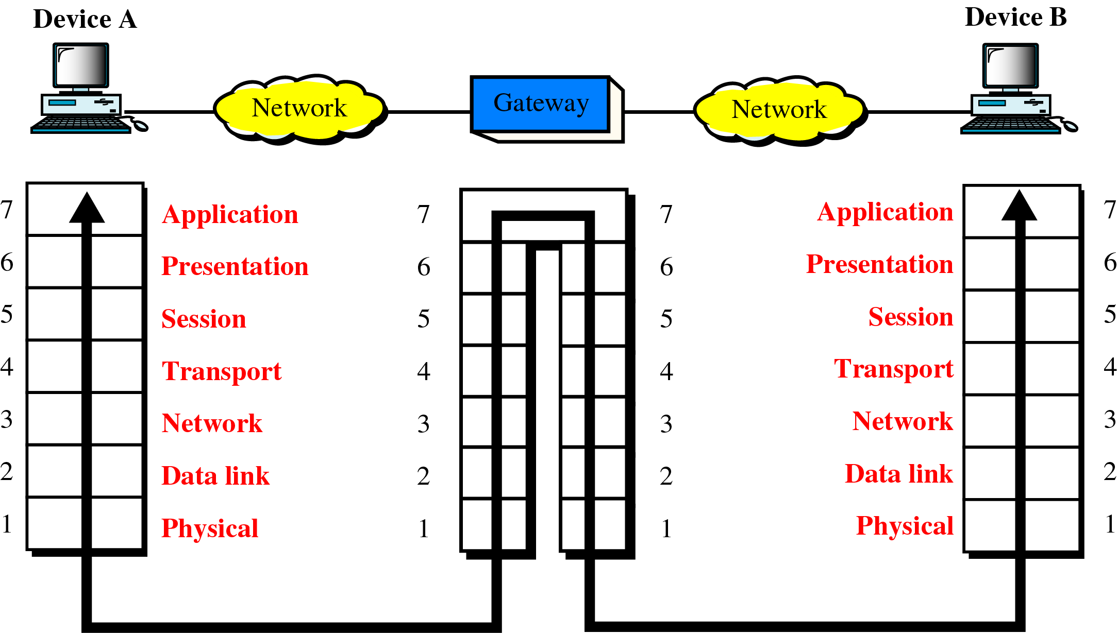
Figure 21-12
A Gateway in the OSI Model

Slide 14
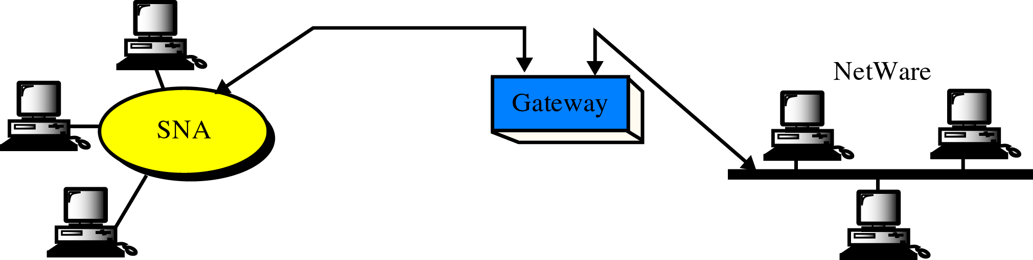
Figure 21-13
A Gateway

Slide 15
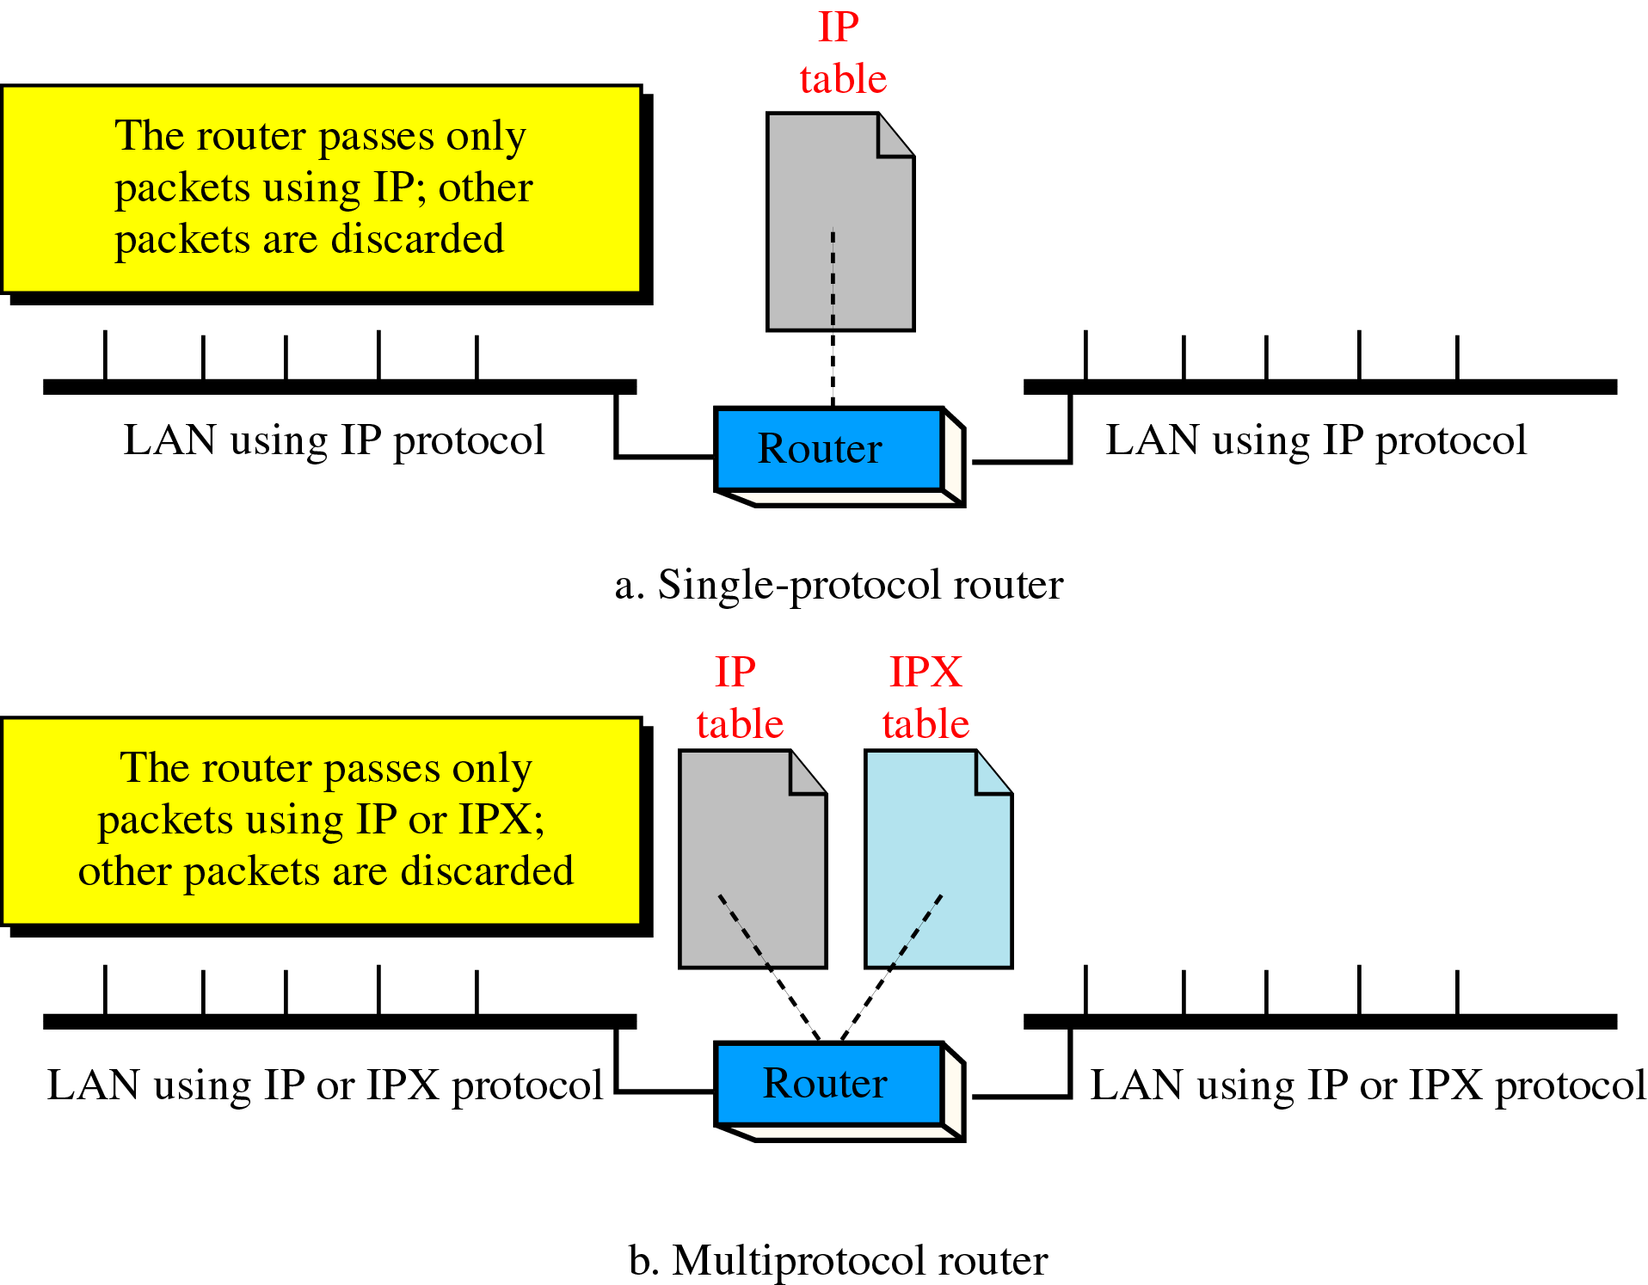
Figure 21-14
Single-Protocol versus
Multiprotocol Router

Slide 16
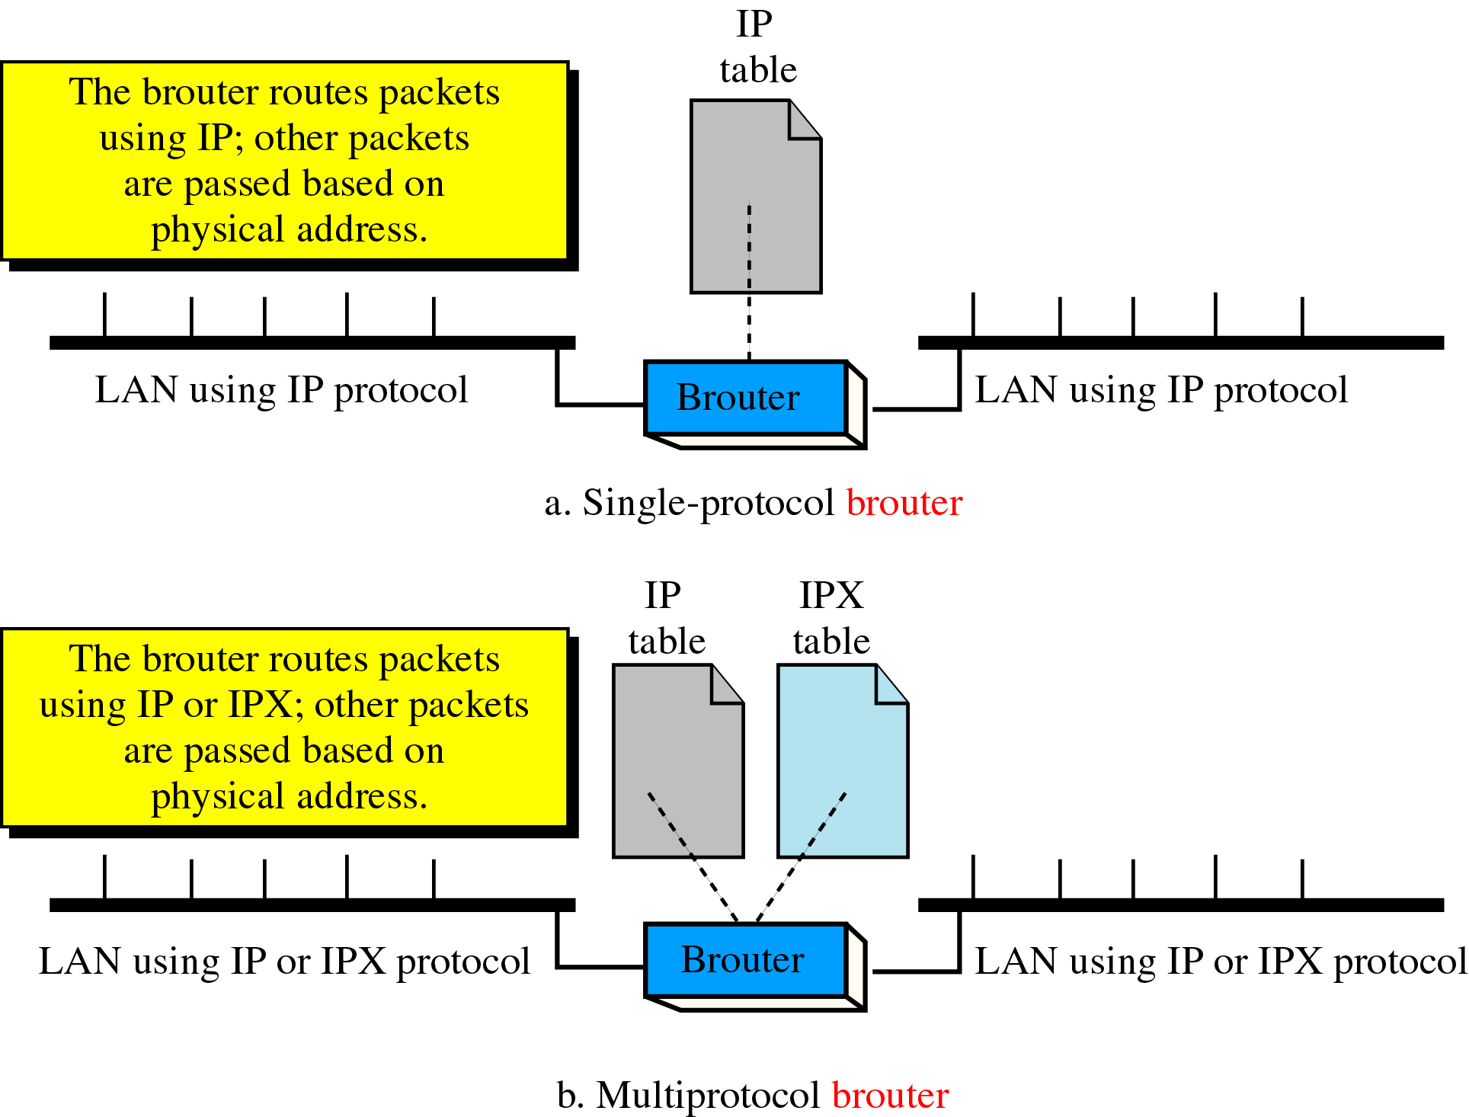
Figure 21-15
Brouter

Slide 17
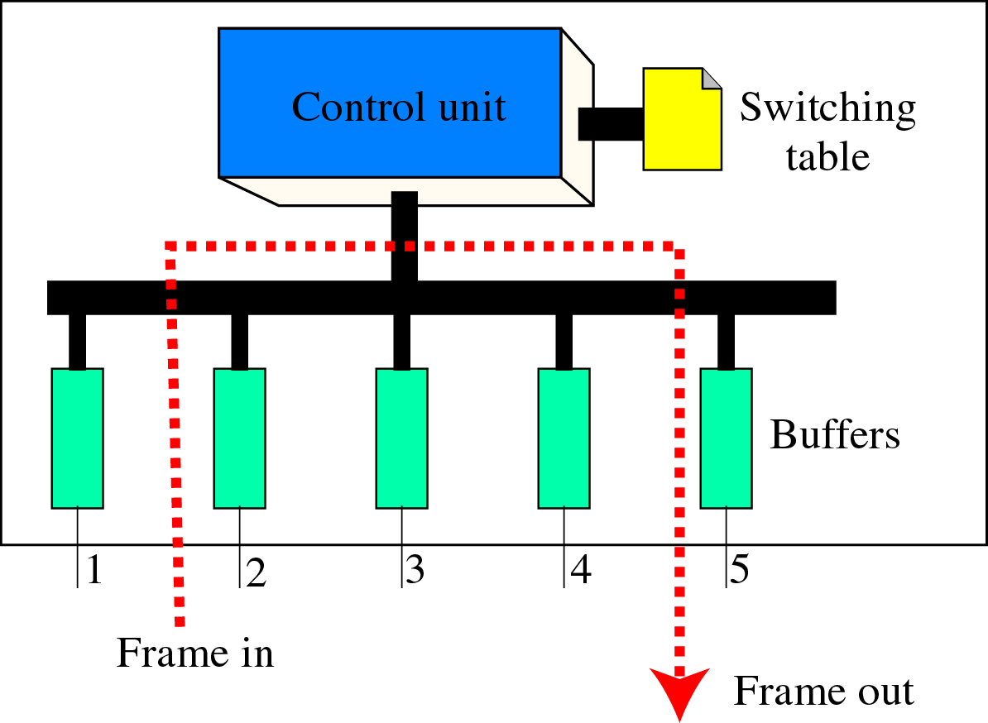
Figure 21-16
Switch

Slide 18
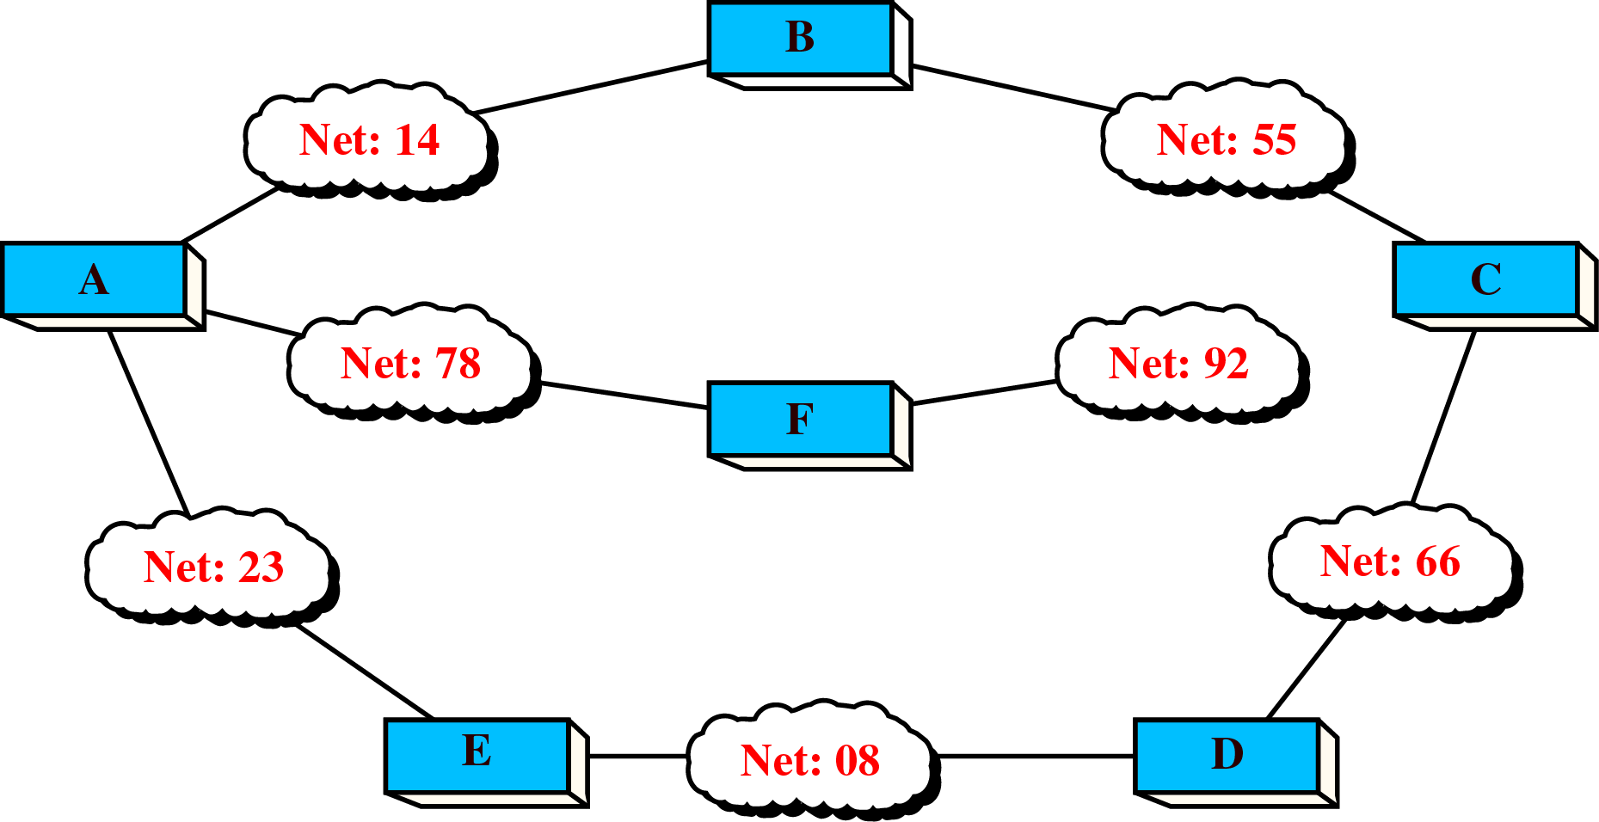
Figure 21-17
Example of an Internet

Slide 19
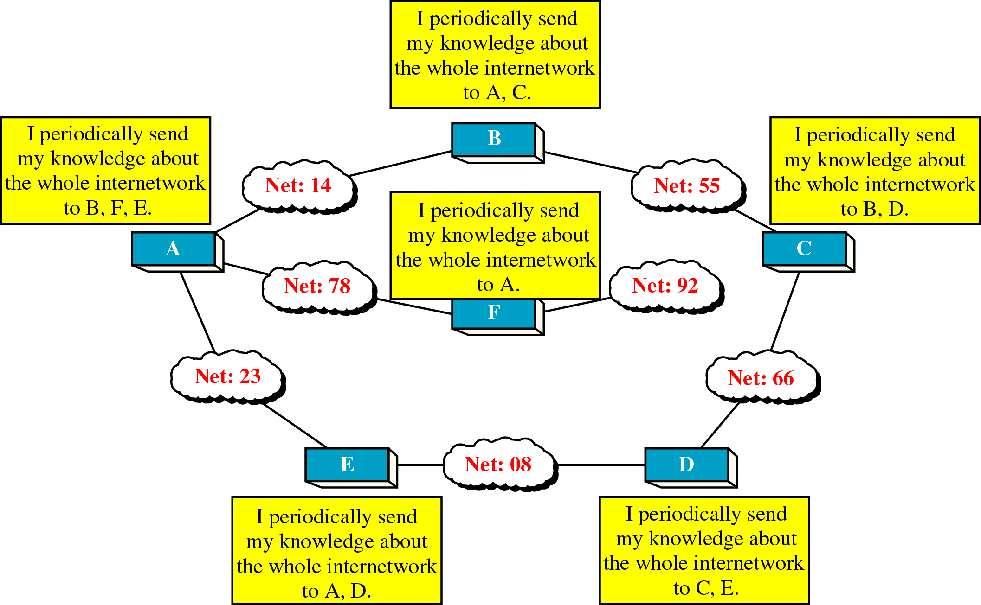
Figure 21-18
The Concept of Distance
Vector Routing

Slide 20
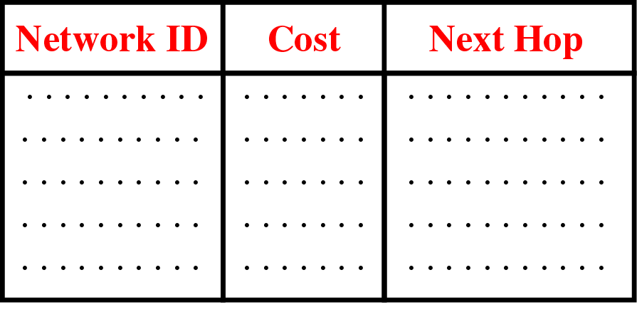
Figure 21-19
Distance Vector Routing Table

Slide 21
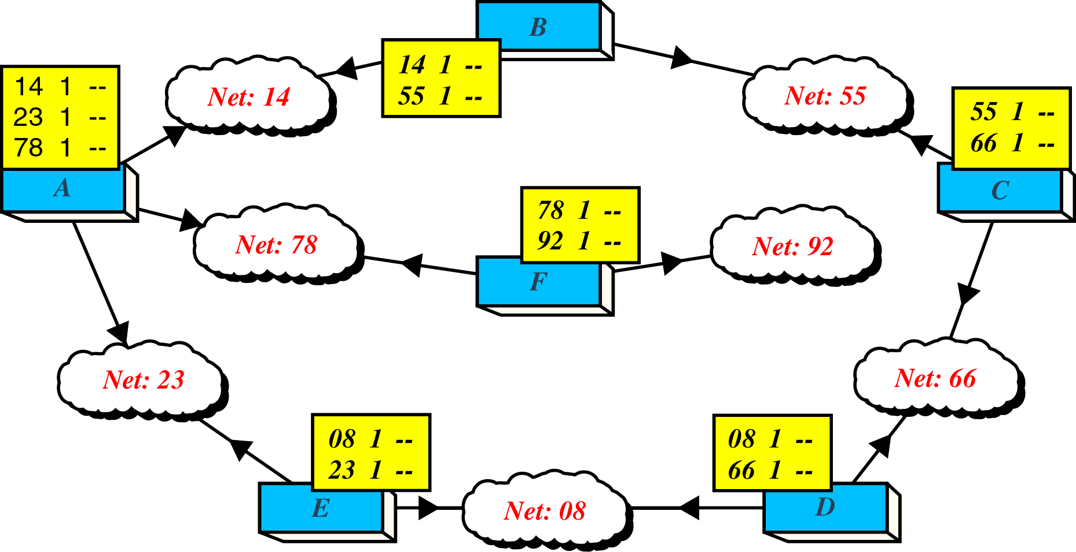
Figure 21-20
Routing Table Distribution

Slide 22
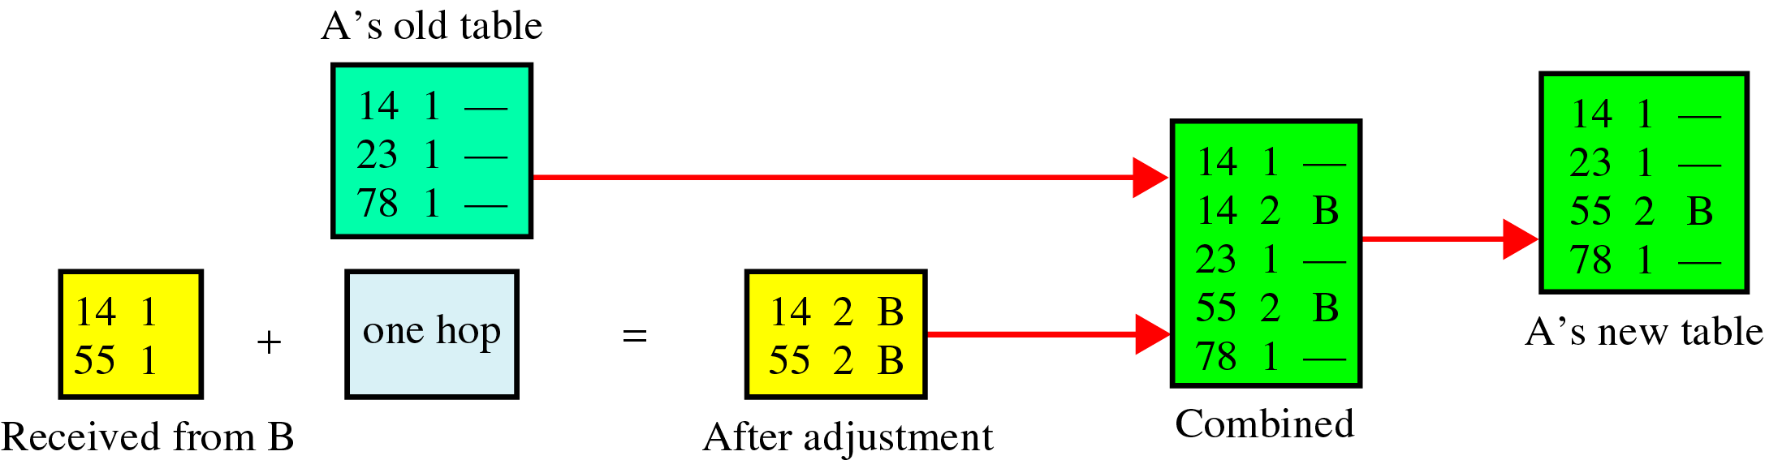
Figure 21-21
Updating Routing Table for Router A

Slide 23
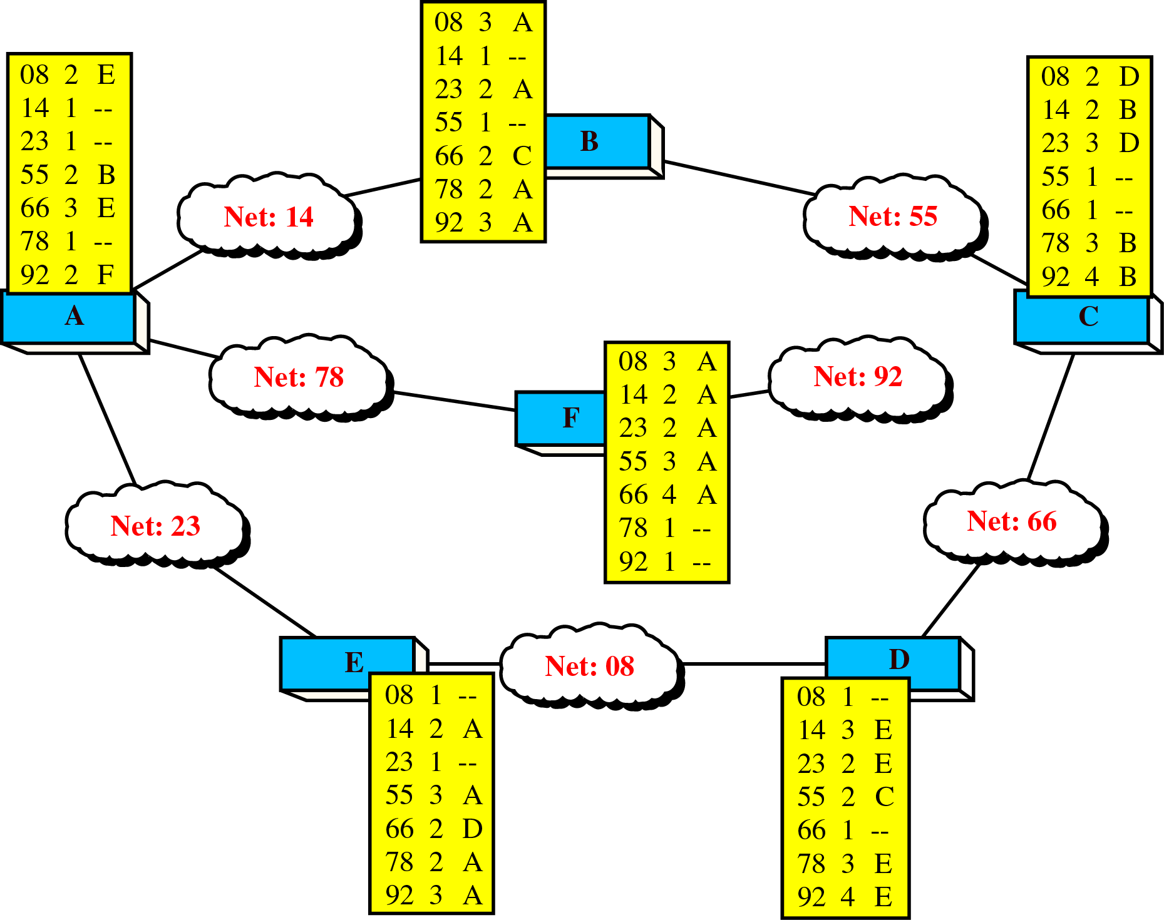
Figure 21-22
Final Routing Tables

Slide 24
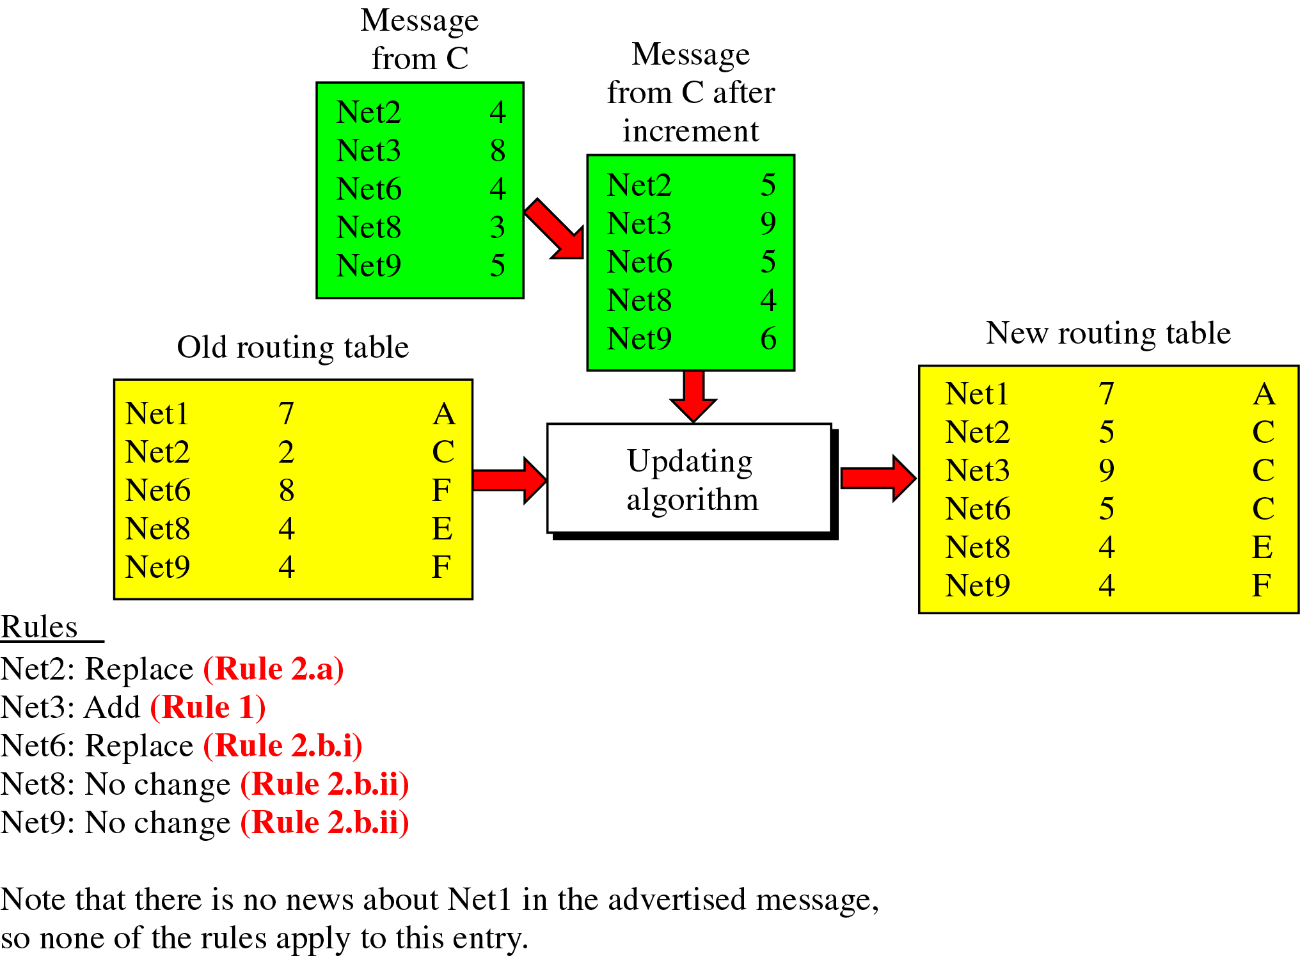
Figure 21-23
Example 21.1

Slide 25
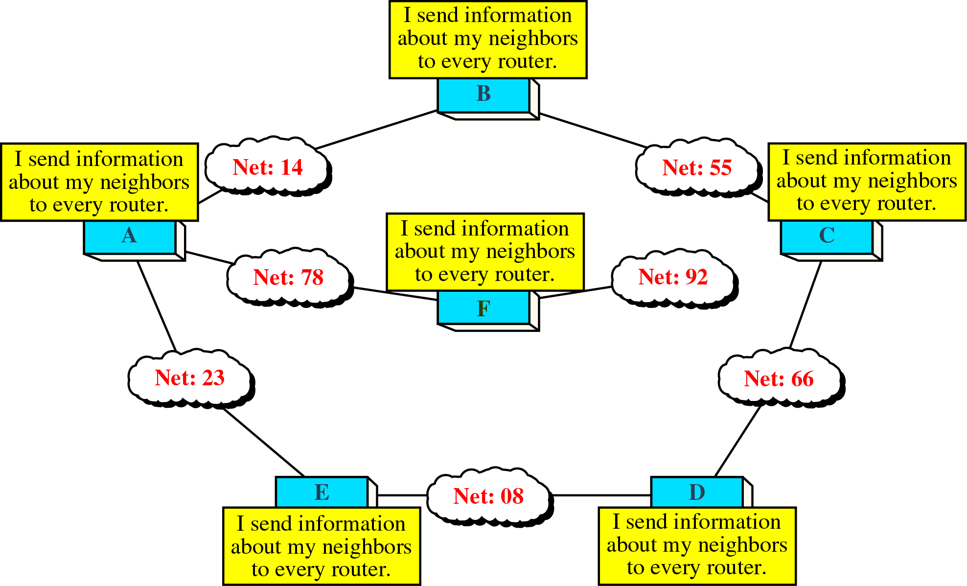
Figure 21-24
Concept of Link State Routing

Slide 26
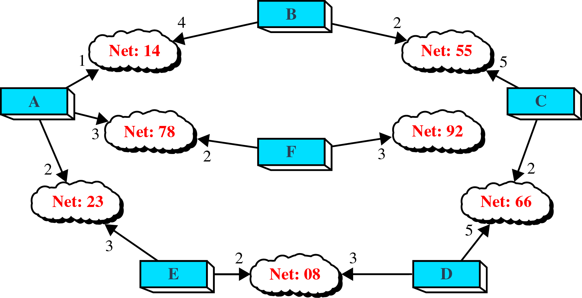
Figure 21-25
Cost in Link State Routing

Slide 27
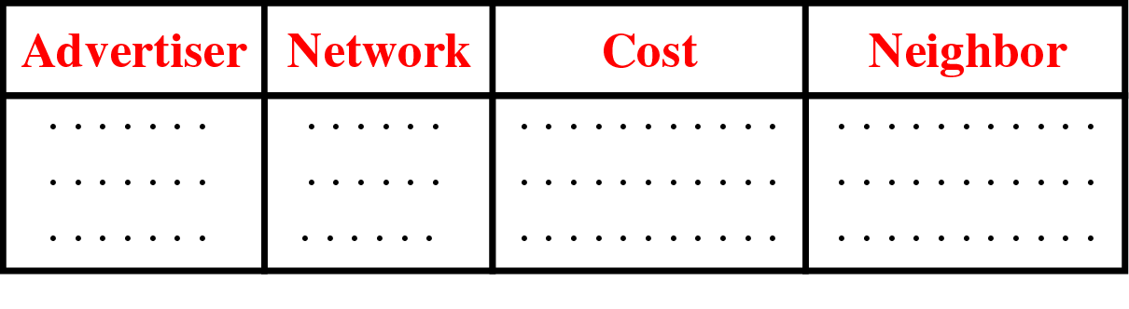
Figure 21-26
Link State Packet

Slide 28
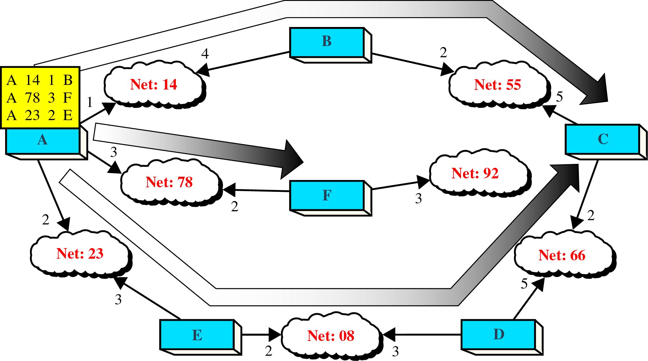
Figure 21-27
Flooding of A’s LSP

Slide 29
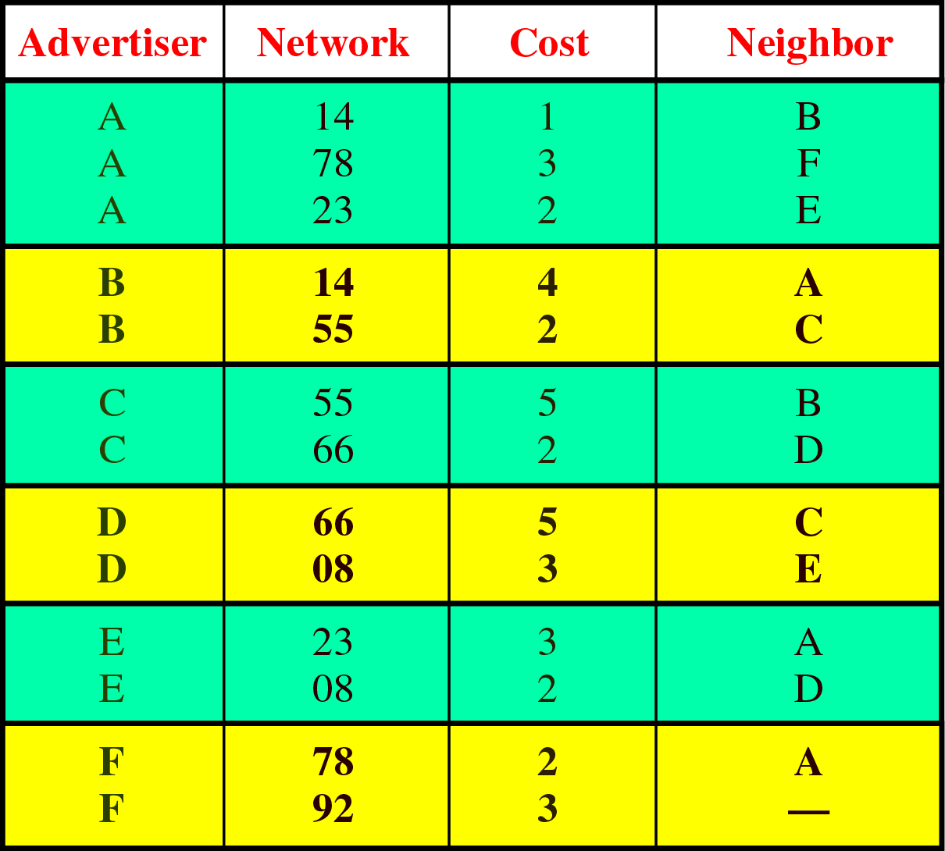
Figure 21-28
Link State Database

Slide 30
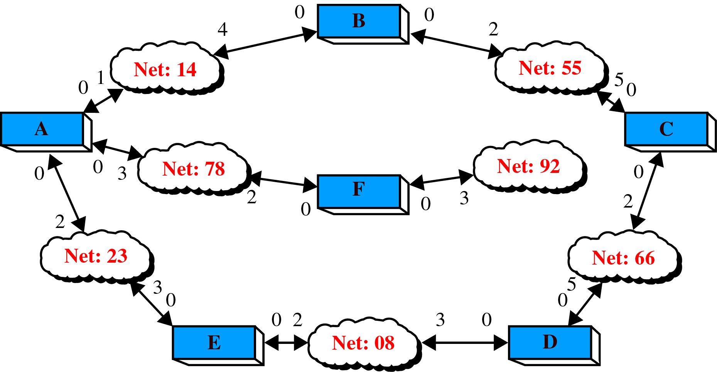
Figure 21-29
Costs in the Dijkstra Algorithm

Slide 31
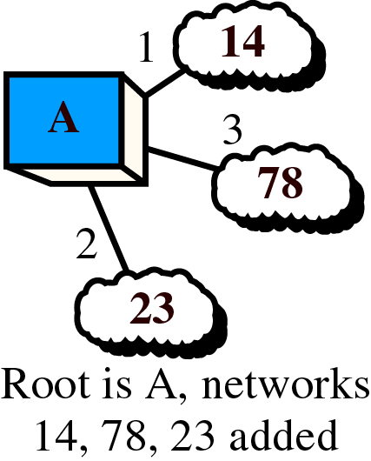
Figure 21-30, Part I
Shortest Path Calculation, Part I

Slide 32
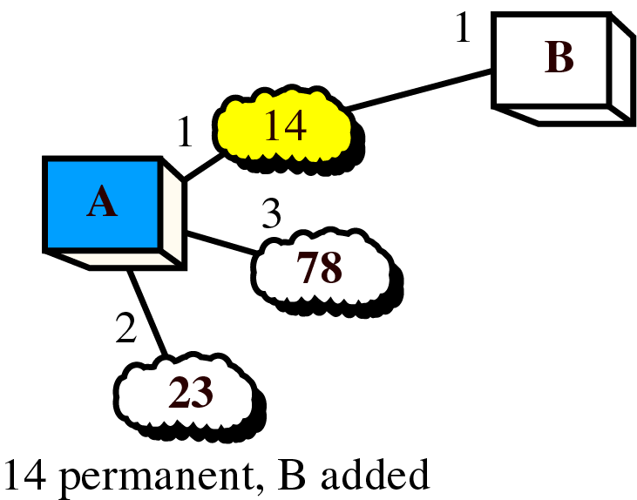
Figure 21-30, Part II
Shortest Path Calculation, Part II

Slide 33
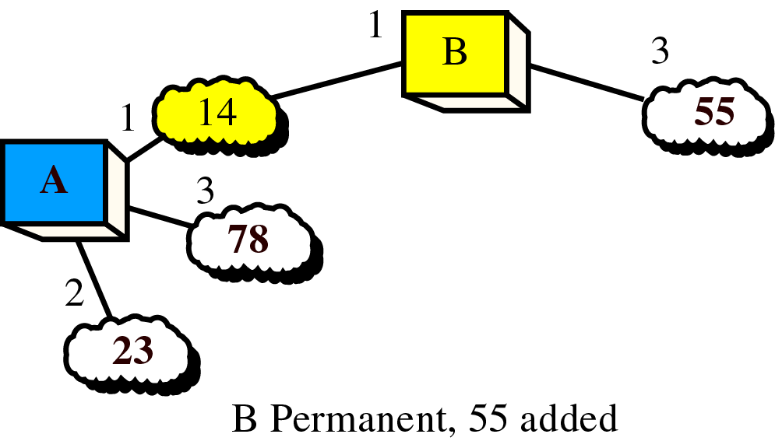
Figure 21-30, Part III
Shortest Path Calculation, Part III

Slide 34
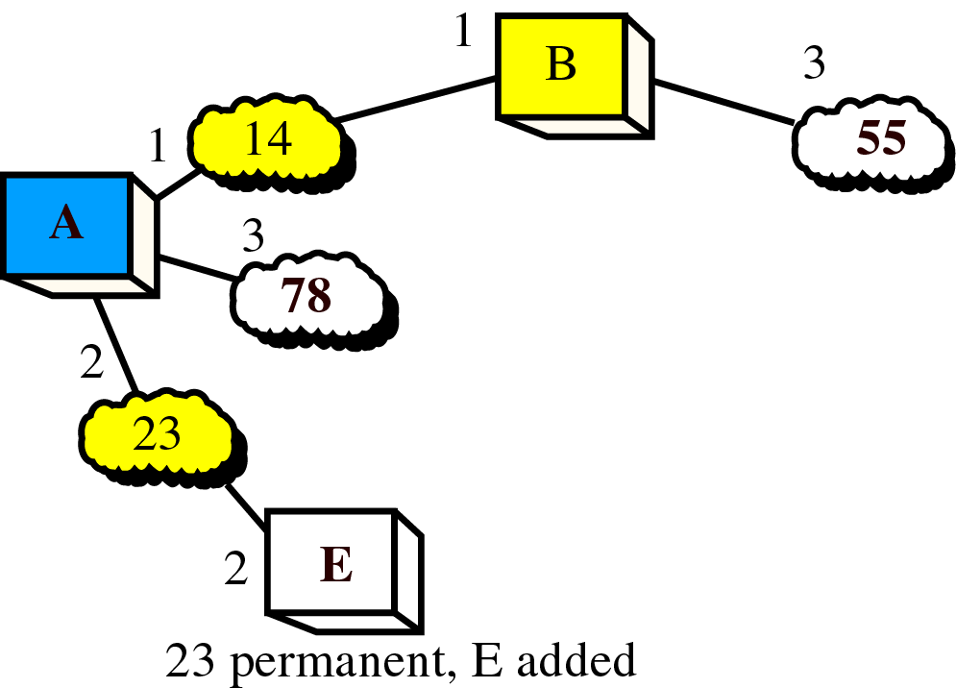
Figure 21-30, Part IV
Shortest Path Calculation, Part IV

Slide 35
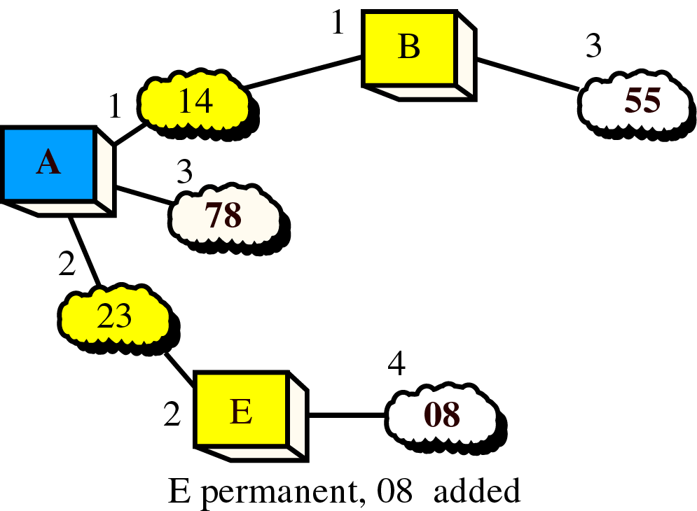
Figure 21-30, Part V
Shortest Path Calculation, Part V

Slide 36
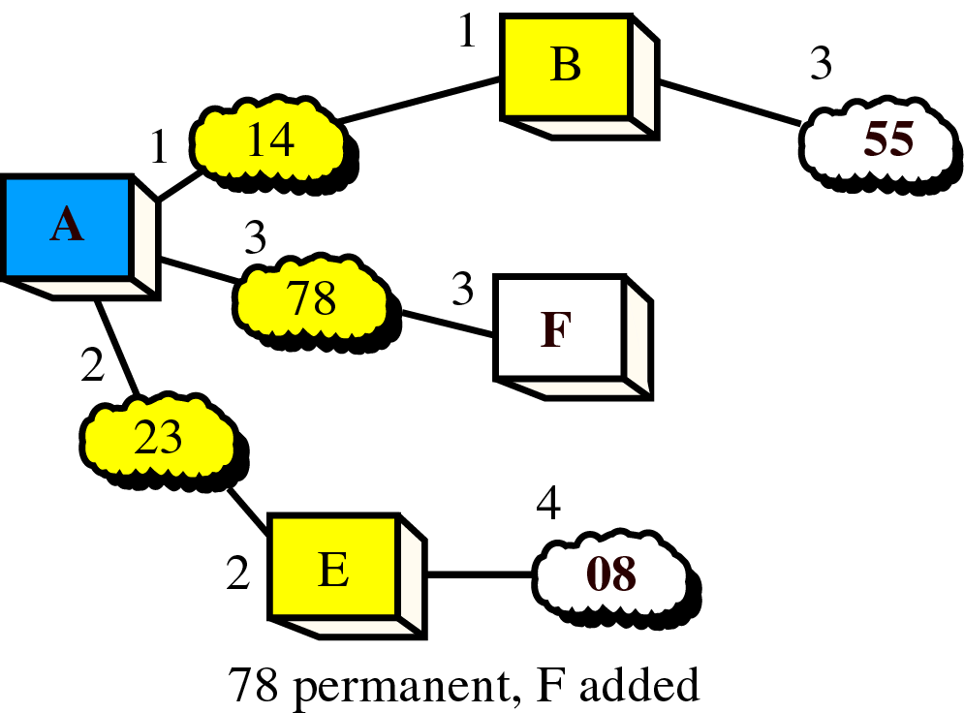
Figure 21-30, Part VI
Shortest Path Calculation, Part VI

Slide 37
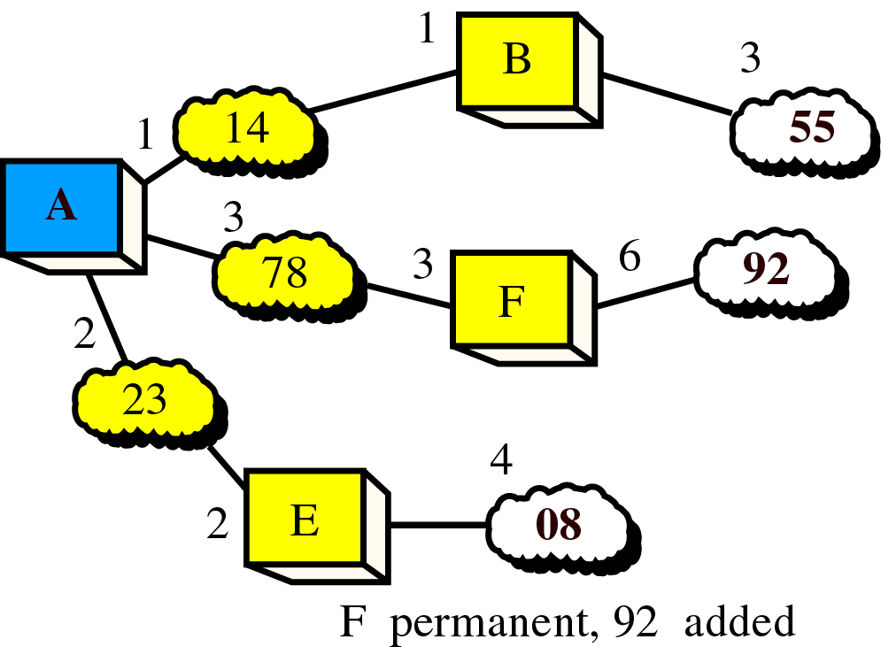
Figure 21-31, Part VII
Shortest Path Calculation, Part VII

Slide 38
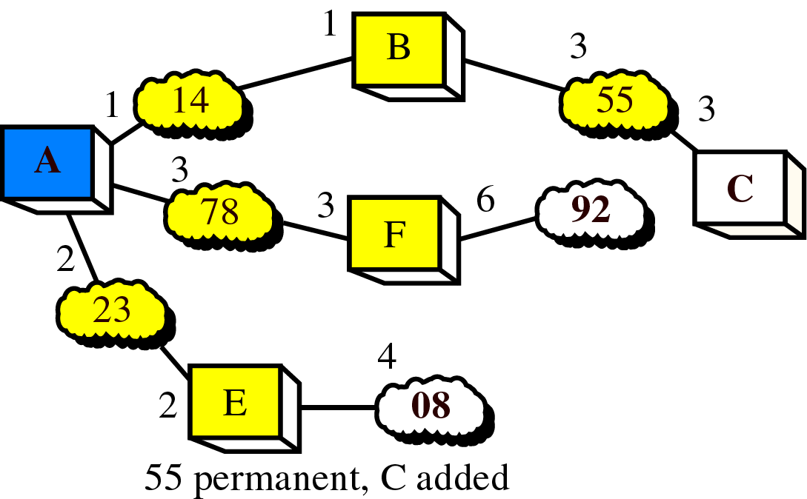
Figure 21-31, Part I
Shortest Path Calculation, Part VIII

Slide 39
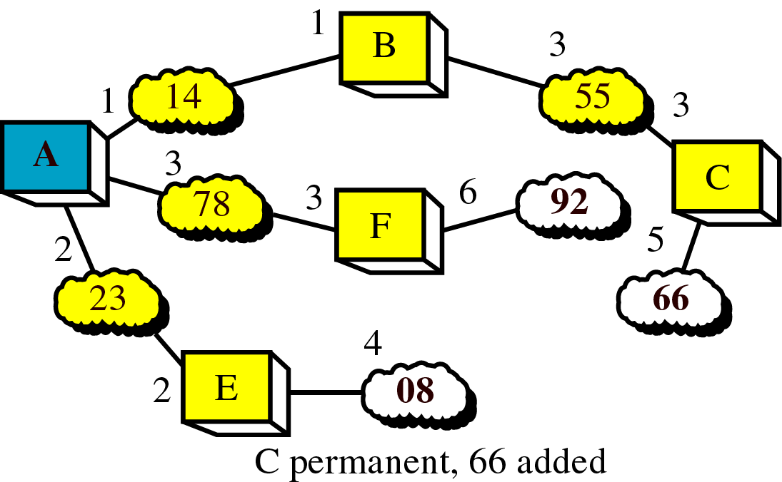
Figure 21-31, Part II
Shortest Path Calculation, Part IX

Slide 40
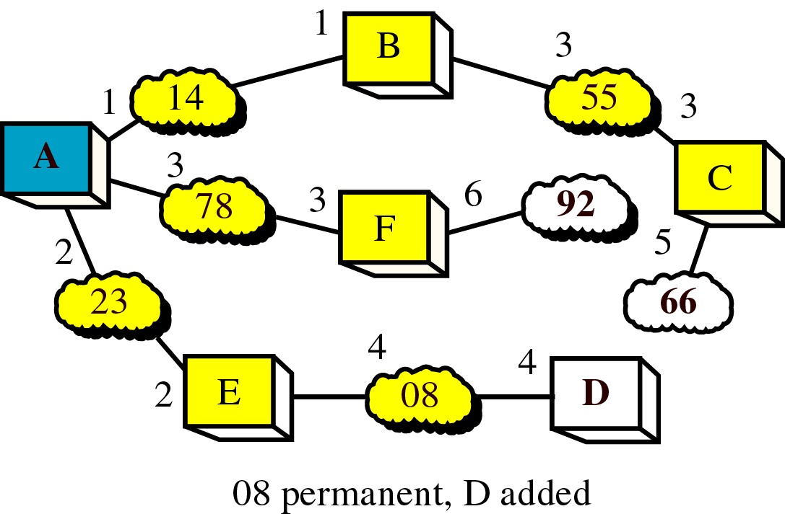
Figure 21-31, Part III
Shortest Path Calculation, Part X

Slide 41
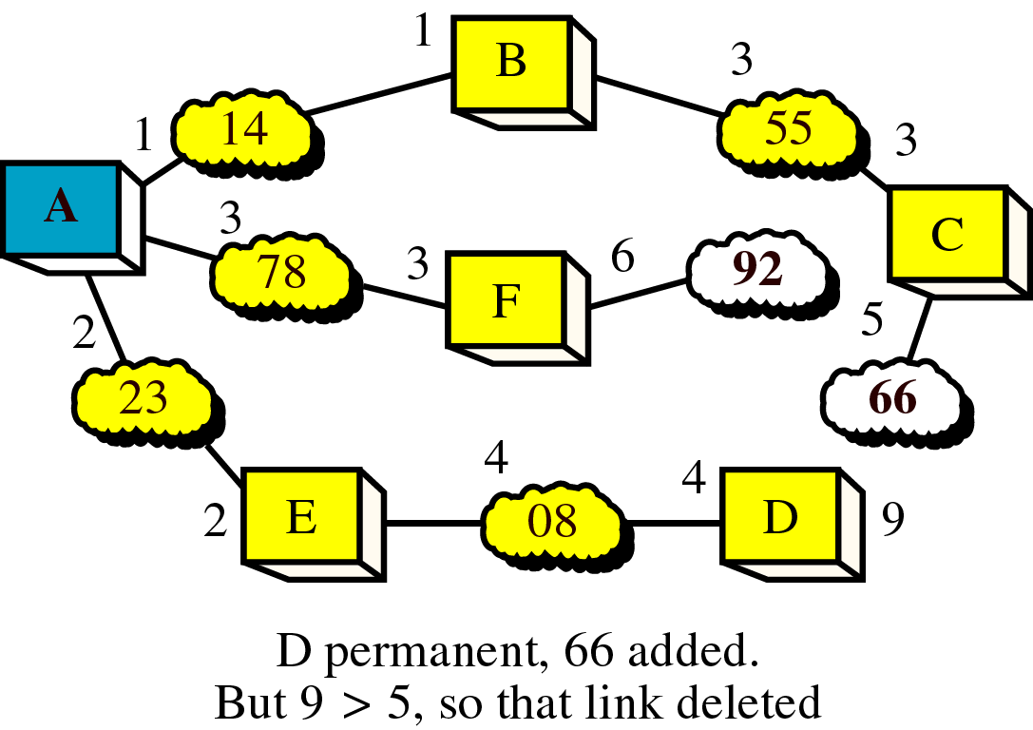
Figure 21-31, Part IV
Shortest Path Calculation, Part XI

Slide 42
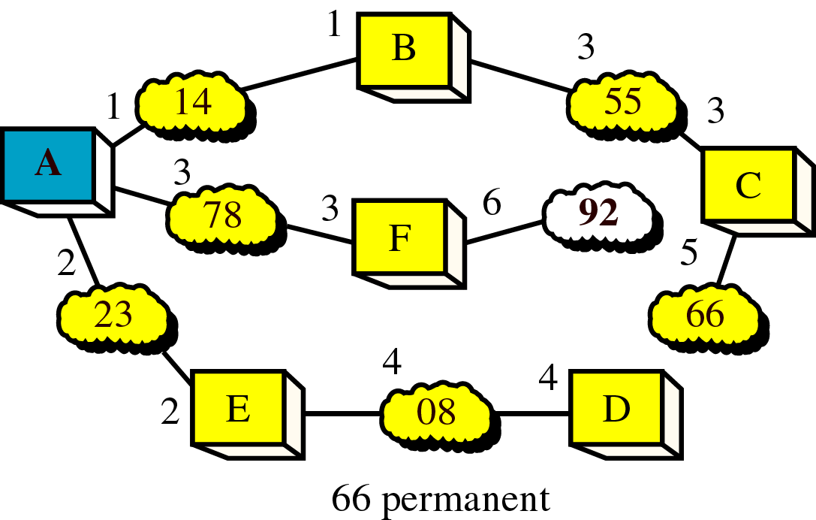
Figure 21-31, Part V
Shortest Path Calculation, Part XII

Slide 43
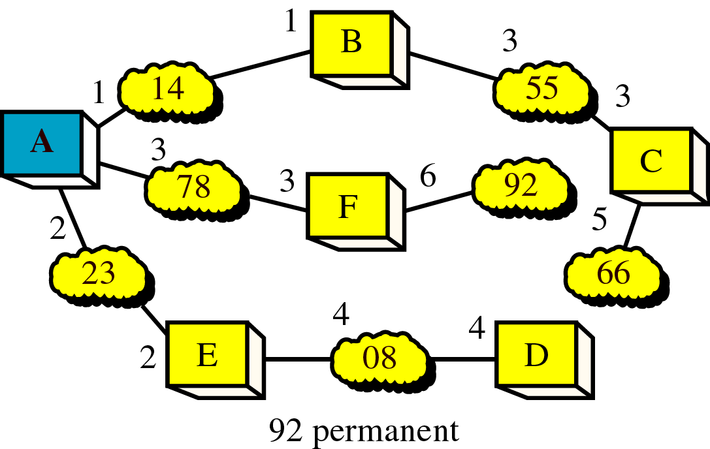
Figure 21-31, Part VI
Shortest Path Calculation, Part XIII

Slide 44
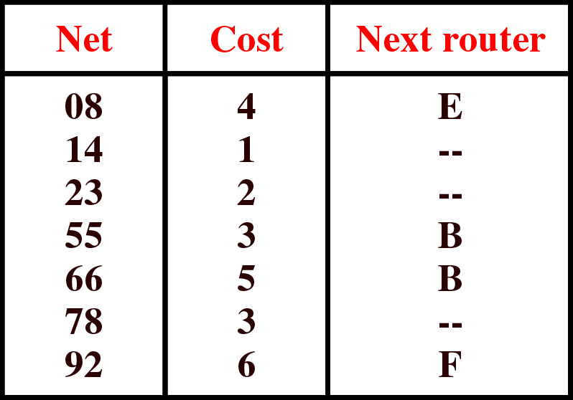
Figure 21-32
Routing Table for Router A

