Slide 1
Switches: The Basics
CIS 83 (CCNA 3)
Rick Graziani
Cabrillo College

Slide 2
Transparent Bridge Process - Jeff Doyle
Receive Packet
Learn source address or refresh aging timer
Is the destination a broadcast, multicast or unknown unicast?
No
Yes
Flood Packet
Are the source and destination on the same interface?
No
Yes
Filter Packet
Forward unicast to correct port

Slide 3
Switch Process – Another Look
For every frame that enters a switch…
Learning Stage (Building/Updating of SAT/MAC table)
Examines Source MAC Address:
If Source MAC Address is in the SAT/MAC table, update 5 minute timer
If Source MAC Address is NOT in the SAT/MAC table, add Source MAC Address and incoming port number to SAT/MAC table
Forwarding Stage (Flood or Filter)
Examines Destination MAC Address:
If Destination MAC Address is in the SAT/MAC table, forward the frame only out that port (Filter), unless it is the outgoing port is the same as the incoming port (checks Source MAC Address)
If Destination MAC Address is NOT in the SAT/MAC table, forward the frame only out all ports except incoming port (Flood)

Slide 4
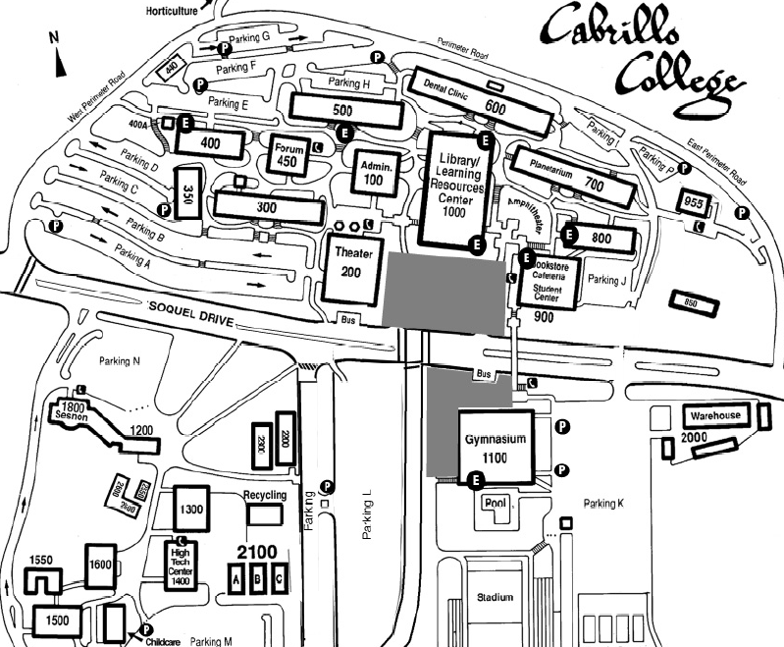
Cabrillo College – MDF/IDF Map
MDF
IDF

Slide 5
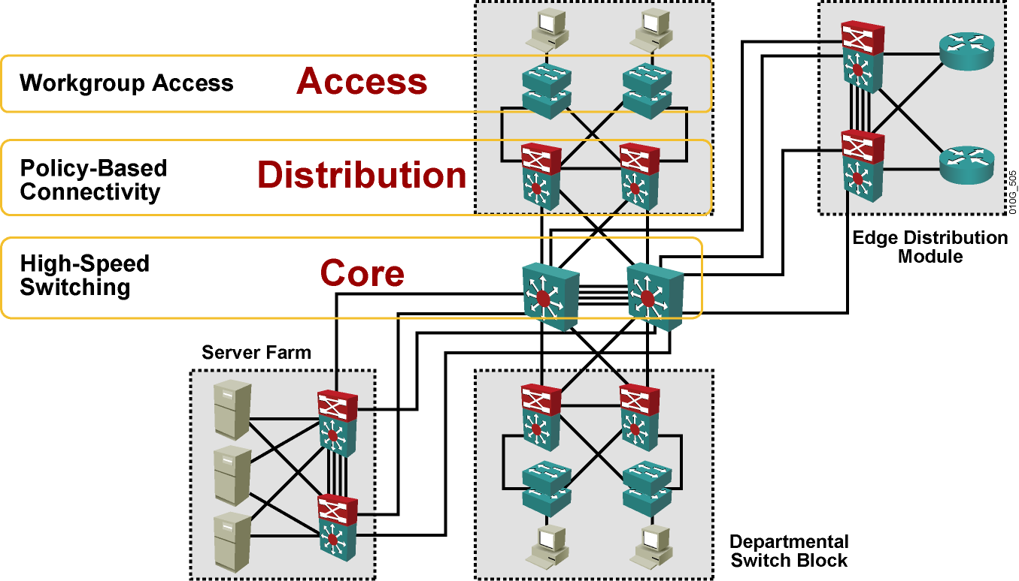
Switched LANs, access layer overview
The hierarchical design model includes the following three layers:
The access layer provides users in workgroups access to the network.
The distribution layer provides policy-based connectivity.
The core layer provides optimal transport between sites.
The core layer is often referred to as the backbone.

Slide 6
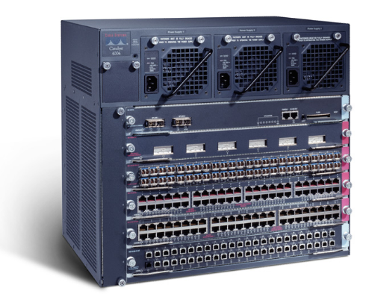
Access layer switches
Access layer switches operate at Layer 2 of the OSI model and provide services such as VLAN membership.
The main purpose of an access layer switch is to allow end users into the network.
An access layer switch should provide this functionality with low cost and high port density.
Catalyst 1900 series
Catalyst 2820 series
Catalyst 2950 series
Catalyst 4000 series
Catalyst 5000 series

Slide 7
Distribution Layer
The purpose of this layer is to provide a boundary definition in which packet manipulation can take place.
Networks are segmented into broadcast domains by this layer.
Policies can be applied and access control lists can filter packets.
The distribution layer also prevents problems from affecting the core layer.
Switches in this layer operate at Layer 2 and Layer 3.
The distribution layer includes several functions such as the following:
Aggregation of the wiring closet connections
Broadcast/multicast domain definition
Virtual LAN (VLAN) routing
Any media transitions that need to occur
Security

Slide 8
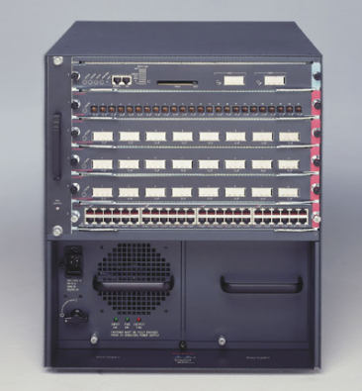
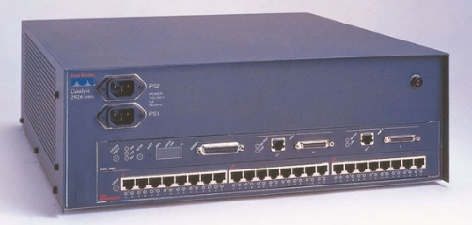
Distribution layer switches
6500
2926G
Distribution layer switches are the aggregation points for multiple access layer switches.
The switch must be able to accommodate the total amount of traffic from the access layer devices.
The distribution layer combines VLAN traffic and is a focal point for policy decisions about traffic flow.
For these reasons distribution layer switches operate at both Layer 2 and Layer 3.
The following Cisco switches are suitable for the distribution layer:
Catalyst 2926G
Catalyst 5000 family
Catalyst 6000 family

Slide 9
Core Layer
The core layer is a high-speed switching backbone.
If they do not have an associated router module, an external router is used for the Layer 3 function.
This layer of the network design should not perform any packet manipulation.
Packet manipulation, such as access list filtering, would slow down the switching of packets.
Providing a core infrastructure with redundant alternate paths gives stability to the network in the event of a single device failure.

Slide 10
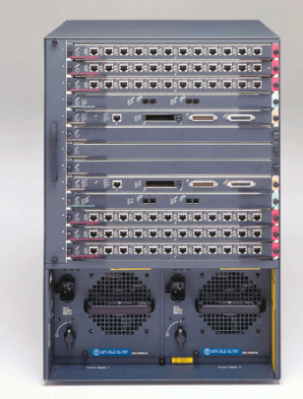
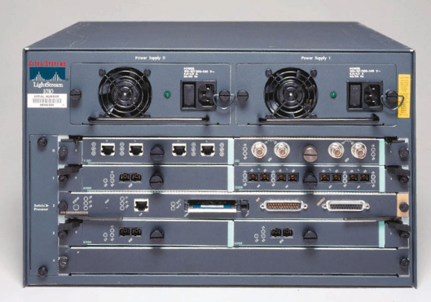
Core Layer Switches
Lightstream 1010
8540
In a network design, the core layer can be a routed, or Layer 3, core.
Core layer switches are designed to provide efficient Layer 3 functionality when needed.
Factors such as need, cost, and performance should be considered before a choice is made.
The following Cisco switches are suitable for the core layer:
Catalyst 6500 series
Catalyst 8500 series
IGX 8400 series
Lightstream 1010

Slide 11
Switch Configuration
CIS 83 (CCNA 3)
Rick Graziani
Cabrillo College

Slide 12
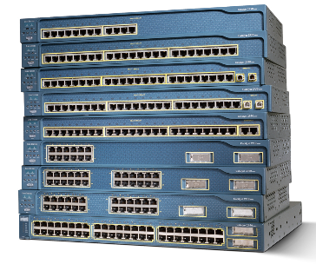
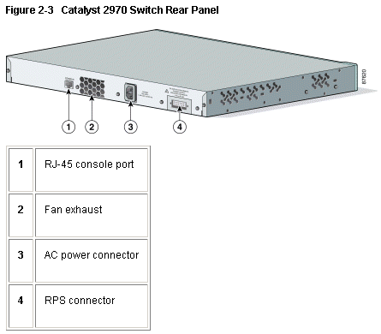
Physical startup of the Catalyst switch
Switches are dedicated, specialized computers;
Central Processing Unit (CPU)
Random Access Memory (RAM)
Operating System
A switch can be managed by connecting to the console port to view and make changes to the configuration.
Lower model switches typically have no power switch to turn them on and off.
They simply connect or disconnect from a power source.

Slide 13
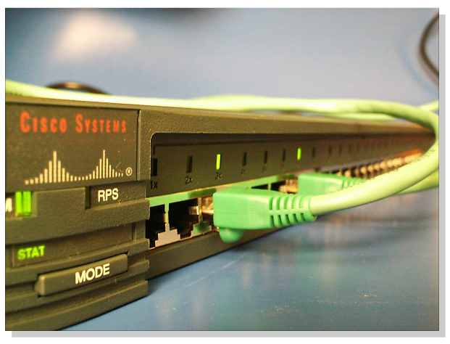
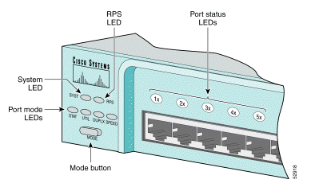
Switch LED indicators
We will examine LED indicators.
Note: Many of these are switch specific, although green is usually good.
LED indicators are only quick view of the status of the switch.
For a more detailed view, use IOS commands.

Slide 14
Switch LED indicators - 2950
The front panel of a switch has several lights to help monitor system activity and performance.
These lights are called light-emitting diodes (LEDs).
The front of the switch has the following LEDs:
System LED
Whether the system is receiving power and functioning correctly.
Remote Power Supply (RPS) LED
Whether or not the remote power supply is in use
Port Mode LED
Indicates the current state of the Mode button.
The modes are used to determine how the Port Status LEDs are interpreted.
Port Status LEDs
Has different meanings, depending on the current value of the Mode LED.

Slide 15
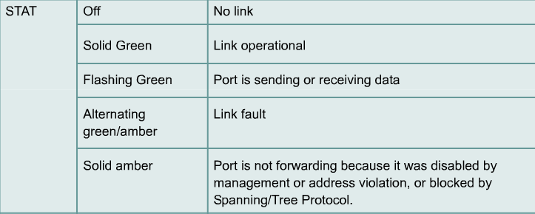
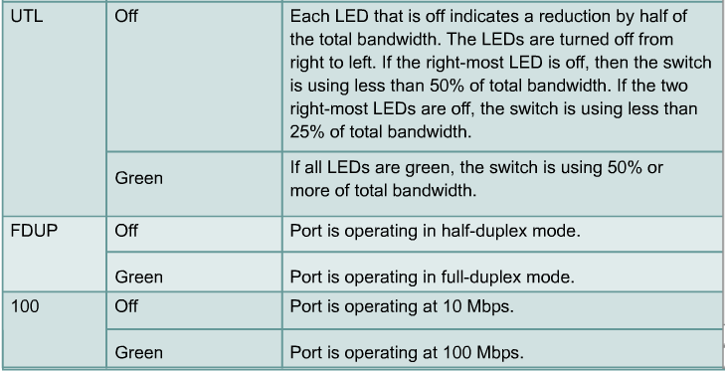
Switch LED indicators: Port Status LED

Slide 16
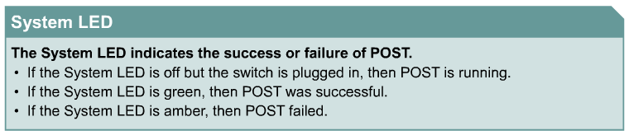
Port LEDs during switch POST – System LED
Once the power cable is connected, the switch initiates a series of tests called the power-on self test (POST).
If the System LED is green, then POST was successful.
If the System LED is amber, then POST failed. POST failure is considered to be a fatal error.

Slide 17
Port LEDs during switch POST – Port Status LED
The Port Status LEDs also change during switch POST.
The Port Status LEDs turn amber for about 30 seconds as the switch discovers the network topology and searches for loops.
If the Port Status LEDs turn green, the switch has established a link between the port and a target, such as a computer.
If the Port Status LEDs turn off, the switch has determined that nothing is plugged into the port.

Slide 18
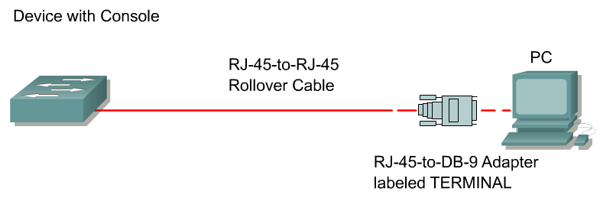
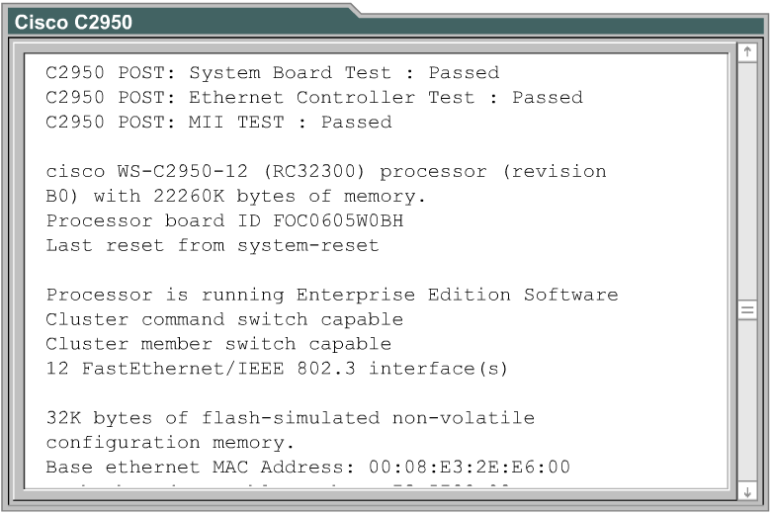
Viewing initial bootup output from the switch
The switch may be configured manually with or without the assistance of the System Configuration dialog.
The System Configuration dialog on the switch is simpler than that on a router.

Slide 19
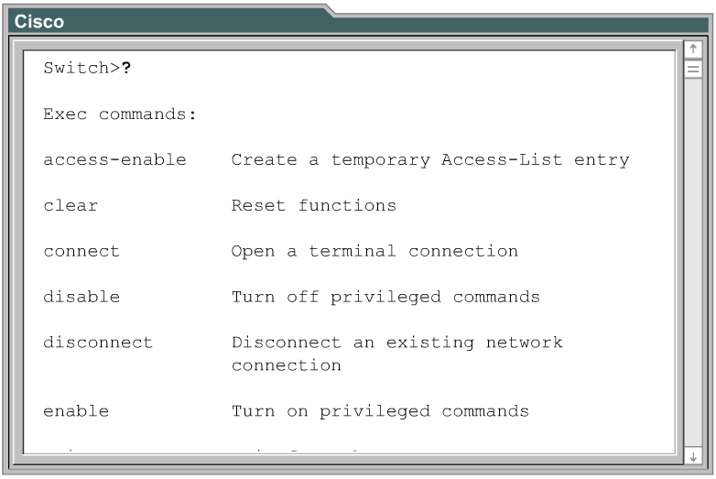
Examining help in the switch CLI
The command-line interface (CLI) for Cisco switches is very similar to the CLI for Cisco routers.

Slide 20
Show running-config
ALSwitch#show running-config
Building configuration...
Current configuration : 1300 bytes
!
version 12.1
no service pad
service timestamps debug uptime
service timestamps log uptime
no service password-encryption
!
hostname ALSwitch
!
!
ip subnet-zero
!
!
spanning-tree mode pvst
no spanning-tree optimize bpdu transmission
spanning-tree extend system-id
!
!
!
!
interface FastEthernet0/1

Slide 21
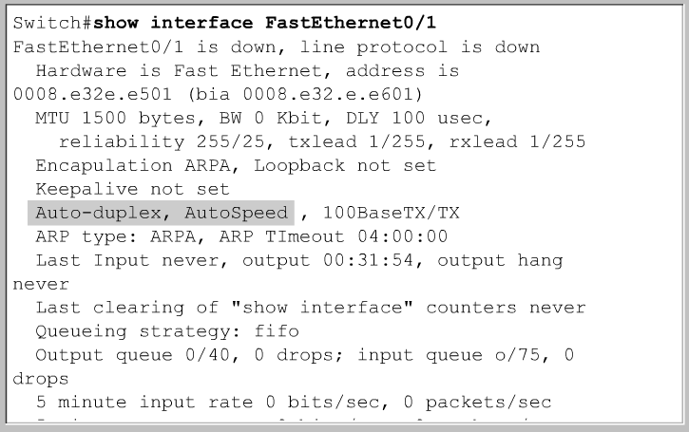
show interface

Slide 22
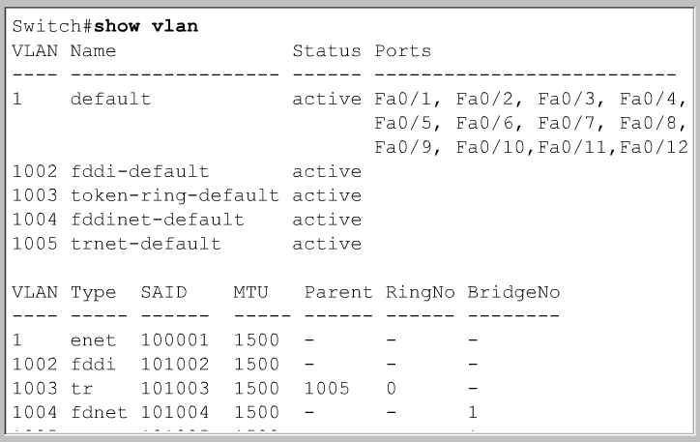
show vlan

Slide 23
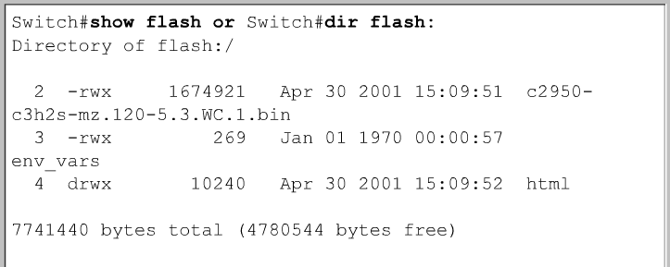
show flash

Slide 24
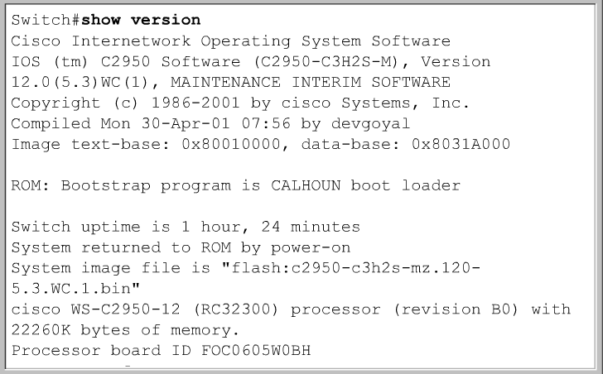
show version

Slide 25
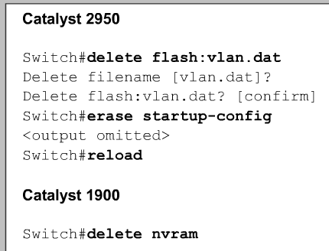
Reset all Switch Configurations & Reload
The following steps will ensure that a new configuration will completely overwrite any existing configuration:
Remove any existing VLAN information by deleting the VLAN database file vlan.dat from the flash directory
Erase the back up configuration file startup-config
Reload the switch

Slide 26
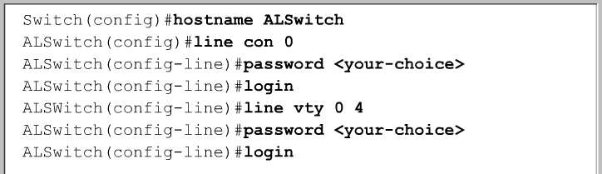
Security, documentation, and management
The same class rules apply for passwords on switches as they did on routers.
“cisco” and “class”
We will not need to configure “enable secret”, console, and vty passwords until the case study.

Slide 27
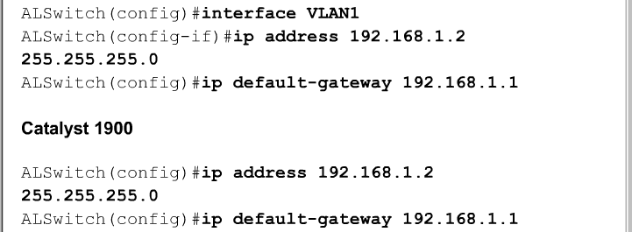
Set IP Address and Default Gateway
To allow the switch to be accessible by Telnet and other TCP/IP applications, IP addresses and a default gateway should be set.
By default, VLAN 1 is the management VLAN. (more later)
In a switch-based network, all internetworking devices should be in the management VLAN.
This will allow a single management workstation to access, configure, and manage all the internetworking devices.
The default gateway is only for management purposes, not for user Ethernet frames (and packets).
This is only used if you wanted to telnet from this switch into a device on another network.

Slide 28
Set Port Speed and Duplex Settings
The Fast Ethernet switch ports default to:
auto-speed
auto-duplex.
This allows the interfaces to negotiate these settings.
When a network administrator needs to ensure an interface has particular speed and duplex values, the values can be set manually.
More later…

Slide 29
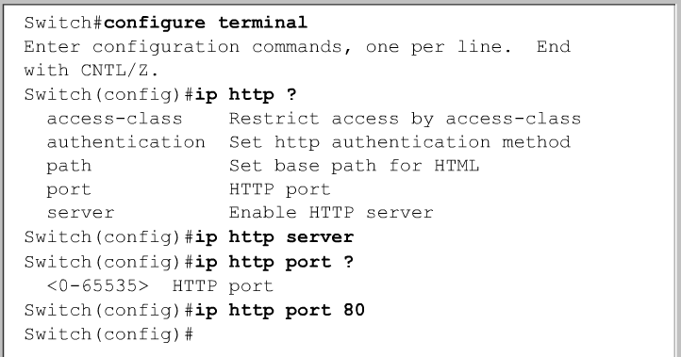
HTTP Service and Port
A web browser can access this service using the IP address and port 80, the default port for http.
The HTTP service can be turned on or off, and the port address for the service can be chosen.

Slide 30
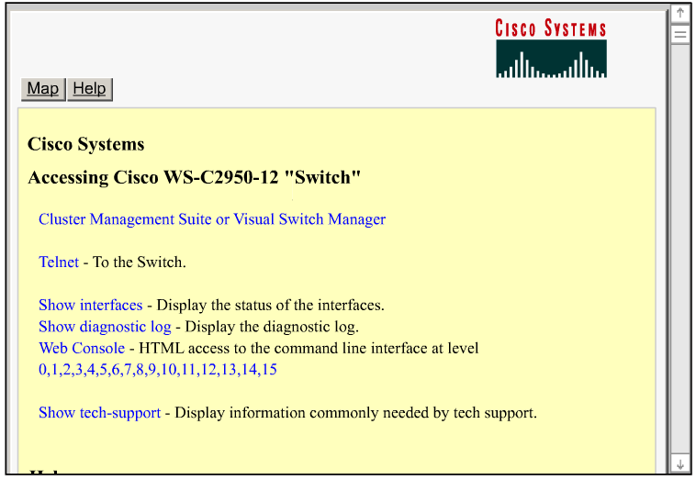
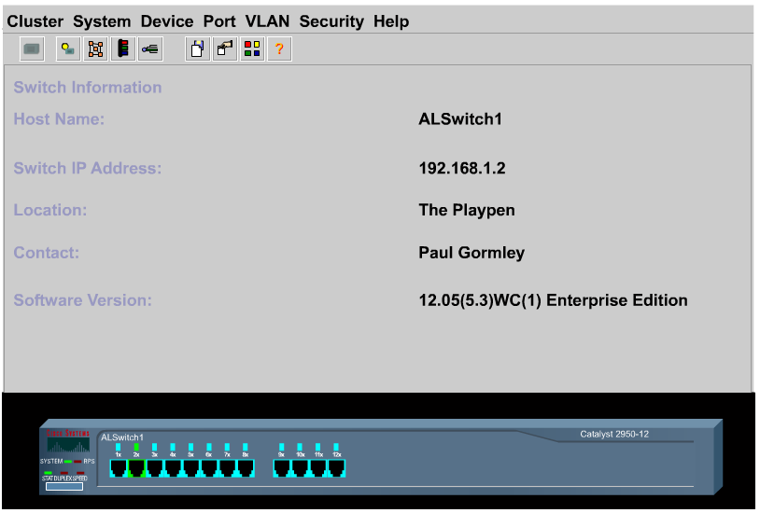
The GUI Interface

Slide 31
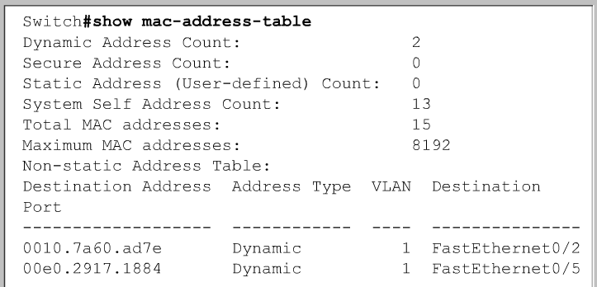
Managing the MAC address table
Switches learn the MAC addresses of PCs or workstations that are connected to their switch ports by examining the source address of frames that are received on that port.
Machines may have been removed from a port, turned off, or moved to another port on the same switch or a different switch.
This could cause confusion in frame forwarding.
The MAC address entry is automatically discarded or aged out after 300 seconds.

Slide 32
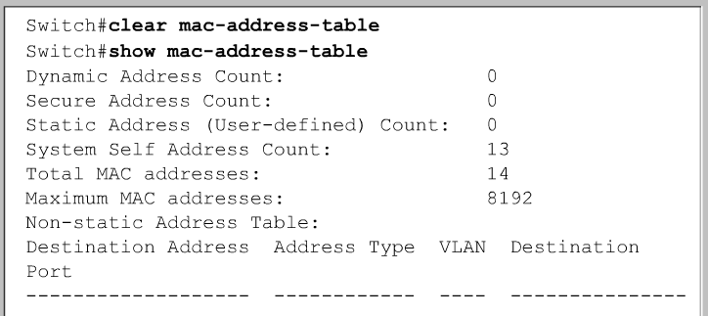
Managing the MAC address table
Rather than wait for a dynamic entry to age out, the administrator has the option to use the privileged EXEC command clear mac-address-table.

Slide 33
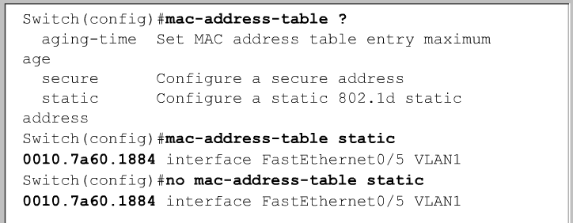
Configuring static MAC addresses
The reasons for assigning a permanent MAC address to an interface include:
The MAC address will not be aged out automatically by the switch.
A specific server or user workstation must be attached to the port and the MAC address is known.
If the device is moved on the switch, it will not be able to reached.
Security is enhanced.
To set a static MAC address entry for a switch:
Switch(config)#mac-address-table static <mac-address of host> interface FastEthernet <Ethernet numer> vlan

Slide 34
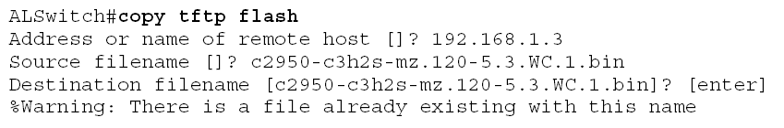
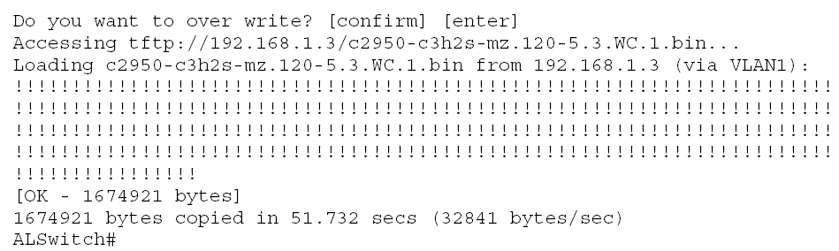
Copying IOS from TFTP Server

Slide 35
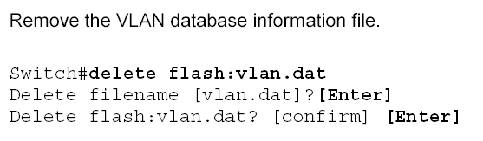

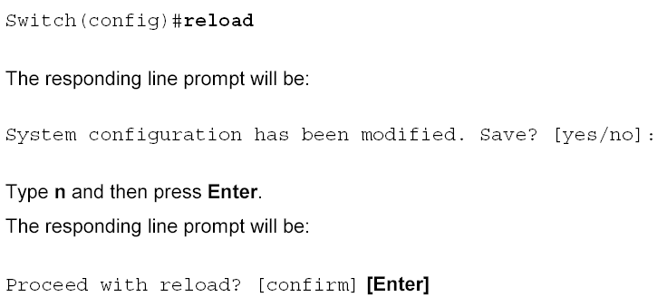
Erasing and Reloading the Switch

