Slide 1
VLANs (Virtual LANs)
CIS 83
Rick Graziani
Cabrillo College

Slide 2
Note to instructors
If you have downloaded this presentation from the Cisco Networking Academy Community FTP Center, this may not be my latest version of this PowerPoint.
For the latest PowerPoints for all my CCNA, CCNP, and Wireless classes, please go to my web site:
http://www.cabrillo.edu/~rgraziani/
    The username is cisco and the password is perlman for all of my materials.
If you have any questions on any of my materials or the curriculum, please feel free to email me at graziani@cabrillo.edu (I really don’t mind helping.) Also, if you run across any typos or errors in my presentations, please let me know.
I will add “(Updated – date)” next to each presentation on my web site that has been updated since these have been uploaded to the FTP center.
Thanks! Rick
Rick Graziani graziani@cabrillo.edu

Slide 3
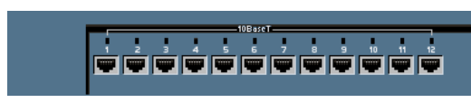
VLAN introduction
Default vlan 1
vlan 10
Default vlan 1
VLANs provide segmentation based on broadcast domains.
VLAN = Subnet
VLANs can logically segment switched networks based on:
  Physical location (Example: Building)
  Organization (Example: Marketing)
  Function (Example: Staff)
Rick Graziani graziani@cabrillo.edu

Slide 4
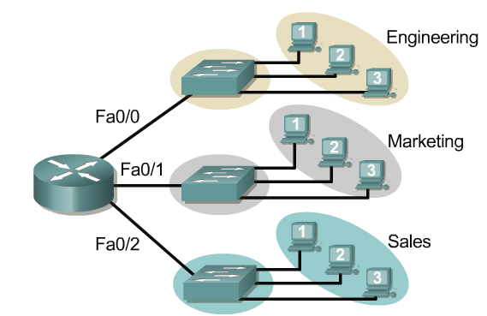
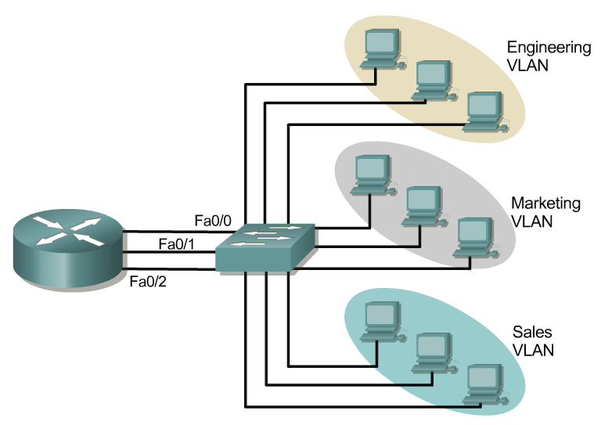
VLAN introduction
One link per VLAN or a single VLAN Trunk (later)
Without VLANs
10.1.0.0/16
10.1.0.0/16
With VLANs
10.2.0.0/16
10.2.0.0/16
10.3.0.0/16
10.3.0.0/16
VLANs are created to provide segmentation services traditionally provided by physical routers in LAN configurations.
VLANs address scalability, security, and network management.
Rick Graziani graziani@cabrillo.edu

Slide 5

Two Subnets, One Switch, No VLANs
10.1.0.10/16 DG: 10.1.0.1
10.2.0.20/16 DG: 10.2.0.1
10.1.0.30/16 DG: 10.1.0.1
10.2.0.40/16 DG: 10.2.0.1
Layer 2 Broadcasts
  What happens when 10.1.0.10 sends an ARP Request for 10.1.0.30?
Rick Graziani graziani@cabrillo.edu

Slide 6
Two Subnets, One Switch, No VLANs
10.1.0.10/16 DG: 10.1.0.1
10.2.0.20/16 DG: 10.2.0.1
10.1.0.30/16 DG: 10.1.0.1
10.2.0.40/16 DG: 10.2.0.1
Layer 2 Broadcasts
  Switch floods it out all ports.
  All hosts receive broadcast, even those on a different subnet.
  Layer 2 broadcast should be isolated to only that network.
  Note: If the switch supports VLANs, by default all ports belong to the same VLAN and it floods it out all ports that belong to the same VLAN as the incoming port (coming).
Rick Graziani graziani@cabrillo.edu

Slide 7
Two Subnets, One Switch, No VLANs
10.1.0.10/16 DG: 10.1.0.1
10.2.0.20/16 DG: 10.2.0.1
10.1.0.30/16 DG: 10.1.0.1
10.2.0.40/16 DG: 10.2.0.1
Layer 2 Unknown Unicasts
  This is the same for unknown unicasts.
Rick Graziani graziani@cabrillo.edu

Slide 8

Two Subnets, One Switch, No VLANs
Fa 0/0
Fa 0/1
10.1.0.1/16
10.2.0.1/16
10.1.0.10/16 DG: 10.1.0.1
10.2.0.20/16 DG: 10.2.0.1
10.1.0.30/16 DG: 10.1.0.1
10.2.0.40/16 DG: 10.2.0.1
Even though hosts are connected to the same switch (or even hub), devices on different subnets must communicate via a router.
Remember a switch is a layer 2 device, it forwards by examining Destination MAC addresses, not IP addresses.
Rick Graziani graziani@cabrillo.edu

Slide 9
Traditional Solution: Multiple Switches
Fa 0/0
Fa 0/1
10.1.0.1/16
10.2.0.1/16
ARP Request
10.1.0.10/16 DG: 10.1.0.1
10.1.0.30/16 DG: 10.1.0.1
10.2.0.20/16 DG: 10.2.0.1
10.2.0.40/16 DG: 10.2.0.1
The traditional solution is have devices on the same subnet connected to the same switch.
This provides broadcast and unknown unicast segmentation, but is also less scalable.
Rick Graziani graziani@cabrillo.edu

Slide 10
Broadcast domains with VLANs and routers
Port 1 VLAN 10
Port 4 VLAN 20
Port 9 VLAN 10
Port 12 VLAN 20
10.1.0.10/16 DG: 10.1.0.1
10.2.0.20/16 DG: 10.2.0.1
10.1.0.30/16 DG: 10.1.0.1
10.2.0.40/16 DG: 10.2.0.1
A VLAN is a broadcast domain created by one or more switches.
VLANs are assigned on the switch and correspond with the host IP address.
Each switch port can be assigned to a different VLAN.
Rick Graziani graziani@cabrillo.edu

Slide 11
Broadcast domains with VLANs and routers
Port 1 VLAN 10
Port 4 VLAN 20
Port 9 VLAN 10
Port 12 VLAN 20
ARP Request
10.1.0.10/16 DG: 10.1.0.1
10.2.0.20/16 DG: 10.2.0.1
10.1.0.30/16 DG: 10.1.0.1
10.2.0.40/16 DG: 10.2.0.1
Ports assigned to the same VLAN share the same broadcast domain.
Ports in different VLANs do not share the same broadcast domain.
Rick Graziani graziani@cabrillo.edu

Slide 12
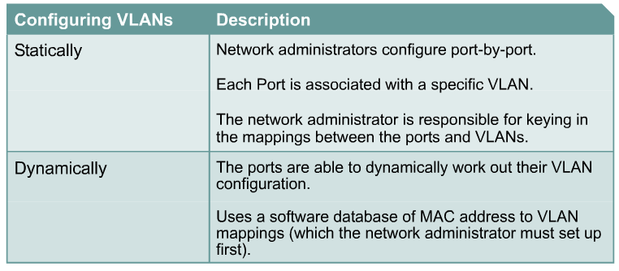
VLAN operation
Rick Graziani graziani@cabrillo.edu

Slide 13
Static VLANS
Default VLAN 1
Default VLAN 1
Switch(config)#interface fastethernet 0/9
Switch(config-if)#switchport access vlan 10
VLAN 10 Configured
Static membership VLANs are called port-based and port-centric membership VLANs.
This is the most common method of assigning ports to VLANs.
As a device enters the network, it automatically assumes the VLAN membership of the port to which it is attached.
There is a default VLAN, on Cisco switches that is VLAN 1.
Rick Graziani graziani@cabrillo.edu

Slide 14
VLAN operation
Port 1 VLAN 10
Port 4 VLAN 20
Port 9 VLAN 10
Port 12 VLAN 20
10.1.0.10/16 DG: 10.1.0.1
10.2.0.20/16 DG: 10.2.0.1
10.1.0.30/16 DG: 10.1.0.1
10.2.0.40/16 DG: 10.2.0.1
VLANs are assigned on the switch port.
In order for a host to be a part of that VLAN, it must be assigned an IP address that belongs to the proper subnet.
  Remember: VLAN = Subnet
Rick Graziani graziani@cabrillo.edu

Slide 15
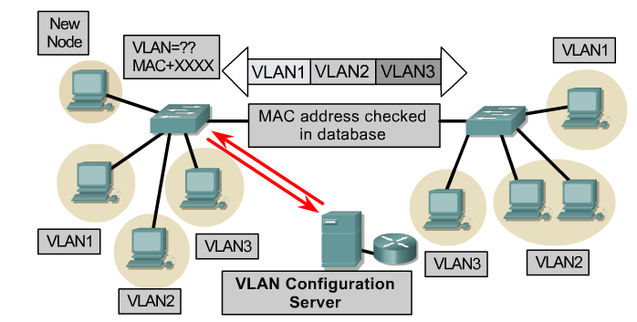
VLAN operation
Dynamic membership VLANs are created through network management software. (Not as common as static VLANs)
CiscoWorks 2000 or CiscoWorks for Switched Internetworks is used to create Dynamic VLANs.
Dynamic VLANs allow for membership based on the MAC address of the device connected to the switch port.
As a device enters the network, it queries a database within the switch for a VLAN membership.
Rick Graziani graziani@cabrillo.edu

Slide 16
Two Types of VLANs
.
End-to-End or Campus-wide VLANs
Geographic or Local VLANs
Rick Graziani graziani@cabrillo.edu

Slide 17
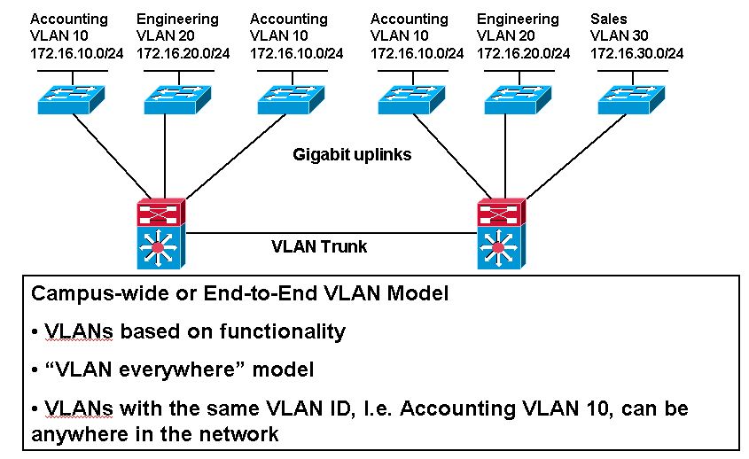
End-to-End or Campus-wide VLANs
This model is no longer recommended by Cisco and other vendors, unless there is a specific need for this method.
Rick Graziani graziani@cabrillo.edu

Slide 18
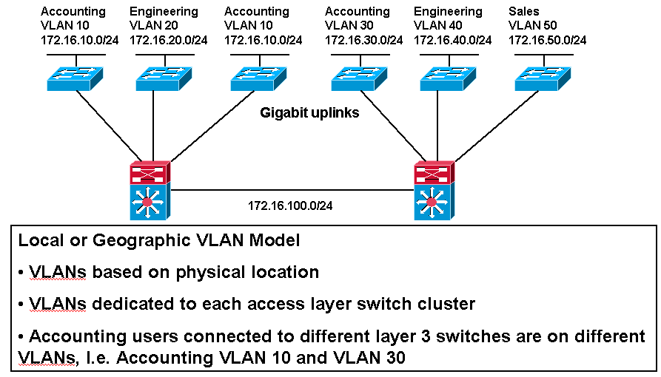
Geographic or Local VLANs
This model is the recommended method. More in CIS 187 (CCNP 3).
Rick Graziani graziani@cabrillo.edu

Slide 19
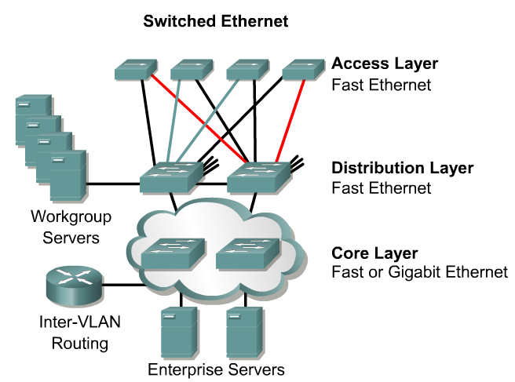
80/20 and 20/80 Rule
The network is engineered, based on traffic flow patterns, to have 80 percent of the traffic contained within a VLAN.
The remaining 20 percent crosses the router to the enterprise servers and to the Internet and WAN.
This is known as the 80/20 rule.
Note:
  With today’s traffic patterns, this rule is becoming obsolete.
  The 20/80 rule applies to many of today’s networks, with 20% of the traffic within a VLAN, and 80% outside the VLAN.
Rick Graziani graziani@cabrillo.edu

Slide 20

Geographic or Local VLANs
As many corporate networks have moved to centralize their resources, end-to-end VLANs have become more difficult to maintain.
Users are required to use many different resources, many of which are no longer in their VLAN.
Because of this shift in placement and usage of resources, VLANs are now more frequently being created around geographic boundaries rather than commonality boundaries.
Rick Graziani graziani@cabrillo.edu

Slide 21
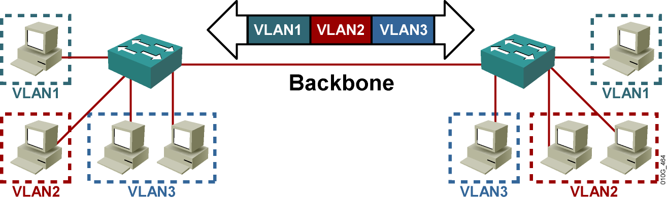
Quick Introduction to Trunking
More in the next presentation.
Rick Graziani graziani@cabrillo.edu

Slide 22
VLAN Trunking/Tagging
VLAN Tagging is used when a link needs to carry traffic for more than one VLAN.
Trunk link: As packets are received by the switch from any attached end-station device, a unique packet identifier is added within each header.
This header information designates the VLAN membership of each packet.
Rick Graziani graziani@cabrillo.edu

Slide 23
VLAN Trunking/Tagging
The packet is then forwarded to the appropriate switches or routers based on the VLAN identifier and MAC address.
Upon reaching the destination node (Switch) the VLAN ID is removed from the packet by the adjacent switch and forwarded to the attached device.
Packet tagging provides a mechanism for controlling the flow of broadcasts and applications while not interfering with the network and applications.
This is known as a trunk link or VLAN trunking.
Rick Graziani graziani@cabrillo.edu

Slide 24
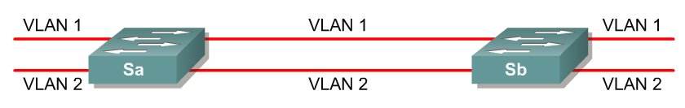
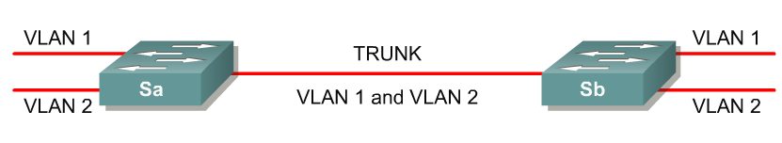
VLAN Trunking/Tagging
No VLAN Tagging
VLAN Tagging
VLAN Tagging is used when a single link needs to carry traffic for more than one VLAN.
Rick Graziani graziani@cabrillo.edu

Slide 25
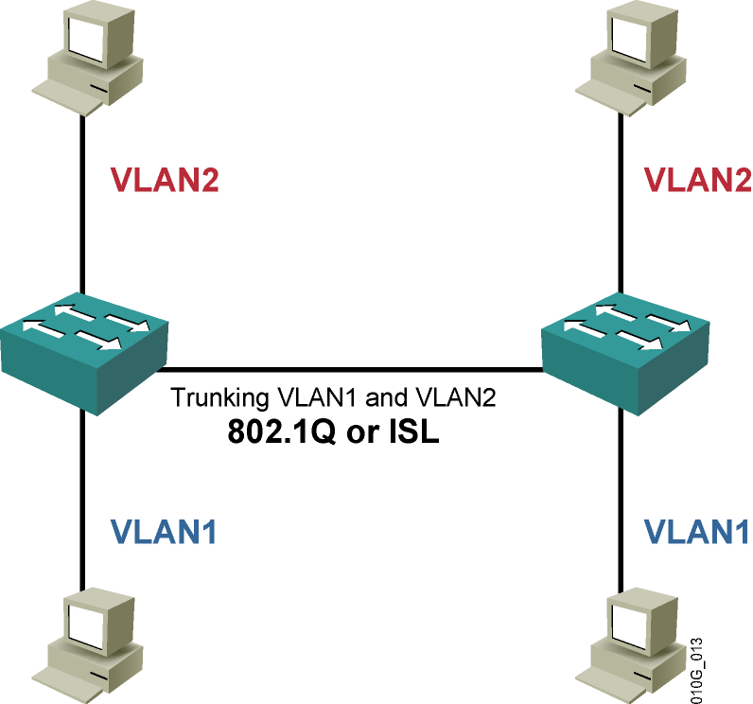
VLAN Trunking/Tagging
There are two major methods of frame tagging, Cisco proprietary Inter-Switch Link (ISL) and IEEE 802.1Q.
ISL used to be the most common, but is now being replaced by 802.1Q frame tagging.
Cisco recommends using 802.1Q.
VLAN Tagging and Trunking will be discussed in the next chapter.
Rick Graziani graziani@cabrillo.edu

Slide 26
Configuring VLANs
Default vlan 1
vlan 10
Default vlan 1
Rick Graziani graziani@cabrillo.edu

Slide 27
Configuring static VLANs
The following guidelines must be followed when configuring VLANs on Cisco 29xx switches:
  The maximum number of VLANs is switch dependent.
    29xx switches commonly allow 4,095 VLANs
  VLAN 1 is one of the factory-default VLANs.
  VLAN 1 is the default Ethernet VLAN.
  Cisco Discovery Protocol (CDP) and VLAN Trunking Protocol (VTP) advertisements are sent on VLAN 1. (later)
  The Catalyst 29xx IP address is in the VLAN 1 broadcast domain by default.
Rick Graziani graziani@cabrillo.edu

Slide 28
Creating VLANs
.
Assigning access ports (non-trunk ports) to a specific VLAN
  Switch(config)#interface fastethernet 0/9
  Switch(config-if)#switchport access vlan vlan_number
  Switch(config-if)#switchport mode access
Create the VLAN: (This step is not required and will be discussed later.)
  Switch#vlan database
  Switch(vlan)#vlan vlan_number
  Switch(vlan)#exit
Rick Graziani graziani@cabrillo.edu

Slide 29
Creating VLANs
.
Default vlan 1
vlan 10
Default vlan 1
Assign ports to the VLAN
  Switch(config)#interface fastethernet 0/9
  Switch(config-if)#switchport access vlan 10
  Switch(config-if)#switchport mode access
access – Denotes this port as an access port and not a trunk link (later)
Rick Graziani graziani@cabrillo.edu

Slide 30
Creating VLANs
Default vlan 1
vlan 300
Default vlan 1
Switch(config)#interface fastethernet 0/9
Switch(config-if)#switchport access vlan 300
Switch(config-if)#switchport mode access
Rick Graziani graziani@cabrillo.edu

Slide 31
Configuring Ranges of VLANs
vlan 2
Switch(config)#interface fastethernet 0/5
Switch(config-if)#switchport access vlan 2
Switch(config-if)#switchport mode access
Switch(config-if)#exit
Switch(config)#interface fastethernet 0/6
Switch(config-if)#switchport access vlan 2
Switch(config-if)#switchport mode access
Switch(config-if)#exit
Switch(config)#interface fastethernet 0/7
Switch(config-if)#switchport access vlan 2
Switch(config-if)#switchport mode access
Rick Graziani graziani@cabrillo.edu

Slide 32
Configuring Ranges of VLANs
.
vlan 3
Switch(config)#interface range fastethernet 0/8 - 12
Switch(config-if)#switchport access vlan 3
Switch(config-if)#switchport mode access
Switch(config-if)#exit
This command does not work on all 2900 switches, such as the 2900 Series XL.
This format of this command may vary somewhat on various 2900 switches.
It does work on the 2950.
Rick Graziani graziani@cabrillo.edu

Slide 33
Creating VLANs
.
Default vlan 1
vlan 300
Default vlan 1
SydneySwitch(config)#interface fastethernet 0/1
SydneySwitch(config-if)#switchport mode access
SydneySwitch(config-if)#exit
Note: The switchport mode access command should be configured on all ports that the network administrator does not want to become a trunk port.
This will be discussed in more in the next chapter, section on DTP.
Rick Graziani graziani@cabrillo.edu

Slide 34
Creating VLANs
Default: dynamic desirable
This link will become a trunking link unless one of the ports is configured with as an access link, I.e. switchport mode access
By default, all ports are configured as switchport mode dynamic desirable, which means that if the port is connected to another switch with an port configured with the same default mode (or desirable or auto), this link will become a trunking link. (See my article on DTP on my web site for more information.)
Both the switchport access vlan command and the switchport mode access command are recommended. (later)
This will be discussed in more in the next chapter, section on DTP.
Rick Graziani graziani@cabrillo.edu

Slide 35
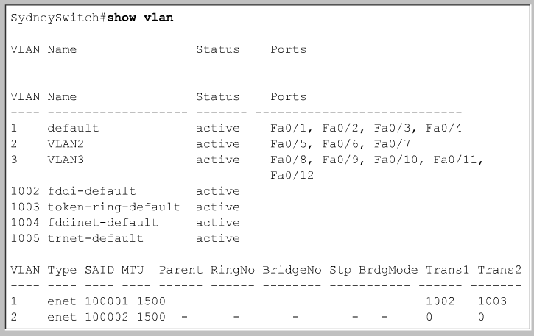
Verifying VLANs – show vlan
vlan 1 default
vlan 2
vlan 3
Rick Graziani graziani@cabrillo.edu

Slide 36
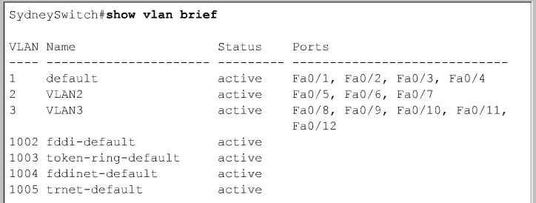
Verifying VLANs – show vlan brief
vlan 1 default
vlan 2
vlan 3
Rick Graziani graziani@cabrillo.edu

Slide 37
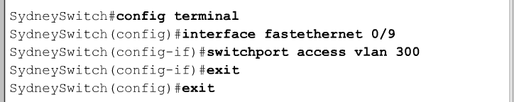
Deleting VLANs
Switch(config-if)#no switchport access vlan vlan_number
This command will reset the interface to VLAN 1.
VLAN 1 cannot be removed from the switch.
Rick Graziani graziani@cabrillo.edu

Slide 38
Accessing/Managing the Switch
Switch(config)#interface vlan 1
Switch(config-if)#ip address 10.1.0.5. 255.255.0.0
Switch(config-if)#no shutdown
Switch(config-if)#exit
Switch(config)#ip default-gateway 10.1.0.1
The IP Address, Subnet Mask, and Default Gateway on a switch is for the same purposes as when you configure it for a host.
Note: The switch must be configured with a vty login/password and a privileged password for telnet access.
IP Address and Subnet Mask
By default, VLAN 1 is the “management VLAN”.
This is where you assign the IP Address and Subnet Mask to the switch.
This address is for management purposes only and does not affect the Layer 2 switching operations of the switch.
The address allows you the ability to ping the switch or telnet into the switch.
Default Gateway
The default gateway is also used for management purposes.
Once you are telnetted into the switch, if you need to ping or telnet into a device on another network, the default-gateway is where those frames will be sent.
Rick Graziani graziani@cabrillo.edu

Slide 39
Accessing/Managing the Switch
Switch(config)# enable secret class
Switch(config)#line vty 0 4
Switch(config-line)#password cisco
Switch(config-line)#login
Switch(config)#inter vlan 1
Switch(config-if)#ip add 10.1.0.5. 255.255.0.0
Switch(config-if)#no shut
Switch(config)#ip default-gateway 10.1.0.1
Rick Graziani graziani@cabrillo.edu

Slide 40
Accessing/Managing the Switch
10.1.0.5/16 DG: 10.1.0.1
Fa 0/0
Fa 0/1
10.1.0.1/16
10.2.0.1/16
10.1.0.10/16 DG: 10.1.0.1
10.1.0.30/16 DG: 10.1.0.1
10.2.0.20/16 DG: 10.2.0.1
10.2.0.40/16 DG: 10.2.0.1
Host
C:\>telnet 10.1.0.1
username:cisco
password:class
Switch>show vlan
Switch>ping 10.2.0.20
Switch>telnet 10.1.0.1
Switch>exit
Rick Graziani graziani@cabrillo.edu

Slide 41
Erasing VLAN information
Switch#delete flash:vlan.dat
Delete filename [vlan.dat]?
Delete flash:vlan.dat? [confirm]
Switch#erase startup-config
Switch#reload
VLAN information is kept in the vlan.dat file.
The file is not erased when erasing the startup-config.
To remove all VLAN information, use the command above and reload the switch.
Rick Graziani graziani@cabrillo.edu

