Slide 1
InterVLAN

Slide 2
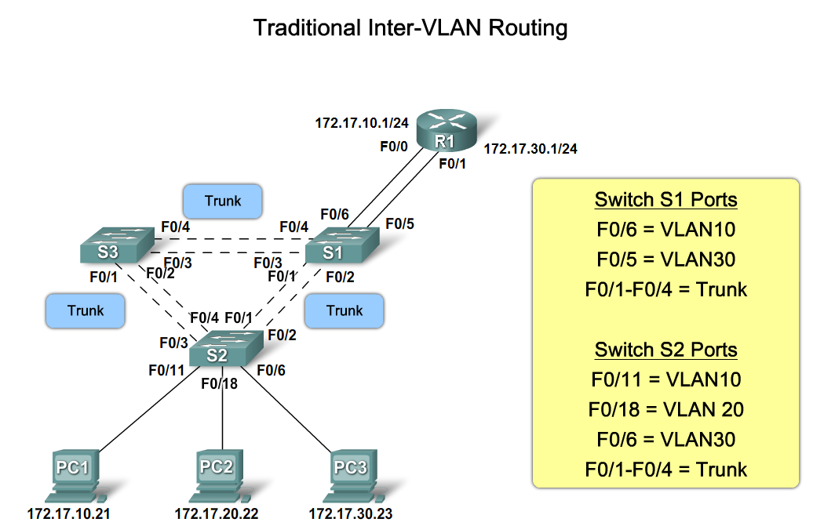

Slide 3
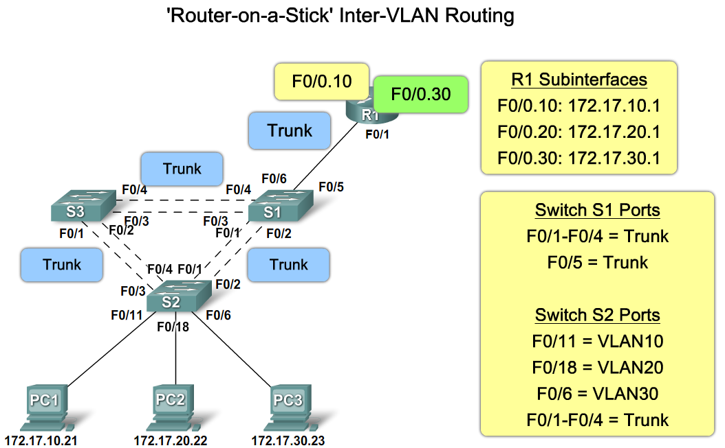

Slide 4
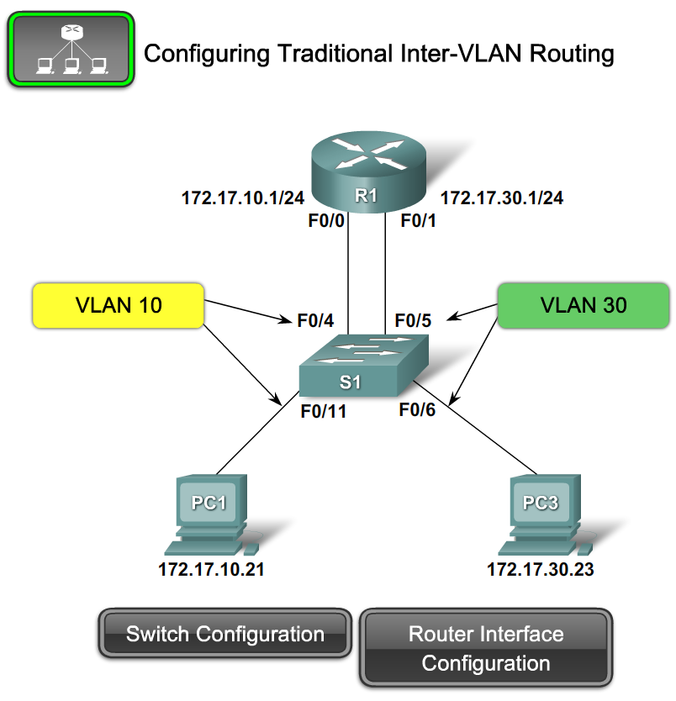
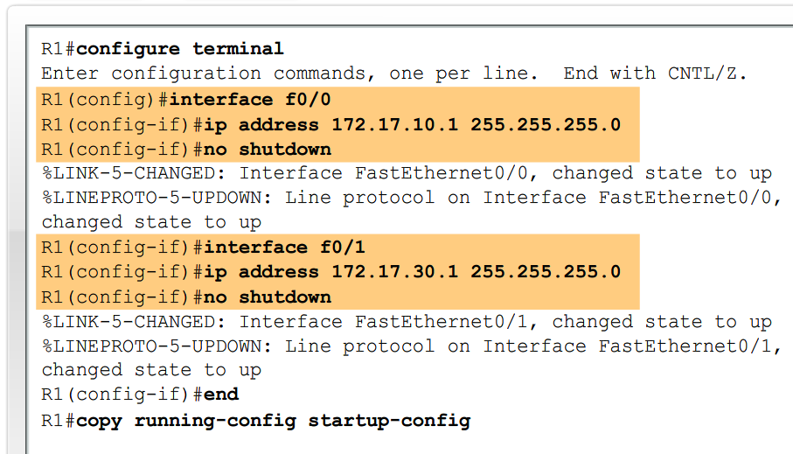
Configure Inter-VLAN Routing
configure inter-VLAN routing

Slide 5
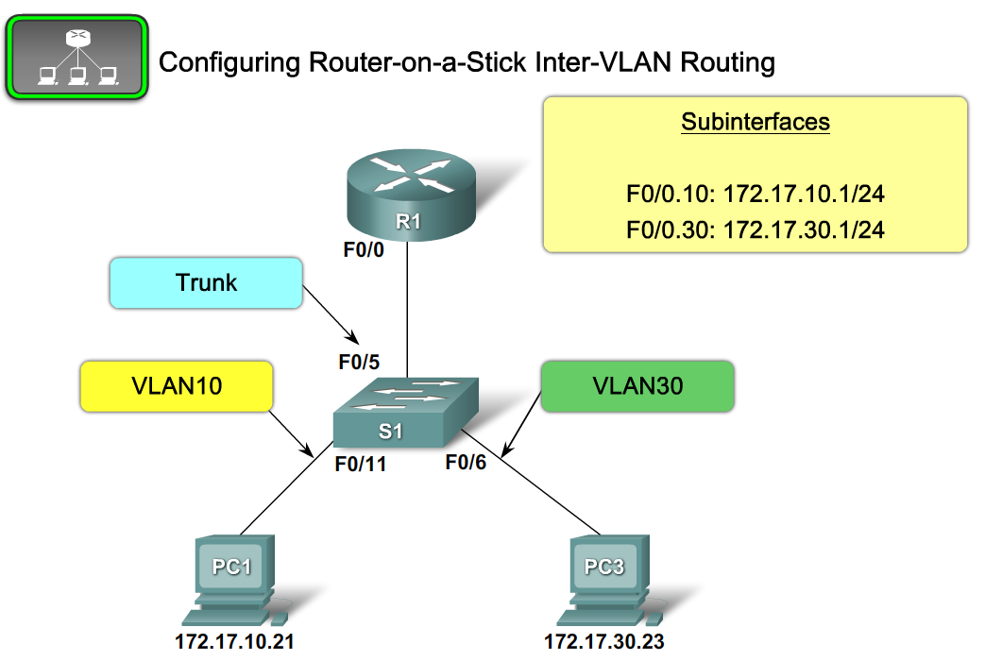
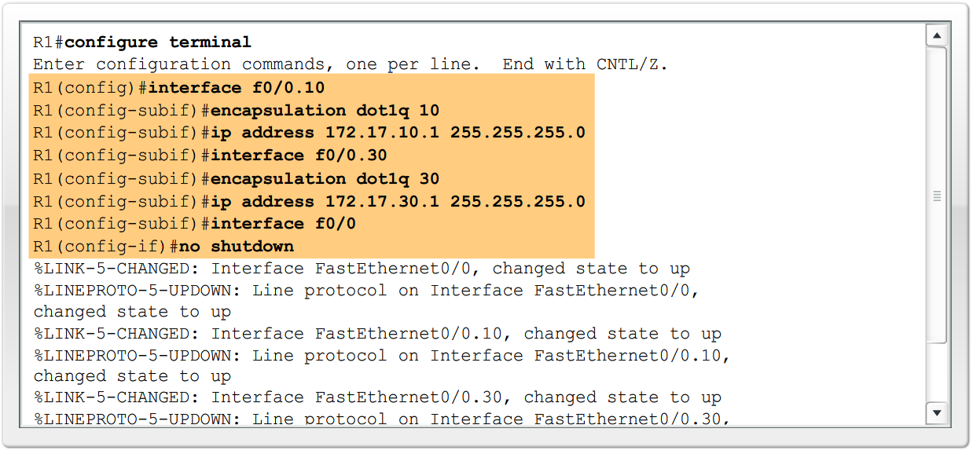
Configure Inter-VLAN Routing
the steps to configure inter-VLAN routing

Slide 6
Inter VLAN
S1 (S2#, S3#) # conf t
S1# ip default-gateway 172.17.99.1
S1# ip http server
VTP
#vtp mode server
#vtp domain test
#vtp password cisco

Slide 7
Inter VLAN
port 할당
# int range fa0/1-5
#sw mode trunk
#sw trunk native vlan 99
# int range fa0/6-10
#sw mode access vlan 30
VLAN 생성
#vlan 99
#name management
관리 인터페이스 주소 할당
#int vlan 99
#ip add 172.17.99.11 255.255.255.0
#no shutdown

Slide 8
Inter VLAN
Router
# int fa0/1
#no sh
#int fa 0/1.1
#encap dot1q 1
#ip add 172.17.1.1 255.255.255.0
#int fa0/1.10
#encap dot1q 10
#ip add 172.17.10.1 255.255.255.0
#int fa0/1.99
#encap dot1q 99 native
#ip add 172.17.99.1 255.255.255.0

Slide 9
Summary
Router on a stick
this is an inter-VLAN routing topology that uses router sub interfaces connected to a layer 2 switch.
Each Subinterface must be configured with:
An IP address
Associated VLAN number
Configuration of inter VLAN routing
Configure switch ports connected to router with correct VLAN
Configure each router subinterface with the correct IP address & VLAN ID
Verify configuration on switch and router

