Slide 1
Implement Spanning Tree Protocols
LAN Switching

Slide 2
Objectives
Explain the role of redundancy in a converged network
Summarize how STP works to eliminate Layer 2 loops in a converged network
Explain how the STP algorithm uses three steps to converge on a loop-free topology
Implement rapid per VLAN spanning tree (rapid PVST+) in a LAN to prevent loops between redundant switches.

Slide 3
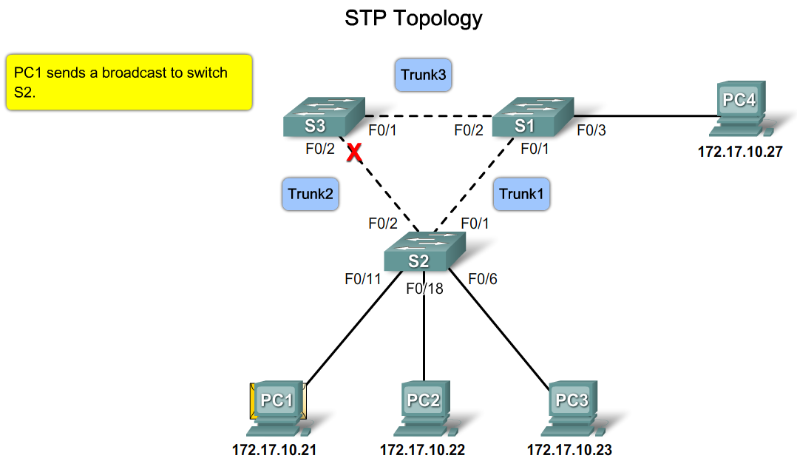
Explain how Layer 2 loops occur in well managed networks

Slide 4
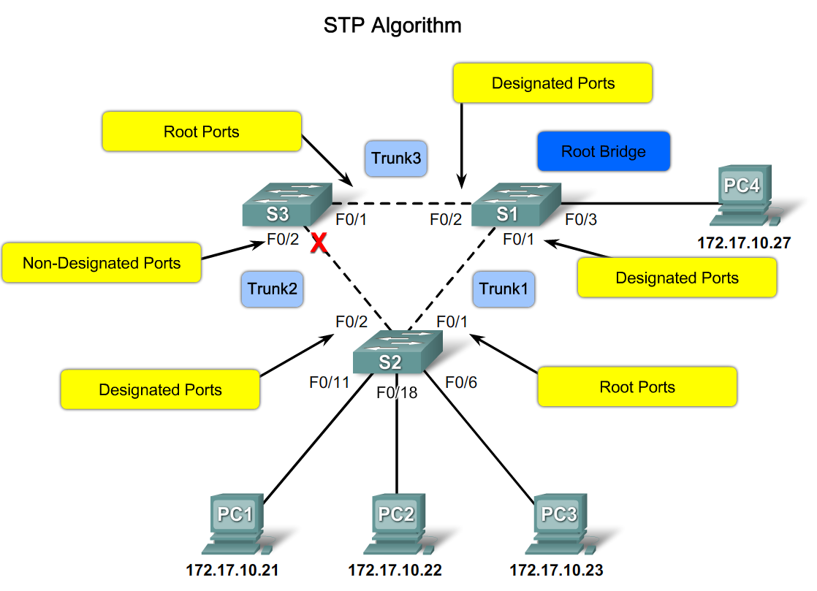
Summarize How STP works to Eliminate Layer 2 Loops in a Converged Network
Describe the STP algorithm

Slide 5
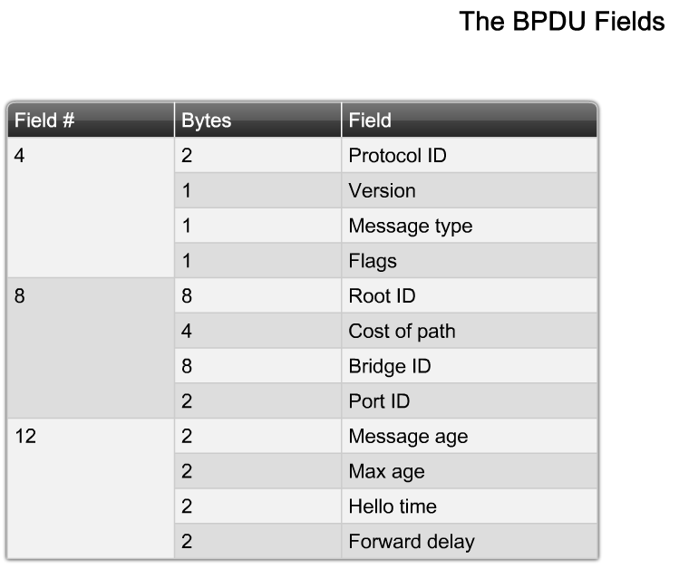

Slide 6
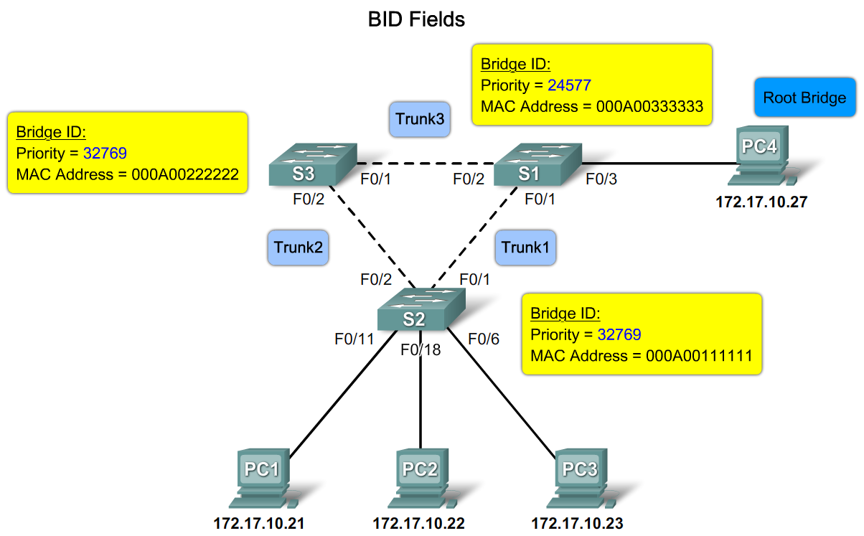
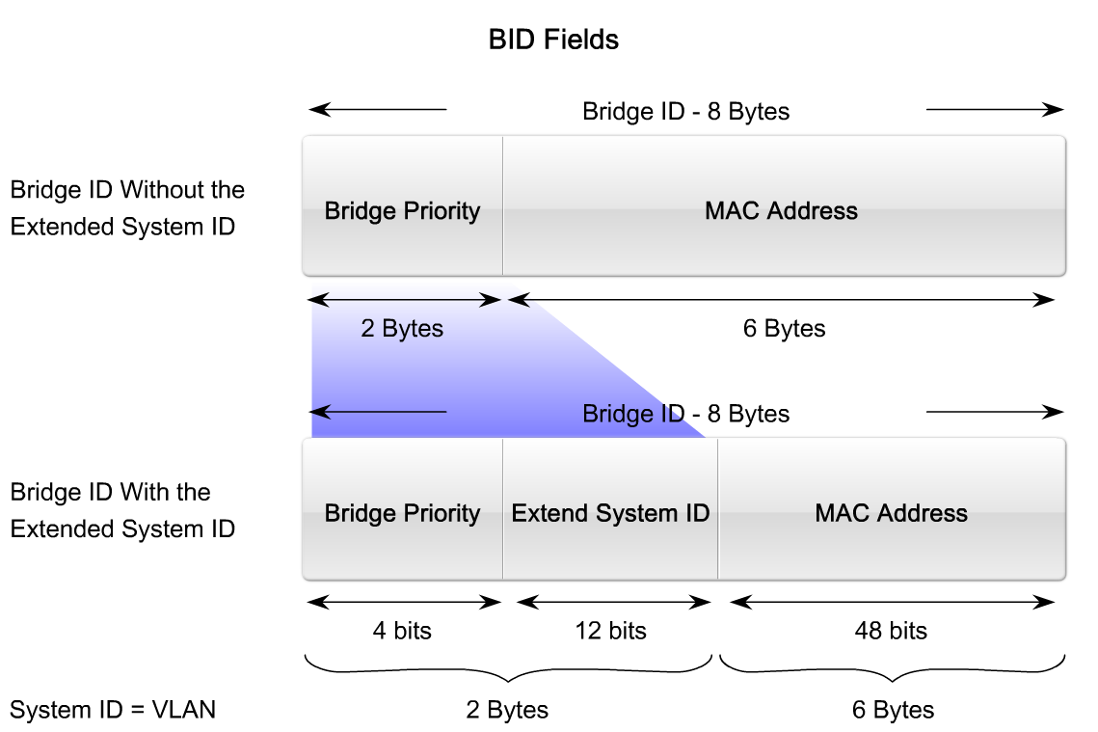

Slide 7
Extended System-id
  the consumption of MAC addresses this way was simply too large and ineffective. At the same time, having 65536 different values for priority in the BID was largely useless. So IEEE came with the idea of Extended System ID in which they reused a part of the priority field for a unique instance identifier. In Cisco's implementation, this field is populated with the VLAN number the STP/RSTP instance runs in. This easily and effectively makes the BID unique - even with the same priority for all VLANs on a single switch, and a single switch MAC address, multiple STP/RSTP instances running on this same switch with the same priority have different BIDs thanks to different VLAN numbers embedded into the BID.
  spanning-tree extend system-id

Slide 8
RSTP (Rapid Spanning Tree Protocol)
STP
  BPDU(Bridge Protocol Data Unit)
  BID(8byte) = Bridge priority(2byte) + Mac Address(6byte)
  Bridge priority= 32768 (= 0x8000)
  전달 지연 시간 (30초) = listening (15ch) + learning(15초)
RSTP
  Listening에서 Fowarding까지 2초 = 빠르다
  Learning 과정 없음

Slide 9
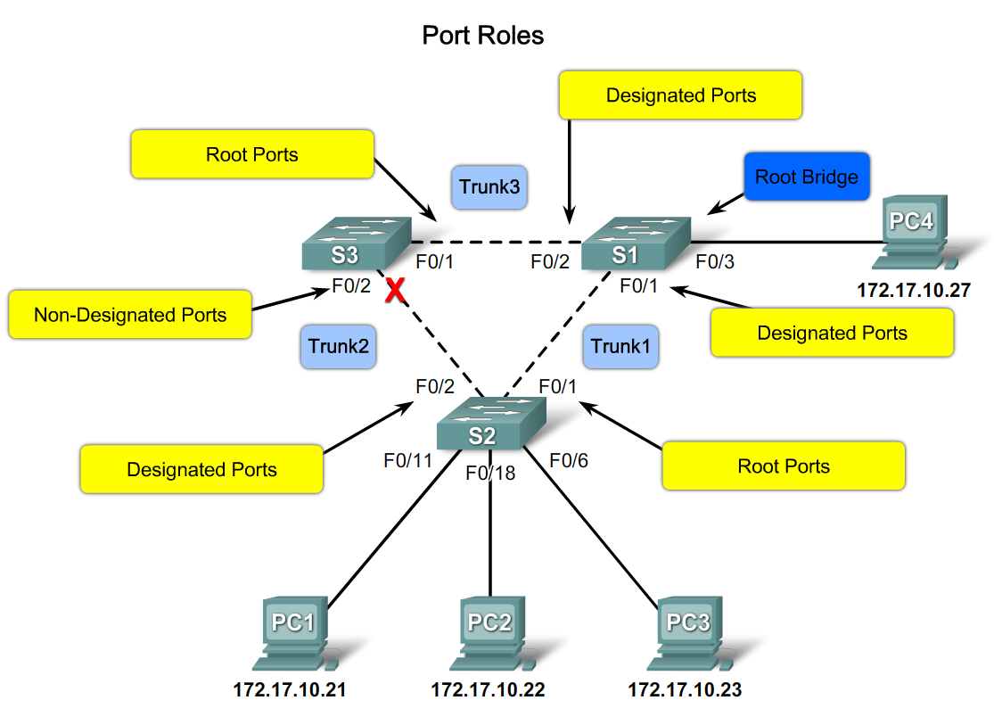
Describe the how port roles support the operation of STP

Slide 10
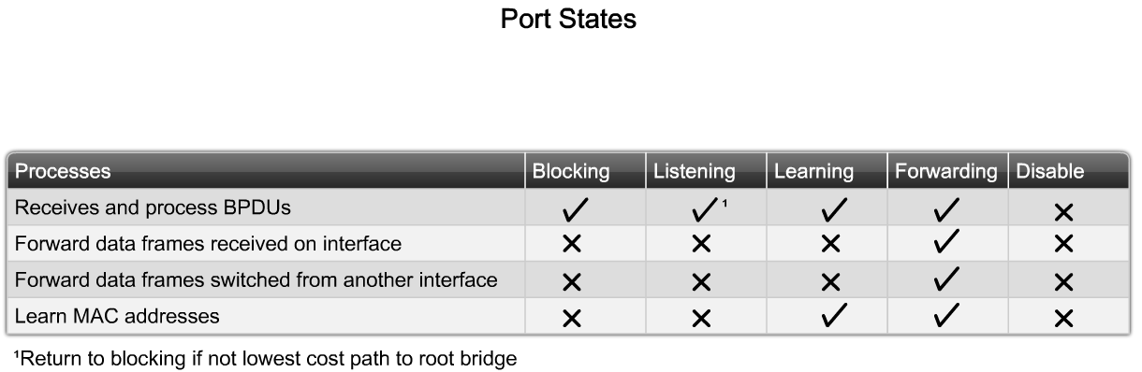
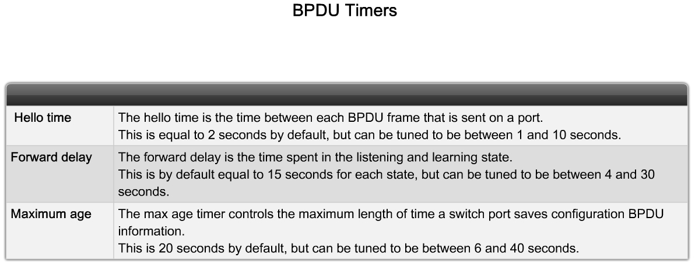
Summarize How STP works to Eliminate Layer 2 Loops in a Converged Network
Describe the role of STP port states and BPDU timers in the operation of STP

Slide 11
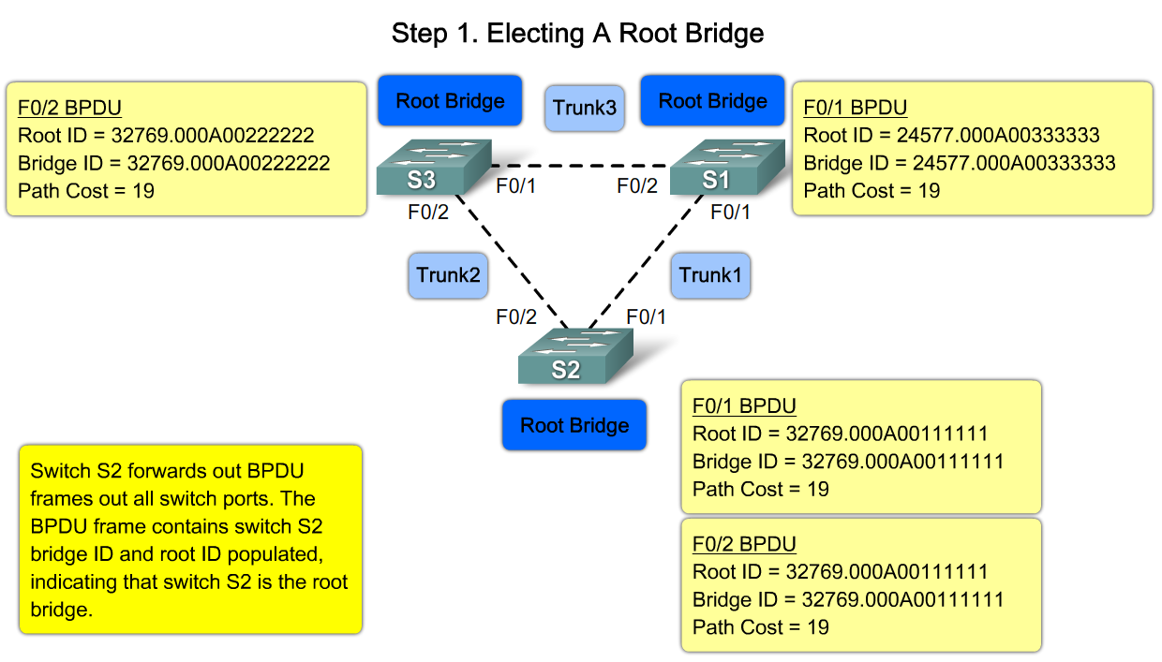

Slide 12
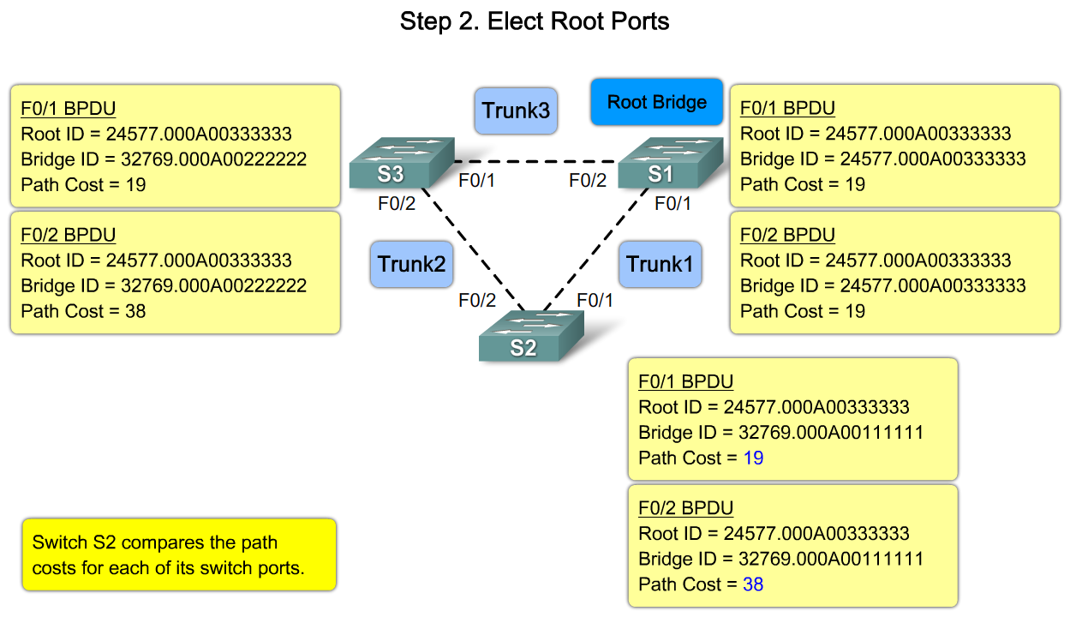
Describe the process of electing a root port on a switch

Slide 13
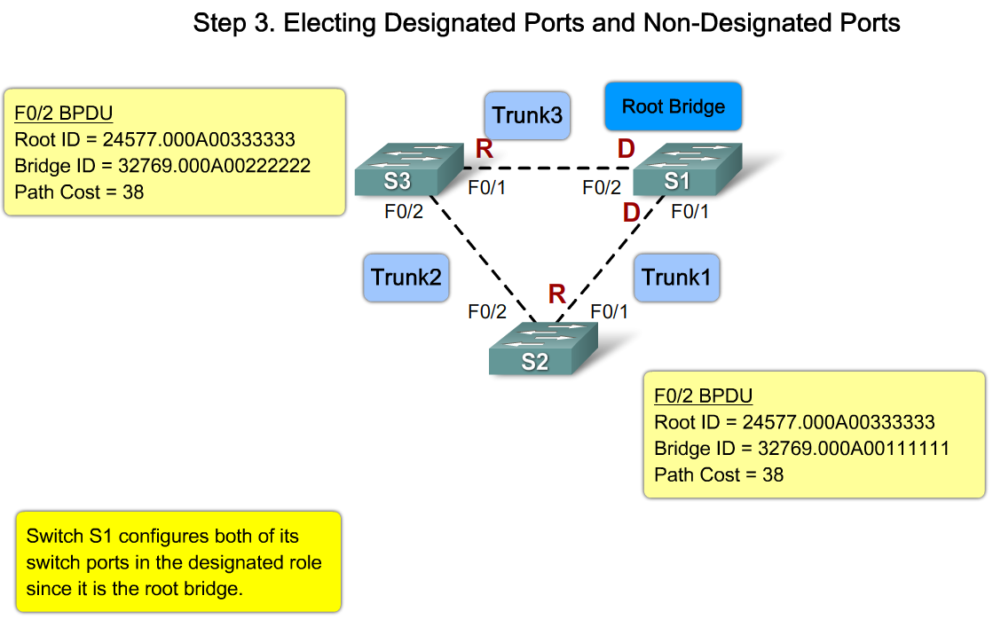
Describe the process of electing designated ports and non-designated ports on a switch

Slide 14
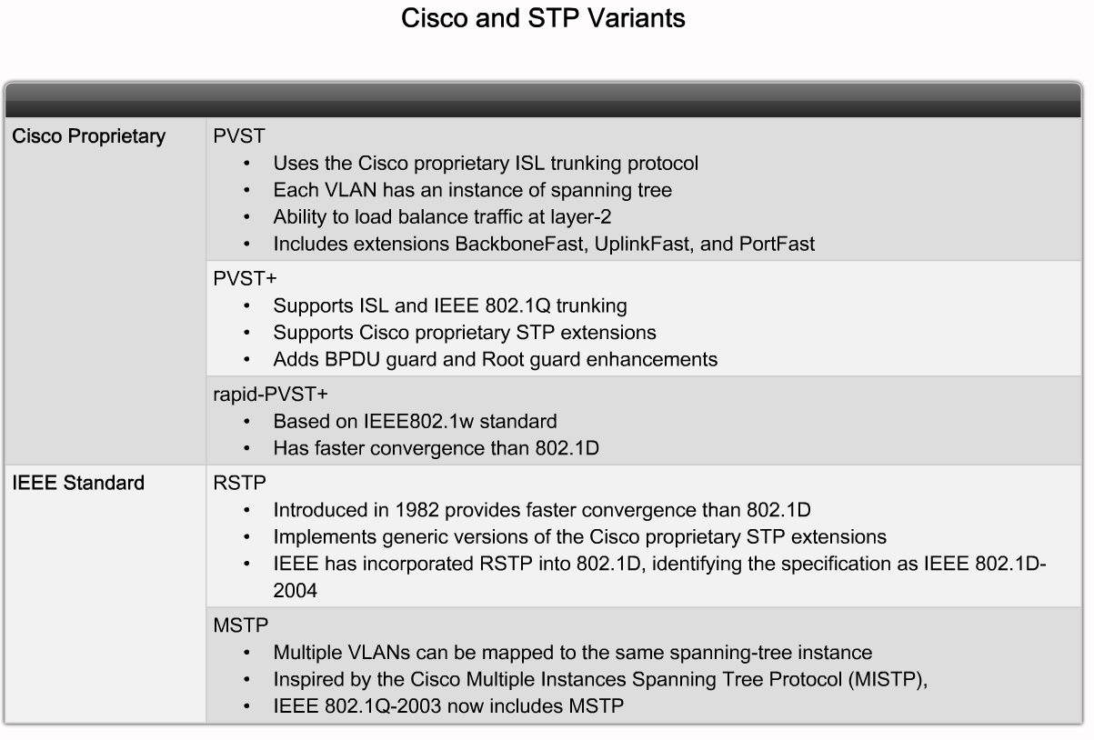
Implement Rapid per VLAN Spanning Tree (rapid PVST+) in a LAN
Summarize the features of the PVST+, RSTP and rapid PVST+ variants of STP

Slide 15
Summary
Spanning Tree Protocol (STP) is used to prevent loops from being formed on redundant networks
STP uses different port states & timers to logically prevent loops
There is at least one switch in a network that serves as the root bridge
  Root bridge is elected using information found in BPDU frames
Root ports are determined by the spanning tree algorithm and are closest to the root bridge

