Slide 1
SubString question
  s.substring(i, j) returns: ???
  first j characters of s starting at index i
  first j-1 characters of s starting at index i
  s starting at index i and ending at j
  s starting at index i and ending at j-1

Slide 2
object and classes and Strings
  What's the difference between =, ==, and equals?
  How can I check whether a string s is the empty string?
  Is there a difference between the empty string and null?
  if the following legal? s.trim().toLowerCase().equals("saturday")

Slide 3
object and classes and Strings
  data types
  primitive types vs. reference types.
  primitive types in Java: boolean, char, byte, short, int, long, float, and double
  arrays are object
  call by value

Slide 4
int compareTo(String anotherString)
  let k be the smallest such index; then the string whose character at position k has the smaller value, as determined by using the < operator, lexicographically precedes the other string.
  this.charAt(k)-anotherString.charAt(k)
  if there no such index
  this.length()-anotherString.length()
  returns: integer

Slide 5
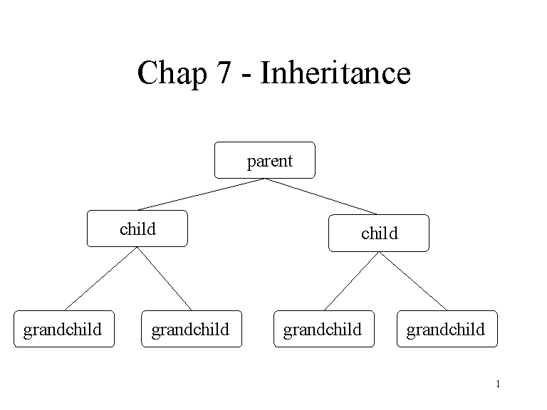

Slide 6
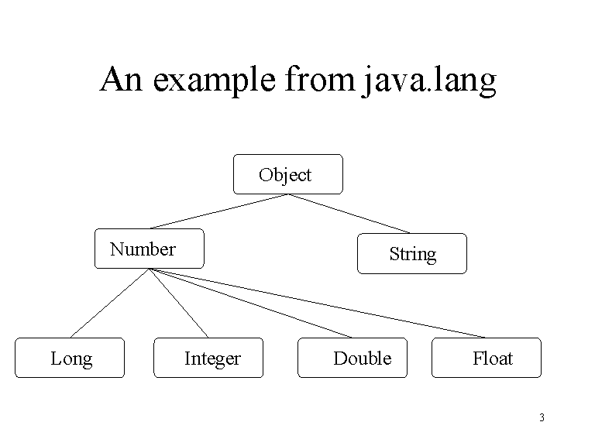

Slide 7
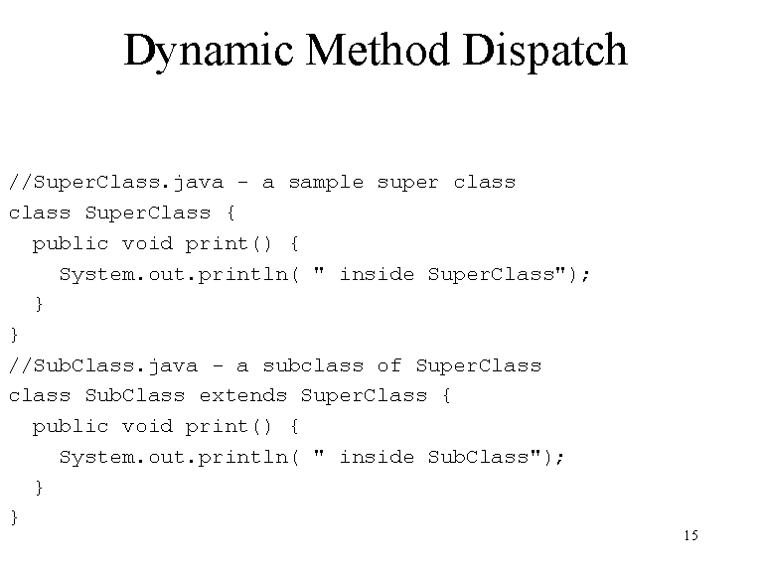

Slide 8
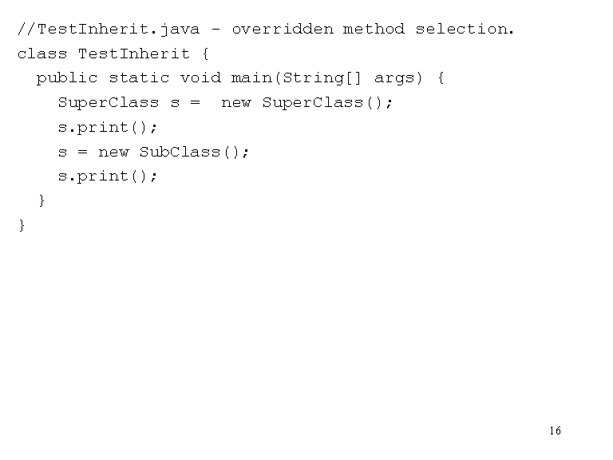

Slide 9
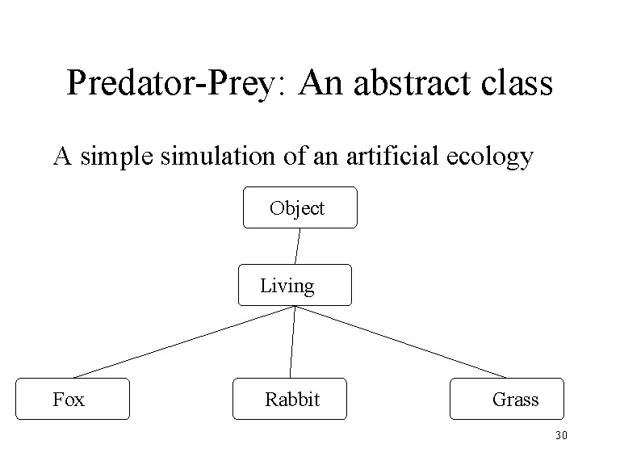

Slide 10
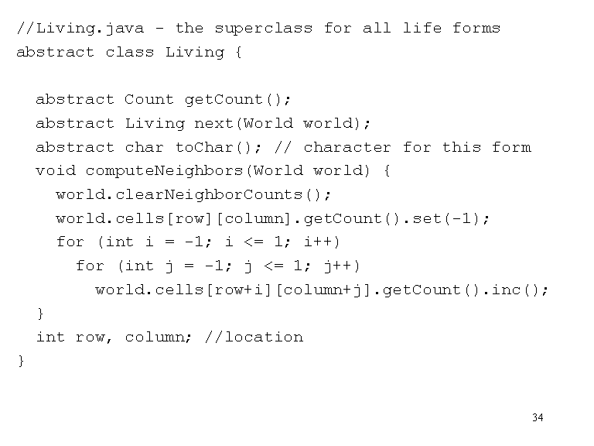

Slide 11
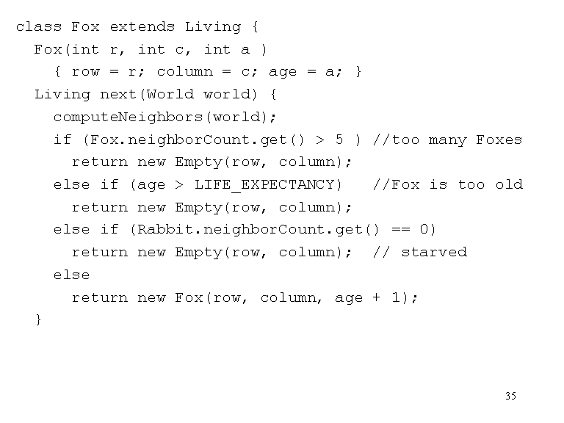
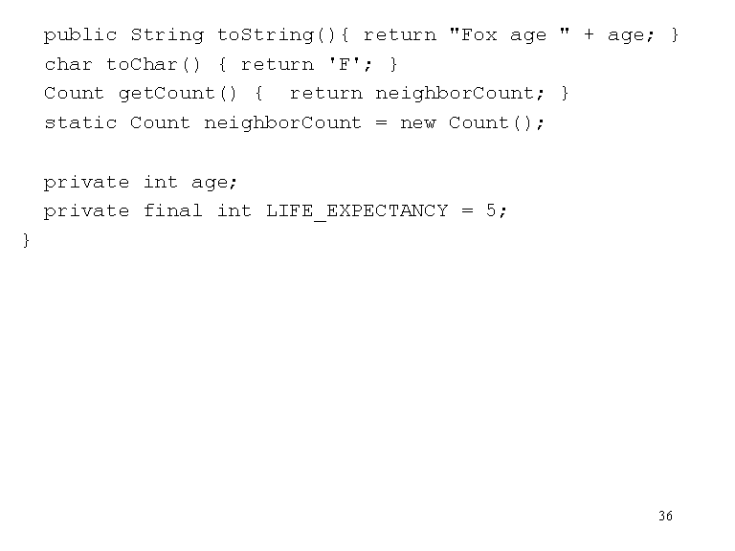

Slide 12
