Slide 1
OMET

Slide 2
Wrapper Classes
classes that wrap up primitive values in classes that offer utility methods to manipulate the values
they also offer utility methods for converting to and from the int values they represent
once assigned a value, the value of a wrapper class cannot be changed

Slide 3
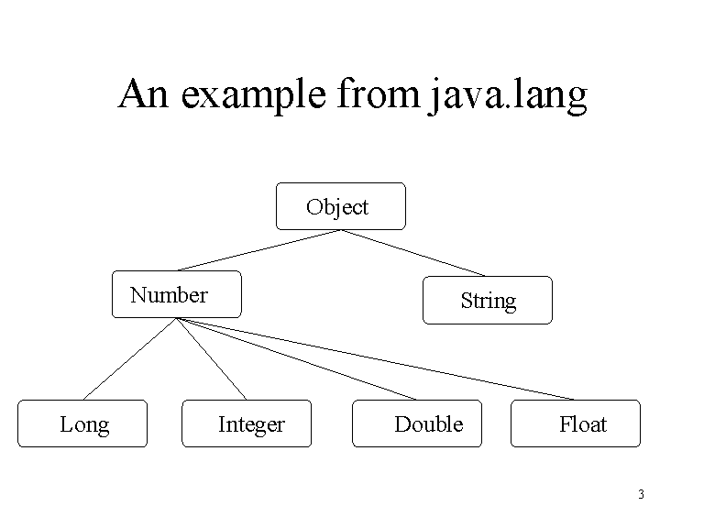
Wrapper Classes

Slide 4
Wrapper Classes
book p. 247:
static Number elementMin(Number[] array) {
    Number min = array[0];
    for (int i=1; i<array.length; i++)
      if (array[i].doubleValue < min.doubleValue)
        min = array[i];
    return min;
    }
test yourself: http://www.jchq.net/certkey/0803certkey.htm

Slide 5
Objects
primitive vs. reference type
static vs. instance
abstract vs. concrete vs. interface

Slide 6
The static keyword
Java methods and variables can be declared static
These exist independent of any object
This means that a Class’s
  static methods can be called even if no objects of that class have been created and
  static data is “shared” by all instances (i.e., one value per class instead of one per instance
  http://www.csee.umbc.edu/~nicholas/331/webFa01/lectures/
class StaticTest {static int i = 47;}
StaticTest st1 = new StaticTest();
StaticTest st2 = new StaticTest();
// st1.i == st2.I == 47
StaticTest.i++; // or st1.I++ or st2.I++
// st1.i == st2.I == 48

Slide 7
Static vs. instance
import java.util.Date;
class DateApp {
public static void main(String args[]) {
Date today = new Date();
System.out.println(today);
}
}

Slide 8
Abstract classes and methods
Abstract vs. concrete classes
Abstract classes can not be instantiated
  public abstract class shape { }
An abstract method is a method w/o a body
  public abstract double area();
(Only) Abstract classes can have abstract methods
In fact, any class with an abstract method is automatically an abstract class

Slide 9
Example abstract class
public abstract class Shape {
public abstract double area(); // Abstract methods: note
public abstract double circumference();// semicolon instead of body.
}
class Circle extends Shape {
public static final double PI = 3.14159265358979323846;
protected double r; // Instance data
public Circle(double r) { this.r = r; } // Constructor
public double getRadius() { return r; } // Accessor
public double area() { return PI*r*r; } // Implementations of
public double circumference() { return 2*PI*r; } // abstract methods.
}
class Rectangle extends Shape {
protected double w, h; // Instance data
public Rectangle(double w, double h) { // Constructor
this.w = w; this.h = h;
}
public double getWidth() { return w; } // Accessor method
public double getHeight() { return h; } // Another accessor
public double area() { return w*h; } // Implementations of
public double circumference() { return 2*(w + h); } // abstract methods.
}

