Slide 1
Small decoder-only transformers
ENG and SRB corpora · comparing tokenization, architecture and training
d_model 256 · 4 heads · 6 layers · block 64 · CrossEntropy

Slide 2
Experiment setup
Same architecture, different tokenizers and training sets
Corpora: ENG ≈ 12.6 M characters (Shakespeare + Bible + modern text) · SRB ≈ 10.1 M characters (Serbian prose, Cyrillic)
Tokenizers: char-level · SentencePiece 10k (trained on the corpus) · HF BPE 10k (trained) · tiktoken o200k_base (pretrained, ~200k)
Architectures: "old" (hand-written TransformerBlock) and "nn" (nn.TransformerEncoder with a causal mask)
Full matrix: 16 runs (2 languages × 4 tokenizers × 2 architectures), each with its own verified log
Note on method: the 1st epoch of each run is shown (after it the models pass their minimum); tying, bias and the optimizer were not changed in isolation, so the comparisons are indicative
What we measure: per-token cross-entropy loss on the validation set (10% of the corpus); lowest val loss = best model.
2

Slide 3
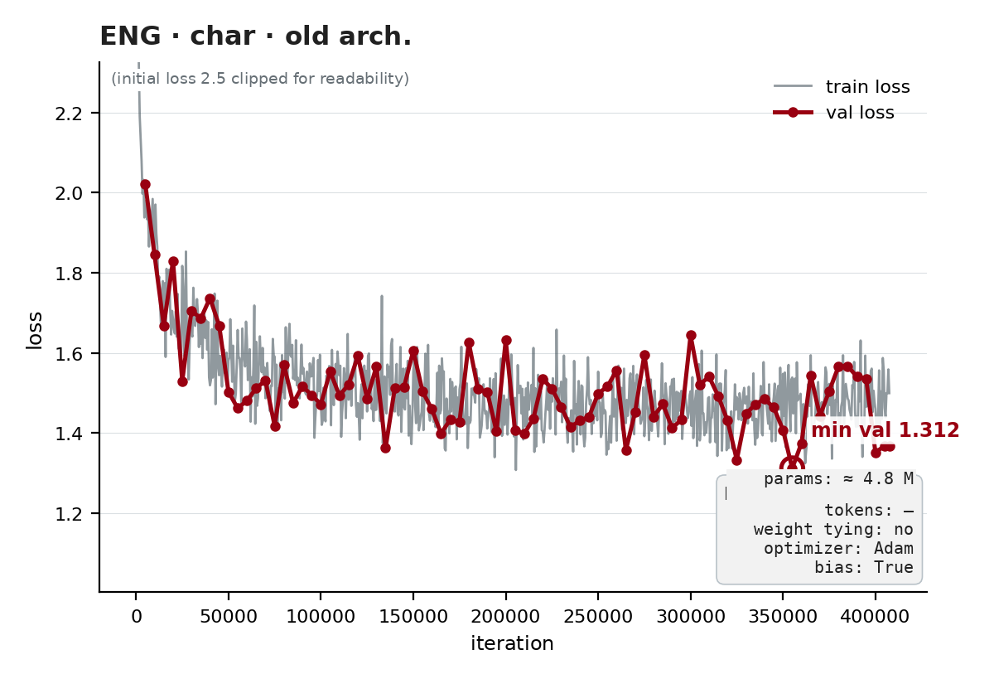
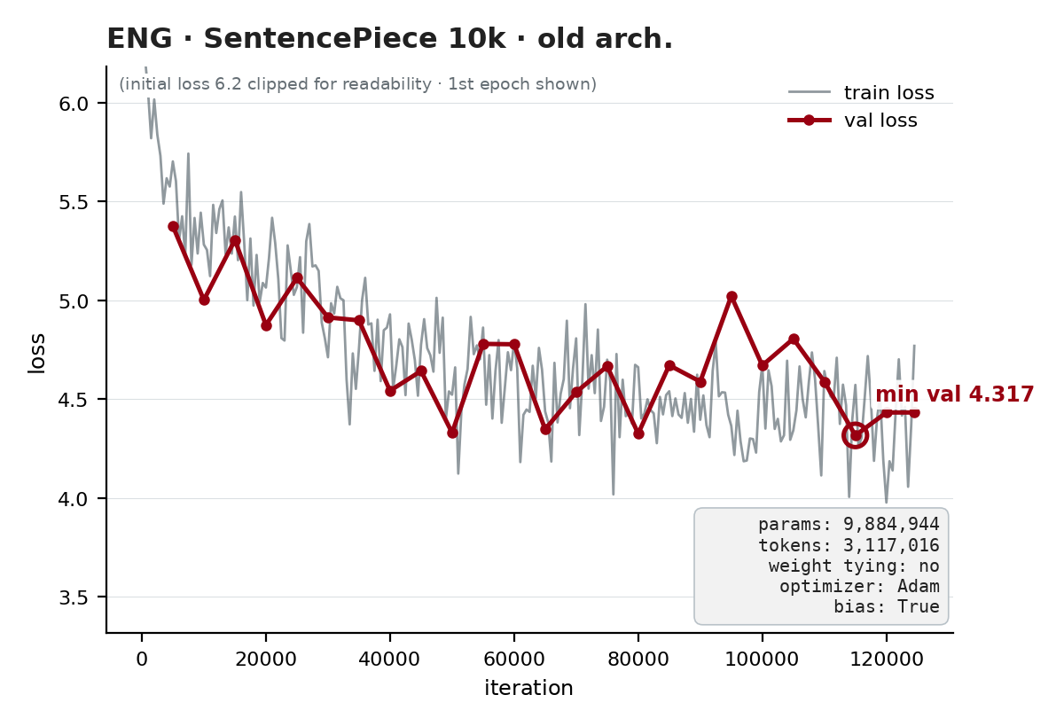
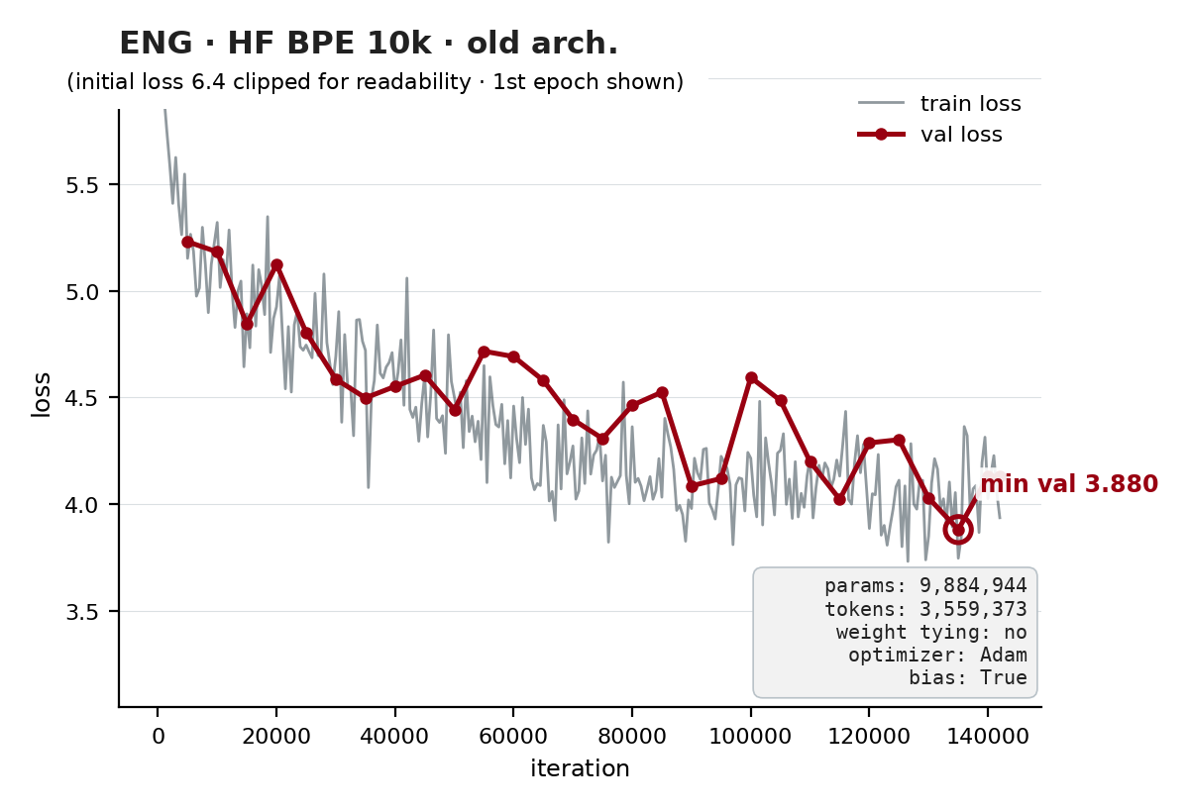
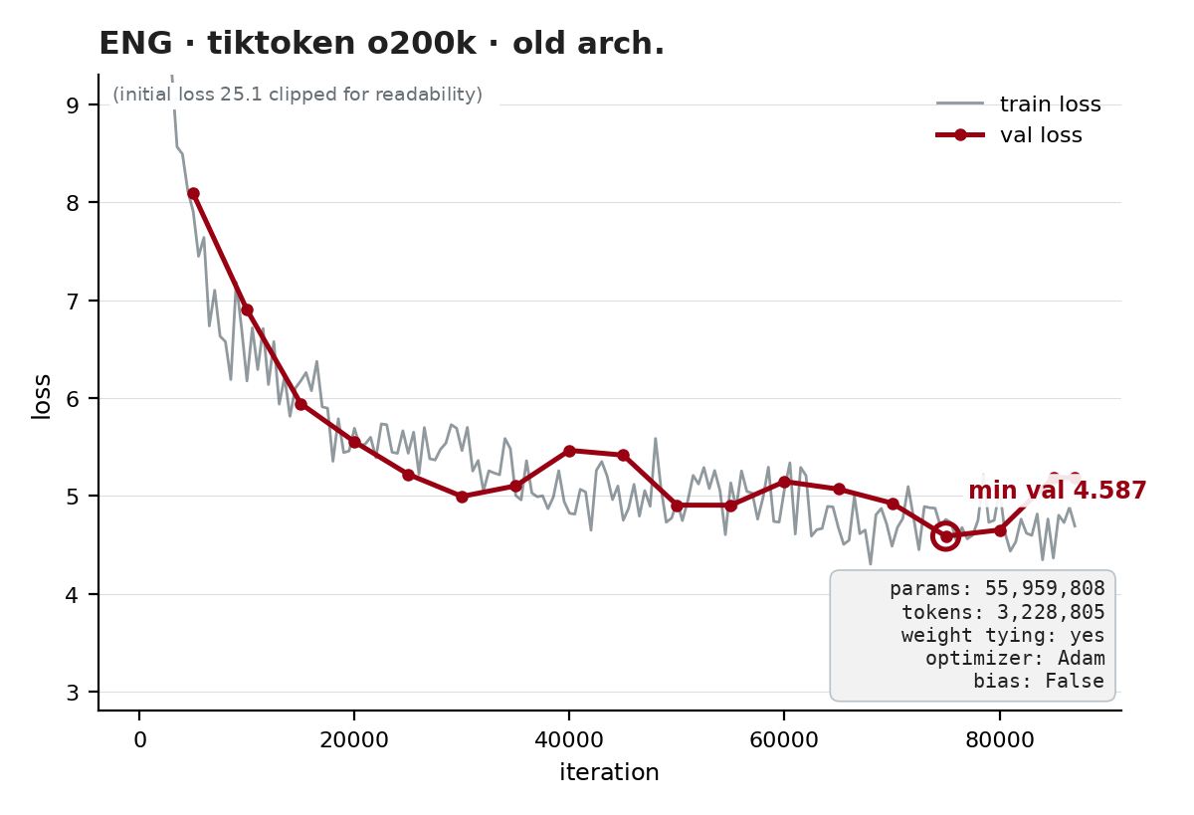
ENG — old architecture
Hand-written TransformerBlock · all 4 tokenizers
HF BPE (3.880) and SentencePiece (4.317) with a 10k vocabulary beat tiktoken (4.587) — on English, a corpus-trained vocabulary beats sheer size.
3

Slide 4
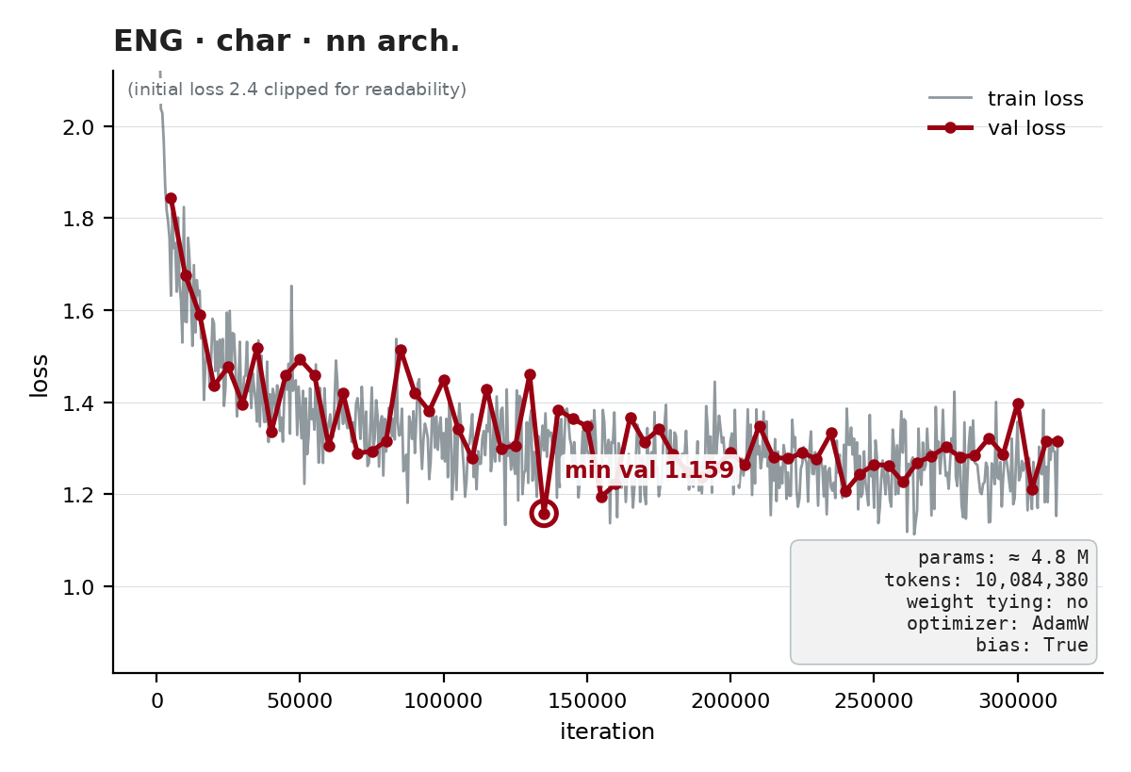
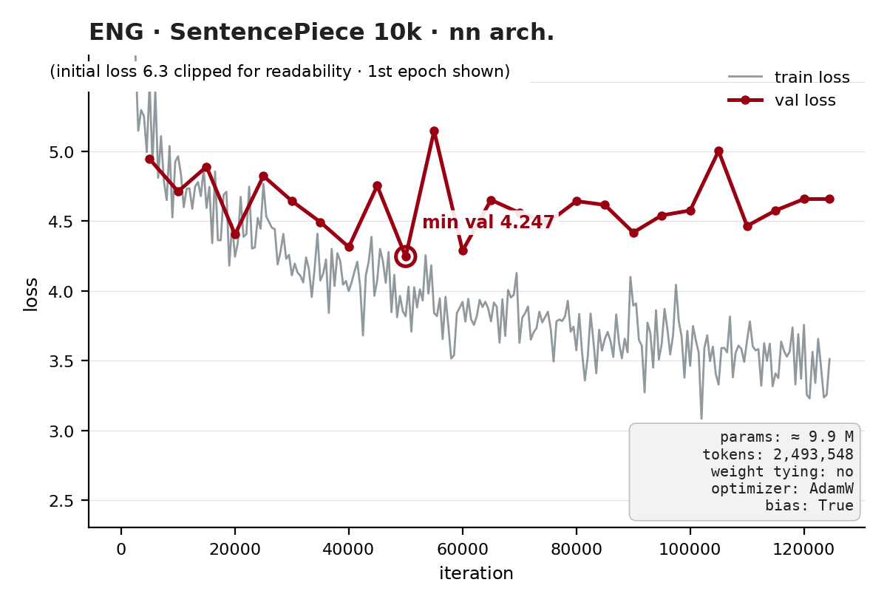
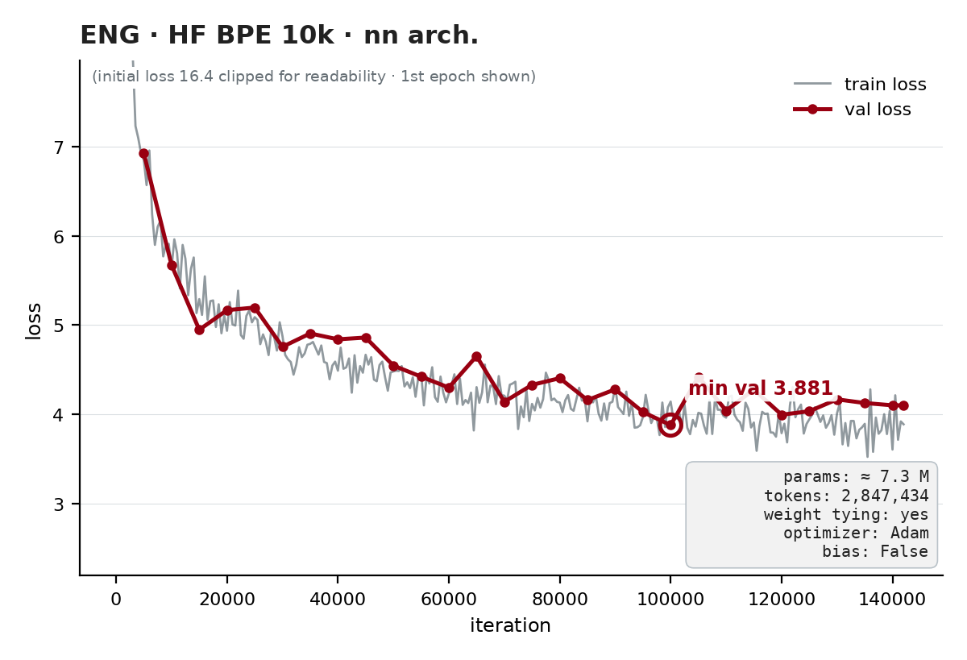
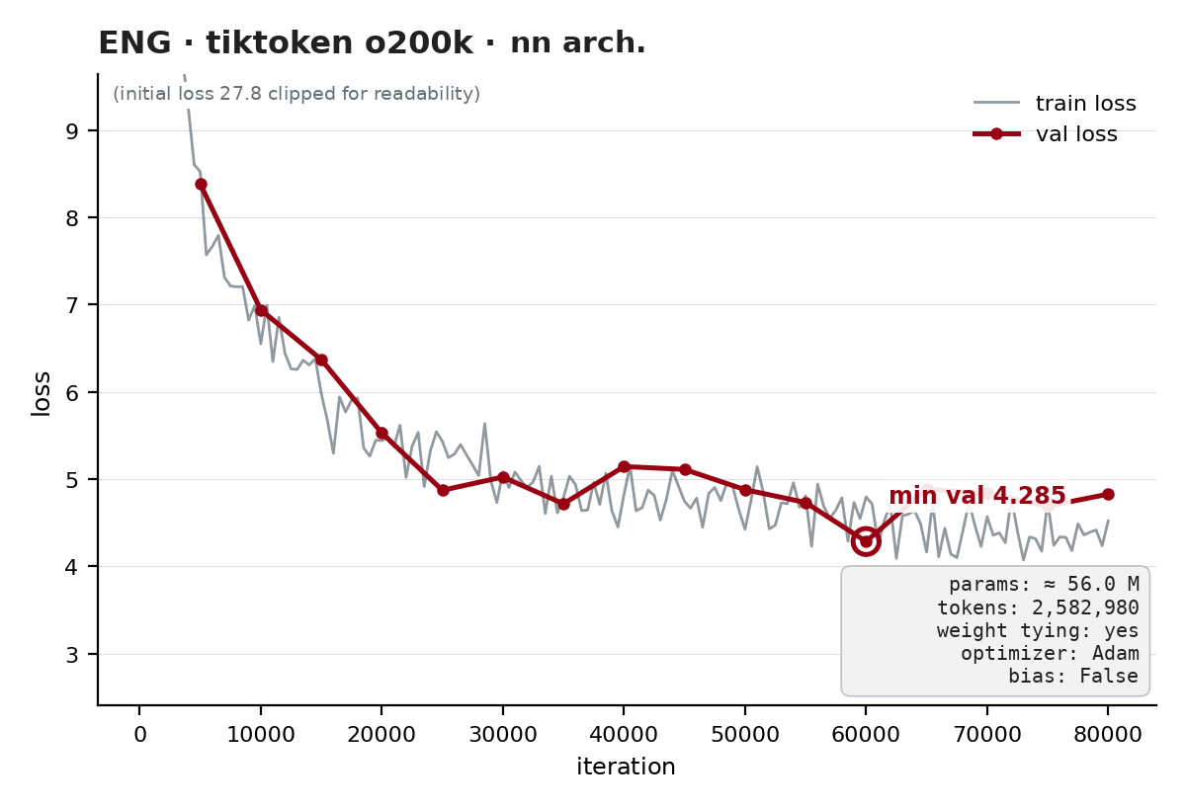
ENG — nn.TransformerEncoder architecture
All 4 tokenizers
With the fixed LR, char-nn stays stable (1.159). HF BPE-nn is the best ENG word-level model (3.881), ahead of SPM-nn (4.247).
4

Slide 5
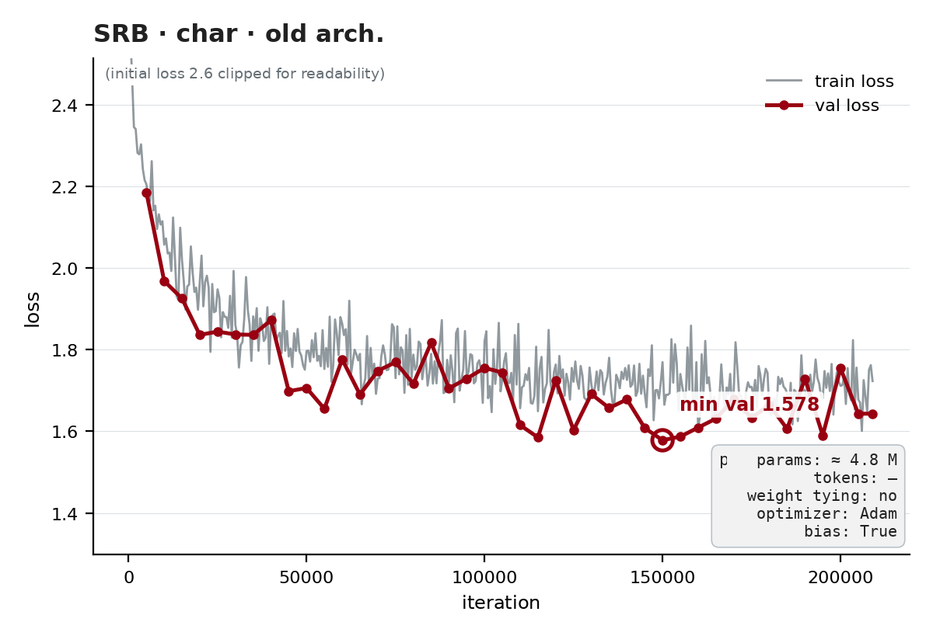
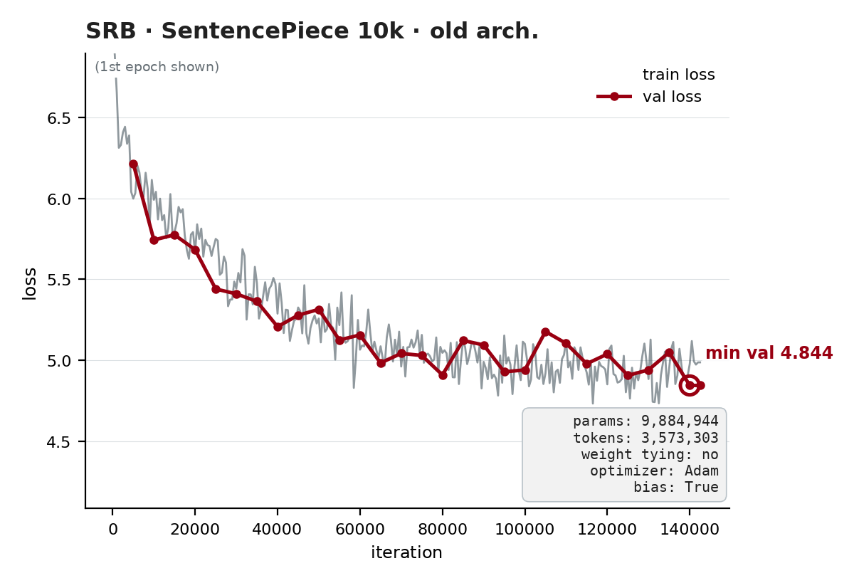
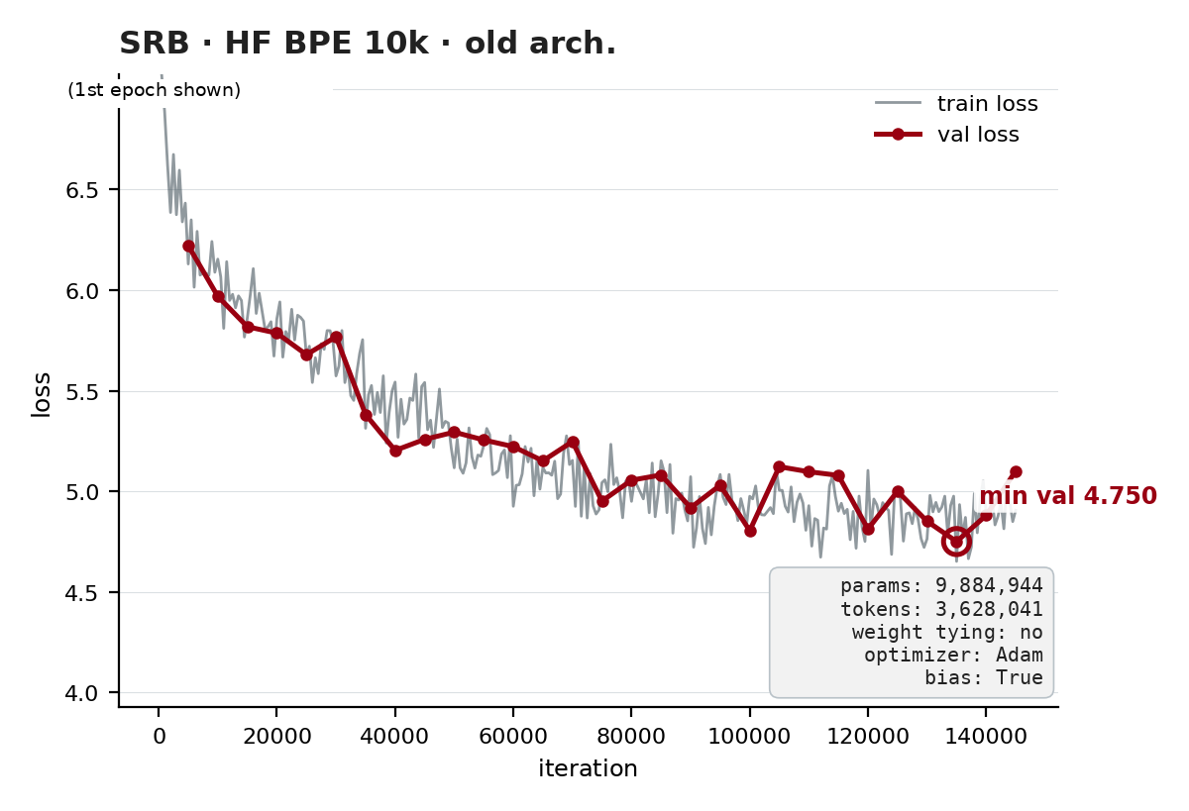
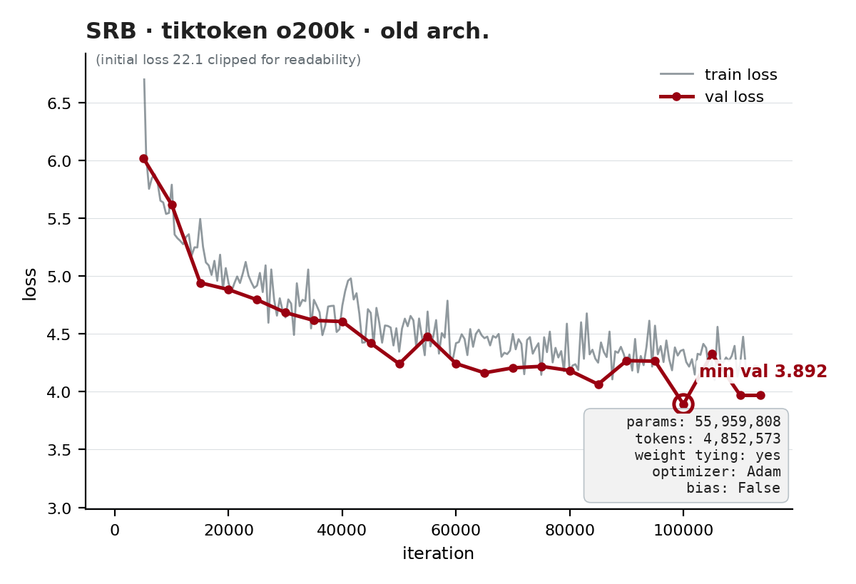
SRB — old architecture
Hand-written TransformerBlock · all 4 tokenizers
tiktoken (200k vocabulary), despite 5.7× more parameters, reaches the lowest word-level val loss (3.892) — shorter sequences per word + weight tying.
5

Slide 6
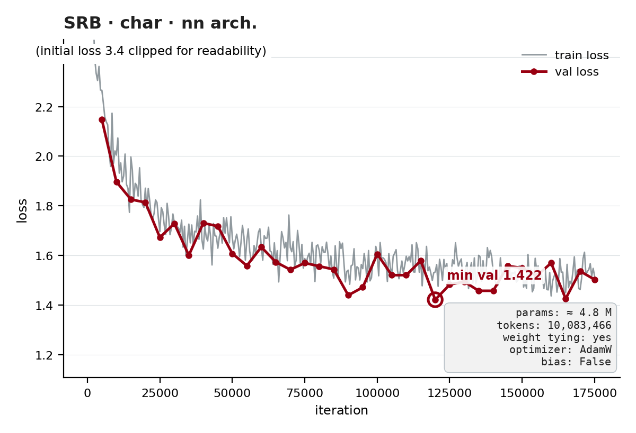
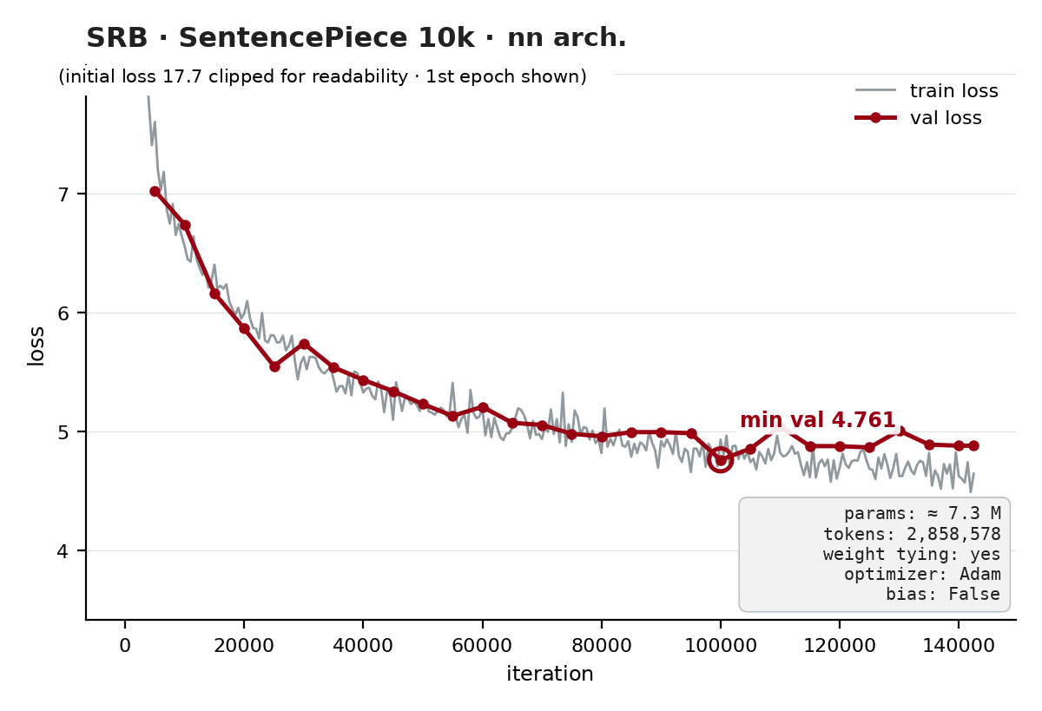
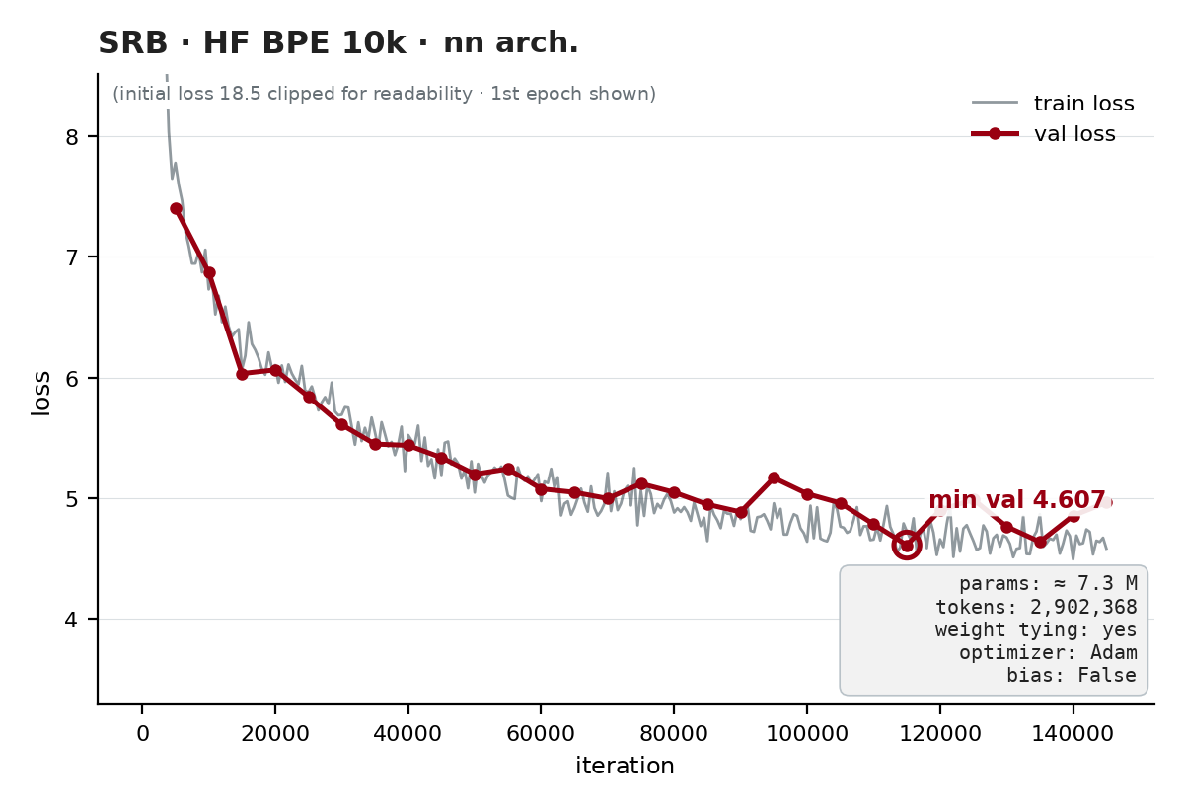
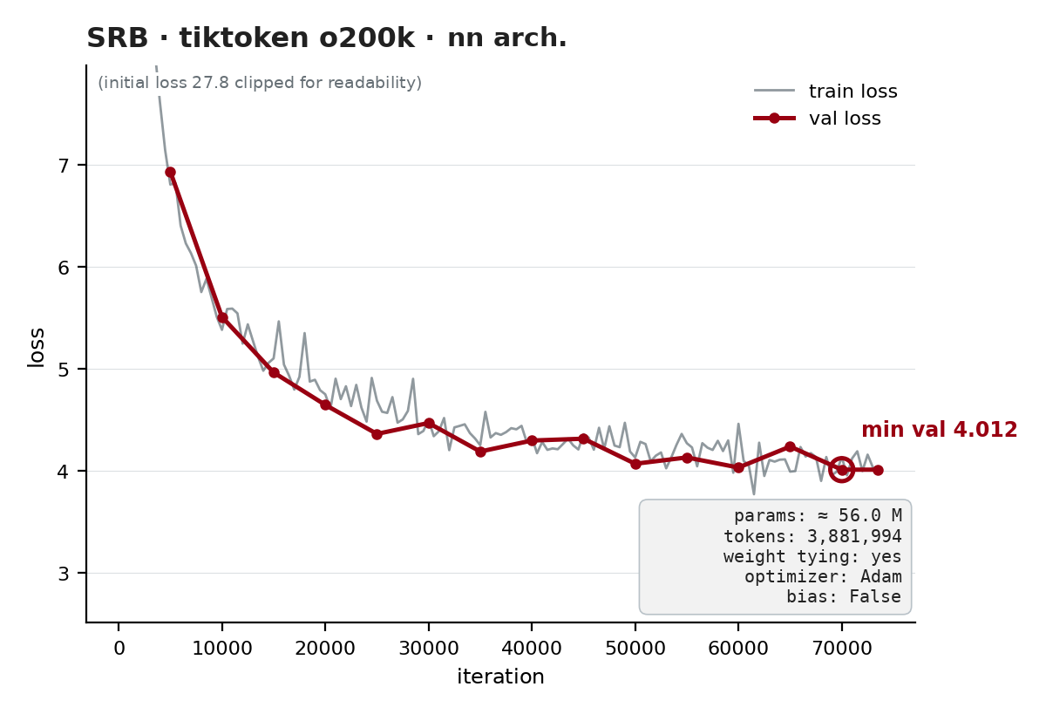
SRB — nn.TransformerEncoder architecture
All 4 runs with weight tying
Same pattern: char has the lowest absolute loss, tiktoken the best word-level (4.012). SPM with tying 4.761 vs 4.844 without (old arch.).
6

Slide 7
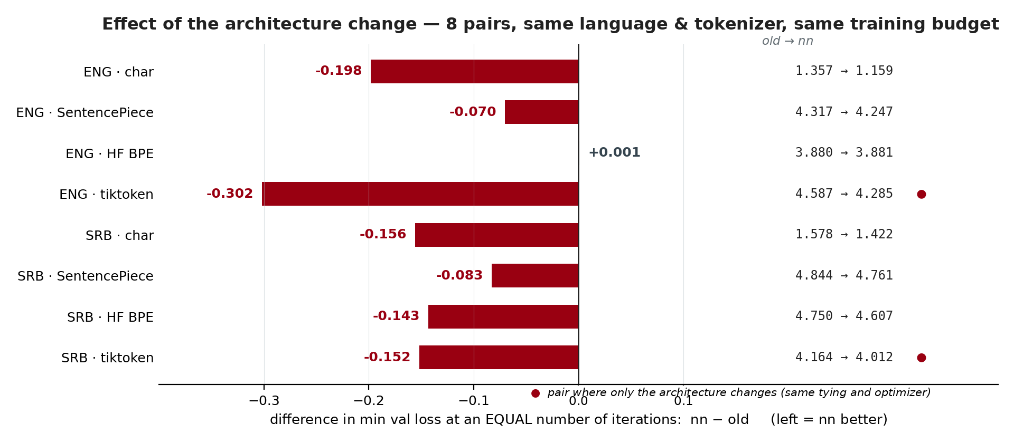
Old architecture vs nn.TransformerEncoder
8 pairs: same language, same tokenizer, same number of iterations
Each bar = how much lower (left) or higher (right) the nn model's min val loss was compared to its old-architecture pair, measured at the same number of iterations. nn is better in 7 of 8 pairs (mean −0.138), tied in 1, never worse. Both pairs where only the architecture changes — ENG and SRB tiktoken — point the same way (−0.302 and −0.152).
7

Slide 8
Why nn.TransformerEncoder usually does better
Same math, better implementation
Fused scaled-dot-product attention (FlashAttention kernels) — faster and more numerically stable than a hand-written softmax(QKᵀ/√d)V
Proven placement of LayerNorm and residual connections; a hand-written block can easily get the order or scaling wrong
Built-in dropout in the right places and correct mask handling in every layer
Faster step → more effective iterations in the same time on the same GPU
Limitation: only 2 of 8 pairs change the architecture alone — both favor nn, but the sample is small
8

Slide 9
Adam vs AdamW
Where the difference is and why W is more correct
Adam
g ← ∇L(w) + λ·w (decay in the gradient)
w ← w − lr · m̂ / (√v̂ + ε)
AdamW
g ← ∇L(w)
w ← w − lr·( m̂ / (√v̂+ε) + λ·w )
In Adam, decay passes through the division by √v̂ — parameters with large gradients get less decay than specified
AdamW applies decay separately ("decoupled") — every parameter shrinks by exactly λ, independent of the gradient
That is why AdamW is the standard for transformers: regularization is predictable and easier to tune
Our runs: the two AdamW runs point in opposite directions: SRB char (AdamW-nn 1.422 < Adam-old 1.578), but ENG SPM (AdamW-nn 4.247 > Adam-old 4.317). In both pairs the architecture changes along with the optimizer — the optimizer is not isolated, so the runs prove nothing; the theoretical advantage of AdamW still stands.
9

Slide 10
Weight tying
One table instead of two
The input embedding (vocab × 256) and the output lm_head (vocab × 256) learn the same thing: a "description" of each token
Input: a table row = what the token means · Output: logit = dot product of the context x with that same row ("which token's description the context resembles most")
Tying: lm_head.weight = embedding.weight → one tensor, gradients from both ends add up (twice the signal per token)
bias=False because the embedding has no bias — the logit stays a pure similarity, with no per-token constant
Small models/corpora: the savings are huge (with o200k: 51 M parameters = half the model) and it acts as regularization → better val loss
Large models (Llama, Mistral): the embedding is a negligible share, so untied matrices can afford the extra flexibility
10

Slide 11
Why nn.TransformerEncoder as a decoder?
A decoder without an encoder = an encoder with a causal mask
nn.TransformerDecoder expects TWO inputs: the target sequence + memory from the encoder (cross-attention) — we have neither an encoder nor memory
A GPT-style model is just self-attention over a single sequence → exactly what nn.TransformerEncoder computes
The only difference: the future must be hidden → generate_square_subsequent_mask(T) puts −inf above the diagonal
Encoder + causal mask ≡ decoder-only transformer (GPT); is_causal=True is just an optimization hint alongside the mask
token t sees tokens 1…t, never t+1…T
11

Slide 12
Perplexity — e^loss
"How many tokens the model is effectively choosing between"
model | min val loss | perplexity
ENG · char (old) | 1.312 | 3.7
ENG · char (nn) | 1.159 | 3.2
ENG · SentencePiece 10k (old) | 4.317 | 75.0
ENG · SentencePiece 10k (nn) | 4.247 | 69.9
ENG · HF BPE 10k (old) | 3.880 | 48.4
ENG · HF BPE 10k (nn) | 3.881 | 48.5
ENG · tiktoken o200k (old) | 4.587 | 98.2
ENG · tiktoken o200k (nn) | 4.285 | 72.6
SRB · char (old) | 1.578 | 4.9
SRB · char (nn) | 1.422 | 4.2
SRB · SentencePiece 10k (old) | 4.844 | 127.0
SRB · SentencePiece 10k (nn) | 4.761 | 116.9
SRB · HF BPE 10k (old) | 4.750 | 115.6
SRB · HF BPE 10k (nn) | 4.607 | 100.2
SRB · tiktoken o200k (old) | 3.892 | 49.0
SRB · tiktoken o200k (nn) | 4.012 | 55.3
ppl = e^(cross-entropy) — how many equally likely candidates would give the same loss
char ppl (≈4) and word ppl (≈50–115) are NOT comparable: char chooses among ~100 characters, word among 10k–200k tokens
The comparison only makes sense within the same tokenization
12

Slide 13
SentencePiece vs tiktoken
Trained subword vocabulary vs pretrained byte-level BPE
SentencePiece (unigram, 10k)
• trained on OUR corpus — every token actually appears in the text
• starts from whole words, splits into frequent subwords ("kuć" + "om")
• small vocabulary → small embedding (2.6 M) and a ~10 M model
• Serbian: ~1–2 tokens per word because the vocabulary is native
tiktoken o200k_base (pretrained, ~200k)
• byte-level BPE — merges the most frequent BYTE pairs from the general web
• any UTF-8 text works with no <unk>, Cyrillic included
• fixed vocabulary: 200k → the embedding alone is 51 M parameters
• most of the 200k tokens never appear in our corpus
In short: SentencePiece = a vocabulary tailored to the corpus; tiktoken = universal but bulky.
13

Slide 14
Why do some models have 56 M parameters and others 10 M?
The vocabulary sets the size, not the network depth
200,000 × 256 ≈ 51 M
the tiktoken model's embedding table — before a single attention layer
all 6 transformer layers combined: ~4.7 M parameters
vocab 10k → 2.6 M table → whole model ~10 M
vocab 200k → 51 M table → whole model ~56 M (with tying; without it ~107 M)
Takeaway: in small models the tokenizer is the single biggest decision about size
14

Slide 15
Lowest val loss per dataset
Overall winners — both char-level
Why char wins on the numbers: it chooses among ~100 characters (word models among 10k–200k) — the per-token task is easier, so the loss is not directly comparable. Best ENG word-level: HF BPE 10k (3.880 old / 3.881 nn); SRB word-level: tiktoken o200k old (3.892). ENG char-nn with the fixed LR: min val 1.159, flat curve to the end; the same models without a schedule diverged after the minimum.
15

Slide 16
Conclusion
Tokenizer > everything else. The same model ranges from 10 M–56 M parameters and 4–115 perplexity purely from the choice of tokenization.
Weight tying is a free win. Halves the 200k-vocab model and adds regularization — a must for small models.
nn.TransformerEncoder instead of a hand-written block. At an equal number of iterations it is better in 7 of 8 pairs — a proven implementation of attention and normalization.
AdamW instead of Adam. Decoupled decay is the correct regularization and the standard for training transformers.
Early stopping on val loss. Without an LR schedule the longest runs diverge after the minimum; with lr·0.33 char stays stable to the end. Rule: lower the LR and keep the checkpoint with the lowest val loss.
16

