Slide 1

SHLOMI MOR WIGS · NYC
EDITION 01 · 2025
the
Brand Book.
Crown
Your
Confidence
VISUAL IDENTITY GUIDELINES
VOL. I — FOUNDATIONS
MADE IN NY · USA

Slide 2
CONTENTS
02
02 — CONTENTS
Table of contents.
A nineteen-section brand book covering identity foundations, visual language and brand applications. Designed to be read in sequence, referenced as a system.
01
Cover
11
Display Serif — idot
02
Contents
12
Functional Sans — Futura LT / Inter
03
Welcome & Brand Story
13
Script Accent — Sacramento / Snell Roundhand
04
Mission · Vision · Values
14
Hierarchy & Pairing
05
Two Streams — Medical & Luxury
15
Grid System
06
Logo Variations
16
Photography Direction
07
Logo Construction & Clear Space
17
Tone of Voice
08
Logo Misuse
18
Applications
09
The Main Colors
19
Contact & Credits
10
Color Usage & Proportions
CONTENTS
02

Slide 3
WELCOME
03
03 — WELCOME
A house of hair, confidence
and quiet craft.
Shlomi Mor Wigs is a luxury custom-wig atelier based in New York City. We work with two women: the one rebuilding her sense of self after medical hair loss, and the one looking for the most exquisite, undetectable wig of her life. Both deserve the same level of craft, intimacy and editorial restraint — and both find it here.
WELCOME
03

Slide 4
FOUNDATIONS
04
04 — FOUNDATIONS
Mission · Vision · Values
MISSION
VISION
VALUES
Mission
Vision
Values
To return a woman's reflection to her — through European hair, hand-tied craftsmanship and a private, unhurried experience.
To become the most trusted custom-wig atelier between Tel Aviv and New York, known equally for medical sensitivity and editorial excellence.
Discretion · Craft · Empathy · Longevity · Beauty without compromise.
FOUNDATIONS
04

Slide 5
STREAMS
05
05 — STREAMS
Two women, one
atelier.
MEDICAL HAIR LOSS
LUXURY CUSTOM WIGS
Restoration
Style & status
Soft, supportive, undetectable. We meet her where she is — with European hair, custom caps and the quiet space to recognise herself again.
Fashion-editorial restraint with the craft of a couture house. Made for clients who never compromise on the quality of their hair.
STREAMS
05

Slide 6


IDENTITY
06
06 — IDENTITY
The Logo
PRIMARY · CREAM
REVERSED · BLACK
MONOGRAM · BLUSH
PRIMARY LOCKUP
REVERSED
MONOGRAM
The full mark: SM monogram crowning the SHLOMI MOR WIGS wordmark. Used on cover, packaging, signage and editorial.
For dark surfaces and editorial imagery the full mark is set in soft paper white. Always reserve quiet contrast around it.
The SM monogram alone. Used for stamps, favicons, embroidery, dust-bag corner marks and any small applications.
IDENTITY
06

Slide 7
CONSTRUCTION & CLEAR SPACE
07
07 — CONSTRUCTION & CLEAR SPACE
Built on x.
CLEAR SPACE
x = height of the M stem
Reserve at least one x of empty space on all sides of the mark. This is a non-negotiable minimum — never crowd the logo with text, imagery or color blocks.
MINIMUM SIZE
Digital 28 px · Print 16 mm
CONSTRUCTION & CLEAR SPACE
07

Slide 8
MISUSE
08
08 — MISUSE
Please, don't.
The logo is a quiet object. The following alterations damage its tone, legibility or accessibility — and are never permitted in brand communication.
×
×
×
01 · NEVER ROTATE
02 · NEVER STRETCH
03 · NEVER LOW CONTRAST
Keep the mark upright.
Always uniform scale.
Always legible.
×
×
×
04 · NEVER ADD SHADOWS
05 · NEVER APPLY GRADIENTS
06 · NEVER OFF-BRAND COLOR
The mark stands flat.
Solid brand color only.
Use approved palette.
MISUSE
08

Slide 9
COLOR
09
09 — COLOR
The main colors.
RICH DUSTY ROSE
SOFT POWDER BLUSH
MUTED ANTIQUE GOLD
SOFT CHAMPAGNE
SIGNATURE BLACK
ELEGANT STONE GRAY
#B68F90
#FCE3E5
#A78D52
#C9AC7F
#0E0E0E
#6E6663
R 182 · 143 · 144
R 252 · 227 · 229
R 167 · 141 · 82
R 201 · 172 · 127
R 14 · 14 · 14
R 110 · 102 · 99
C 30 · 47 · 36 · 11
C 0 · 13 · 5 · 0
C 30 · 38 · 75 · 16
C 20 · 30 · 53 · 5
C 0 · 0 · 0 · 95
C 48 · 50 · 51 · 38
COLOR
09

Slide 10
PROPORTIONS
10
10 — PROPORTIONS
How the palette
breathes.
RECOMMENDED DISTRIBUTION
45%
25%
15%
8%
5%
2%
PAPER CREAM
SIGNATURE BLACK
POWDER BLUSH
ANTIQUE GOLD
DUSTY ROSE
CHAMPAGNE
Cream and black form the canvas. Blush and gold deliver warmth and luxury. Rose and champagne are reserved for accents and seasonal materials.
PROPORTIONS
10

Slide 11
DISPLAY SERIF
11
11 — DISPLAY SERIF
Headlines — idot.
AaBb
TYPEFACE
idot — high-contrast didone
ROLE
Headlines, covers, editorial titles
MOOD
Vogue · Harper's Bazaar · Couture
TRACKING
-1% to -2% at display sizes
STYLE MIX
Roman for statements, italic for emphasis
DISPLAY SERIF
11

Slide 12
FUNCTIONAL SANS
12
12 — FUNCTIONAL SANS
Body & UI — Futura LT / Inter.
Aa Bb
TYPEFACE
Futura LT — with Inter as digital alternative
ROLE
Body, captions, navigation, CTAs, microcopy
MOOD
Clean, geometric, modern
TRACKING
+22% for eyebrows · 0% for body
WEIGHTS
Light · Book · Medium · Bold
FUNCTIONAL SANS
12

Slide 13
ACCENT
13
13 — ACCENT
A whisper — Sacramento.
she
TYPEFACE
Sacramento / Snell Roundhand
ROLE
Accent only — one or two words per page
USE CASES
Hero accents · taglines · signatures · social
COLOR
Muted Antique Gold or Soft Champagne
TRACKING
0%, never tracked or stretched
ACCENT
13

Slide 14
PAIRING & HIERARCHY
14
14 — PAIRING & HIERARCHY
How they speak.
EYEBROW / 11 / 220
HAND-CRAFTED IN NYC
DISPLAY HEADLINE / 56 / DIDOT
A wig that feels like you, only quieter.
BODY / 14 / 1.7
Each piece is custom-made for the woman who wears it — European hair, hand-knotted lace, a private fitting. The work happens slowly; the result feels inevitable.
CTA / 12 / 180 / UPPERCASE
BOOK CONSULTATION →
PAIRING & HIERARCHY
14

Slide 15
GRID
15
15 — GRID
A quiet twelve.
The book is built on a 12-column grid with a 72 px outer margin and a 24 px gutter, on a 1440 × 900 px stage. Each page is structured around an editorial silence — content occupies roughly 60% of the surface; the rest breathes.
12 COLUMNS · 72 PX MARGIN · 24 PX GUTTER
GRID
15

Slide 16
PHOTOGRAPHY
16
16 — PHOTOGRAPHY
Light, skin, silence.
MEDICAL · RESTORATION
LUXURY · EDITORIAL
Warm window light. Hands, jewellery, the back of a neck. The wig as a quiet companion, not a performance.
Studio lighting. Bare shoulders, ironed silk, the architecture of a face. The wig as couture, photographed like couture.
Always shoot on neutral grounds — paper white, cream, clay. Never on saturated color. Models are calm, off-centre, never looking at the camera.
PHOTOGRAPHY
16

Slide 17
TONE OF VOICE
17
17 — TONE OF VOICE
Speak softly.
INTIMATE
CONFIDENT
Intimate
Confident
Like a fitting in a quiet room.
Without ornament or proof.
EDITORIAL
EMPATHIC
Editorial
Empathic
Composed sentences, generous space.
Especially with the medical client.
TONE OF VOICE
17

Slide 18
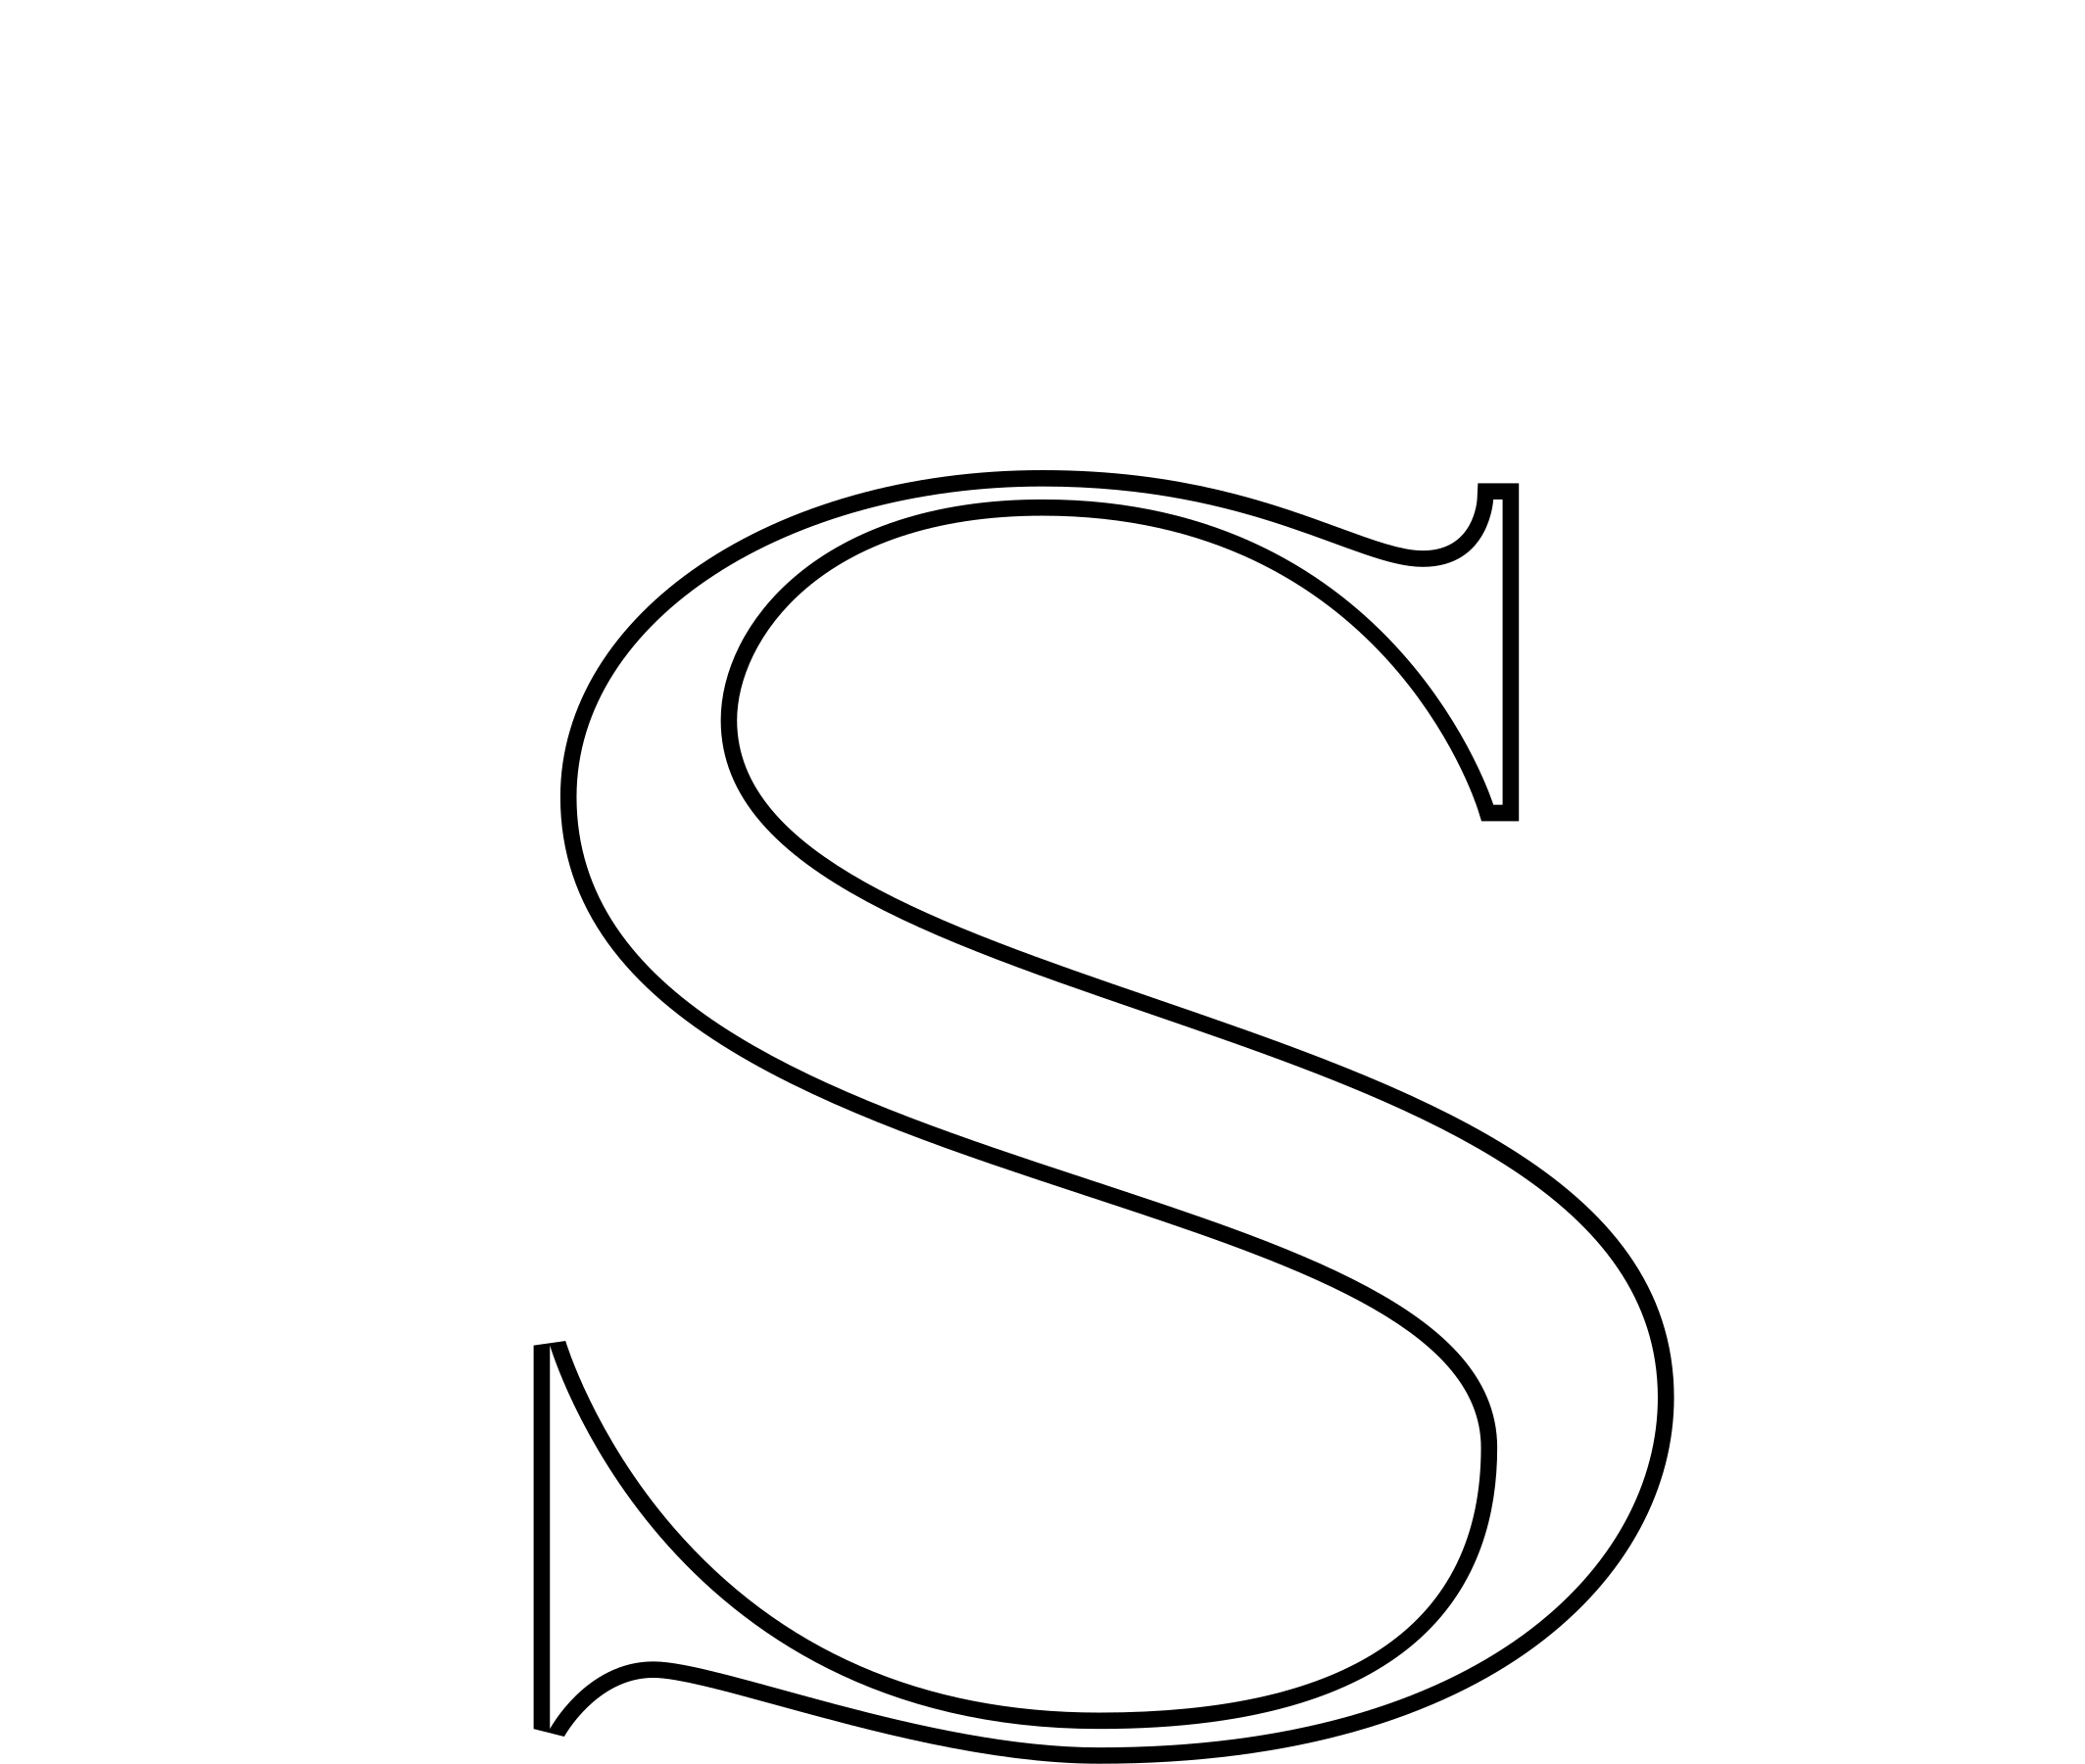
APPLICATIONS
18
18 — APPLICATIONS
In the world.
Shlomi Mor
MASTER WIGMAKER · OWNER
SHLOMIMORWIGS.COM
BUSINESS CARD · FRONT
DUST BAG
@shlomimorwigs
SOCIAL · INSTAGRAM 1:1
A wig that feels like you, only quieter.
BOOK CONSULTATION →
AD BANNER · 1200 × 600
APPLICATIONS
18

Slide 19
Crown your confidence.
SHLOMIMORWIGS.COM · INFO@SHLOMIMORWIGS.COM · @SHLOMIMORWIGS
SHLOMI MOR WIGS · 580 5TH AVENUE · NEW YORK, NY
BRAND GUIDELINES · EDITION 01 · 2025

