Slide 1
I. introDUCTION Ii. Approach III. challenges iV. Next steps V. Q&A
Brandon Wong – SG DAT 1

Slide 2



0. Quick intro I. my approach II. My challenges iii. Next steps III. Q&A
agenda
INTRODUCTION
$40,000 prize
1,269 teams
Timeline: 18/01/16 – 25/04/16
Predict Relevance of Search Results
Home Depot: Home Depot is an American retailer of home improvement and construction products and services
Competition Basics: Improve customer’s shopping experience by developing a model that can accurately predict the relevance of search results

Slide 3
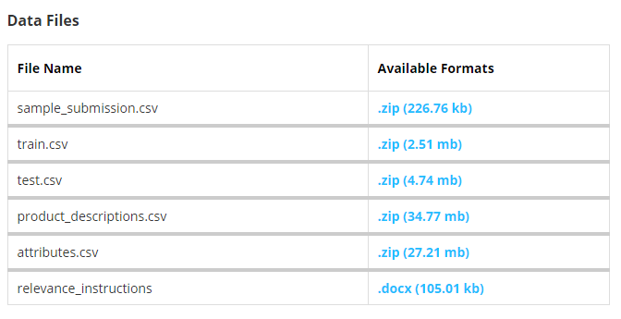
0. Quick intro I. my approach II. My challenges iii. Next steps III. Q&A
agenda
Introduction (CONT)
Train and Test have similar columns
BUT
relevance score not provided in Test.

Slide 4

0. Quick intro I. my approach II. My challenges iii. Next steps III. Q&A
agenda
Approach
Picking a Model
I have:
Labeled data (Classification?)
Not a huge volume, classifiers (Random Forest?)
I need:
Root words / Stems (Snowball Stemmer / PyStemmer?)
Rank variable importance

Slide 5
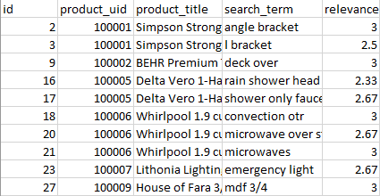
0. Quick intro I. my approach II. My challenges iii. Next steps III. Q&A
agenda
Approach (CONT)
Relevance is a number between 1 (not relevant) and 3 (most relevant)
E.g. Search for Steel Saw
Steel Saw ( R = 3)
Steel Nails (R = 2)
Shovel (R = 1)
Each pair was (search_term, product) evaluated by at least 3 human raters.
The provided relevance scores are the average value of the ratings

Slide 6
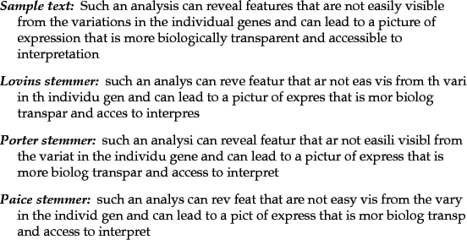
0. Quick intro I. my approach II. My challenges iii. Next steps III. Q&A
agenda
Approach (CONT)
Why Stemmer?
Messy!
Product Names
vs
Search Terms

Slide 7
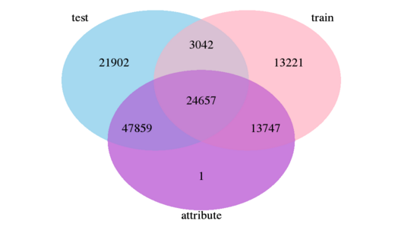
0. Quick intro I. my approach II. My challenges iii. Next steps III. Q&A
agenda
Approach
There is one value in attributes.csv file that is not in either train or test files.
On further investigation there are 155 rows that do not have a product_uid value

Slide 8
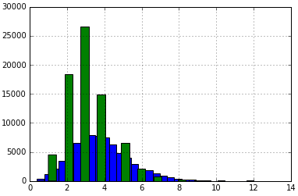
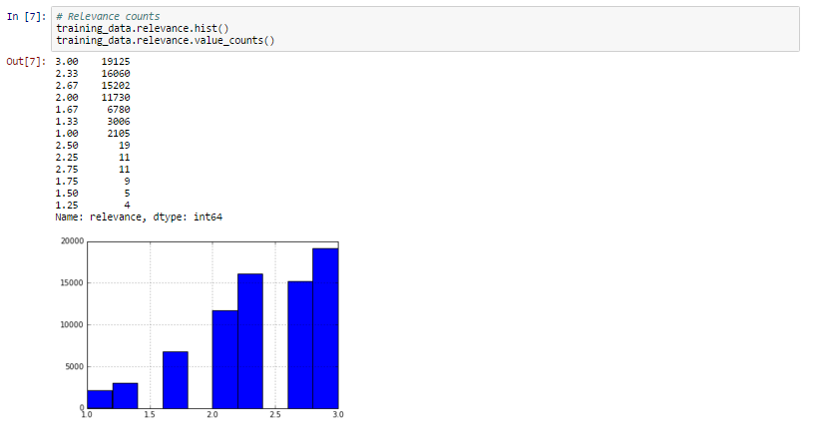
0. Quick intro I. my approach II. My challenges iii. Next steps III. Q&A
agenda
Approach (cont)
Relevance Counts
Search Terms Dist (binned)

Slide 9
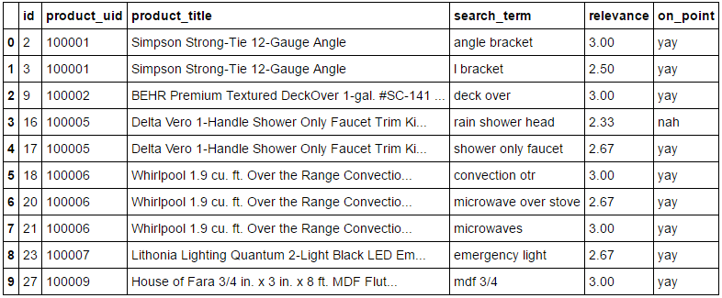
0. Quick intro I. my approach II. My challenges iii. Next steps III. Q&A
agenda
approach (CONT)
Playing around, yay or nah?

Slide 10
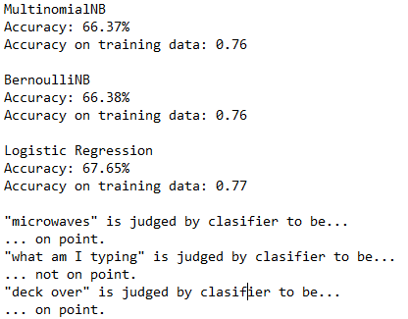
0. Quick intro I. my approach II. My challenges iii. Next steps III. Q&A
agenda
Approach (cont)

Slide 11
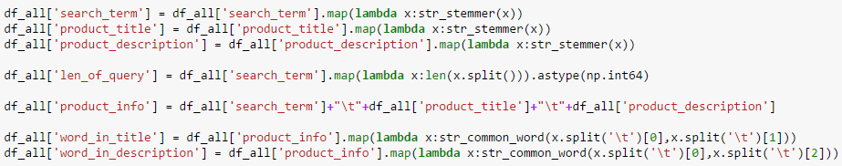

0. Quick intro I. my approach II. My challenges iii. Next steps III. Q&A
agenda
Approach (cont)

Slide 12
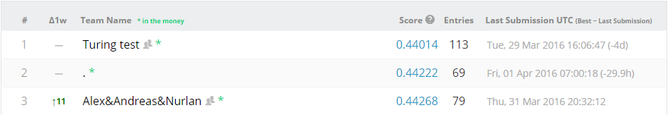
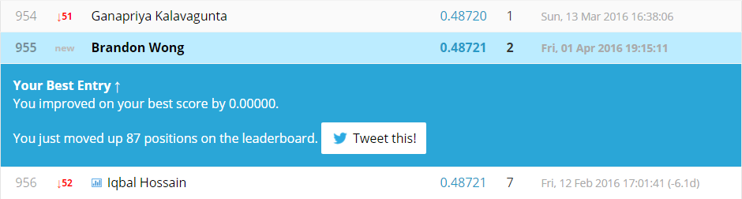
0. Quick intro I. my approach II. My challenges iii. Next steps III. Q&A
agenda
Leaderboard

Slide 13
0. Quick intro I. my approach II. My challenges iii. Next steps III. Q&A
agenda
CHALLENGEs
Not trying to predict the true relevancy of the product as a response to a search query
Instead, build program to mimic human raters, assuming they are the most efficient method of assessing relevancy
Have to teach the models/machines to act like humans? Need to “create a search system auditor that can help measure the efficacy of changes in algorithms preferably in real time”

Slide 14
0. Quick intro I. my approach II. My challenges iii. Next steps III. Q&A
agenda
Next steps
Check out winning strategies on Kaggle, improve on them
Keep competing in Kaggle competitions
Try out Natural Language Processing

