Slide 1
I. introDUCTION Ii. approach III. challenges iV. Next steps V. Q&A
Brandon Wong – SG DAT 1

Slide 2



0. Quick intro I. my approach II. My challenges iii. Next steps III. Q&A
agenda
INTRODUCTION
$40,000 prize
1,269 teams
Timeline: 18/01/16 – 25/04/16
Predict Relevance of Search Results
Home Depot: Home Depot is an American retailer of home improvement and construction products and services
Competition Basics: Improve customer’s shopping experience by developing a model that can accurately predict the relevance of search results

Slide 3
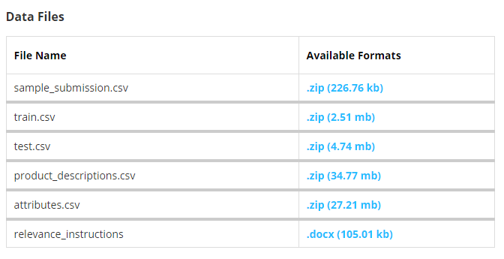
0. Quick intro I. my approach II. My challenges iii. Next steps III. Q&A
agenda
Introduction (CONT)
Train and Test have similar columns
BUT
relevance score not provided in Test.

Slide 4

0. Quick intro I. my approach II. My challenges iii. Next steps III. Q&A
agenda
Approach
Picking a Model
I have:
Labeled data (Classification?)
Mid-scale volume, classifiers (Random Forest?)
I need:
Root words / Stems (Snowball Stemmer / PyStemmer?)

Slide 5
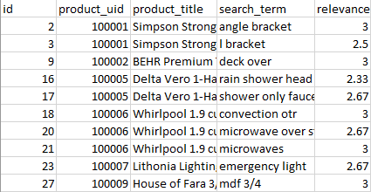
0. Quick intro I. my approach II. My challenges iii. Next steps III. Q&A
agenda
Approach (CONT)
Relevance is a number between 1 (not relevant) and 3 (most relevant)
E.g. Search for Steel Saw
Steel Saw ( R = 3)
Steel Nails (R = 2)
Shovel (R = 1)
Each pair was (search_term, product) evaluated by at least 3 human raters.
The provided relevance scores are the average value of the ratings

Slide 6
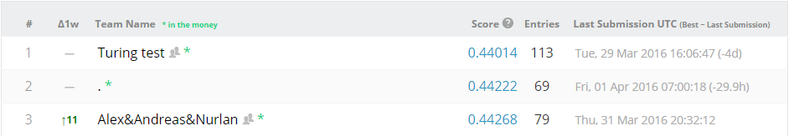
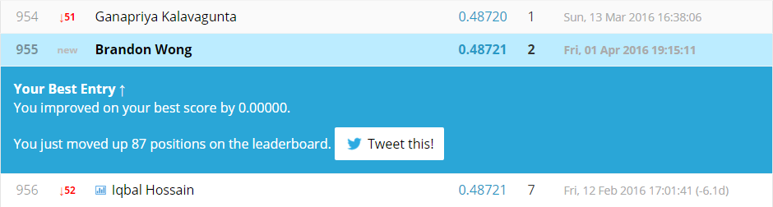
0. Quick intro I. my approach II. My challenges iii. Next steps III. Q&A
agenda
Leaderboard

Slide 7
0. Quick intro I. my approach II. My challenges iii. Next steps III. Q&A
agenda
CHALLENGEs
Not trying to predict the true relevancy of the product as a response to a search query
Instead, build program to mimic human raters, assuming they are the most efficient method of assessing relevancy
Have to teach the models/machines to act like humans? Need to “create a search system auditor that can help measure the efficacy of changes in algorithms preferably in real time”

Slide 8
0. Quick intro I. my approach II. My challenges iii. Next steps III. Q&A
agenda
Next steps
Check out winning strategies on Kaggle, improve on them
Keep competing in Kaggle competitions
Try out Natural Language Processing

Slide 9
0. Quick intro I. my approach II. My challenges iii. Next steps III. Q&A
agenda
Q&A

