Slide 1
Predicting warfarin dosage from clinical and pharmocogenetic data
Rajashree Mishra
EPID 600 Final Project
December 1, 2015

Slide 2
Introduction
5 mg
Warfarin is an anticoagulant drug
How it’s administered?
Start of with 5mg, measure International Normalized Ratio(INR), repeat until target INR is reached and stable
Pharmacogenetic Data
inherited genetic differences in drug metabolic pathways which can affect individual responses to drugs, both in terms of therapeutic effect as well as adverse effects
VKORC1 & CYP2C9.
Measure PT/INR
Prolonged?
Adjust
Dose
Notes:
The formation of blood clots in the blood vessels and their migration else where in the body can be prevented by warfarin, an anticoagulant. More than 30 million patients are prescribed warfarin, however, the proper dose of warfarin is difficult to determine because it can vary among patients by a factor of 10. The consequences of taking the incorrect dose can be fatal. The first dose administered is usually 5 mg and the time it takes for the blood to clot is measured. This is called Prothrombin Time(PT) or the International Normalized Ratio(INR). INR is the same as PT but normalized based on a person of the same demographic. The INR value should be prolonged by the warfarin, and based on this measure, the next daily dose will be adjusted. The patient has to stay in the hospital until the INR value is in the normal range for at least 2 repetitions. Studies have shown that warfarin activity can be determined partially by genetic factors. Specifically, the two variants in VKORC1 and CYP2C9, which are genes involved in warfarin response.

Slide 3
Project Aim
Predict therapeutic warfarin dosage
Reduce cost and time of administration of warfarin dosage
Notes:
The goal of this project is to predict therapeutic warfarin dosage by applying machine learning approaches to a large publicly available data that integrates clinical information as well as genotypic data. The data consists of 5,700 patients and 67 features and by utilizing computational and statistical methods to successfully predict warfarin dosage, the cost and time of administration of warfarin dosage will reduce significantly.

Slide 4
The Data
PharmGKB
International Warfarin Pharmacogenomic Consortium comprised of 21 research groups
5,700 subjects
63 Features
Clinical
Gender, Site, Age, Height, Weight, Race, Medication, Diabetes? Valve Replacement? Smoker?
Genotypic
CYP2C9
VKORC1

Slide 5
Methods Pipeline
5,700 subjects
Clean data
Individual Association Tests
Model Selection
Hold out data
Test Model
Train Model
Notes:
Filter 1: Univariate association test for each feature Missingness
Filter 2: : Univariate association test first
A. Cross validation
B. Stepwise Regression

Slide 6
Methods
Two filter methods
Based on missingness rate
Based on univariate linear regression for each feature
For each method perform model selection on training set
Test best model on validation set
Notes:
Gender + Age + Reached.Stable.Dose + Cyp2C9 + Weight + Height + Race.Reported + Indication + INR.Reported + Height + VKORC1.1 + Heart.probs + Valve + Simvastatin + Aspirin
Gender,Rifam,Site,Smoker ,Weight,Height,Race.Reported,INR.Reported + VKORC1.1 + Valve + Herbal.Medications.Vitamins.Supps + Combined.QC4.CYP2C9

Slide 7
Model Selection
Considers all possible subsets of features
Finds the model that best fits the data according to some criteria
BIC → Bayesian Inference Criterion
Avoid over fitting by introducing a penalty term for the number of parameters in the model
BIC = -2 * log( p(x | features, M) + k * log(n)
Choose model with lowest BIC is chosen
Notes:
Model selection is a process of seeking the model in a set of candidate models that gives the best balance between model fit and complexity (Burnham & Anderson 2002). I have always used AIC for that. But you can also do that by crossvalidation. Specifically, Stone (1977) showed that the AIC and leave-one out crossvalidation are asymptotically equivalent.

Slide 8
Univariate association: clinical features
< 1e-5 | 0.001 | 0.01 | >.1
Weight Race Height Site* INR reported* Smoker Amiodarone Herbal Medication/Vitamins/ Supplemants Carbamazepine Gender Rifam Valve Replacement | Tylenol Phenytoin | Target INR Reached Stable Dose* Heart problems Diabetes Atorvastatin Aspirin* | Antifunal azoles Age Simvastatin* Sulfanamide antibiotics Comorbities Indication Rosuvastatin High Dose of tylenol Pravastatin Fluvastatin
* Was significantly associated when filtered by missingness (pval<0.000005)
Notes:
Antiarrhythmics Drugs to Treat Heart Disease
Site, Race defined by Office of Management and Budget, Combined separate genotypes for *2 and *3 into single CYP2C9 diplotypes with possible values *1/*1, *1/*2, *1/*3, *2/*2, *2/*3, *3/*3, VKORC1 genotype: -1639 G>A (3673); chr16:31015190; rs9923231; C/T, weight, whether or not they had a valve replacement, whether or not they take aspirin, whether or not they take Simvastatin, VKORC1 QC genotype: -1639 G>A (3673); chr16:31015190; rs9923231; C/T, INR reported, and whether or not they reached stable dose.
Features significantly associated with therapeutic dosage of warfarin
Site
Race defined by Office of Management and Budget
Combined separate genotypes for CYP2C9
VKORC1 genotype: -1639 G>A (3673); chr16:31015190; rs9923231; C/T
INR reported
Whether or not they reached stable done
VKORC1.1-1.7 consensus, VKORC1.1, VKORC1.1 consensus, VKORC1.1, VKORC1.6 consensus, VKORC1.6, VKORC1.3 consensus

Slide 9
Univariate association: clinical features
Filtered by Missingness
CYP2CP variant at rs1799853 and at rs1057910
VKORC1 variant at rs9923231
Filtered by significant association
All variants had a significant association except for
VKORC1 QC genotype at rs2884737
VKORC1 consensus, qc, and original genotype at rs17880887
VKORC1 genotype at rs9934438
CYP2CP genotype consensus
Notes:
VKORC1 QC genotype: T>G at rs2884737
VKORC1 consensus, qc, and original genotype: C>A variant at rs17880887[
VKORC1 genotype: C>T at rs9934438
CYP2CP genotype consensus c <t

Slide 10
Model Selection
Missingingness + step ()
Dose ~ VKORC1.1 + Age + Weight + Cyp2C9 + Race.Reported + Reached.Stable.Dose + Site
AIC=6151.98
Most significant independent features +step ()
Dose ~ Weight + Rifam + VKORC1.1 + Race.Reported + Herbal.Medications.Vitamins.Supps + Smoker + Height + Gender + INR.Reported + Combined.QC.CYP2C9
AIC=3827.92
Notes:
Cyp2CP = variant/ no variant
VKORC1.1 = VKORC1 genotype: -1639 G>A (3673); chr16:31015190; rs9923231; C/T
Combined.QC4.CYP2C9 = if they have variant C>T at rs#1799853 and A>C at rs#1057910

Slide 11
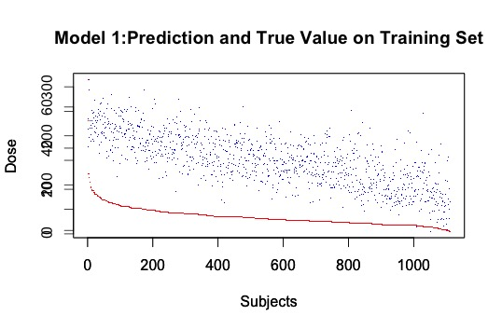
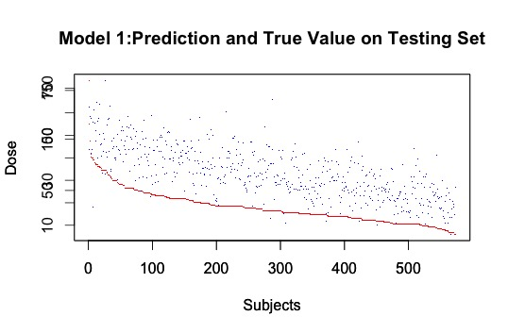
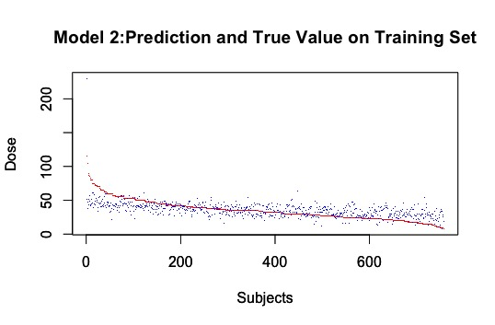
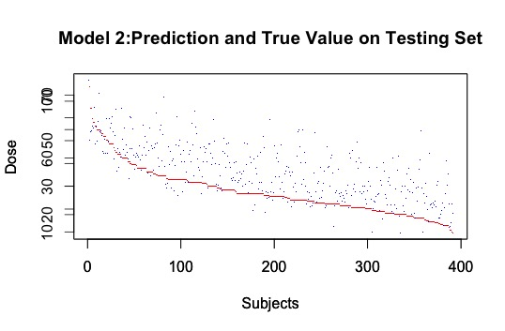
Performance

Slide 12
Conclusion
Filtering out data based on which variables are least informative performed better than the method of filtering out data based on missingness.
Both models still over fit
Weight and the variant at rs9923231 shows to be significant in both models
Have more than one variant in CYP2C9 may give us more information, than just one variant.

Slide 13
Next steps
Power calculation
Combine filtering methods 1 and 2
Throw out outlier data
Maximum warfarin dosage
Add BMI variable to model

Slide 14
Acknowledgments
Blanca Himes
Ryan Urbanowicz
Casey Greene
Shana McCormack
Struan Grant

