Slide 1
Finding out a suitable location in Hong Kong to open a Bollywood themed restaurant
Subhra misra

Slide 2
background
A Famous Indian restaurant chain wants to open Bollywood themed restaurant in Hong Kong.
The chain wants to expand its presence in South East Asia and chose Hong Kong as it has high number of People of Indian Origin (POI) and Bollywood cinema is very popular there.
Main USP of the restaurant chain is movie inspired décor and Indian cuisine.
It is also known for inviting Bollywood celebrities for events and handing out movie tickets, movie hall food coupon etc. during festive seasons.

Slide 3
Criteria for selecting restaurant location
Target customers: Movie going crowd, POIs and NRI Indians.
Restaurant should have one or more favorite cinemas of the stakeholders nearby. List of such cinemas provided by stakeholders.
Having shopping places, amusement parks or other places of interest are a plus as that will ensure more visibility.
Good public transport is a must. Public transport facilities within 5-minute walking distance is preferable.

Slide 4
Data acquisition & Processing
The existing list of cinemas in Hong Kong are available in the website https://hkmovie6.com/cinema
Stakeholders have given a list of their favorite cinemas and ranking of the cinemas The cinemas are ranked in a scale of 1 to 5 where 1 is least favorite and 5 is most favorite. The below is the list of the favorite cinemas:
Name | Rating | Address | Latitude | Longitude
Broadway Circuit - MONGKOK | 4.5 | 6-12 Sai Yeung Choi Street, Mongkok, Kowloon | 22.317077 | 114.170662
Broadway Circuit - The ONE | 4.5 | 6-11/F, The ONE, No. 100 Nathan Road, Tsim Sha... | 22.300058 | 114.172667
Grand Ocean | 4.3 | Ocean Centre, 3 Canton Road, Kowloon | 22.295165 | 114.169176
The Grand Cinema | 3.4 | 2/F, Elements, 1 Austin Road West, Kowloon | 22.304118 | 114.161466
AMC Pacific Place | 2.3 | Level 1, Pacific Place, 88 Queensway Road, Hon... | 22.277673 | 114.165566
UA IMAX @ Airport | 1.5 | 6P059, Level 6, Terminal 2, 1 Sky Plaza Road, ... | 22.316668 | 113.937787

Slide 5
Data acquisition & Processing
Based on the requirement we conducted some market analysis and came up with five possible locations for the restaurant. The locations are given below:
Location | Address | Latitude | Longitude
L1 | Sau Mau Ping Shopping Centre, Sau Mau Ping | 22.319503 | 114.232187
L2 | Tuen Mun Ferry, Tuen Mun | 22.371780 | 113.966039
L3 | Un Chau Shopping Centre, Cheung Sha Wan | 22.337280 | 114.156457
L4 | Prosperity Millennia Plaza, North Point | 22.291698 | 114.208168
L5 | Tsuen Fung Centre Shopping Arcade, Tsuen Wan | 22.372112 | 114.119317

Slide 6
Data acquisition & Processing
Based on the requirement we identified the below 6 categories of venues one or more of which type should be nearby to the location of the restaurant. The venues are:
Food – other restaurants and coffee shops
Bus stop
Metro station
Shop & Services
Arts & Entertainment
Night life
We used Foursquare API to find the list of such venues around the cinemas in the mast list as well as surrounding the proposed locations.

Slide 7
Data cleaning
While processing the master list of cinemas in Hong Kong we found many cinemas with duplicate address. These are generally ‘Special Houses’ associated with a main cinemas. We removed such entries.
We also dropped unnecessary attributes from the data set.
As we found only 2 nightlife spots in our dataset of venues nearby cinemas, we ignored this venue category.

Slide 8
Data analysis
We performed the following data analysis methodologies
Generated descriptive statistics that summarize the central tendency, dispersion and shape of a dataset's distribution.
Created distribution plot diagrams for each venue category from the master list of cinemas to better visualize frequency of distribution of each type of venue.
Performed regression analysis and used P-Value analysis to find out the best possible location for opening the restaurant.
Visualized the data in a map of Hong Kong where we showed the master set of cinemas ,favorite cinemas provided by stakeholders and proposed location and tried to figure out which was the best location in terms of nearness to one or more of the favorite cinemas listed by the stakeholders as well as by the number and type of venues nearby.

Slide 9
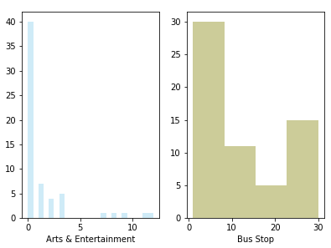
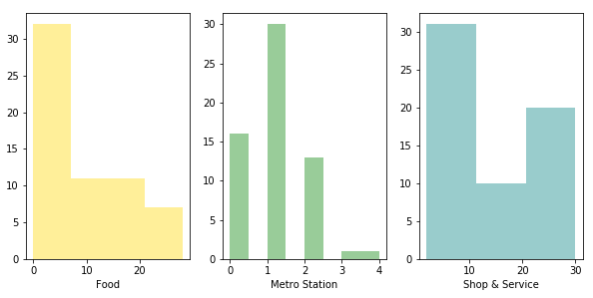
distribution plot diagrams for each venue category

Slide 10
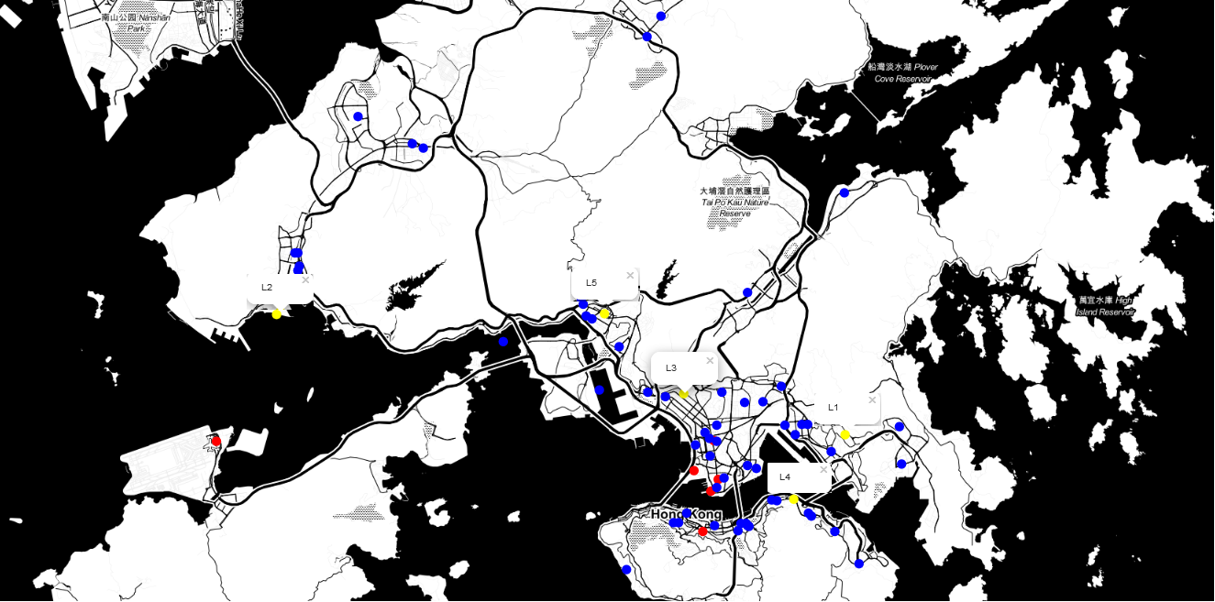
Cinemas in Hong Kong
Proposed locations
Favorite locations

Slide 11
P-Value analysis
Category | Arts & Entertainment | Bus Stop | Food | Metro Station | Shop & Service
Arts & Entertainment | strong | strong | strong | weak | strong
Bus Stop | strong | strong | strong | strong | strong
Food | strong | strong | strong | strong | strong
Metro Station | weak | strong | strong | strong | strong
Nightlife Spot | strong | moderate | moderate | no | moderate
Shop & Service | strong | strong | strong | strong | strong
The correlation between 'Food', 'Bus Stop', 'Metro Station' and 'Shop & Service' categories are strong and significant.

Slide 12
Result
The result of our data analysis is represented in the form of a table which gives a numeric rating to each one of the 5 proposed venues suitable for opening the restaurant. To generate the table we followed following mechanism:
We used Content-Based recommendation systems as we have a list of cinemas which are preferred by the stakeholders.
Taking weighted average of every location based on the profile we recommended the top location that is most suitable for the new Bollywood themed restaurant.
To draw our conclusion, we created the final sorted and weighted data which is given below.
Location | Address | Latitude | Longitude | Rating
L5 | Tsuen Fung Centre Shopping Arcade, Tsuen Wan | 22.372112 | 114.119317 | 0.869006
L3 | Un Chau Shopping Centre, Cheung Sha Wan | 22.337280 | 114.156457 | 0.660942
L4 | Prosperity Millennia Plaza, North Point | 22.291698 | 114.208168 | 0.546807
L2 | Tuen Mun Ferry, Tuen Mun | 22.371780 | 113.966039 | 0.136733
L1 | Sau Mau Ping Shopping Centre, Sau Mau Ping | 22.319503 | 114.232187 | 0.053035

Slide 13
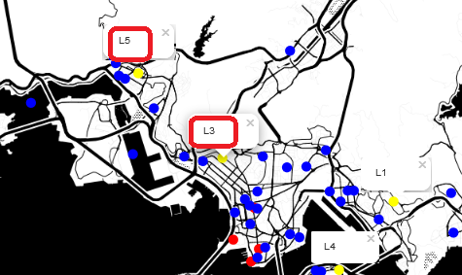
discussion
From the table in previous slide we can see that location L5 has the greatest number of venues such as shops, bus stops, metro stations near to it. However, from the map, we can’t find any of the stakeholder’s favorite cinemas near to L5 locality. Also, there are only 3 other cinemas near to it.
From the map we can see that venue L3 is near to 3 of the favorite cinemas and this location has many other cinemas surrounding it. It also has the second highest number of bus stops, metro stations and shops in the vicinity.

Slide 14
conclusion
Our team has decided to propose the location L3 with address Un Chau Shopping Centre, Cheung Sha Wan to the stake holders based on the following observations:
Movie goers are our target consumers and hence nearness to many cinemas, including favorite cinemas, is a must.
The brand can continue with its existing strategy of giving out movie tickets, food coupons and inviting celebrities with greater success in a locality populated with movie going crowd.
This location (L3) is well surrounded with venues such as bus stops, metro stations, shops etc. which is great for pulling family crowd.

