Slide 1
ML PIPELINE PROJECT
Body Performance
Full ML Pipeline · Data Cleaning · EDA · Feature Engineering · 5 Models
13,393
12
5
Records
Features
ML Models

Slide 2
Project Overview
Data Cleaning
Dataset Overview
Medical-grade limits
Duplicate removal
Blood pressure validation
13,393 rows × 12 columns
Target: class (A/B/C/D)
Regression: broad_jump_cm
Exploratory Data Analysis
Feature Engineering
Distributions, boxplots
Correlation heatmap
KDE & scatter plots
BMI, grip_per_weight
fitness_composite, bp_diff
7 engineered features
5 ML Models Trained
Evaluation & Tuning
KNN · Logistic/Linear
Decision Tree · SVM · MLP
Classification + Regression
GridSearchCV tuning
5-Fold Cross Validation
Final leaderboard ranking

Slide 3
Data Cleaning — Medical Grade
Data Type Verification
Missing Values
age, diastolic, systolic, sit-ups counts
Converted float64 → int64
Prevents misleading decimal output
0 missing values across all 12 columns
No imputation required
Confirmed by count + percentage check
Duplicate Rows
Medical Limits Validation
1 exact duplicate detected and removed
Prevents over-representation bias
Final shape: 13,392 rows
Physiological bounds: age 20–90, height 25–220cm
Rows outside clinical ranges dropped
Domain-informed — not statistical IQR
Blood Pressure Logic
Medical rule: diastolic < systolic always
Rows violating this are recording errors
Dropped impossible BP readings

Slide 4
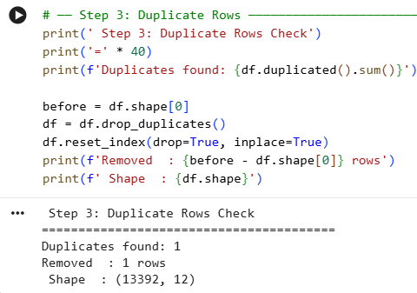
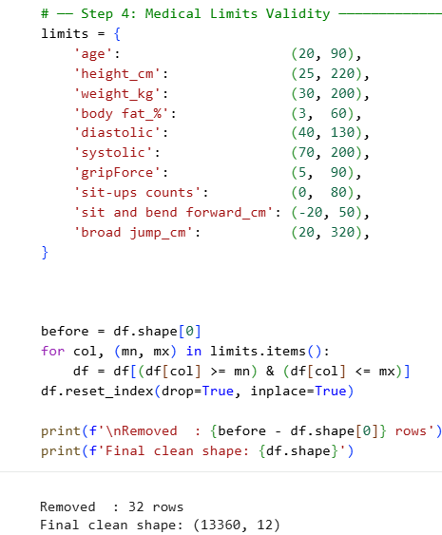
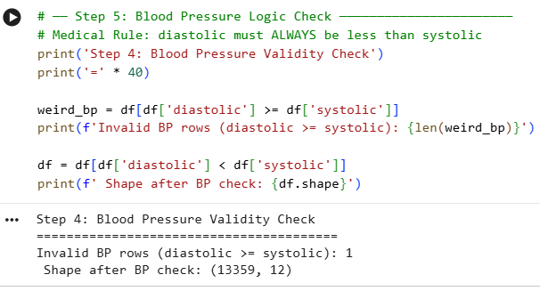
Project Overview
01
Data Cleaning
Duplicate removal
Medical-grade limits
Blood pressure validation
06

Slide 5
Dataset & Features
Column | Type | Description
age | Numeric | Age in years
gender | Categorical | M / F
height_cm | Numeric | Height (cm)
weight_kg | Numeric | Weight (kg)
body fat_% | Numeric | Body fat percentage
diastolic | Numeric | Diastolic BP
systolic | Numeric | Systolic BP
gripForce | Numeric | Grip strength (kg)
sit & bend fwd | Numeric | Flexibility (cm)
sit-ups counts | Numeric | # of sit-ups
broad jump_cm | Numeric | Regression target
class ★ | Target | A=Best → D=Worst
13,392
Clean Records
4 Classes
A · B · C · D
Balanced
~25% per class
0 Missing
No imputation

Slide 6
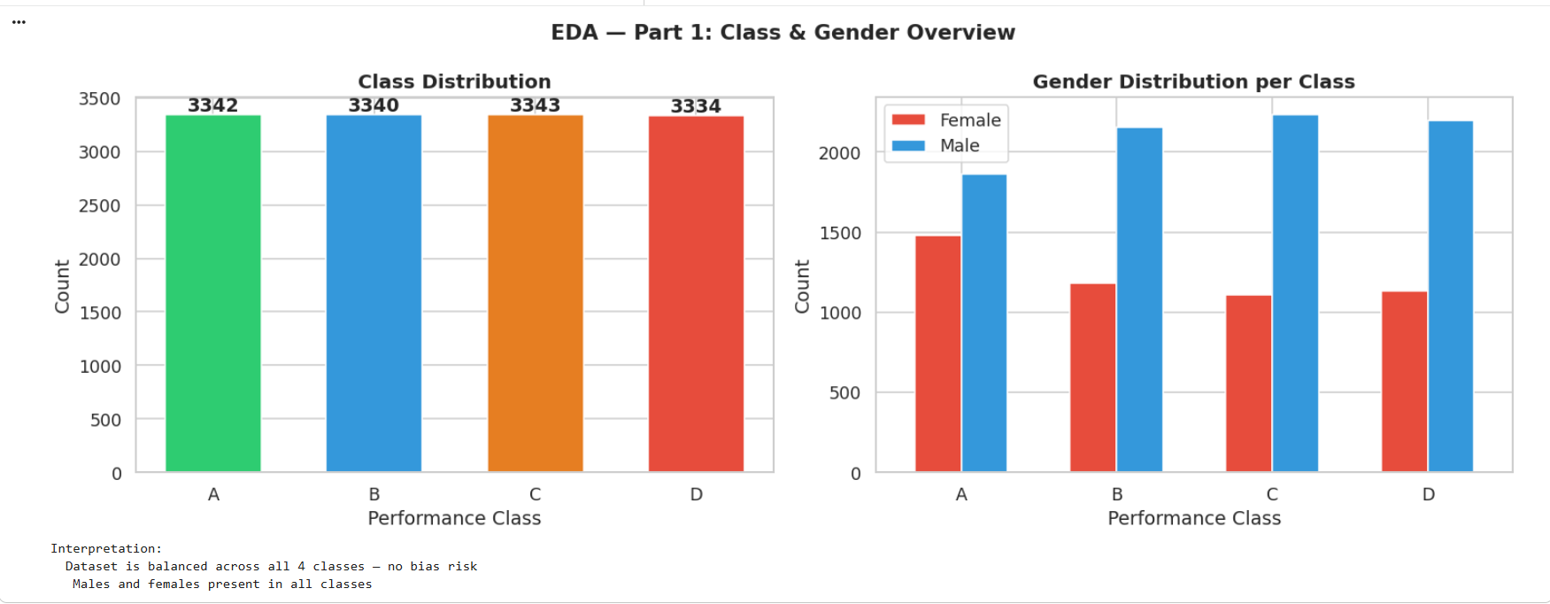
Project Overview
Dataset Overview
02
03
04
13,359rows × 12 columns
Target: class (A/B/C/D)

Slide 7
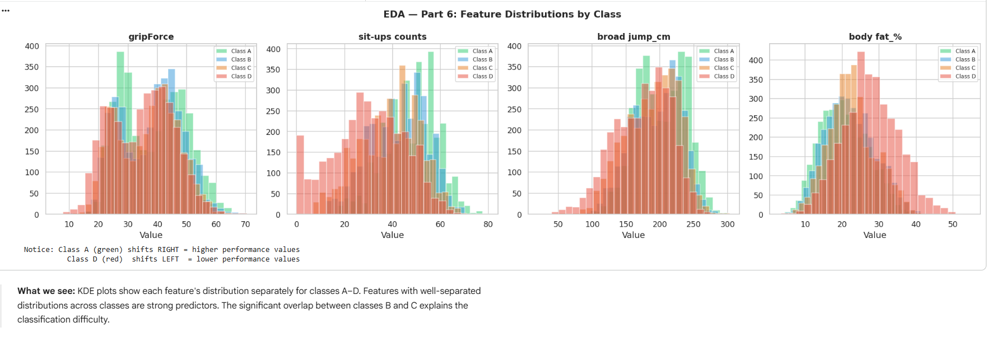
Project Overview
Exploratory Data Analysis
Distributions, boxplots
Correlation heatmap
KDE & scatter plots

Slide 8
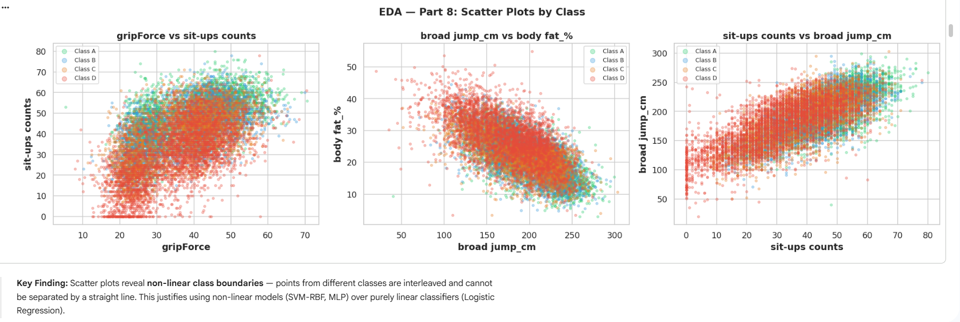
Project Overview
Exploratory Data Analysis
Distributions, boxplots
Correlation heatmap
KDE & scatter plots

Slide 9
Feature Engineering & Preprocessing
BMI
grip_per_weight
weight / height²
gripForce / weight
Body composition index
Relative strength (fair comparison)
fitness_composite
bp_diff
sit-ups×0.4 + jump×0.4 + grip×0.2
systolic − diastolic
Single overall fitness score
Pulse pressure — cardiovascular health
age_fat_interaction
jump_per_weight
age × body fat%
broad jump / weight
Aging amplifies fat impact
Explosive power relative to body size
situp_per_age
sit-ups / age
Endurance adjusted for age

Slide 10
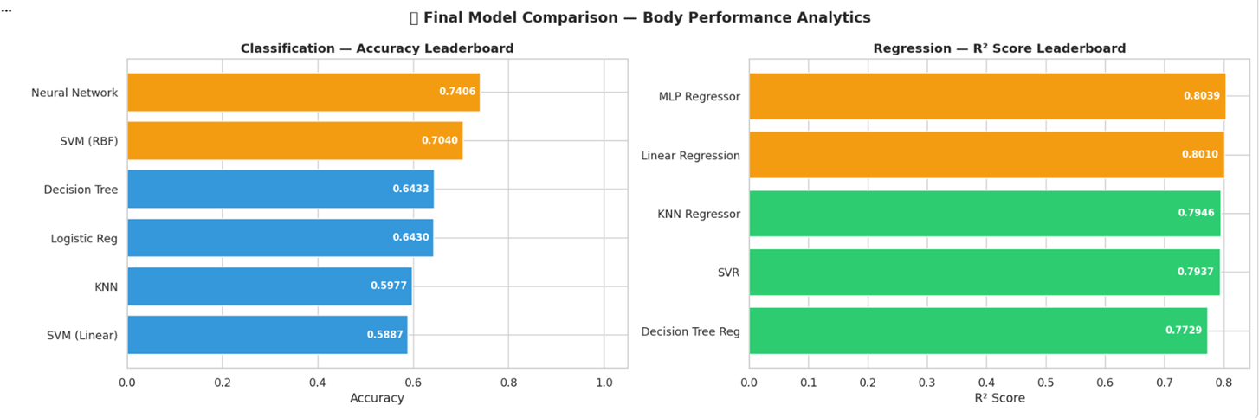
Machine Learning Models

Slide 11
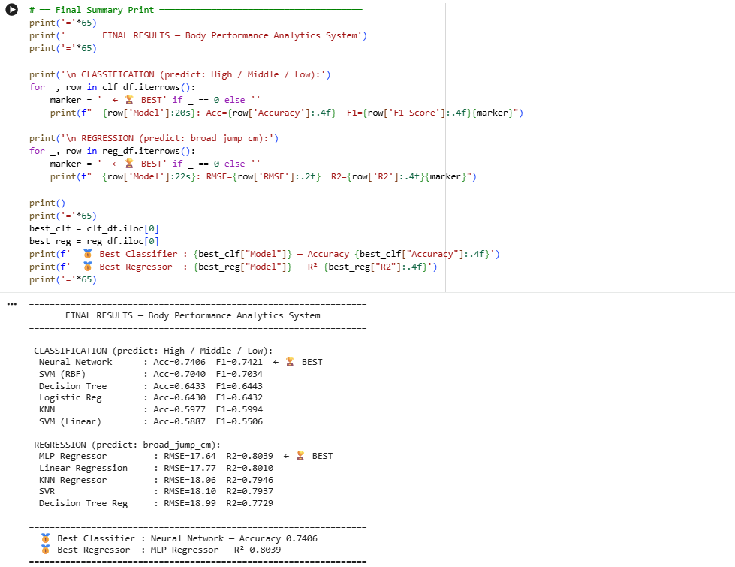
Final Results — Model Leaderboard

Slide 12
✓
✓
Thank You
✓

