Slide 1
Lesson Objectives
Construct truth tables for a given logic statement (AND, OR NOT)
Produce logic statements for a given problem
Literacy – Key Words
Binary Logic | Also known as Boolean Logic, it is the process of reducing values to either True or False, in order to perform calculations.
Logic Gate | A logic gate is a building block of the digital circuitry found in a CPU. It performs a logical operation on the inputs it receives.
Truth Table | A table showing all possible outputs from the various combinations of inputs that a gate can be supplied with.

Slide 2
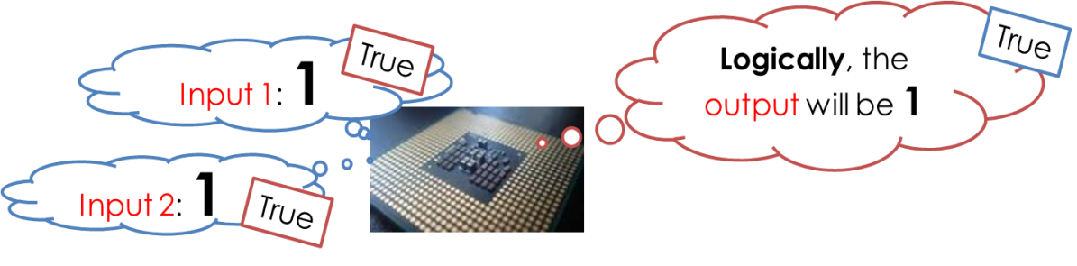
What is Logic? What is Binary Logic?
Human logic works with rules / facts / statements which are either True or False.
Computers have been designed to do the same.
Binary logic is what a CPU uses to make decisions based on the inputs it receives.
The CPU (like us) will take inputs which may be true or false (1 or 0) and make a decision which will produce a particular output.

Slide 3
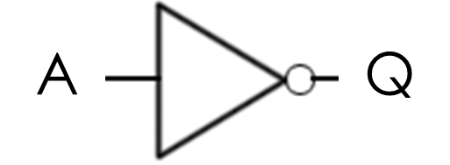
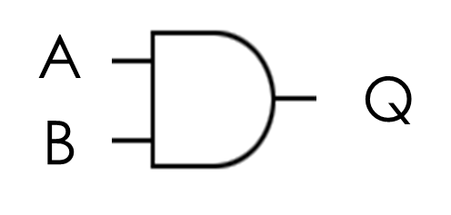
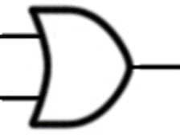
Binary Logic gates
Electronics engineers have developed components that can carry out the AND, OR and NOT logic operations. The are made up of transistor switches arranged in particular ways.
The NOT gate produces an output which is the reverse of the input. | Q = NOT A
The rule for this gate is that if both A and B are True then the output is also True, otherwise it is False. | Q = A AND B
The rule for this gate is that if either input, or both inputs are True then the output is also True. | Q = A OR B
A | Q
0 | 1
1 | 0
A | B | Q
0 | 0 | 0
1 | 0 | 0
0 | 1 | 0
1 | 1 | 1
A | B | Q
0 | 0 | 0
1 | 0 | 1
0 | 1 | 1
1 | 1 | 1
A
Q
B

Slide 4
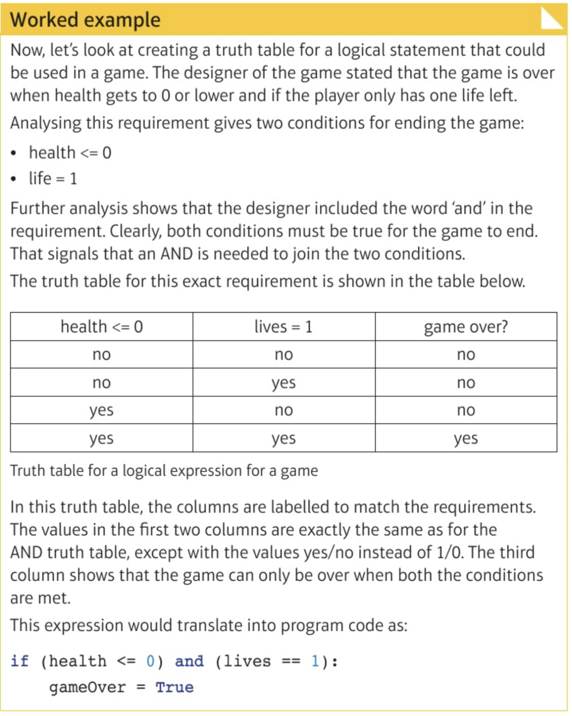
Worked Example
The designer of the game stated that the game is over when health gets to 0 or lower and if the player only has one life left.
The two conditions for ending the game:
health <=0
life = 1
Both conditions must be True to end the game (AND)

