Slide 1
Learning Aims
Describe different input devices
Explain how different input devices can be applied as a solution to different problems
Describe how different output devices can be applied as a solution to different problems

Slide 2
Input Devices
Manual | Automatic
Keyboards Touch-sensitive keyboards and concept keyboards Touch screens Graphical tablets Mice Image capture Web Cams and microphones Voice recognition Scanners Digital Cameras Biometric devices – Fingerprint, facial, and retinal scanning | Automatic data input methods: Bar codes Laser scanners Camera based readers Radio Frequency Identification (RFID) Data logging: Heart rate sensor GPS (receiver) Accelerometer/gyroscope/motion sensor Thermometers, light and UV sensors, skin response sensors, magnetometers, gyrometer, ECG etc.

Slide 3


Optical recognition
Optical recognition refers to technologies that enable computers to identify and interpret visual information.
1. Optical Character Recognition (OCR)
Recognizes printed or handwritten text in images or documents.
Used for: document scanning, digitizing books, extracting text from images.
2. Intelligent Character Recognition (ICR)
An advanced form of OCR that recognizes handwritten characters more accurately.
Used for: handwritten forms, surveys, notes.
3. Optical Mark Recognition (OMR)
Detects marks or checkboxes on paper forms.
Used for: multiple-choice tests, ballots, surveys.
4. Optical Barcode Recognition
Reads 1D barcodes (e.g., UPC, EAN).
Used for: retail checkout, inventory systems.
5. QR Code Recognition
Detects and decodes 2D QR codes.
Used for: payments, authentication, linking URLs.

Slide 4
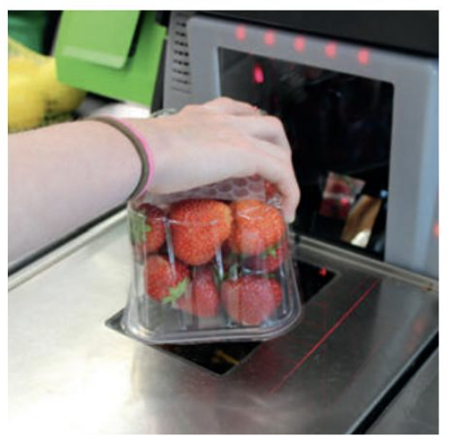
Readers
Laser Scanners
Laser scanners work like pen scanners but use a laser beam as the light source. They are commonly seen in supermarket checkout counters. They are reliable, low-cost, and suitable for low-volume scanning.
Camera-Based Readers
These scanners use a camera and image processing to read 1D and 2D barcodes. They can scan barcodes from paper, screens, or damaged labels.
They are used for:
• Age verification (e.g., scanning a driver’s licence)
• Digital couponing (scanning 2D codes from phones at checkout)
• Event ticketing (scanning electronic tickets from screens)
Consumers can also use smartphone cameras to scan QR codes to:
• View catalogues
• Play media
• Access product information

Slide 5
Question
Mastercard is testing a new app that allows customers to make purchases online by taking a selfie rather than entering a password.
Currently, Mastercard customers enter a password at the point of sale to verify their identity, but these can be forgotten, stolen or intercepted.
Participants in the trial are prompted to take a photograph of their face using the Mastercard app, which is then converted to a binary code using facial recognition technology.
This is then compared with a stored code and if the two match up, the purchase is approved.
1. Do you see any problems with this procedure?
2. What other forms of identification could be used for this application rather than entering a
password?
Some users may not know how to take a photo on their phone, or may not have a mobile phone.
Some phones may be out of battery power.
The software may not recognise the face if a beard has been grown, hair style changed, etc.

Slide 6
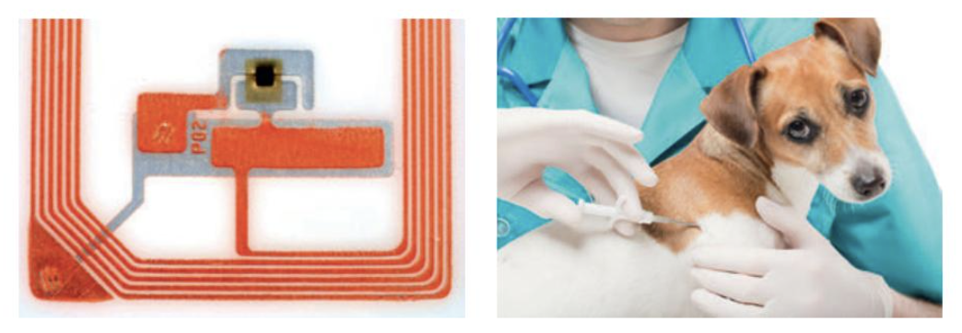
Radio Frequency Identification (RFID)
RFID technology uses both input and output. A reader picks up signals from an RFID chip, and an active RFID tag can also send signals back.
Like barcodes, RFID tags are used to identify and track many things—products, cars, bank cards, and even animals.
But unlike barcodes, RFID tags do not need a line of sight and can be read from up to 300 metres away. They can also send stored data to the receiver and sometimes receive data back.
An RFID tag has two main parts:
a tiny microchip (often smaller than 1 mm)
an antenna (which must be larger to allow communication)
Because of the antenna, the smallest tags are about the size of a grain of rice. These are often placed in capsules and implanted under the skin of pets for identification.

Slide 7
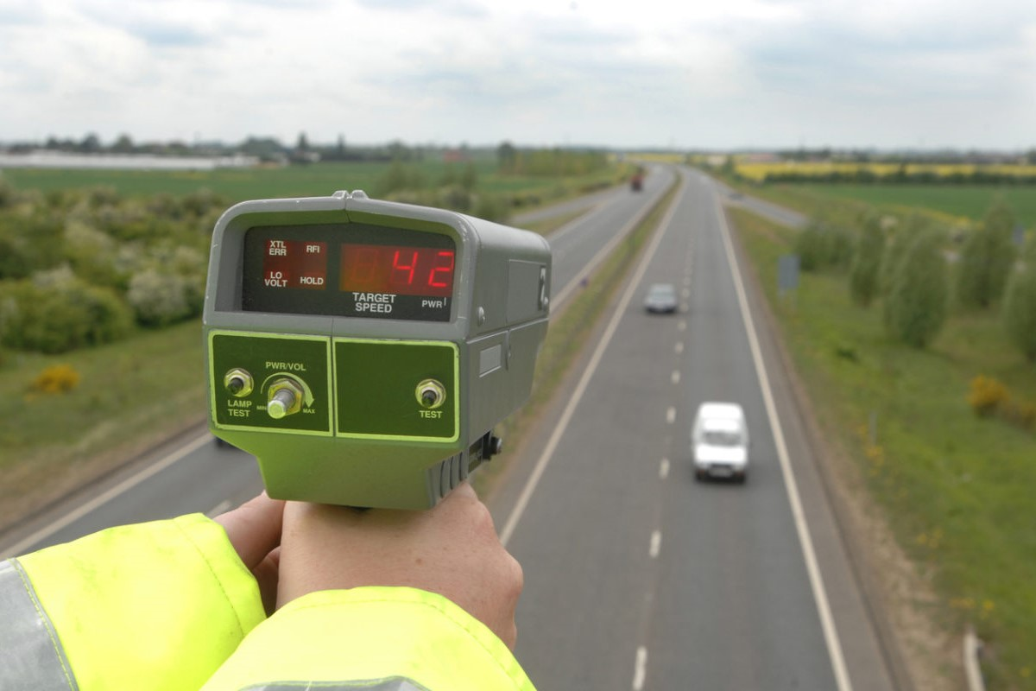
Passive and active tags
Active tags are physically larger as they include a battery to power the tag so that it actively transmits a signal for a reader to pick up. These are used to track things likely to be read from further away, such as cars as they pass through a motorway toll booth or runners in a marathon as they pass mile markers. | Passive tags are much cheaper to produce as they do not have a battery. They rely on the radio waves emitted from a reader up to a metre away to provide sufficient electromagnetic power to the card using its coiled antenna. Once energised, the transponder inside the RFID tag can send its data to the reader nearby. These are most common in tagging items such as some groceries, music CDs, and for smart cards such as Transport for London’s Oyster Card or a contactless bank card.

Slide 8
Output devices
Output devices take data produced by the computer and turn it into a form that humans can understand.
This could be, for example, written or spoken text, an image on a screen, music or a multimedia presentation.
A different type of output device is an actuator, which might respond to an input signal to turn on a sprinkler, open or close windows in a greenhouse, or perform any number of other actions.
Common output devices include screens, printers, multimedia projectors, speakers and actuators.

Slide 9
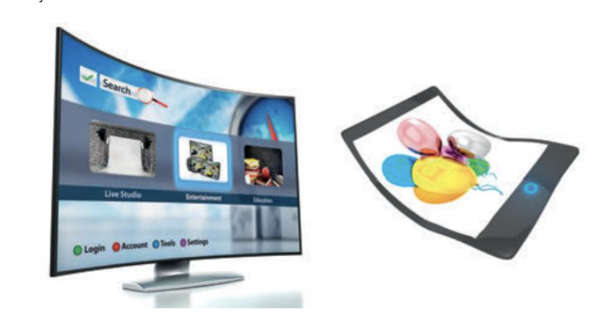
Organic LED (OLED) screens
OLED screens are brighter, thinner, and lighter than traditional LCD or LED screens. They use plastic instead of glass, which makes them flexible.
OLEDs can be used anywhere LCDs are used, such as TVs, computer monitors, phones, and MP3 players. In the future, they could be used for flexible billboards, ultra-thin e-book pages, wall-sized digital art, or even clothing as part of wearable technology.
Advantages of OLEDs over LCDs
Can be flexible when made from plastic
Much thinner
Brighter and do not need backlighting, so they use less power and save battery
Refresh much faster (up to 200 times faster), useful for fast-moving images
Better, more accurate colours, even when viewed from the side
Drawback
They don’t last as long—wearing out about four times faster than LCDs
Very sensitive to water, which can be a problem for devices like phones

Slide 10
Printers
Laser printers Laser printers offer high-quality, high-speed printing. Their function is similar to that of a photocopier, using powdered ink called toner. This type of printer is becoming increasingly affordable and is frequently used as a home printer, in businesses and in professional printing services. Colour laser printers are far more expensive to run than black and white versions. They contain four toner cartridges (Cyan, Magenta, Yellow and Black or CMYK) and the paper must go through a similar process to the black-only printer four times; once for each colour. The usage of laser printers for print jobs other than text is limited by the quality of the print produced, which at about 1200 dpi makes photorealistic prints impossible and best left to inkjet printers. | Inkjet printers Inkjet printers work by spraying minute dots of ink onto paper to create an image. Depending on the resolution (dots per inch) of the model, the number of colour cartridges used and the quality of the paper being used, they can produce excellent, photo-realistic images. They are cheaper than laser printers but much slower, and the ink cartridges have to be replaced quite frequently. Given the choice, it is preferable to use a laser printer when a lot of text needs to be printed, and an inkjet printer to produce high quality photographic images.
Dot matrix printers These are known as impact printers. The print head has a matrix of pins which strike the surface of the paper through an inked ribbon to form letters. These printers are useful when multi-part stationery is required, and they can operate in damp or dirty environments. However, they are noisy, slow and the print quality is poor. | 3-D printers 3D printers have been used to create car and aeroplane parts, medical equipment, prosthetic limbs, fashion accessories and a multitude of other items. They have even, controversially, been used to produce working firearms and other weapons. They are used for creating spare parts for obsolete equipment and to produce prototypes of new products. They can be used in many situations where a one-off item is required, for example to fill in the missing parts of a dinosaur skeleton or a 2000-year old artefact.

Slide 11
Multimedia projectors
What are the benefits of using a multimedia presentation in a classroom?
There are many benefits both to teachers and students:
in the bad old days 20 or more students would crowd around a desk trying to catch a glimpse of what the teacher was demonstrating on a 16” screen.
copying down notes written on a chalkboard or whiteboard was a chore
having an image to focus on while the teacher is explaining something can aid concentration
watching educational videos or even live webcams adds interest to the lesson
From the teacher’s point of view, being able to prepare the lesson in advance and deliver it to several different groups without having to write the same thing on the board every lesson, means the lessons are consistent in quality.
With the aid of a projector, the teacher can present text, graphics, audio and video on the screen, display images or videos from the Internet, display PC applications or programs, and use the screen interactively, adding impact to every lesson.
Multimedia projectors are now viewed as essential classroom tools.

Slide 12
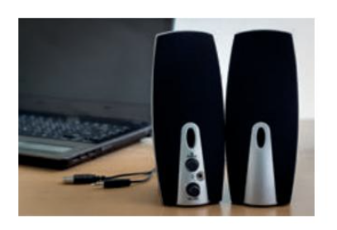
Computer speakers
PCs, smartphones and other portable devices generally have a basic inbuilt speaker which can be used to output music, voice or sound tracks from a video.
High quality speakers can be bought separately and when in use, they disable the inbuilt speakers.
Apart from playing music and video soundtracks, uses include giving verbal instructions in a sat-nav system, reading text from the screen for visually impaired people, giving warning beeps and notification alerts (e.g. when you receive an email).

Slide 13
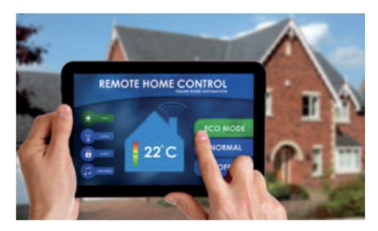
Actuators
Actuators are motors that are commonly used in
conjunction with sensors to control a mechanism,
for example:
• opening a window or valve
• starting or stopping a pump
• turning a wheel
• moving an aircraft aileron
• controlling devices in a “smart home”

Slide 14
Learning Aims
Storage devices
• Know the main uses of magnetic, flash and optical storage devices

Slide 15
Common storage technologies
There are three main types of technology for storage.
These are solid state, magnetic and optical.

Slide 16
The need for secondary storage
A computer’s primary store is Random Access Memory.
Unlike RAM, secondary storage is not directly accessible to the processor and has slower access speeds.
Secondary storage, however, has the advantage that it retains its contents when the computer’s power is turned off.
This includes the computer’s internal hard disk, optical media and solid state disks.

Slide 17
How storage devices store data
Hard disks, optical disks and solid state disks all use different methods to store data, but in each case, use a technique which allows them to create and maintain a toggle state without power to represent either a 1 or a 0.

Slide 18
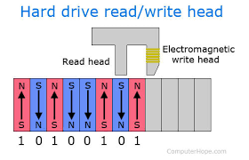
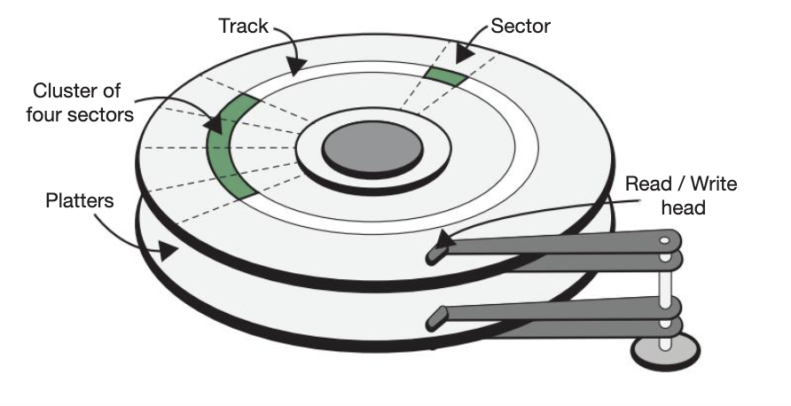
Magnetic Hard Disk
A hard disk stores data on rigid spinning platters coated with magnetic material. Tiny iron particles on the surface are magnetised as either north or south, representing 0s and 1s.
The disk is organised into tracks (circles) and sectors (sections of those circles).
It spins very fast—up to 10,000 times per minute.
A drive head, similar to a needle on a record player, moves across the disk to read or write data as the platter spins underneath it. When not in use, the head is moved safely to the side to avoid damage.
A hard disk often has multiple platters, each with its own drive head.
Less portable than optical or solid state media,
Huge capacity makes them very suitable for desktop purposes.

Slide 19
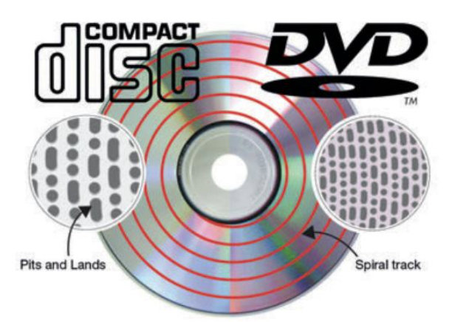
Optical disk
Optical disks work by using a laser. A high-powered laser “burns” tiny marks onto the disk surface, making those spots less reflective.
A low-powered laser is then used to read the disk by measuring how much light is reflected back.
On a manufactured CD-ROM, the surface contains tiny pits and flat areas called lands.
Where pits begin or end, less light is reflected, and these differences in reflection are read as 0s and 1s.
Read-only (e.g., CD-ROM)
Recordable (e.g., CD-R)
Rewritable (e.g., CD-RW)
Optical storage is very cheap to produce and easy to send through the post for distribution purposes.
It can however be corrupted or damaged easily by excessive sunlight or scratches.

Slide 20
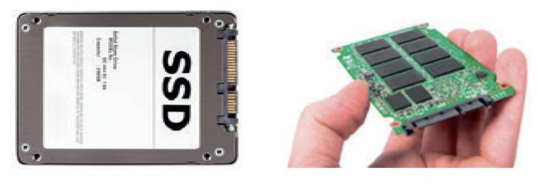
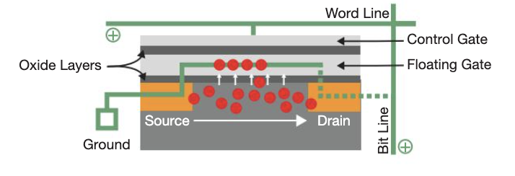
Solid-state disk (SSD)
Solid state drives (SSDs) are made to look like traditional hard drives (usually 2.5 or 3.5 inches) so they can fit into existing laptops and desktop computers.
But inside, instead of spinning platters and a read/write head, an SSD contains chips arranged on a circuit board.
SSDs use NAND flash memory, which is made up of millions of tiny memory cells plus a controller to manage how data is stored.
Each NAND cell stores data by trapping electrons:
  If the floating gate has no charge, it is read as 1
  If the floating gate has some charge, it is read as 0
Data is stored in pages (about 4 KB each), which are grouped into blocks (often around 512 KB).
NAND flash cannot overwrite existing data. Before new data can be written:
The old block must be erased.
A new block is created and filled with updated data.
The old block is marked as “invalid” and later erased when needed.
This process is why SSDs must manage data carefully behind the scenes, even though they appear simple to the user.
Solid state drives (SSDs) don’t hold as much data as hard disks, but they are much faster.
Because they have no moving parts, any piece of data can be accessed instantly, no matter where it is stored.
SSDs also:
use much less power, which improves battery life and keeps laptops cooler
are more durable because there are no fragile moving parts
are silent, lighter, and very portable
These advantages make solid state memory ideal for phones, MP3 players, and other mobile devices.

Slide 21
The uses of storage devices
When comparing and contrasting different storage devices, we could use a number of criteria:
The type of technology they used (solid state, magnetic or optical).
How fast the media can be accessed.
Whether data can be accessed directly or serially.
How much data can be stored on the media.
What the media might typically be used for.
How commonly used the media is.
The cost of the media and the cost of the actual device used to read from or write to it.
Whether the media is read-only or read-write.
Whether the storage medium is 'virtual' and requires an Internet connection or physical.
How portable the device is.

Slide 22
How the capacity of secondary storage media is measured
Data storage is measured in 'bytes'. When you talk about storage media, however, you quickly end up talking about thousands of bytes, millions of bytes, millions and millions of bytes and so on. There are lots of different ways of talking about these large numbers. We have met the following summary before:
1 Kilobyte (1 Kbyte) is 1024 bytes exactly, or 210 bytes exactly, or about 1000 bytes, or about a thousand bytes.
1 Megabyte (1 Mbyte) is 1048576 bytes exactly, or 220 bytes exactly, or about 1000 000 bytes, or about a million bytes.
1 Gigabyte (1 Gbyte) is 1073741824 bytes exactly, 230 bytes exactly, or about 1000 000 000 bytes, or about a thousand million bytes.
So 15 Kbytes is about 15 thousand bytes. 128 Mbytes is about 128 million bytes. 20 Gbytes is about 20 thousand million bytes. More often than not, you don't need to know the exact number of bytes, just an approximation!

