Slide 1
Predicting accident severity
Coursera Capstone Project

Slide 2
Introduction and business problem
First responders to vehicle accidents include both emergency first aiders, fire fighters and the police department
Government departments providing first response to accidents usually have limited resources and manpower
Data science can help to predict the severity of an accident being reported such that allocation of resources can be made more efficient

Slide 3
Data
The dataset consists of vehicle collisions reported and compiled by the SPD and the Traffic Department of Seattle from 2004 to present
The data set consist of 38 columns and 194673 rows of data
The data contains the severity of the accident and other attributes that are commonly reported or collected in the course of an accident report
These attributes can be used to predict the severity of an accident

Slide 4
Methodology
Extract the relevant attributes required for the project
"SEVERITYCODE", "ADDRTYPE", "COLLISIONTYPE", "PERSONCOUNT", "VEHCOUNT", "WEATHER", "ROADCOND", "LIGHTCOND"
Identify and drop missing data
Simplify values of data for weather, road condition and light condition by grouping values into commonly reported information
Encode dummy variables for categorical data in the attributes
Compute correlation matrix and drop highly correlated attributes
Scale and split data into training and testing set
Perform Decision Tree and Logistic Regression on training and use these models on test data
Compute accuracy, Jaccard, F1 and LogLoss scores, and confusion matrix

Slide 5

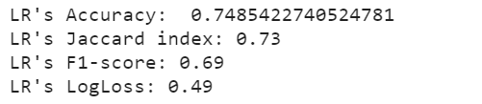
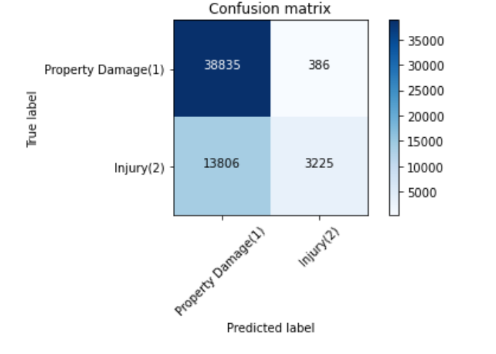
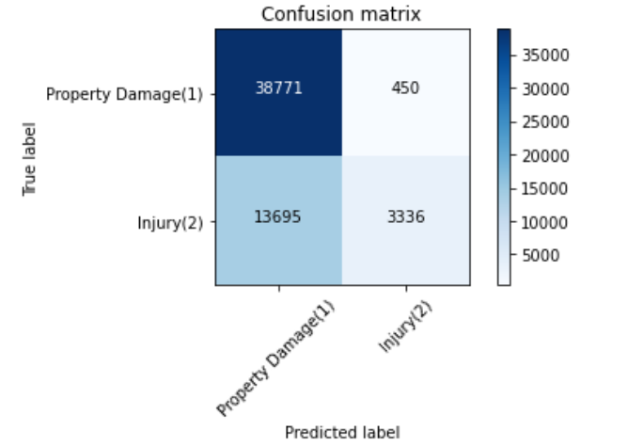
Results
Decision Tree
Logistic Regression
Models appear to be able to predict well when it is a property only damage
However, models appear to be weak in predicting when personnel injury is involved,

Slide 6
Discussion
Models may not be as useful in ruling out those accidents where there may not be any injury to people
In the dataset, there were many more instances of property damage type of accident as compared to injuries, which may have skewed the dataset
Possible improvements may be to balance out the number of accidents involving property damage only and those involving injury to increase precision of model
Randomly replicating the data which shows that the accident involves personnel injury so that there is more training data
Utilise cross validation so that the model has more data to train on

