Slide 1
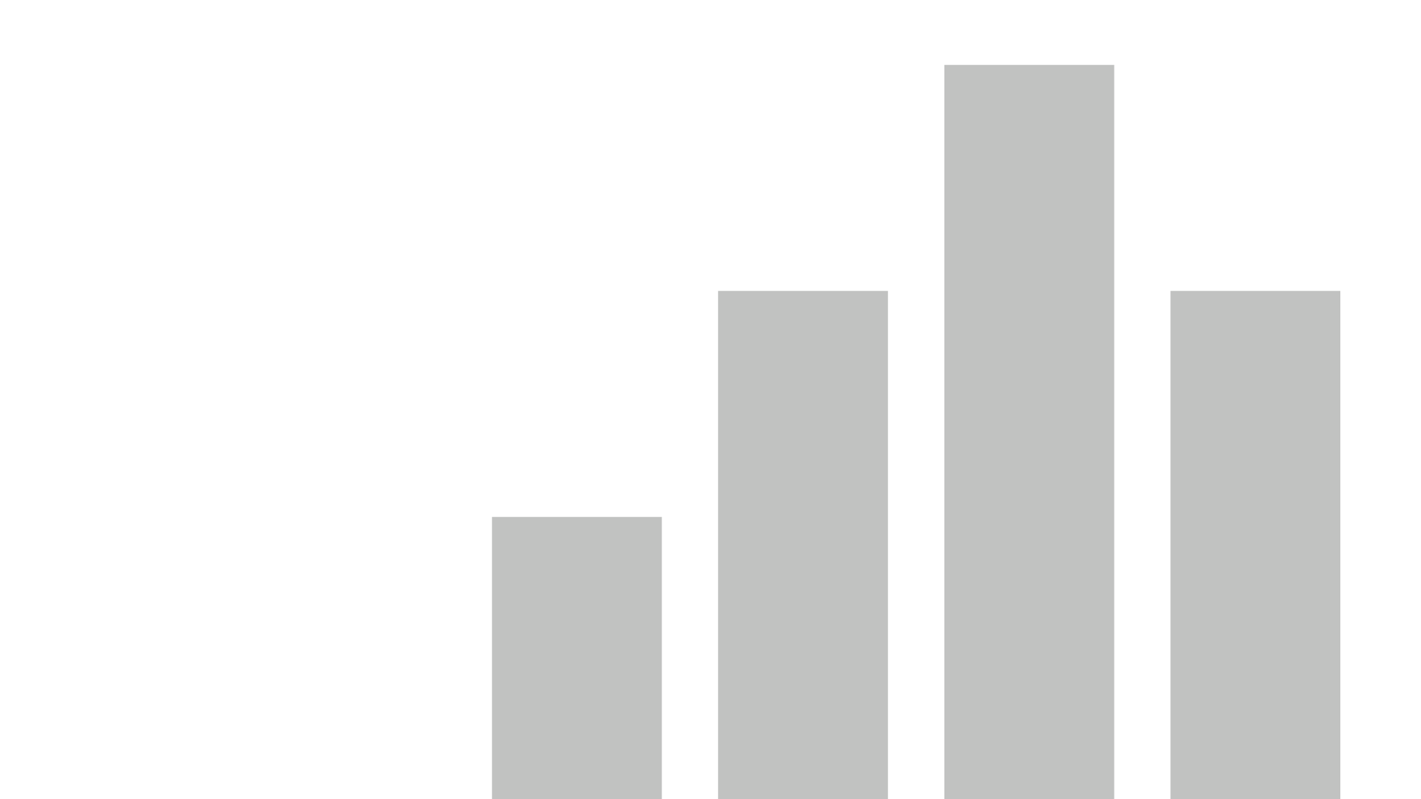


Dashboard_TendenciaCrimes
View in Power BI
Last data refresh:
20/03/2025 16:10:41 UTC
Downloaded at:
20/03/2025 16:18:45 UTC

Slide 2
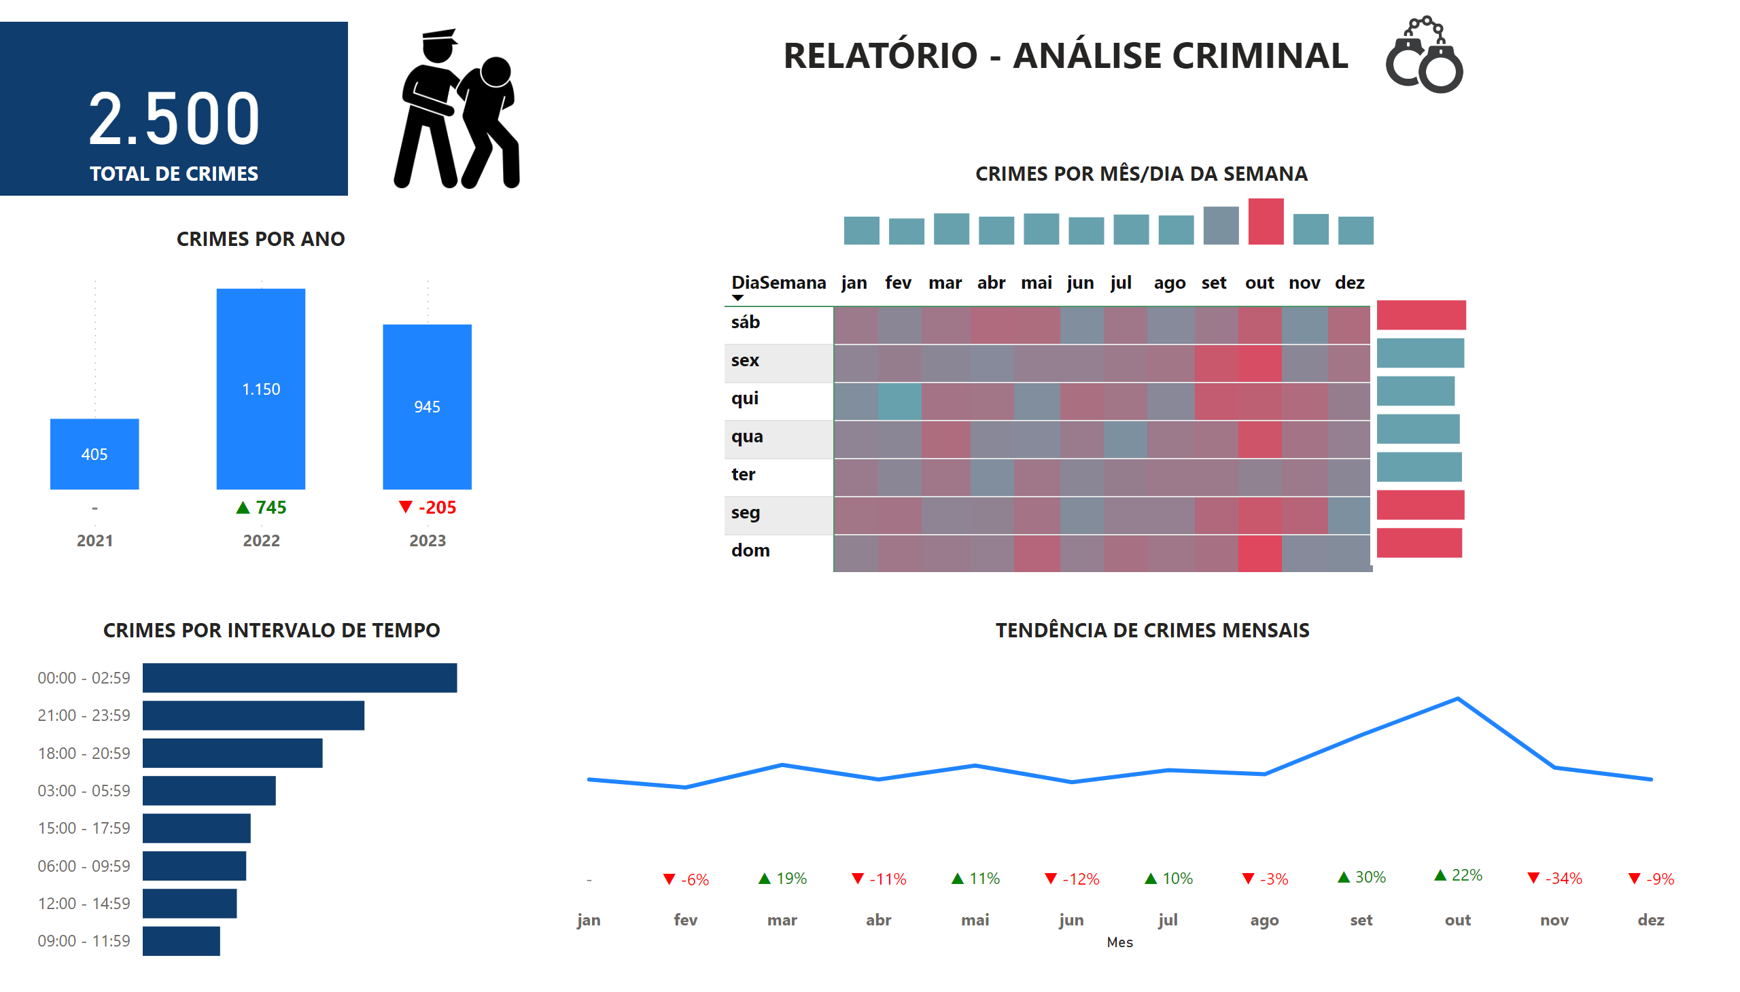
RELATÓRIO
Notes:
card
No alt text provided
columnChart
No alt text provided
lineChart
No alt text provided
barChart
No alt text provided
pivotTable
No alt text provided
clusteredColumnChart
No alt text provided
clusteredBarChart
No alt text provided
textbox
No alt text provided
textbox
No alt text provided
textbox
No alt text provided
textbox
No alt text provided
textbox
No alt text provided
textbox
No alt text provided
image
No alt text provided
image
No alt text provided

