Slide 1



Dashboard_Pacientes
View in Power BI
Last data refresh:
20/03/2025 16:39:55 UTC
Downloaded at:
20/03/2025 16:41:13 UTC

Slide 2
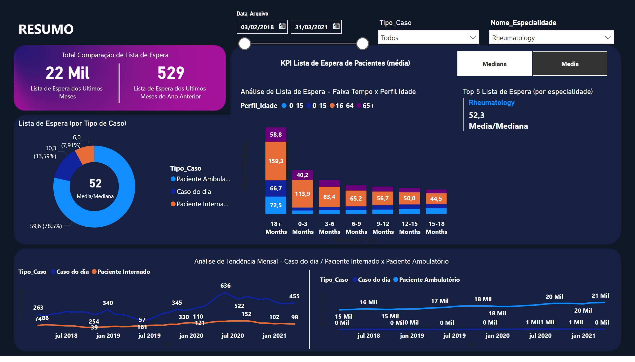
Resumo
Notes:
card
No alt text provided
card
No alt text provided
lineChart
No alt text provided
slicer
No alt text provided
card
No alt text provided
textbox
No alt text provided
card
No alt text provided
textbox
No alt text provided
shape
No alt text provided
card
No alt text provided
textbox
No alt text provided
card
No alt text provided
slicer
No alt text provided
slicer
No alt text provided
Lista de Espera (por Tipo de Caso)
No alt text provided
slicer
No alt text provided
Top 5 Lista de Espera (por especialidade)
No alt text provided
Análise de Lista de Espera - Faixa Tempo x Perfil Idade
No alt text provided
lineChart
No alt text provided
shape
No alt text provided

Slide 3
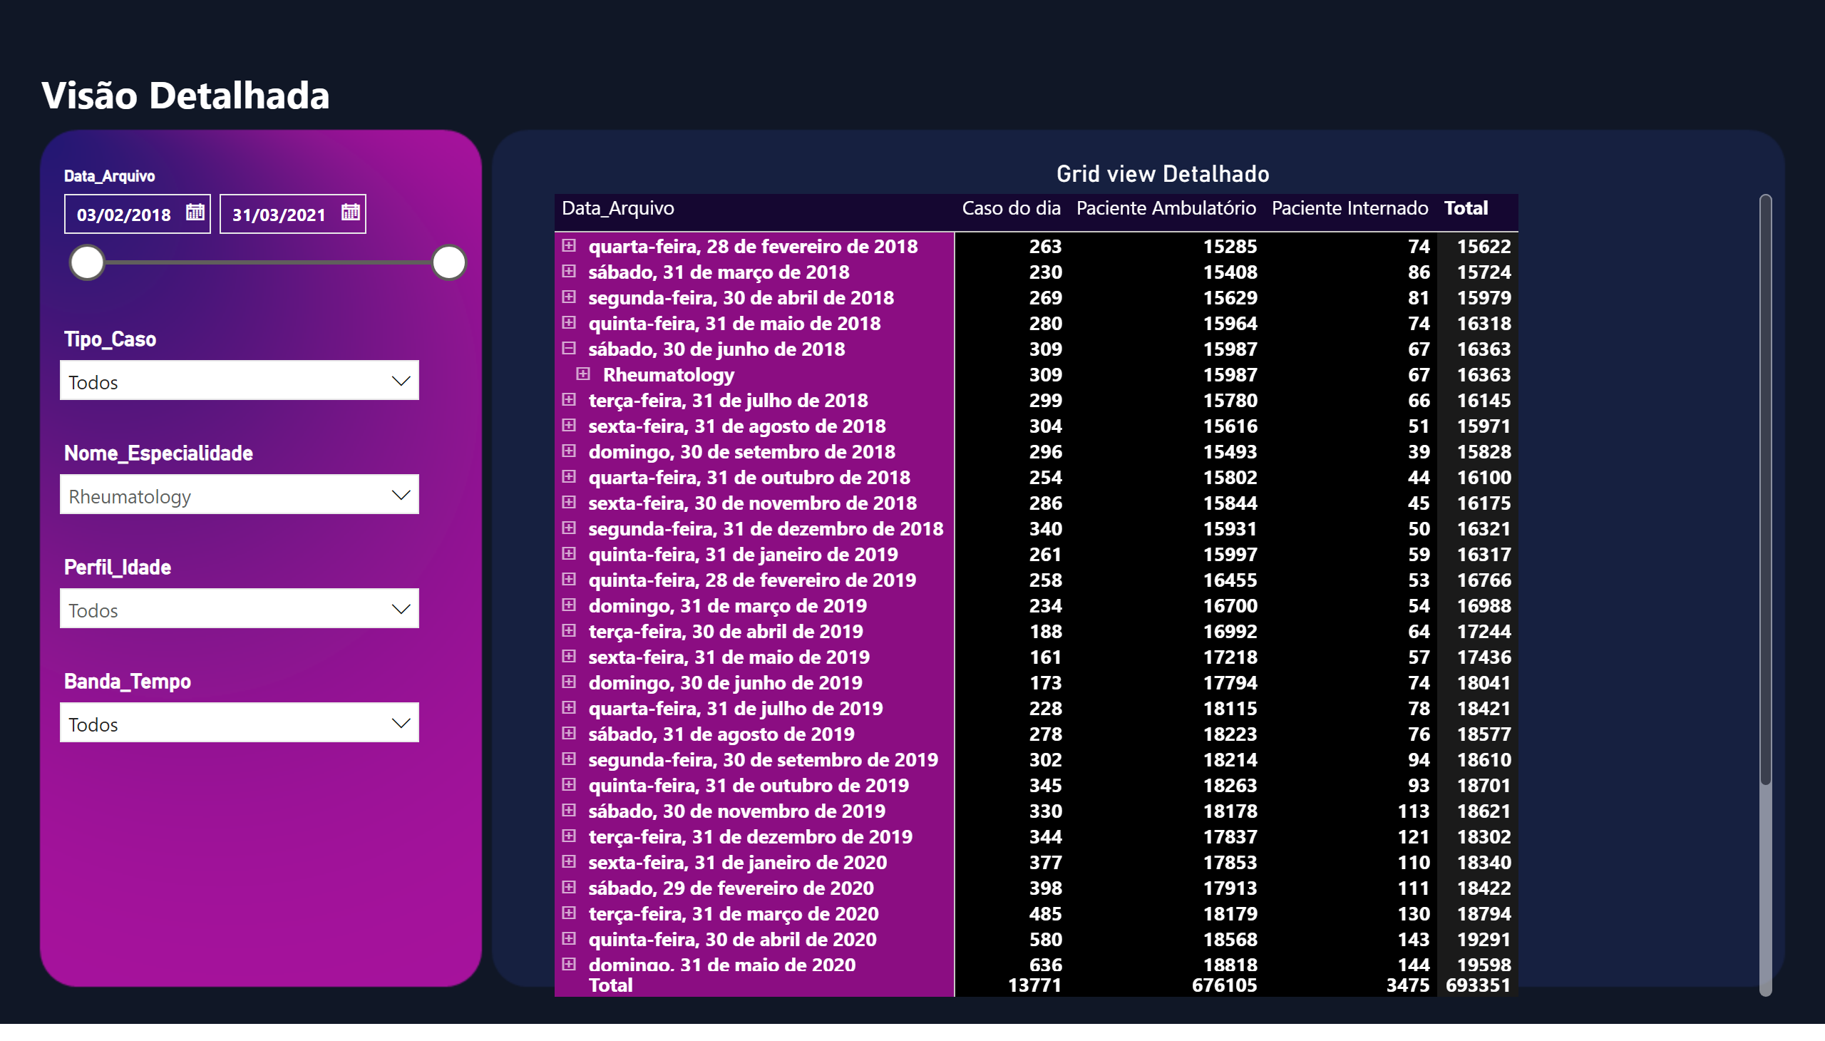
Detalhes
Notes:
slicer
No alt text provided
slicer
No alt text provided
Grid view Detalhado
No alt text provided
slicer
No alt text provided
slicer
No alt text provided
slicer
No alt text provided
textbox
No alt text provided

