Slide 1


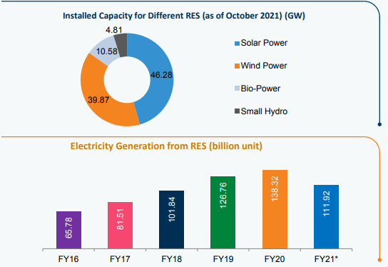

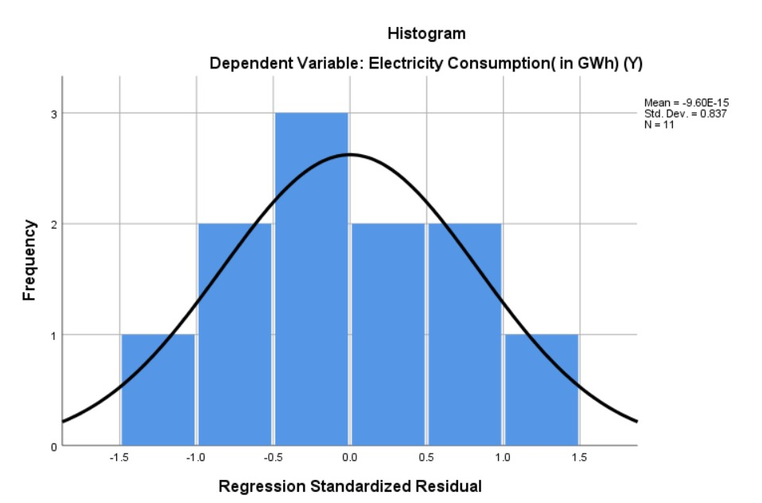
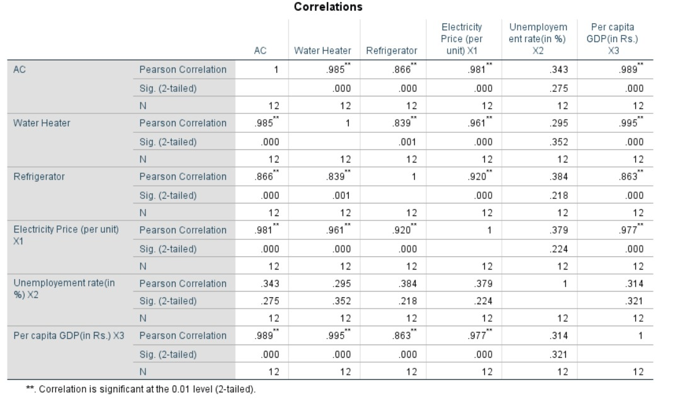
Track Name: B
Analytics with Python
Understanding power consumption in Indian states
Team Name :
Goal Hackers
Akansha Khatuwala -RBA_004
Anant Kalamkar - PG_064
Bhakti Andurkar - RBA_017
Ruchit Makwana- RBA_045
Anuja Biyani- RBA_011
Electricity consumption in Indian homes has tripled since 2000. The percentage of households with access to electricity has increased from 55% in 2001 to more than 80% in 2017.
To understand the trend in consumption of power in India, we have analysed consumption based on two factors:
Macro (Socioeconomic)
Micro (Direct use)
Primary Research-Macroeconomic Factor
Factors Considered are :
Per capita GDP(GDPt)
Electricity price(Pt)
Unemployment rate(UnEmpt)
Analysing the data from 2010 to 2021 of the Macro economic variables, these are normally distributed and used for the hypothesis testing.
The equation formed using variables for REGRESSION MODEL : Et =α0 + α1GDPt + α2Pt + α3UnEmpt​
Inspiring Innovators
Act with Integrity
Purpose
passionate about learning.
Expectations
We unite to deliver results
We structure our work environment
Goal Hackers
We commit ourselves to continuously improving
Core Values
Everyone is empowered to own their work
seek to constantly improve and innovate
Secondary Research- Microeconomic Factor
Considered the top ten high electricity-consuming appliances and analyzed the consumption of the electrical appliances popularly utilized in households.​
Considered these factors for the correlation with top 3 electricity consuming appliances.
Analysed the output of the correlation so as to concentrate on the factors which are highly impacting electricity consumption
Insights
We have combined the outputs of correlation and regression model to determine the variables and appliances that should be prioritized.
We have concluded that Per capita GDP and Employment rate highly affects the power consumption.
AC, Refrigerators, and Water heaters are the top 3 electricity consuming appliances that should be prioritized.
Solution
The top 3 appliances that consume the maximum electric power should have a sensor installed in them so when appliances are not in use gets automatically switched off to save electricity.
The state government should utilize more renewable energy sources to generate power rather than non-renewable sources of energy.
Time has indirect relation with the efficiency of the appliances, hence the Govt. should also introduce "Policy of Appliance Disposal" to minimize the consumption of electricity.
Way Ahead
We can reduce the electricity consumption by focusing more on renewable sources of energy like production of electricity through solar, hydro and wind energy.

