Slide 1
Data Incubator Capstone Project Proposal
Michelle (Qin) Peng

Slide 2
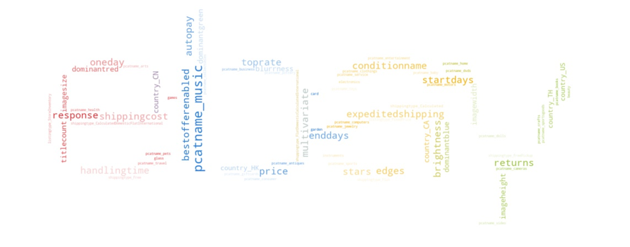
Dataset Overview
Data source:
Ebay API and Ebay WebScrapping
Number of Observations: 708
Response variable:
Sales Percentage (How much is sold)
Features:
31 (Categorical Variables (6), Numerical Variables (25))

Slide 3
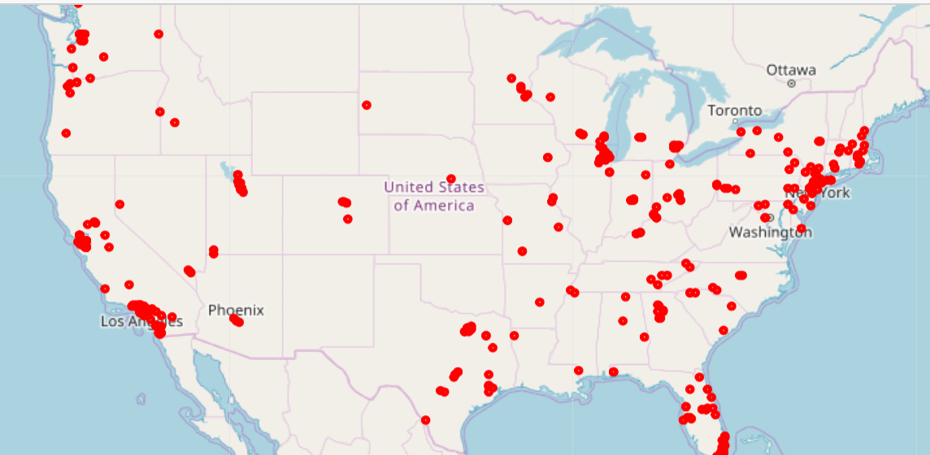

Slide 4
Exploratory Data Analysis

Slide 5
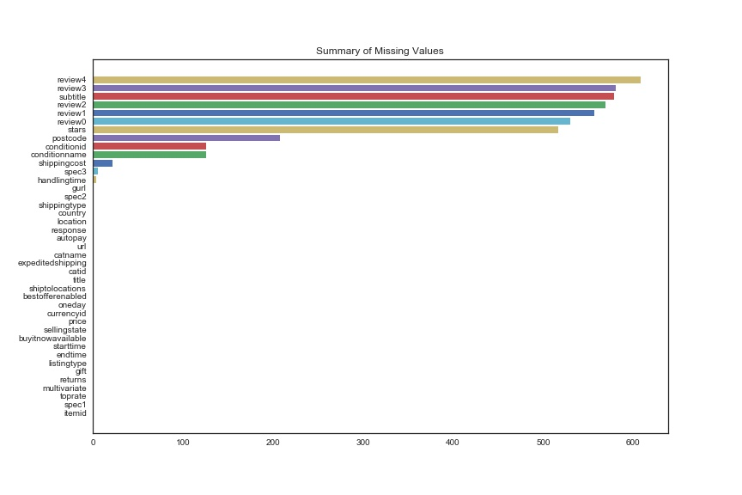
Missing Values

Slide 6
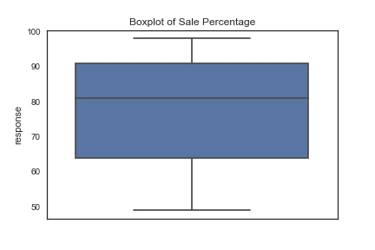
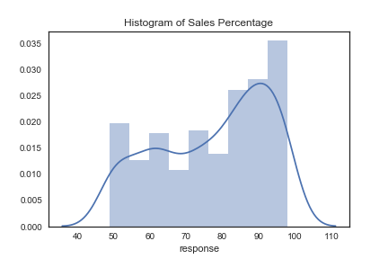
Response Variable: Sales Percentage

Slide 7
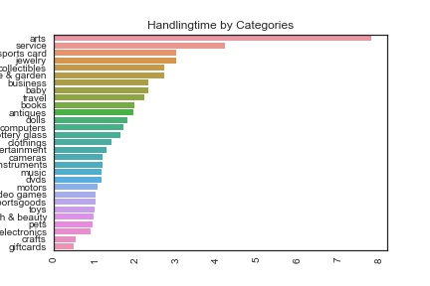
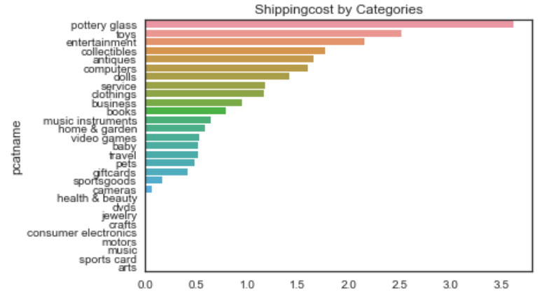
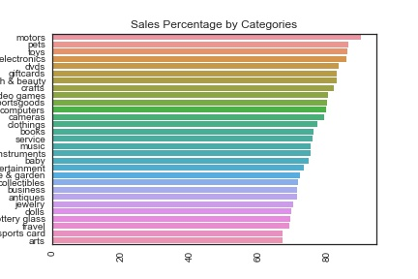
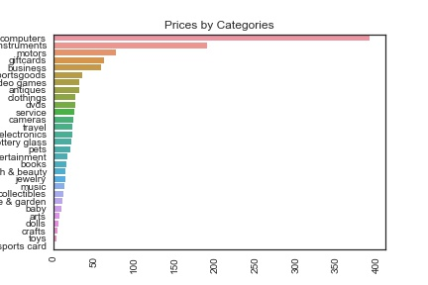

Slide 8
Feature Engineering

Slide 9
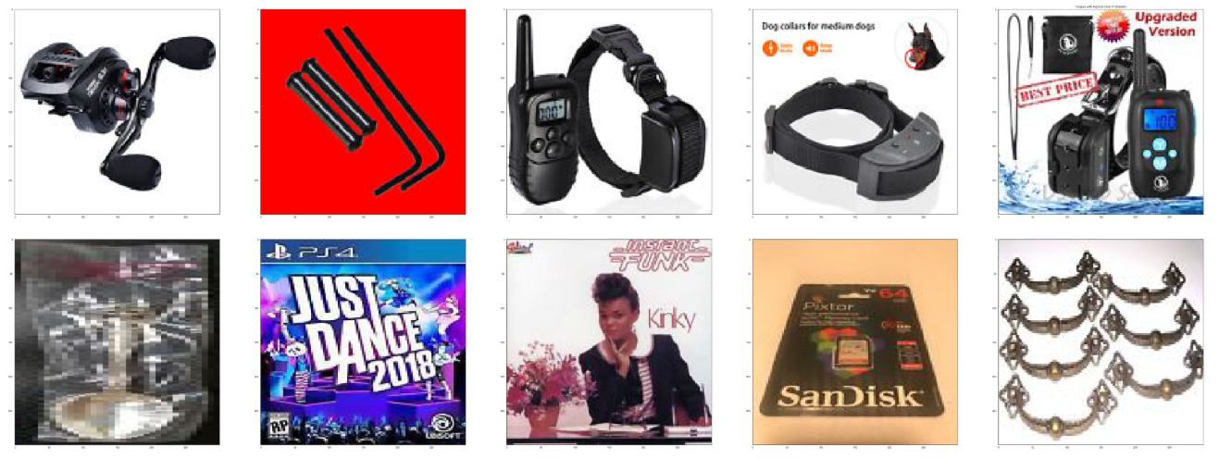
Image Variables:
Each picture is broken into Brightness, Blurness, Dominant Colors, Size

Slide 10
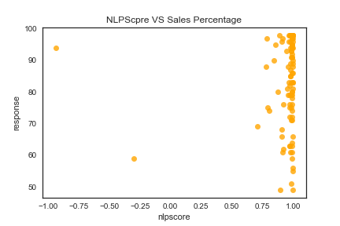
NLP Variables:
A sentiment score is calculated for each review using the VaderSentiment
“I\'m a longtime Shania fan but "Now" is a dud in my books.
It really saddens me to say that.
It\'s very different from what she has previously released
and I just cannot get into it.
If your expecting the sounds you\'ve come accustomed to with..”
{'compound': 0.7781, 'neg': 0.08, 'neu': 0.788, 'pos': 0.132}

Slide 11
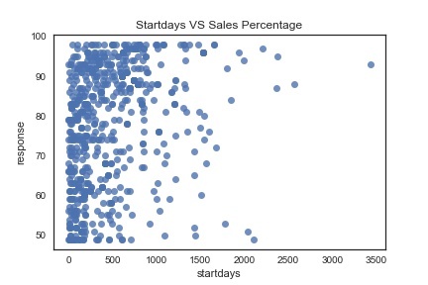
Date Variables
Turns starttime, endtime into startdays, enddays which means how long have the product has been posted(startdays) and how many days left(enddays

Slide 12
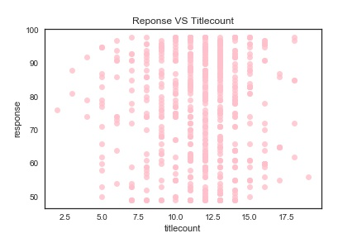
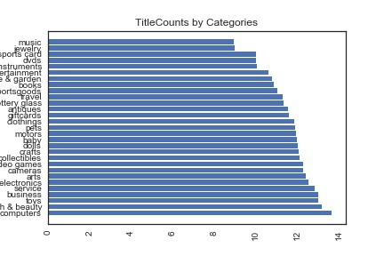
Title Variables
Construct the counts of words in the title.

Slide 13
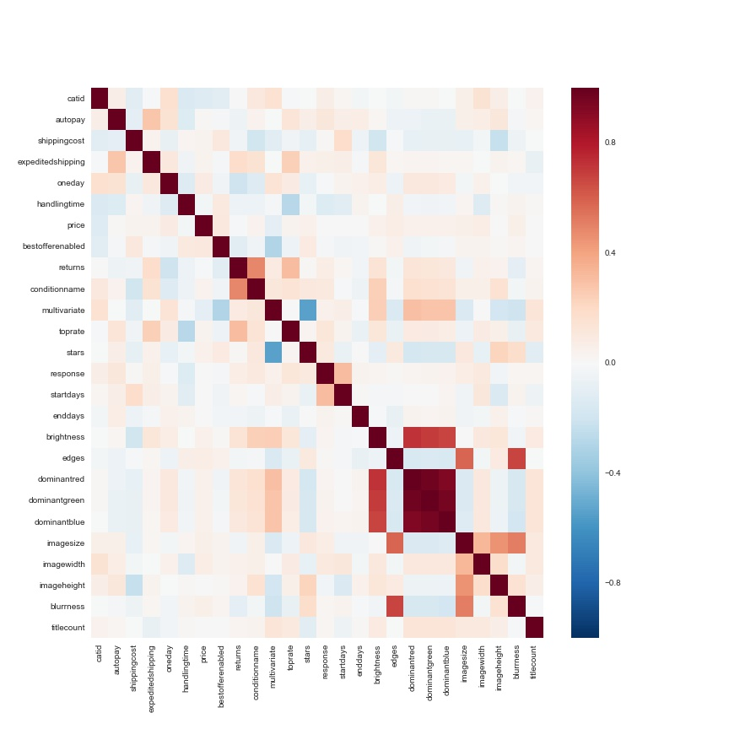
Strong Correlation pairs:
Image colors
Image size VS Image widths & heights
Returns VS ConditionName
Number of Stars VS Multivariate Listing
Sales Percentage VS
Startdays

Slide 14
Basic Model Fitting

Slide 15
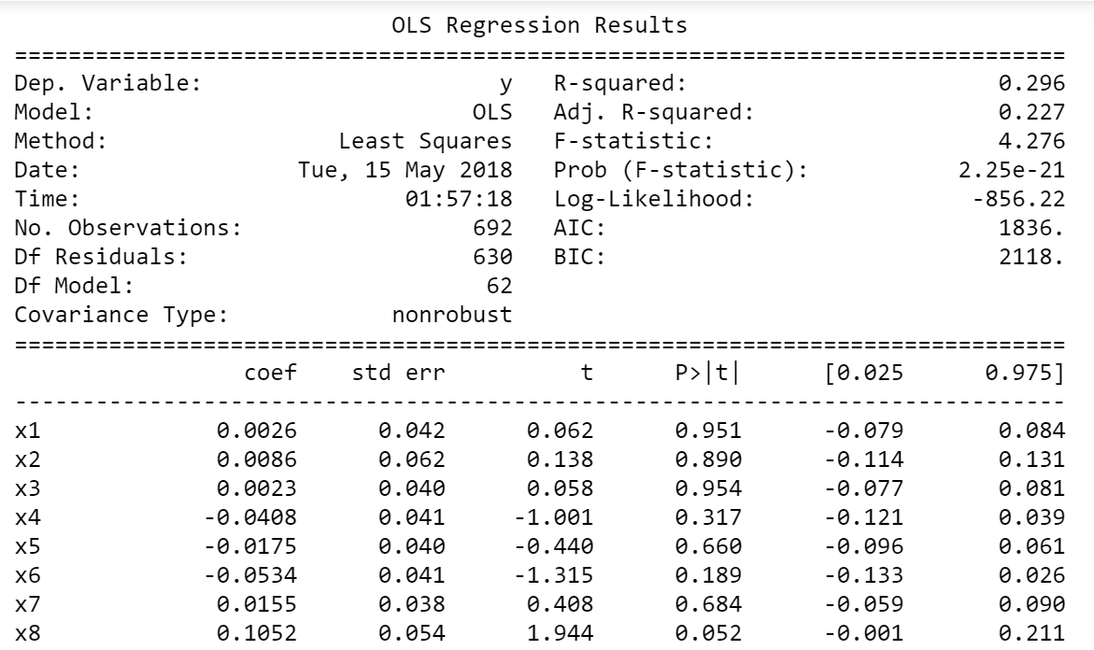

Slide 16
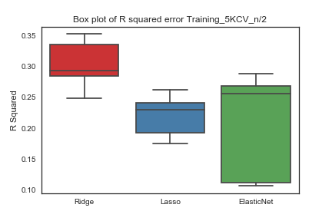
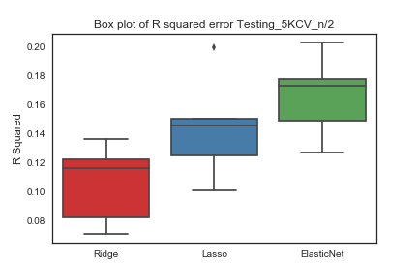

Slide 17
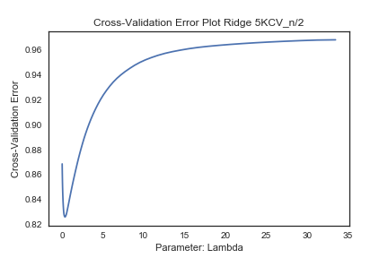
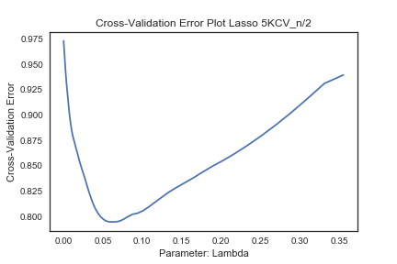
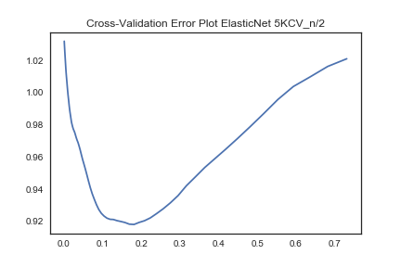
0.384907
5KCV Lambda: 0.062056
5KCV CV Error: 0.794761
5KCV Lambda: 0.384907
5KCV CV Error: 0.826143
5KCV Lambda: 0.181029
5KCV CV Error: 0.918099

Slide 18
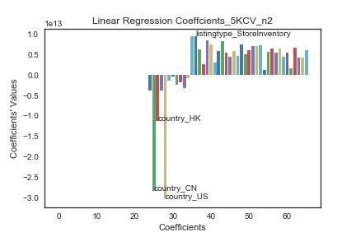
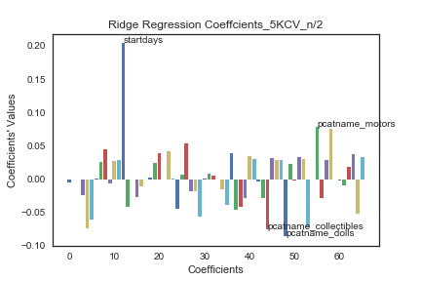
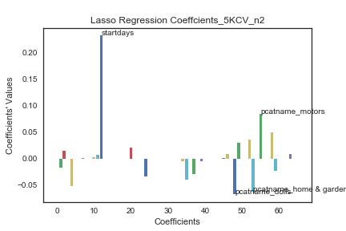
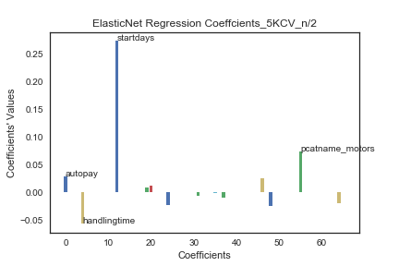

Slide 19
Thanks for watching!

