Slide 1
MongoDB
The storage!

Slide 2
What’s MongoDB
NoSQL database - MongoDB stores data in flexible, JSON-like documents, meaning fields can vary from document to document and data structure can be changed over time.
Use it anytime you want to use data and persist it in your app.
The document model maps to the objects in your application code, making data easy to work with
Mongo is the ‘M’ in MERN

Slide 3
MERN’s - M (MongoDB)
CLIENT (BROWSER)
Client makes a request
ODM for Node and MongoDB. We install it using the npm npm install mongoose
SERVER (NODE)
Mongoose
Server fetches the requested data from DB.
MongoDB

Slide 4
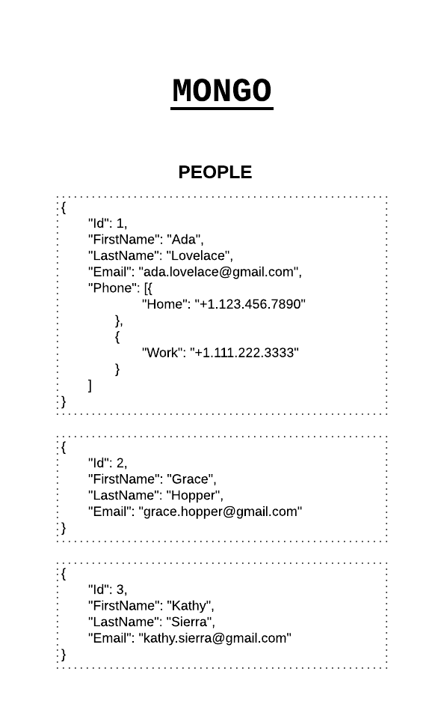
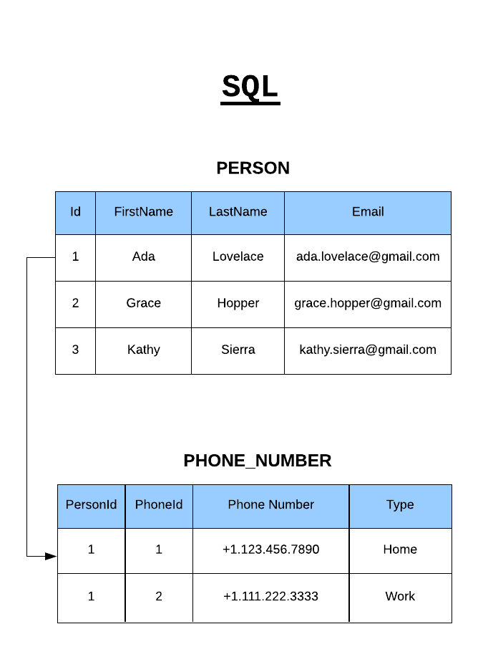
NoSQL vs SQL

Slide 5
Installing MongoDB
Step 1: Download and install MongoDB tool for local here - https://www.mongodb.com/download-center/community Step 2: Since mongoDB automatically looks for data/db in your system. We will create a data/db directory in our root directory (C: if you are using windows).
mkdir data
cd data
mkdir db
Step 3: Run mongo locally. Documentation: https://docs.mongodb.com/manual/tutorial/install-mongodb-on-windows/

Slide 6
Terminologies
Collection - ‘Collections’ in Mongo are equivalent to tables in relational databases. They can hold multiple JSON documents.
Documents - ‘Documents’ are equivalent to records or rows of data in SQL. While a SQL row can reference data in other tables, Mongo documents usually combine that in a document.
Fields- ‘Fields’ or attributes are similar to columns in a SQL table.
Schema- A Mongoose ‘schema’ is a document data structure (or shape of the document) that is enforced via the application layer.
Models- ‘Models’ are higher-order constructors that take a schema and create an instance of a document equivalent to records in a relational database.

Slide 7
Collections
Database
GOT Characters
{
name: ‘Jon Snow’
house: ‘stark’
}
GOT Characters
{
name: ‘Khaleesi’
house: ‘targaryen
}
Marvel Characters

Slide 8
Testing with Mocha
Mocha is a testing framework
Use to perform testing within our app to check if everything is working fine.
Test our database connections for:
Creating Records
Updating Records
Reading Records
Deleting Records
npm install mocha - to use the mocha testing framework.

Slide 9
Database Managing & Viewing Tool (roboMongo)
We use the tool called robomongo to view the data that we are going to save. To use robomongo - download from here ---- https://robomongo.org/download
Click on the Robo 3T button:
For windows: Select the windows Tab
For Mac OS: Use the Mac OS Tab
For Linux: Use the Linux Tab

Slide 10
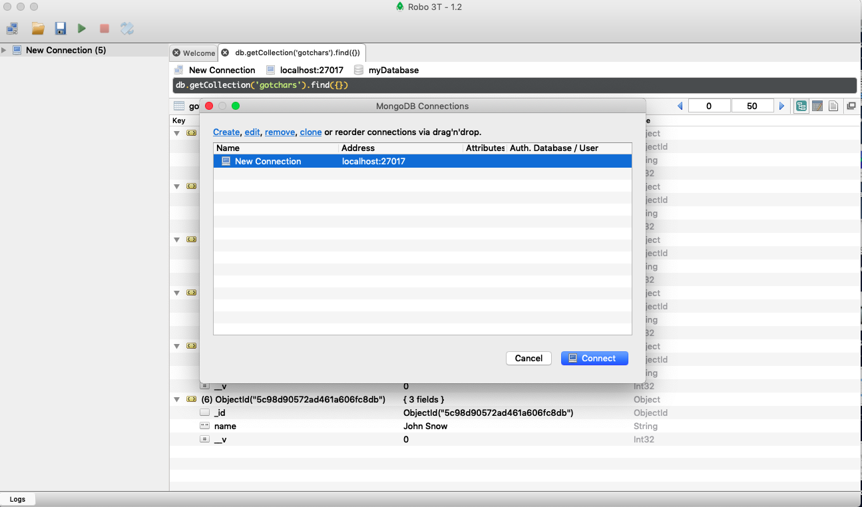
RoboMongo Looks like?

Slide 11
Create a new connection
Click on the create link once open a connection and it will create a new connection for you.
Then you will be able to see the new connection and all the database you have created!
The roboMongo GUI will show you the collections and the database you have created.

Slide 12
Drop collection
We drop (delete) a collection using a simple command:
mongoose.connection.collections.<model_name>s.drop();
The above drop function is an asynchronous request.

Slide 13
What have done till now!
Make a connection to mongoDB using mongoose
Use mocha to test -- testing framework
Create a model and a schema. Example:
var Schema = new Schema( { <schema definition >}) -- for schema
var myModel = mongoose.model(‘modelName’, Schema)
Create an instance of a model and save it to the database
Drop a collection from the database.

Slide 14
Let’s find some records to DB
We use different methods to find records/documents in our db. Two such methods are:
find(<finding criteria>)
Ex: db.gotchars.find( { name: ‘John’ } )
The above example will return all the entry for the name - John in the collection gotchars
findOne(<finding criteria>)
Ex: db.gotchars.findOne( { name: ‘John’ } )
The above example will return the first entry for the name - John in the collection gotchars
We can use these methods ( find(), findOne() ) on models directly unlike the save() which is used on the instance of the model.

Slide 15
Example for .save() and find()
save() method is used on a single instance of the model. For Example:
myChar = new GOTChar( { name: ‘John Snow’ } )
myChar.save();
find() method is used directly on the models rather than the instance of the model.
GOTChar.find( { name: ‘John Snow’} )

Slide 16
Deleting Record
For deleting we can use methods:
myRecord .remove(); --- this will remove a particular record or single instance of our Record model
Record.remove();
this will remove the whole model (Record) if we don’t pass any criteria in remove();
If we pass Record.remove( myRecord.name === ‘Jon’) -- it will remove all the record with name Jon.
Record.findOneAndDelete()
The findOneAndRemove() -- will remove the first occurence of the criteria we pass.
Record.findOneAndRemove( myRecord.name === ‘Jon’) -- will remove 1st Jon from the collections

Slide 17
How do we test the if data is removed.
Create and save the record to the db
Use findOneAndDelete() to remove the saved record
Try to findOne in the db -- one we removed in the above step
Assert the result to null after finding.

Slide 18
Updating Records
For updating we can use methods:
myRecord .update(); --- this will update a particular record or single instance of our Record model
Record.update();
Record.findOneAndUpdate()

Slide 19
How do we test the if data is updated.
Create and save the record to the db
Use findOneAndUpdate() to update the name in the record
Try to findOne in the db -- one we updated in the above step
Assert that result has the updated value.

