Slide 1

“NSTU
Sportify”

Slide 2
Introduction
The "Physical Education" department at NSTU faces the challenge of coordinating numerous events and tournaments. However, the absence of a digital platform necessitates reliance on traditional manual methods for tasks such as distributing notices, managing registrations, and scheduling events. This outdated approach often leads to missed event schedules and deadlines among both departments and students.

Slide 3
Functional Requirements
Update Event: Administrators can create, update, and delete events.
Update Schedule: Administrators can create, update, and delete match schedules.
Update Notices: Administrators can provide real-time updates about notices.
Update Results: Administrators can update match results and overall standings.
Notices: Administrators can post important notices related to sports activities.
Representative Registration: By registering they can make their own team.
Admin Login: Admin can create, update, delete events, notices, schedules.
Event: Users can view upcoming events and their details.
Schedule: Users can view scheduled matches and their details.
Results: Users can view match results and current standings.
Notices: Users can view important notices.
Previous Year Results: Users can access results from previous years' events.

Slide 4
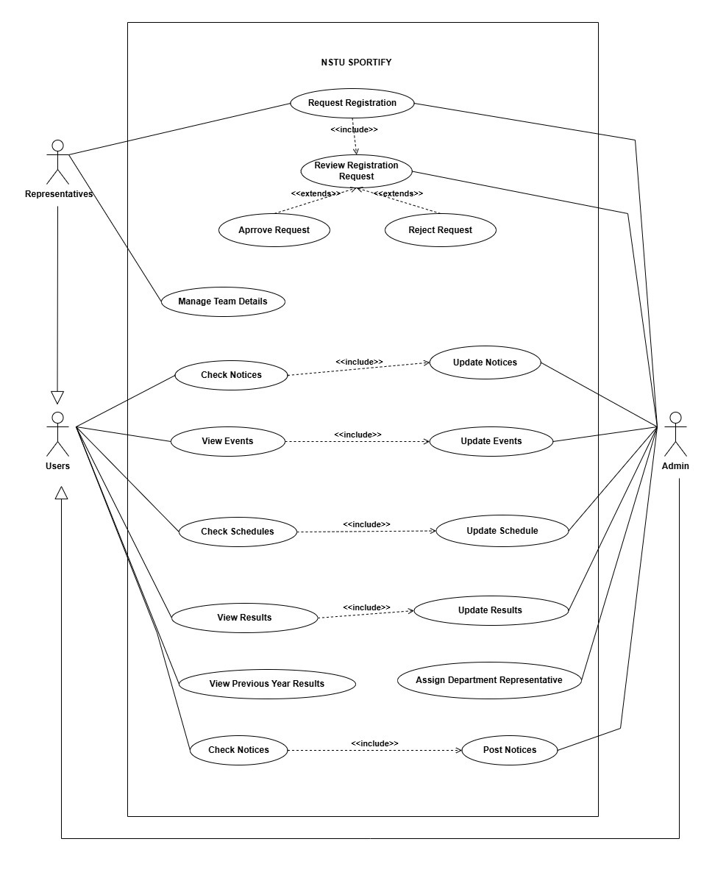
Use Case

Slide 5

Objectives
To introduce a comprehensive digital solution to simplify sports events.
For ensuring timely notifications are sent to students' smartphones, keeping them informed about upcoming and ongoing sports events.
Design a user-friendly app to enhance accessibility and ease of us.

Slide 6

Motivation
To digitalize the overall work process of the physical education dept.
To gather all sport enthusiastic of NSTU into a digital platform.
To reduce the hassle of notice circulation and registration process.

Slide 7

Features
Notices: Get updates about upcoming game events.
Events: See when and where events are happening.
Schedule: Know who's playing when and where.
Representatives: Access details of event organizers and coordinators.
Participants: View information about teams and players.
Result: Track game outcomes and match statistics.
Admin Login: Allows administrators to manage notices, events, and related content by creating, updating, editing, and deleting data.

Slide 8

Stakeholders
Students
Faculty Members
Departments
Administrations

Slide 9

Languages:
Frontend: Flutter
Backend: Python Django(Framework)
Ide:
Android Studio
Visual Studio Code

Slide 10

Challenges:
Technical Complexity
User Adoption and Engagement
Resource Constraints
Scalability and Sustainability
Database Management

