Slide 1
Creditax.ai
Nigerian tax compliance, made creditworthy.
AI canvas for tax answers grounded in NTA / NTAA / FIRS · credit health score · verified pro marketplace · partner APIs
Investor deck · September 2026 · Track A demo build
Creditax.ai · demo_seed UI until live cutover · 1/12

Slide 2
Problem
Nigeria’s 2024 tax reforms (NTA, NTAA, Capital Gains) left millions of workers, freelancers and SMEs unsure what they owe.
Generic AI tools hallucinate jurisdiction-specific law — no citations, no audit trail, no trust for filing or lending.
Credit underwriting ignores tax compliance data, while lenders still demand BVN/TIN proof without a clean UX.
Tax pros still acquire clients via word-of-mouth; consumers cannot verify who is real.
Developers who need PAYE/VAT/WHT primitives hand-code rules and re-learn them every reform cycle.
Creditax.ai · demo_seed UI until live cutover · 2/12

Slide 3
Solution — one platform, four outcomes
Canvas AI agent answers tax questions with citations to published Nigerian law (NTA / NTAA / FIRS guides).
Sidebar document uploads turn receipts, invoices and payslips into structured filing inputs.
Credit health score links compliance + financial signals — the differentiator no tax app owns.
Verified tax professional marketplace: when stakes are high, the agent refers real humans nearby.
Same engines exposed as versioned APIs for fintechs, payroll and ERP partners (B2B2C wedge).
Creditax.ai · demo_seed UI until live cutover · 3/12

Slide 4
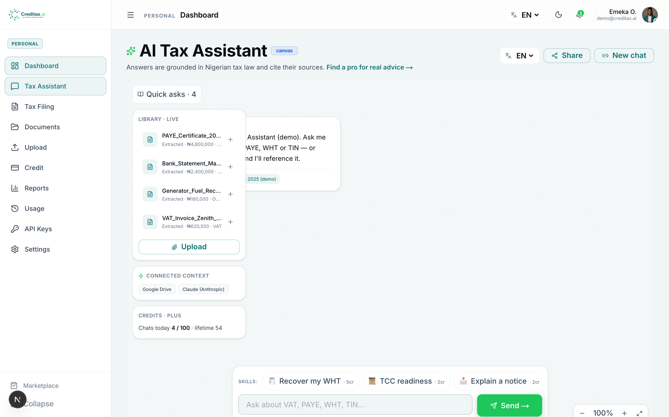
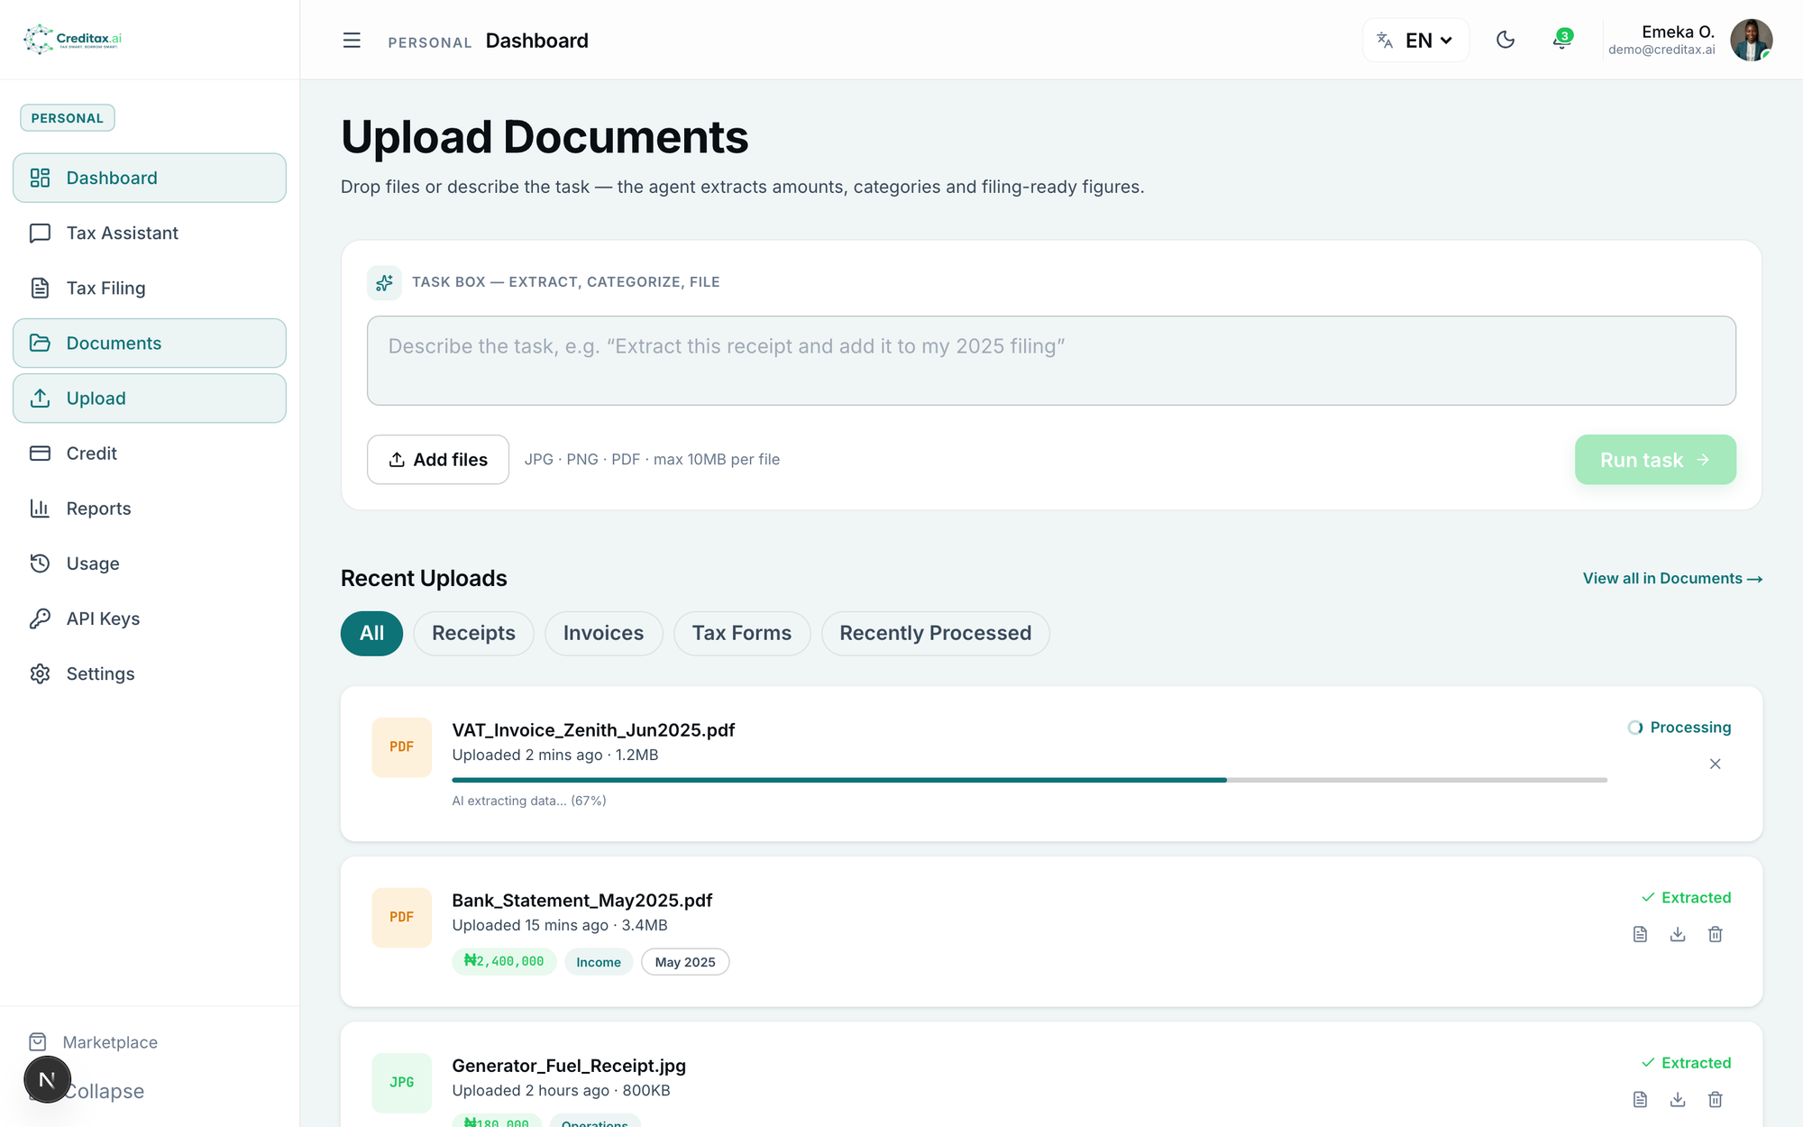
Product — grounded answer + document pipeline
Live captures (fa-5). Simulated data is labelled demo_seed until production cutover.
Creditax.ai · demo_seed UI until live cutover · 4/12

Slide 5
Moat — RAG + compliance–credit flywheel
Dual vector indexes: tax_document_chunks (law Q&A) + tax_professionals_embeddings (marketplace matching).
Deterministic tax calculators (PAYE / VAT / WHT / CIT) sit beside generative answers — figures you can defend.
Compliance activity feeds credit score factors; score visibility drives filing behaviour → more signal.
Legal posture: published law only — no unofficial government-system access; citations on every answer.
4-language product (EN / YO / HA / IG) including agent prompting — distribution moat in Nigeria.
Creditax.ai · demo_seed UI until live cutover · 5/12

Slide 6
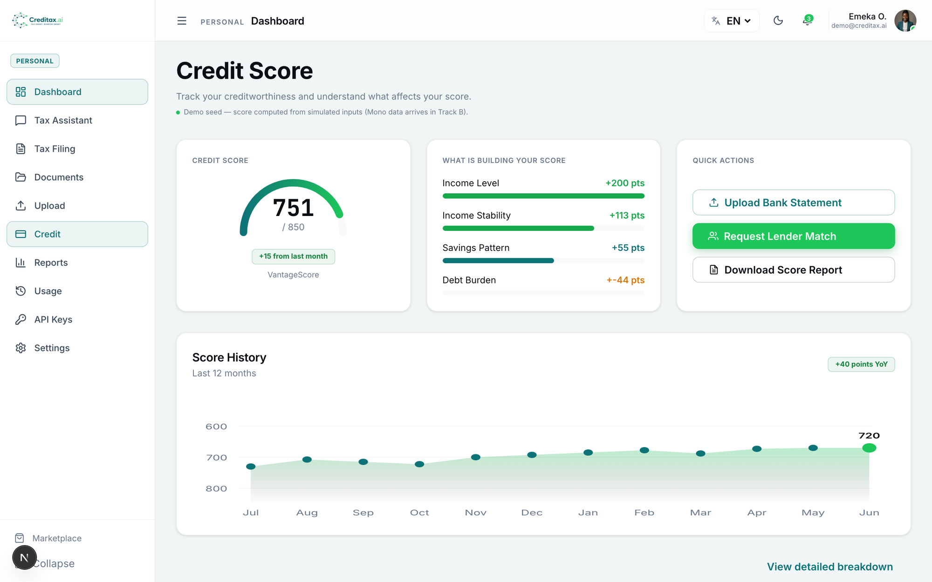
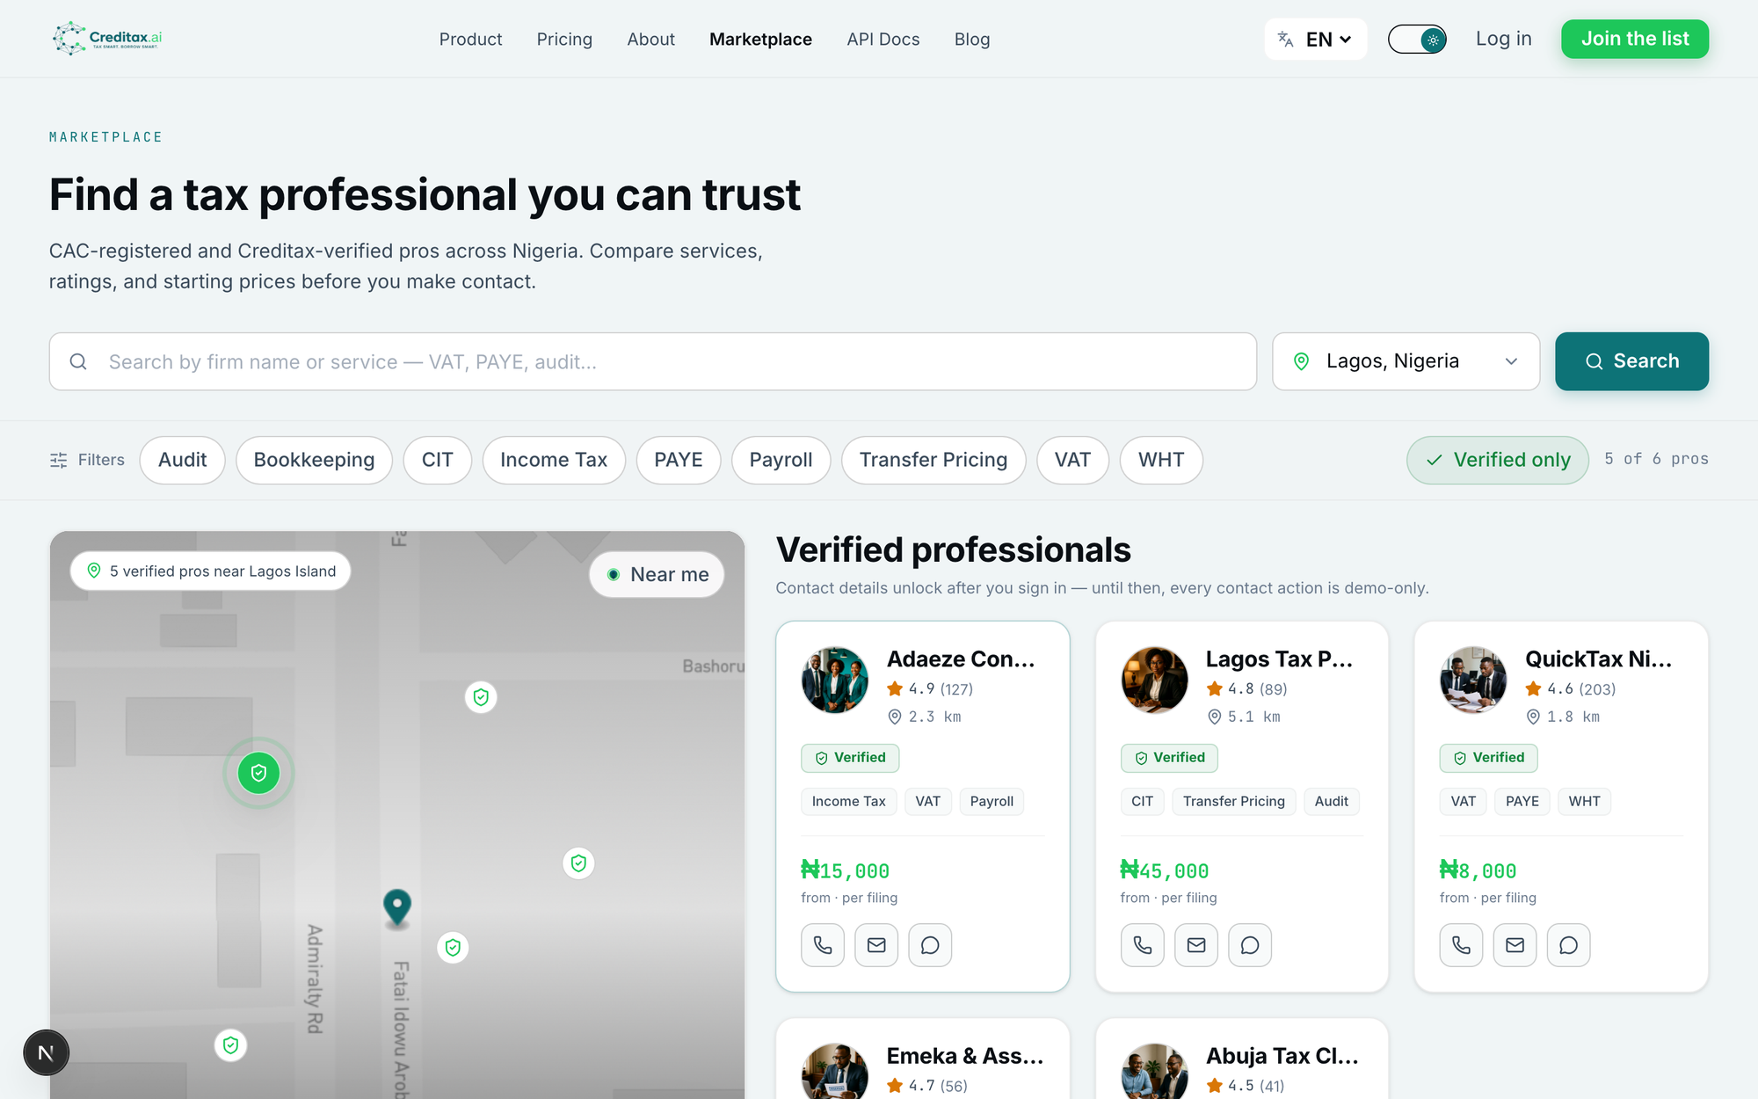
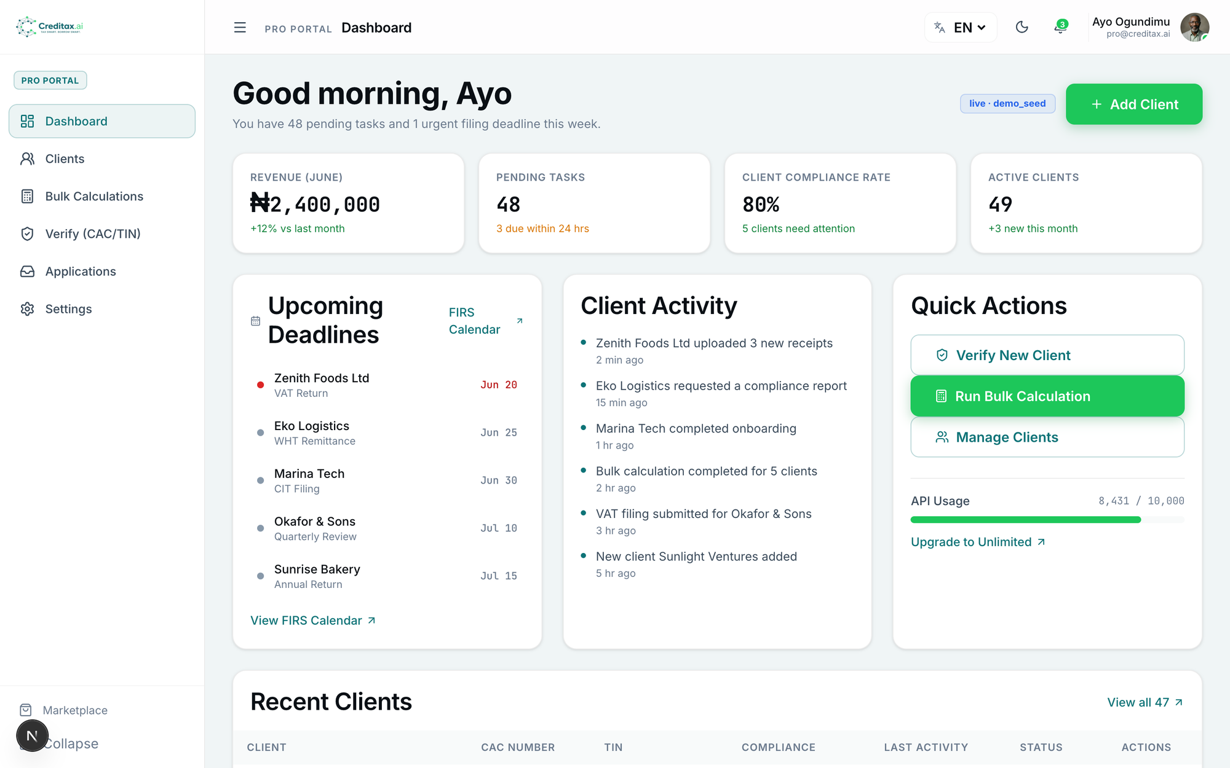
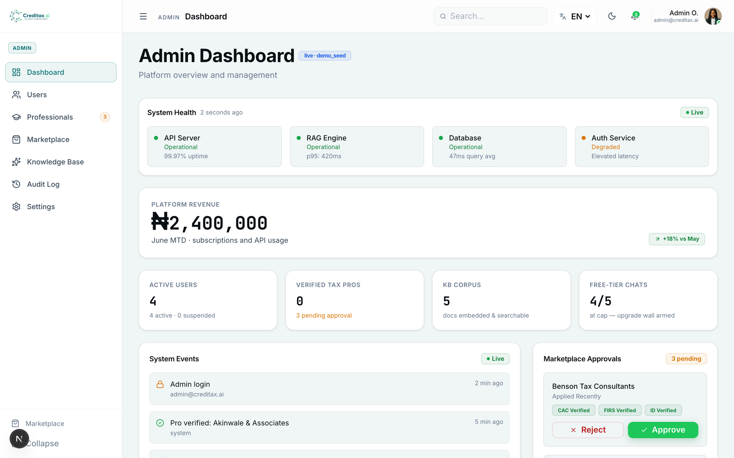
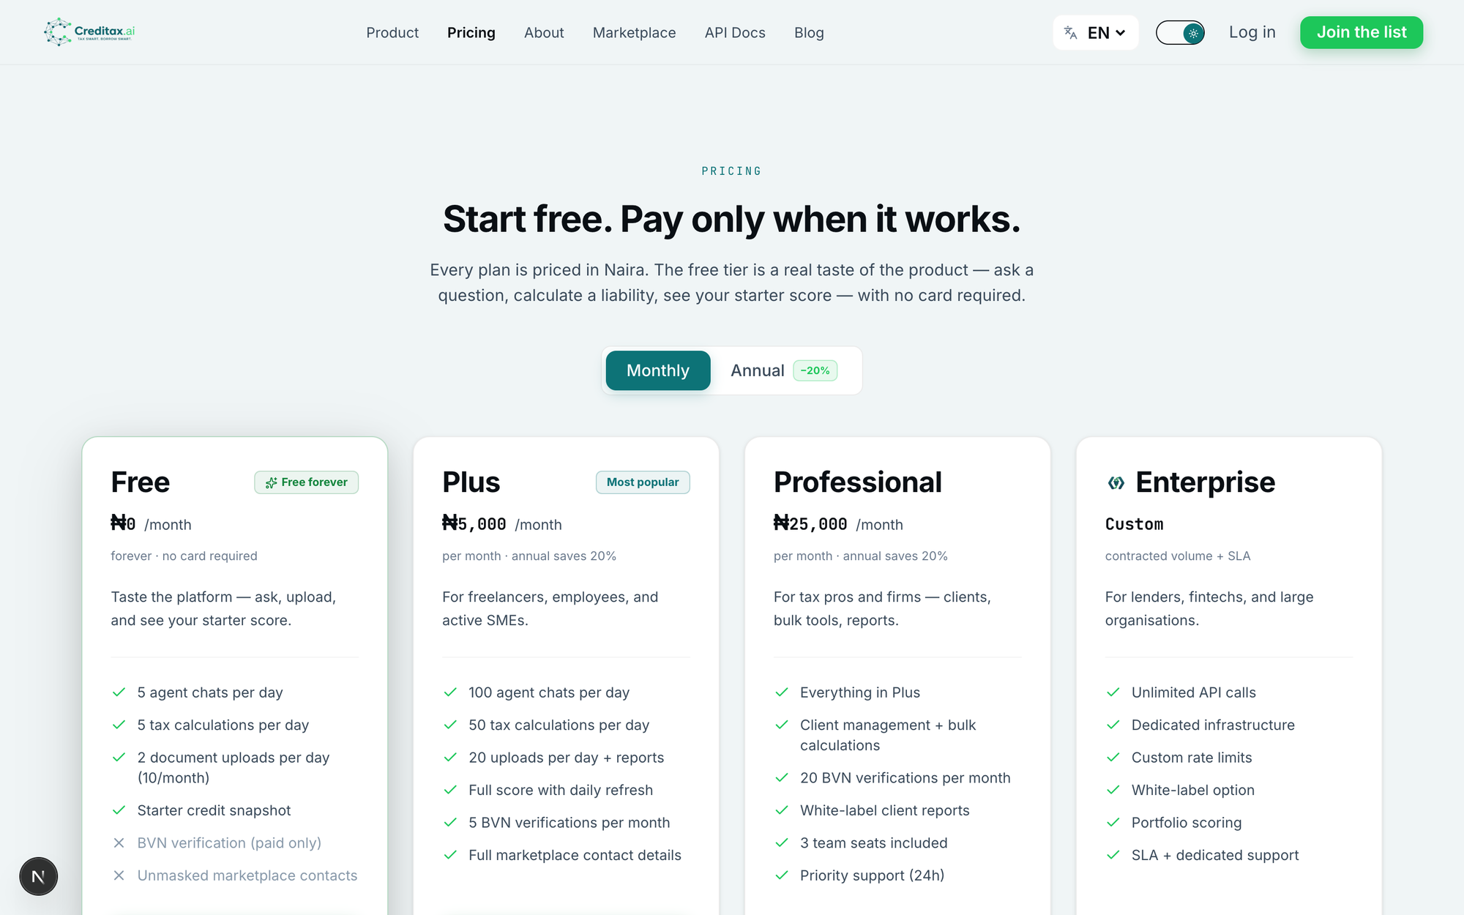
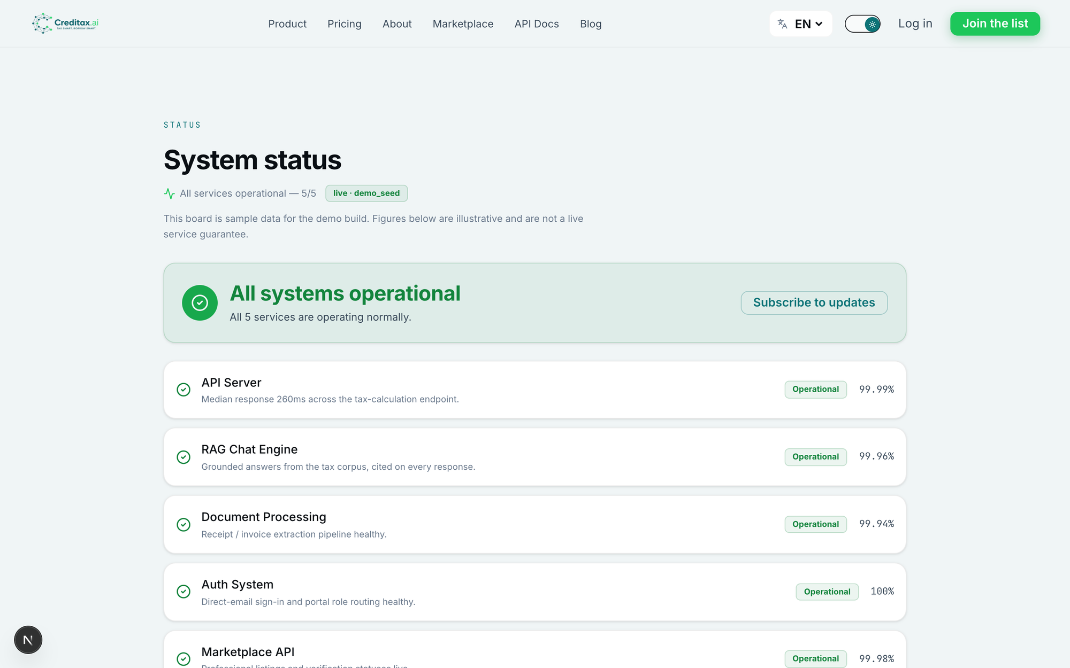
Product surfaces — consumer, pro, admin
Credit snapshot
Admin board
Marketplace search
₦ pricing tiers
Pro portal
Status — all green
Creditax.ai · demo_seed UI until live cutover · 6/12

Slide 7
Market — Nigeria first, depth over breadth
P0 consumers & micro/SMEs: “tell me what I owe, help me file, make lenders trust me.”
P1 tax professionals: verified client flow + bulk calc / verification / reports tools.
P2 fintechs, payroll, ERP: maintained Nigerian tax primitives without hand-coded reform debt.
P3 banks & institutions: compliance signals and white-label rails (Enterprise).
No competitor combines tax-compliance AI with credit scoring on published Nigerian law.
Creditax.ai · demo_seed UI until live cutover · 7/12

Slide 8
Business model — Naira-only, quota-enforced
Free ₦0
Plus ₦5,000/mo
Pro ₦25,000/mo
Enterprise
5 chats/day · 60 lifetime
Starter score · 2 BVN teaser
100 sandbox API calls/mo
100 chats/day
Full score + simulator
5 BVN · 5k API calls
Unlimited fair-use
Practice tools · 3 seats
50k API · 20 BVN
Contracted volume
SSO + SLA
Portfolio scoring
Revenue streams: subscriptions · BVN pay-per-use (₦350) · marketplace take-rate · partner API calls · Enterprise white-label.
Unit economics (locked method): free CAC envelope ₦2,000 · grounded chat ≈ ₦5 · BVN ≈ ₦90 cost vs ₦350 price · Plus conversion target ≥1 per 10 active free in 90 days.
Creditax.ai · demo_seed UI until live cutover · 8/12

Slide 9
Traction — full-access build green
20-phase product chain complete; full-access next build exit 0.
Live Mapbox: reverse + search return geo_source=mapbox; raster overlay on marketplace.
Mono host fixed to api.withmono.com (mono-sec-key); demo path fail-closed with mono.attempted.
37 demo screenshots A–G captured (desktop + mobile) for client pitches.
charged:false invariant holds with empty PSP keys (honest not-configured).
Blocked honestly: Mono live data_source=mono-sandbox needs test_sk_* + sandbox kv/kvn (never committed).
Creditax.ai · demo_seed UI until live cutover · 9/12

Slide 10
Go-to-market — Twitter-first + marketplace supply
Launch plan: SuperScale content (explainer, mock-ups, threads) → public launch → marketplace RAG live.
Supply first: onboard verified tax pros (CAC + Mono Lookup + certificate review) before demand spikes.
Developer distribution: sandbox keys, quickstart, status page — partners ship PAYE/VAT without re-implementation.
6-month success metrics: 100 API signups · 25 active API users · first revenue · NPS > 40.
Legal gate: NDPA/DPIA complete before production real-data launch (legal-compliance.md).
Creditax.ai · demo_seed UI until live cutover · 10/12

Slide 11
Team & 3-year outlook
Founder-led (solo Phase 0–Track A): full-stack + RAG + payments; hiring plan post-seed (marketplace ops, compliance, AE).
Year 1: Nigeria consumer + pro launch; partner API pilots; NDPA production cutover.
Year 2: portfolio scoring for lenders; Enterprise white-label; expand verification beyond BVN/TIN.
Year 3: regional fintech rails / BaaS add-on (priced only after scoped — pricing-and-access.md open item).
Risk posture: versioned law content, no unofficial FIRS hooks, fail-closed identity, quota abuse controls.
Creditax.ai · demo_seed UI until live cutover · 11/12

Slide 12
The ask
Capital to move Track A demo → Track B production (Supabase + NDPA DPIA + Mono live + PSP test→live).
Runway for marketplace supply (tax pro onboarding) + first partner API deals.
Use of funds: infra & compliance, BD (lenders/payroll), content/GTM, 2–3 hires.
What we will show next: mono-sandbox data_source flip, PSP test charge path (charged stays false until live), case studies from 4–5 warm leads.
creditax.ai · hello@creditax.ai · investors@creditax.ai
Creditax.ai · demo_seed UI until live cutover · 12/12

