Slide 1

B- Trees
COL 106
Shweta Agrawal, Amit Kumar
Slide Credit : Yael Moses, IDC Herzliya
Animated demo: http://ats.oka.nu/b-tree/b-tree.html
https://www.youtube.com/watch?v=coRJrcIYbF4

Slide 2
Motivation
Large differences between time access to disk, cash memory and core memory
Minimize expensive access (e.g., disk access)
B-tree: Dynamic sets that is optimized for disks

Slide 3
B-Trees
A B-tree is an M-way search tree with two properties :
It is perfectly balanced: every leaf node is at the same depth
Every internal node other than the root, is at least half-full, i.e. M/2-1 ≤ #keys ≤ M-1
Every internal node with k keys has k+1 non-null children
For simplicity we consider M even and we use t=M/2:
2.* Every internal node other than the root is at least half-full, i.e. t-1≤ #keys ≤2t-1, t≤ #children ≤2t

Slide 4
Example: a 4-way B-tree
20 40
20 40
0 5 10
25 35
45 55
0 5
25 35
45 55
10
B-tree 4-way tree
B-tree
1. It is perfectly balanced: every leaf node is at the same depth.
2. Every node, except maybe the root, is at least half-full t-1≤ #keys ≤2t-1
3. Every internal node with k keys has k+1 non-null children

Slide 5
B-tree Height
Claim: any B-tree with n keys, height h and minimum degree t satisfies:
Proof:
The minimum number of KEYS for a tree with height h is obtained when:
The root contains one key
All other nodes contain t-1 keys

Slide 6
B-Tree: Insert X
As in M-way tree find the leaf node to which X should be added
Add X to this node in the appropriate place among the values already there (there are no subtrees to worry about)
Number of values in the node after adding the key:
Fewer than 2t-1: done
Equal to 2t: overflowed
Fix overflowed node

Slide 7
Fix an Overflowed
Split the node into three parts, M=2t:
Left: the first t values, become a left child node
Middle: the middle value at position t, goes up to parent
Right: the last t-1 values, become a right child node
Continue with the parent:
Until no overflow occurs in the parent
If the root overflows, split it too, and create a new root node
J
x
… 56 98 ….
x
… 56 68 98 ….
split
y
60 65 68 83 86 90
60 65
83 86 90
y
z

Slide 8
Insert example
20 40 60 80
0 5 10 15
25 35
45 55
62 66 70 74 78
87 98
Insert 3:
20 40 60 80
0 3 5 10 15
25 35
45 55
62 66 70 74 78
87 98

Slide 9
20 40 60 80
0 3 5 10 15
25 35
45 55
62 66 70 74 78
87 98
Insert 61:
20 40 60 80
OVERFLOW
0 3 5 10 15
25 35
45 55
61 62 66 70 74 78
87 98
SPLIT IT
20 40 60 70 80
0 3 5 10 15
25 35
45 55
61 62 66
74 78
87 98

Slide 10
20 40 60 70 80
Insert 38:
0 3 5 10 15
25 35
45 55
61 62 66
74 78
87 98
20 40 60 70 80
0 3 5 10 15
25 35 38
45 55
61 62 66
74 78
87 98

Slide 11
Insert 4:
20 40 60 70 80
0 3 5 10 15
25 35 38
45 55
61 62 66
74 78
87 98
20 40 60 70 80
OVERFLOW
0 3 4 5 10 15
25 35 38
45 55
61 62 66
74 78
87 98
SPLIT IT
OVERFLOW
5 20 40 60 70 80
SPLIT IT
0 3 4
10 15
25 35 38
45 55
61 62 66
74 78
87 98

Slide 12
OVERFLOW
5 20 40 60 70 80
SPLIT IT
0 3 4
10 15
25 35 38
45 55
61 62 66
74 78
87 98
60
5 20 40
70 80
0 3 4
10 15
25 35 38
45 55
61 62 66
74 78
87 98

Slide 13
Complexity Insert
Inserting a key into a B-tree of height h is done in a single pass down the tree and a single pass up the tree
Complexity:

Slide 14
B-Tree: Delete X
Delete as in M-way tree
A problem:
might cause underflow: the number of keys remain in a node < t-1
Recall: The root should have at least 1 value in it, and all other nodes should have at least t-1 values in them

Slide 15
Underflow Example
Delete 87:
60
5 20 40
70 80
0 3 4
10 15
25 35 38
45 55
61 62 66
74 78
87 98
60
B-tree
UNDERFLOW
5 20 40
70 80
0 3 4
10 15
25 35 38
45 55
61 62 66
74 78
98

Slide 16
B-Tree: Delete X
Delete as in M-way tree
A problem:
might cause underflow: the number of keys remain in a node < t-1
Solution:
make sure a node that is visited has at least t instead of t-1 keys
Recall: The root should have at least 1 value in it, and all other nodes should have at least t-1 (at most 2t-1) values in them

Slide 17
B-Tree-Delete(x,k)
1st case: k is in x and x is a leaf → delete k
k=66
x
62 66 70 74
x
62 70 74
How many keys are left?
Example t=3

Slide 18
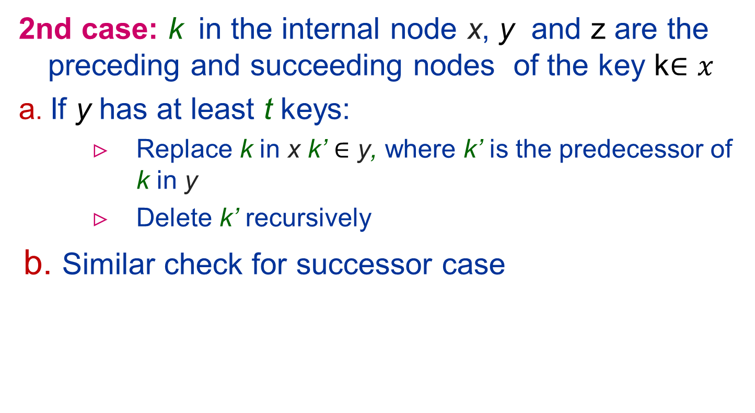
k=50
x
30 50 70 90
x
30 45 70 90
5
6
7
5
6
7
y
35 40 45
y
35 40 45
Example t=3

Slide 19
2nd case cont.:
Both a and b are not satisfied: y and z have t-1 keys
Merge the two children, y and z
Recursively delete k from the merged cell
x
30 70 90
x
30 50 70 90
y
35 40
55 60
z
35 40 50 55 65
y
1
2
3
4
5
6
1
2
3
4
5
6
Example t=3

Slide 20
Questions
When does the height of the tree shrink?
Why do we need the number of keys to be at least t and not t-1 when we proceed down in the tree?

Slide 21
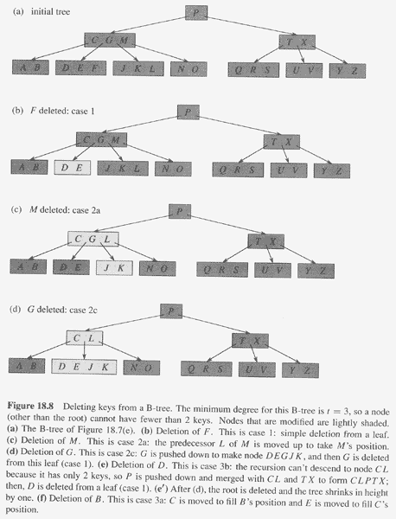
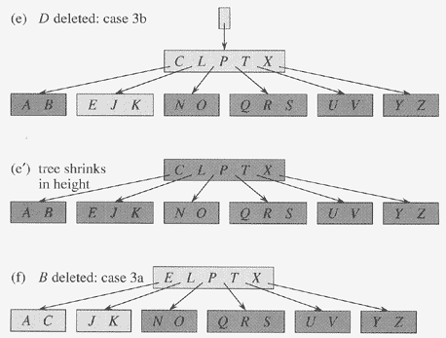
Copyright © The McGraw-Hill Companies, Inc. Permission required for reproduction or display.

Slide 22
Delete Complexity
Basically downward pass:
Most of the keys are in the leaves – one downward pass
When deleting a key in internal node – may have to go one step up to replace the key with its predecessor or successor
Complexity

Slide 23
Run Time Analysis of B-Tree Operations
For a B-Tree of order M=2t
#keys in internal node: M-1
#children of internal node: between M/2 and M
➔ Depth of B-Tree storing n items is O(log _{M/2} N)
Find run time is:
O(log M) to binary search which branch to take at each node, since M is constant it is O(1).
Total time to find an item is O(h*log M) = O(log n)
Insert & Delete
Similar to find but update a node may take : O(M)=O(1)
Note: if M is >32 it worth using binary search at each node

Slide 24
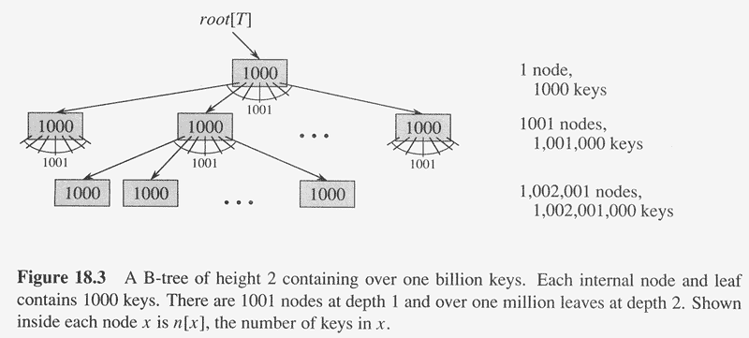
A typical B-Tree
Copyright © The McGraw-Hill Companies, Inc. Permission required for reproduction or display.

Slide 25
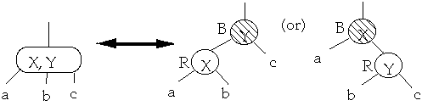
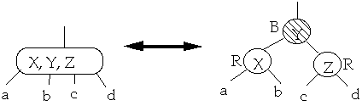
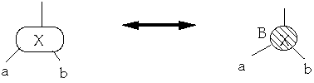
B-Trees and RB-Trees
Nice Observation: B-trees of degree 4 are equivalent to RB-trees
Sketch of Proof: The following structures are equivalent.
Need to verify:
If a node is red, then both its children are black
Every simple path from a node to a descendant leaf contains the same number of black nodes.

Slide 26
Why B-Tree?
B-trees is an implementation of dynamic sets that is optimized for disks
The memory has an hierarchy and there is a tradeoff between size of units/blocks and access time
The goal is to optimize the number of times needed to access an “expensive access time memory”
The size of a node is determined by characteristics of the disk – block size – page size
The number of access is proportional to the tree depth

