Slide 1
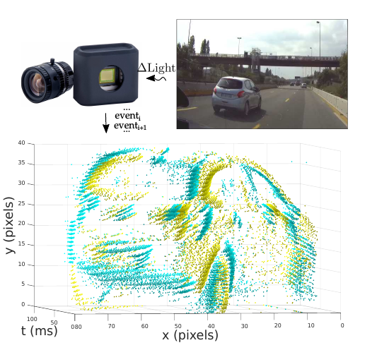
HATS: Histograms of Averaged Time Surfaces for Robust
Event-based Object Classification

Slide 2
Dataset – N-CARS
The dataset was obtained with the following semi-automatic protocol.
First, they captured approximately 80 minutes of video using an ATIS camera mounted behind the windshield of a car.
The driving was conducted in a natural way, without particular regards for video quality or content.
In a second stage, they converted gray-scale measurements from the ATIS sensor to conventional gray-scale images.
It was processed them with a state-of-the-art object detector, to automatically extract bounding boxes around cars and background samples. Finally, the data was manually cleaned to ensure that the samples were correctly labeled.

Slide 3
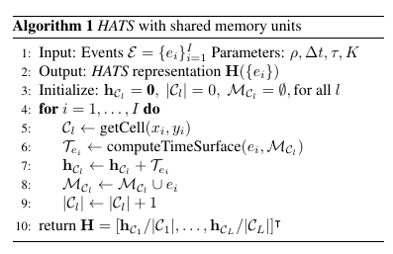
Software Implementation
The HATS paper introduces new concept of Local Memory Time Surfaces and there is no implementation available. It makes a histogram from these time surfaces and then further uses a SVM classifier to classify the images.

Slide 4
Hardware Implementation
If the software implementation is sucessful, then the hardware part will be implemented.
The algorithm described can be parallelized and a dedicated FPGA implementation can be implemented. The rest details can be figured out after the software implementation. Some techniques used in HOG will be used further to classify it.
The results of latency in the paper are :
“As we can see, our method is more than 20x faster than HOTS and almost 40x times faster than a 2-layer SNN.In particular our method is 13 times faster than real time.” (Intel i7 16 GB DDR4)

