Slide 1
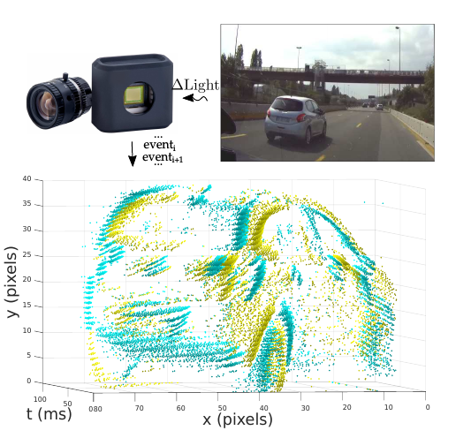
HATS: Histograms of Averaged Time Surfaces for Robust
Event-based Object Classification

Slide 2
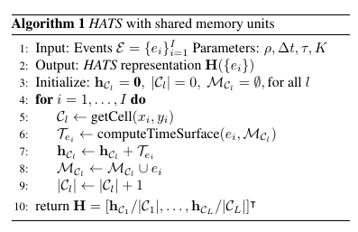
Software Implementation
The HATS paper introduces new concept of Local Memory Time Surfaces and there is no implementation available. It makes a histogram from these time surfaces and then further uses a SVM classifier to classify the images.

Slide 3
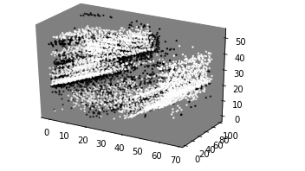
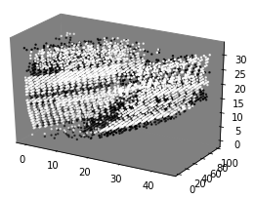
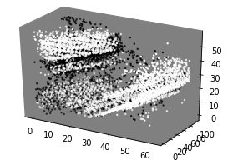
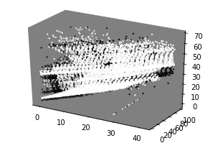
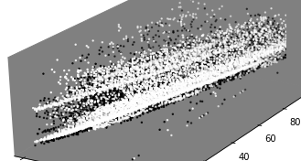
N-CARS Dataset
Real Worl Challenging images from the N-Cars Dataset. (Shown for Events>5000).
The below image shows the occlusion produced by fast-moving cars.
Expanded in Time

Slide 4
N-CARS Dataset
Real Dataset for CARS detection acquired from ATIS camera.
Different poses and illumination of Cars with real -world noise.
100ms of video for each sample.
7940 car training samples and 7482 bckg samples.
4396 car test samples and 4291 bckg test samples

Slide 5
SoC design Flow (Zedboard)
Vivado HLS C code+testing, synthesis and analysis, optimisation for Hats IP production
Vivado Design – block design, synthesis and implementation
Linux SDK for ARM processor

Slide 6
HATS hardware algorithm for inference
AER data
Compute
histogram of time
surfaces
AER data
AER data
AER data
AER data
AER data
Apply a SVC
Apply a SVC
Detection
Detection
For each cell a histogram is calculated.
Computation of hisogram requires memory cell for storing past events.
Memory extensive procedure for storing histogram of time surface
Continous
Stream of data
Multipy withSVC coeff to
calculate
sum
AER data
AER data
Compute
modified local
time surface
Store sum
Accumulate
sum
Compute
modified local
time surface
Multipy withSVC coeff to
calculate
sum
Store sum
Accumulate
sum
+
Return sum
Adder tree for
n-cell ids
Reset Memory
Hardware hats IP design

Slide 7
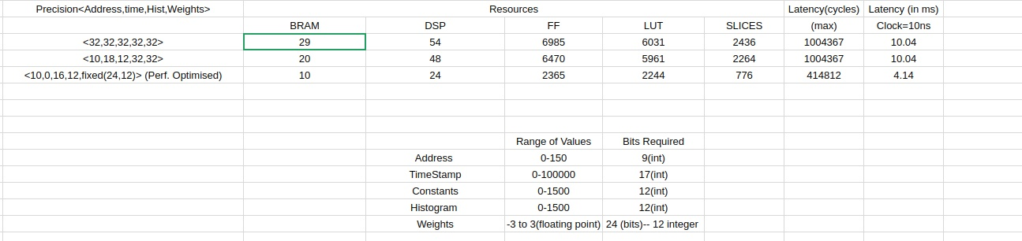
FPGA Resource Utilisation
HATS IP (Average resource utilisation/ip)
8 Hats Accelerators used with different SVM weights

Slide 8
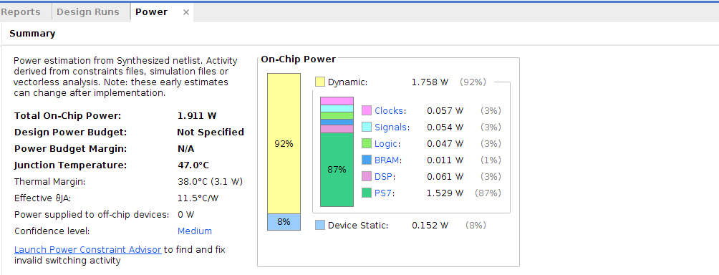
Performance Comparison
Hardware Latency : 4.14ms/event
Inference Power Estimation : 1.911 W (Logic Power – 0.382 W)
Avg. Throughput : 750*8/4.14 Kevnts/s or 1.45 Mevnts/s
Software Parallelized Latency (in Python) : 34.38 ms/event

Slide 9
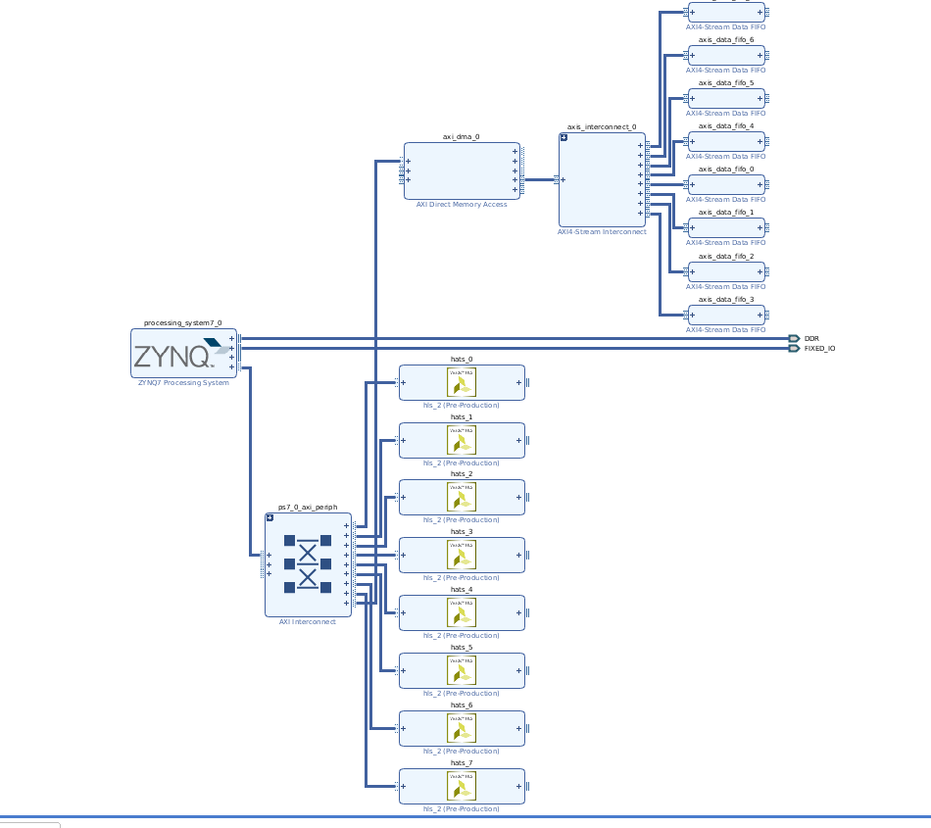
Block Design

