Slide 1
CUSTOMER CHURN ANALYSIS An End-to-End Data Analytics Project
Presented By: Nikita Kumari
Program: Bachelor of Computer Applications (Data Analytics)
Tools: Excel | SQL | Python | Power BI

Slide 2
Project Overview
Customer Churn Analysis is an end-to-end data analytics project.
The project focuses on understanding customer churn behavior.
Data was analyzed using Excel, SQL, Python, and Power BI.
The analysis identifies customer segments and churn-related patterns.
The findings are used to develop customer retention recommendations.

Slide 3
Objectives
Analyze customer churn behavior.
Identify patterns associated with churn.
Understand customer segments with different churn behavior.
Perform data cleaning and validation.
Analyze data using SQL and Python.
Build an interactive Power BI dashboard.
Generate business recommendations for customer retention.

Slide 4
Dataset
Dataset Description
Total Customers: 1,000 Churned Customers: 17 Active Customers: 983 Overall Churn Rate: 1.70%
Key Features
CustomerID
Age
Gender
Tenure
Balance
Number of Products
Credit Card Ownership
Active Membership
Estimated Salary
Churn

Slide 5
Tools & Technologies
Tool | Purpose
Excel | Cleaning & initial analysis
SQL / MySQL | Database & querying
Python | EDA & visualization
Pandas | Data manipulation
NumPy | Numerical analysis
Matplotlib | Visualization
Seaborn | Statistical visualization
Power BI | Interactive dashboard

Slide 6

Data Preparation & SQL Analysis
Data Cleaning
Dataset structure was reviewed.
Duplicate records were checked.
Customer IDs were validated.
Data types and relevant fields were reviewed.
Cleaned data was prepared for analysis.
SQL Analysis
Database and table creation
Data querying
Filtering
Aggregation
Churn analysis
Customer segmentation

Slide 7
Python Exploratory Data Analysis
Python was used to analyze:
Churn by Gender
Churn by Number of Products
Churn by Tenure
Churn by Active Membership
Churn by Credit Card Ownership
Churn by Age

Slide 8
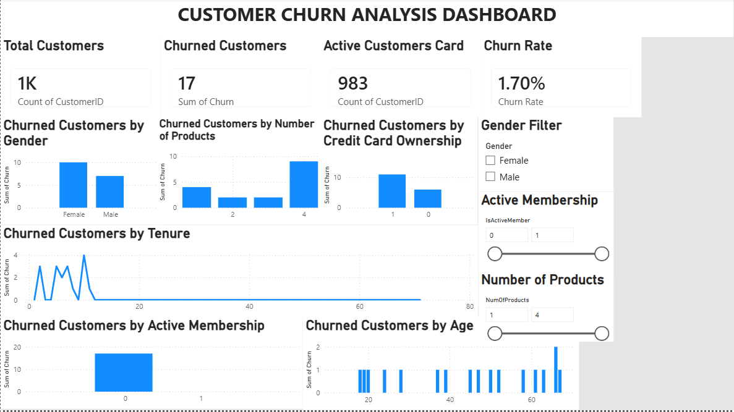
Power BI Dashboard

Slide 9

Key Findings
The dataset contains 1,000 customers.
17 customers are marked as churned.
Overall churn rate is 1.70%.
Customers with four products show the highest observed churn rate in the analyzed product groups.
Customer activity status is an important variable for retention analysis.
Tenure shows variation in observed churn.
Age, gender, balance, product usage, and salary can support customer segmentation.
The relatively small number of churn observations requires careful interpretation.

Slide 10
Business Recommendations
Monitor customers with multiple products Review the experience of customers using multiple products.
Improve customer engagement Monitor inactive customers and encourage engagement.
Focus on early-tenure customers Provide better onboarding and engagement support.
Use customer segmentation Create retention strategies based on customer characteristics.
Monitor churn regularly Use dashboards for proactive retention campaigns.
Collect more historical data More churn observations can improve analysis reliability.

Slide 11
Conclusion
The project successfully analyzed customer churn using Excel, SQL, Python, and Power BI.
The analysis identified several customer characteristics associated with observed churn.
Power BI provided an interactive way to monitor churn KPIs and customer segments.
The findings can support targeted customer retention strategies.
A larger historical dataset would provide stronger evidence for reliable churn patterns.

Slide 12
THANK YOU
Questions & Answers
Presented By: Nikita Kumari

