Slide 1
HOW TO INCREASE ANNUAL MEMBERSHIP AMONG CASUAL BIKERS. A Case Study
By Songhita Misra,
Date: 08-11-2022

Slide 2
Business Task
How does casual and member bikers differ
Statistics of Casual bikers in the industry
Recommendations: how to increase the annual memberships among the casual bikers

Slide 3
Data Source Details And Tools Used
Link:https://divvy-tripdata.s3.amazonaws.com/index.html
Dataset year: 2020
License:https://ride.divvybikes.com/data-license-agreement
Data manipulation and cleaning platform: Bigquery SQL workspace, Google Spreadsheet
Data visualization platform: Tableau, Google Spreadsheet

Slide 4
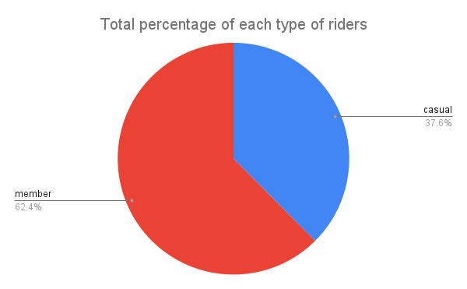
Key Observations
1. Out of the total population, 37.6% of the riders are casual riders while 62.4% of the total population is member riders

Slide 5
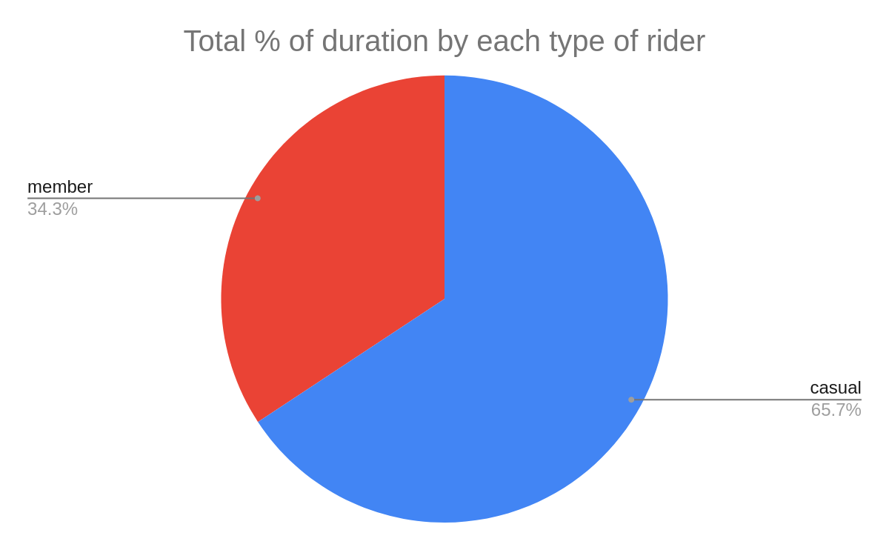
Key Observations..
2. However, duration of rides by casual rider is much higher than member riders. The duration of casual rider is 31% higher than member riders over the last 1 year.
Notes:
*This shows that casual riders usually books the bike for longer rides as compared to member riders.

Slide 6
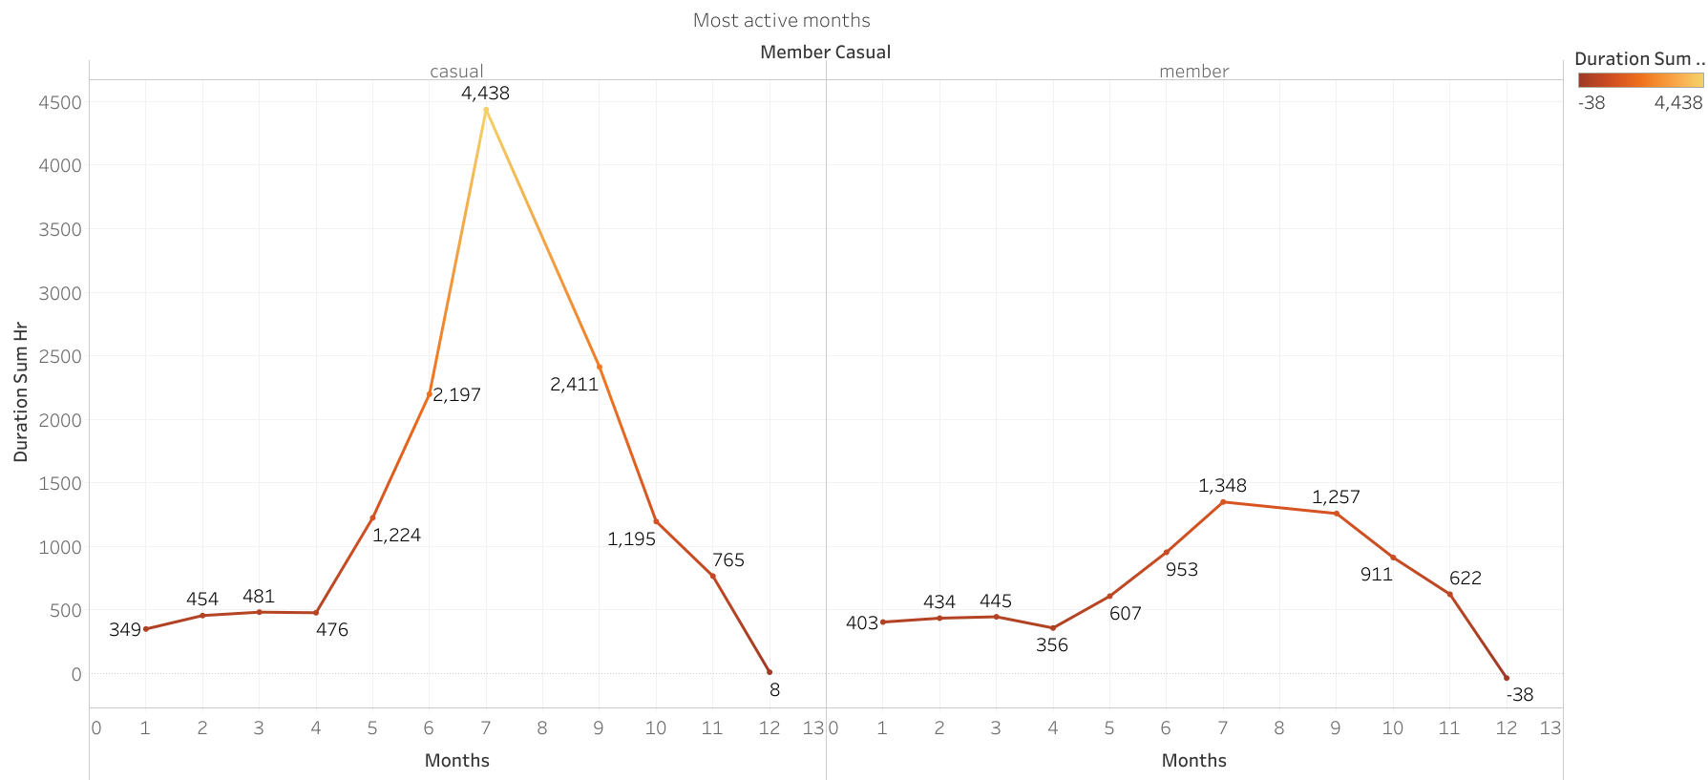
Key Observations..
3. The casual bikers and members are most active in the last spring and summer seasons. And the activity gradually decreases through the winters.
Notes:
The duration of activity of casual bikers is much higher than member bikers during these periods.
The behavior of activity in the first quarter and end of the year, is the same for all bikers.

Slide 7
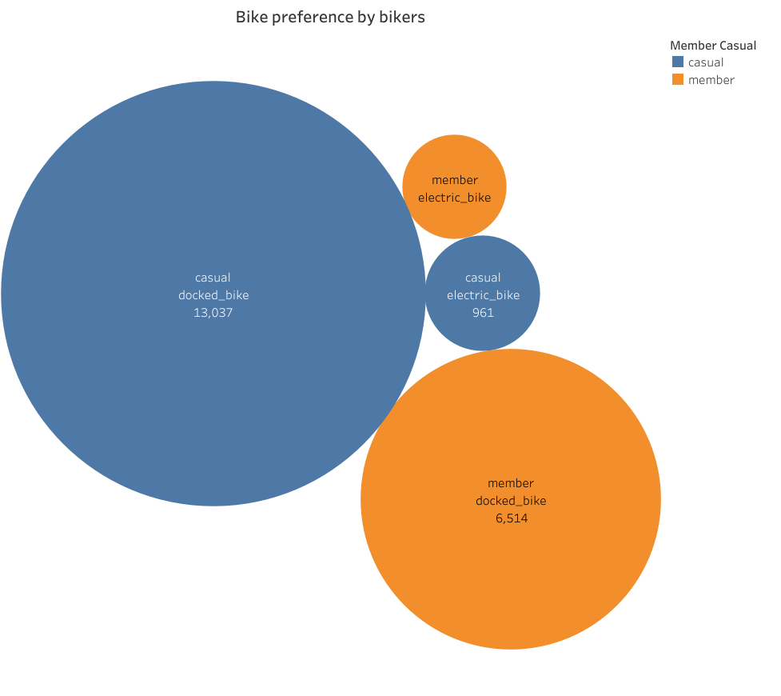
Key Observations..
Based on duration: Both casual bikers and member bikers prefer docked bike much more than electric bikes.

Slide 8
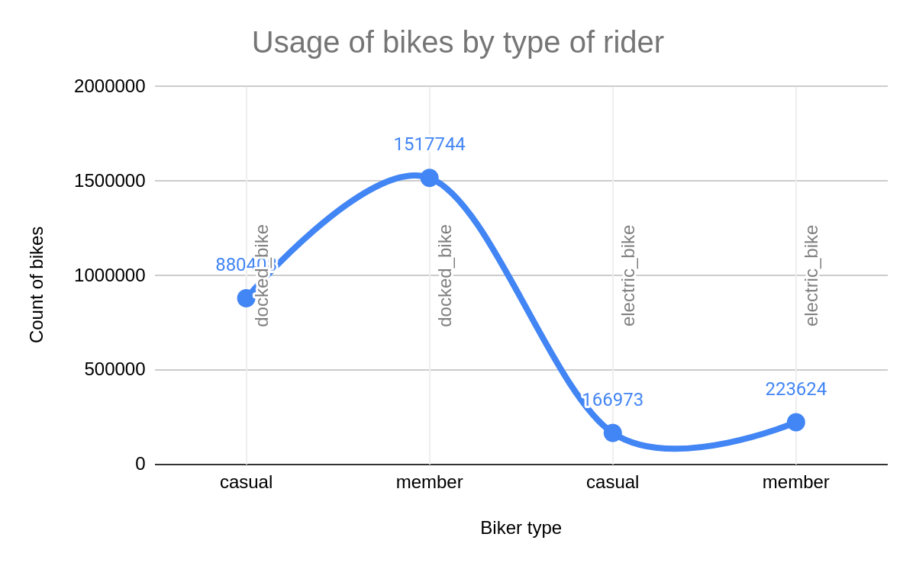
Key Observations..
Based on counts: Both casual bikers and member bikers prefer docked bike much more than electric bikes.

Slide 9
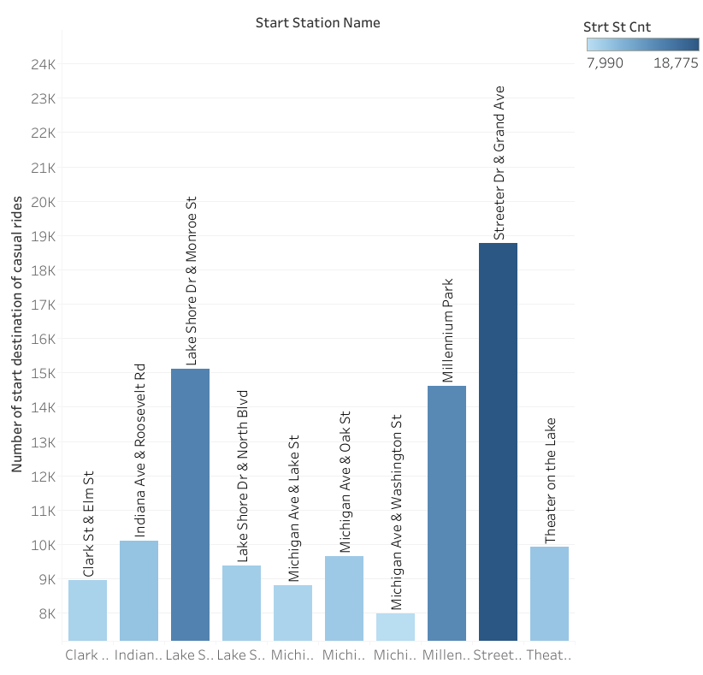
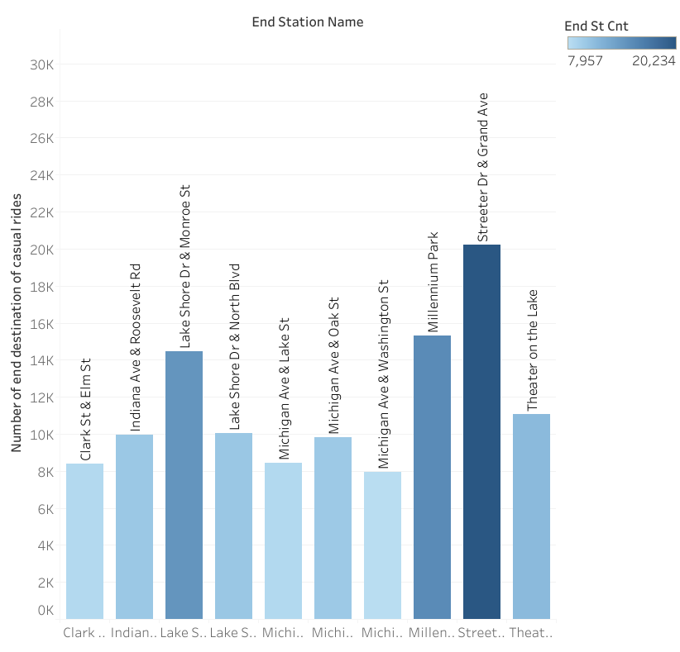
Key Observations..
Top 10 Start and End station names
Notes:
The top 10 station names popular among casual bikers.

Slide 10
Recommendations
1
The advertisements for memberships can be targeted from the month of April to October to get attention of casual bikers.
These months casual bikers uses the bikes for longer duration as compared to member bikers.
2
Casual bikers prefer docked bike much more than electric bike
the ads focusing on docked bikes might be more profitable
3
Initial in-place advertisements for memberships can be run in the 10 most popular start and end destinations of the bikers

Slide 11
Thank You... Any questions ??

