Slide 1
INTRODUCTION
TO DATA SCIENCE
Notes:
We will solve a data science problem very shortly.
But before, we get to that I want to give you an taste of what I think data science is.

Slide 2
What is Data Science?
Notes:
To answer this question I consulted a reliable, open source
place on the internet called Wikipedia.

Slide 3
What’s Data Science?
“Data Science is an interdisciplinary field that uses scientific methods, processes, algorithms and systems to extract knowledge and insights from data.”
- Wikipedia
Notes:
And according to Wikipedia…
And this definition is 100% correct.
But I had a look at a more fun part of the internet
called twitter to find out what people were saying
About data scientists and what they do.

Slide 4
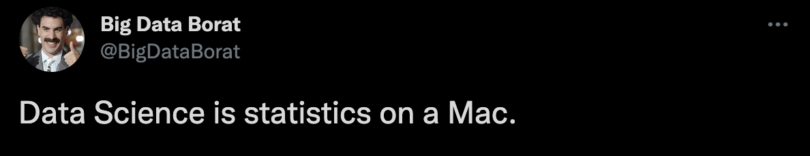
What is Data Science?
https://twitter.com/bigdataborat/status/372350993255518208?lang=en
Notes:
This is of course totally 100% false.
You can use any platform or operating system
or cloud provider of your choice to do the data science work.

Slide 5
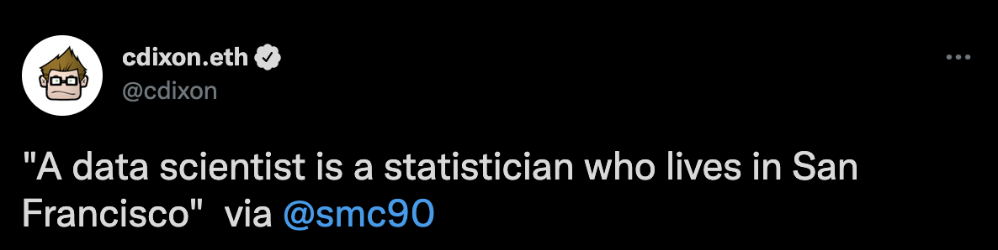
Who is a Data Scientist?
https://twitter.com/mcmoots/status/429318287864770560
Notes:
This one is half true. Because you could live
anywhere with an internet connection and do
The data science work.
And I think that you can’t do data science
Without Statistics.
There is Statistics at the beginning, middle and end.

Slide 6
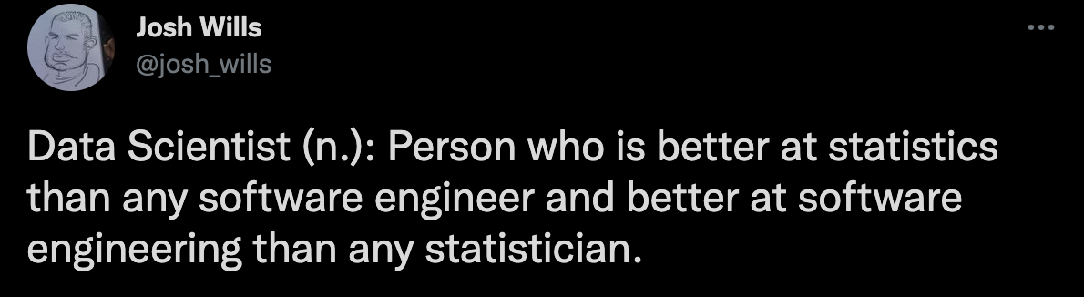
Who is a Data Scientist?
https://twitter.com/josh_wills/status/198093512149958656
Notes:
My favorite answer for who is a
Data scientist.
It says,…
This answer makes a point that I think is very valid.
That until recently we did not have a description for
professionals that did data science work.
By recently I mean the 2010s which is
when this role really exploded.
This is partly because people all over the
world started to carry a small device which is the smart phone.
Which in turn gave companies the access to tons
of data to experiment and play with. And this was not possible earlier.
And I want to make an important point here.
Which is that data science work is not new, it has
been studied ever since the 1950s. But theoretically.
And applications in the real world were not feasible.
But that changed when smart phones became ubiquitous.
Models could be trained with the millions of data points
companies were collecting so that models could
generalize better and predictions had higher accuracy than before.
With that short history lesson out of the way, I will be stopping the memes.

Slide 7
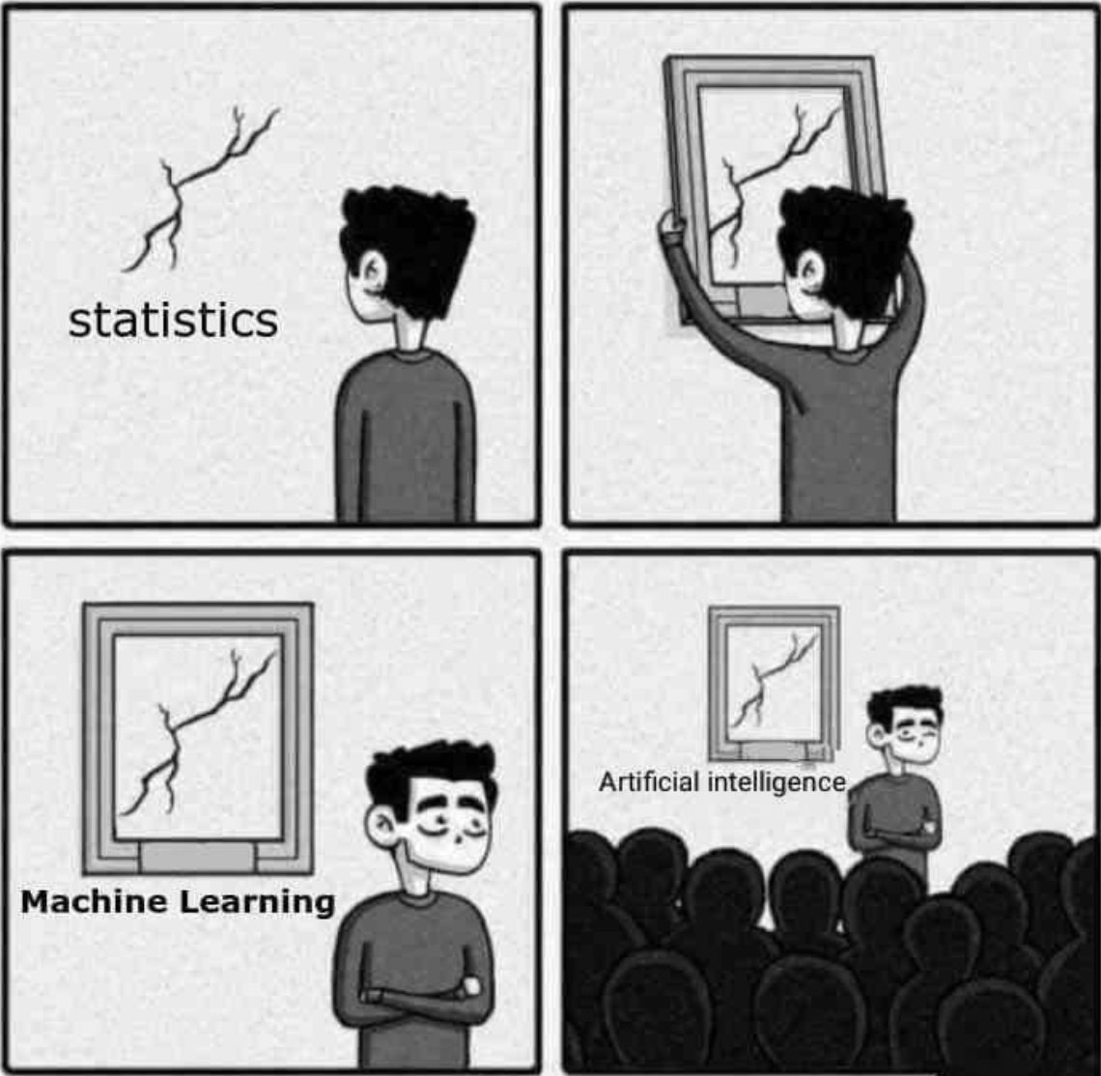
What is Data Science?
Meme source unknown. Based on an original comic by sandserif.
Notes:
Ok I lied, but this is a favorite of mine.
It’s funny because there is a element of truth here.
The truth is that we’ve been using statistics for 100s of years.
According to wikipedia (https://en.wikipedia.org/wiki/History_of_statistics)
modern statistics began to get popular in the 18th century.
What helped drive the popularization of data science in the
last decade is the widespread use of smart
phone like I mentioned in the previous slide.
And the second major reason for the popularity is
how cheap computing became. Universities and Companies could
Afford faster processors and GPUs overtime.
As computing became more accessible and cheaper we
Were able to train models faster and with larger data sets.
This took ML and AI out of research labs and put it in applications like
Recommendation engines, facial recognition, and fraud detection.
Before I move on.
I don’t want you to think of ML or AI as a rebranding of statistics.
At the end of the day statistics, ML, AI are just different tools.
As a company investing in technology you want to have
Different tools in your tool box. So that when you are facing a
Problem you can look into your toolbox and pick the most
Appropriate tool for the job.
And that’s is why being a data scientist is so exciting-
You get to decide which problems you care about and
Specialize in the tools that help you solve those problems.

Slide 8
The “tools” in the toolbox
Machine Learning
Artificial Intelligence
Knowledge Discovery
Deep Learning
Statistical Learning
Data Mining
Natural Language Processing

Slide 9
The “tools” in the toolbox
Machine Learning
Artificial Intelligence
Knowledge Discovery
Deep Learning
Statistical Learning
Data Mining
Natural Language Processing
Notes:
A major component of data science.
Any my personal favorite and how I got started with data science.
So let’s check out our trusty website for a definition.

Slide 10
Machine Learning
“Machine learning (ML) is the study of computer algorithms that can improve automatically through experience and by the use of data.”
- Wikipedia
Notes:
You can think of a human child’s brain at this point.
And how the child learns by observation.
Over time the child observes more and more
Data points and is able to answers questions
More correctly or in other words with a higher accuracy.
For example the child might call everything that is red and
Spherical an apple at the start. But over time as the child
Interacts with more objects the child learns that something
Is a red ball v/s a red apple.

Slide 11
Machine Learning
Titanic Dataset on Kaggle
-https://www.kaggle.com/c/titanic/

Slide 12
Machine Learning
Titanic Dataset on Kaggle
-https://www.kaggle.com/c/titanic/
-Will a given passenger survive or not?
Hypothesis: We can Predict survival on the Titanic based on Age, Sex, and Ticket Class.

Slide 14
What’s Data Science?
Computer
Science
and
Programming
Skills
Notes:
Interdisciplinary: requires the study of more than one domain.

Slide 15
What’s Data Science?
Math
and
Statistics
Computer
Science
and
Programming
Skills
Machine
Learning
Business
Knowledge
Data
Science
Research
Software
Dev
Notes:
Interdisciplinary: requires the study of more than one domain.

Slide 16
What’s Data Science?
“Data Science is an interdisciplinary field that uses scientific methods, processes, algorithms and systems to extract knowledge and insights from data.”
- Wikipedia
Notes:
Interdisciplinary: requires the study of more than one domain.
Scientific:

