Slide 1

Students Alcohol Consumption
Social, gender and study data from secondary school students
By: Vicki Nomwesigwa

Slide 2
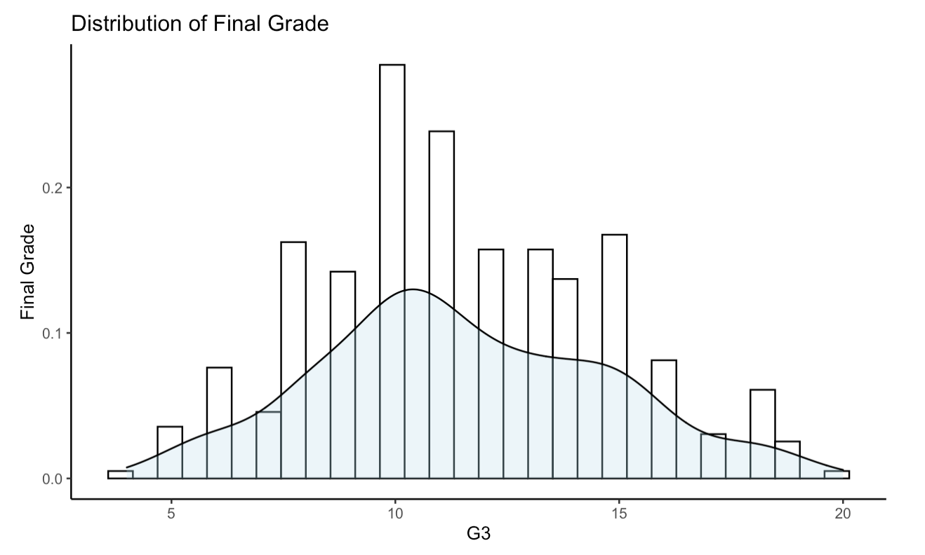
Introduction
Survey of Math and Portuguese language courses in secondary school
Two datasets corresponding to each course and both containing interesting social, gender and study information about students.
382 students take both Math and Portuguese. But for this project we focus on 395 who took the Math course
Estimate factors that are related to the final grade. How alcohol consumption influences the student’s final grade?

Slide 3
EDA and Data Wrangling
Response variable is G3(Final Grade)
No missing data.
Age and Failures variables do not have enough data
Grades (The higher the 1st or 2nd period grade the higher the final grade)
Mean center Grades and Absence variables

Slide 4
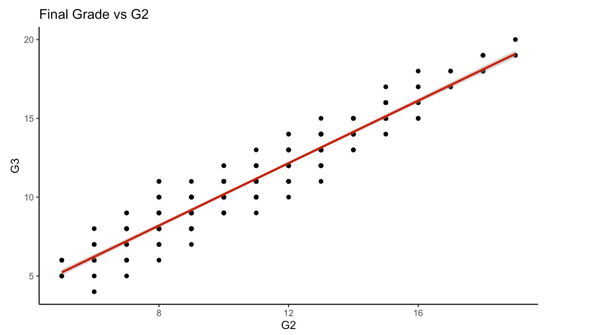
EDA…

Slide 5
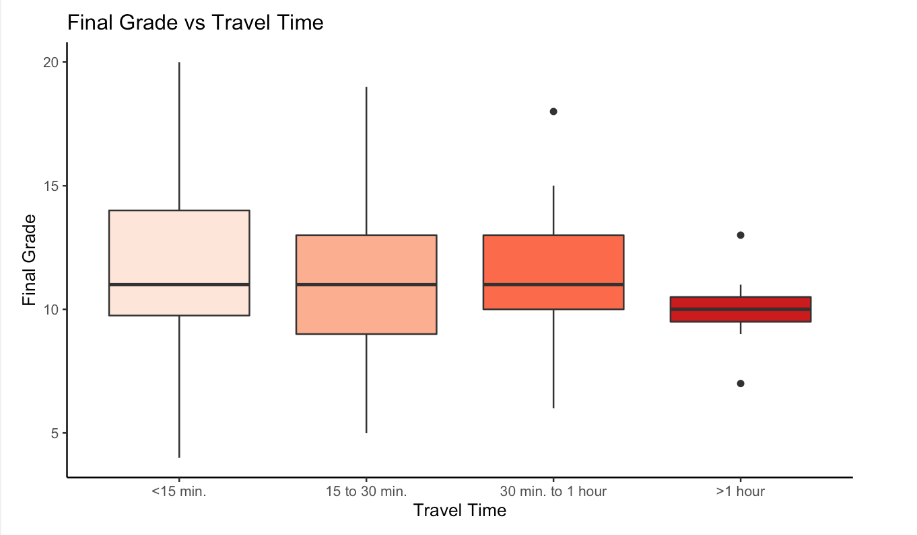
EDA…

Slide 6
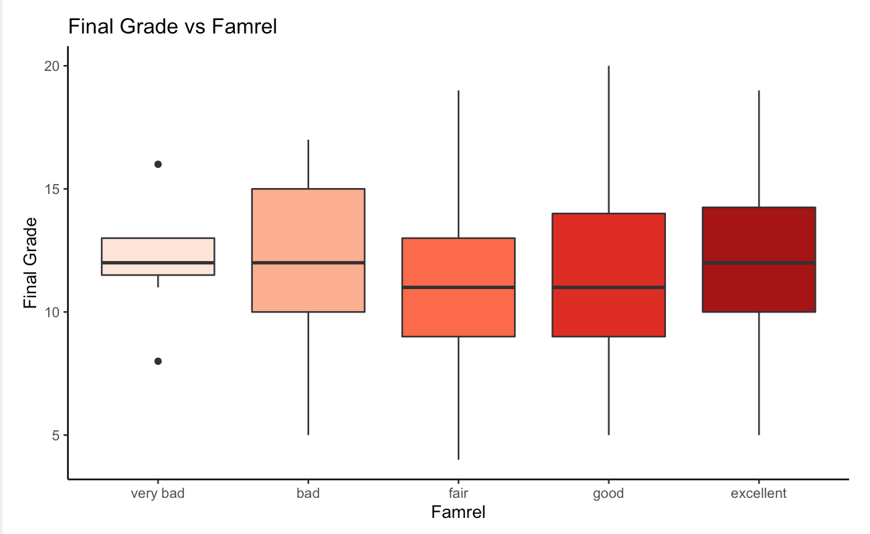
EDA…

Slide 7
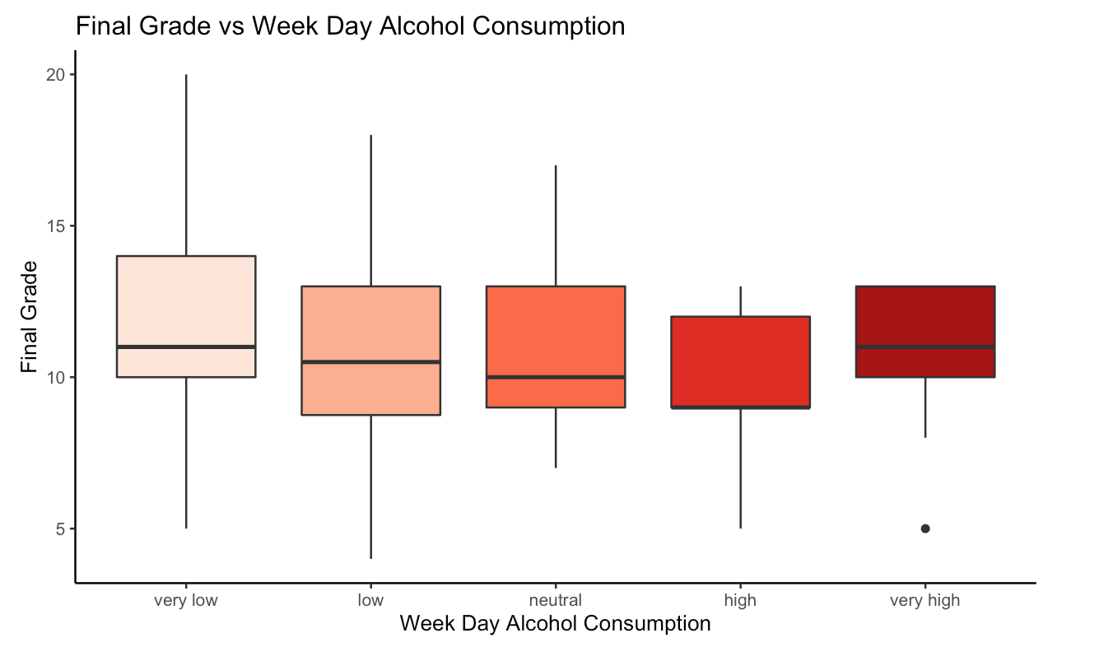
EDA…

Slide 8
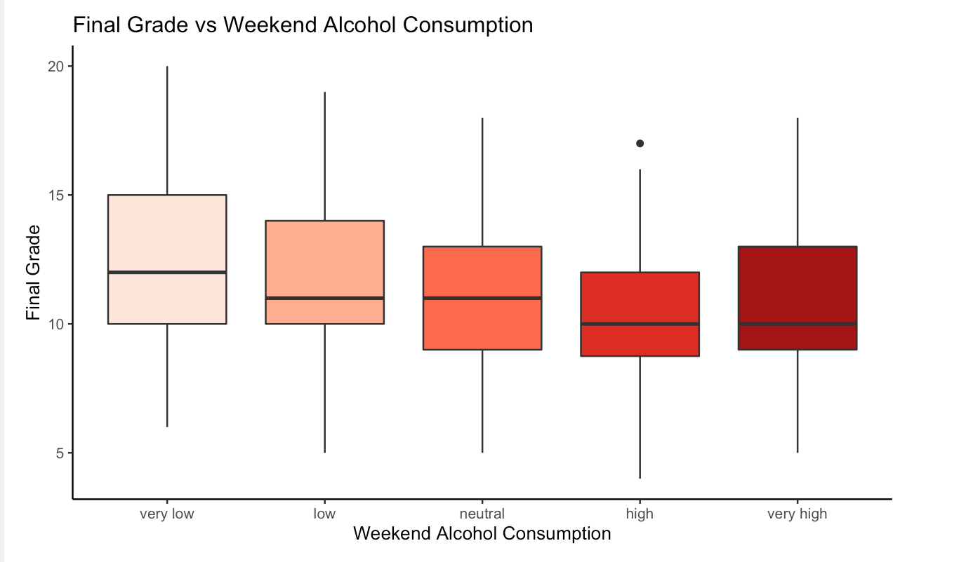
EDA…

Slide 9
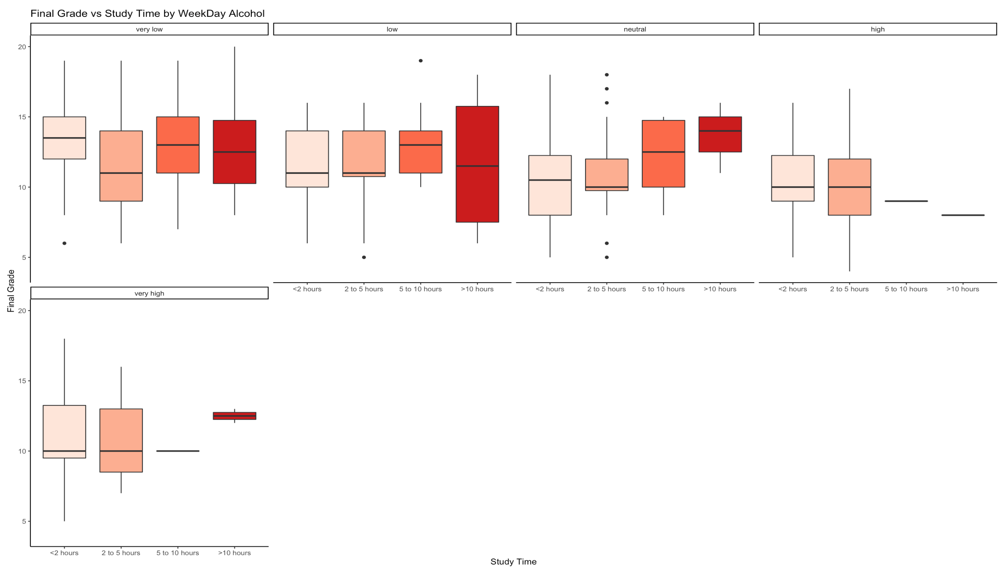
Interactions

Slide 10
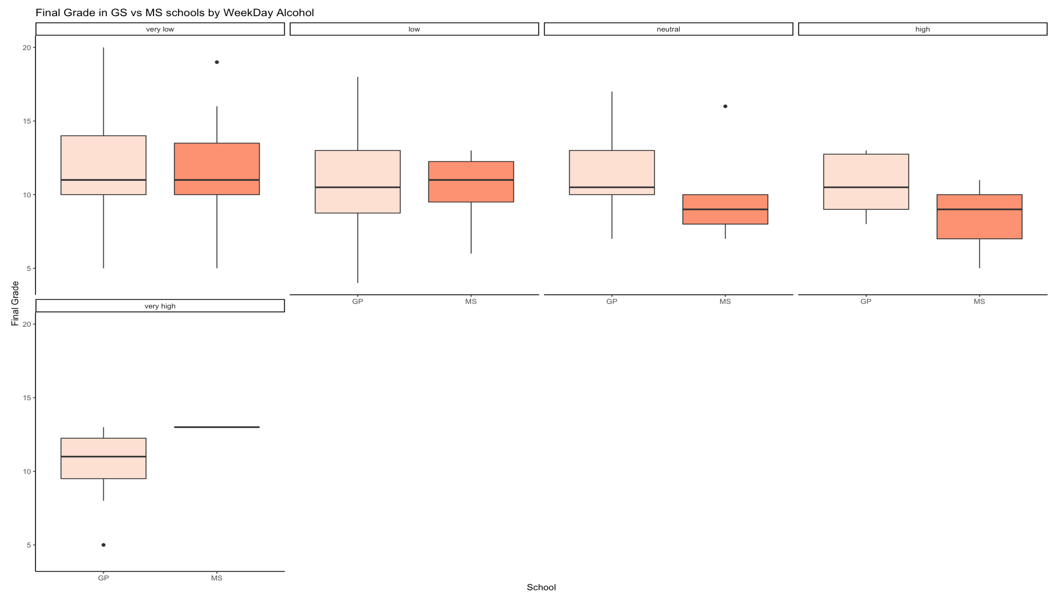
Interactions…

Slide 11
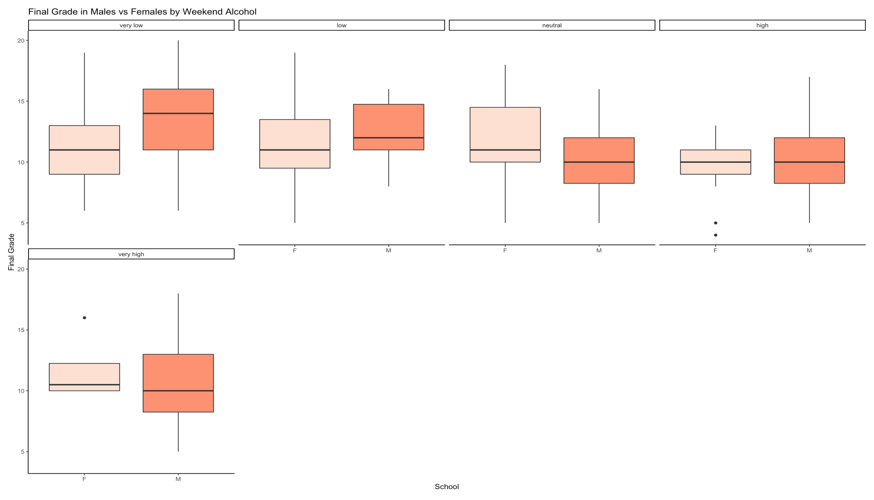
Interactions…

Slide 12
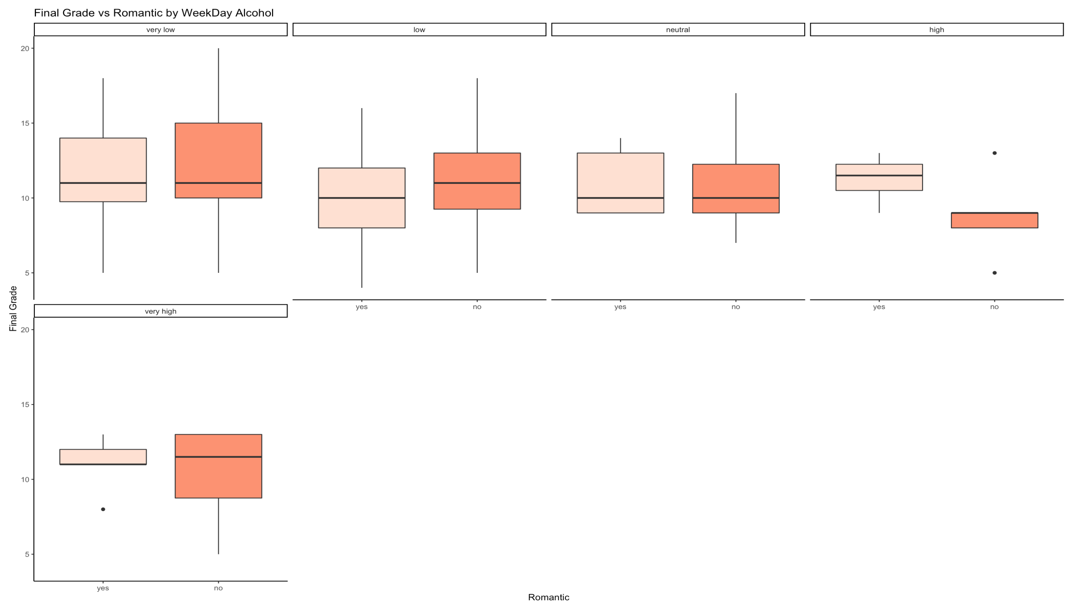
Interactions…

Slide 13
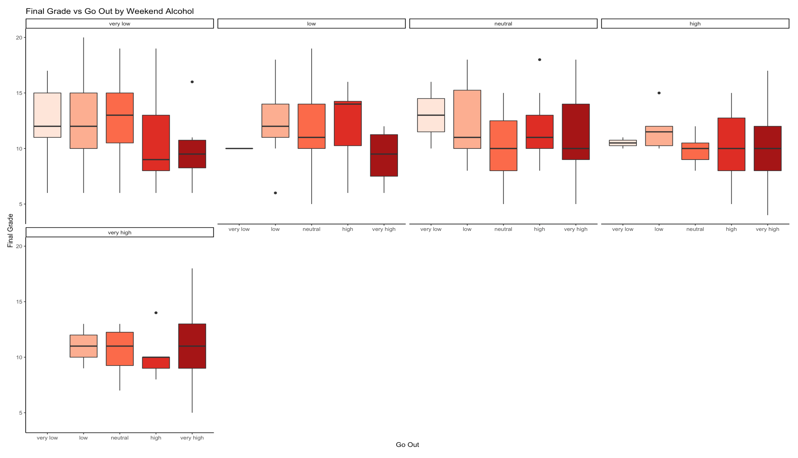
Interactions…

Slide 14
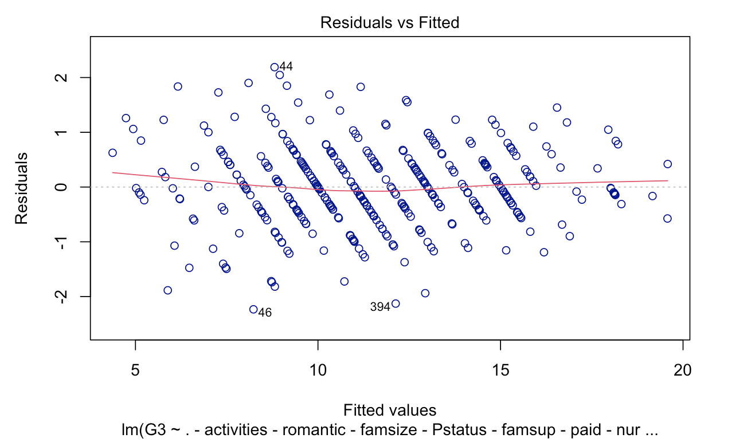
Models
All predictors model (-age and –failures)
Grades, travel time, mother’s job, family relationships, go out are significant
Normality check, no outliers, not linear
2 High influential points
EDA model
Not any better. Normality poor.
Travel time, grades, family relationships, go out are significant
2 High influential points
Interaction model
Normality check. Not linear. Independence check. Equal variance check.
Very many High influential points

Slide 15
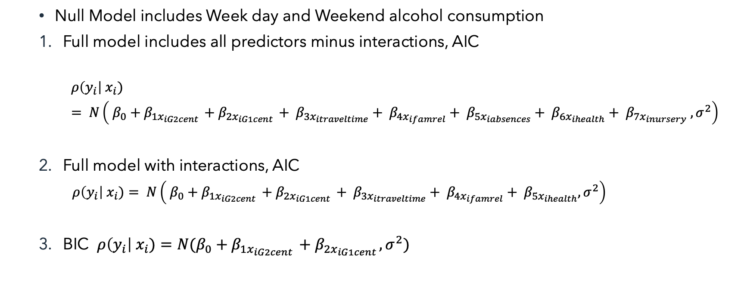
Model Selection
Null Model includes Week day and Weekend alcohol consumption
Full model includes all predictors minus interactions, AIC
$$ρ\left(y_{i}\right| x_{i})= N\left( β_{0}+β_{1x_{iG2cent }}+β_{2x_{iG1cent }}+ β_{3x_{itraveltime}}+ β_{4x_{ifamrel}}+ β_{5x_{iabsences}}+ β_{6x_{ihealth}}+ β_{7x_{inursery}} , σ^{2}\right)$$
Full model with interactions, AIC
$$ρ\left(y_{i}\right| x_{i})= N\left( β_{0}+β_{1x_{iG2cent }}+β_{2x_{iG1cent }}+ β_{3x_{itraveltime}}+ β_{4x_{ifamrel}}+ β_{5x_{ihealth}}, σ^{2}\right)$$
BIC $ρ\left(y_{i}\right| x_{i})=N(β_{0}+β_{1x_{iG2cent }}+β_{2x_{iG1cent }}, σ^{2})$

Slide 16
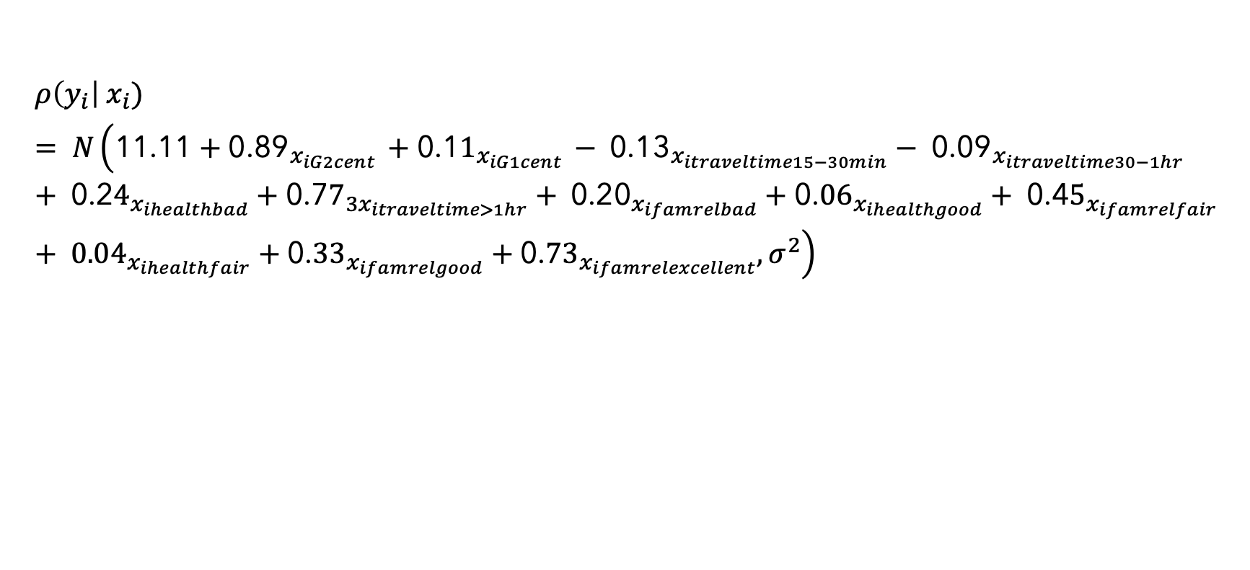
Final Model
$$ρ\left(y_{i}\right| x_{i})= N\left(\text{11.11}+{\text{0.89}}_{x_{iG2cent }}+{\text{0.1}1}_{x_{iG1cent }}− {\text{0.13}}_{x_{itraveltime15−30min}}− {\text{0.09}}_{x_{itraveltime30−1hr}}+ {\text{0.2}4}_{x_{ihealthbad}}+{\text{0.7}7}_{3x_{itraveltime>1hr}}+ {\text{0.20}}_{x_{ifamrelbad}}+{\text{0.}06}_{x_{ihealthgood}}+ {\text{0.4}5}_{x_{ifamrelfair}}+ {0.04}_{x_{ihealthfair}}+{\text{0.}33}_{x_{ifamrelgood}}+{\text{0.}73}_{x_{ifamrelexcellent}}, σ^{2}\right)$$

Slide 17
Final Model Assessment
Model explains 94% of the data
1
Linearity, independence, equal variance and normality look good
2
Family relationships is highly correlated. G1 and G2 are moderately correlated
3
Prediction accuracy of 71%
4
No high influence or leverage points
5

Slide 18
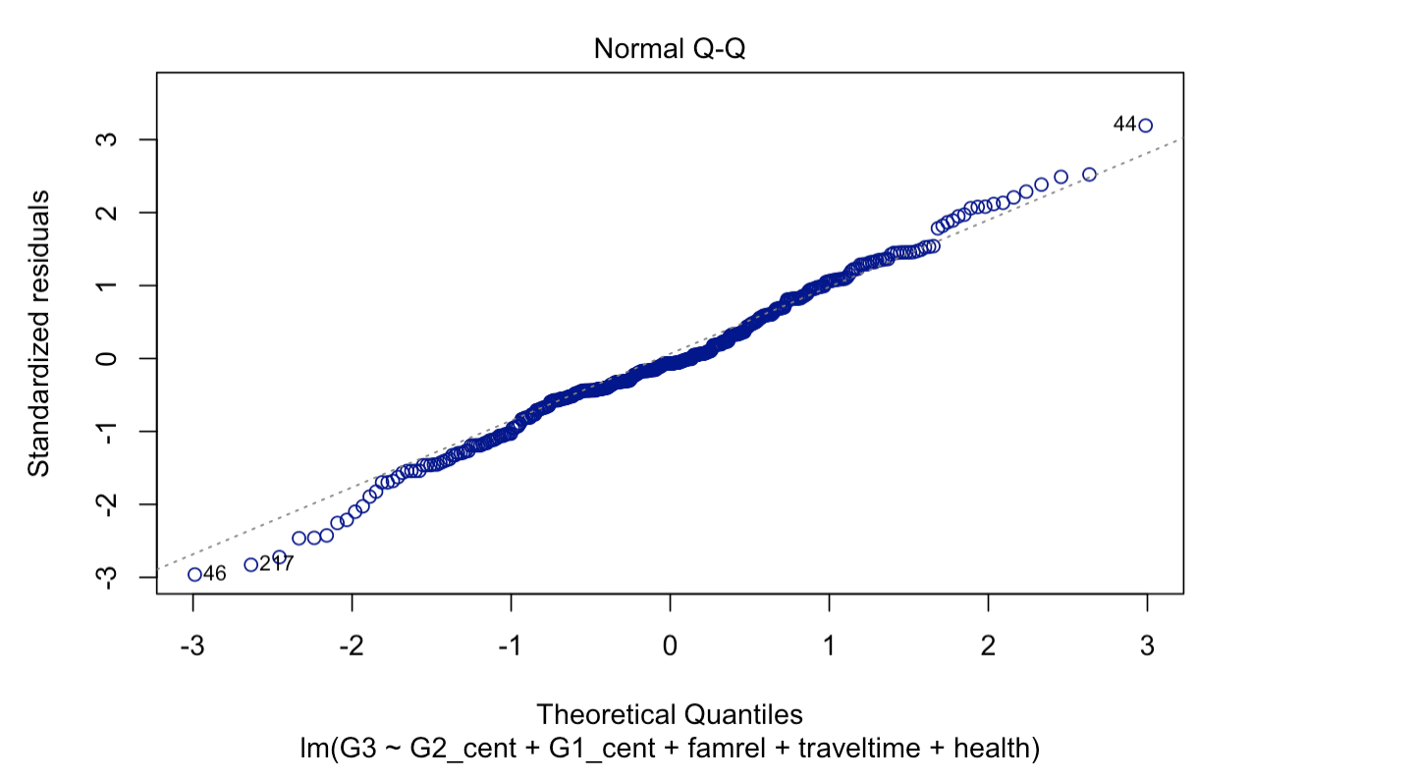
Assessment…

Slide 19
Conclusions
We expect the average final grade to increase by about 0.89 at the average second period grade points, holding all other variables constant with 95% CI (0.83, 0.96).
We expect the average final grade to increase by about 0.11 at the average first period grade points, holding all other variables constant with 95% CI (0.04, 0.17).
Holding all other factors constant, we expect students with excellent family relationships to have a final grade around 0.73 higher than students with very bad family relationships at a 95% CI (0.09, 1.36)
Holding all other factors constant, we expect students with a travel time greater than 1 hour to have a final grade of 0.76 higher than students with a travel time of less than 15 min at a 95% CI (0.15, 1.38)

Slide 20
Conclusion…
Females consume a lot of alcohol over the weekend than males
GP school has a higher week-day alcohol consumption
Week-day alcohol consumption is low during increased study times
Week-day alcohol consumption is less in students with no romantic relationships
Students who go out a lot drink more over the weekend than those who do not go out

Slide 21
Limitations
Resolve multicollinearity
Explore data in Portuguese students and make comparisons between the results

