Slide 1
US National Park Visits
Group 2 | Project One

Slide 2
Project Description
Analysis of usage of US National Parks between 2017 and 2020
Project Team
Laurel Williamson
Missy
Meyer-Bush
George
Aziz
Jet
Simpson
Notes:
Missy
Split into two (2)
Throw in google map showing focus parks
1 vis

Slide 3
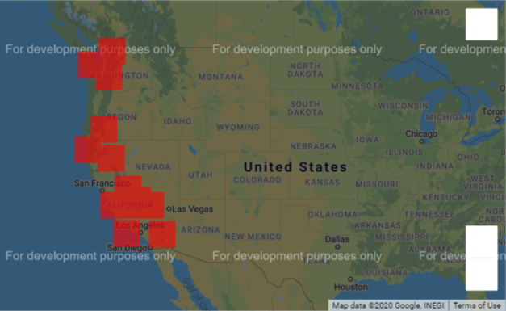
HYPOTHESIS: National park visitation has declined over 2020 due to factors such as COVID-19 and the California wildfires.
* this analysis relies on data related solely to National Parks located on the west coast to limit variation potentially caused by climate

Slide 4
Data Sources
US National Parks Website
Monthly visit stats for 2017-2020 (csv)
Base park information (csv)
HealthData.gov
State Emergency Orders Issued (Excel)
Google
Park geocoordinates (API)
California State Geoportal
Wildfire Perimeters (csv)
Notes:
Missy
Split into two (2)
Throw in google map showing focus parks
1 vis

Slide 5
Three Main Questions
Motivation for Analysis
Has COVID had a greater impact on National Park visitation than the wildfires?
Has the COVID-19 pandemic had an affect on National Park usage?
Project Team
Were there variables beyond COVID that affected park usage in 2020?
Notes:
Define the core message or hypothesis of your project.
Describe the questions you asked, and _why_ you asked them

Slide 6
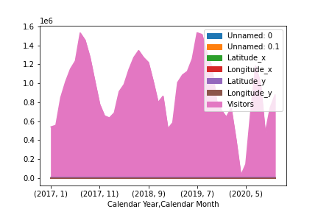
- Insert area map
Notes:
Describe whether you were able to answer these questions to your satisfaction, and briefly summarize your findings
Elaborate on the questions you asked, describing what kinds of data you needed to answer them, and where you found it

Slide 7
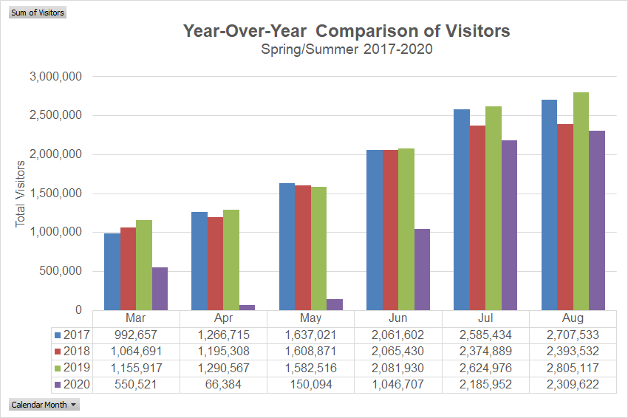

Slide 8
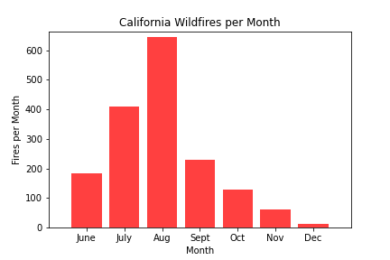
Insert wildfire vis
2020

Slide 9
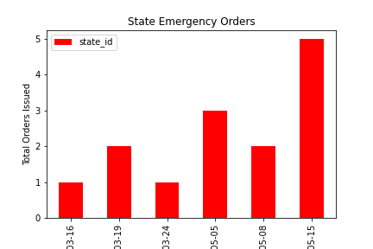
Insert state order vis
Notes:
Covid – specifc (so answers Q1)

Slide 10
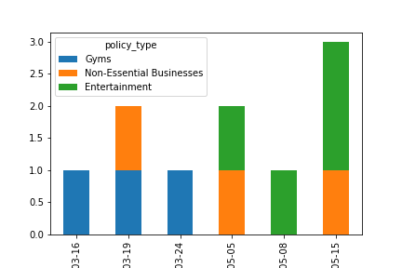
State over state vis

Slide 11
Data Exploration & Deliverables
- Data Exploration Jupyter Notebook
\
Notes:
Describe the exploration and cleanup process
* Discuss insights you had while exploring the data that you didn't anticipate
* Discuss any problems that arose after exploring the data, and how you resolved them
* Present and discuss interesting figures developed during exploration, ideally with the help of Jupyter Notebook

Slide 12
Data Analysis
- Visualizations Jupyter Notebook
Notes:
Discuss the steps you took to analyze the data and answer each question you asked in your proposal
* Present and discuss interesting figures developed during analysis, ideally with the help of Jupyter Notebook

Slide 13
Post Mortem
Difficulties and Limitations
Issues cleaning suboptimal data sources
Hard to find complete, thorough data sets
Further Exploration
Statistical significance
Lessons Learned
Adapt & overcome
Steal shamelessly
Notes:
Discuss any difficulties that arose, and how you dealt with them
* Discuss any additional questions that came up, but which you didn't have time to answer: What would you research next, if you had two more weeks?

Slide 14

Questions

