Slide 1
Object Oriented Programming I (C++)
Mehedi Hasan Riad

Slide 2
Pre-requisites
I will imagine that you have a very good knowledge of programming in C (Structure Programming).

Slide 3
What will we learn in this course?
Class & Object
Constructor & Destructor
Encapsulation
Inheritance
Polymorphism
Friend Class & Function
Virtual Function & Abstraction
GUI

Slide 4
What is Object-Oriented Programming (OOP)?

Slide 5
Key Concepts in OOP

Slide 6
Benefits of Object-Oriented Programming
Modularity: Programs are divided into smaller, manageable objects, making code maintenance and reuse easier.
Encapsulation: Objects encapsulate data and related behaviors, ensuring data integrity and hiding implementation details.
Inheritance: Objects can inherit properties and behaviors from other objects, enabling code reuse and hierarchical relationships.
Polymorphism: Objects can exhibit different behaviors based on their specific types or classes, providing flexibility and extensibility.

Slide 7
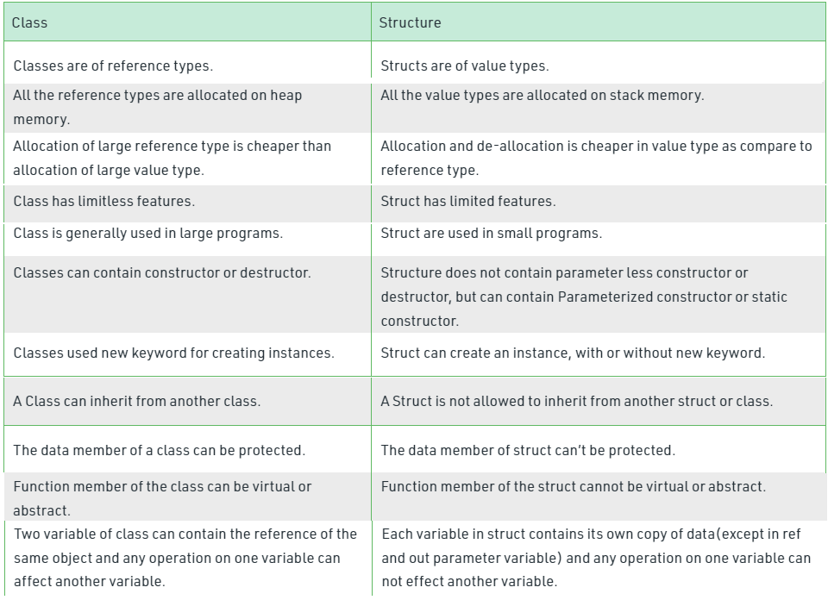
Difference Between Class based & Structure Programming

Slide 8
Thank You………………… ☺

