Slide 1
Object Oriented Programming I (C++)
Mehedi Hasan Riad

Slide 2
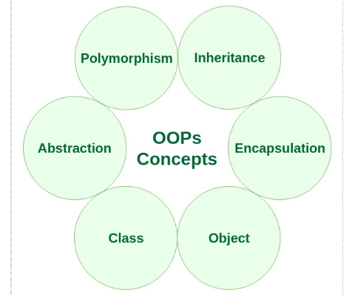
Characteristics of an Object Oriented Programming language

Slide 3
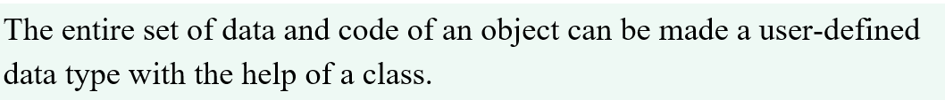
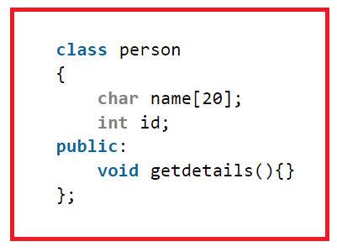
Class

Slide 4
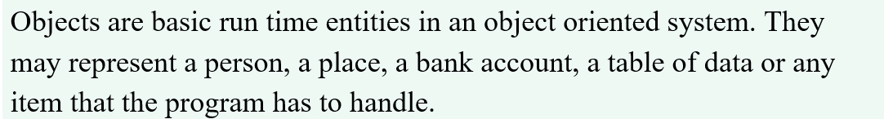
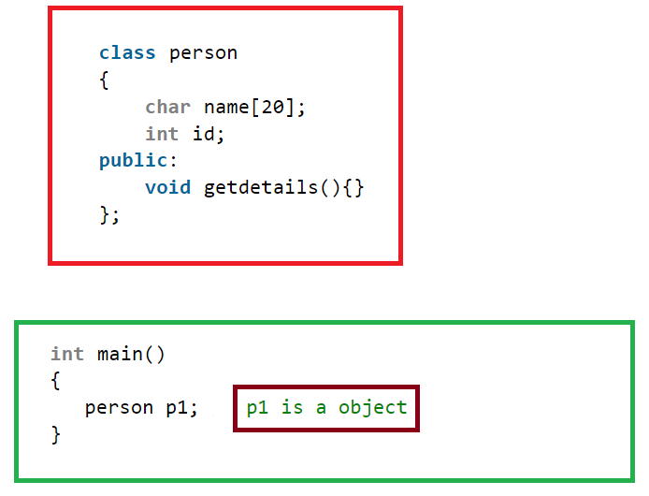
Object

Slide 5
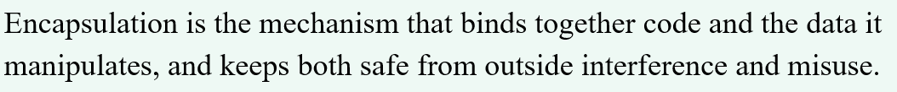
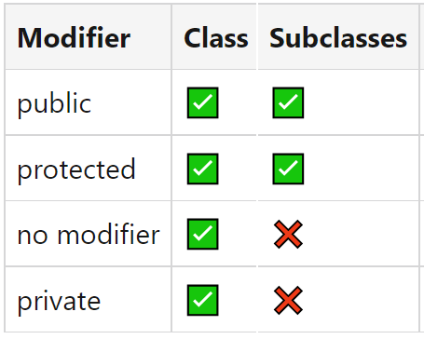
Encapsulation

Slide 6
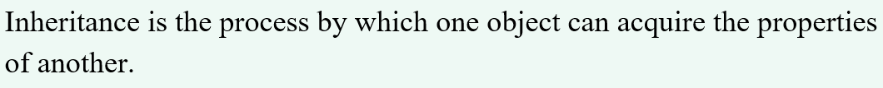
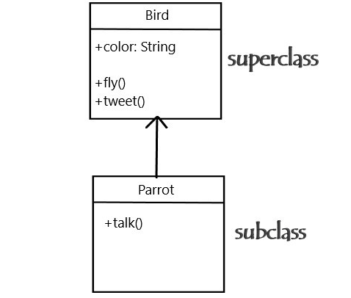
Inheritance

Slide 7
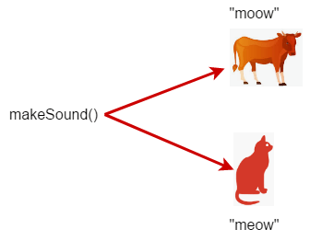
Polymorphism

Slide 8
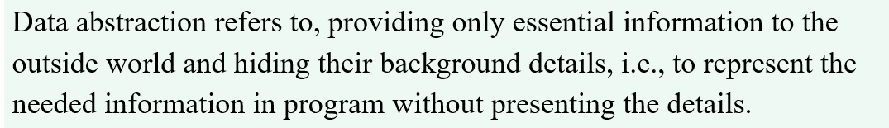
Abstraction

Slide 9
Classes & Objects
Class is a fundamental block of a program that has its own set of methods and variables.
Class is a user-defined type that describes what a certain type of object will look like.

Slide 10
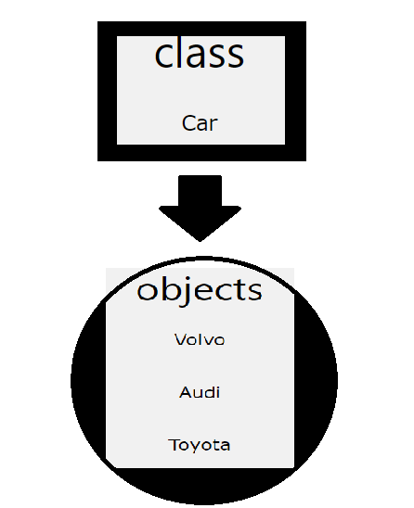
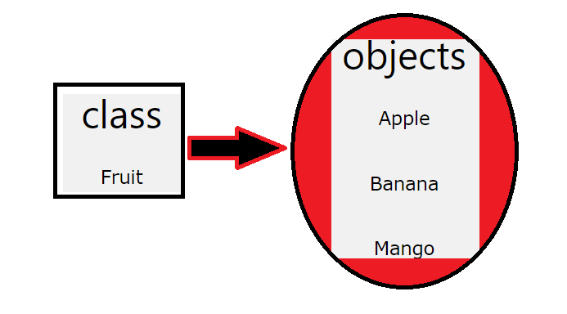
Classes & Objects
Example

Slide 11
Object Oriented Structure

Slide 12
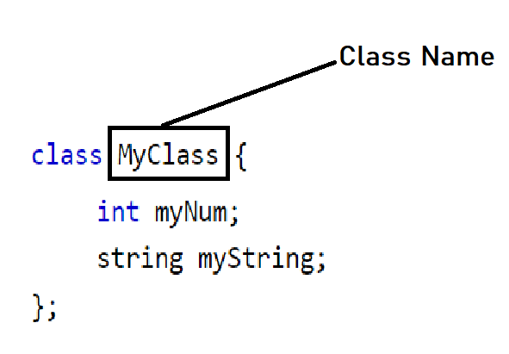
How to create a class?
Class syntax:

Slide 13
Can you create a class Student with 4 entities?
Define a class named ‘Student’ then include four fields name, id, email, cgpa to assign data.

Slide 14
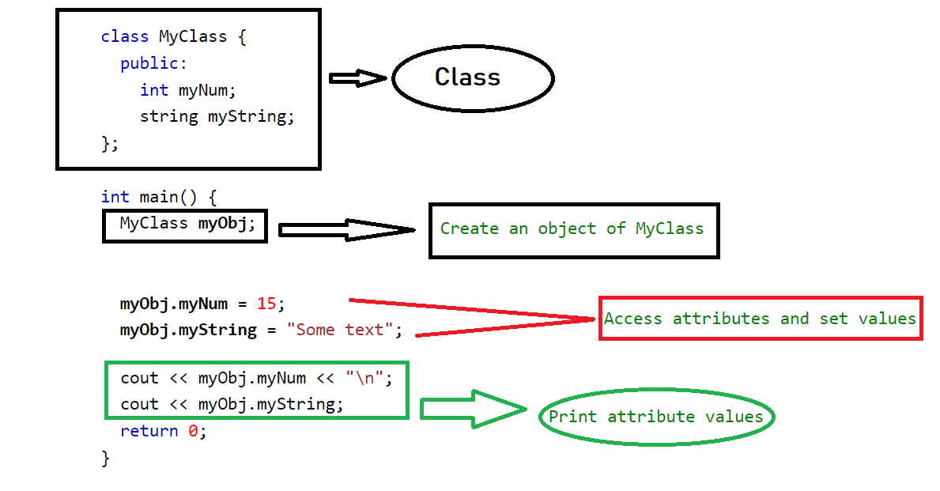
How to Create an object of a class?

Slide 15
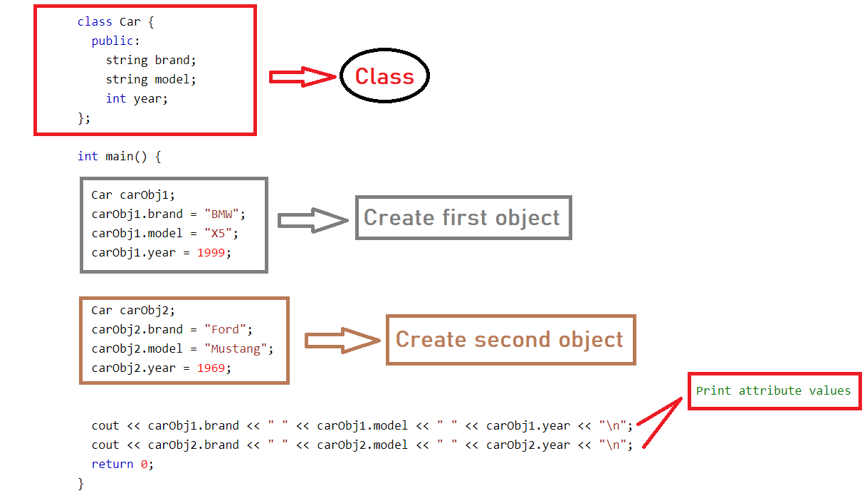
How to create multiple objects of a class?

Slide 16
Can you initialize yourself as the Student class object?
Assign yourself as a object of previously defined ‘Student’ class then give input to the four entities of the class according to your information.

Slide 17
Thank You……… ☺

