Slide 1
Decentralized RAG
Combining Retrieval Augmented Generation with Blockchains
Reed White
12367576
5567-0001 Blockchain

Slide 2
Domain
Large-Language Models (LLMs) rarely meet business needs out of the box
Pre-training or fine-tuning LLMs is expensive and slow
Retrieval-Augmented Generation (RAG) allows businesses to inject context to LLMs quickly and at low cost

Slide 3
Problem
Managing the corpus used in a RAG can be difficult
Basic file shares and vector databases have control, auditing, and availability issues
Standard relational databases have similar issues and are also difficult to integrate with a RAG

Slide 4
Proposed Solution
Store the corpus in a private blockchain
Any administrator will be able to contribute to the corpus with a MetaMask account
Contributions and other changes will be tracked by the blockchain
Blockchain (and supporting technologies, if used) will ensure high-availability of corpus documents
Blockchain will ensure the integrity of the corpus

Slide 5
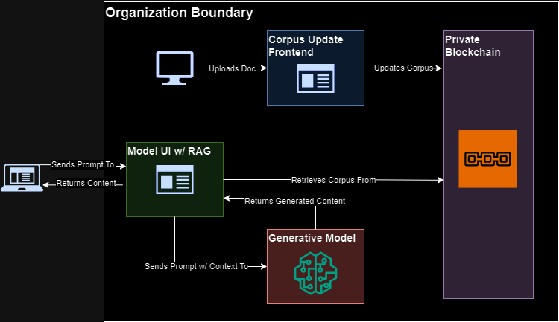
Proof-of-Concept: On-Chain Corpus

Slide 6
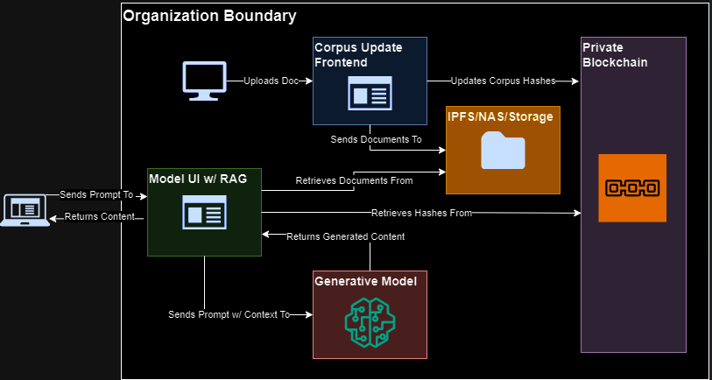
Proof-of-Concept: Off-Chain Corpus

Slide 7
Challenges
On-chain storage, while simpler and more highly-available, is extremely computationally expensive
Off-chain storage, while much less computationally expensive, requires an extra storage system
Any user with a MetaMask account can read the corpus, which may or may not be desired (and makes this unsuitable for a public blockchain in most cases)
Any user with a MetaMask account made for the private blockchain can manage the corpus, which may or may not be desired
The corpus is loaded into an in-memory vector store, which may or may not be desired

Slide 8
Areas of Improvement
Implement on a permissioned blockchain (to improve authentication)
Implement permissions in the smart contract (to improve authorization)
Add support for custom tokens
Add support for more file types
Standardize overwriting or duplicating files
Modify corpus keys to be hashes or filenames, to simplify administration
Containerize the Administrator and Model/RAG frontends, for improved scalability
Add options to integrate with permanent vector stores

Slide 9
Demo + Q/A
Panopto Video: https://umsystem.hosted.panopto.com/Panopto/Pages/Viewer.aspx?id=603bf6e5-e1de-4f6d-9577-b2170161bed2
Github: https://github.com/mist861/5576-Blockchain

