Slide 1


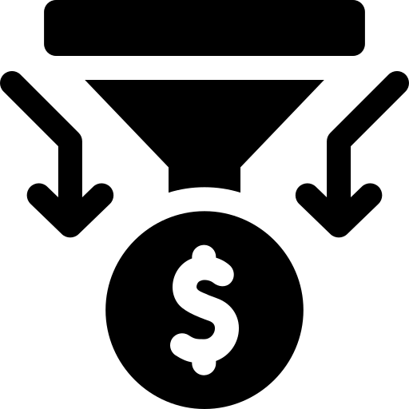
The forge
Idea forge – idea pipeline
Uli Stormanns, Gernot Schulmeister
5. to 25. October 2026

Slide 2

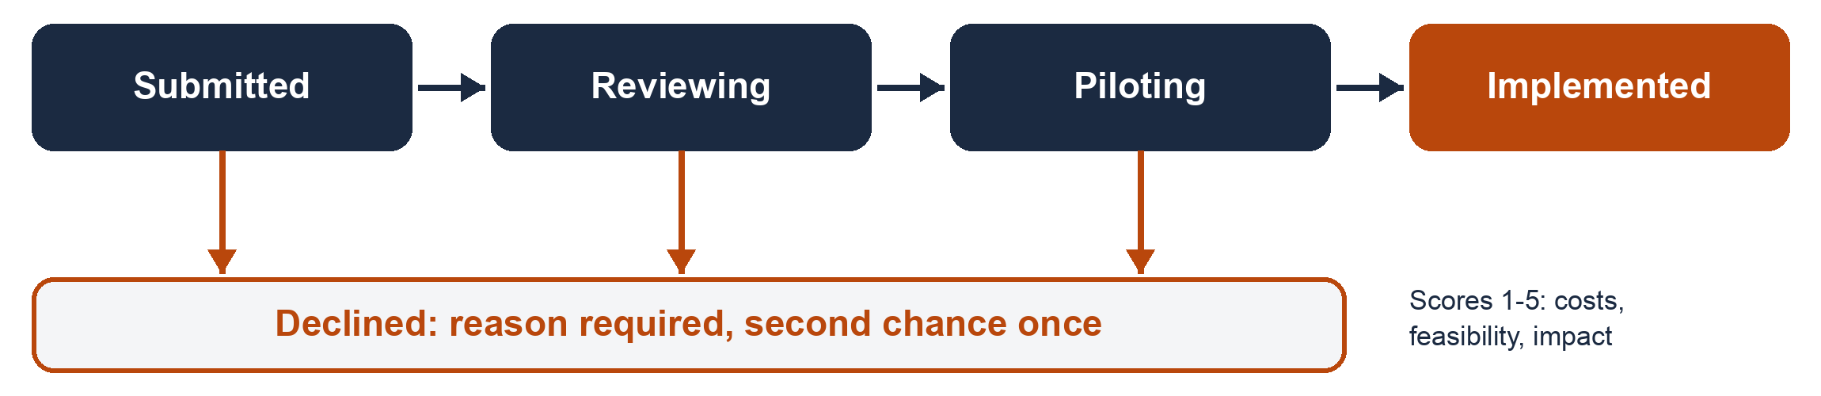
The problem
The client
Tallis & Reeves: innovative ideas get lost in email folders
Wanted: a clear pipeline from submission to implemented, with a sortable, filterable dashboard
The input
Three roles: admin, reviewer, staff
Client brief with Must, Should and Could haves; an AI client (Gemini) answers open questions
Three implementation pathways: Google Sheets, Local-first, GitHub with Supabase
The stage model

Slide 3

Approach, requirements and design
Approach
Milestones first: best practices before building
Team charter: how we work together
CLAUDE.md: rules and context for the AI
One GitHub repo: all artefacts as Markdown, folders follow the SDLC
Requirements
PRD: Must and Should haves
AI client Q&A saved as chat protocols
Open questions revealed anonymous and confidential ideas and a second chance
Result: one user story with acceptance criteria per Must and Should
Design
Design pack: data model, user journey, mockups (Claude, ChatGPT), React prototype
Prototype built for Supabase, reused unchanged
Keep it simple: data models simplified step by step
CLAUDE.md rule and senior developer skill (least code necessary)

Slide 4

Build (Setup and process)
Setup
Public repo: https://github.com/mistakanista/ideaforge/ (push via SSH key, granted to Uli)
Backend: Supabase, after the Oracle free tier login failed; Java in Docker also considered
Supabase linked to GitHub: migrations run on push; seed data imported manually
Netlify linked to GitHub: every push is deployed, https://ideaforge-tou.netlify.app/
Process
Slices: one user story at a time, starting with US-0 (Google login and database)
New Claude session with a plan step for every build step
Unclear points questioned and acceptance criteria adjusted
Order: data model adjustments first, then the frontend

Slide 5
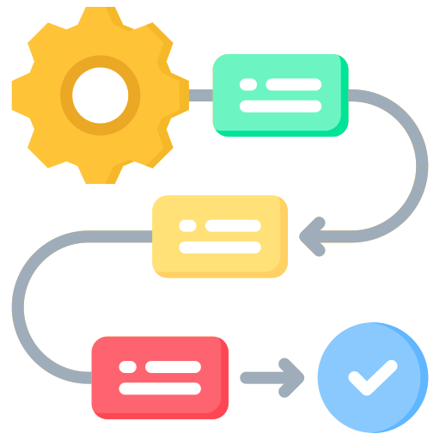
Build (Security and test)
Security
Supabase row level security handles authentication and permissions
Imported Tallis users set a new password at first login
Default password removed from CLAUDE.md after Gabi found it; a script now generates new ones
CLAUDE.md rule: never use a password or secret in the code
Test
Claude wrote and ran frontend and database tests after every feature and kept the build log
We ran the tests, checked the feature in the browser and reviewed the code changes
We committed and pushed manually, although Claude offered to do it
Build log summary records our AI experience for the last user story

Slide 6

Deploy and maintenance
Deploy
Checklist template created for deployments
Netlify, chosen after evaluating Vercel: commercial use and unlimited members are allowed
Maintain
Folders for bugs and change requests
Impact note template: Claude writes one for every change request
Every change request gets a new user story with acceptance criteria
Decision example
Relate ideas instead of merging them: a merge loses data and gives one idea more than one owner, which is not clean and could cause other problems

Slide 7
How we handled change
Request | What we did | How we checked nothing broke | What we did not do, and why
CR-1 Monthly email digest | Impact note first. New admin page "Top ideas digest", database functions for the top 5 and a test mail on the first working day | New database tests (14 + 19); older test suites run again; 116 unit tests | No real send to all staff yet: needs a scheduler and client answers (holidays, time window)
CR-2 Merge ideas | Impact note first. Ideas are related instead of merged (duplicates / replaces / is related to): new table, "Relate" form, "Related ideas" list | New database tests (19); all older suites run again; 128 unit tests; browser test | No merge: it loses data and gives one idea two owners. Confidential ideas cannot be related, so nothing leaks
Bug: double vote | Tried to reproduce the report from Glasgow | A quick double click removes the vote again; the count never rises by two | No fix, there is no defect. Documented in the bug file

Slide 8
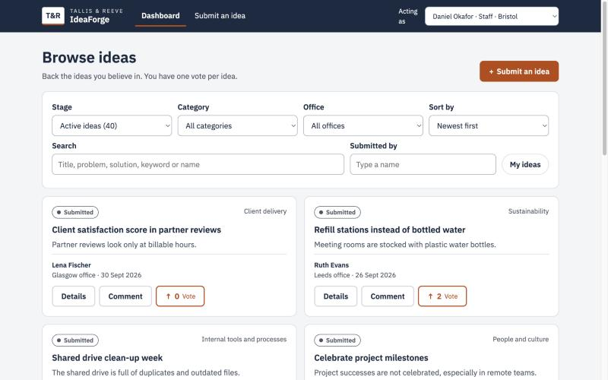
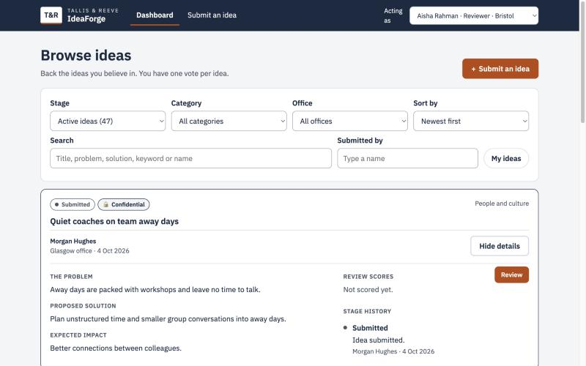
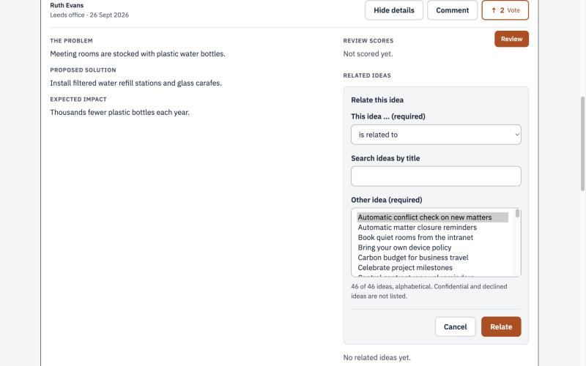
The app in action
Dashboard: staff browse, search and vote
Rule: a confidential idea is visible only to its submitter and reviewers
Change request 2: a reviewer relates two ideas
Screenshots from the local prototype mode with fictional demo data.

Slide 9

Try it yourself
Live app: https://ideaforge-tou.netlify.app/
Run locally: Readme.md in https://github.com/mistakanista/ideaforge/
Demo accounts (fictional data only, sign-in limited to an allowlist):
Admin: Dev.Anand@tallis.uk : h5ggHkLL&41
Only role that opens Users, Categories and Top ideas digest; cannot review ideas
Reviewer: Ruth.evans@tallis.uk : hhgR5TTx%
Scores or declines ideas and relates ideas; cannot review her own ideas
Staff: Sofia.Marin@tallis.uk : htzCvvG56?
Submits and votes; confidential ideas of others stay invisible

Slide 10

What we learned
What AI did well
Claude worked reliably; only a few bugs had to be corrected
We learned a lot about the SDLC, its artefacts and building with Claude
Where it went wrong or needed correcting
The first data modes and the generated diagrams were too complex; we added a "keep it simple" rule to CLAUDE.md
We added a rule to never store passwords, even not the default password
Supabase: business rules sit in immutable migrations, so they are hard to oversee and not well structured
What we would do differently
Small steps and understanding what Claude did was a bit slower than necessary, but avoided bugs: we would keep it
For bigger projects: keep the business rules readable in one place

