Slide 1
From Sketch to Solid
How every 3D design begins as a 2D drawing
Intro to Mechanical Drawing · before we open Fusion

Slide 2
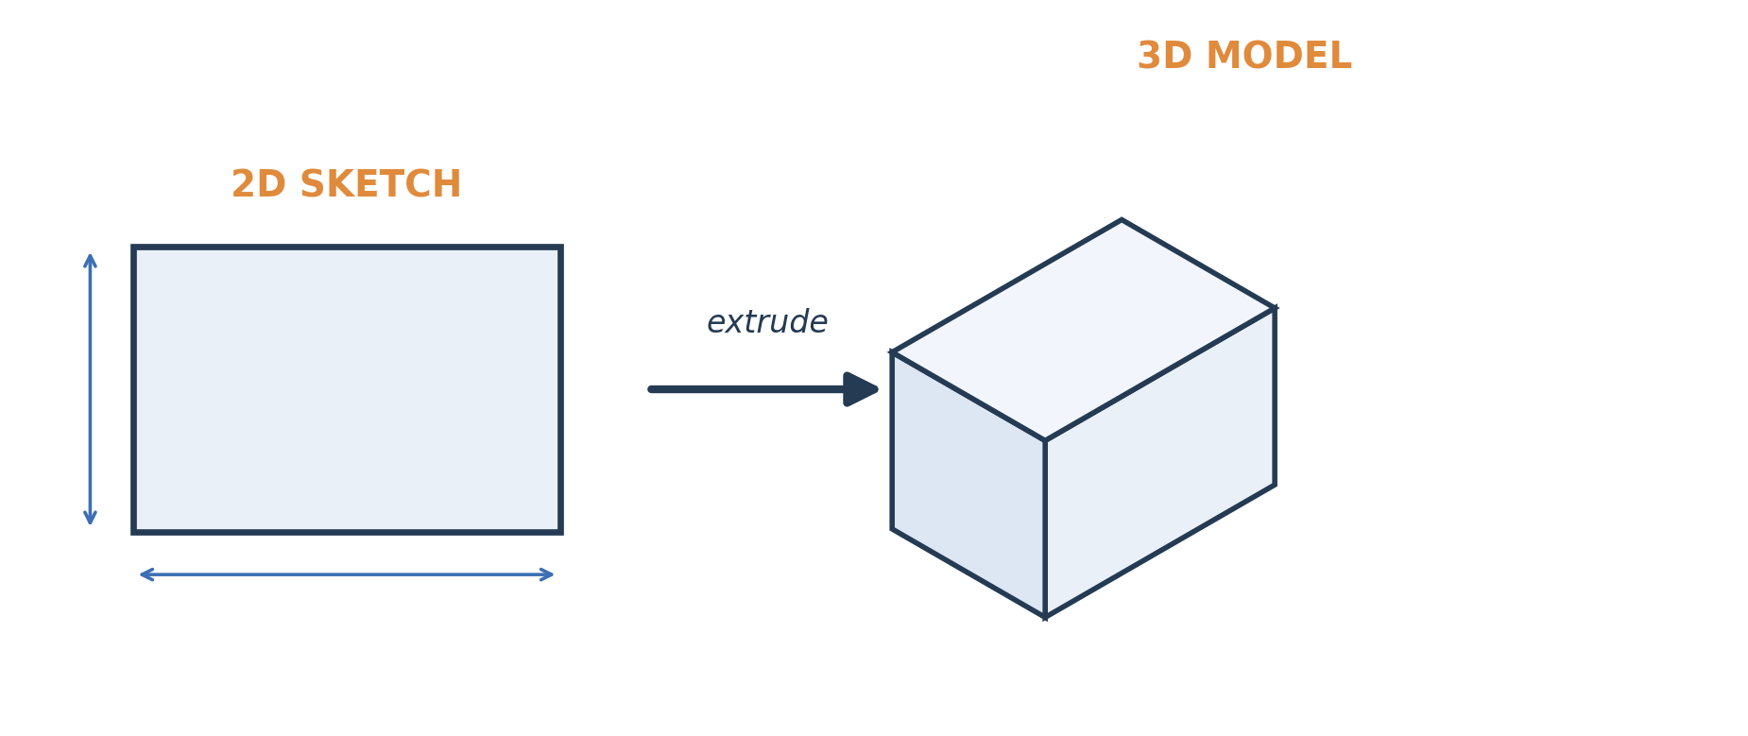
The big idea
3D models start as flat, 2D sketches
A designer almost never starts in 3D. They start by drawing a simple, flat shape — then give it depth. That flat starting shape is called a sketch. Get the 2D sketch right, and the 3D shape follows.

Slide 3
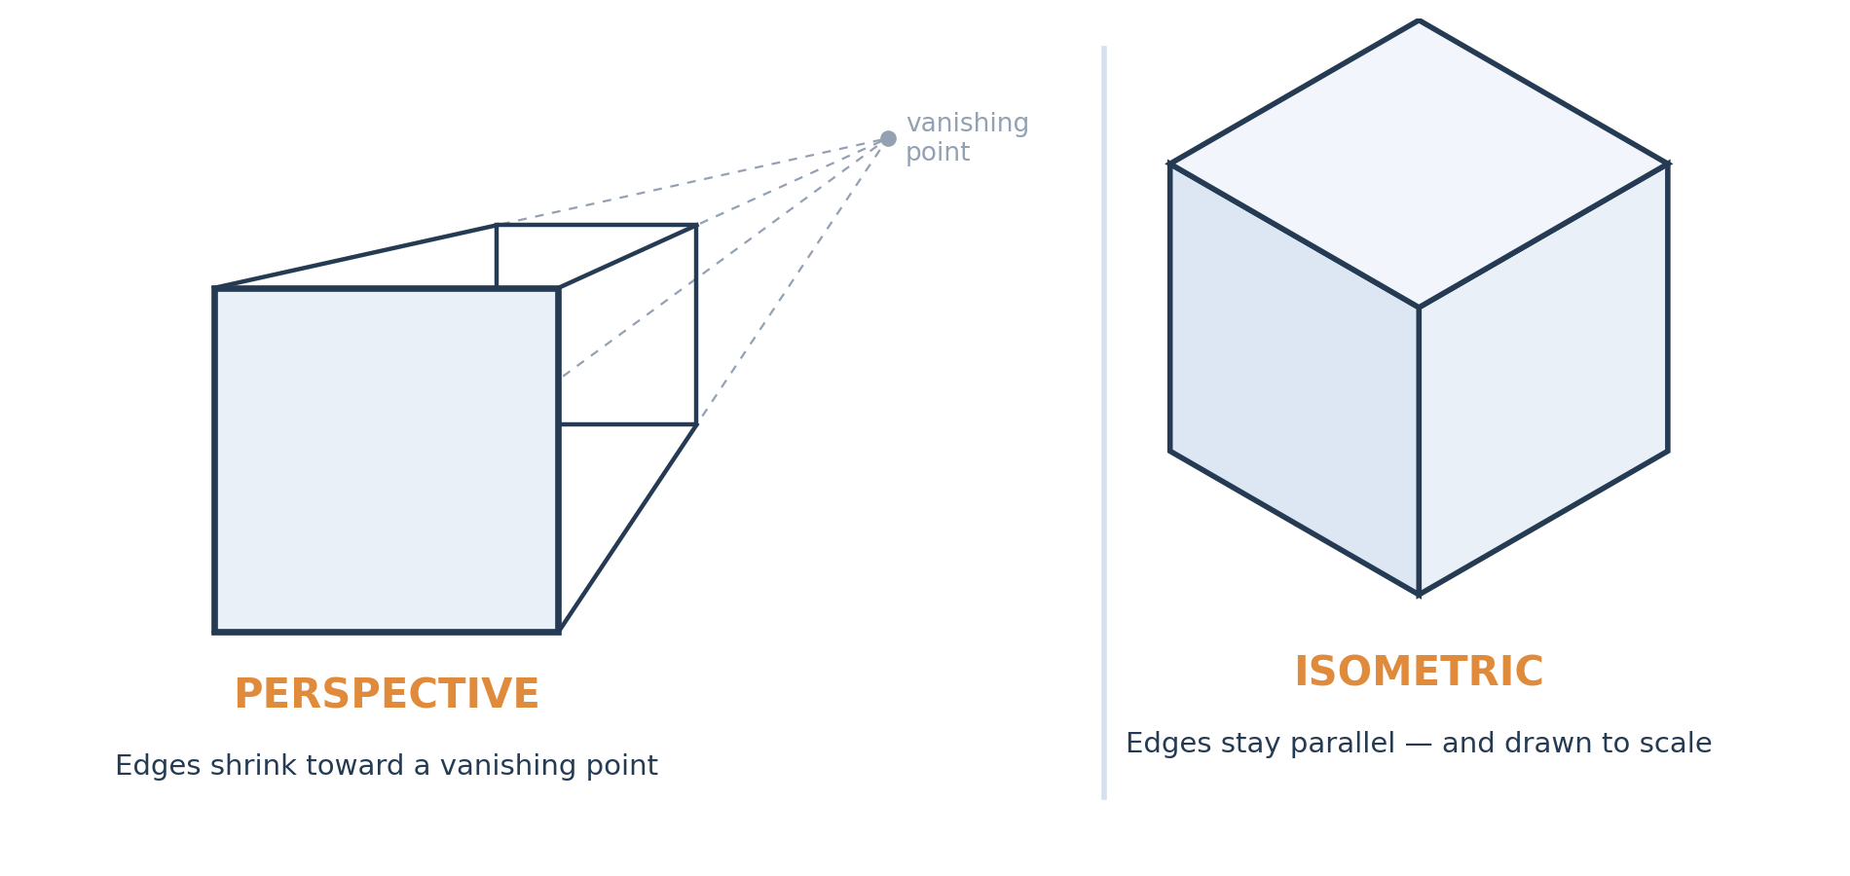
Two ways to draw in 3D
Perspective vs. isometric
Both look three-dimensional. But perspective distorts sizes, while an isometric drawing keeps every edge parallel and to scale — so you can measure it. That's why engineers use isometric, not perspective.
Notes:
Both drawings look 3D. Perspective is what a camera/eye sees (converging edges); isometric keeps edges parallel and to scale, so it's the technical pictorial. Perspective is for art, isometric for engineering.

Slide 4
What "orthographic" means
A big word for a simple idea
ortho = straight / square-on
graphic = drawing
You look at one face head-on, at a right angle.
So it just means a straight-on drawing.
Why engineers draw this way:
1
Nothing is distorted — every length is the true, real-world size.
2
You can put exact measurements on it.
3
Someone else can build the part from it — no guessing.

Slide 5
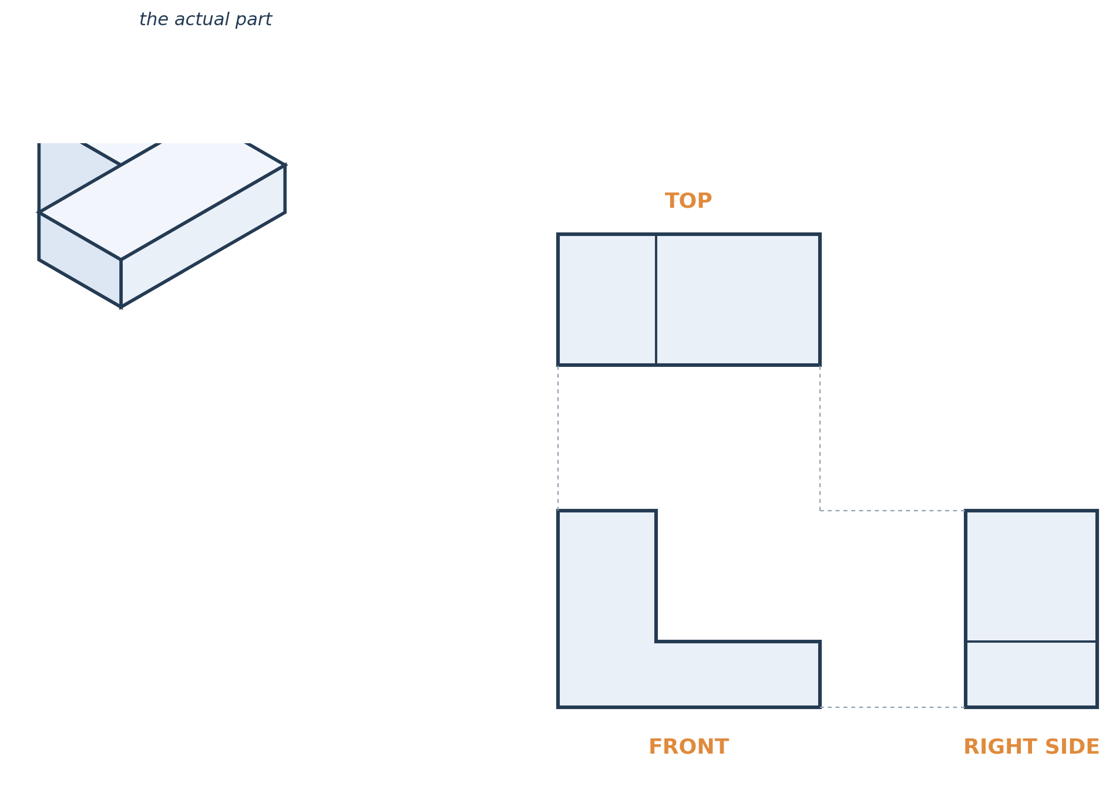
One object → three flat views
The three orthographic views: Top, Front, Side
To describe a 3D object completely, we draw it from three straight-on directions:
1
Front looking straight at it
2
Top looking down from above
3
Side looking from the right
Together, these flat views hold everything needed to build the real part.
Notes:
Third-angle layout: top sits above front, side to the right. The dashed lines show how the views line up and share dimensions.

Slide 6
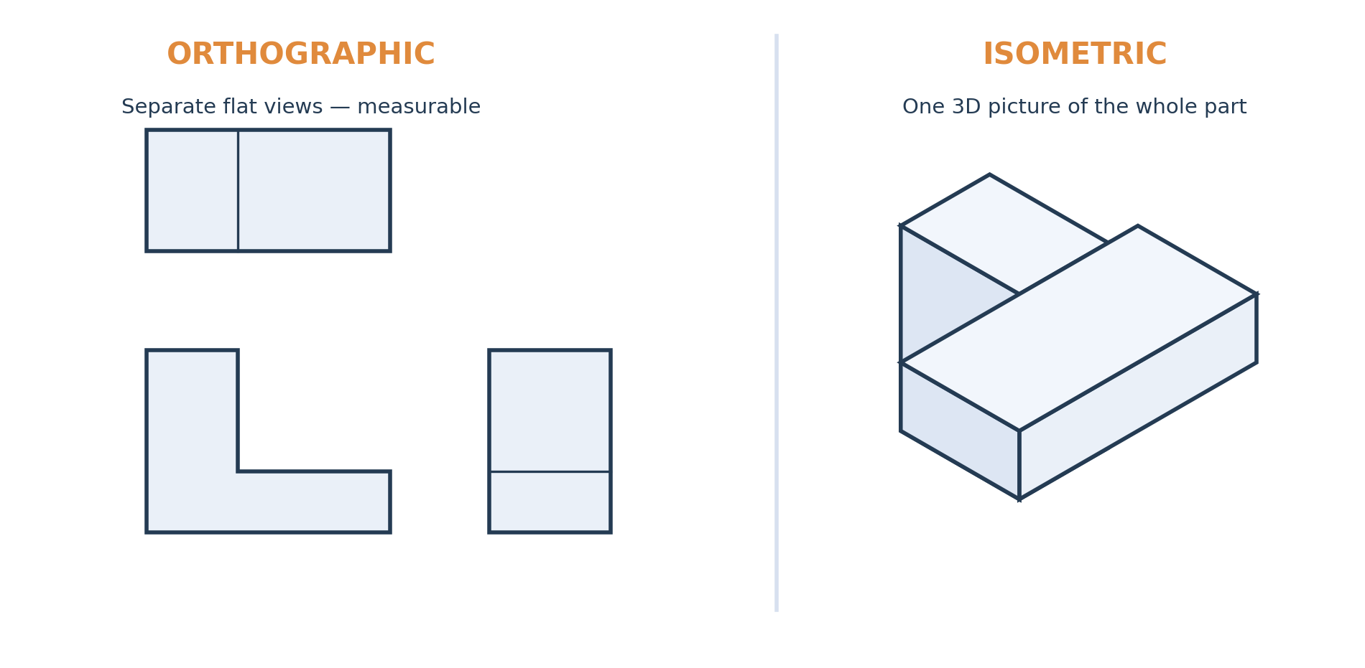
Orthographic vs. isometric
The two drawing styles you'll use today
On your grid paper: the three square-grid panels are the Orthographic views; the triangular-grid panel is the Isometric view.
Notes:
Tie directly to the grid paper: three square-grid panels = orthographic Top/Front/Side; the triangular-grid panel = the isometric view. Same part, two ways of showing it.

Slide 7
Why draw it by hand today?
We're after the idea, not the technique
Today
You'll sketch by hand on grid paper. The goal is to train your eye to see an object as separate 2D views.
Next week
Autodesk Fusion draws the perfect lines for you — but it still asks you to think in 2D sketches first.
The point
Software changes; the way of thinking doesn't. That's what today is really about.

Slide 8
Next week: Autodesk Fusion
The same idea, on a computer
In Fusion you'll draw a 2D sketch, then "extrude" it to add depth — turning your flat shape into a solid 3D model. Exactly what you'll practice on paper today.

Slide 9
Today's mission
1
Pick a simple object and sketch its Top, Front, and Side views by hand.
2
Keep every view straight-on — true shapes, true sizes.
3
Notice how three flat drawings can capture one solid object.
Draw in 2D. Think in 3D.

