Slide 1
LAYER 1 · LAYER 2 · LAYER 3 · … · LAYER 1,200
0.9 mm · 45° · 10 mm · 0.1 / 0.2 / 0.3 mm
Design for 3D Printing
It can't print on air.
High School Engineering • Autodesk Fusion
Notes:
The numbers in green are the whole lab in four figures: wall thickness, overhang angle, bridge length, and the three fits. By the end of today they should mean something. Why this lab exists: last year a lot of prints failed, and almost none of those failures were the printer's fault. The design told the printer to do something it can't. The next project is a mechanism you design, print, and build, so every part has to survive the trip through the printer. The one idea underneath everything today is on the slide: a printer can't print on air.

Slide 2

Video: “Prusa MK4 Vase Time Lapse 6h 30min” by mygiguser, YouTube (youtube.com/watch?v=LNr7dX0oeKI)
Notes:
Play it and talk over it; it has background music, so mute it if it competes with you. It's an MK4, the model just before our MK4S; they look and print the same. 6.5 hours of printing in under 3 minutes, about 130 g of PETG, the tallest part that fits in the printer. Point out how it moves: the nozzle slides left and right, the bed slides front to back, and the whole gantry climbs one thin layer at a time. Every layer sits on the one below it. Ask while it plays: 'What would happen if this vase had a handle sticking straight out from the side?' (Nothing under it: it would print on air. That's today's first rule.) 'What if it were upside down?' (The top rim would be the only thing touching the bed.) Credit: "Prusa MK4 Vase Time Lapse 6h 30min" by mygiguser on YouTube, https://www.youtube.com/watch?v=LNr7dX0oeKI. The slide plays it from YouTube, so the classroom needs internet; if it won't play in the slide, open the link.

Slide 3
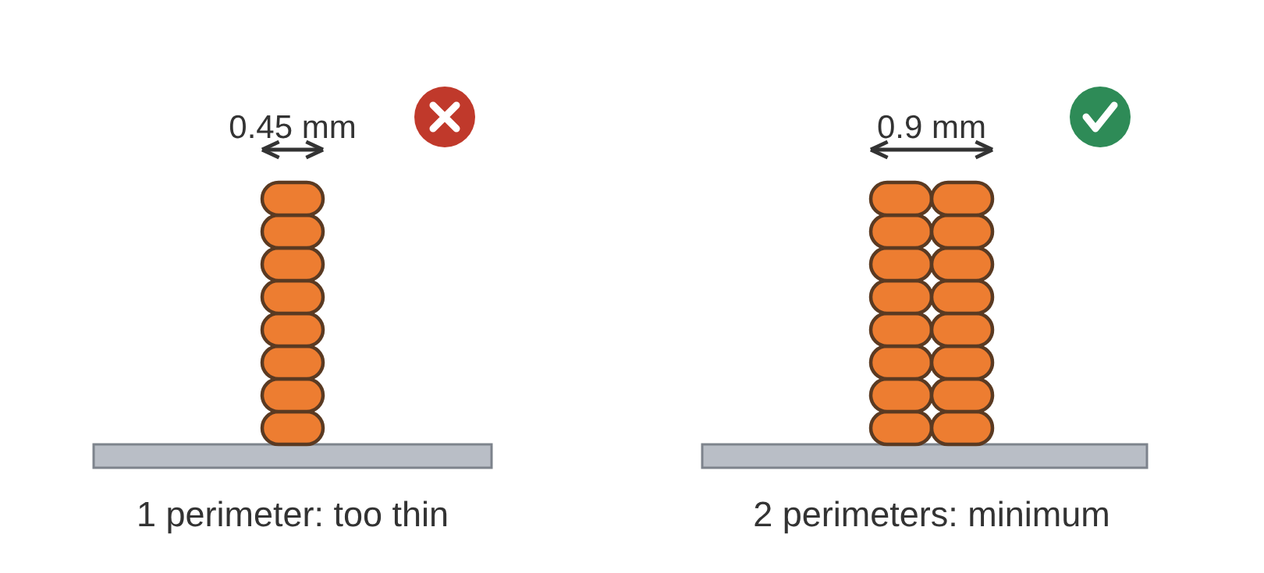
1. Walls: At Least 2 Perimeters
Notes:
Make every wall at least 0.9 mm thick, which is 2 perimeters. Use 3 perimeters (1.35 mm) where the part needs to be strong. A perimeter is one line of plastic around the outside of a layer, about 0.45 mm wide on our printers (the 0.4 mm nozzle lays a line slightly wider than itself). A wall thinner than two of them prints weak, or the slicer skips it entirely: it isn't printed badly, it isn't printed at all. Check it in Fusion: Section Analysis to see the wall, then Measure its thickness. The full rule, with its picture, is on the wiki's Design Rules for 3D Printing page; students keep it open all year.

Slide 4
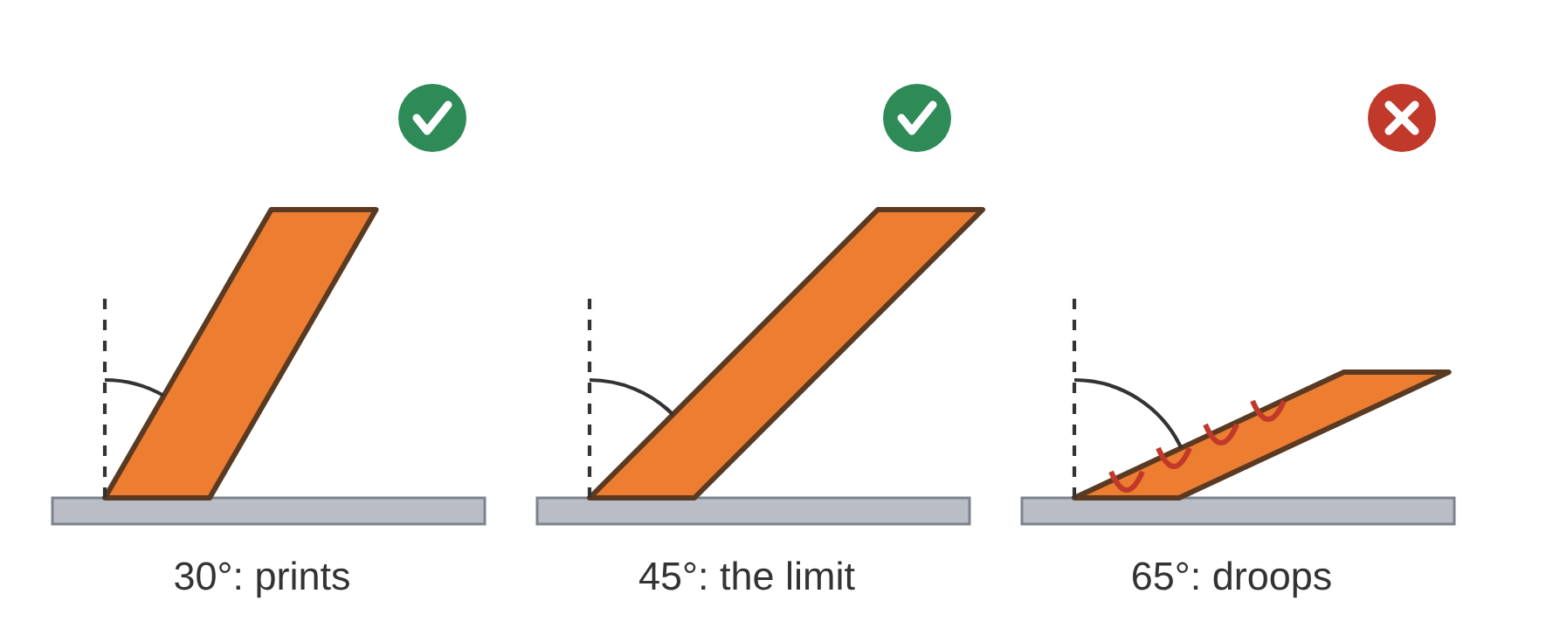
2. Overhangs: No More Than 45°
Notes:
An overhang is any surface that faces down with nothing under it. Up to 45° from vertical prints fine, because each layer rests mostly on the one below. Past 45°, the layers droop, and the part needs supports. Point at the vase from the video: its sides lean, but never past 45°. Check it in Fusion: Draft Analysis with the direction set to the Z axis turns every downward face blue. Measure the angle of the ones that tilt. The full rule, with its picture, is on the wiki's Design Rules for 3D Printing page; students keep it open all year.

Slide 5
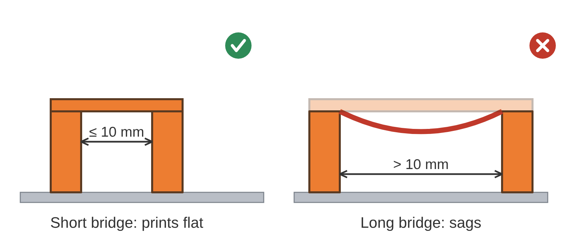
3. Bridges: No Longer Than 10 mm
Notes:
A bridge is a flat span across a gap, supported at both ends. Up to 10 mm prints flat. Longer bridges sag. If a gap is long in one direction and short in the other, turn the part so it bridges the short way. Ask: what's the difference between a bridge and an overhang? (A bridge is held at both ends; an overhang at one.) Check it in Fusion: a flat blue face in Draft Analysis, then Measure the gap. The full rule, with its picture, is on the wiki's Design Rules for 3D Printing page; students keep it open all year.

Slide 6
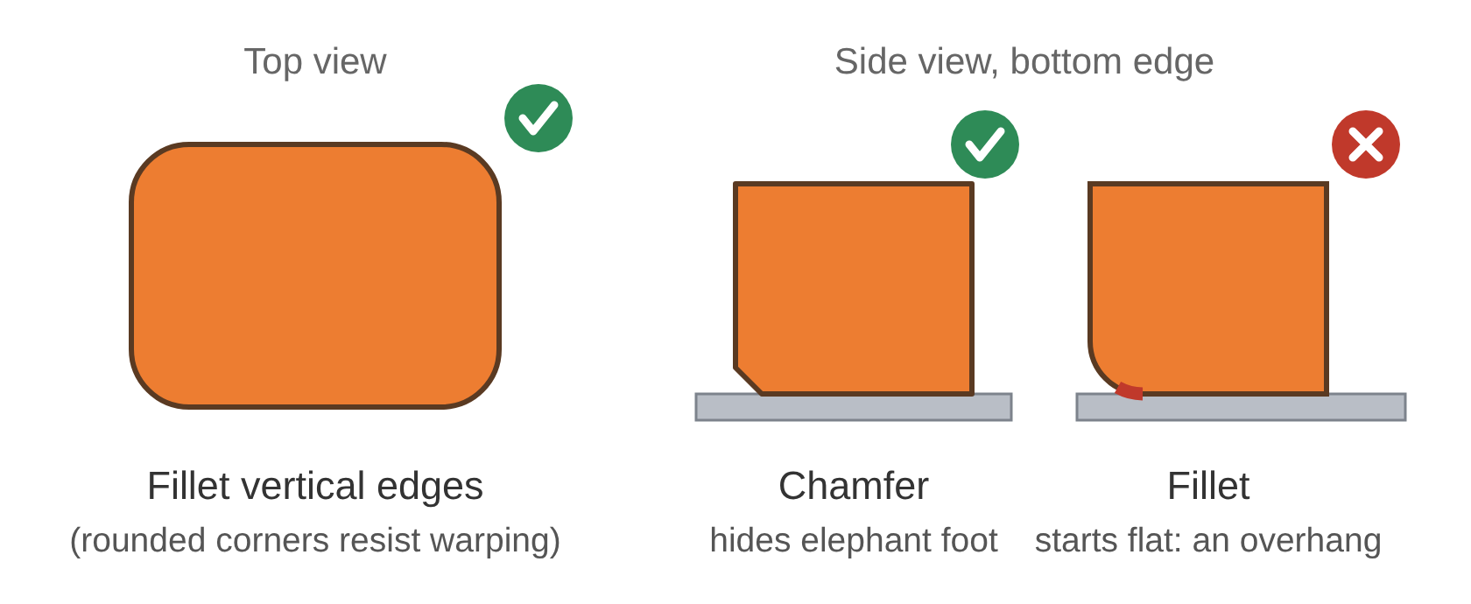
4. Edges: Fillet Vertical, Chamfer Horizontal
Notes:
Fillet the vertical edges. Rounded corners help the part resist warping and lifting off the bed. Chamfer the horizontal edges, especially where the part meets the bed. A small chamfer hides the slight bulge of the first layers (elephant foot). A fillet on a bottom edge starts out flat, which makes it an overhang, so it breaks rule 2. Check it in Fusion: a fillet along a bottom edge shows up as a blue strip in Draft Analysis. The full rule, with its picture, is on the wiki's Design Rules for 3D Printing page; students keep it open all year.

Slide 7
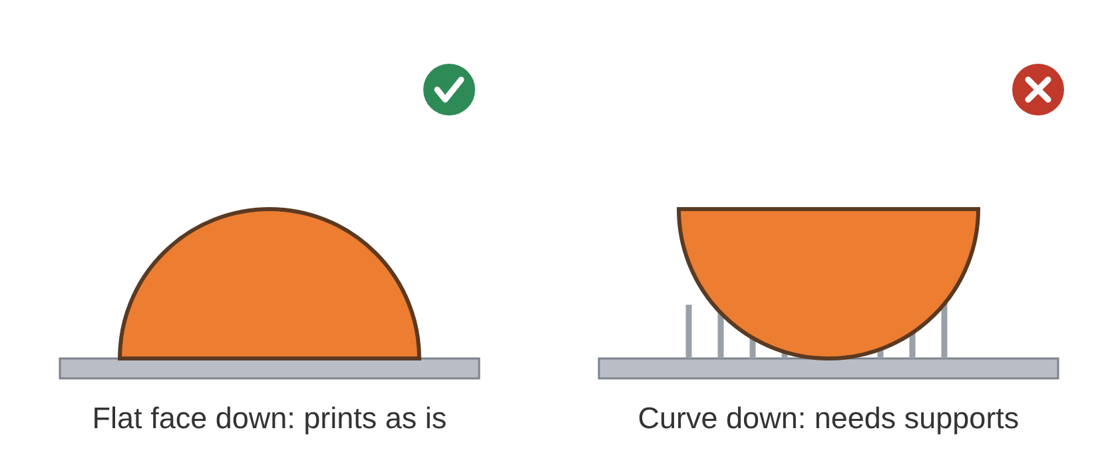
5. Bed Contact: Biggest Flat Face Down
Notes:
Put the largest flat face on the bed. Choose the direction that needs the fewest supports. Supports waste plastic, add print time, and leave scars where they're broken off. If no direction works, split the part (rule 8). This is the THEY worksheet in one picture: the same shape, two directions, two very different prints. Check it in Fusion: every blue face in Draft Analysis should either sit on the bed or pass rules 2 and 3. The full rule, with its picture, is on the wiki's Design Rules for 3D Printing page; students keep it open all year.

Slide 8
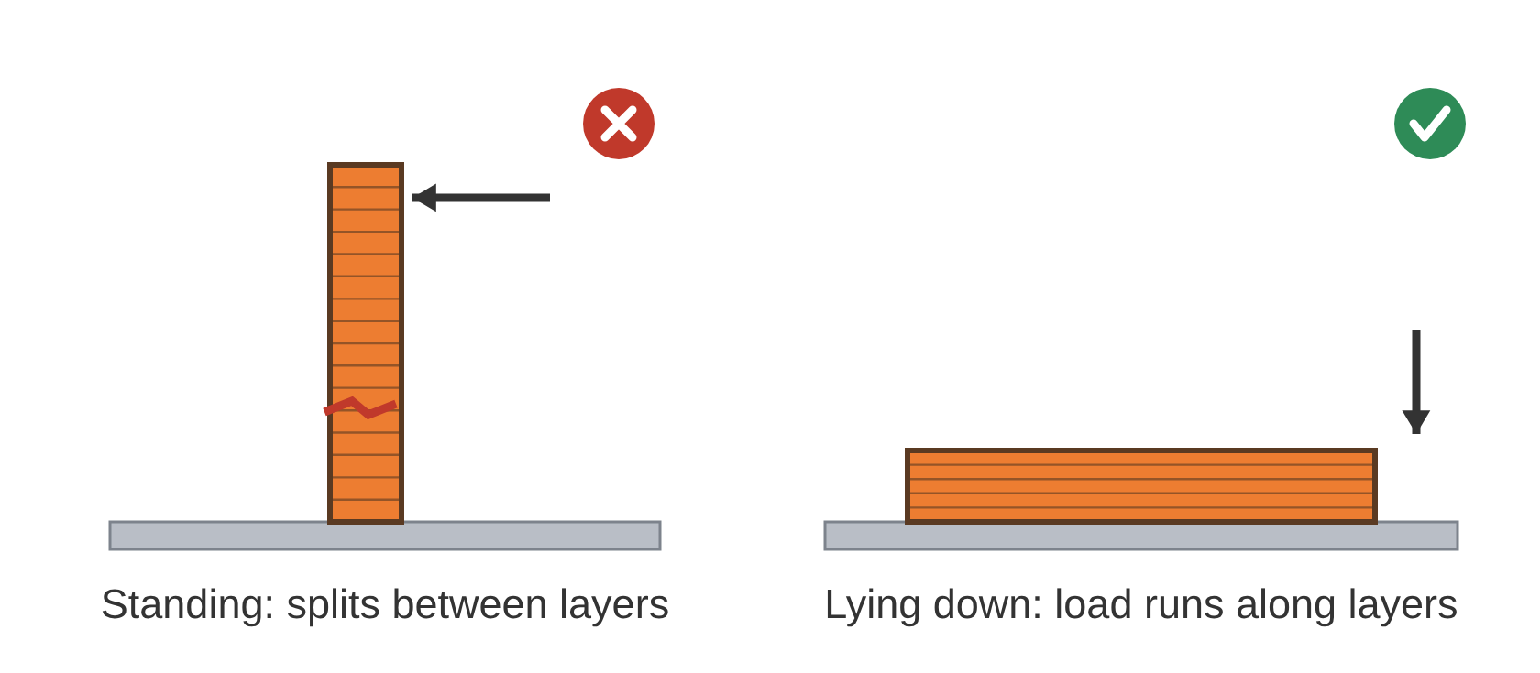
6. Strength: Strong Along the Layers, Weak Across Them
Notes:
A print is strong along its layers (X and Y) and weak across them (Z). Two layers peel apart far more easily than a single layer snaps. Point the load along the layers. A pin, hook, or clip that will be pushed sideways should usually print lying down. Analogy: a stack of pancakes. Pushing the stack sideways slides the pancakes apart; tearing one pancake takes real effort. Its limit: our layers are glued, not just stacked, so it's weaker, not free. Check it in Fusion: no tool for this one. Ask which way the part gets pushed, then look at which way it sits on the bed. The full rule, with its picture, is on the wiki's Design Rules for 3D Printing page; students keep it open all year.

Slide 9
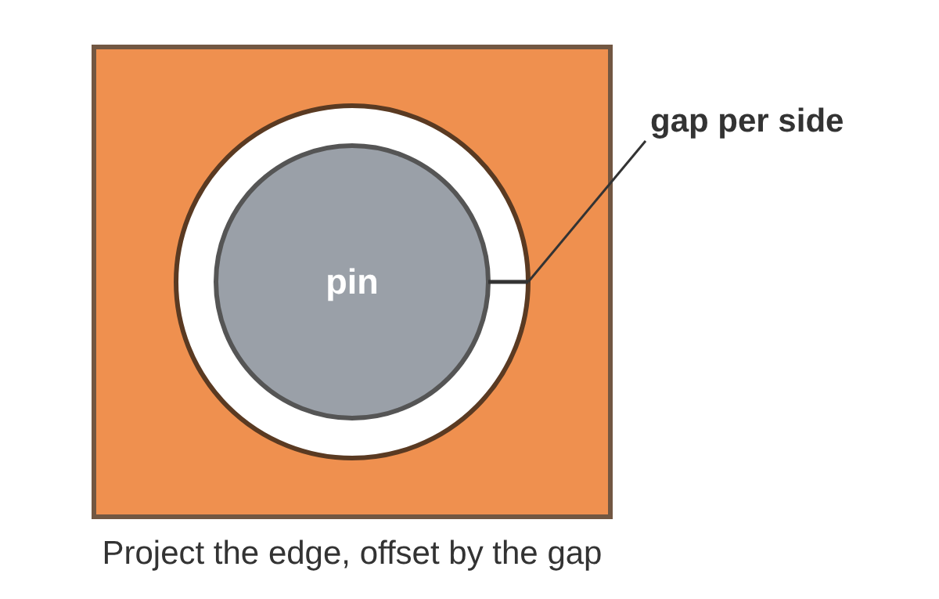
7. Fits: Leave a Gap
Notes:
Parts that fit together need a gap per side: the space between the pin and the wall of its hole, all the way around. Draw it by projecting the edge of the mating part and offsetting it by the gap. Press 0.1 mm: pushed together once and stay put. Close 0.2 mm: go together by hand and don't move. Free 0.3 mm: turn or slide against each other. Pins must be at least 3 mm across; thinner ones bend or snap. The numbers already allow for holes printing slightly small. Holes that run sideways have one more problem: their tops droop, and a teardrop shape fixes it (the picture is on the Design Rules page). Per side is the trap: a 0.1 mm gap per side makes the hole 0.2 mm bigger across. Check it in Fusion: click the curved face of a hole or pin with Measure to read its diameter. The gap per side is (hole − pin) ÷ 2. Interference finds parts that overlap. The full rule, with its picture, is on the wiki's Design Rules for 3D Printing page; students keep it open all year.

Slide 10
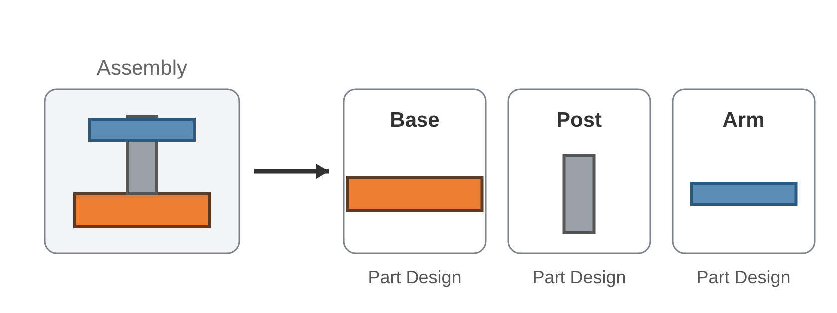
8. One Piece, One Part Design
Notes:
Every piece that prints separately gets its own Fusion Part Design. An assembly puts them together, the same way the slider-crank did in the last lab. Splitting a part lets you orient each piece its own best way (rule 5), and a failed print costs you one piece instead of all of them. Check it in Fusion: your project folder holds one Part Design per printed piece, with the assembly beside them. The full rule, with its picture, is on the wiki's Design Rules for 3D Printing page; students keep it open all year.

Slide 11
Your mission
Two notebook entries. Turn It In is the same list you'll be graded on.
1
A notebook entry titled Which Way Up? with Parts 1 and 2 of the worksheet complete, and your sentences on where Fusion disagreed with you.
2
A notebook entry titled Hand Crank Inspection with the Problems and Fits tables complete.
Next: a mechanism of your own, designed to print the first time.
Notes:
Read both items; they are the lab's Turn It In word for word. The worksheet comes first and needs no computer: predict, then check in Fusion. The Hand Crank has seven problems and two features that look wrong but aren't; nobody gets told which two. Keep the Design Rules page open the whole time. Understand your mission for today?

