Slide 1

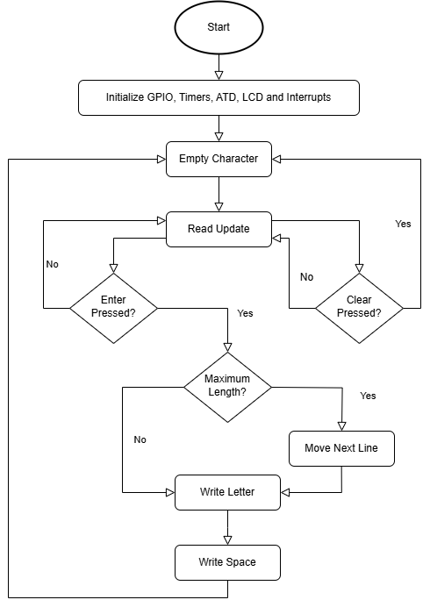
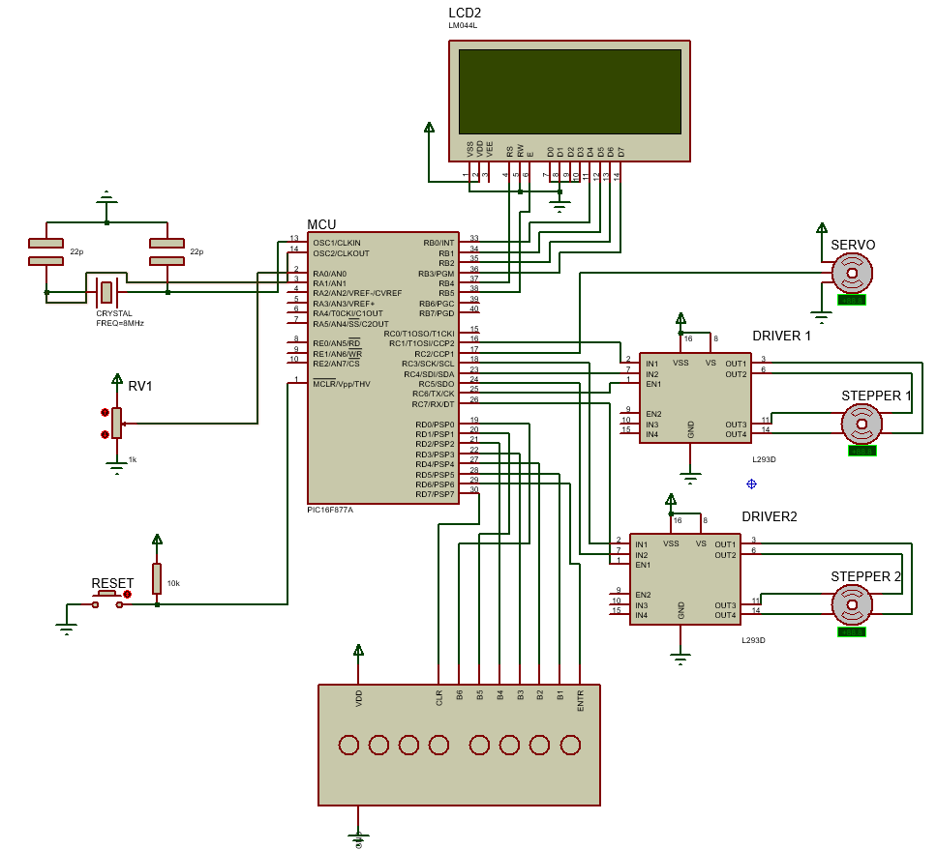
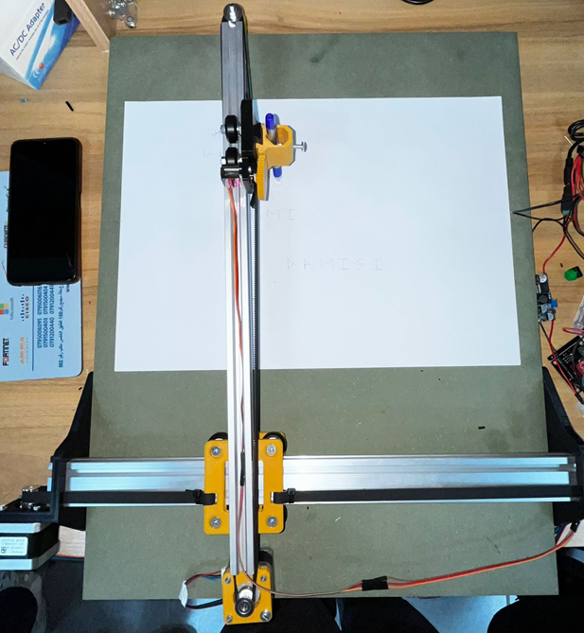

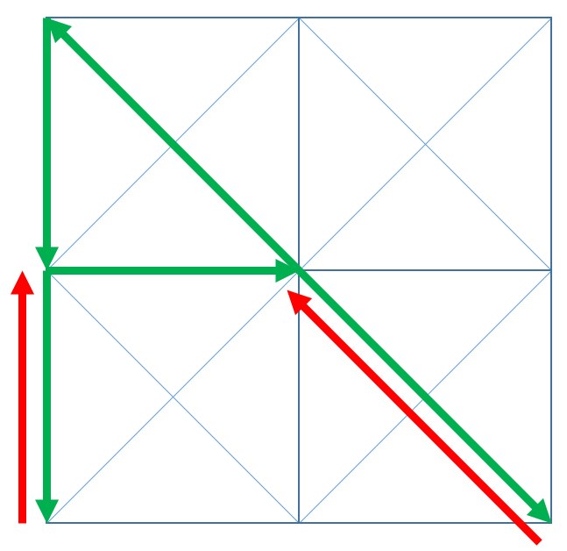
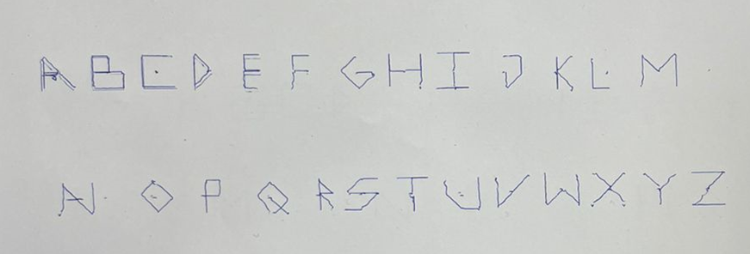
Braille-to-English CNC Machine
M. Abu-Qteish, A. Damisi, and G. Abboud
Supervisor: Dr. Belal Sababha
Embedded Systems Final Design Project, Fall 2024
King Abdullah II School of Engineering
Princess Sumaya University for Technology
Introduction
This project introduces a Braille-to-English CNC machine that converts Braille inputs into written English letters. Using a custom Braille keyboard, the system decodes characters and translates them into precise movements for stepper motors and a servo motor. Letters are written on paper using a 20-segment grid controlled by a PIC16F877A microcontroller, with adjustable letter size via a potentiometer. The design bridges Braille literacy and visual communication, emphasizing accessibility and automation.
Results
The physical structure of the CNC machine were constructed using 3D printed parts, attached to aluminum profiles and GT belts for the X and Y axes.
Design
We utilized two stepper motors to control the pen’s movement along the X and Y axes, along with a servo motor to raise and lower the pen.
With the physical components in place, the system code was developed to be non-blocking, ensuring minimal wait time between input and writing on the paper. Once a character is entered, the microcontroller translates it into G-code instructions, which are sent to the motors using a custom library designed to draw every letter of the English alphabet using a custom 20-segment grid.
The letter size can be dynamically adjusted using a potentiometer. To prevent larger letters from taking extra time to draw, the delay time for each character is fixed, while the speed of the stepper motors adjusts dynamically based on the letter size, allowing for efficient operation regardless of letter dimensions.
An LCD screen provides real-time updates on the current character and letter size, aiding in efficient testing. It mirrors the letters being written, ensuring that new lines on the page correspond to new lines on the LCD screen.
Figure 1: Electrical Schematic
Figure 4:Software Design
Figure 2: 20-Segment Grid
Figure 3: “A” G-Code
Figure 5: Final Design
Conclusion
The Braille-to-English CNC machine effectively translates Braille inputs into clean, visually accurate English letters on paper. Its combination of a custom Braille keyboard, precise motor control, and 3D-printed components ensures high-quality writing and smooth operation. This innovative design provides a practical solution for bridging Braille literacy with clear visual communication.
Figure 6: Character Map

