Slide 1
IO on the Raspberry Pi*
Bonnie King
PyCon Canada
November 11 2012
* Raspberry Pi is a trademark of the Raspberry Pi Foundation

Slide 2
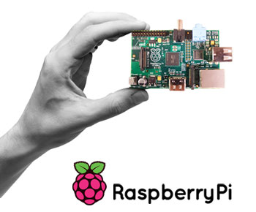

Slide 3
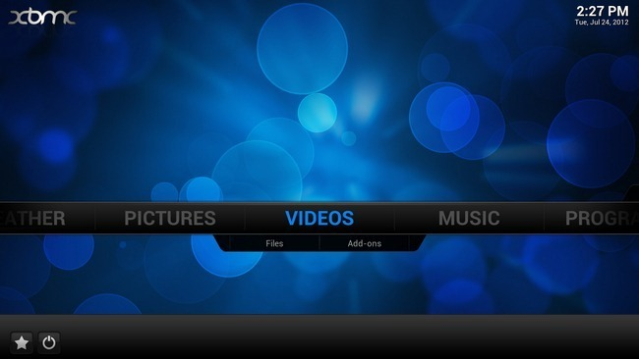
Media Center (XBMC)

Slide 4
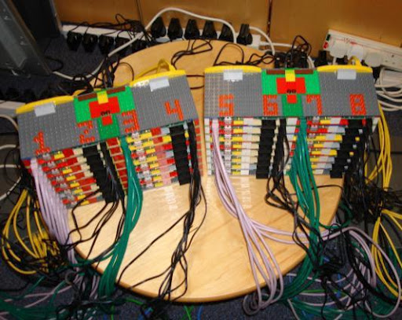
http://www.southampton.ac.uk/~sjc/raspberrypi/

Slide 5
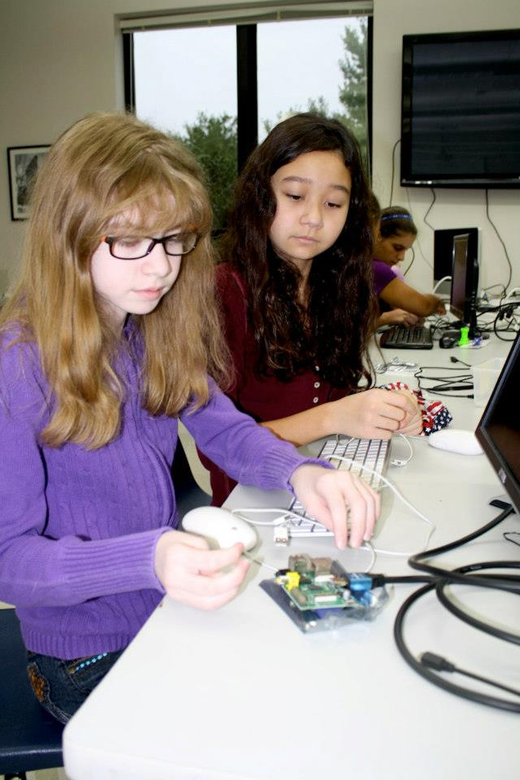
http://www.raspberrypi.org/archives/2159

Slide 6
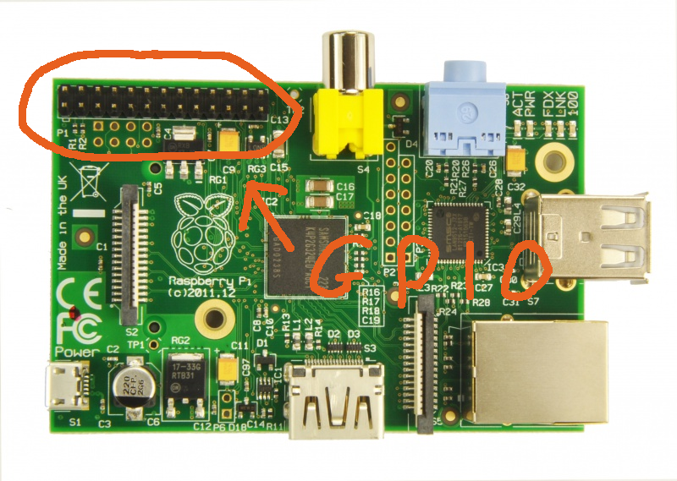

Slide 7
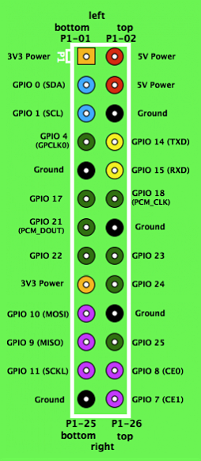

Slide 8
http://pypi.python.org/pypi/RPi.GPIO

Slide 9
import Rpi.GPIO as GPIO

Slide 10
GPIO.setmode(GPIO.BCM)

Slide 11
GPIO.setup(17, GPIO.OUT)

Slide 12
GPIO.output(17, GPIO.HIGH)

Slide 13
GPIO.setup(11, GPIO.IN)

Slide 14
input_value = GPIO.input(11)

Slide 15


