Slide 1
ATTACHMENT THEORY:
GNU screen (and|vs) tmux
Bonnie King
Fermi Linux User Group
January 30, 2013

Slide 2

SIGHUP
Sent to process when controlling terminal is closed
Usually, programs exit

Slide 3
nohup
nohup ./scrape_entire_interweb.py --debug > /var/backup/internet.xml 2> /tmp/err.out < /dev/null &

Slide 4
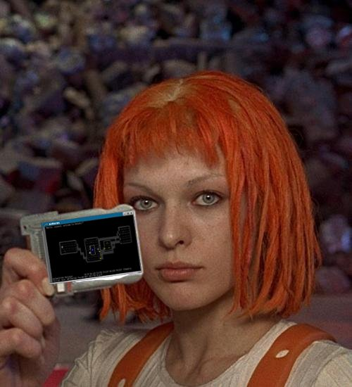
terminal multiplexers

Slide 5
GNU screen
Available in Scientific Linux
Session persistence
Sessions can be shared
Can connect to serial tty
zmodem transfers

Slide 6

Still using
GNU screen, eh?

Slide 7
tmux
Available from epel
Session persistence
Shared sessions
Window splitting into “panes
Client/Server model
Send input to all panes

