Slide 1
Impact of Gender Schemas on Political Candidates: Evaluation, Attitudes, and Retrieval
NAME
Presented to Committee Members
DATE

Slide 2
Overview
Review of Important Prior Research
Participants
Measures
Hypothesis
Analyses used
Results
Theories
Gender Schema Theory
Social Distance Theory
Dual Coding Theory
Limitations
Future Research
Implications

Slide 3
Literature Review: Leadership
Corporate
Managerial
Political

Slide 4
Literature Review: Leadership
Leadership Qualities
Ambitious
Individualistic
Self-Focused
Achievement Oriented
Assertive
Strong & Controlling

Slide 5
Literature Review: Leadership
Male Traits (Agentic)
Self-focused
Achievement Oriented
Competitive
Self-confident
Objective
Aggressive
Ambitious
Having leadership abilities
Female Traits (Communal)
Warm
Caring
Deferential
Interpersonally skilled
Relationship skills
Sensitive to self and others
Democratic
Collaborative

Slide 6
Literature Review: Sex Differences
Biological Psychological (essentialist)
Social Psychological (constructionist)
Biosocial
(interactionist)
Gender Schema Theory
Social Role Theory

Slide 7
Schema, Stereotypes, Retention
What is a schema?
“cognitive structures that organize an individual’s gender related knowledge, preferences, beliefs and attitudes”
(Cherney, 2005, p. 12).
Faulty shortcuts prompt us to respond in stereotype-consistent ways
(Dodson, Darragh, & Williams, 2008).
Perpetuate prejudice against women and minorities
(Fiske & Taylor, 1991).
Gender stereotypes have been found to affect retention
(Pittinsky, Shih, & Trahan, 2006)

Slide 8
Meet the Participants…

Slide 9
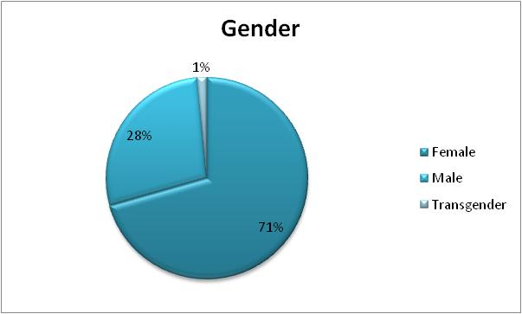
Participants

Slide 10
Participants

Slide 11
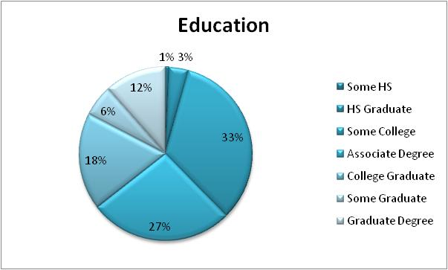
Participants

Slide 12
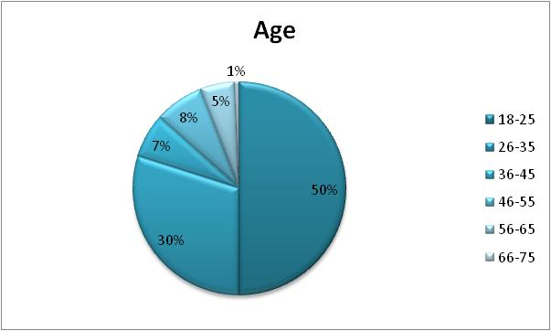
Participants

Slide 13
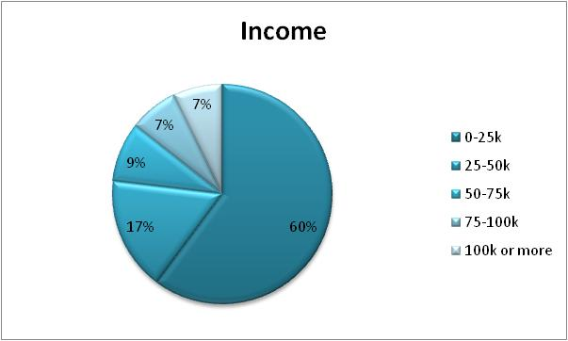
Participants

Slide 14
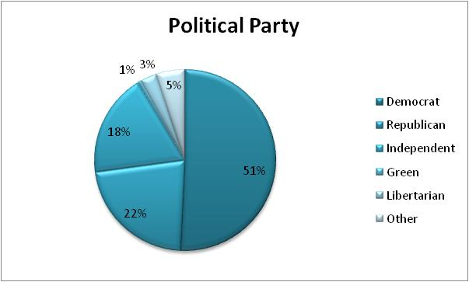
Participants

Slide 15
Participants

Slide 16
Participants

Slide 17
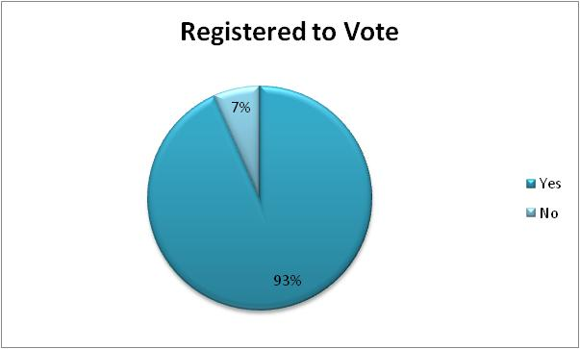
Participants

Slide 18
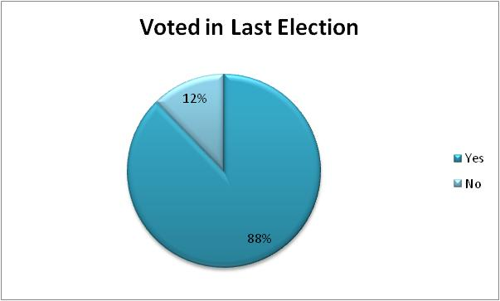
Participants

Slide 19
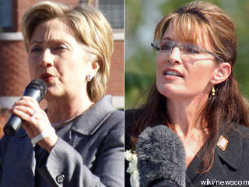
Measures
Video and Script
Retention
Evaluation of the Candidate
Ambivalent Sexism Inventory

Slide 20
Political Issue Retrieval Measure
52 Phrases
30 Political issues
“Allowing prayer and silent reflection in schools”
6 Statements personal qualifications
“Earned a degree in public policy”
16 Not reported
“Increased testing on nuclear weapons”
Reliability
Total Retention .615
Hard Issues .755
Soft Issues .609

Slide 21
Political Issues
Hard/Soft Issues and Political Parties in Script .
Soft or Hard: Issue Political Party
Hard: International Issues Republican
Hard: International Issues Democratic
Soft: Education Republican
Soft: Education Democratic
Hard: Crime & Drugs Republican
Hard: Crime & Drugs Democratic
Soft: Environment Republican
Soft: Environment Democratic

Slide 22
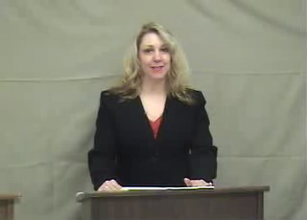
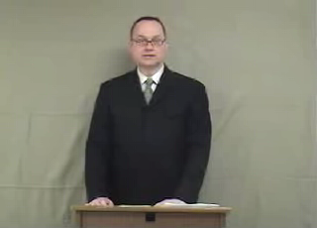
Actors
Susan Carver
John Stevens

Slide 23
Evaluation of the Candidate (Rojahn & Willemsen, 1994)
Likeability
“How much do you think you would like this individual?” was rated on a nine-point scale (likeable-not likeable)
“How much would you want this person as your friend?” was rated on a scale ranging from not at all (1) to very much (9)
Reliability Coefficient (John = .869, Susan = .859)
Competence
A composite score for rating of the candidates on three bipolar adjectives (competent – incompetent; effective – ineffective; productive – unproductive
Reliability Coefficient in this study for Likeability (John = .937, Susan = .925)
Desirability
“How likely would you be to vote for this candidate?”

Slide 24
Ambivalent Sexism Inventory (Glick & Fiske, 1996)
22-items
6-point Likert-type (Disagree strongly to Agree strongly)
Hostile Sexism (Reliability .828)
“Once a woman gets a man to commit to her, she usually tries to put him on a tight leash”
Benevolent Sexism (Reliability .808)
“Women should be cherished and protected by men”

Slide 25
Hypothesis 1A
Overall, participants will accurately retrieve a higher number of items delivered by the male candidate than by the female

Slide 26
Hypothesis 1A
ANCOVA
Not supported
F(1,123) = 0.008, p = 0.930
A significant interaction between gender of participant and gender of candidate was found
F(1,122) = 2.670, p = 0.027

Slide 27
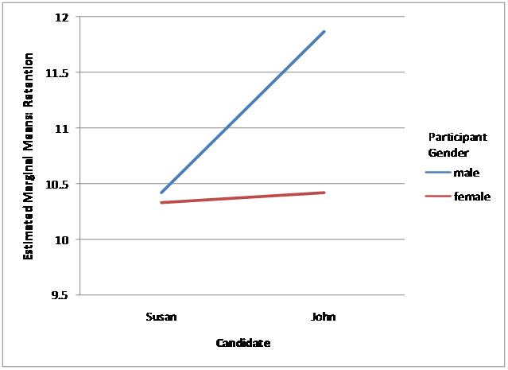
Male participants recalled more of the male candidate’s platform than of the female candidate’s platform, although female participants recalled the male and female candidates’ platforms equally

Slide 28
Hypothesis 1B
Participants will attribute more male stereotypic items (“hard issues”) to the male candidate and more female stereotypic items (“soft issue”) to the female candidate

Slide 29
Hypothesis 1B
Two mixed-model ANCOVAs
Supported!!!
Participants, both male and female, attributed more male stereotypic items (“hard issues”) to the male candidate and more female stereotypic items (“soft issue”) to the female candidate
Marginal Means for Male/Hard and Female/Soft Issues
Item John Susan Comparison
Mean (sd) Mean (sd) F p
Male 9.17 (.62) 6.51(.58) 5.917 0.016
Female 8.68 (.57) 9.98(.64) 4.158 0.044

Slide 30
Hypothesis 1C
Participants will attribute a higher number of items pertaining to political qualifications to the male candidate and a higher number of items pertaining to personal information to the female candidate

Slide 31
Hypothesis 1C
Two mixed-model ANCOVAs
Not supported
An interaction between gender of the participant and candidate occurred:
F(1,123) = 5.311, p = 0.023

Slide 32
Hypothesis 1C
Means for Political Issues and Candidates
 | Attributed to John | Attributed to Susan | Comparison
Issues | Mean(sd) | Mean(sd) | F, p
Political | 16.4(4.5) | 16.9(4.9) | 1.095, 0.298
Personal | 2.7(1.2) | 2.6(1.2) | .143, 0.706

Slide 33
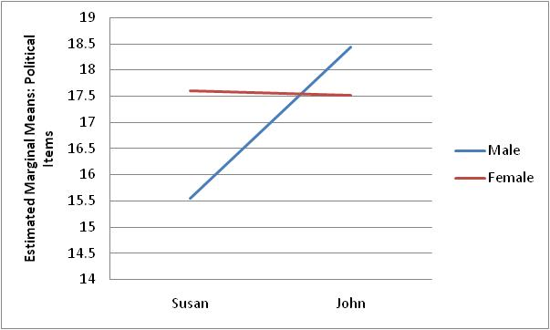
Male participants attributed significantly fewer political qualifications to the female candidate than to the male candidate, whereas female participants made similar attributions to both male and female candidates

Slide 34
Hypothesis 2A
Overall, the male candidate will receive higher evaluations and be rated as more competent, likeable, and desirable than the female candidate

Slide 35
Hypothesis 2A
Three mixed-model ANOVAs
Not supported
Participants rated the female candidate as more competent, likeable, and desirable than the male candidate

Slide 36
Hypothesis 2A
Means for Likeability, Competency, and Desirability for Candidates
Dependent John Susan F p
Variable Mean (sd) Mean (sd)
Likability 8.8 (3.6) 10.2 (3.7) 4.519 0.001
Competency 19.7 (4.4) 20.8 (4.1) 3.391 0.018
Desirability 4.7 (2.2) 5.4 (2.3) 3.326 0.021

Slide 37
Hypothesis 2B
For likeability, there will be an interaction between gender and information about family, such that the female candidate who explicitly mentions her family (a spouse and three children) will be rated as more likeable than the female candidate without an explicit description, whereas for male candidates the explicit description of family will not effect likeability ratings

Slide 38
Hypothesis 2B
A mixed model 2x2 ANOVA
Not found
An interaction was found for candidate gender by video order on likeability ratings
F = 6.678, p = 0.011

Slide 39
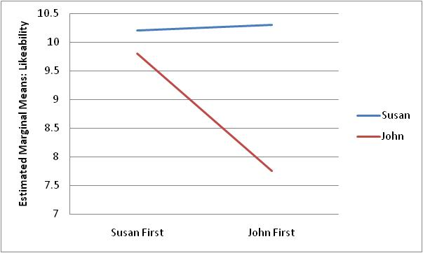
When the female candidate’s video was presented first, likeability ratings of the two candidates did not differ, whereas participants rated the male candidate less likeable than the female candidate when his video was presented first

Slide 40
Hypothesis 3A
Accuracy of retrieval and evaluations of candidates will be moderated by participants’ attitudes toward women such that higher scores on the Ambivalent Sexism Inventory will be related to greater accuracy in retrieval of information for male candidates, more gender schematic retrieval of information, and higher evaluations of male candidates

Slide 41
Hypothesis 3A
Twelve repeated-measures ANCOVAs: four using Total Sexism, four using Hostile Sexism, four using Benevolent Sexism
Not found
Two interactions were found:

Slide 42
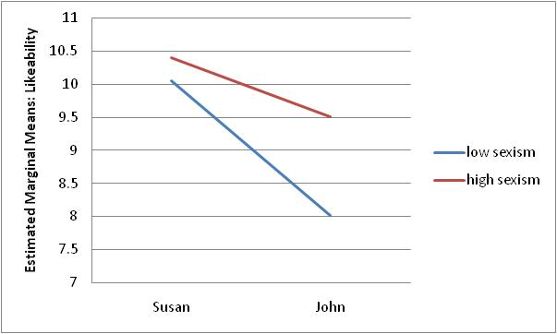
Participants scoring low on the Total Sexism scale rated the female candidate higher than the male candidate on likeability, with no differences in likeability ratings found for participants with high scores on the Total Sexism Scale, F = 4.078, p = 0.046

Slide 43
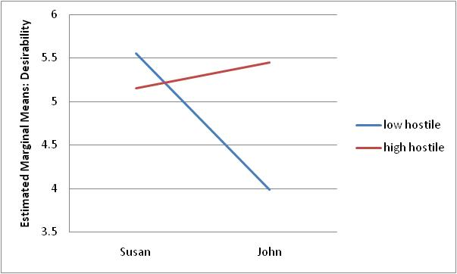
For participants scoring low on the Hostile Sexism scale, the female candidate was rated as more desirable for the position than was the male candidate. For participants with high Hostile Sexism scores, Susan and John received similar ratings of desirability, F = 6.937, p = 0.010

Slide 44
Research Question 1 “If you had to choose between these two candidates, which one would you vote for?”
Chi-Square Test of Independence: A significantly larger proportion of participants reported that they would vote for the female candidate (59.4%) than the male candidate (40.6%)
χ² = 4.562, p = 0.033
Independent-samples t-test: Participants who reported they would vote for the female had significantly lower Hostile Sexism scores (M = 27.802) than those who reported they would vote for the male candidate (M = 32.536)
t = -2.938, p = 0.004
Independent-samples t-tests: Those who stated they would vote for the female candidate also rated her higher than the male on desirability, likeability, and competency

Slide 45
Research Question 2 “Which candidate do you consider the most competent?”
More participants reported that they thought the female candidate was more competent (60%)
This did not differ by participant gender, χ² = 1.3, p = 0.508
Independent-samples t-test: Participants who reported they thought the female was more competent had significantly lower Hostile Sexism scores (M = 28.049) than those who reported they thought the male was more competent (M = 32.273)
t = -2.596, p = 0.010
Independent-samples t-tests: Those who stated they thought the female candidate was more competent also rated her higher than the male on desirability, likeability, and competency

Slide 46
Research Question 3 “Which candidate do you consider the most likeable?”
More participants reported that they thought the female candidate was more likeable (70%)
This did not differ by participant gender, χ² = 1.588, p = 0.452
Independent-samples t-test: Participants who reported they thought the female was more competent had significantly lower Hostile Sexism scores (M = 28.049) than those who reported they thought the male was more competent (M = 32.273)
t = -2.596, p = 0.010
Independent-samples t-tests: Those who stated they thought the female candidate was more competent also rated her higher than the male on likeability and desirability

Slide 47
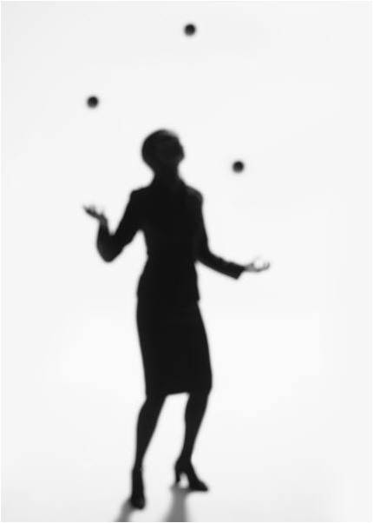
Not heard by men
The Labyrinth vs. the Glass Ceiling
Despite the fact that my contribution is largely associated with hard issues only soft issues are retained

Slide 48
Theories
Gender Specific Stereotyping
Gender Schema Theory (Bem, 1985)
Social Distance Theory (Borgardus, 1925)

Slide 49
Theories
Incongruent findings with measures
Dual Coding Theory (Paivio, 1971)
Logogens
Imagens

Slide 50
Limitations
Limited to participants with computer and internet
Majority are ODU students
More women than men
Actors in the video stimulus were similar but not equal in attractiveness

Slide 51
Future Research
Controlled testing environment
Gain a more diverse population (i.e. elderly or other regions of the country)
Exploring retention rates with states with a history of female verse male representation
Cross-sectional and longitudinal studies to determine if there is a difference in implicit vs. explicit findings with women leaders over time
Multiple videos with different actors
Determine if there is a relationship with sexist attitudes of participants and gender specific versus co-ed group experiences
Performance Evaluation of Candidates on Hard & Soft Issues
Study with longer delay to test for stereotypes over the course of the campaign trail

Slide 52
Implications
Women recalled the platforms equally regardless of candidate gender, whereas men recalled fewer platform issues or professional qualifications of the female candidate
However, if both men and women are raised in the same gender schematic world, what can explain the mixed gender responses?
Women showed less gender schematic behavior than men in their retention of political platforms and professional qualifications
but still continued to categorize the platform messages into gender specific domains (e.g. hard and soft issues)
The female candidate was seen as more likeable, desirable, and competent in comparison to her male counterpart

Slide 53
What Does this Mean for Women in Politics?
If a female candidate is speaking about her political platform and men do not retain what she is saying, then how could they possibly vote for her based on an informed decision?
If men and women remember information about a candidate that coincides with gender schematic views (i.e. hard and soft issues) then how accurate is one’s real understanding of the political candidate’s views?
What does this mean for women on the campaign trail if her views are not in line with her gender stereotypes?
If the female is more liked, desired, and perceived as competent, then what does it mean that equal amounts of political information were not attributed to her by men and that men and women recalled information about her in line with her gender stereotypes?

Slide 54
Thank you!!!
Questions and Comments

