Slide 1
PREFERRED PERCENT CORRECT (PPC) IN NOVEL COMPUTER BASED TASKS
Steven Riley
Presented to Dr. Michelle Haley and Dr. Matthew Harris
12/9/2014

Slide 2
Overview
Questions
Review of Important Prior Research
Measures
Participants
Hypotheses, Analysis and Results
Questions Answered
Explanatory Theories
Limitations
Future Research
Implications

Slide 3
Questions
When given a new task that has no associated consequences for outcomes, how often do we want to get it right?
What is our PPC on novel tasks?
Are there factors that change this percentage?

Slide 4
Easy And Obvious (But Very Wrong) Answer
100%

Slide 5
Overview
Questions
Review of Important Prior Research
Measures
Participants
Hypotheses, Analysis and Results
Questions Answered
Explanatory Theories
Limitations
Future Research
Implications

Slide 6
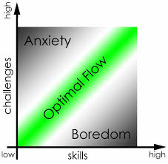
Argument For Moderate PPC Values: Flow
Mihaly Csikszentmihalyi
Positive Psychologist at Claremont Graduate School
Requirements for flow states
Skills and challenges evenly matched
Clear goals, immediate feedback
Results of flow states
Altered sense of time
Concentration
Sense of control
Loss of ego

Slide 7
Argument For Moderate PPC Values: Formal Theory Of Creativity, Fun, And Intrinsic Motivation
Juergen Schmidhuber
AI researcher from Germany
Interestingness, fun, enjoyment
Learning how to compress data
Outcomes must be regular in a way that is novel to the learner, but learnable
Too regular = already known
Too irregular = appears random
Learning = fun!

Slide 8
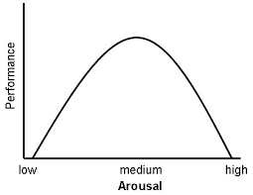
Argument For Moderate PPC Values: Yerkes-Dodson Law
Ability is best when arousal, stress or frustration is at a moderate level
Some frustration is necessary for peak performance
Notes:
If someone has decided that doing well on a task is important, they will want to attempt it at a level that creates a bit of frustration

Slide 9
Factors That Might Change PPC: Neuroticism
Definition
“The propensity to experience distress and negative emotions” (Jeroniumus, Riese, Sanderman & Ormel, 2014)
Individuals with high Neuroticism
Are more reactive to stress (Ormel, et. al., 2013)
Cannot deal with minor frustrations (Kundu & Basu, 1991)
Avoid ambiguous situations which might result in negative outcomes (Lommen, Engelhard, & van den Hout, 2010)

Slide 10
Factors That Might Change PPC: Preferred Learning Modalities
Swassing-Barbe Modality Index
Auditory
Visual
Kinesthetic

Slide 11
Factors That Might Change PPC: Guessing
Correct results stem from knowing the answer or being lucky
Probability rules
P(A OR B) = P(A) + P(B) – P(A AND B)
P(A AND B) = P(A) * P(B|A)
When answering in a multiple choice environment
Correct answer (C) = Knowing answer (K) OR Guessing correctly (G)
P(C) = P(K) + P(G) – P(K)*P(G)
P(C) = P(K) + (1 – P(K))*P(G)

Slide 12
Overview
Questions
Review of Important Prior Research
Measures
Participants
Hypotheses, Analysis and Results
Questions Answered
Explanatory Theories
Limitations
Future Research
Implications

Slide 13
Problems Measuring PPC
PPC is implicit knowledge
Answers to “how often do you want to get the right answer?” might be invalid (i.e., “Duh, 100%”)
Variation in required skills
Visual acuity
Working memory
Reading speed
Hand-eye coordination
Variation in computer hardware

Slide 14
Strategies For Measuring PPC
Create tasks which are intrinsically motivating
Use preferred difficulty (after some practice) as an intermediate value, and convert this to PPC
Give a wide range of difficulty choices

Slide 15
Task Design Requirements
One for each of the three SBMI domains
Visual
Verbal
Kinesthetic
Intrinsically motivating
Clear success or failure
Immediate feedback
Novel but quickly learnable
Adjustable difficulty
Short (< 15 seconds per trial)
Easy to input answer on computer

Slide 16
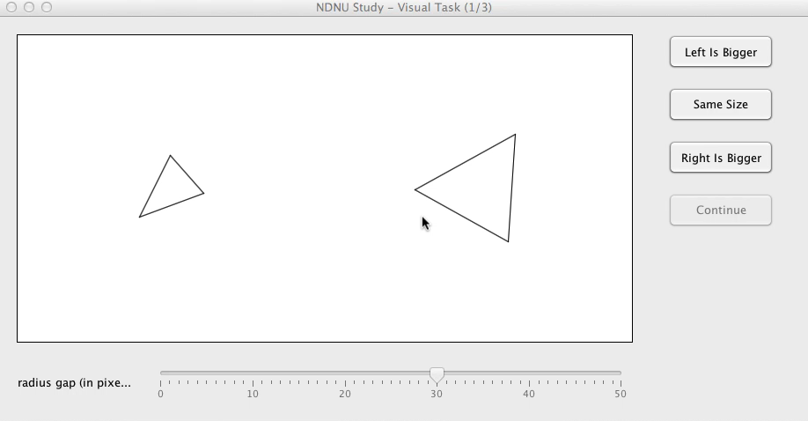
Visual Task: Comparison Of Circles Around Triangles

Slide 17
Visual Task
Visualize circles which circumscribe triangles
Compare size of circles
Smaller differences in radius are harder
3 answers to choose from
1/3 chance of guess being correct

Slide 18
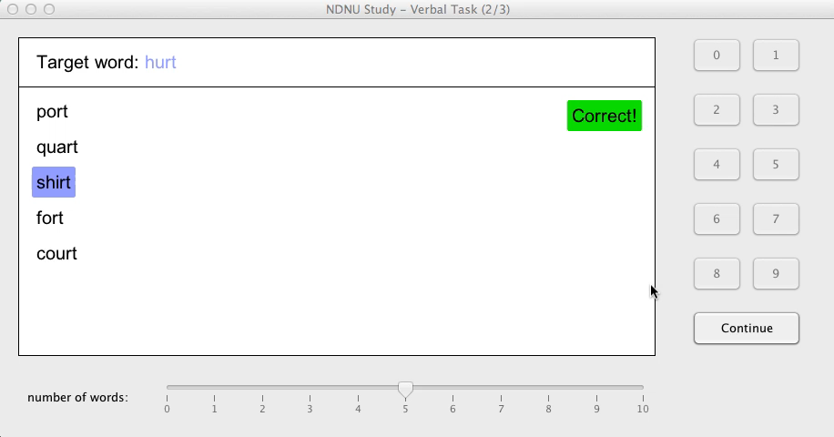
Verbal Task: Count Rhyming Words

Slide 19
Verbal Task
Count number of words on a list which rhyme with a target word
4 seconds to complete task
More words per list makes task harder
N + 1 choices, where N = number of words in list
1/(N + 1) chance of guess being correct

Slide 20
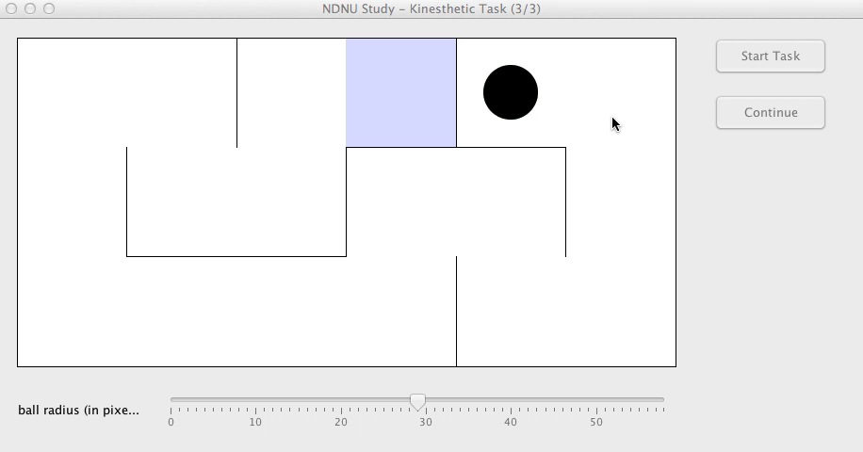
Kinesthetic Task: Navigate The Maze

Slide 21
Kinesthetic Task
Navigate a ball through a maze using arrow keys
Hit a wall = restart
Larger ball radius makes the task harder
Negligible chance of correct guess

Slide 22
Task Script
Tutorial
5 items of increasing difficulty and decreasing hints
Practice
15 items with procedurally decided difficulty
Test
Pre-test difficulty choice
10 items at chosen difficulty
Post-test difficulty choice

Slide 23
How To Estimate PPC?
Assumptions
PPC is associated with preferred difficulty value
Chance of success (corrected for guessing) follows a logistic function

Slide 24
How To Estimate PPC?
First measurement
Aggregate PPC
Fix difficulty for 10 items, calculate percent correct at this value
Ask about desired difficulty change afterward
Create scatter-plot, find value associated with no preferred change

Slide 25
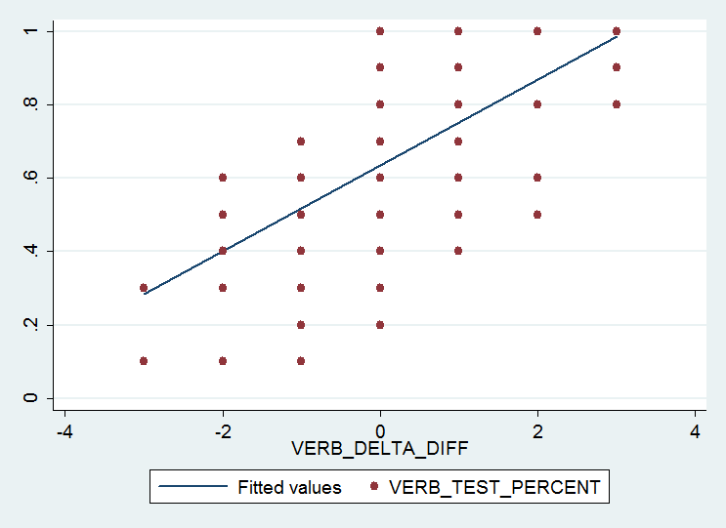
Aggregate PPC (Verbal)
% correct on test
Post-test difficulty minus pre-test difficulty
APPC: .64

Slide 26
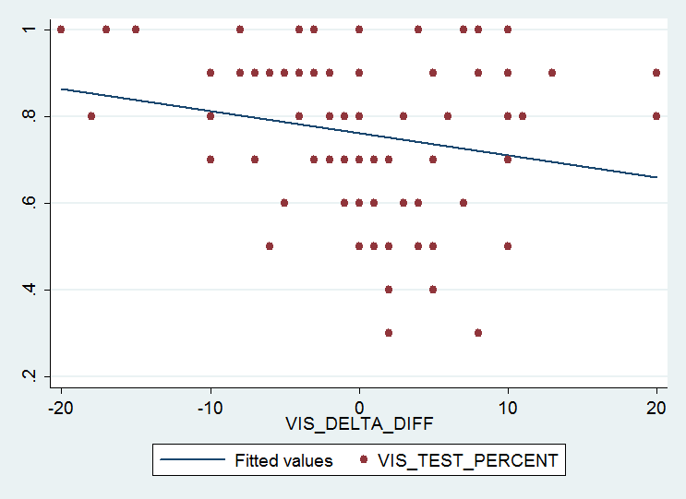
Aggregate PPC (Visual)
% correct on test
Post-test difficulty minus pre-test difficulty
APPC: .76

Slide 27
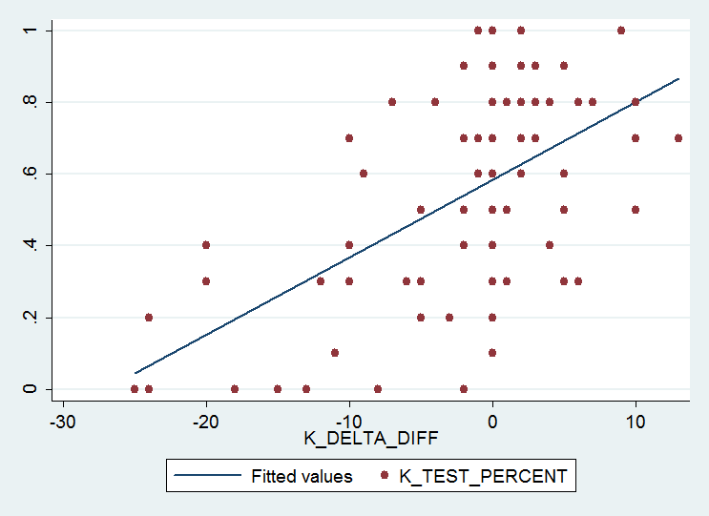
Aggregate PPC (Kinesthetic)
% correct on test
Post-test difficulty minus pre-test difficulty
APPC: .58

Slide 28
How To Estimate PPC?
Second measurement
Individual PPC
Build curve of difficulty vs. chance of success
Ask for preferred difficulty
Plug in to curve

Slide 29
Individual PPC: Verbal
Difficulty choice: 6
Raw IPPC: .728
Guess-corrected IPPC: .684

Slide 30
Individual PPC: Visual
Difficulty choice: 18
Raw IPPC: .561
Guess-corrected IPPC: .345

Slide 31
Individual PPC: Kinesthetic
Difficulty choice: 38
IPPC: .573

Slide 32
Neuroticism Inventory
8 agree or disagree self-assessment questions
“I am someone who is depressed, blue”
5-point Likert-scale
ranged from 1 = “Strongly Disagree” to 5 = “Strongly Agree”
Part of the Big Five Personality Inventory
Scored by averaging Likert-scale values

Slide 33
Gaming Habits Quiz
In a given week, how likely are you to play FIVE OR MORE HOURS of video games?
Likert-scale response
1 = very unlikely
2 = unlikely
3 = equally likely as not
4 = likely
5 = very likely
1 or 2 = low game usage
3, 4 or 5 = high game usage

Slide 34
Overview
Questions
Review of Important Prior Research
Measures
Participants
Hypotheses, Analysis and Results
Questions Answered
Explanatory Theories
Limitations
Future Research
Implications

Slide 35
Participants
102 participants over 2 stages
3 Tasks
Gaming habits survey
Age
Stage 1
65 participants from 8/26 to 10/15
Stage 2
37 participants from 10/30 to 11/22
Demographics questions
Race/Ethnicity
Income
Gender
Neuroticism inventory

Slide 36
Participants: Gender

Slide 37
Participants: Race And Ethnicity

Slide 38
Participants: Age

Slide 39
Participants: Income

Slide 40
Participants: Game Playing

Slide 41
Overview
Questions
Review of Important Prior Research
Measures
Participants
Hypotheses, Analysis and Results
Questions Answered
Explanatory Theories
Limitations
Future Research
Implications

Slide 42
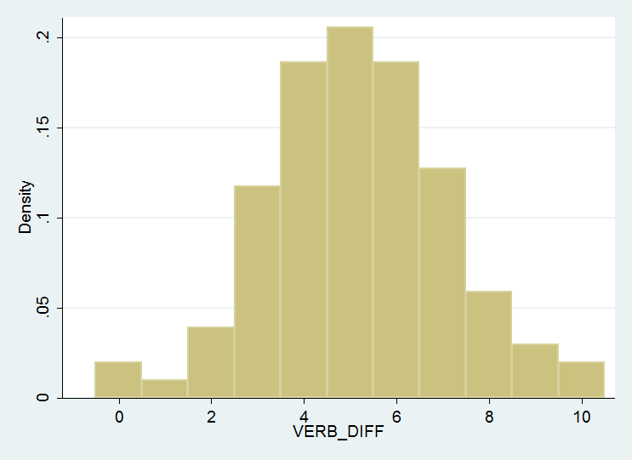
Hypothesis 1: Normally Distributed Difficulty Choices
Participants’ selections for preferred difficulty level will have a normal distribution
Verbal pre-test difficulty choices

Slide 43
Hypothesis 1: Normally Distributed Difficulty Choices
Supported for Verbal
Pre-test: χ² = .45, p = .798
Post-test: χ² = .11, p = .945
Supported for Kinesthetic
Pre-test: χ² = .91, p = .634
Post-test: χ² = 5.73, p = .057
Not supported for Visual
Pre-test: χ² = 13.86, p = .001*
Post-test: χ² = 19.46, p < .001*
Skewness-Kurtosis tests of normality
Jarque and Bera (1987) with corrections by D’Agostino, Belanger and D’Agostino (1990) and Royston (1992)

Slide 44
Hypothesis 1: Reasons For Deviations From Normal
Round number preferences
Mismatched medians

Slide 45
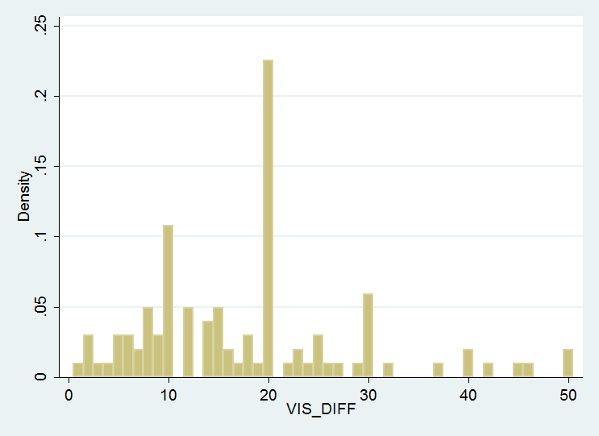
Hypothesis 1: Round Number Preference
Visual pre-test difficulty choices
Difficulty choice sample | Percent of choices ending in 0 | p
Visual pre-test | 43.1% | < .001
Visual post-test | 36.3% | < .001
Kinesthetic pre-test | 34.3% | < .001
Kinesthetic post-test | 33.3% | < .001

Slide 46
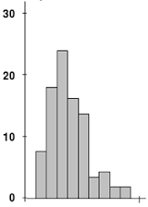
Hypothesis 1: Mismatched Medians
Difficulty choice sample | Median choice | Median of possible choices | Difference of medians | Is sample normal?
Visual pre-test | 18 | 25 | 7 | No
Visual post-test | 13 | 25 | 12 | No
Kinesthetic pre-test | 30 | 29 | 1 | Yes
Kinesthetic post-test | 30 | 29 | 1 | Yes
Verbal pre-test | 5 | 5 | 0 | Yes
Verbal post-test | 5 | 5 | 0 | Yes
Median (sample)
Median (scale)

Slide 47
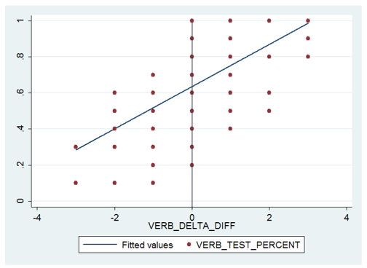
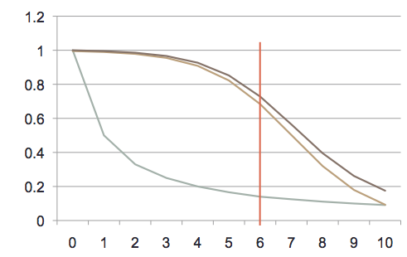
Hypothesis 2: Equivalence Of Measurements
Aggregate PPC and Individual PPC mean will yield the same values

Slide 48
Hypothesis 2: Equivalence Of Measurements
Two-tailed t-tests
Supported for all three tasks
Convergent validity of PPC measurements!
Reasonable to use only one measure from now on
Task | IPPC mean | APPC | t | p
Visual | .7169 ± .0186 | .7612 ± .0176 | 1.73 | .085
Verbal | .6303 ± .0224 | .6355 ± .0177 | .018 | .856
Kinesthetic | .5668 ± .0286 | .5849 ± .0236 | .049 | .623

Slide 49
Hypothesis 3: Portability Of PPC Between Tasks
PPC values will not be dependent upon task type
Research Question 3A: Will guess-corrected or raw PPC values create a better fit for this hypothesis?

Slide 50
Hypothesis 3: Portability Of Raw PPC
One-way repeated measures ANOVA on raw IPPC values
Not supported
Task variable: F(2) = 11.24, p < .001*
Raw PPC is not a portable value

Slide 51
Hypothesis 3: Portability Of Guess-Corrected PPC
One-way repeated measures ANOVA on Guess-corrected IPPC values
Supported!
Task variable: F(2) = .59, p = .553
PPC = .57 + .43*G

Slide 52
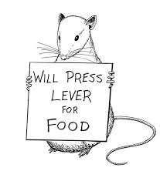
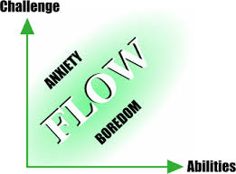
Hypothesis 3: Portability Of PPC Between Tasks
Definitive answer for research question 3A: guess-corrected PPC values are constant
Supports flow theory at expense of behaviorist models

Slide 53
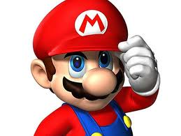
Hypothesis 4: Gamers Are Just Like Us
PPC values will not be dependent upon game usage

Slide 54
Hypothesis 4: Gamers Are Just Like Us
Two-tailed t-tests
Supported for all three task types
Skew towards gamers in the sample does not affect generalizability
It’s not just difficulty of tasks that gamers like about games – likely there is something else
Task | Low game use | High game use | t | p
Visual | .7466 ± .0270 | .7114 ± .0251 | 0.93 | .357
Verbal | .6293 ± .0329 | .6265 ± .0288 | 0.06 | .950
Kinesthetic | .5628 ± .0432 | .5767 ± .0367 | 0.24 | .809

Slide 55
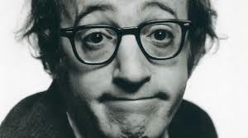
Hypothesis 5: Neuroticism And Failure Avoidance
Neuroticism trait positively correlates with PPC

Slide 56
Hypothesis 5: Neuroticism And Failure Avoidance
One-tailed t-test of regression coefficients (y = PPC, x = Neuroticism) for each task
Only supported for kinesthetic task
Possibility 1: Sample too small (37 Neuroticism respondents)
Possibility 2: Individuals with high Neuroticism are more pessimistic assessing probability of very likely events
Task | Coefficient | t | p
Visual | -.0503 ± .0310 | -1.62 | .943
Verbal | .0377 ± .0367 | 1.03 | .156
Kinesthetic | .1039 ± .0464 | 2.24 | .016*

Slide 57
Overview
Questions
Review of Important Prior Research
Measures
Participants
Hypotheses, Analysis and Results
Questions Answered
Explanatory Theories
Limitations
Future Research
Implications

Slide 58
Questions Answered
When given a new task that has no associated consequences for outcomes, how often do we want to get it right?
What is our PPC on novel tasks?
57% corrected for guessing
57% + 43%*G
Are there factors that change this percentage?
No: Task type, Game usage
Yes: Possibly Neuroticism?

Slide 59
Overview
Questions
Review of Important Prior Research
Measures
Participants
Hypotheses, Analysis and Results
Questions Answered
Explanatory Theories
Limitations
Future Research
Implications

Slide 60
Explanatory Theories
Cognitivism vs. Behaviorism
Prospect theory
Round number preference

Slide 61
Overview
Questions
Review of Important Prior Research
Measures
Participants
Hypotheses, Analysis and Results
Questions Answered
Explanatory Theories
Limitations
Future Research
Implications

Slide 62
Limitations
Indirect measurement
Lack of consequences
Skewed demographics
Accents
Preferred learning modalities
Small sample for Neuroticism inventory

Slide 63
Overview
Questions
Review of Important Prior Research
Measures
Participants
Hypotheses, Analysis and Results
Questions Answered
Explanatory Theories
Limitations
Future Research
Implications

Slide 64
Future Research: Changes If Repeated
Homogenize for accent on verbal task
Decrease range of choices for visual task
Mitigate round number preference
Impose control for preferred learning modality
Extend sample age range

Slide 65
Future Research: New studies
PPC = .57 + .43G
Test with new tasks
Test again with old tasks using different numbers of choices
Add consequences to tasks
Leader boards
Monetary rewards
Extend test to increase investment
Test link between Neuroticism and Prospect Theory

Slide 66
Overview
Questions
Review of Important Prior Research
Measures
Participants
Hypotheses, Analysis and Results
Questions Answered
Explanatory Theories
Limitations
Future Research
Implications

Slide 67
Implications
Some attempts have been made to automatically adjust difficulty of computer tasks
This research gives a target value to aim at
Participants preferred < 60% correct on tasks, adjusted for guessing
Education system emphasizes > 90% correct
Increasing difficulty of assignments and reducing expected percent correct might increase interest

Slide 68
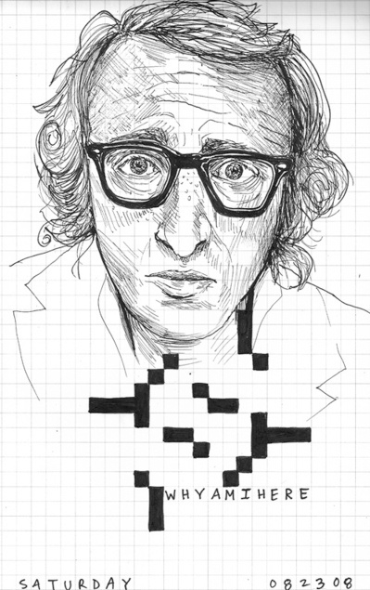

Q and A
Thanks!

