Slide 1
Big mountain Price modeling
Guided capstone - Robert Rustia

Slide 2
Business problem
Gain insight of value of specific facilities to support ticket price changes and changes in facilities.
Uncover insight in position in market to help ticket pricing decisions.

Slide 3
Objectives
This project aims to build a predictive model for ticket price based on several facilities, or properties, the resorts. This model use will be to provide guidance for pricing and facility investment plans.

Slide 4
Modeling Price Insight -
An increase in price has been projected from the final model.
Current tickets are priced at $81.00, the model based on all other resort data provided, predicted Big Mountain Resort price to be $95.97.
Regardless of absolute error an increase in price to match the market value of the resort’s assets should be taken.

Slide 5
Model architecture
The final model that generated predictions is part of the following pipeline.
Simple Imputer replacing missing values with the median.
No scaling done using Standard Scaler.
Random Forest Regressor from SkLearn with 33 estimators (trees).
No limit on depth of trees was tuned in the pipeline.

Slide 6
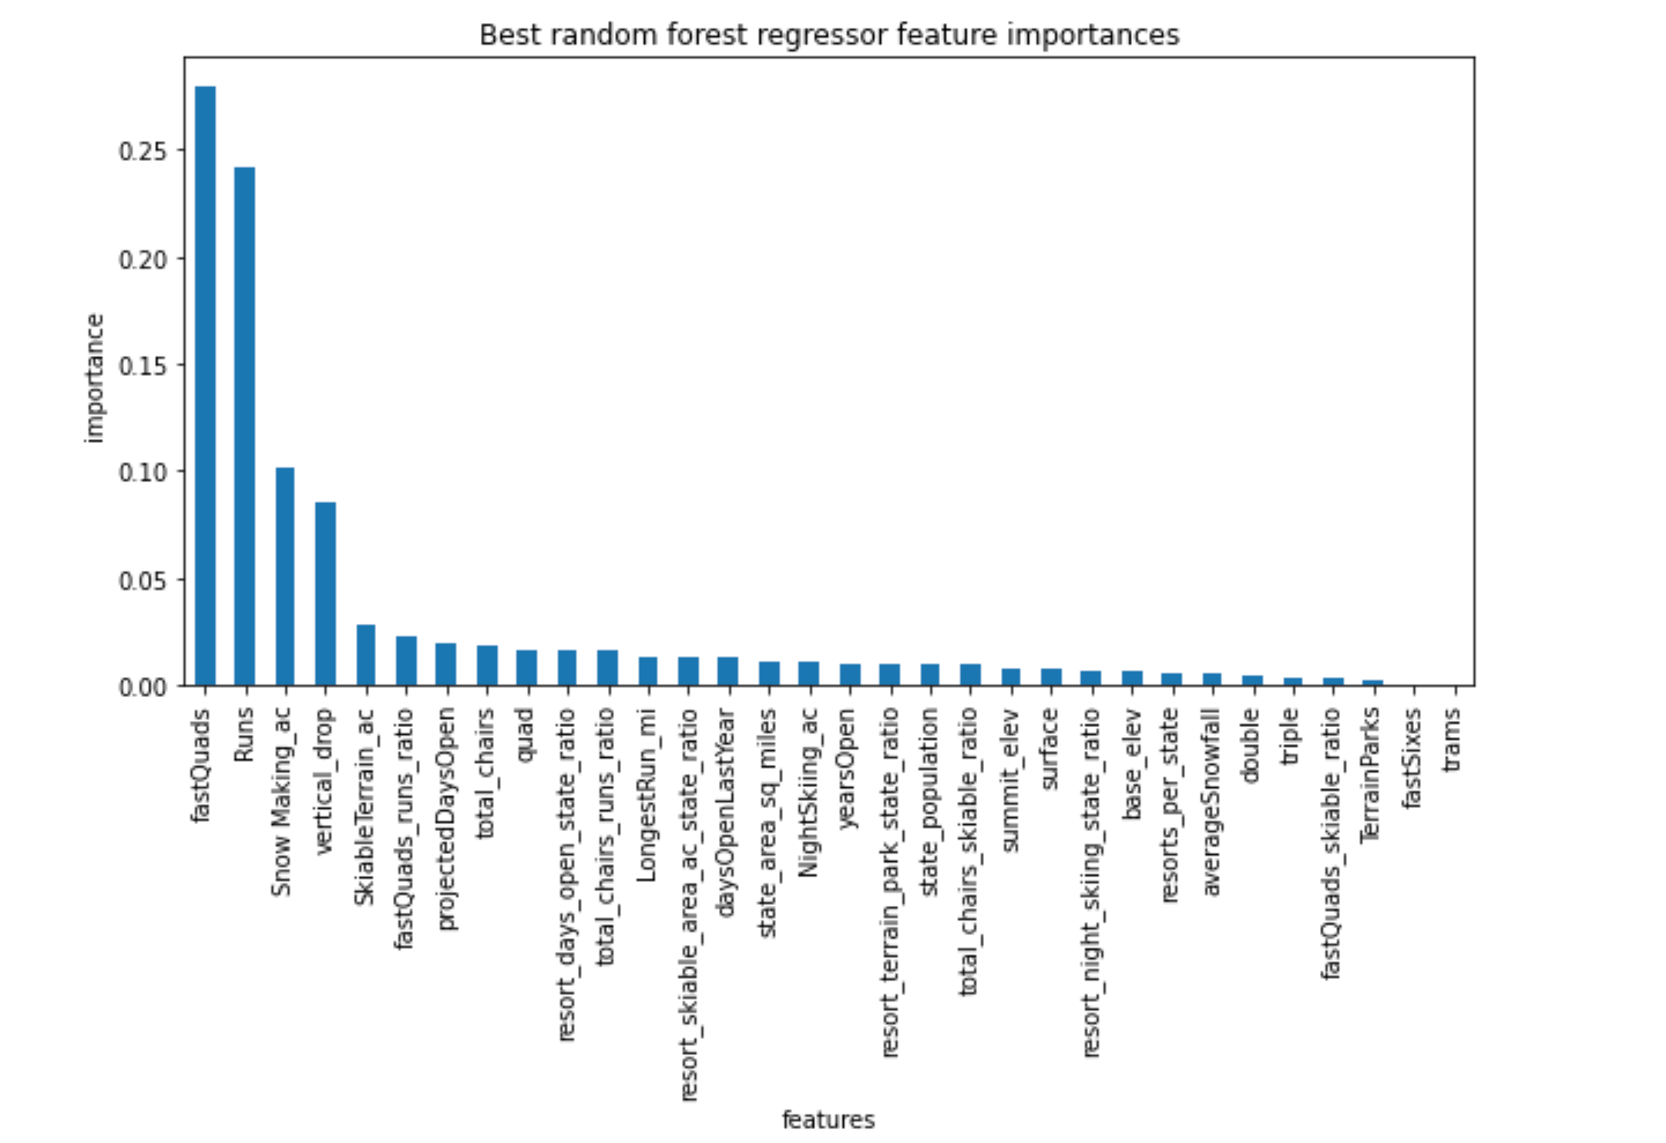
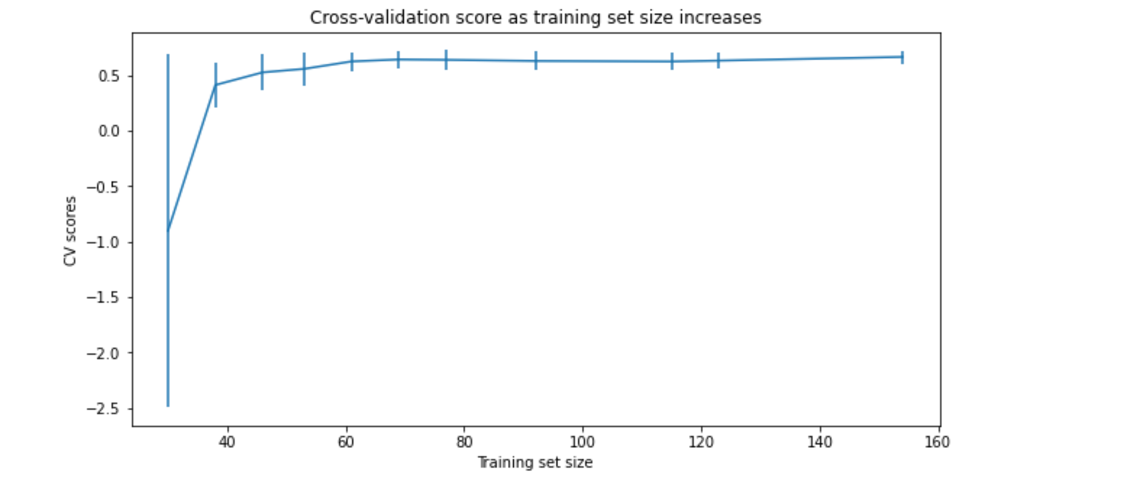
Model feature importance and tuning
Key Features importance from the final model such as fast quads and runs can be seen in the left graph.
The cross validations scores plateau after a training size of 60 targets showing that our data set is large enough to give us reliable predictions.

Slide 7
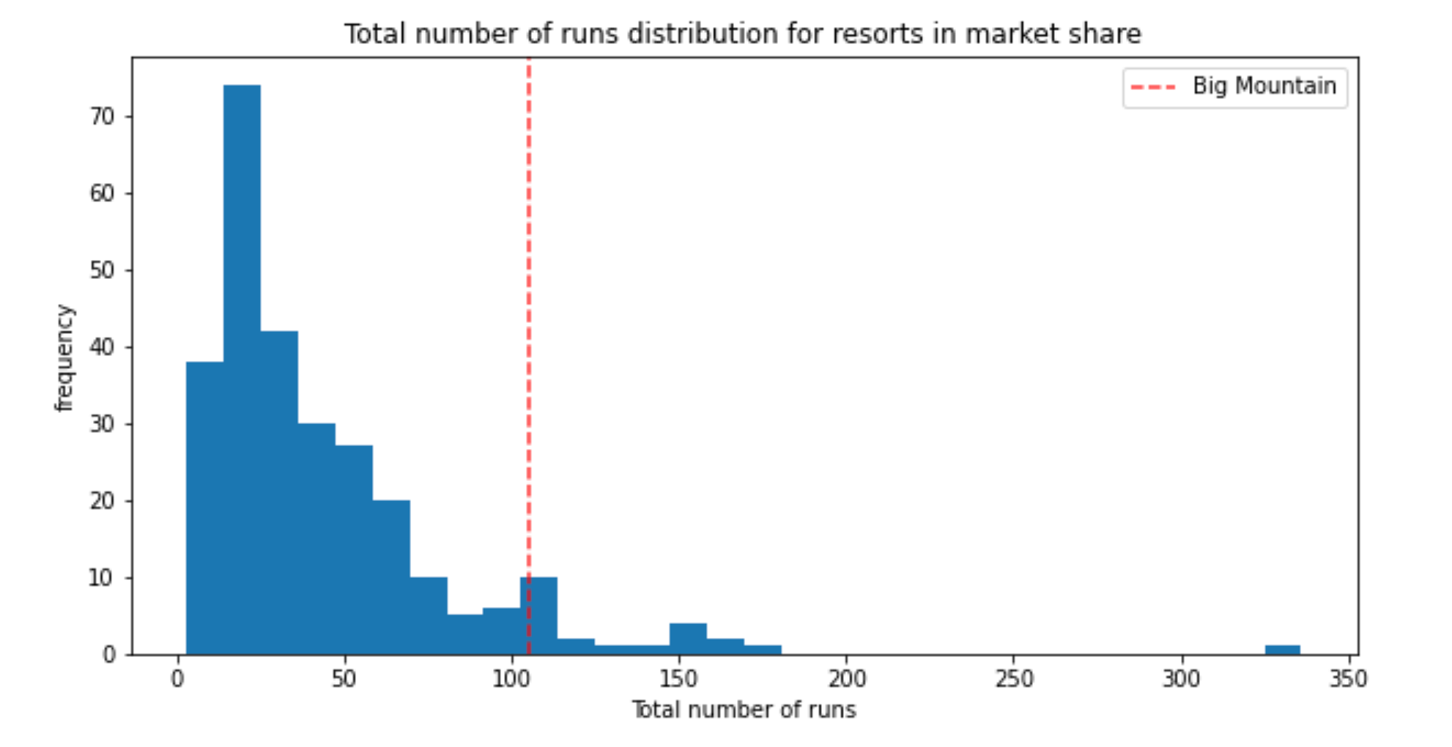
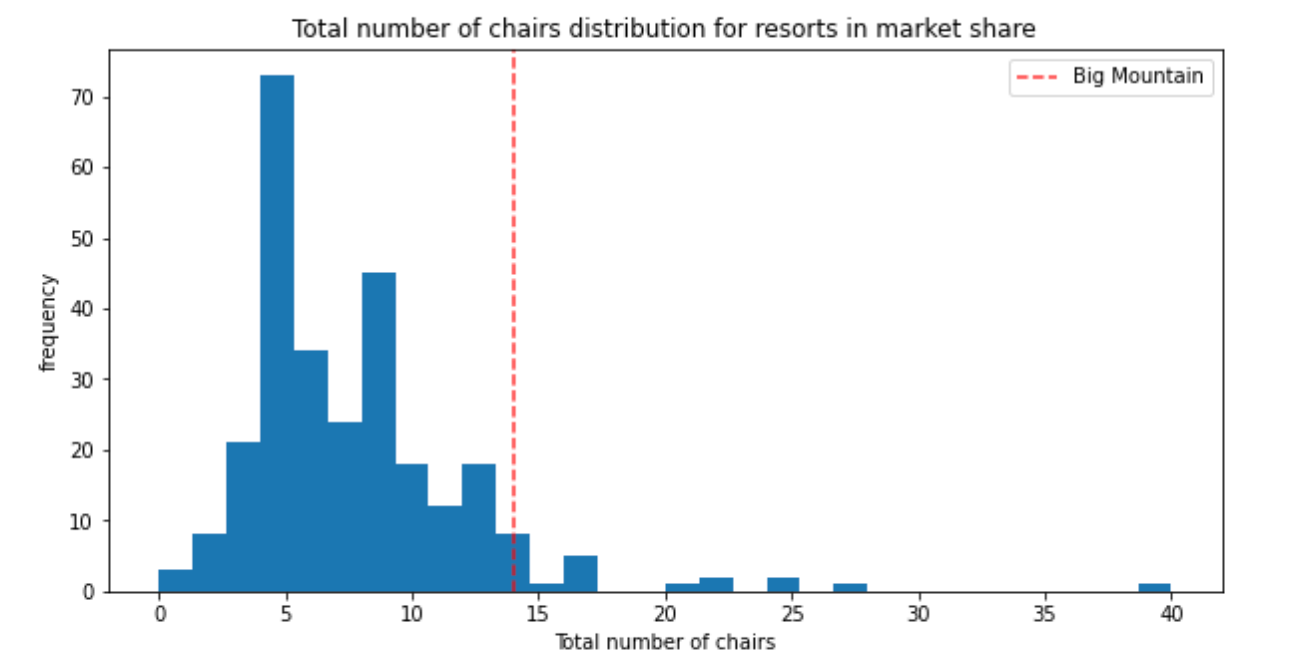
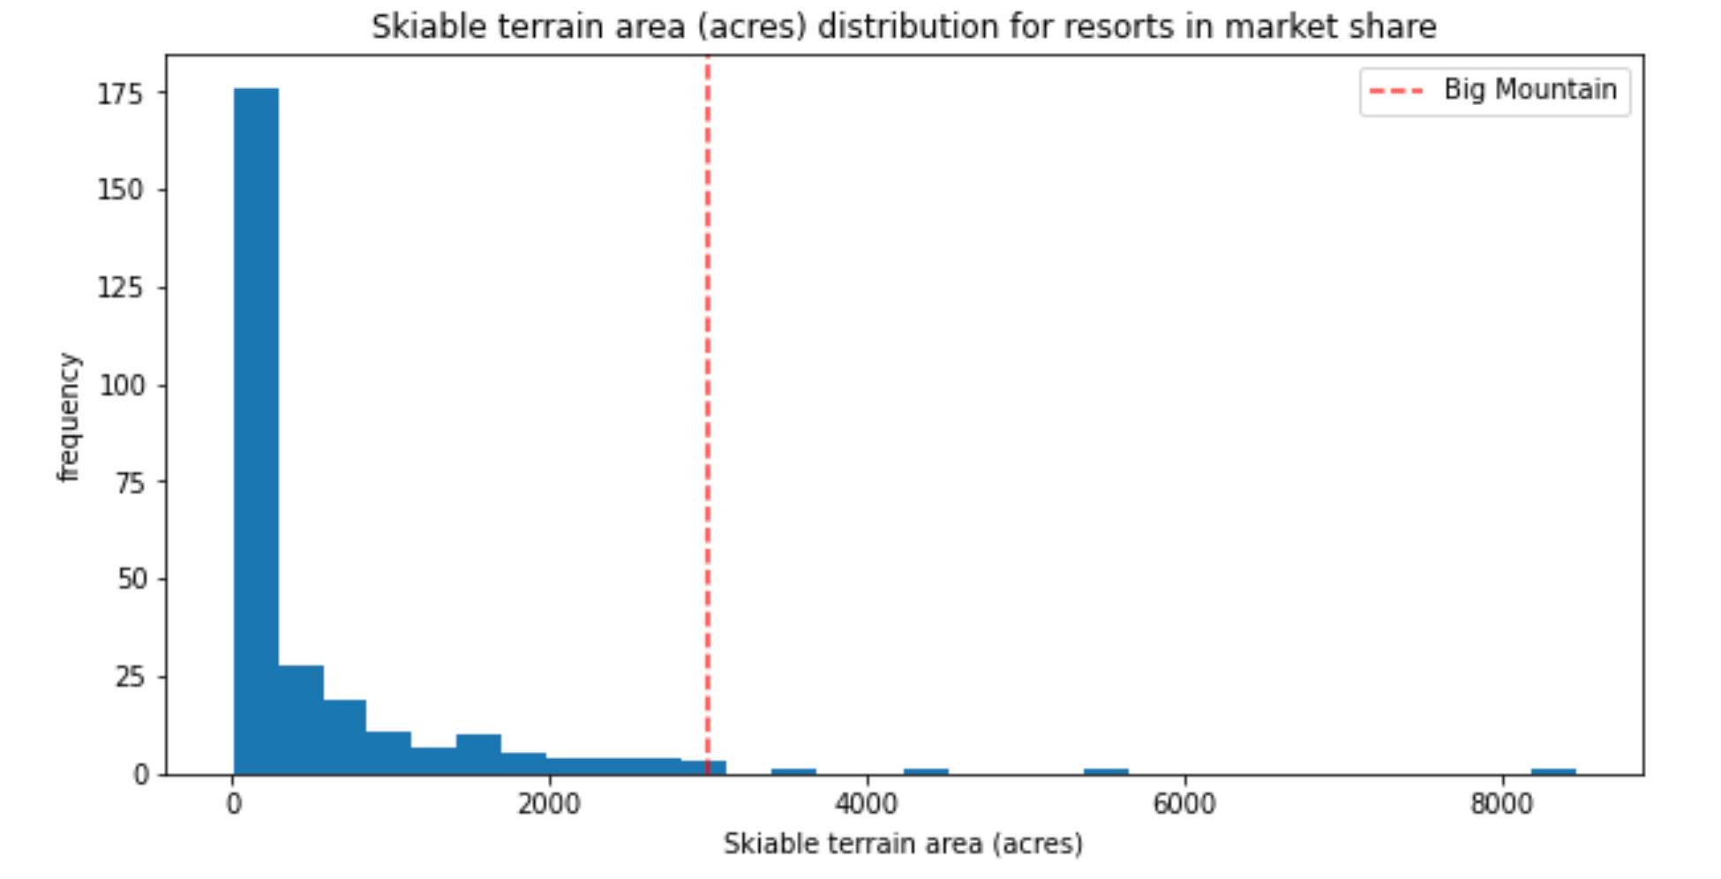
Big Mountain Resort In Market Context
Features that came up as important in the modeling (not just our final, random forest model) included:
vertical_drop
Snow Making_ac
total_chairs
fastQuads
Runs
LongestRun_mi
trams
SkiableTerrain_ac
Big Mountain Resort is in the top quarter of the distribution for many of the key features as seen in the histograms below.

Slide 8
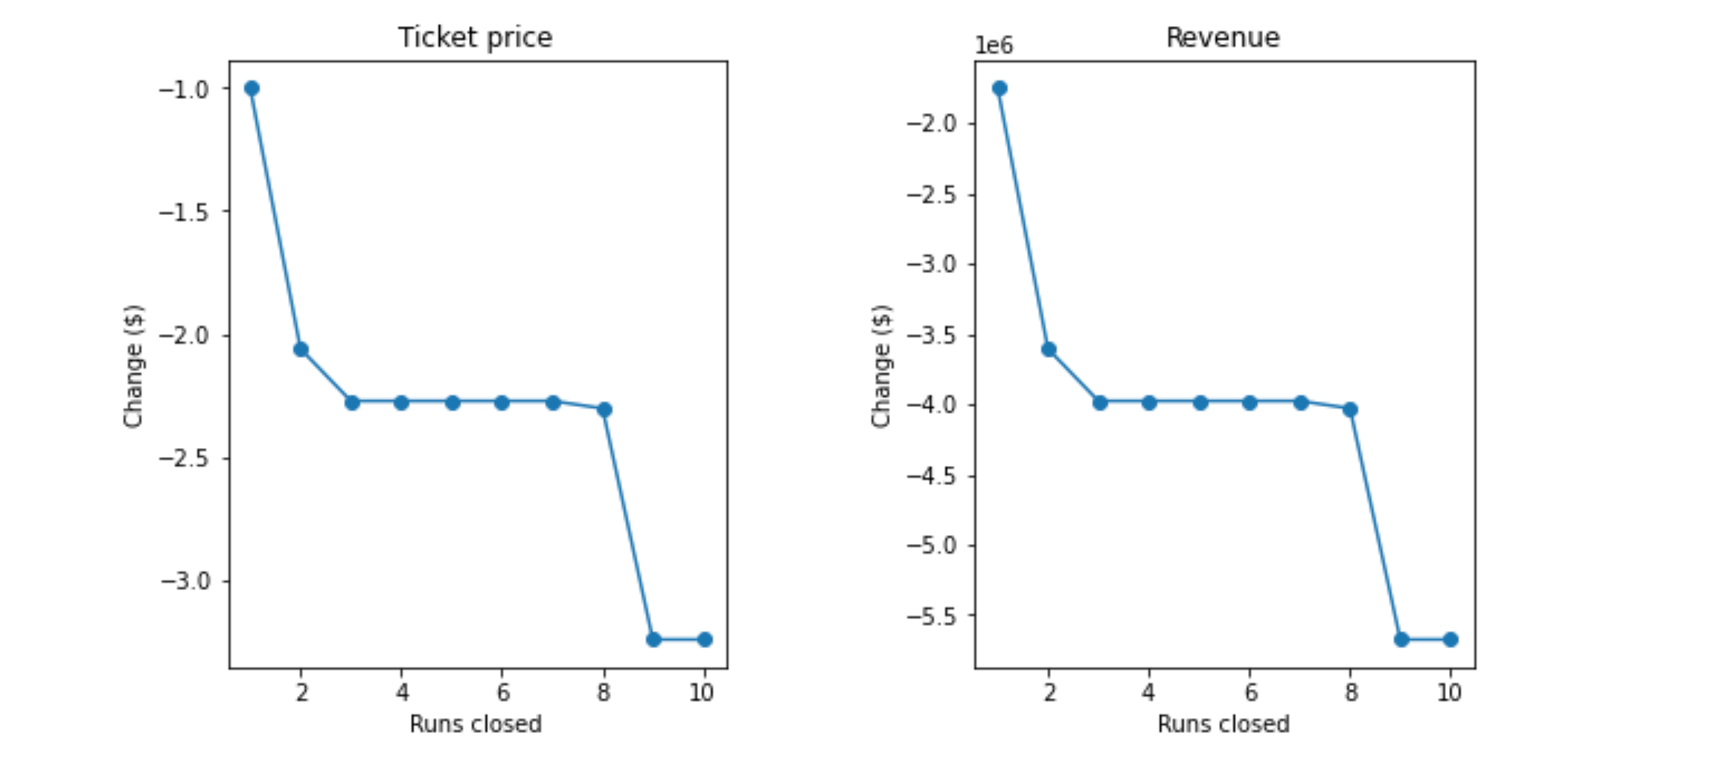
Resort adjustment scenarios 1 - Close up to 10 of the least used runs.
The model output below shows closing one run makes no difference in revenue or modeled ticket price. Closing 2 and 3 runs reduces support for ticket price and so revenue. If Big Mountain closes down 3 runs, it seems they may as well close down 4 or 5 as there's no further loss in ticket price. Increasing the closures down to 6 or more leads to a large drop.

Slide 9
Next steps for model development
The two largest deficiencies in the data set are missing operating cost per facility and staff, and second ticket sales per resort.
A key addition of Operating cost for all facilities would allow for changes in value in relation to cost to be modeled. The effect of changes in facilities to revenue would be modeled with greater confidence with this data.
Having ticket sales per resort would allow for seasonal revenue to be calculated and added to the model. This value would also help accuracy of projected price allowing for relationships between facilities and ticket value to be strengthened.

Slide 10
Conclusion
Big Mountain Resort can increase in ticket price to match the value modeled with the data provided.
Ticket sales and facility cost data would allow for increased accuracy of model predictions.

