Slide 1

DEMS
Review & Budget Presentation
2021-2022

Slide 2
Proposed Budget for the year 2022-23
Particular | Actual Amount
School Fees | 7728000
Bus Fees | 2500000
Total Income | 10228000
Total Expenses | 11152312
Loss | -924312
Arrears till 02/08/2022 | 5319412
Bank Balance as on 02/08/2022 | 3443839

Slide 3
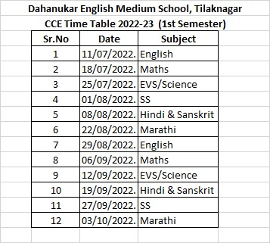
Weekly Test

Slide 4
Achievements & Activities in 2021-22
SSC 100% result 2021-22 batch
Maths Game-a-thon Competition
Mental Math’s Competition
Olympiad Competition Distribution
Book Bee Award Distribution
Homi Bhabha Award Distribution
District Level Martial Art Competition
Daily morning sports
Table Recitation
Summer Camp
Poster Making
Story Telling Competition
Meditation

Slide 5
Achievements & Activities in 2021-22
Independence Day
Hindi Day Celebration
Teachers Day Celebration
Gopal Kala Celebration
Science Exhibition
Tree Plantation
Ashadi Ekadashi Celebration
Guru Pornima Celebration
Home Visits
Fine and Gross Skill Development
News

Slide 6
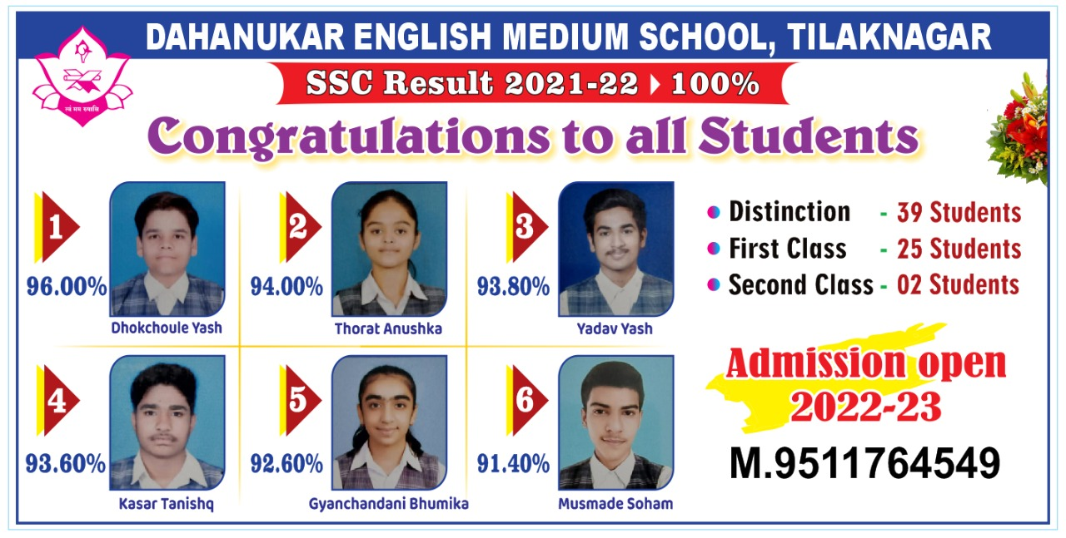
SSC Result 2021-22

Slide 7
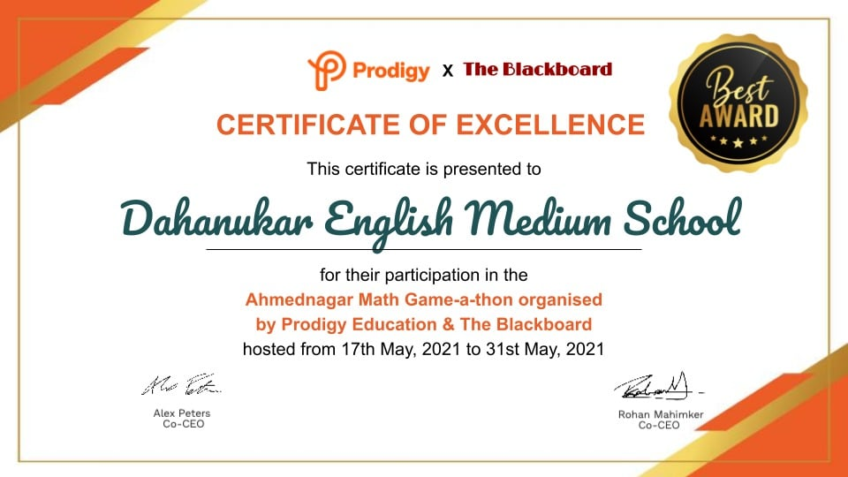
Maths Game-a-thon Competition Certificate

Slide 8
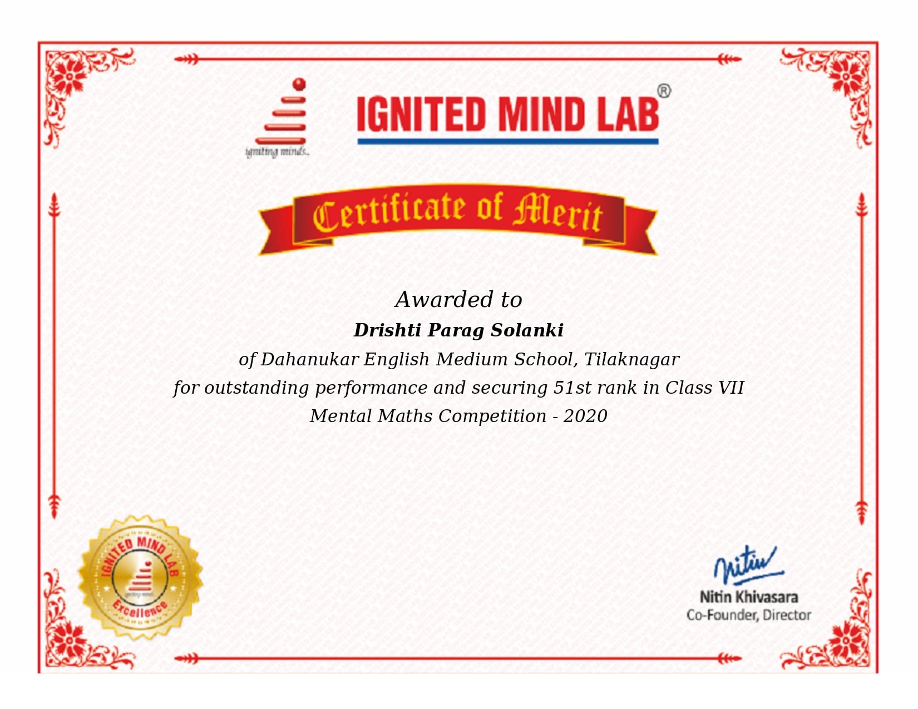

Mental Maths Certificate

Slide 9
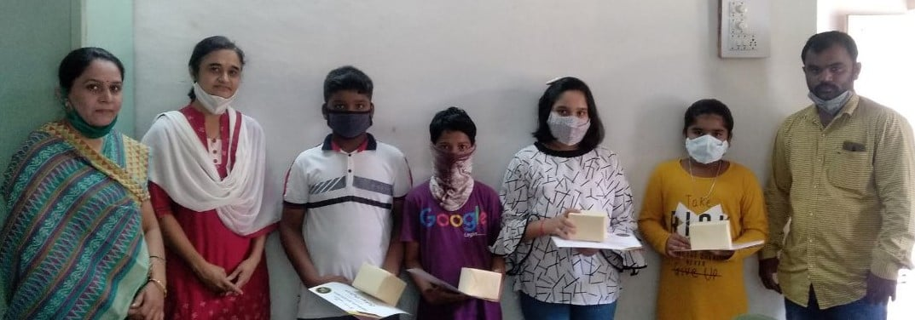
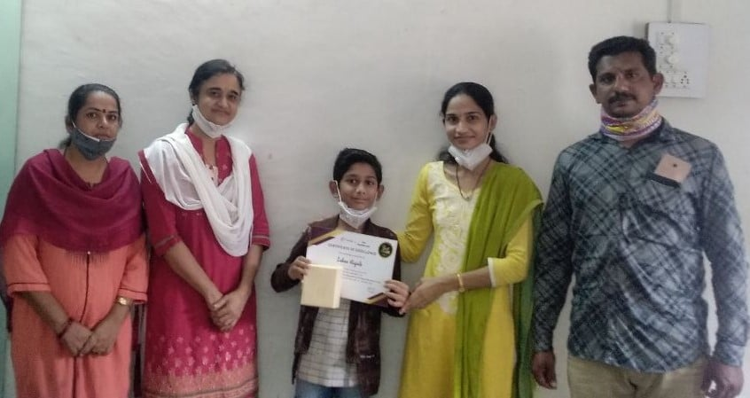
Olympiad Certificate Distribution

Slide 10
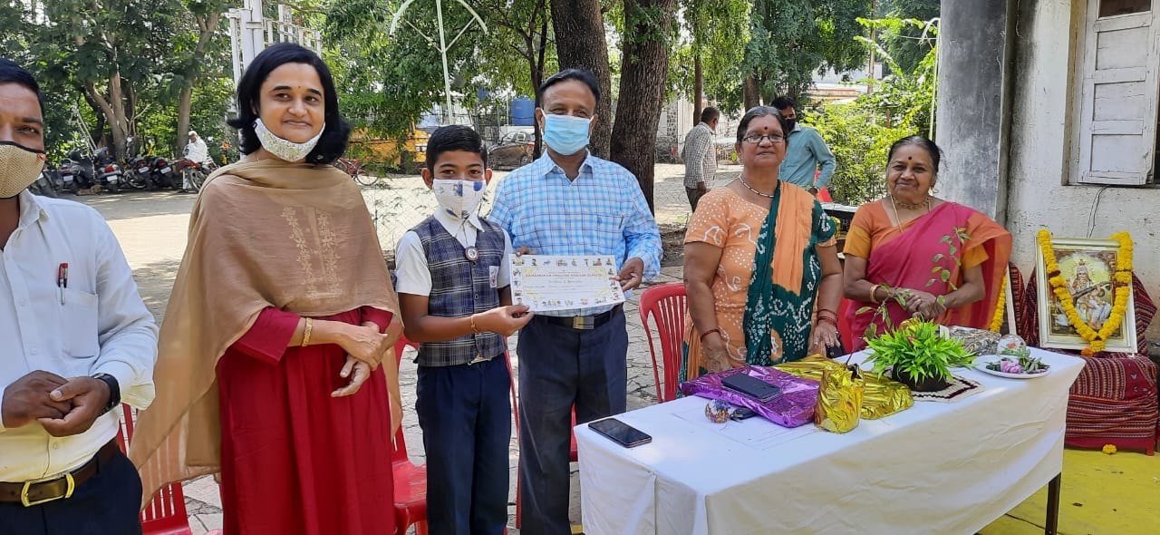
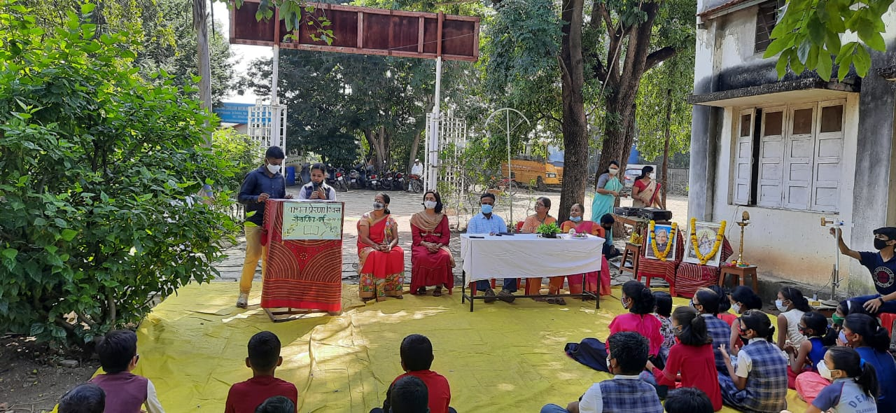
Book Bee Award Distribution 2021-22

Slide 11
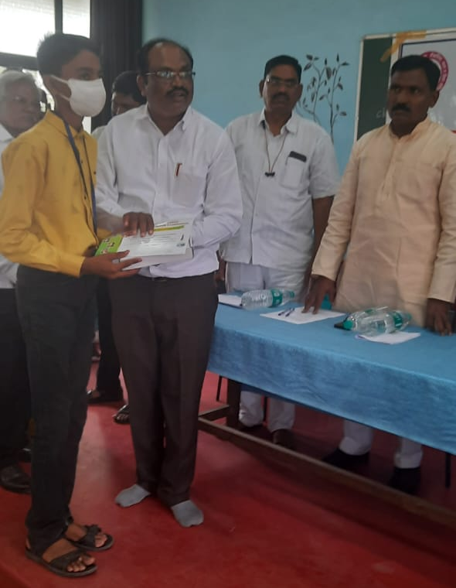
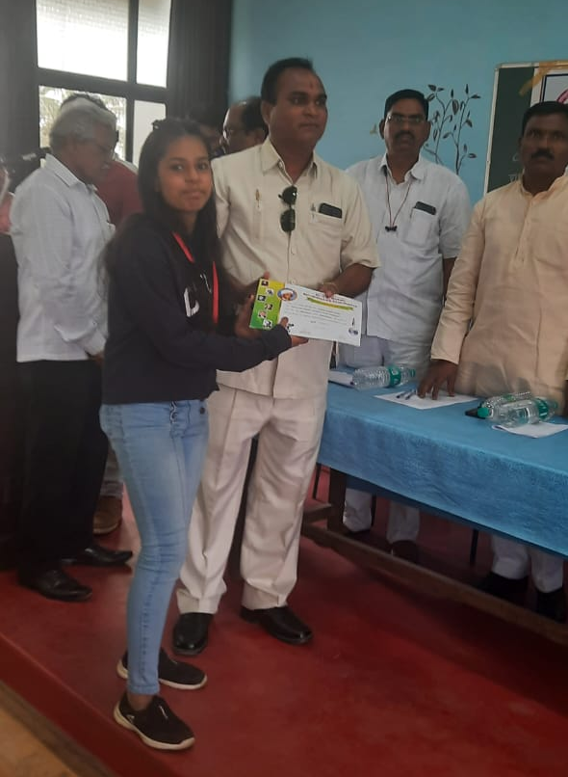
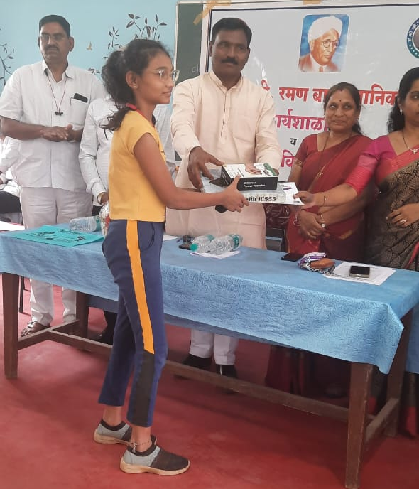
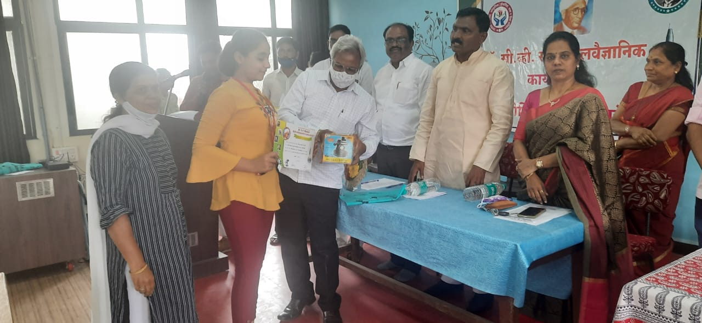
Homi Bhabha Award Distribution

Slide 12
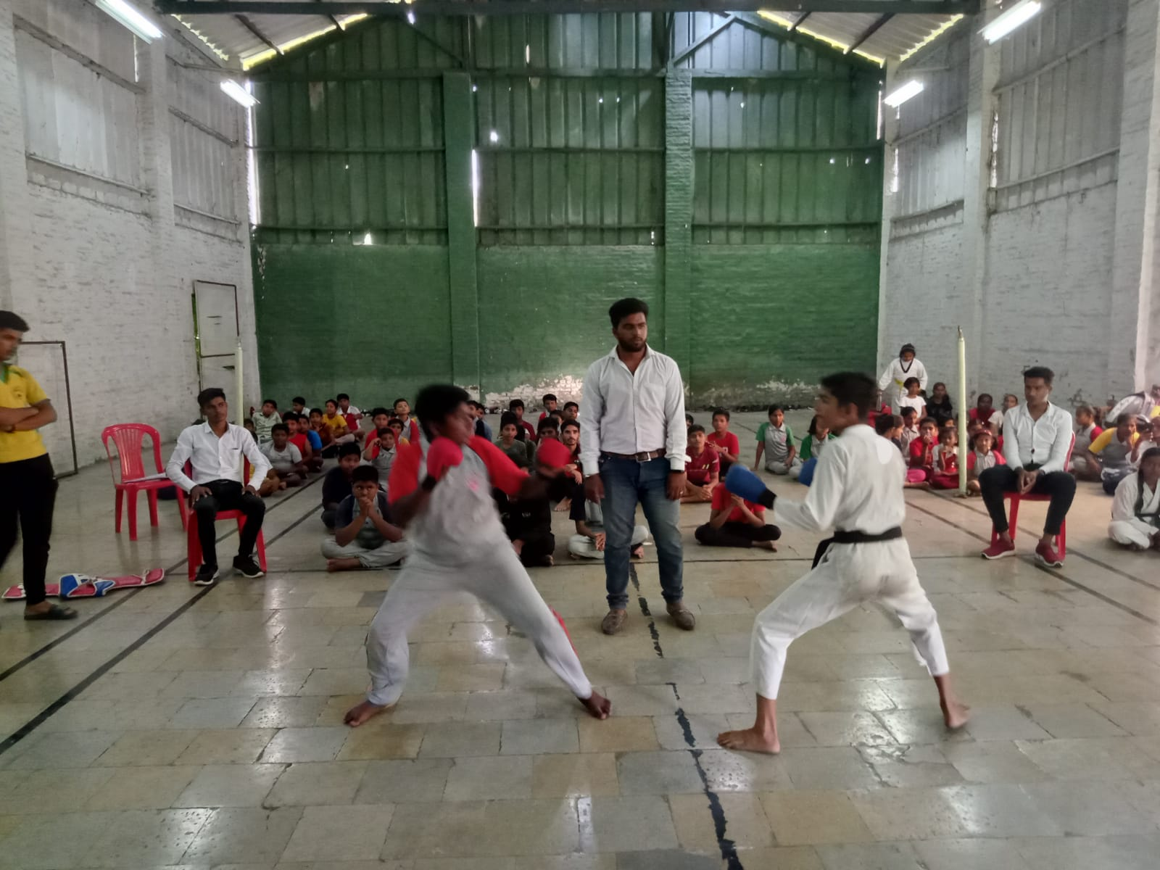
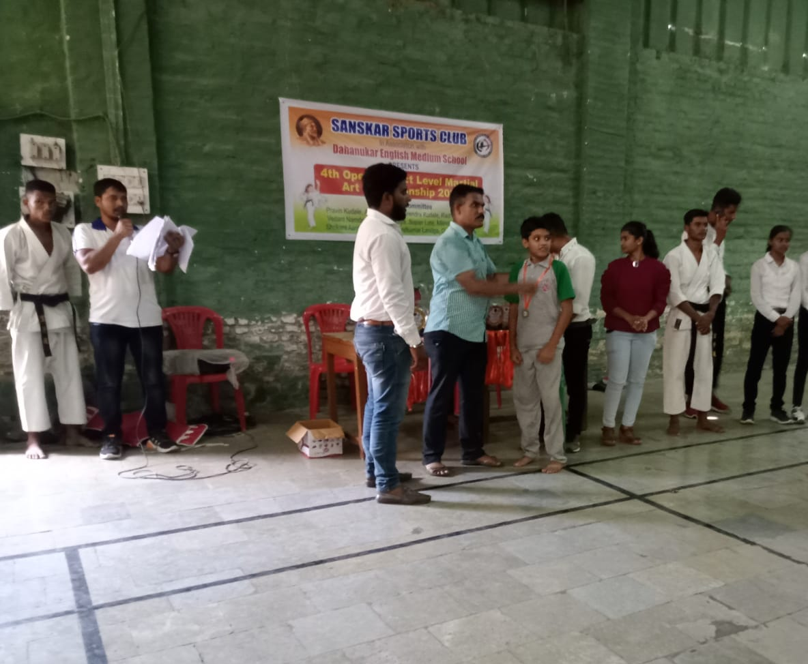
District Level Martial Art
Championship 2022

Slide 13
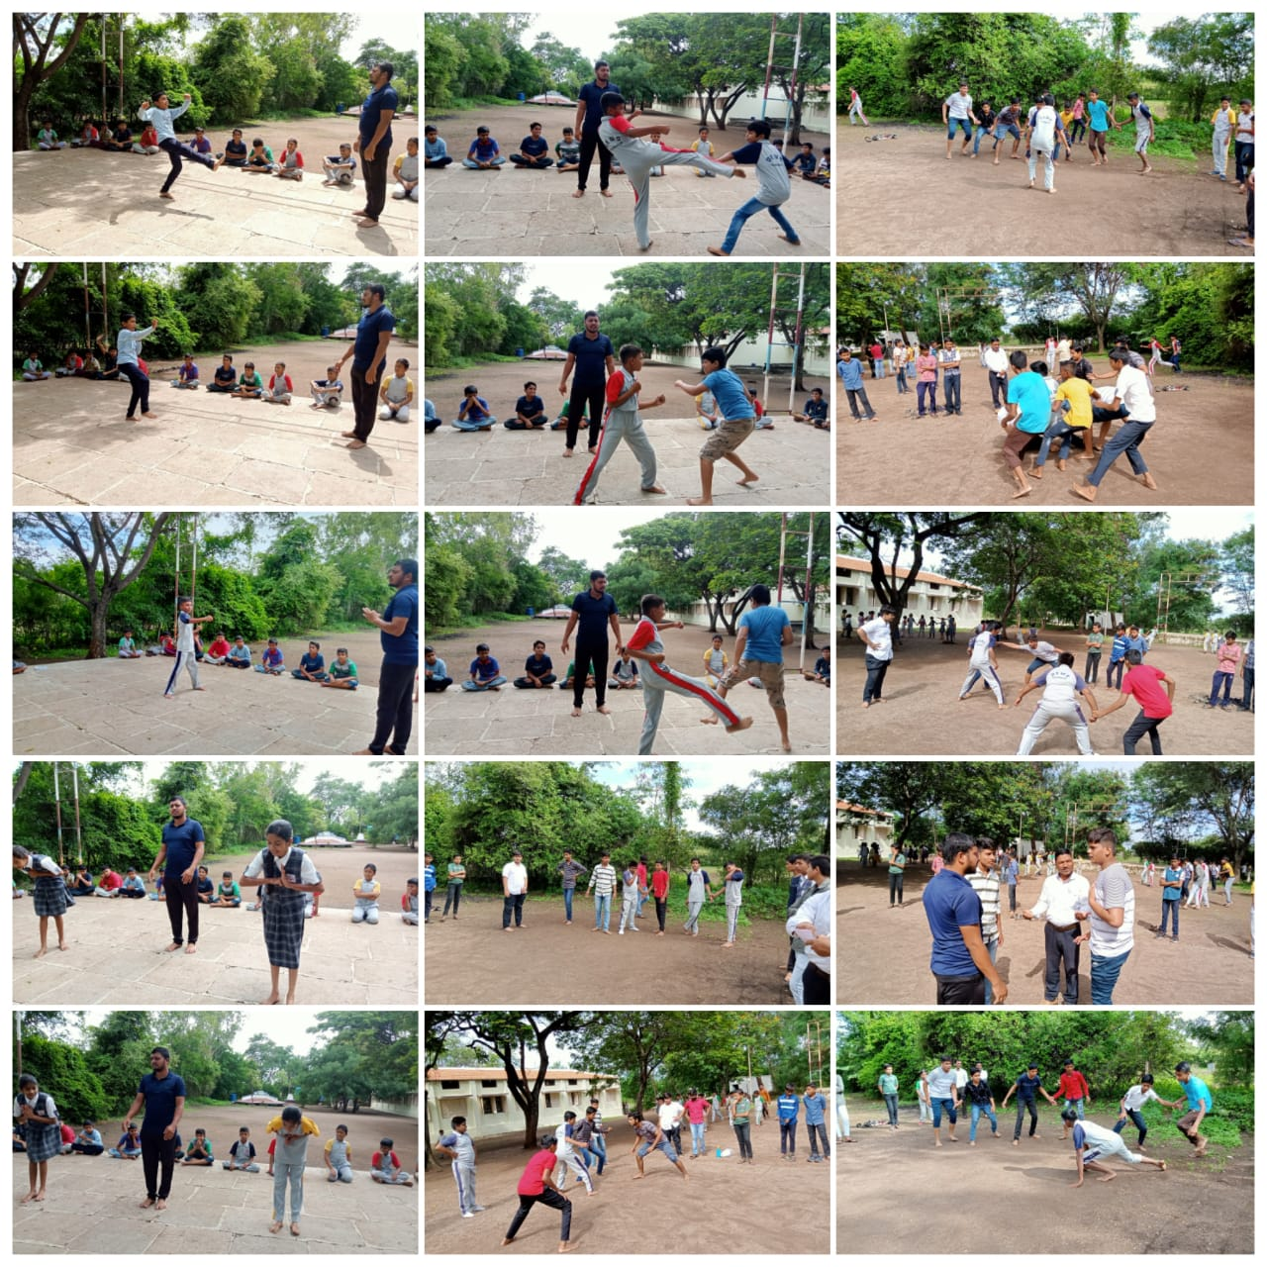
Daily Morning Sports

Slide 14
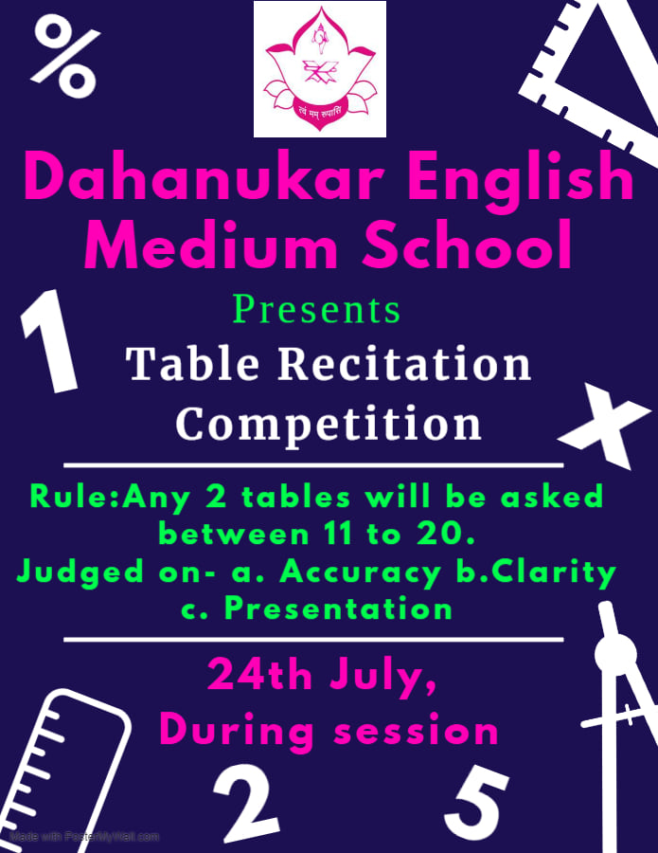
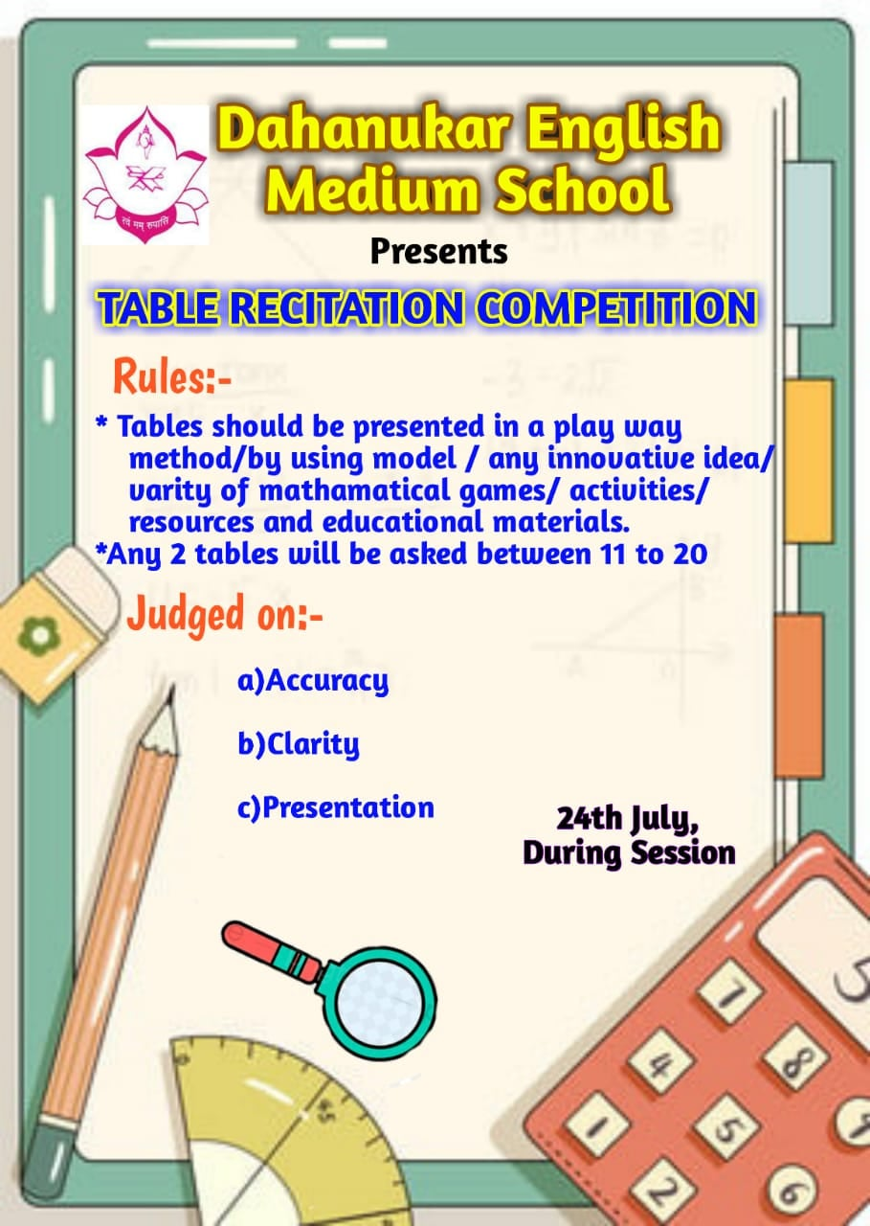
Table Recitation

Slide 15
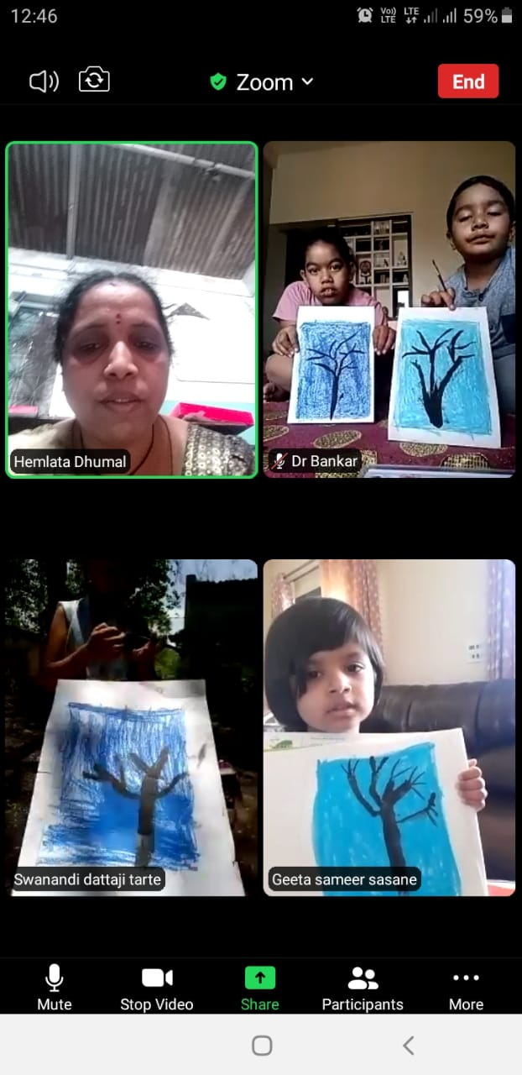
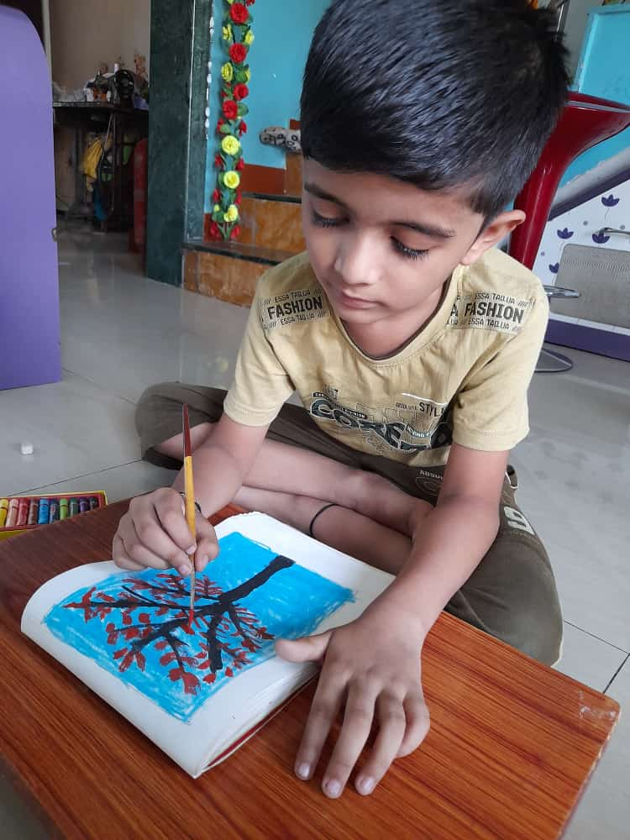
Summer Camp

Slide 16
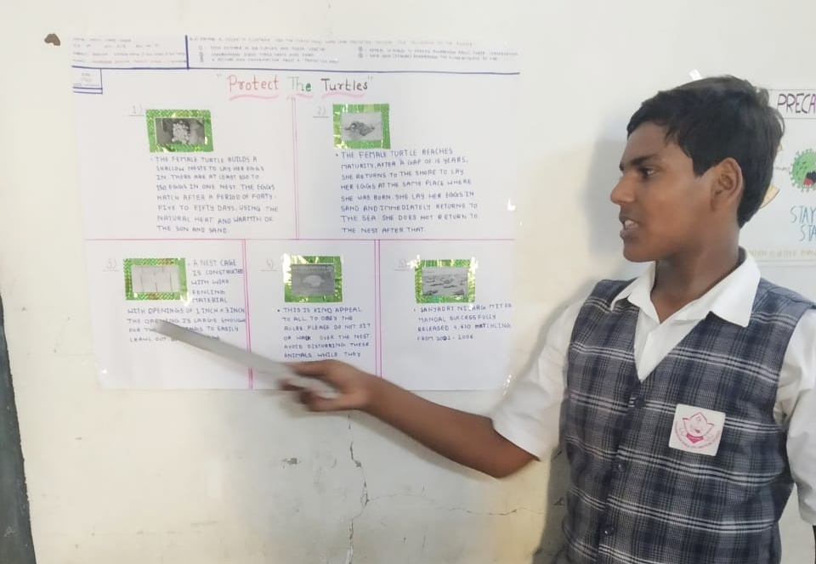
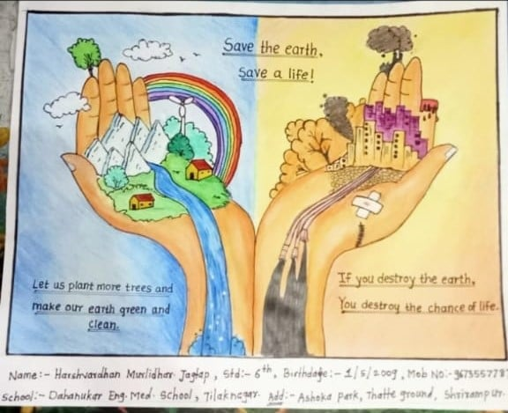
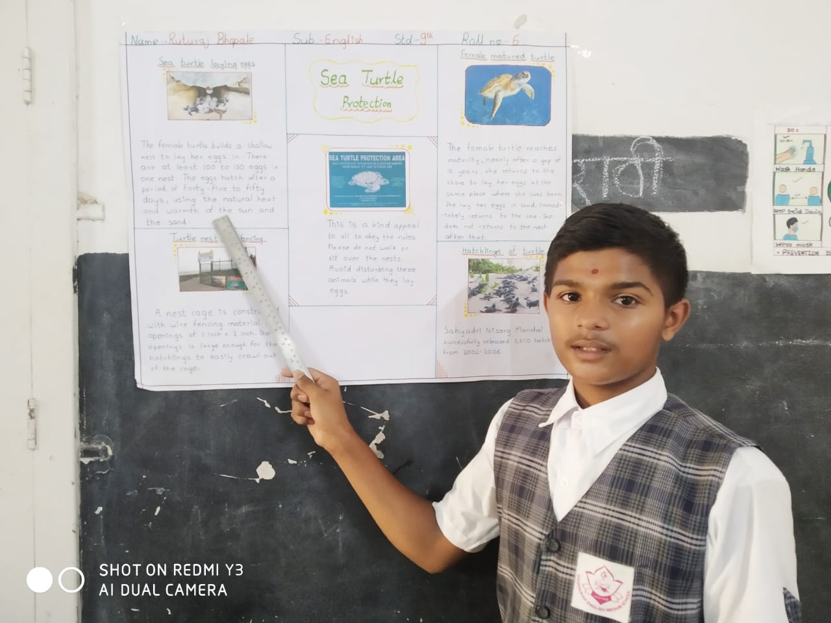
Poster Making

Slide 17

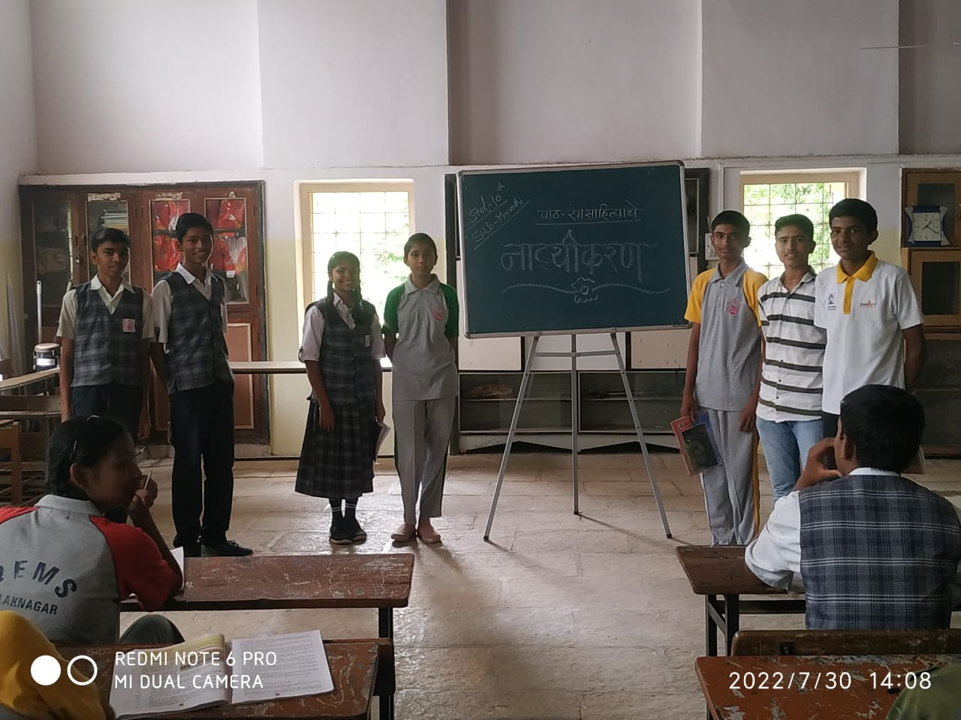
Story Telling Competition

Slide 18
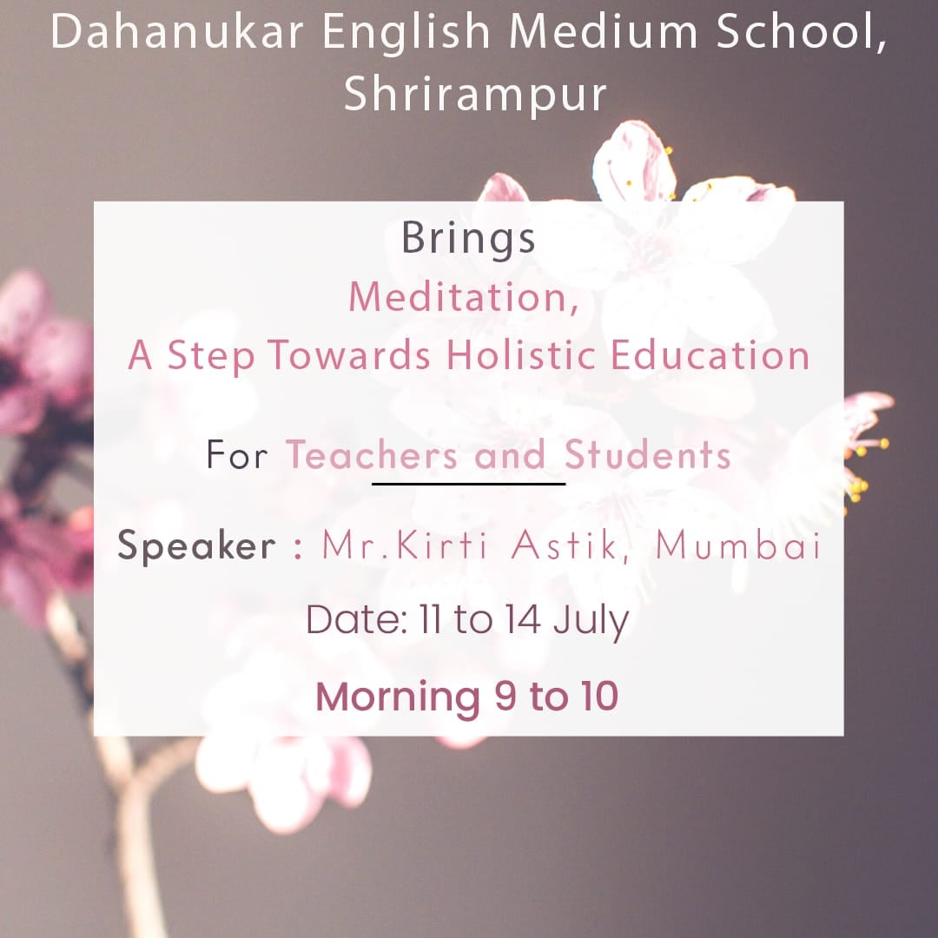
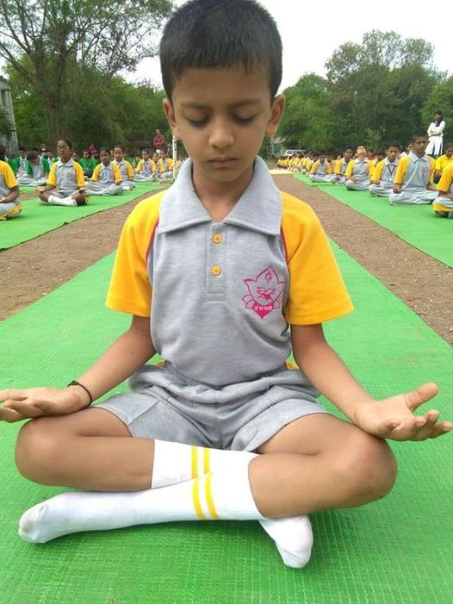
Meditation

Slide 19
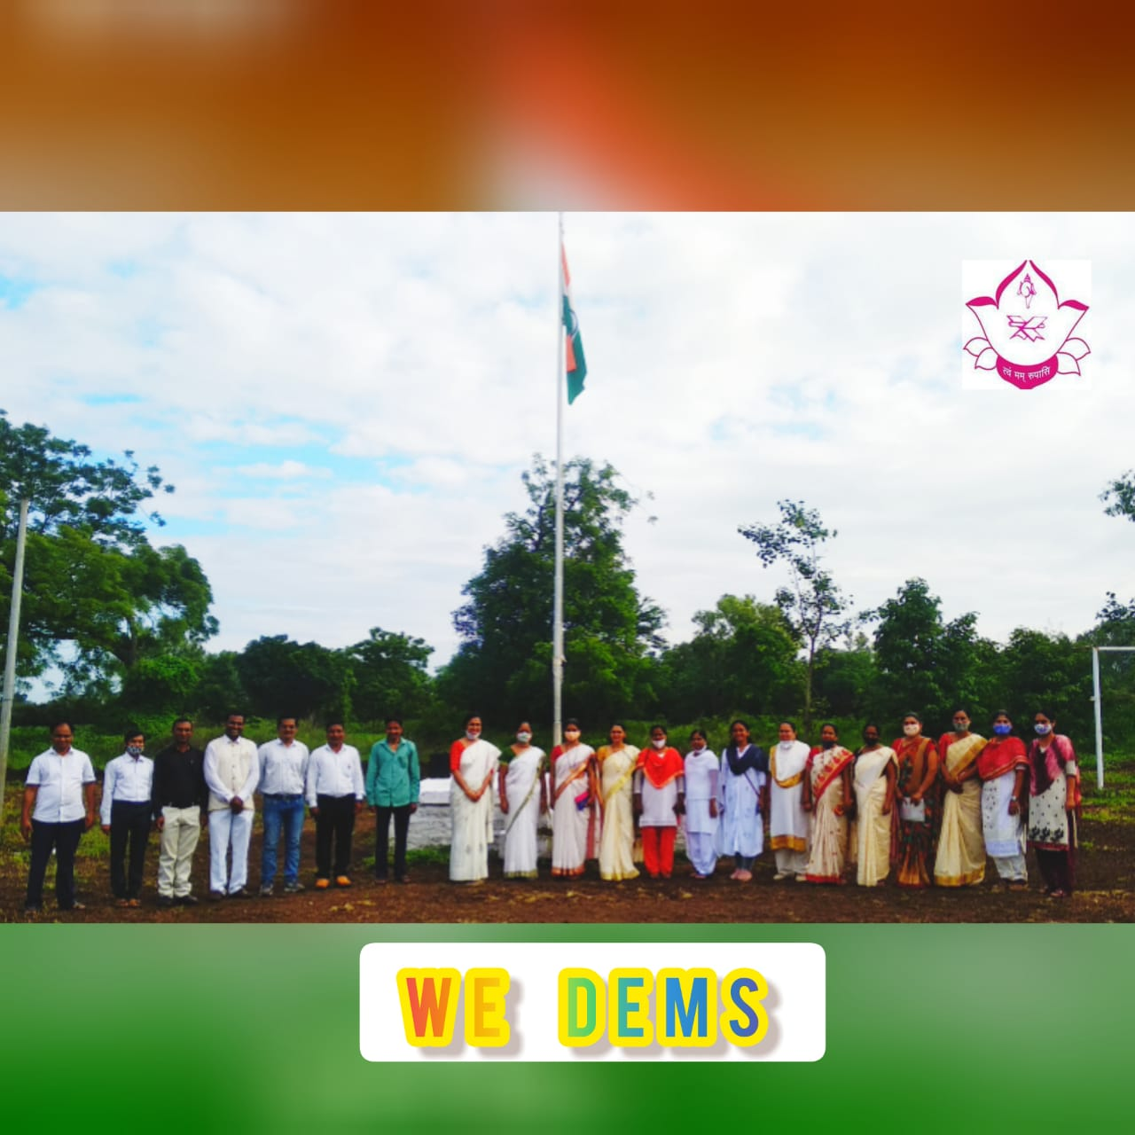
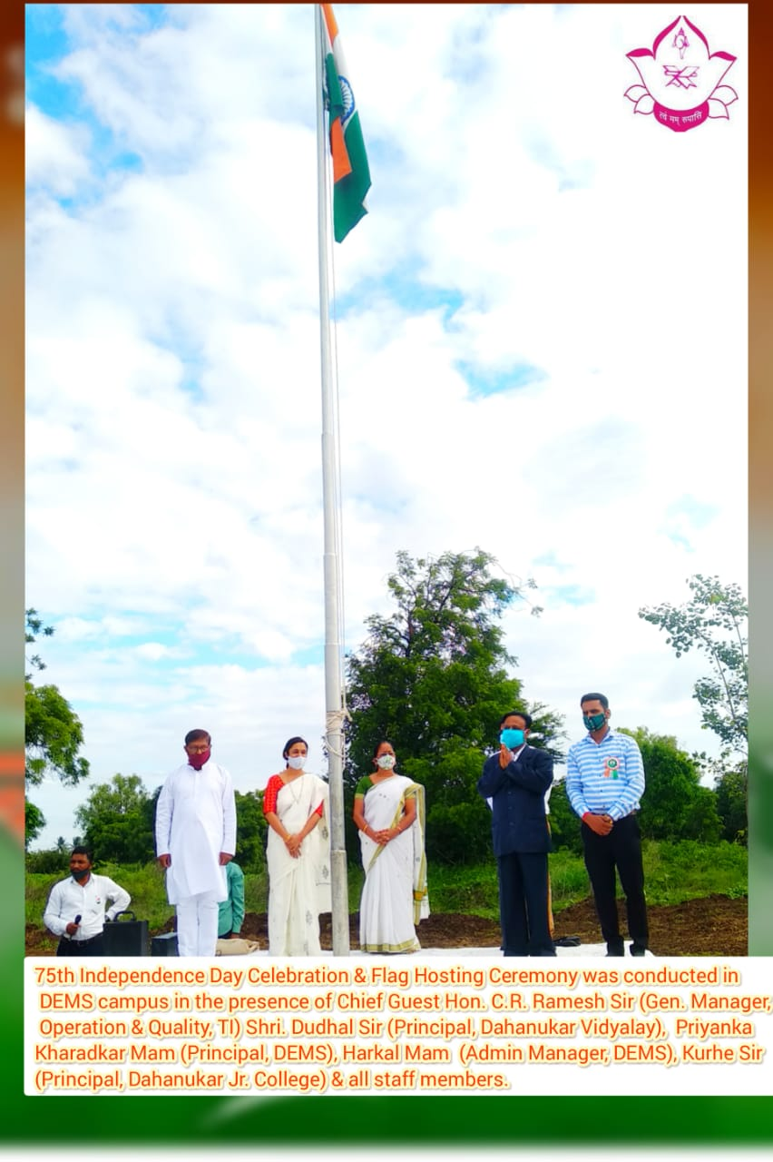
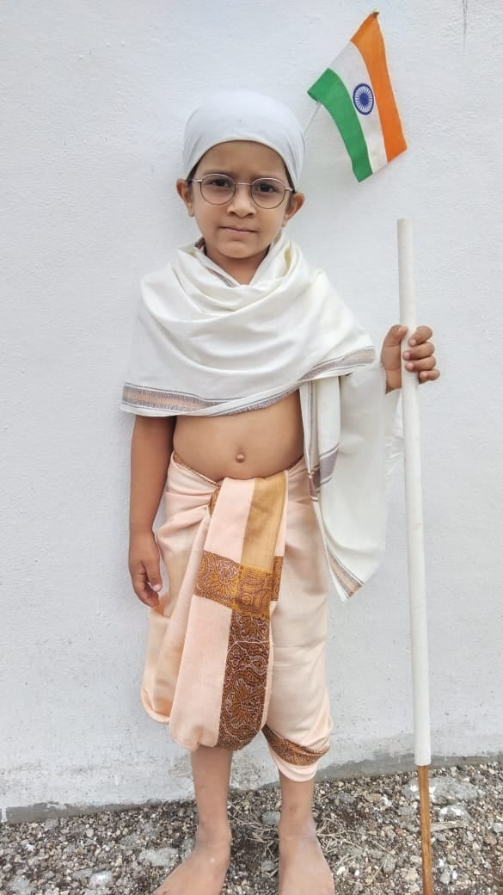
Independence Day

Slide 20
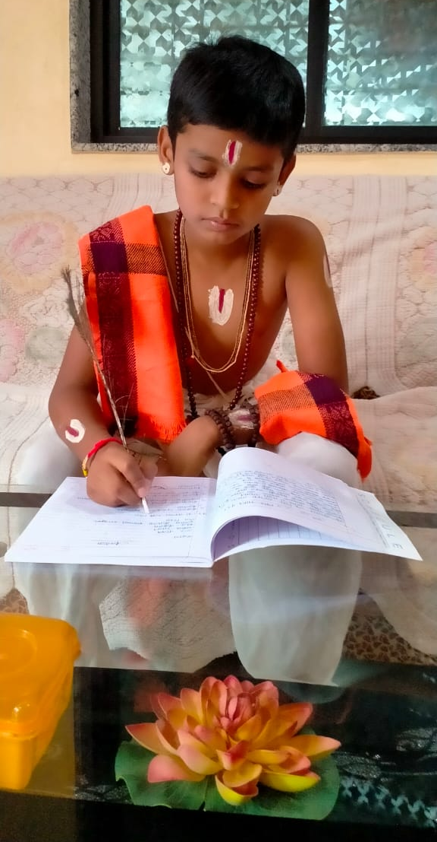
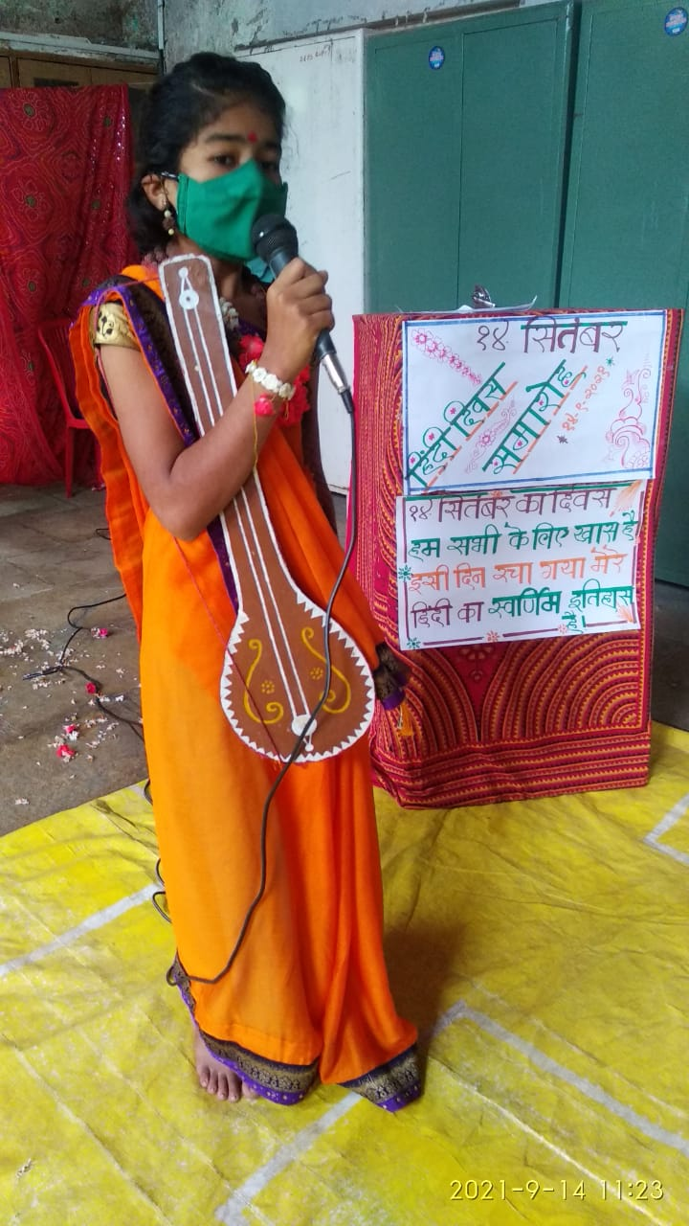

Hindi Day Celebration

Slide 21
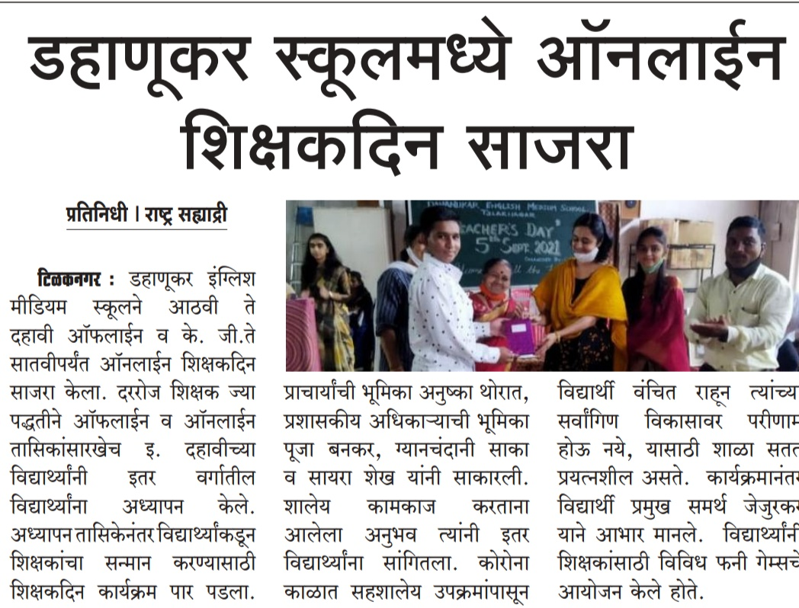
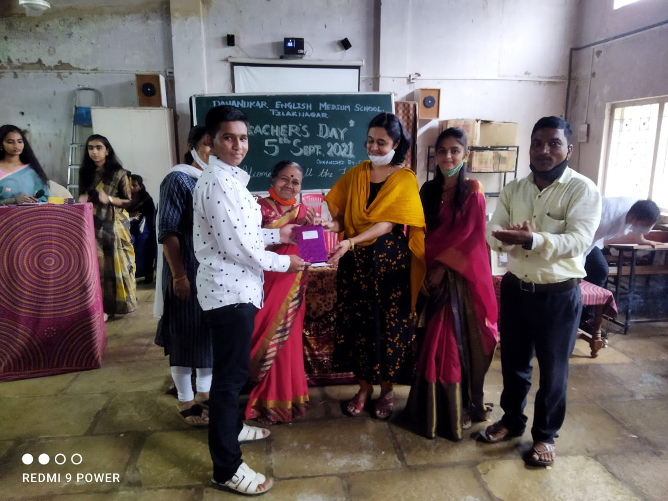
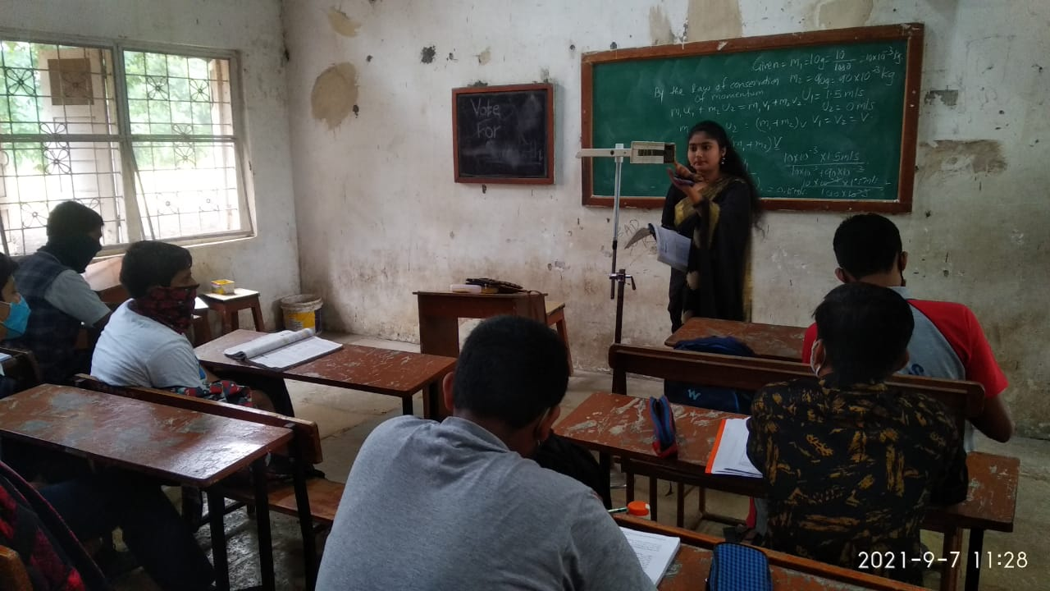
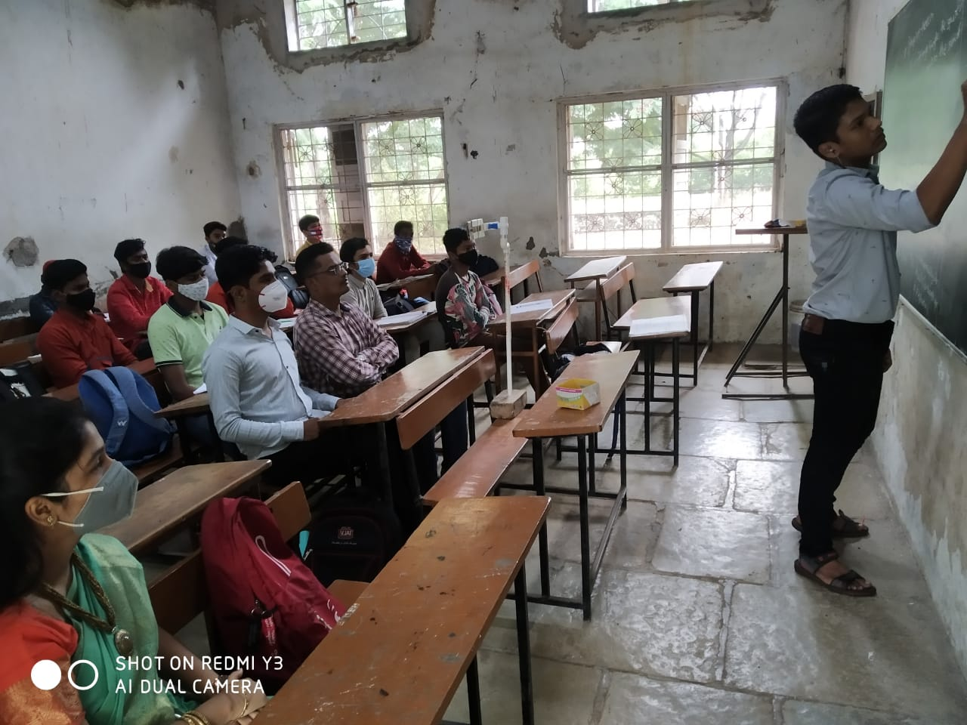
Teacher’s Day Celebration

Slide 22
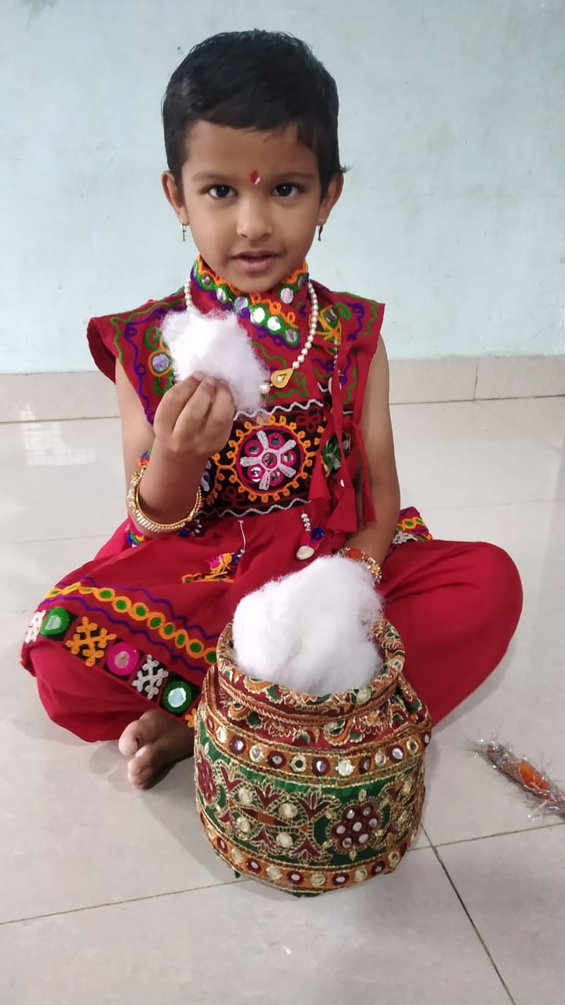
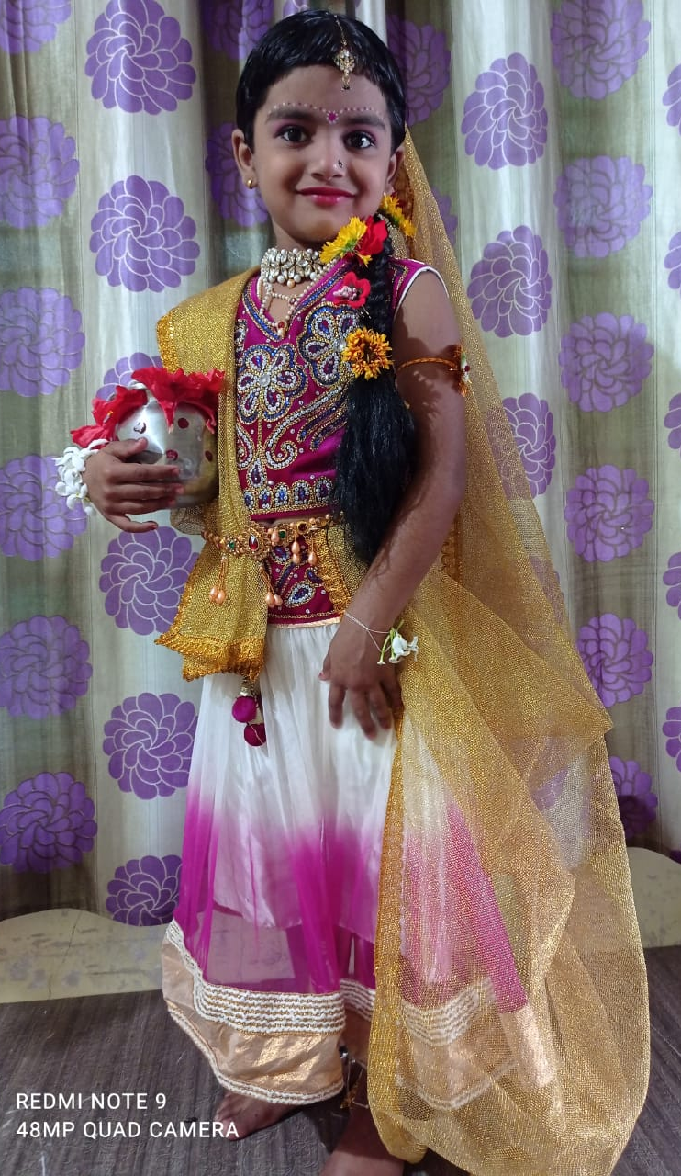
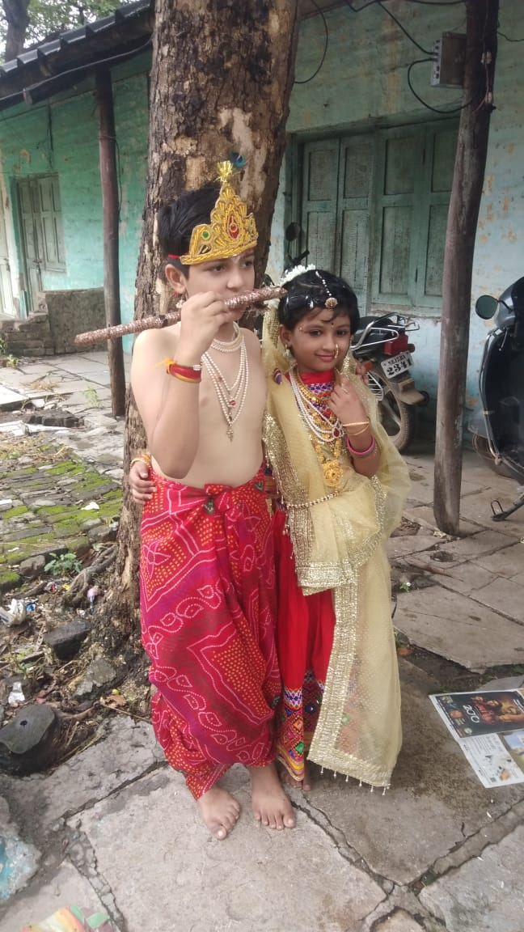
Gopal kala Celebration

Slide 23
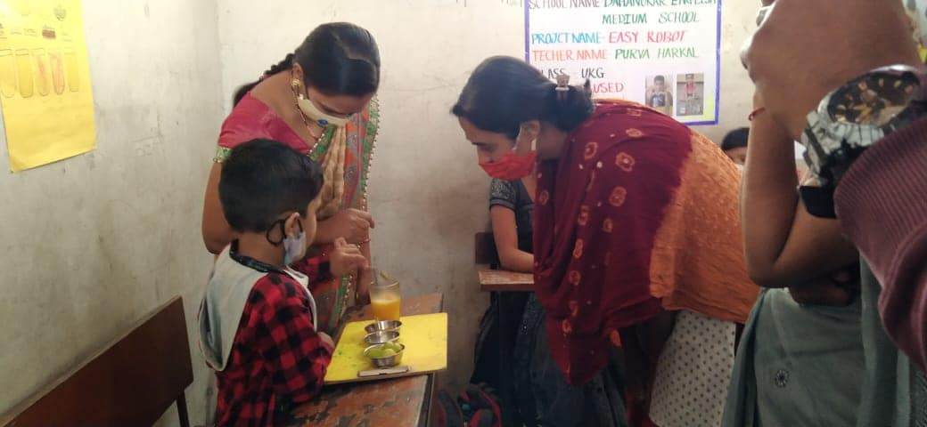
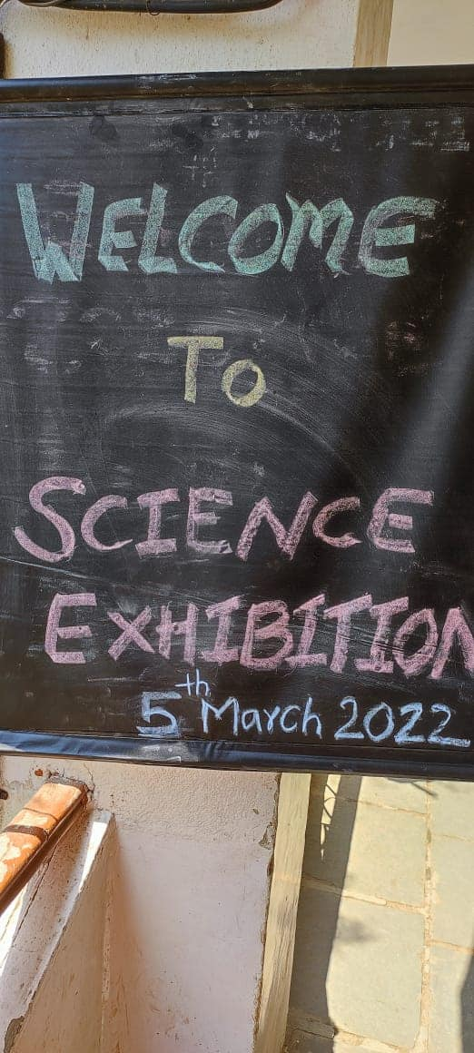
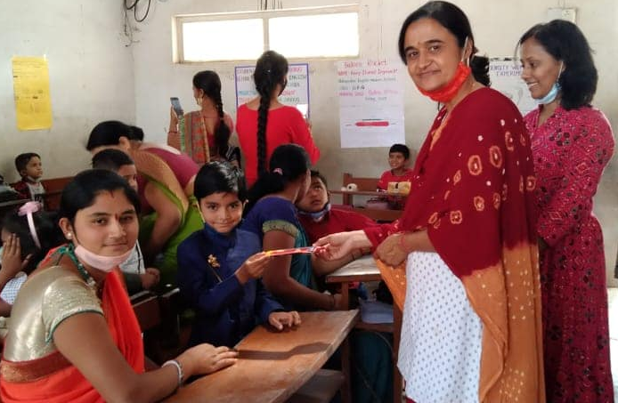
Science Exhibition

Slide 24
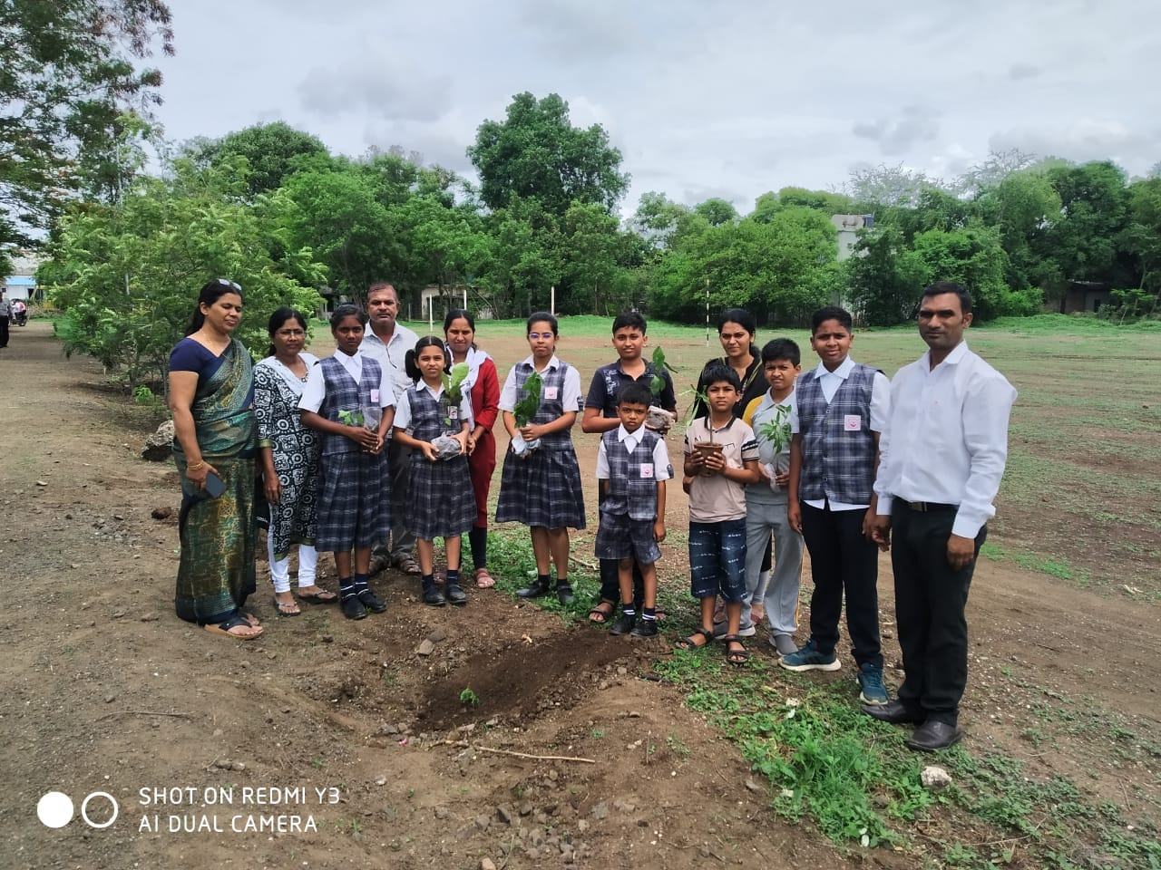
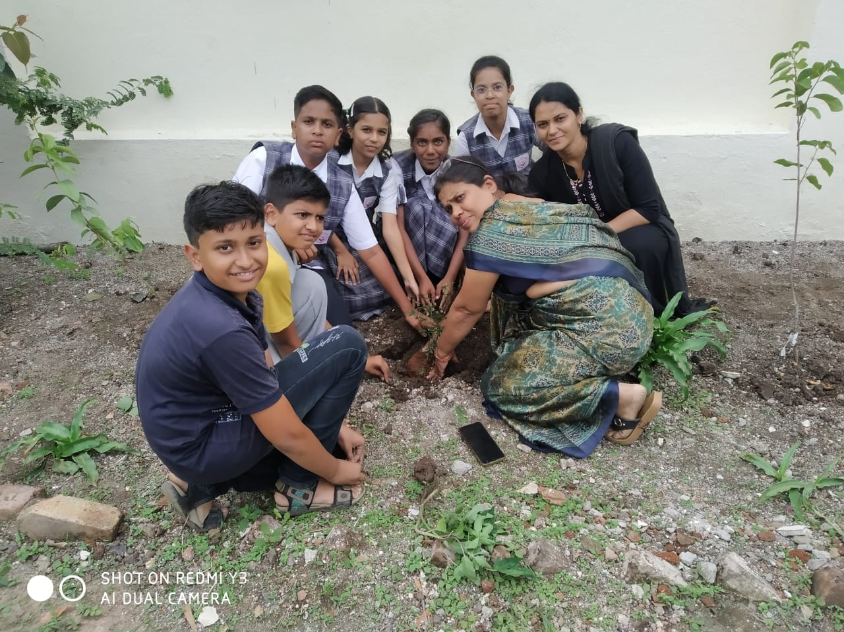
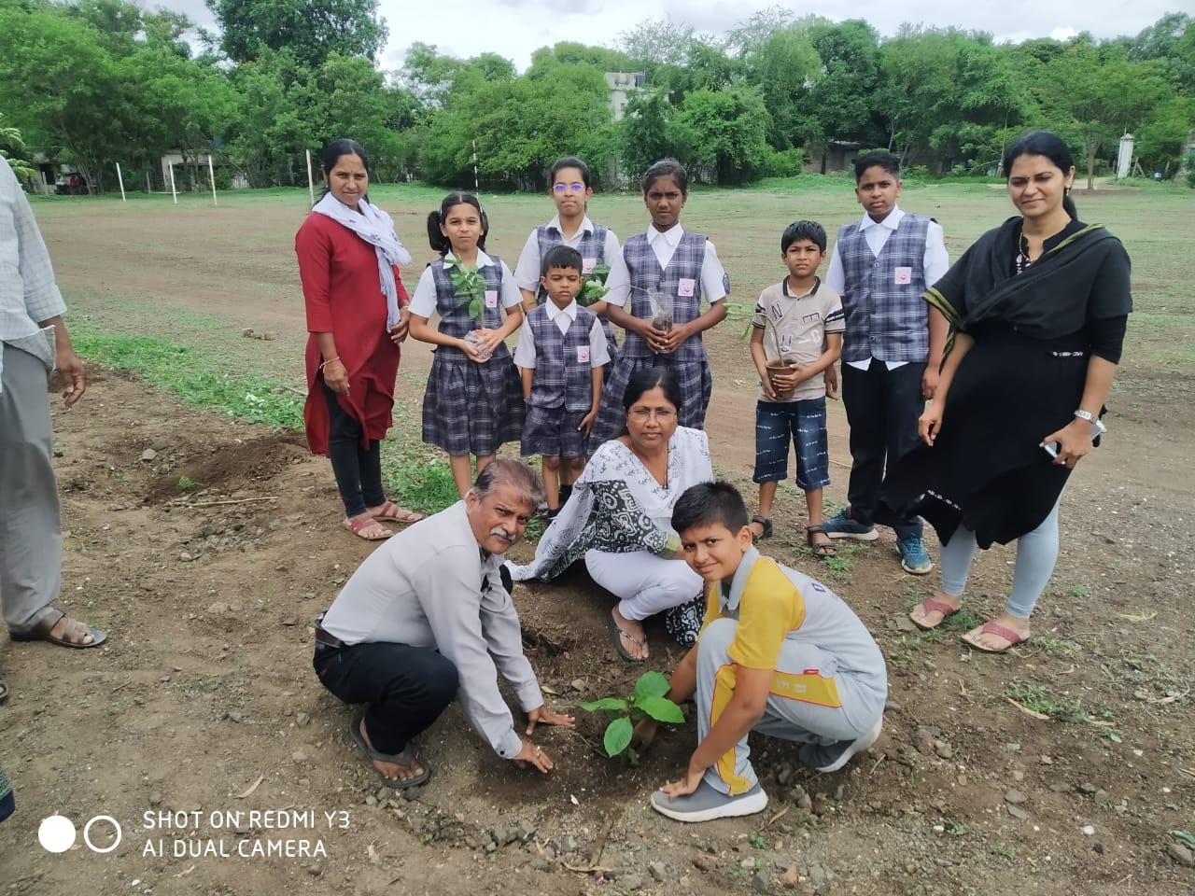
Tree Plantation

Slide 25
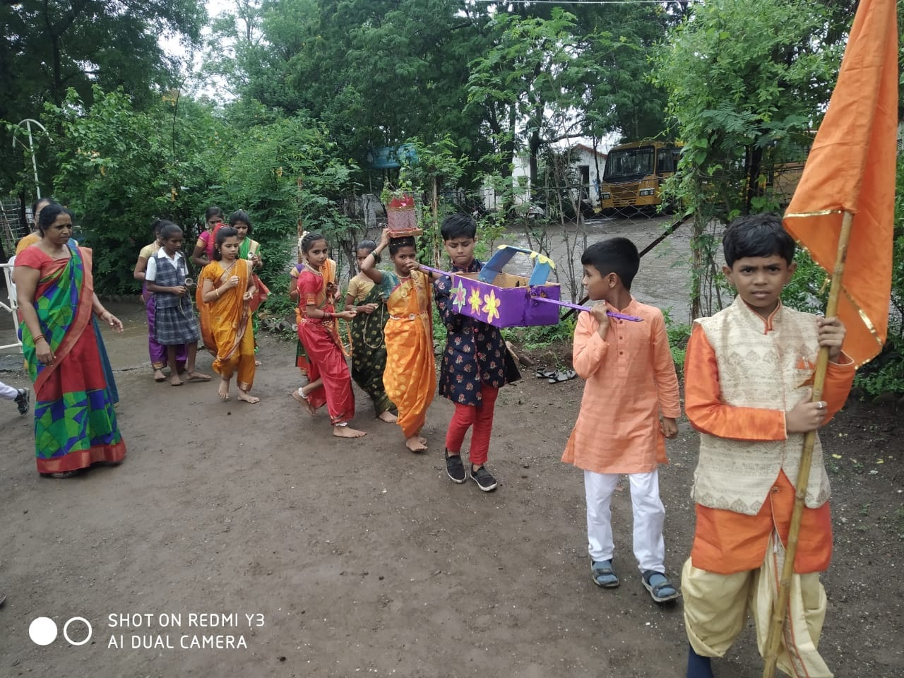
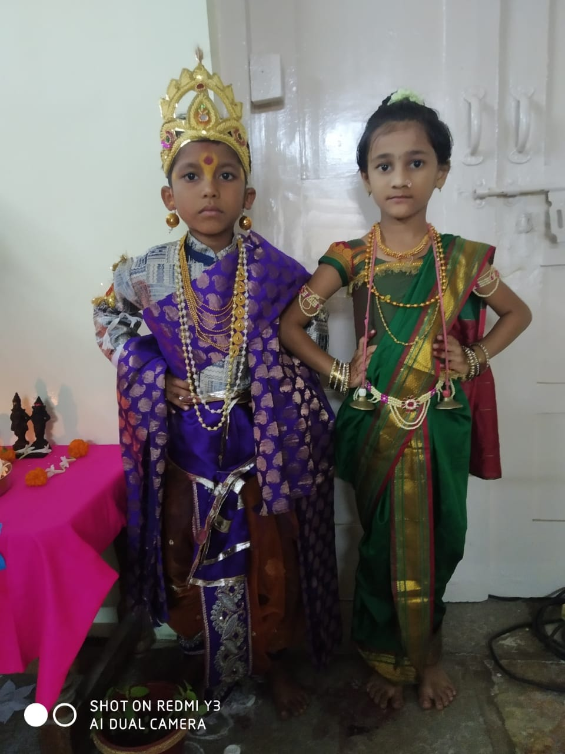
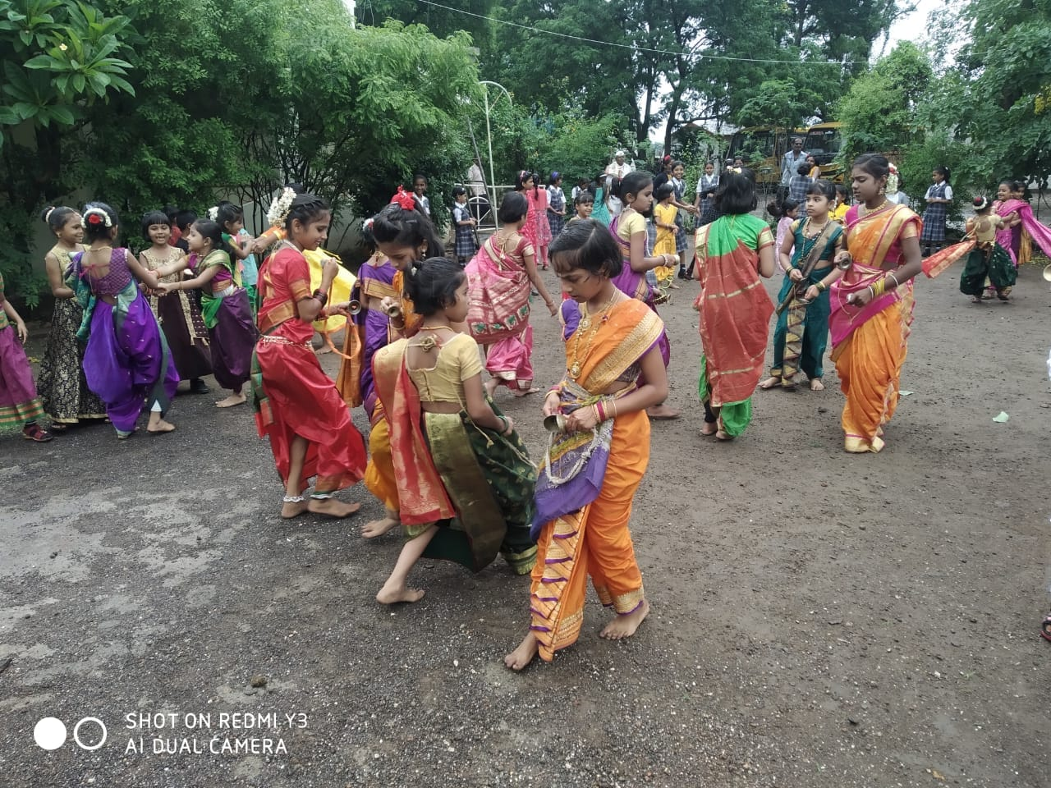
Ashadi Ekadashi Celebration

Slide 26
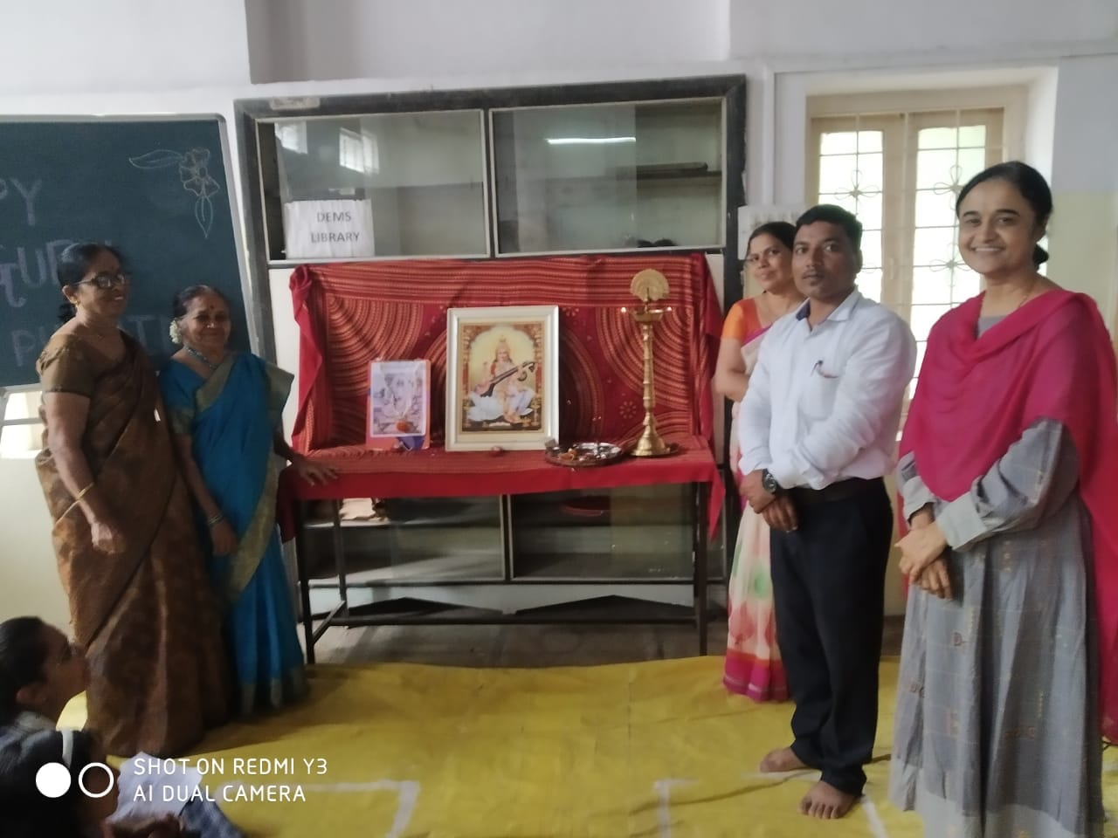
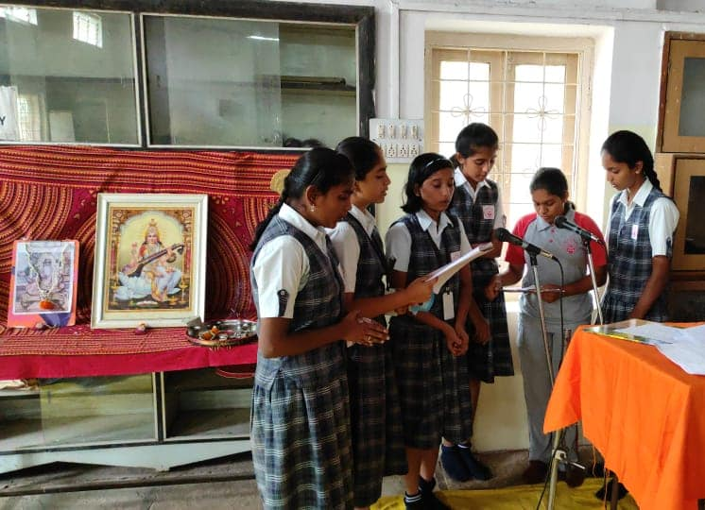
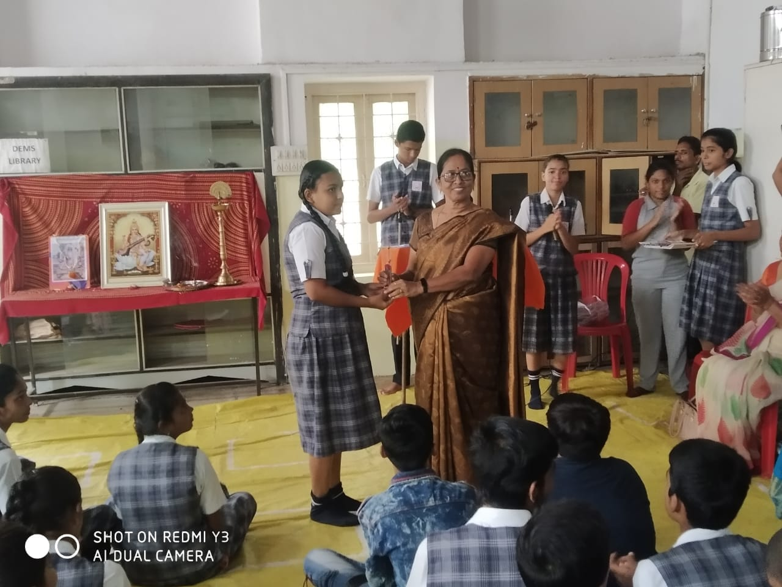
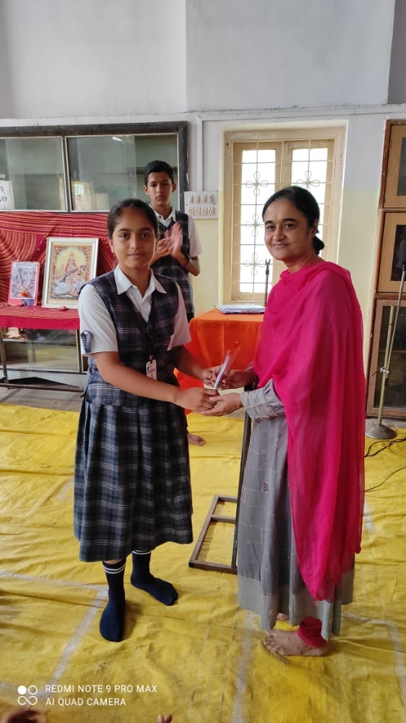
Guru Pornima Celebration

Slide 27




Home Visits

Slide 28



Fine and Gross Skill Development

Slide 29


News

Slide 30

Parenting
During Lockdown

Slide 31
Activities 2022-23
Science Activity (My Family Tree)
SS Activity (States and Capitals)
Maths Activity
Hindi and Marathi Activity
Painting Activity (Ganesh Festival)
Rainy Season Activity
English Activity: Learning Alphabet and Vowels through Phonics

Slide 32
Assembly Schedule 2022-23
Monday
i) Shloka recitation
ii) English news reading (National, International & Sports)
iii) Birthday celebration
iv) Meditation.
Tuesday
i) Saraswati Vandana
ii) Sanskrit Shloka recitation
iii) Student's sharing
iv) Birthday celebration
v) Meditation.
Wednesday
i) National anthem
ii) Pledge / Preamble
iii) Teacher's sharing
iv) Birthday celebration
v) Meditation.
Thursday
i) Prayer (English)
ii) Birthday celebration
iii) Sahajyoga / Pranayam
iv)Skit / dialogue presentation
Friday
i) Prayer (Marathi)
ii) Student's instrumental / Vocal performance
iii) Birthday celebration
iv) Meditation
Saturday
i) Prayer (Hindi)
ii) G.K. quiz
iii) Prize distribution
iv) Birthday celebration
v) Hon. Principal's address
vi) Meditation.

Slide 33


Science Activity (My Family Tree)

Slide 34



Science Activity

Slide 35


SS Activity (States and Capitals)

Slide 36



Maths Activity

Slide 37



Hindi and Marathi Activity

Slide 38



Painting Activity (Ganesh Festival)

Slide 39

Rainy Season Activity

Slide 40


English Activity: Learning Alphabet and Vowels through Phonics

Slide 41
Proposed Goals of 2022-23
Sports Enhancement – Daily Sports zero period.
English Enhancement.
Math’s Enhancement.
Nature Club.
Computer Science and Robotics.
Atal Tinkering lab setup and participation of non-DEMS students .
Increasing admissions.
Arrears recovery.
Academic Planning as per NEP.
Field visits, Career Guidance seminars.

Slide 42
Thank You

